Slide 1

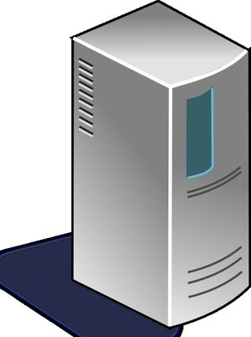
(1)
Static Contents
Dynamic Contents
AP Server

Slide 2
Static Contents
Static Contents
(2)
(1)
Origin Server
Edge Server
Dynamic Contents
AP Server

Slide 3





(1)
Caching static contents.
Clients
Static Contents
CloudFront
S3
(2)
Origins
Static Contents
Image
CSS
JavaScript
Edge Locations
Edge Server
Origin Server
Dynamic Contents
AP Server

