Slide 1
Layout.html
header
header.html
menu
body
menu.html
business.html
footer
footer.html

Slide 2
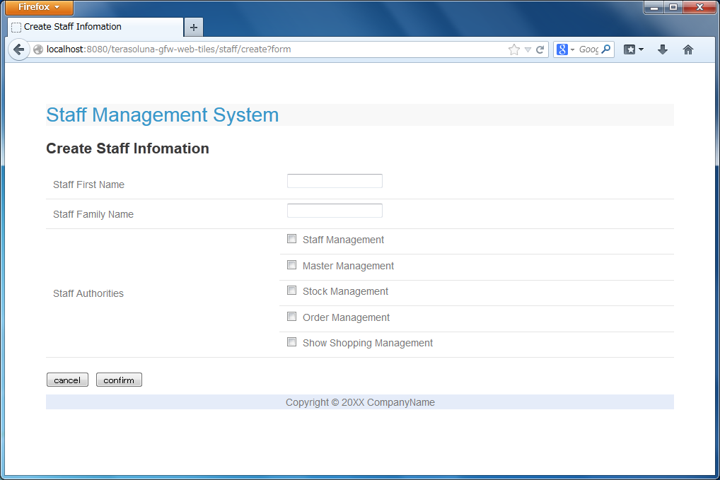
title
template.html
header.html
createForm.html
footer.html

Slide 3
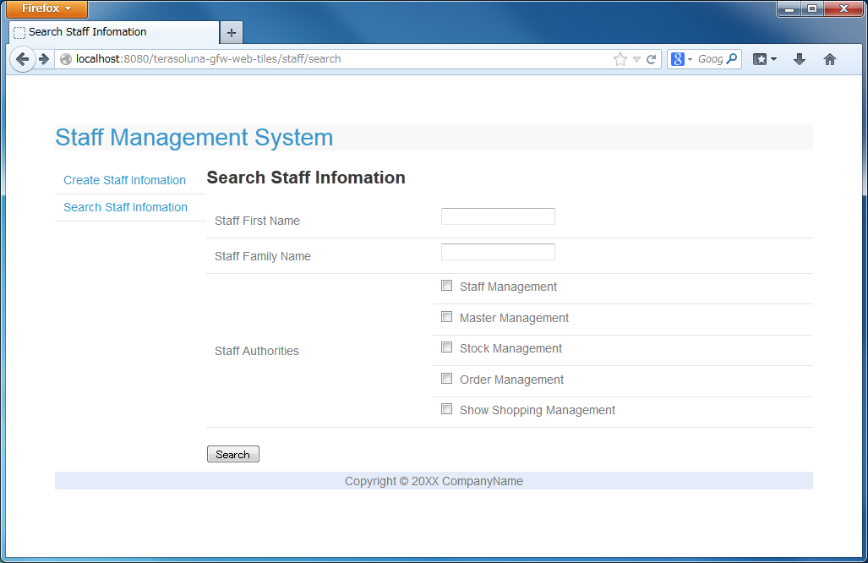
title
templateSearch.jsp
header.jsp
searchStaff.jsp
menu.jsp
footer.jsp

Slide 4
