Slide 1
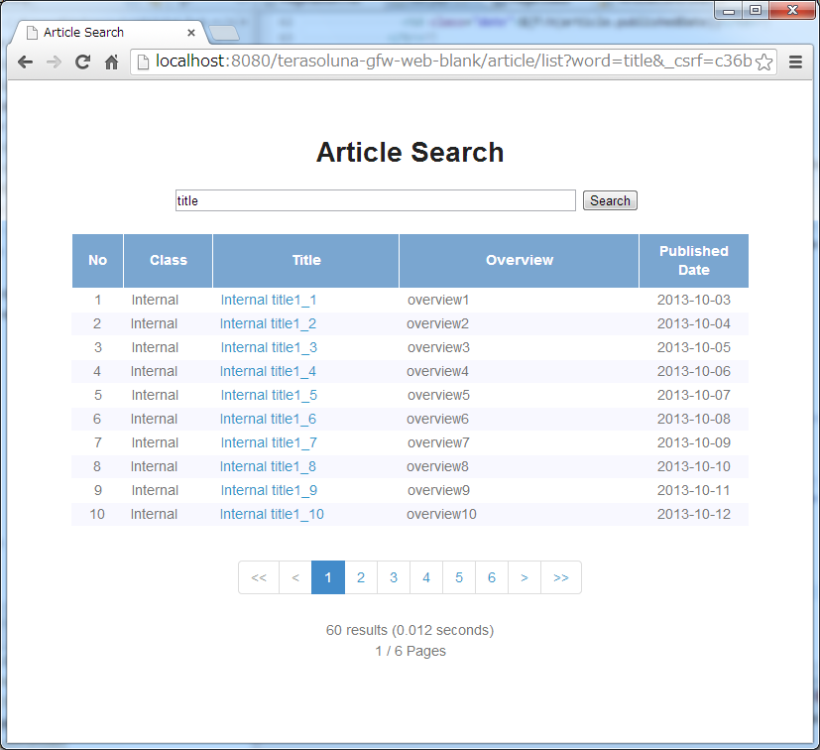
(2)
Pagination Links
(1)
Fetched data
(3)
Pagination Information

Slide 2



Server
<Spring Data>
Pageable
page = 0
Size = 3
<Spring Data>
Pageable
HandlerMethod
ArgumentResolver
(1)
(2)
?page=0&size=3&word=title
Aricle
Controller
(7)
(3)
<Spring Data>
Pageable
<Spring Data>
Page
totalElements = 18
(8)
Article List
Template HTML
Article
Service
<Spring Data>
Pageable
Article
Article
Article
(4)
<Spring Data>
Pageable
(6)
Article
Repositry
(5)
Total
Elements
(9)
Article
Article
Article
?page=2&size=3&word=title
Database

Slide 3

(2)
(4)
(1)
(3)
(5)

Slide 4

(7)
(6)

Slide 5
<ul>
<li class="disabled">
<a href=“javascript:void(0)">&lt;&lt;</a>
</li>
<li class="disabled">
<a href="javascript:void(0)">&lt;</a>
</li>
<li class="active">
<a href="javascript:void(0)">1</a>
</li>
<li>
<a href="?page=1&size=6">2</a>
</li>
<!-- ... -->
<li>
<a href="?page=9&size=6">10</a>
</li>
<li>
<a href="?page=1&size=6">&gt;</a>
</li>
<li>
<a href="?page=9&size=6">&gt;&gt;</a>
</li>
</ul>
(1)
(6)
(2)
(7)
(3)
(4)
(5)

Slide 6
(1)
<ul>
<li>
<a href=“{Page Link URL}">
{Page Link Text}
</a>
</li>
<!-- … -->
</ul>
(2)
(3)
(4)
(5)

Slide 7

(1)
(2)
(3)(4)(5)

Slide 8
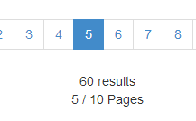
(1)
(2)
(3)

Slide 9
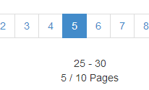
(4)
(5)

