Slide 1
Scheduling a Large DataCenter
Cliff Stein
Columbia University
Google Research
June, 2009
Monika Henzinger, Ana Radovanovic
Google Research

Slide 2
Scheduling a DataCenter
Companies run large datacenters
Construction, maintainence, etc. of datacenters has significant cost, and uses a significant amount of power
Managing such a data center efficiently is an important problem

Slide 3
An abstraction of a computing environment
Users submit jobs consisting of tasks.
Tasks are the unit that is scheduled.
Mix of long-running and short-running jobs.
Mix of user-facing and back-end jobs.
Mix of high and low priority jobs.
We will consider a “datacenter” with thousands of machines, and a time period (“day”) long enough to have hundreds of thousands of tasks.

Slide 4
The goal
We want to evaluate the performance of many different scheduling algorithms on a large datacenter and compare performance
Goal: improve cells utilization and overall productivity

Slide 5
Meta-goal
How does one actually carry out such an experiment?

Slide 6
Some ways to measure scheduling quality
  Throughput - number of processed tasks
  Total flow time – total time tasks spend in system
  Total useful work – total time tasks spend processing work that will not be thrown away
  Number of preemptions – times tasks were interrupted.
  Pending queue size – number of tasks in system but not being scheduled
  Machine fragmentation – roughly the number of unused machines

Slide 7
Primary Goals
Increase throughput.
Reduce machine fragmentation (increase job packing ability).
Increase the number of unused machines (potential for power savings).

Slide 8
Overview
We collected data from google “datacenters”
We built a high-level model of the scheduling system
We experimented with various algorithms

Slide 9
How to model machines and jobs
Machines:
  Disk
  Memory
  CPU
Jobs
  Consist of set of tasks, which have
    Cpu, disk, memory, precedence, priority, etc.
    Processing times
    Long list of other possible constraints

Slide 10
Simulator
Replay a “day” of scheduling using a different algorithm.
Use data gathered from checkpoint files kept by the scheduling system
We tried 11 different algorithms in the simulator.

Slide 11
The Algorithmic Guts of Scheduling
Given a task, we need to choose a machine:
Filter out the set of machines it can run on
Compute score(i,j) for task j on each remaining machine i.
Assign task to lowest scoring machine.
Notes:
The multidimensional nature of fitting a job on a machine makes the scoring problem challenging.

Slide 12
Algorithms
If we place task j on machine i , then
free_ram_pct(i) =
free ram on i (after scheduling j) / total ram on i
free_cpu_pct(i) =
free cpu on i (after scheduling j) / total cpu on i
free_disk_pct(i) =
free disk on i (after scheduling j) / total disk on i

Slide 13
Algorithms
Bestfit: Place job on machine with “smallest available hole”
  V1: score(i,j) = free_ram_pct(i) + free_cpu_pct(i)
  V2: score(i,j) = free_ram_pct(i)² + free_cpu_pct(i)²
  V3: score(i,j) = 10 ^{free_ram_pct(i)} + 10 ^{free_cpu_pct(i)}
  V4: score(i,j) = 10 ^{free_ram_pct(i)} + 10 ^{free_cpu_pct(i)} + 10 ^{free_disk_pct(i)}
  V5: score(i,j) = max(free_ram_pct(i), free_cpu_pct(i))
Firstfit: Place job on first machine with a large enough hole
  V1: score(i,j) = machine_uid
  V2: score(i,j) = random(i) (chosen once, independent of j)
Sum-Of-Squares: tries to create a diverse set of free machines (see next slide)
Worst Fit (EPVM): score(i,j) =
  - (10 ^{free_ram_pct(i)} + 10 ^{free_cpu_pct(i)} + 10 ^{free_disk_pct(i) )}
Random: Random placement

Slide 14
Sum of Squares
Motivation: create a diverse profile of free resources
Characterize each machine by the amount of free resources it has (ram, disk, cpu).
Define buckets: each bucket contains all machines with similar amounts of free resources (in absolute, not relative size).
Let b(k) be the number of machines in bucket k.
Score(I,j) = Σ b(k)² (where buckets are updated after placing job j on maching i.
Intuition: function is minimized when buckets are equal-sized.
Has nice theoretical properties for bin packing with discrete sized item distributions.
Two versions:
  V1: bucket ram and cpu in 10 parts, disk in 5 = 500 buckets.
  V2: bucket ram and cpu in 20 parts, disk in 5 = 2000 buckets.

Slide 15
Sum of Squares (1-D)
Suppose four machines with 1G of Ram:
  M1 is using 0G
  M2 is using 0G
  M3 is using .25G
  M4 is using .75G
Bucket size = .33G. Vector of bucket values = (3,0,1). Σ b(k)² = 10.
.5G job arrives.
  If we add a .5G job to M1 or M2, vector is (2,1,1). Σ b(k)² = 6.
  If we add a .5G job to M3, vector is (2,0,2). Σ b(k)² = 8.
We run the job on M1.
This algorithm requires more data structures and careful coding than others.

Slide 16
Algorithm Evaluation
Big Problem:
If a cell ran all its jobs and is underloaded, almost any algorithm is going to do reasonably well.
If a cell was very overloaded and didn’t run some jobs, we might not know how much work was associated with jobs that didn’t run.

Slide 17
Algorithm Evaluation Framework
As an example, let’s use the metric of throughput (number of completed jobs).
Let T(x) be the number of jobs completed using only x% of the machines in a datacenter (choose a random x%).
We can evaluate an algorithm on a cluster by looking at a collection of T(x) values.
We use 20%, 40%, 60%, 80%, 83%, 85%, 87%, 90%, 93%, 95%, 100% for x.
Same reasoning applies to other metrics.

Slide 18
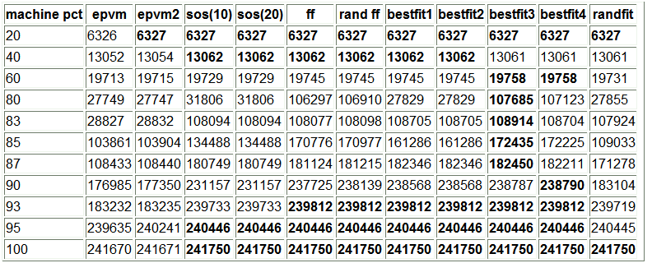
Throughput (one day on one datacenter)

Slide 19
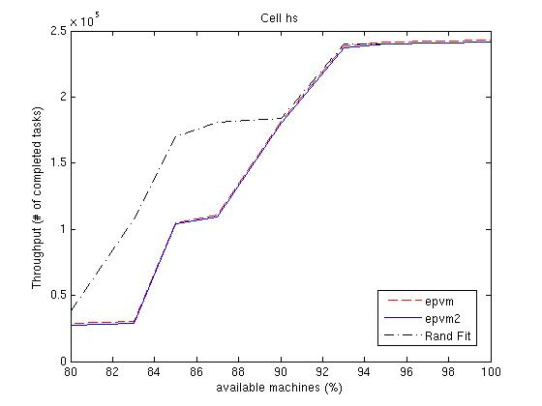
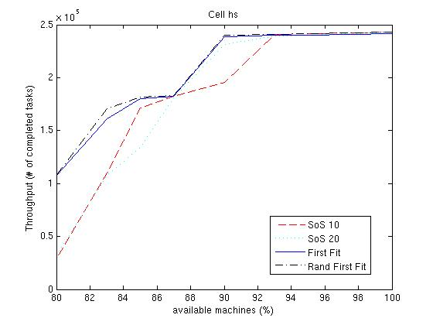
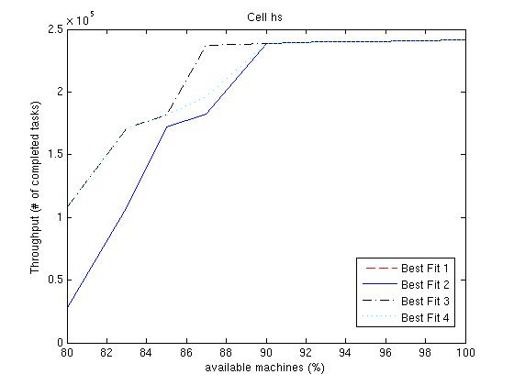
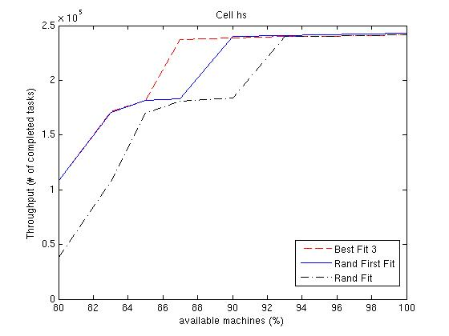

Slide 20
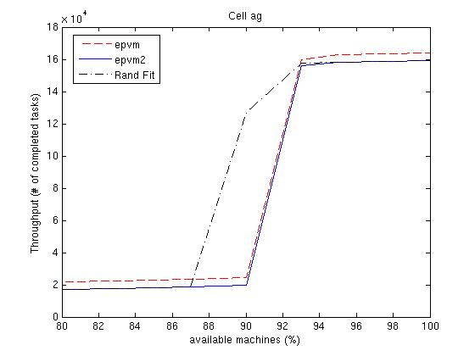
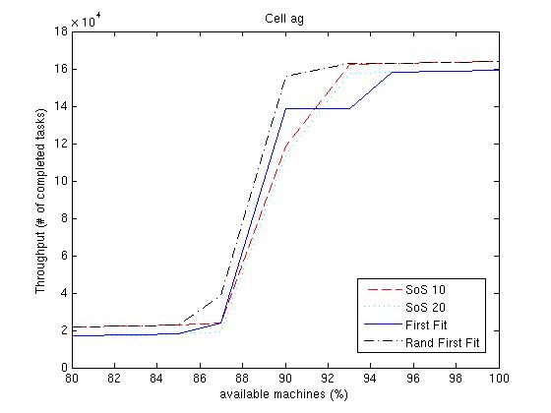
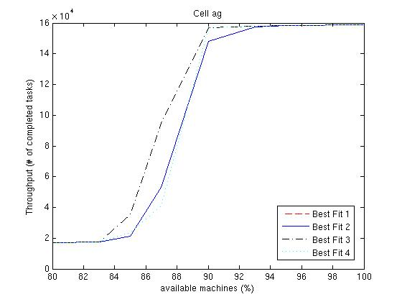
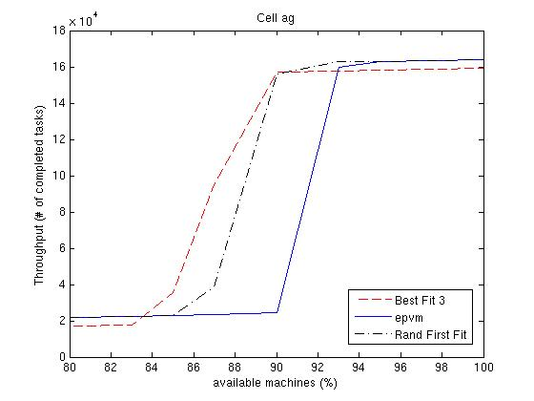

Slide 23
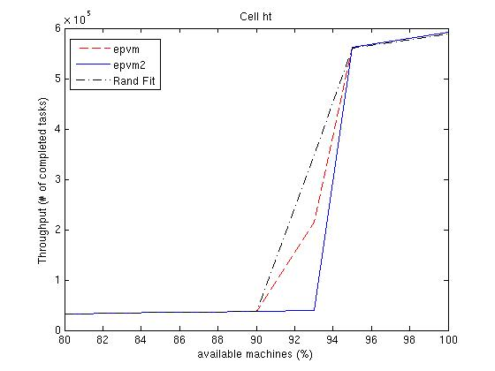
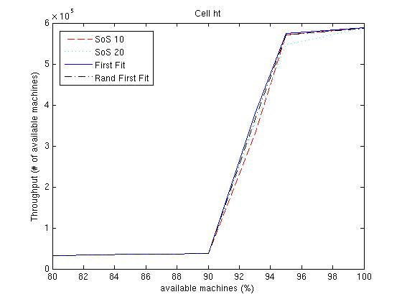
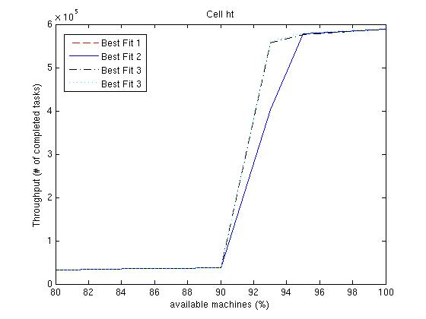
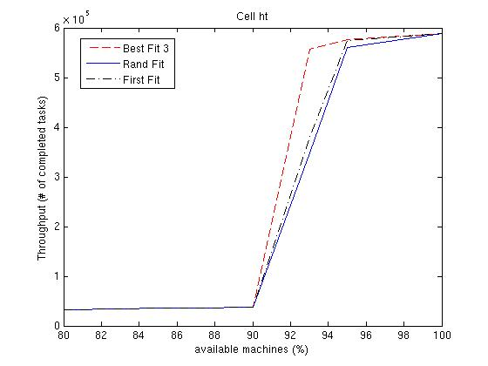

Slide 24
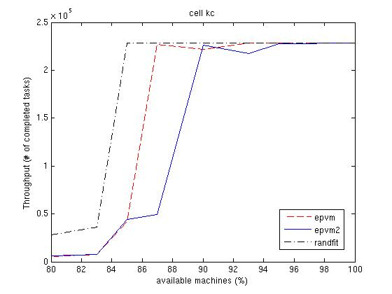
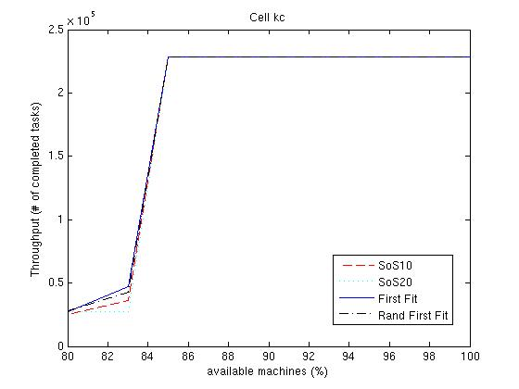
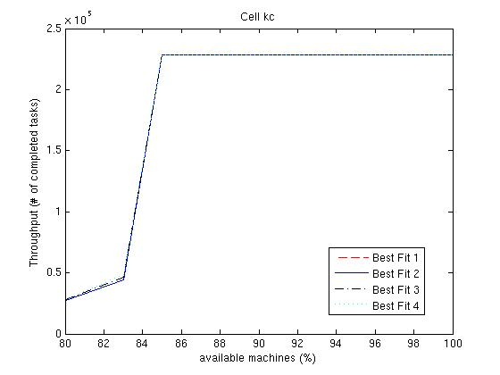
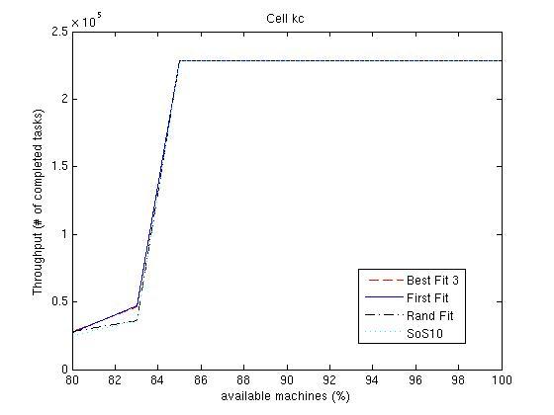

Slide 25
Comparison based on Throughput
(multiple days on multiple datacenters)
Over all cells and machine percentages:
Over all cells at 80%-90% of machines:
Alg | times best | times ≥ 99% best
randFirstFit | 31 | 37
SOS10 | 20 | 41
FirstFit | 15 | 32
BestFit3 | 12 | 38
BestFit4 | 10 | 37
EPVM2 | 6 | 19
EPVM | 5 | 35
BestFit1 | 5 | 29
BestFit2 | 5 | 29
SOS20 | 5 | 26
RandFit | 5 | 26
Alg | times best | times ≥ 99% best
randFirstFit | 11 | 16
BestFit3 | 10 | 20
FirstFit | 7 | 15
BestFit4 | 6 | 19
SOS10 | 5 | 14
BestFit1 | 3 | 12
BestFit2 | 3 | 12
RandFit | 3 | 12
EPVM | 2 | 10
EPVM2 | 2 | 7
SOS20 | 2 | 12

Slide 26
Useful work done (in seconds)

Slide 27
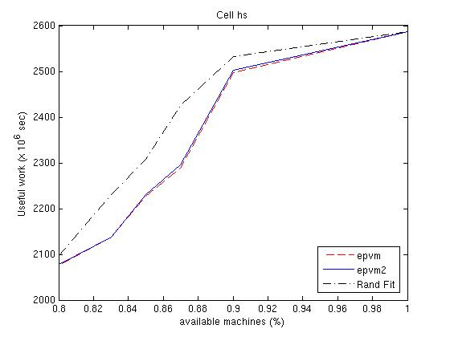
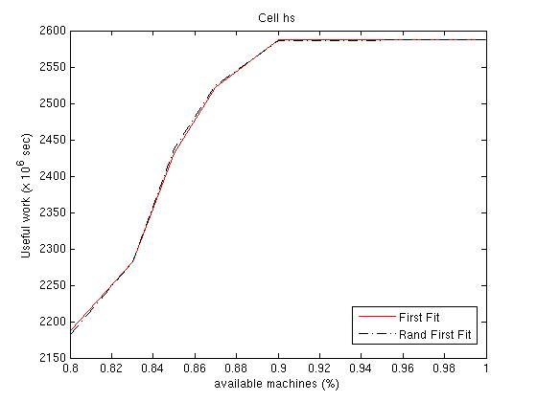
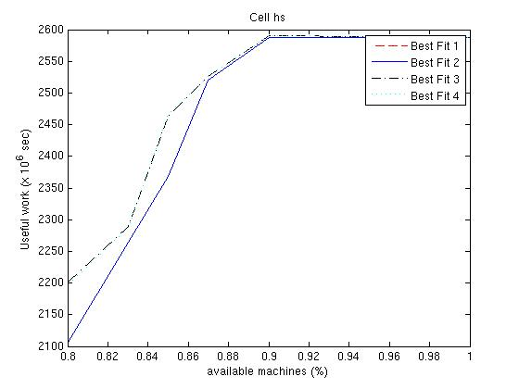
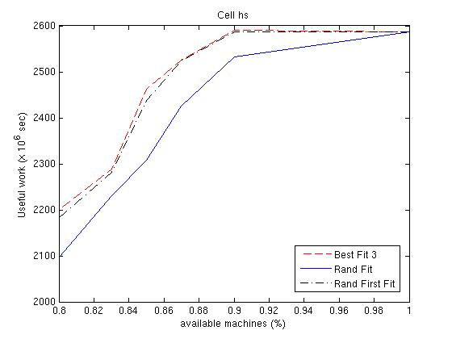

Slide 28
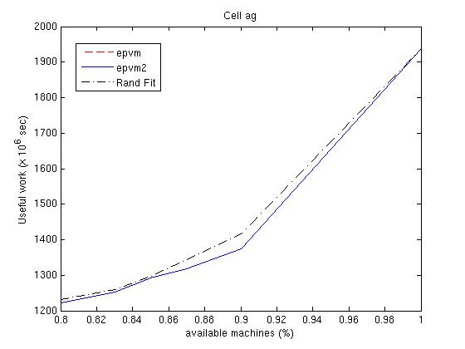
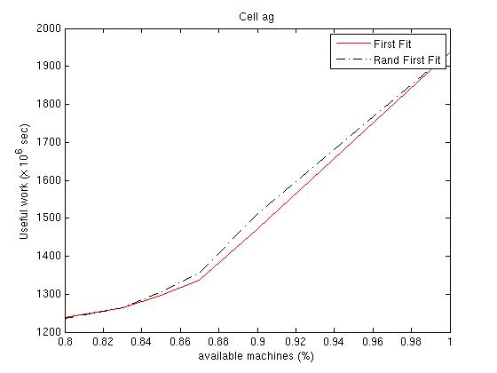
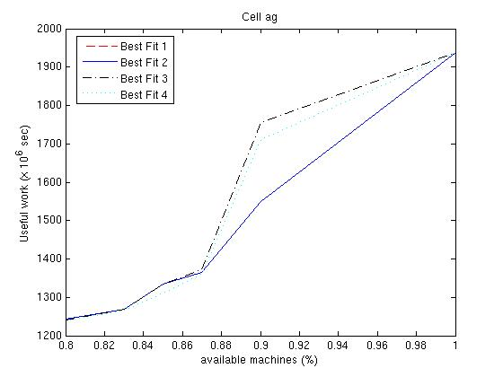
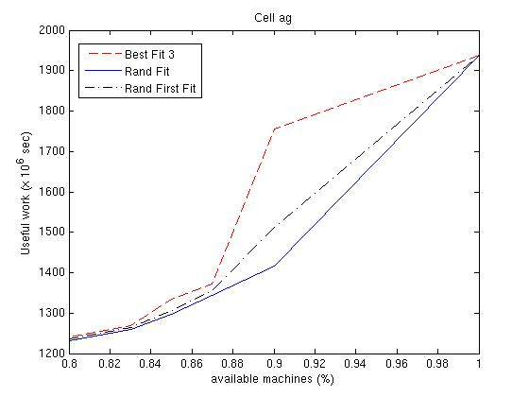
Useful Work in Seconds – Cell ag

Slide 29
Comparison based on Useful Work
Over all days, cells and machine percentages:
Over all days, cells at 80%-90% of machines:
Alg | times best | times ≥ 99% best
BestFit3 | 294 | 318
RandFF | 264 | 306
BestFit4 | 258 | 312
BestFit1 | 246 | 288
BestFit2 | 246 | 288
EPVM | 240 | 270
EPVM2 | 240 | 270
RandFit | 240 | 282
Alg | times best | times ≥ 99% best
BestFit3 | 114 | 138
RandFF | 84 | 126
BestFit4 | 78 | 132
BestFit1 | 66 | 108
BestFit2 | 66 | 108
EPVM | 60 | 90
EPVM2 | 60 | 90
RandFit | 60 | 102

Slide 30
Simulation Conclusions
Many more experiments with similar conclusions.
Bestfit seemed to be best.
Sum-of-squares was also competitive.
First Fit was a little worse than sum-of-squares.
Worst-Fit seemed to do quite poorly.

Slide 31
Machine Fragmentation
Thesis:
  Empty machines are good.
  Machines with large holes are good.
Machine "fullness" can be drastic depending on the algorithm used.
We count machines m for which
  free_cpu(m) < (x/100) * total_cpu(m)
  && free_ram(m) < (x/100)* total_ram(m)

Slide 32
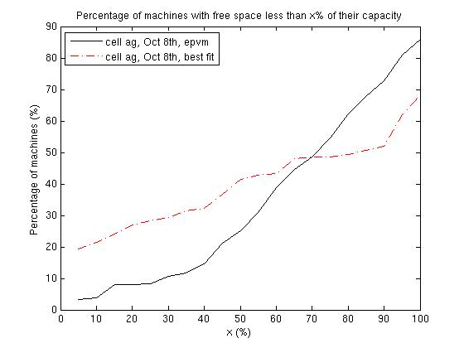
Machine Fragmentation
full
empty

Slide 33
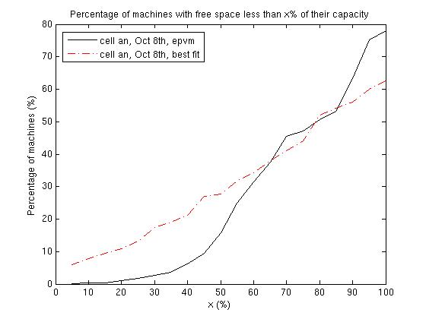
Machine Fragmentation
full
empty

Slide 34
Power
Machines have the following power characteristics:
  Between 50% and 100% utilization, power use is linear in machine load
  At 0% you can turn the machine off
  In between 0% and 50%, power usage is inefficient
By looking at the fragmentation, you can analyze power utilization

Slide 35
Conclusions and Future Directions
Careful study and experimentation can lead to more efficient use of a large datacenter.
Best Fit seems to be the best performer for the environments we studied. (Usually the best, never far from best.)
SOS and first fit are also reasonable choices.
Methodology for real-time testing of scheduling algorithms is an interesting area of study.

