Slide 1
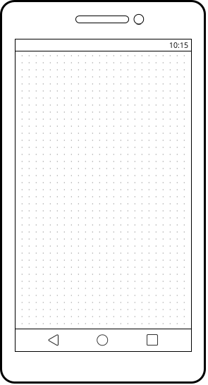

Fitness Plan
Media Sharing App
Notes:
Apps/home screen

Slide 2
Fitness Center
Storage Locker
Plans
Notes:
Home screen of app

Slide 3
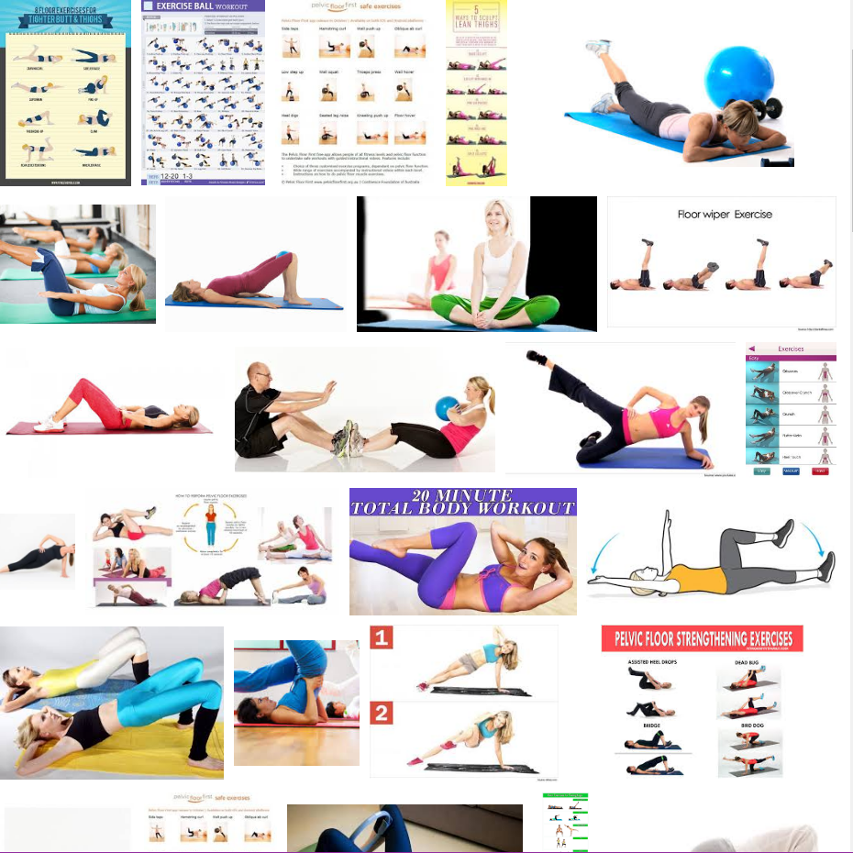
Sort By: Date Added
Storage Locker
Search
Notes:
2:Access storage/View content

Slide 4
Sort By: Date Added New
Date Added Old
Relevance
Popularity
Alphabetical A-Z
Alphabetical Z-A
Search
Notes:
2:Access storage/View content
Sorting

Slide 5
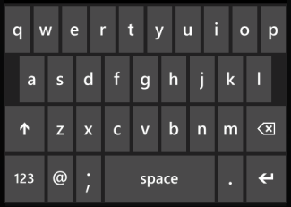
Search...
Yoga
Yogini
Yogini Variation
Suggested search term
Suggested search term
Notes:
2. Access storage/view content
Searching

Slide 6
Sort By: Date Added
Storage Locker
Yoga
Notes:
2:Access storage/View content

Slide 7
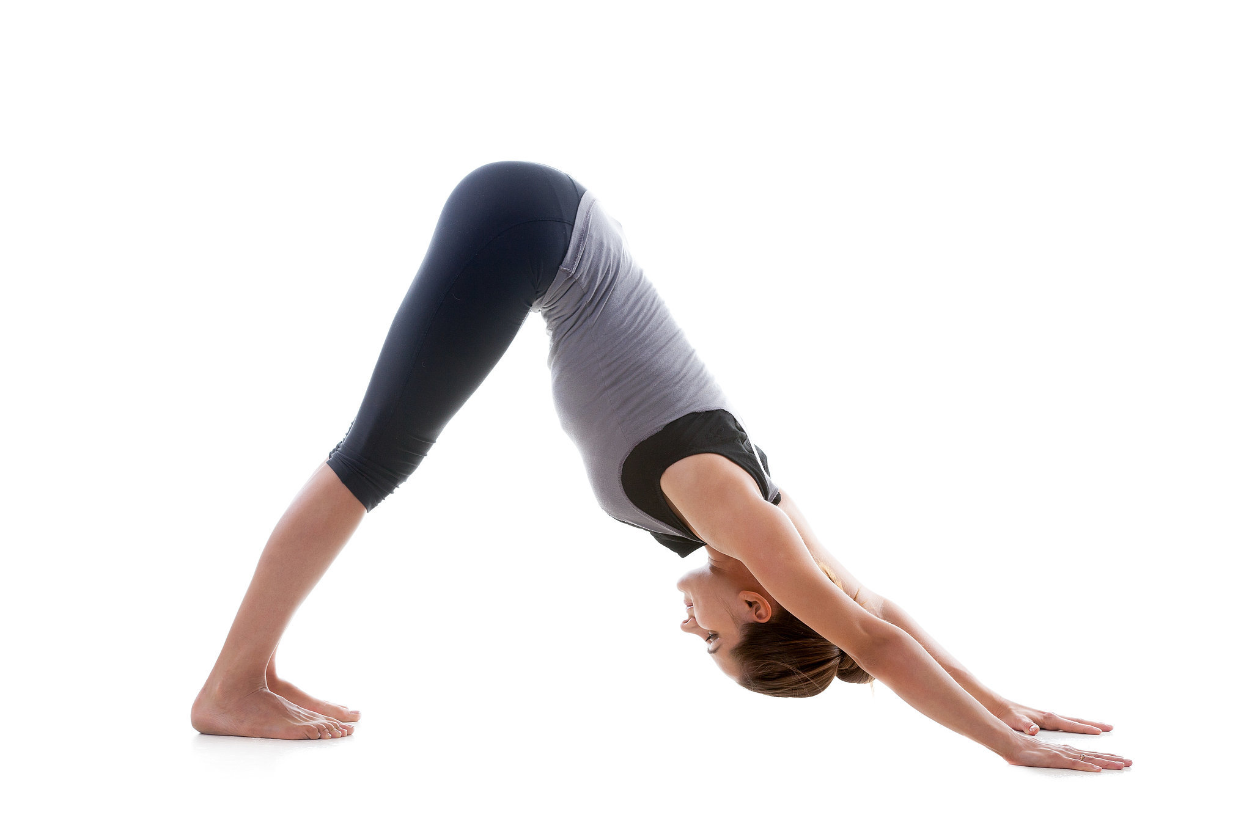
Sort By: Date Added
Downward Dog
Search
#basics #core #flexibility
Create New Plan from Item
Edit Info
Add to Active Plan
Notes:
4. Item details

Slide 8
Title
Downward Dog
Tags
#basics #core #flexibility
Cancel
Save
Remove from Storage
Notes:
Edit Item

Slide 9
Sort By: Date Added
Downward Dog
Search
Saved!
#basics #core #flexibility
Create New Plan from Item
Edit Info
Add to Active Plan
Notes:
4. Item details

Slide 10
Saved Plans
Create New Plan
Plans
Notes:
Plans main page

Slide 11


Plans
Plan 1
Tonight’s Class
New Plan
Old Plan
Notes:
Saved plans 1

Slide 12
Plans
Plan 1
Tonight’s Class
New Plan
Old Plan
Notes:
Active plans add to new plan

Slide 13
Plans
Plan 1
Tonight’s Class
New Plan
Saved!
Old Plan
Plan name
Plan name
Notes:
Active plans add to new plan success message

Slide 14
Plans
Plan 1
Tonight’s Class
New Plan
Old Plan
Notes:
deletion

Slide 15
Plans
Plan 1
Tonight’s Class
New Plan
Old Plan
X
Notes:
Deletion 2

Slide 16
Plans
Plan 1
Tonight’s Class
Deleted!
New Plan
Notes:
Deletion 3

Slide 17
Plans
Plan 1
Tonight’s Class
New Plan
Notes:
Saved plans 2

Slide 18

Plan 1
View Items
Play All
Item
Notes
Item1
Notes1
Item2
Notes2
Item
Notes
Notes:
Plan 1 main screen

Slide 19
Plan 1
View Items
Play All
Item1
Notes1
Item2
Notes2
Item
Notes
Item
Notes
Notes:
Plan 1 success removed

Slide 20
Plan 1
View Items
Play All
Item2
Notes2
Item1
Notes1
Item
Notes
Item
Notes
Notes:
Reorder

Slide 21
Edit Plan Title
Title
Cancel
Save
Notes:
Creating new plan from a selected item

Slide 22
Item Title
Notes:
Cancel
Save
Remove from Plan

Slide 23
Item
Notes
Item
Notes
Item
Notes
Add New
+

Slide 24
Plan 1
View Items
Play All
00:00
00:00

Slide 25
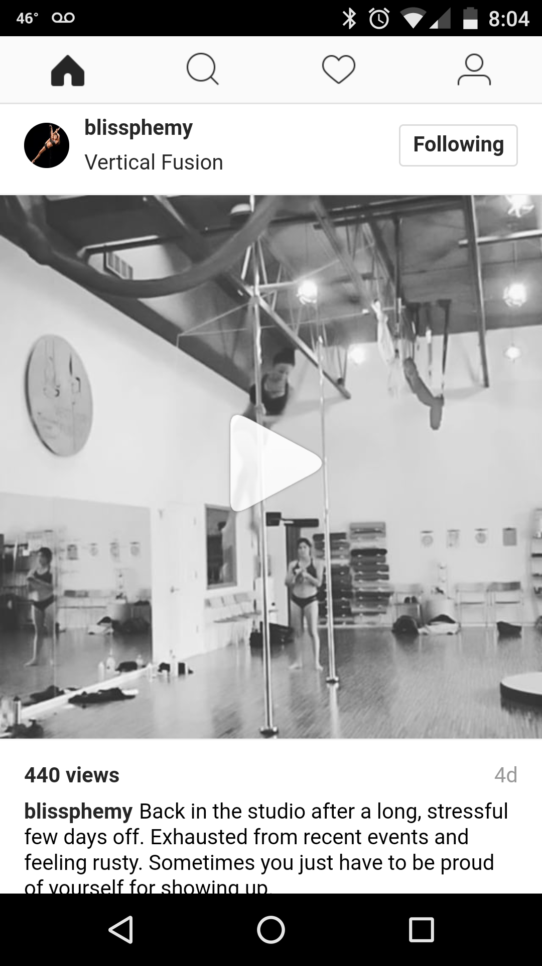
+

Slide 26
Title
Tags
Cancel
Save

Slide 27
+
Added!

Slide 28
Creating a New Plan From an Item
Title
Cancel
Save
Notes:
Creating new plan from a selected item

Slide 29
New Plan
Item
Notes
Add New
+

Slide 30
Creating a New Plan
Title
Cancel
Save
Notes:
Creating new plan from a selected item

Slide 31
New Plan
Add New
+

Slide 32
Sort By: Date Added
Storage Locker
Search
Notes:
2:Access storage/View content

Slide 33
Sort By: Date Added New
Date Added Old
Relevance
Popularity
Alphabetical A-Z
Alphabetical Z-A
Search
Notes:
2:Access storage/View content
Sorting

Slide 34
Search...
Yoga
Yogini
Yogini Variation
Suggested search term
Suggested search term
Notes:
2. Access storage/view content
Searching

Slide 35
Sort By: Date Added
Storage Locker
Yoga
Notes:
2:Access storage/View content

Slide 36
Sort By: Date Added
Downward Dog
Search
#basics #core #flexibility
Create New Plan from
Edit Info
Add to Active Plan
Notes:
4. Item details

Slide 37
New Plan
Item
Notes
Add New
+

Slide 38
Sort By: Date Added
Storage Locker
Search
Notes:
2:Access storage/View content

Slide 39
Sort By: Date Added New
Date Added Old
Relevance
Popularity
Alphabetical A-Z
Alphabetical Z-A
Search
Notes:
2:Access storage/View content
Sorting

Slide 40
Search...
Yoga
Yogini
Yogini Variation
Suggested search term
Suggested search term
Notes:
2. Access storage/view content
Searching

Slide 41
Sort By: Date Added
Storage Locker
Yoga
Notes:
2:Access storage/View content

Slide 42
Sort By: Date Added
Downward Dog
Search
#basics #core #flexibility
Create New Plan from
Edit Info
Add to Active Plan
Notes:
4. Item details

Slide 43
New Plan
Item
Notes
Item
Notes
Add New
+

Slide 44
Sort By: Date Added
Storage Locker
Search
Notes:
2:Access storage/View content

Slide 45
Sort By: Date Added New
Date Added Old
Relevance
Popularity
Alphabetical A-Z
Alphabetical Z-A
Search
Notes:
2:Access storage/View content
Sorting

Slide 46
Search...
Yoga
Yogini
Yogini Variation
Suggested search term
Suggested search term
Notes:
2. Access storage/view content
Searching

Slide 47
Sort By: Date Added
Storage Locker
Yoga
Notes:
2:Access storage/View content

Slide 48
Sort By: Date Added
Downward Dog
Search
#basics #core #flexibility
Create New Plan from
Edit Info
Add to Active Plan
Notes:
4. Item details

Slide 49
New Plan
Item
Notes
Item
Notes
Item
Notes
Add New
+

Slide 50
Cancel
Go/Save
Notes:
Keyboard Screen

