Slide 1

写好科技论文的一些建议
Tips for Writing Effective Papers
主讲人：邵森林
日 期：2021.11.04

Slide 2
为何要写科技论文？
概念
机理
现象

Slide 3


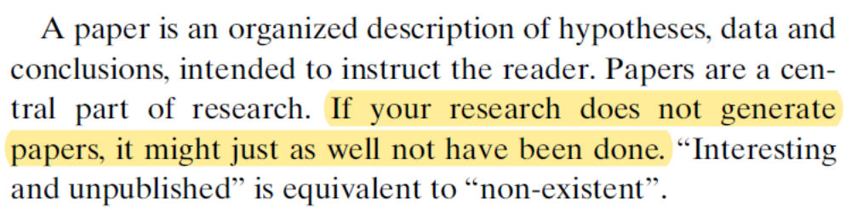
为何要写科技论文？

Slide 4
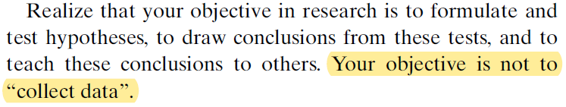
论文不是实验报告（Report）
“
The manuscript looks like a report rather than a scientific paper
”
实验顺序、现象记录、多目标
逻辑顺序、机理分析、单目标

Slide 5
论文的选题（Topic）
工程案例 VS 科学问题
今天晚上吃多少饭能饱腹？
血糖浓度、饱腹感之间关系及作用机制
特殊性
个例
（我）
普适性
基础性
（小白鼠）
选题小、观点少、选题新、方法新
实验思路先于实验

Slide 6
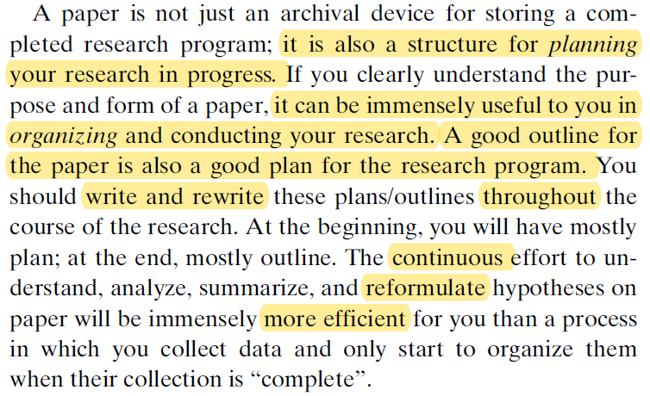
什么时候开始写论文？

Slide 7
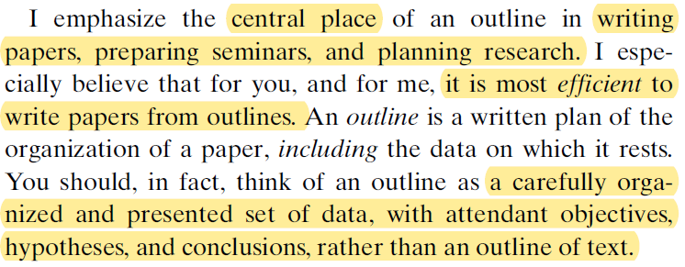
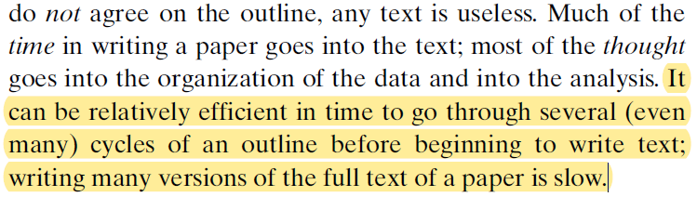
提纲（Outline）的重要性

Slide 8
如何准备Outline
明确研究动机并提出假设
  Why did I do this work？
  What were the central motivations and hypotheses？
可行性——关键的试探性实验
  可以是定性的实验
  实验中的硬骨头，先做最重要的实验
结合预期数据画出简图
  如何更有逻辑地呈现数据
  如何更简洁、有说服力
千万不要等到实验做完了再来准备Outline！
根据实验结果及时反馈

Slide 9
如何准备Outline
Title
Abstract (graphic abstract)
Highlights
Introduction
Theory or Modeling
Materials and Methods
Results and Discussion
Conclusion
Supporting information
Not what you did in the study
But what you want to learn from the study

Slide 10

科技论文最重要的准则
Clarity —— Make the Paper Easier to Read

Slide 11
论文题目
The critical need for increased selectivity, not increased water permeability, for desalination membranes
Antibacterial effect of carbon nanotubes: size does matter!
Aggregation kinetics of multiwalled carbon nanotubes in aquatic systems: measurements and environmental implications
Polyamide membranes with nanoscale Turing structures for water purification
Maximizing the right stuff: The trade-off between membrane permeability and selectivity
Sub–10 nm polyamide nanofilms with ultrafast solvent transport for molecular separation
Enhanced antibacterial activity through the controlled alignment of graphene oxide nanosheets
Attractive Concise Informative

Slide 12
摘要
考虑某些人可能只看看你的论文摘要
对于众所周知的背景问题可以不写
不要过于定性和一般性陈述
适当的放入一些定量的结果（也别太多）
简洁、清晰、概括

Slide 13
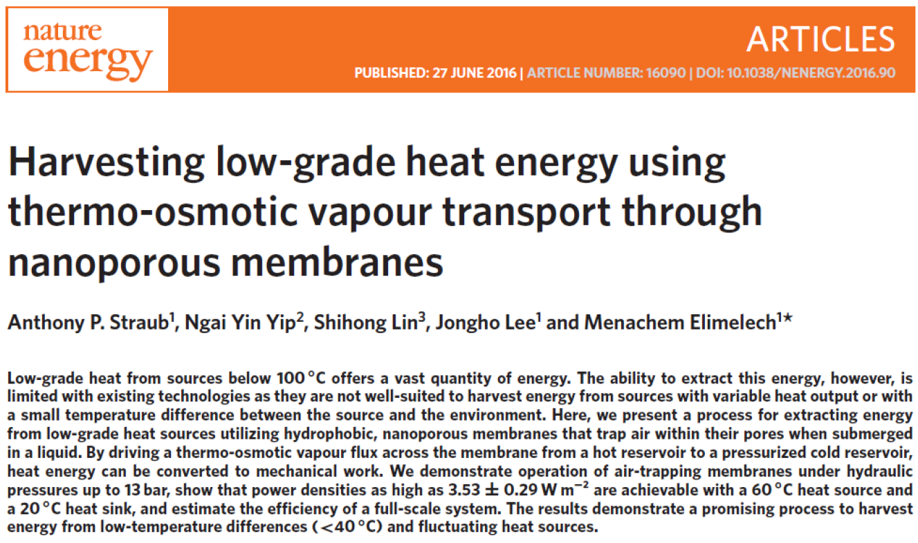
摘要

Slide 14
前言
Introductory paragraph (1-2 paragraphs)
  Give a general introduction to the topic for a broad audience
  Narrow the focus to your particular topic
  State your research problem and aims
Literature review (1-2 paragraphs)
  Summarize the relevant literature on your topic
  Describe the current state of the art
  Note any gaps in the literature that you study will address
Research targets (1 paragraph)
  State your hypothesis or research question
  Based on the above critical review, why your paper is needed and how it will add to the body of knowledge
Paper overview (1 paragraph)
  state the objectives and scope of the paper, with possibly a general finding and/or importance

Slide 15
前言
Start broadly and then narrow down
State the aims and importance
Cite thoroughly but not excessively
Avoid giving too many citations for one point
Clearly state your hypothesis or research question
Show, don’t tell (why the topic is important)
Don’t bury your reader in detail
After stating the objective, highlight in general terms what you have done and the general/broad findings

Slide 16
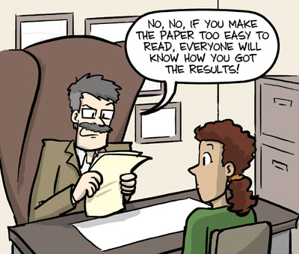
主体
越简单越好、别啰嗦
尽量少使用长句子，在主语之后立刻看到行为动词。句子以熟悉的信息开始，关键信息结束
使用短的段落（3-6句）
每段说明一件事情，段首或段尾总结本段内容
从标题到结论都要连贯
句句相扣，段段相连
语言自信一些

Slide 17
结论
不要重复摘要
核心的结论
说明其潜在的意义

Slide 18
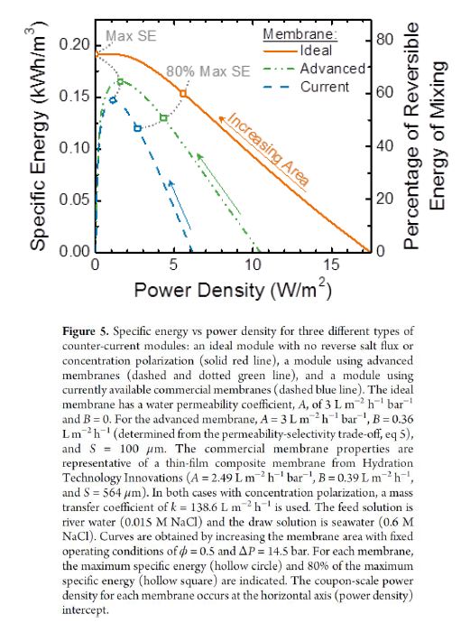
图
清晰的数据、坐标轴标题、图例等
坐标轴标题建议单词首字母大写
详细的图说明
正文对图表的引用不要打断行文流畅性

Slide 19
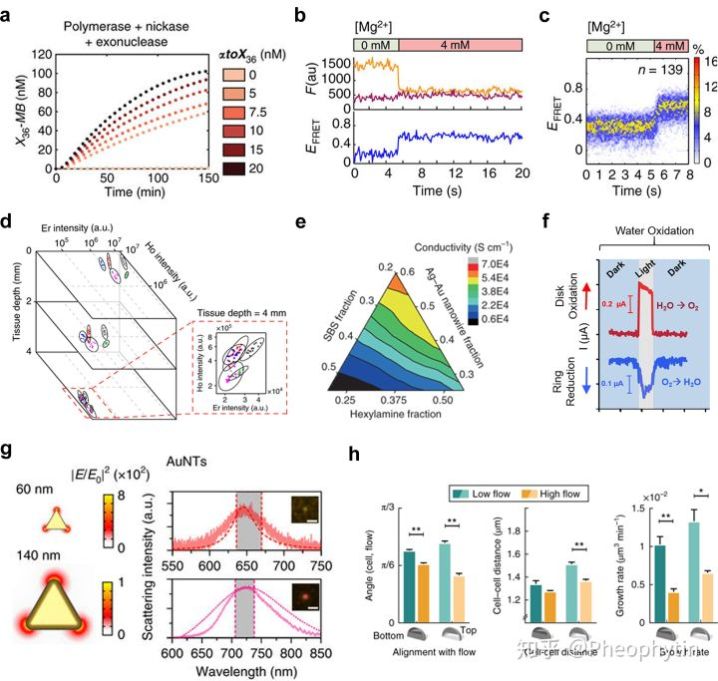
图
字体大小
配色
边距
说明同一内容的图放在一起

Slide 20
英语写作的一些技巧
Subjects and verbs too far apart
NOT: DAN in repeat regions or small microsatellites or with long stretches of the same base causes problems for next-gen sequencers.
BUT: DNA causes problems for next-gen sequencers when it is in repeat regions or small microsatellites or has long stretches of the same base.
Overabundance of nominalizations
NOT: The assumption that all RNAs are poly- adenylated is an oversimplification of the transcription process.
BUT: The model oversimplifies the transcription process because it assumes that all RNAs are polyadenylated.
NOT: Our analysis using regression and k-means clustering revealed...
BUT: We analyzed the data with regression and k-means clustering. This analysis revealed...

Slide 21
英语写作的一些技巧
Poor flow (misplacement of old vs new information)
NOT: We searched the database of sequences to look for similar structures. A protein involved in the regulation of the BRCA1 gene in humans was found by the search.
BUT: We searched the database of sequences to look for similar structures. This search found a protein involved in the regulation of the BRCA1 gene in humans.
Excessive or unnecessary use of passive voice
NOT: To address this problem, a new method was proposed…
BUT: To address this problem, we proposed a new method…

Slide 22
英语写作的一些技巧
Omit needless words
NOT: It is absolutely vital that... BUT: We must...
NOT: There were five mice receiving antibiotics...
BUT: Five mice received antibiotics.
Put actions in verbs
NOT: We performed an analysis… BUT: We analyzed...
NOT: The quantification of the atoms was done…
BUT: The atoms were quantified.
NOT: It was observed that the solution turned red.
BUT: The solution turned red. OR we observed that the solution turned red.

Slide 23
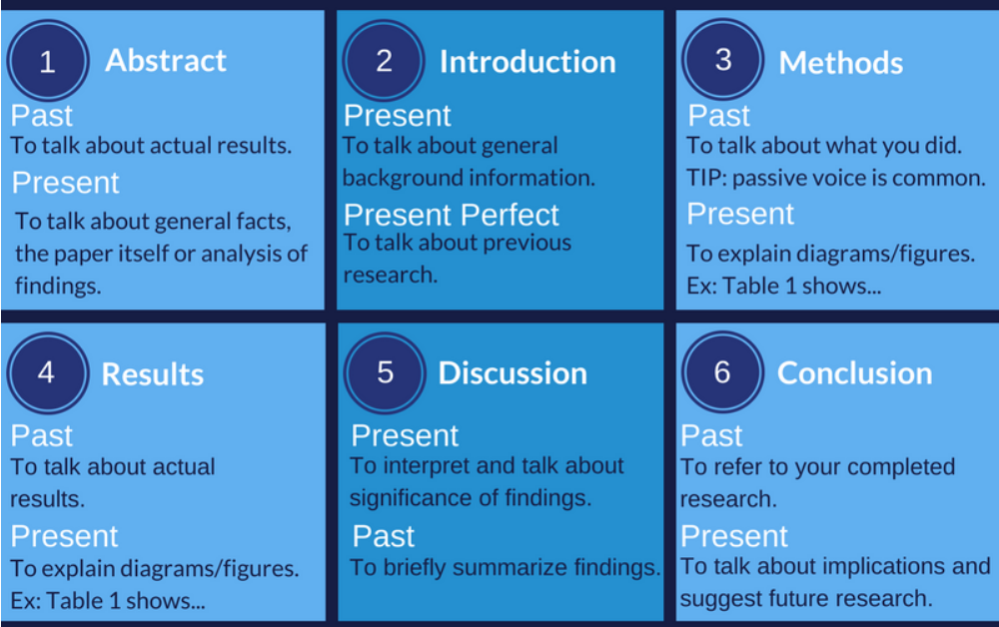
英语写作的时态

Slide 24
联系方式已移除 / Contact details removed

