Slide 1
UDYAM ’22
CASSANDRA
Team - GREEKGODS
Notes:
Good evening everyone today we team GREEKGODS is here to present our key insights and training pipeline used for solving the ps of Cassandra.

Slide 2
PIPELINE
Data Analysis
Model Building
Feature Engineering
Hyperparameter Optimization
Notes:
So, our basic pipeline consists of first data analysis, followed by feature engineering, then model building and finally hyperparameter optimization.
Let us discuss each of these in detail

Slide 3
DATA
ANALYSIS
Notes:
Starting with data analysis….

Slide 4
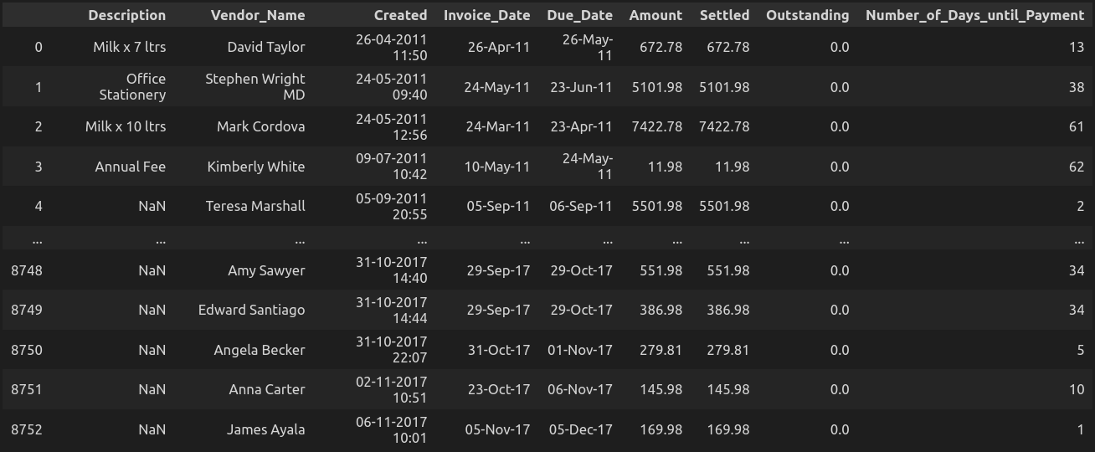
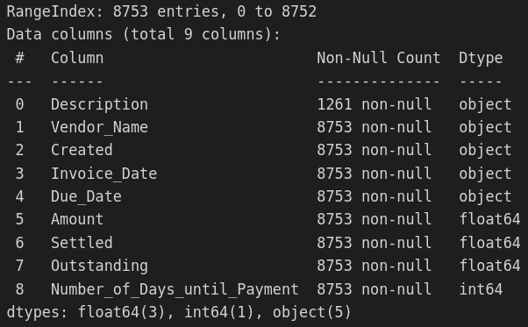
DATA
￼
Notes:
We were given a regression problem in which we had to forecast when the payment of an invoice will occur. The most basic data analysis showed that only the Description feature had missing values ( approximately 86%) , further..

Slide 5
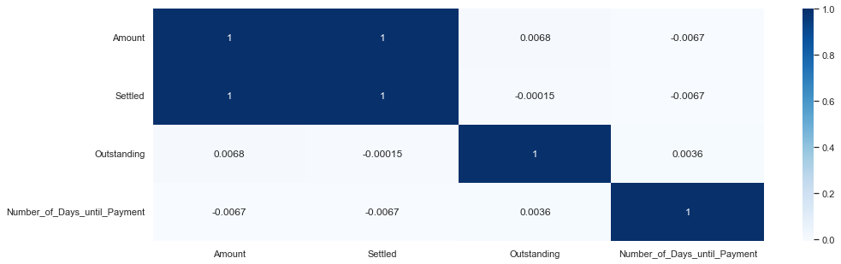
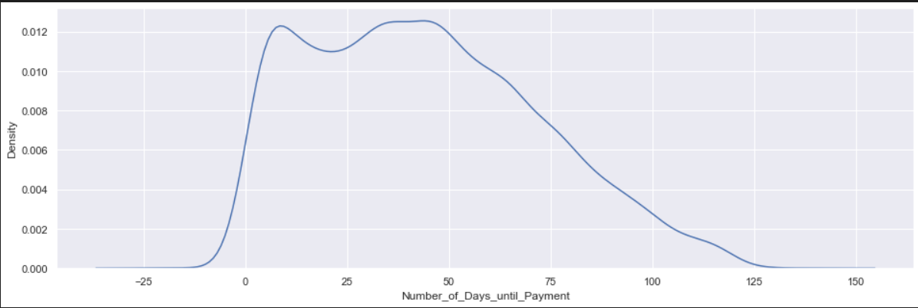
KEY INSIGHTS
Correlation Heatmap
KDE PLOT for
Number of Days until Payment
Notes:
From the correlation heatmap we have that none of the features have a strong correlation with the target value. So, a lot of feature engineering is required to create features on which our model will learn.
Moreover, The Target also had negative values which suggested that the payment are also made even before the goods and services are delivered (invoice is made).

Slide 6
FEATURE
ENGINEERING
Notes:
Okay, so now in feature engineering the first thing we did is to -

Slide 7
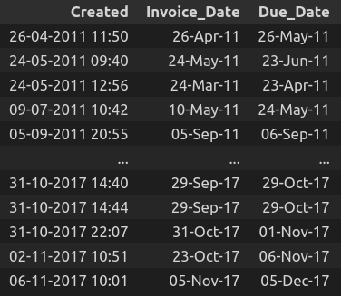
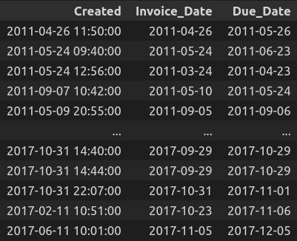
To Datetime Format
Notes:
Convert the object type values to datetime type format for the features Created, Invoice_Date, Due_Date. This enabled us to further use these values to extract the months and years.

Slide 8
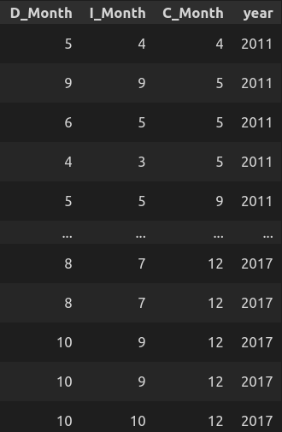
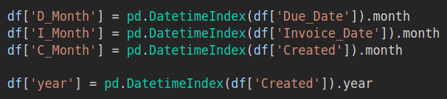
Extracting Months and Years
Notes:
The idea of extracting the moths and the years is based on the fact that a specific month and year can tell a lot about a person's income and wealth, especially for businesses in which certain months are more profitable than others. This can greatly influence the time taken to make the payment.

Slide 9
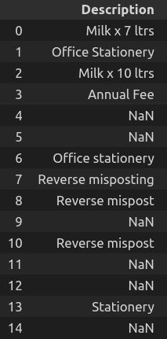
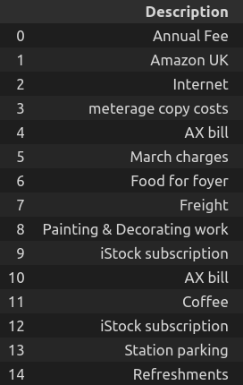
Filling Missing Values in 'Description'
Notes:
Now, After a thorough analysis of the 'Description' column and using different techniques to fill the missing value, we sorted the data using the 'Created' column and then used the forward fill technique to fill the missing. This idea also correlates with the fact that while entering the invoice details on the accounting system, the 'Description' for continuous invoices having the same description doesn't need to be repeated.

Slide 10
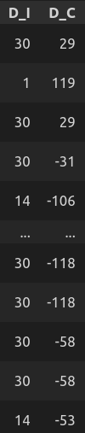
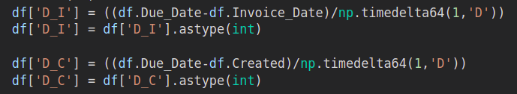
Time given to make the payment
Notes:
This feature will be a key feature in determinig the number of days till payment. The number of days till payment will be more if the time given to make the payment is more and vice-versa.

Slide 11
Target Encoding
Cross-Fold Target Encoding
Leave-one-out Target Encoding
Target Encoding
Notes:
After reading, research, and experimentation, the best encoding technique we could find for encoding ['Description' , 'Vendor_Name'] columns is Target Encoding, in which we encoded the features using the mean value of the corresponding target. To avoid overfitting, we tried Cross-Fold Target Encoding and Leave-one-out Target Encoding, which does not use the target for that particular data point, but it resulted in many Nan values. Since Vendor Name is one of the essential features for predicting the Number of Days until Payment, as it tells about the Vendor's history, we could not afford to lose any data. We decided to go with Target Encoding. We tried a few different features to do encoding, but Target encoding gave the best result.

Slide 12
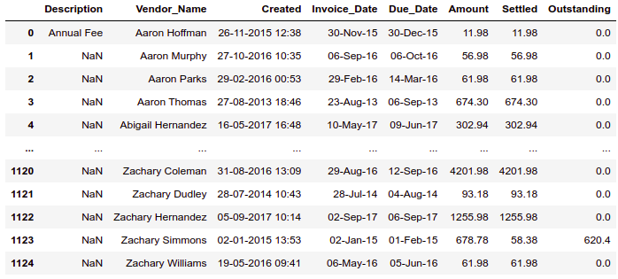
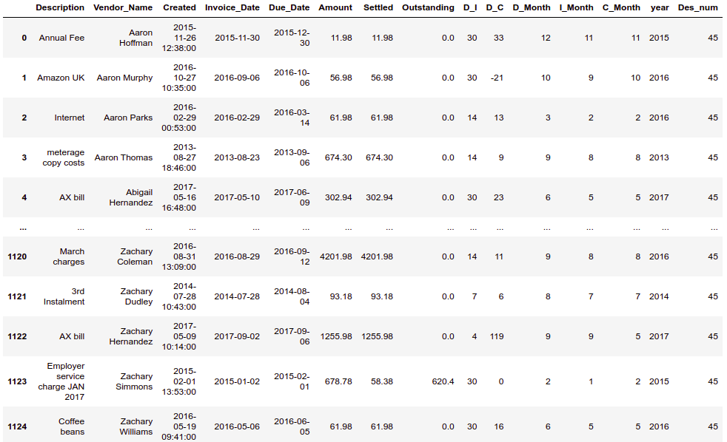
Encoding the testing data
Notes:
Encoding the testing data using the 'Description' and 'Vendor_Name' dictionaries made using the training data. Since there were a few values in the testing data's Description, which were not there in the training data, we encoded such values using the mode of the training data's Encodings.

Slide 13
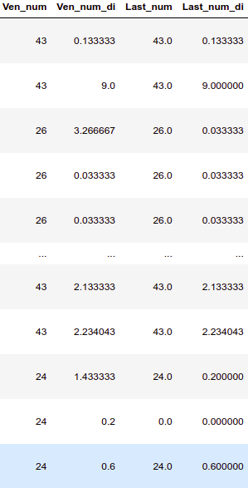
Additional Features
We introduced the following features:
'Ven_num_di' : Average of Number of Days until Payment for each vendor (Target encoding of Vendor) / number of days given to the vendor to make the payment.
'Last_num' : Time taken by the vendor to make Payment on their Last Invoice sorted using 'Invoice_Date'. This feature will indicate the current financial condition of the vendor, which will further affect the number of days until payment.
'Last_num_di' : 'Last_num' / number of days given to the vendor to make the payment
Notes:
Few of the additional features on which we thought the Number of Days until Payment will depend on are -
'Ven_num_di' which represents the Average of Number of Days until Payment for each vendor (Target encoding of Vendor) / number of days given to the vendor to make the payment.
'Last_num' : Time taken by the vendor to make Payment on their Last Invoice sorted using 'Invoice_Date'. This feature will indicate the current financial condition of the vendor, which will further affect the number of days until payment.
'Last_num_di' : 'Last_num' / number of days given to the vendor to make the payment

Slide 14
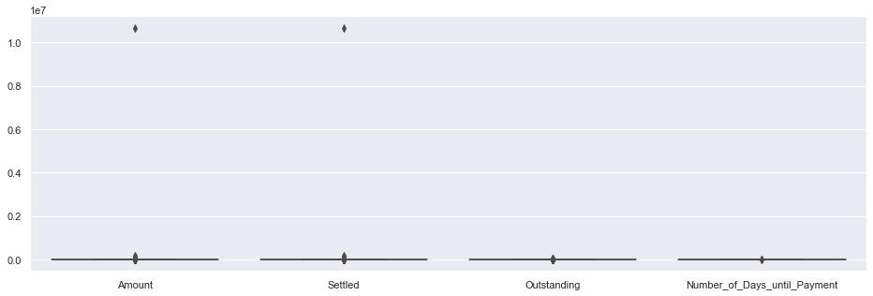
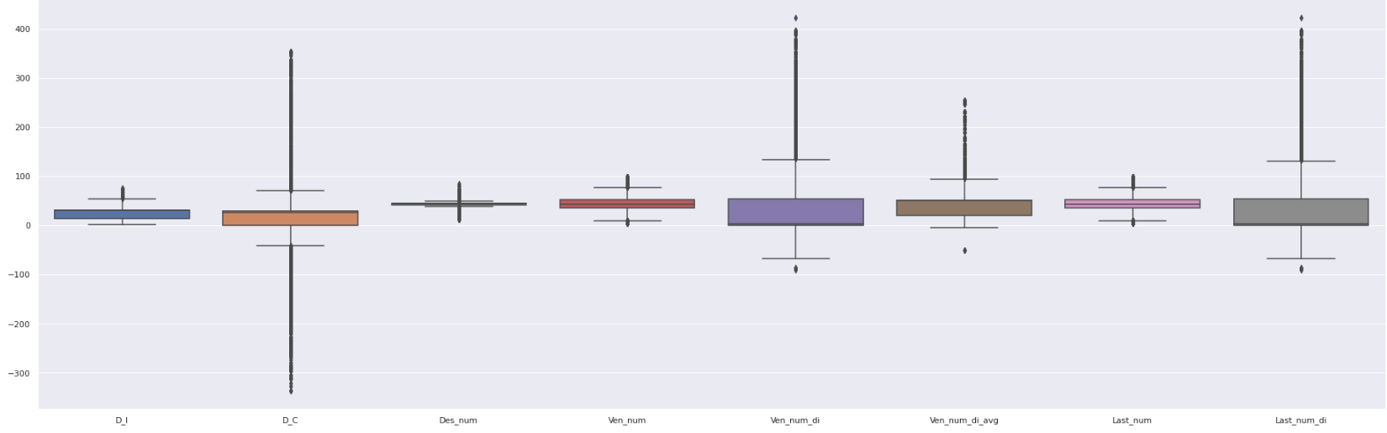
Handling Outliers
Notes:
We intentionally did not remove any outliers from our training dataset. We did not want to lose any vital information about any vendor, and each data point added some information to vendor history. Moreover, the models we used in training were robust to outliers, and any experimentation with removing outliers only resulted in a lesser score.

Slide 15
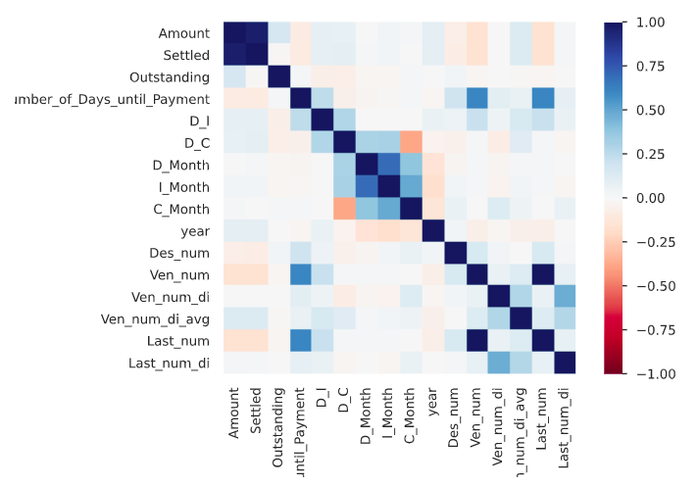
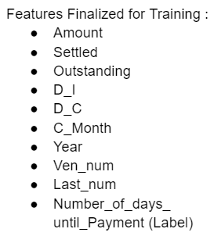
Choosing Features for Training the models
Notes:
From the correlation heatmap and after lot of trial and error we decided to use these few features to avoid over-fitting the model.

Slide 16
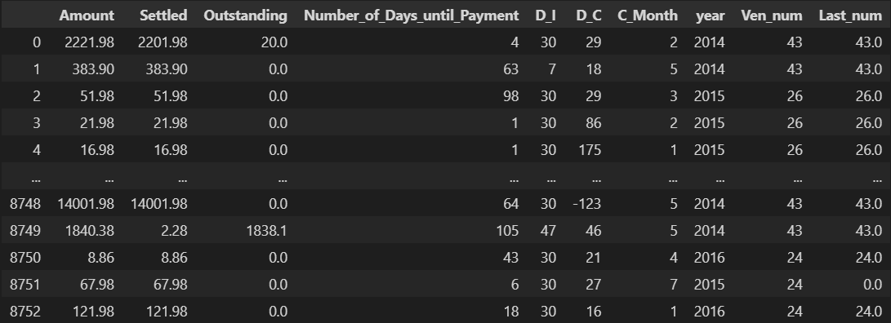
Final Training Data
Notes:
This is our final dataset on which we trained

Slide 17
MODEL
BUILDING

Slide 18
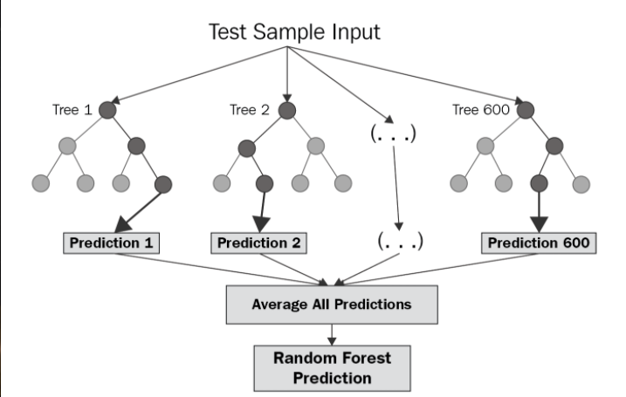
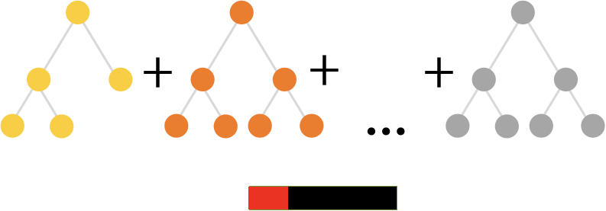
Model Building
Multiple models were tried and implemented on the final training data including:
CatBoost
XGBOOST
RandomForestRegressor
LGBM
The Best score came from an ensemble of CatBoost and RandomForestRegressor.

Slide 19
HYPERPARAMETER
OPTIMIZATION

Slide 20

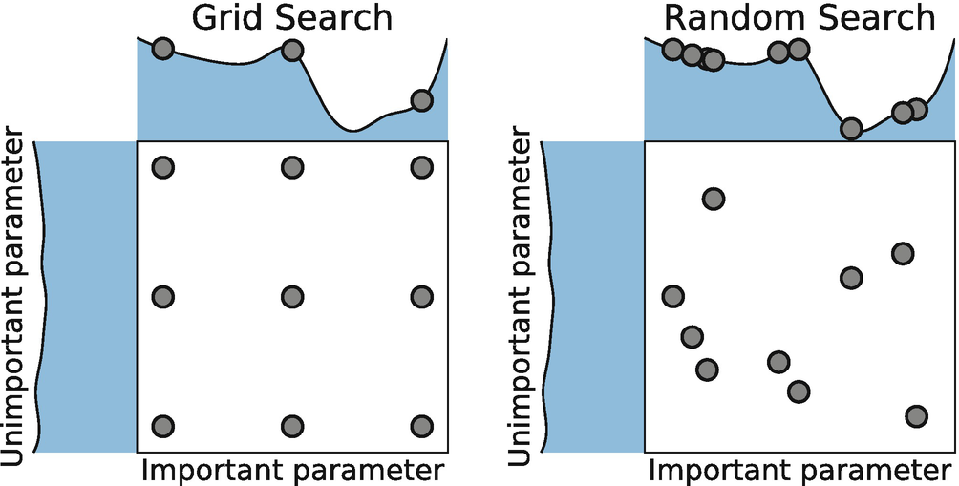
Hyperparameter Optimization
Techniques used for Hyperparameter optimization:
Grid Search over range of parameters
Optuna
Trial, Error, Learn

Slide 21
THANK YOU
OPEN TO QUESTIONS
Team Members:
Dhruv Agarwal
Vivek Agarwal
Aryaman Gupta

