Slide 1
Peppard IPAS Operator Dashboard
One dataset, two regulatory regimes — nothing keyed twice
Department of Justice demo · 8 accommodation centres across Ireland
Origin Care Group × Peppard Investments
peppard-ipas.netlify.app

Slide 2
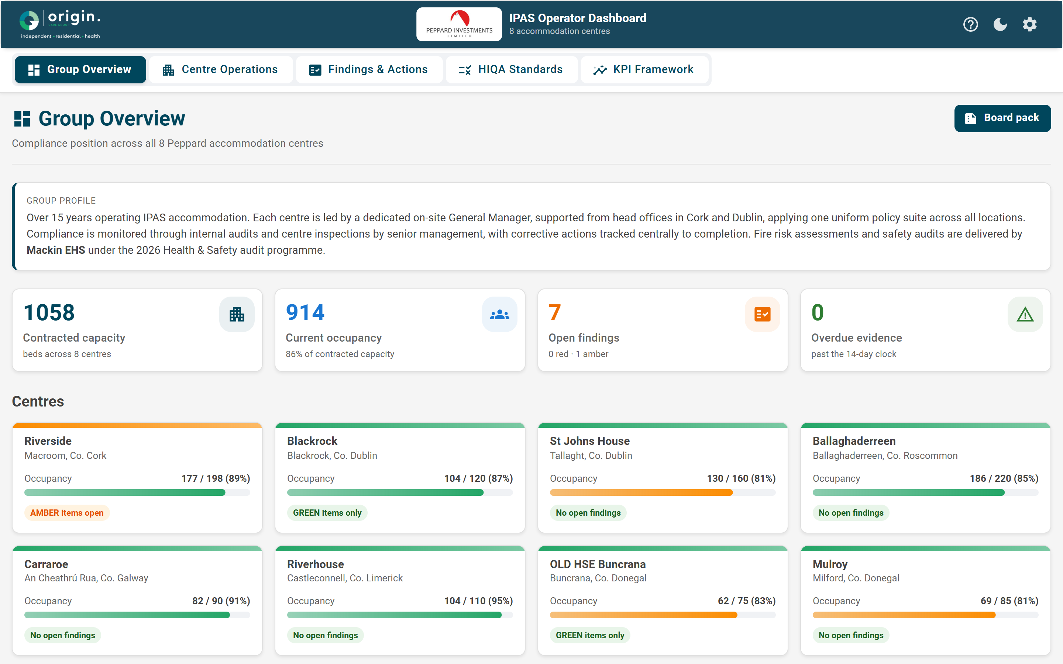
GROUP OVERVIEW
The whole group at a glance
8 centres with live RAG compliance
Occupancy, open findings and overdue evidence roll-up
15 years operating · GM-led · Cork & Dublin offices
Peppard IPAS Operator Dashboard
2

Slide 3
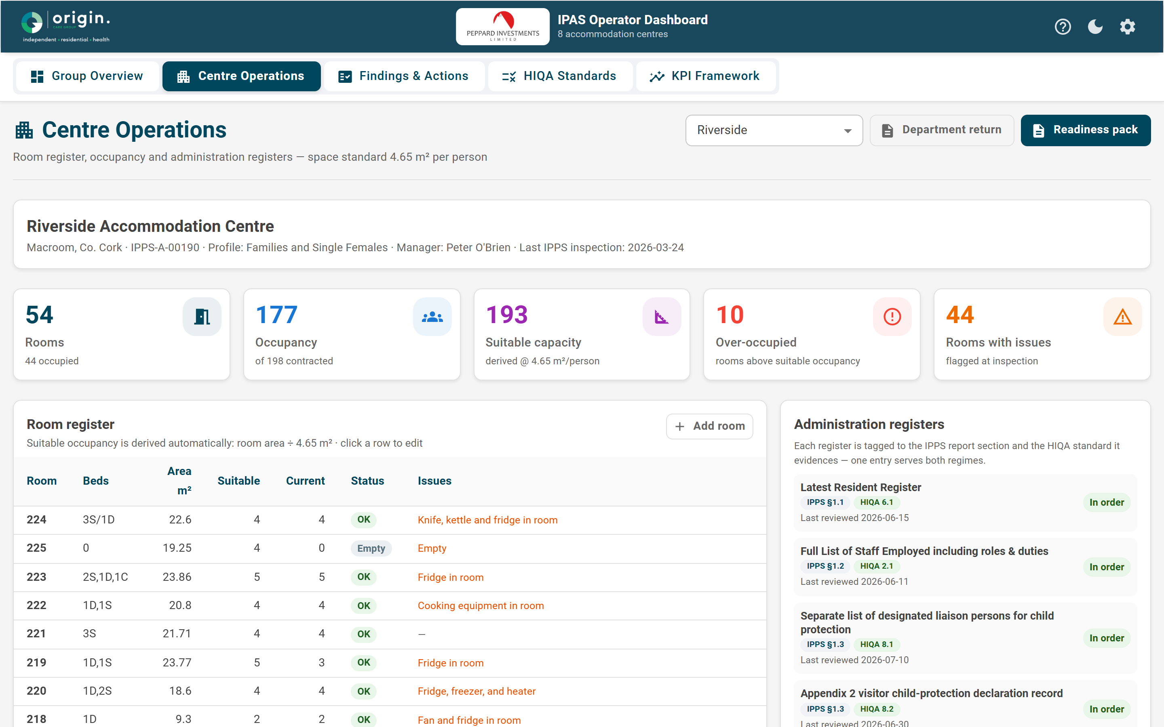
CENTRE OPERATIONS
Every room measured to the 4.65 m² standard
Live room register; suitable occupancy derived automatically
Over-occupancy flagged in real time
Each register tagged to IPPS § and HIQA standard
Peppard IPAS Operator Dashboard
3

Slide 4
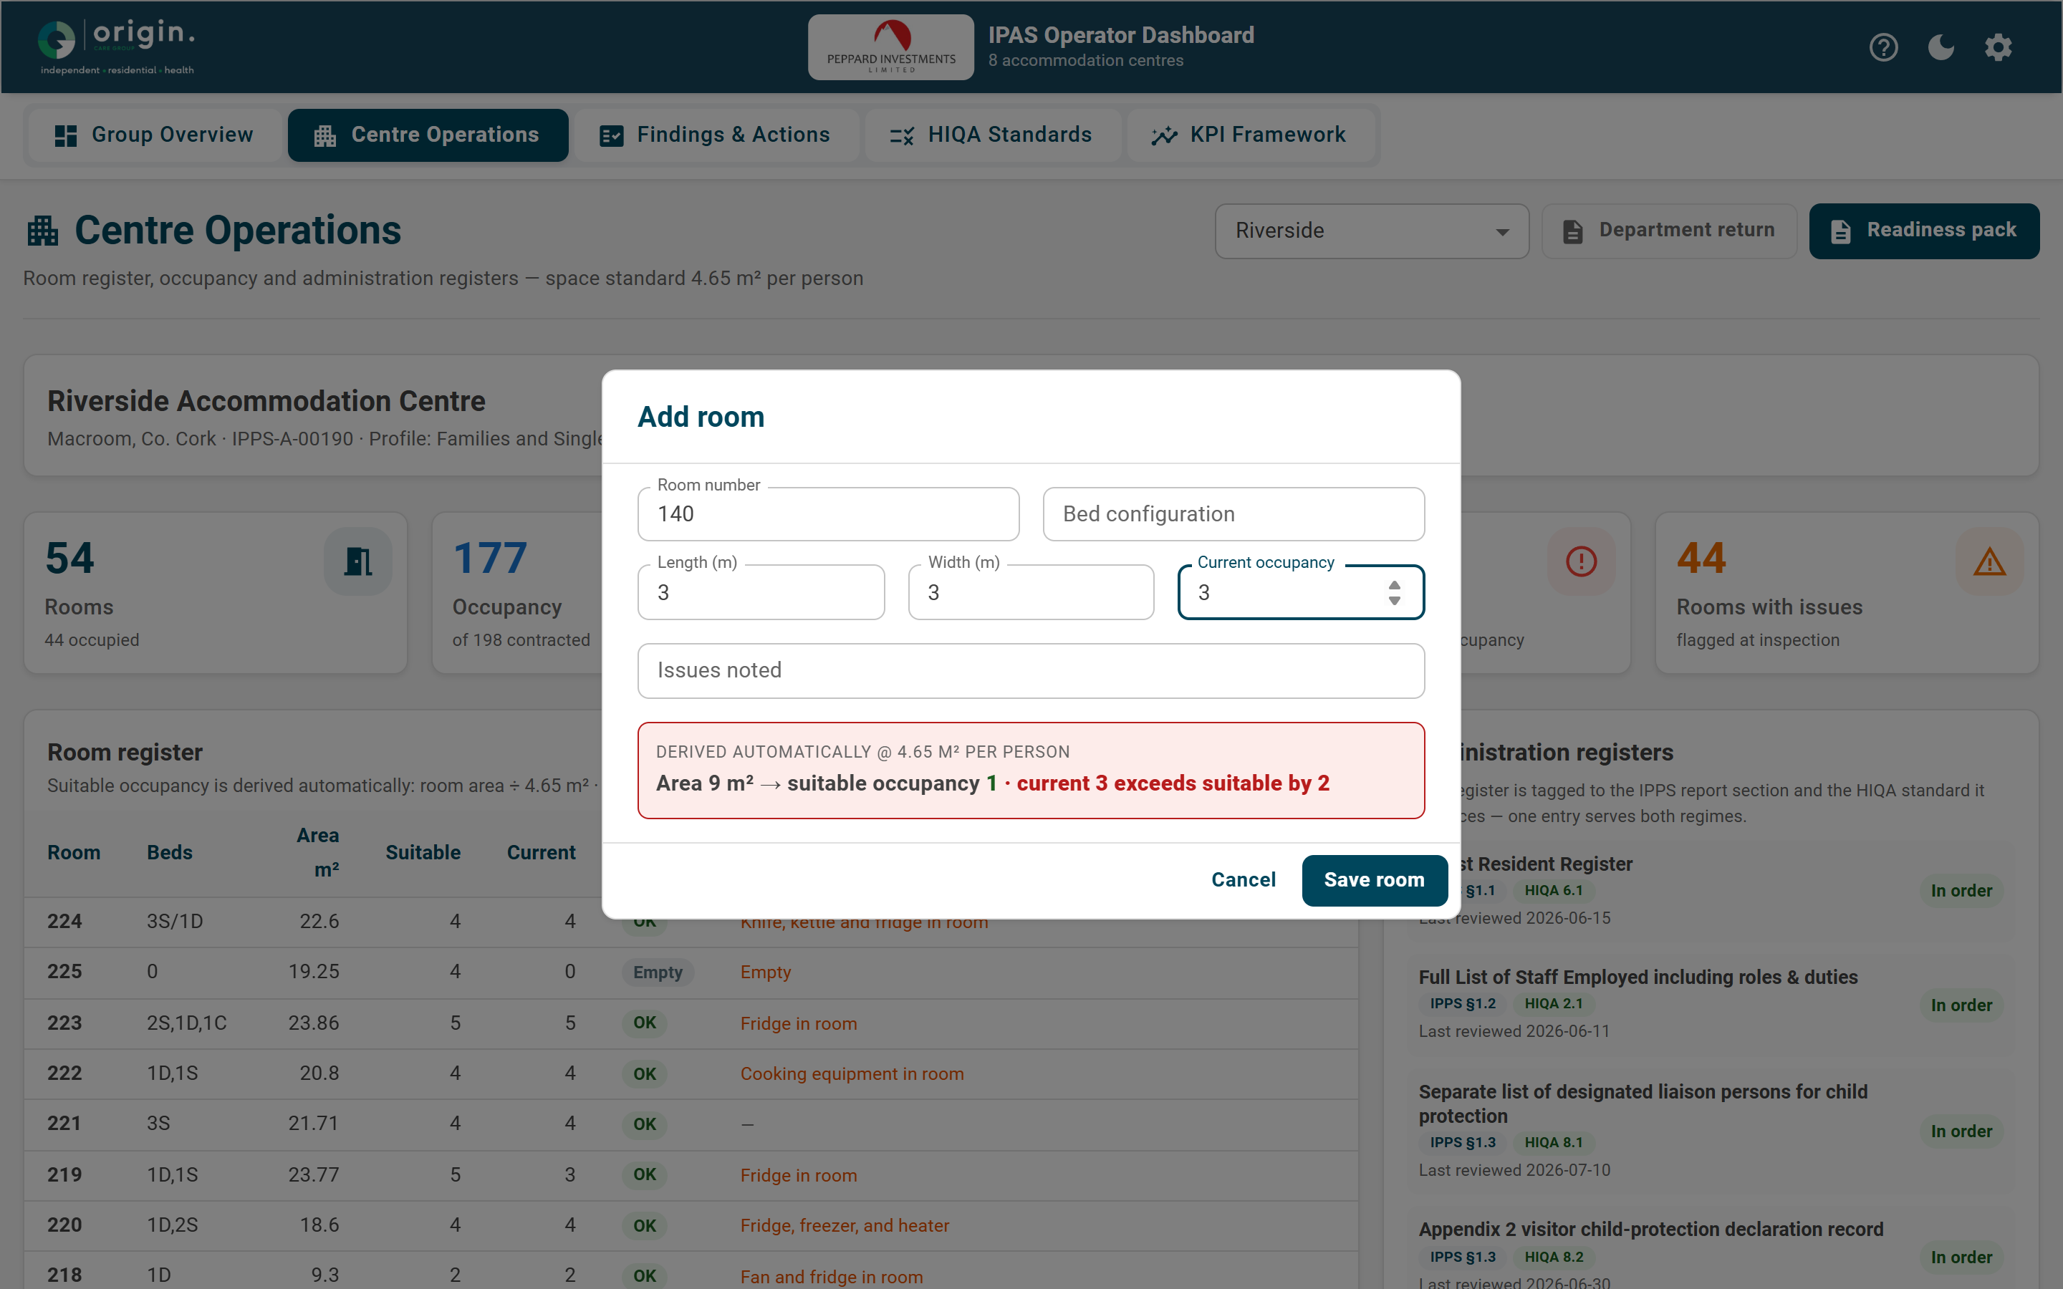
DATA ENTRY
Operators enter data — the system derives the rest
Type length × width → suitable occupancy computes @ 4.65 m²
KPIs, occupancy flags and the Department return update live
Nothing downstream is manually keyed
Peppard IPAS Operator Dashboard
4

Slide 5
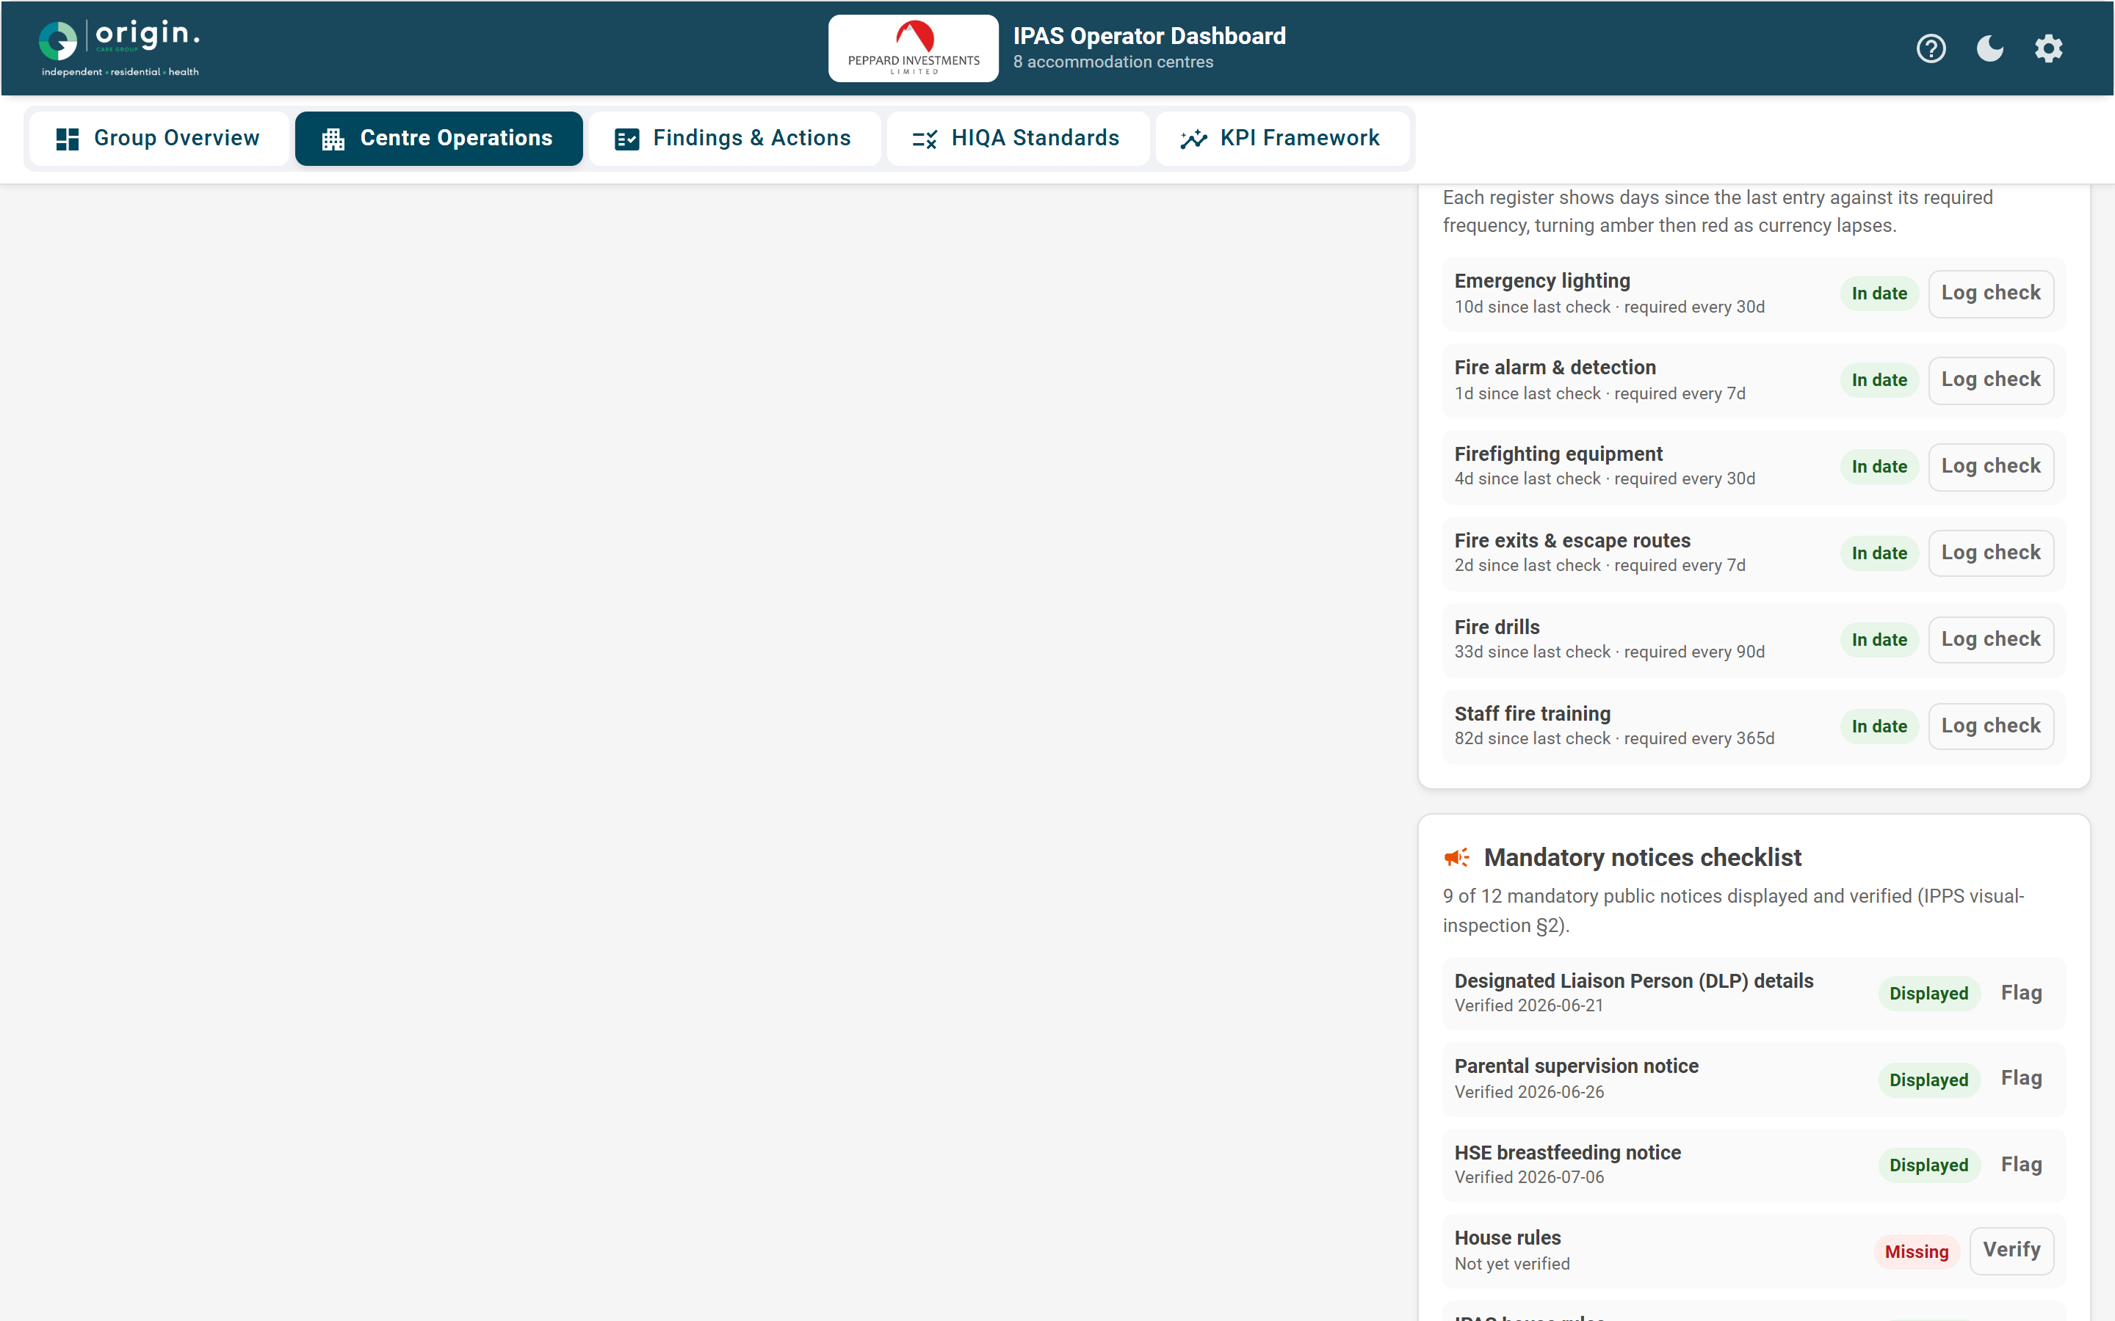
FIRE & NOTICES
Fire currency and notices, self-auditing
Days since last check vs required frequency → amber, then red
One-click 'Log check' refreshes currency
12-point mandatory public-notices checklist
Peppard IPAS Operator Dashboard
5

Slide 6
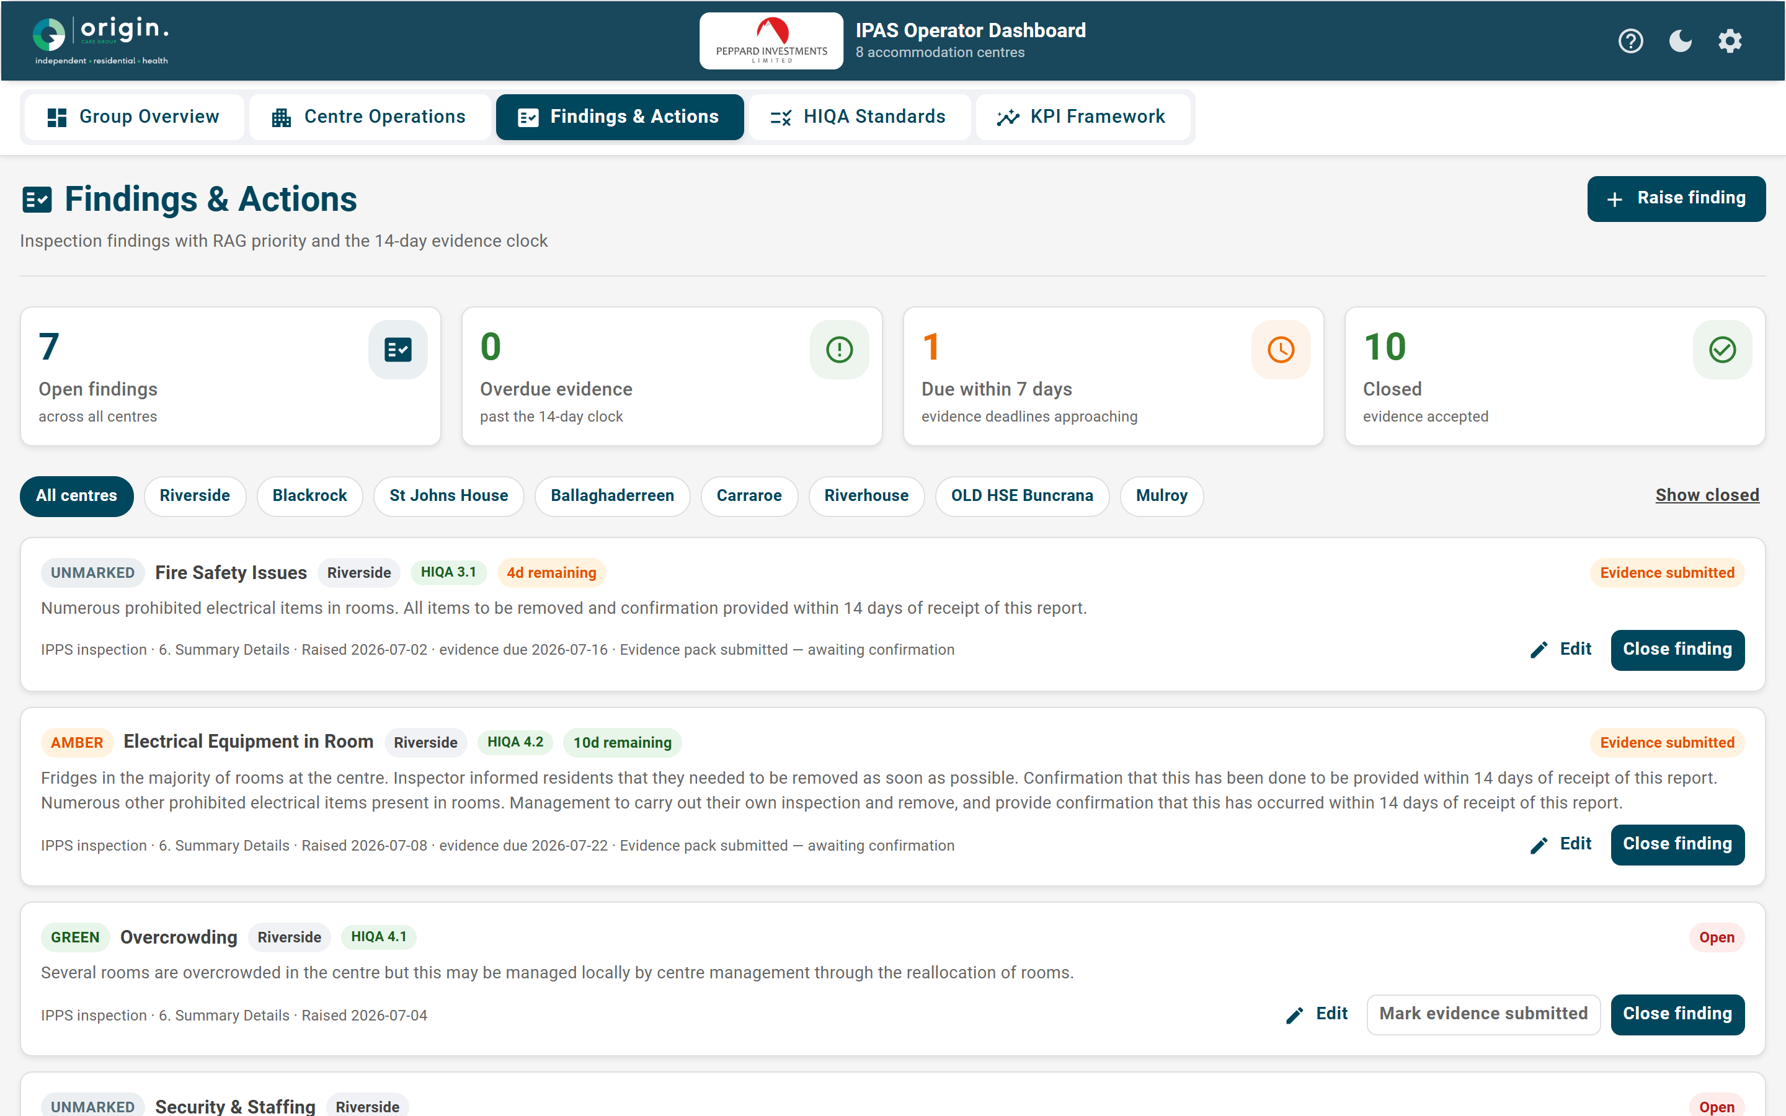
FINDINGS & ACTIONS
The 14-day evidence clock, fully editable
Raise or edit any finding; RED escalates on creation
Source and HIQA standard on every finding
Approaching-breach findings surfaced automatically
Peppard IPAS Operator Dashboard
6

Slide 7
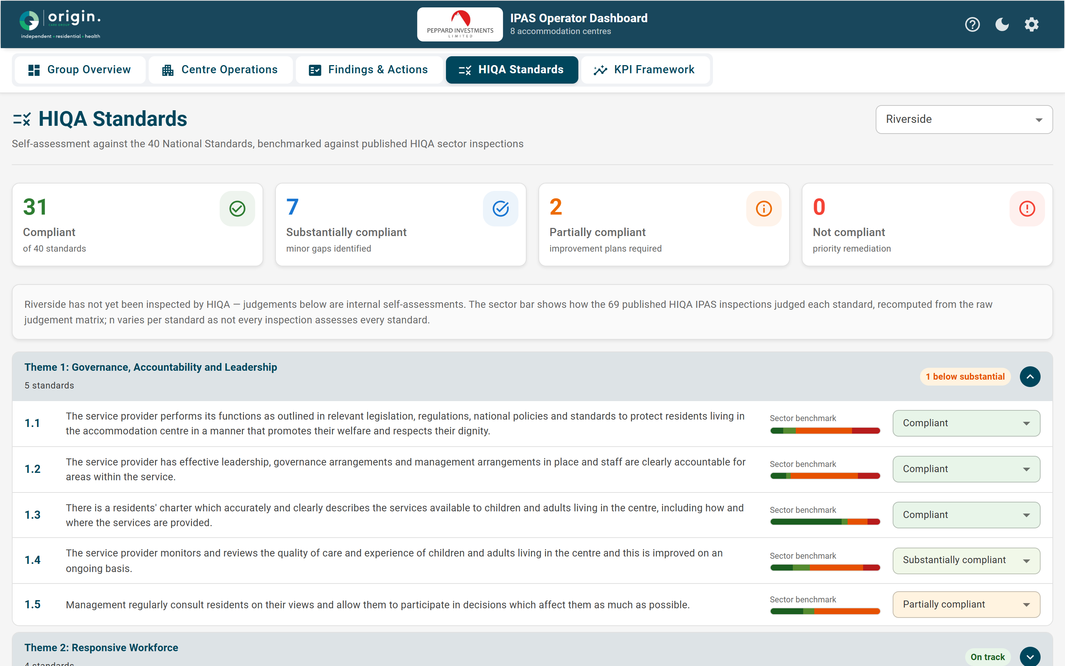
HIQA STANDARDS
40 standards, benchmarked against the sector
Self-assessment on the four-point compliance scale
Overlaid on 69 published HIQA sector inspections
Not yet HIQA-audited — internal self-assessment, stated plainly
Peppard IPAS Operator Dashboard
7

Slide 8
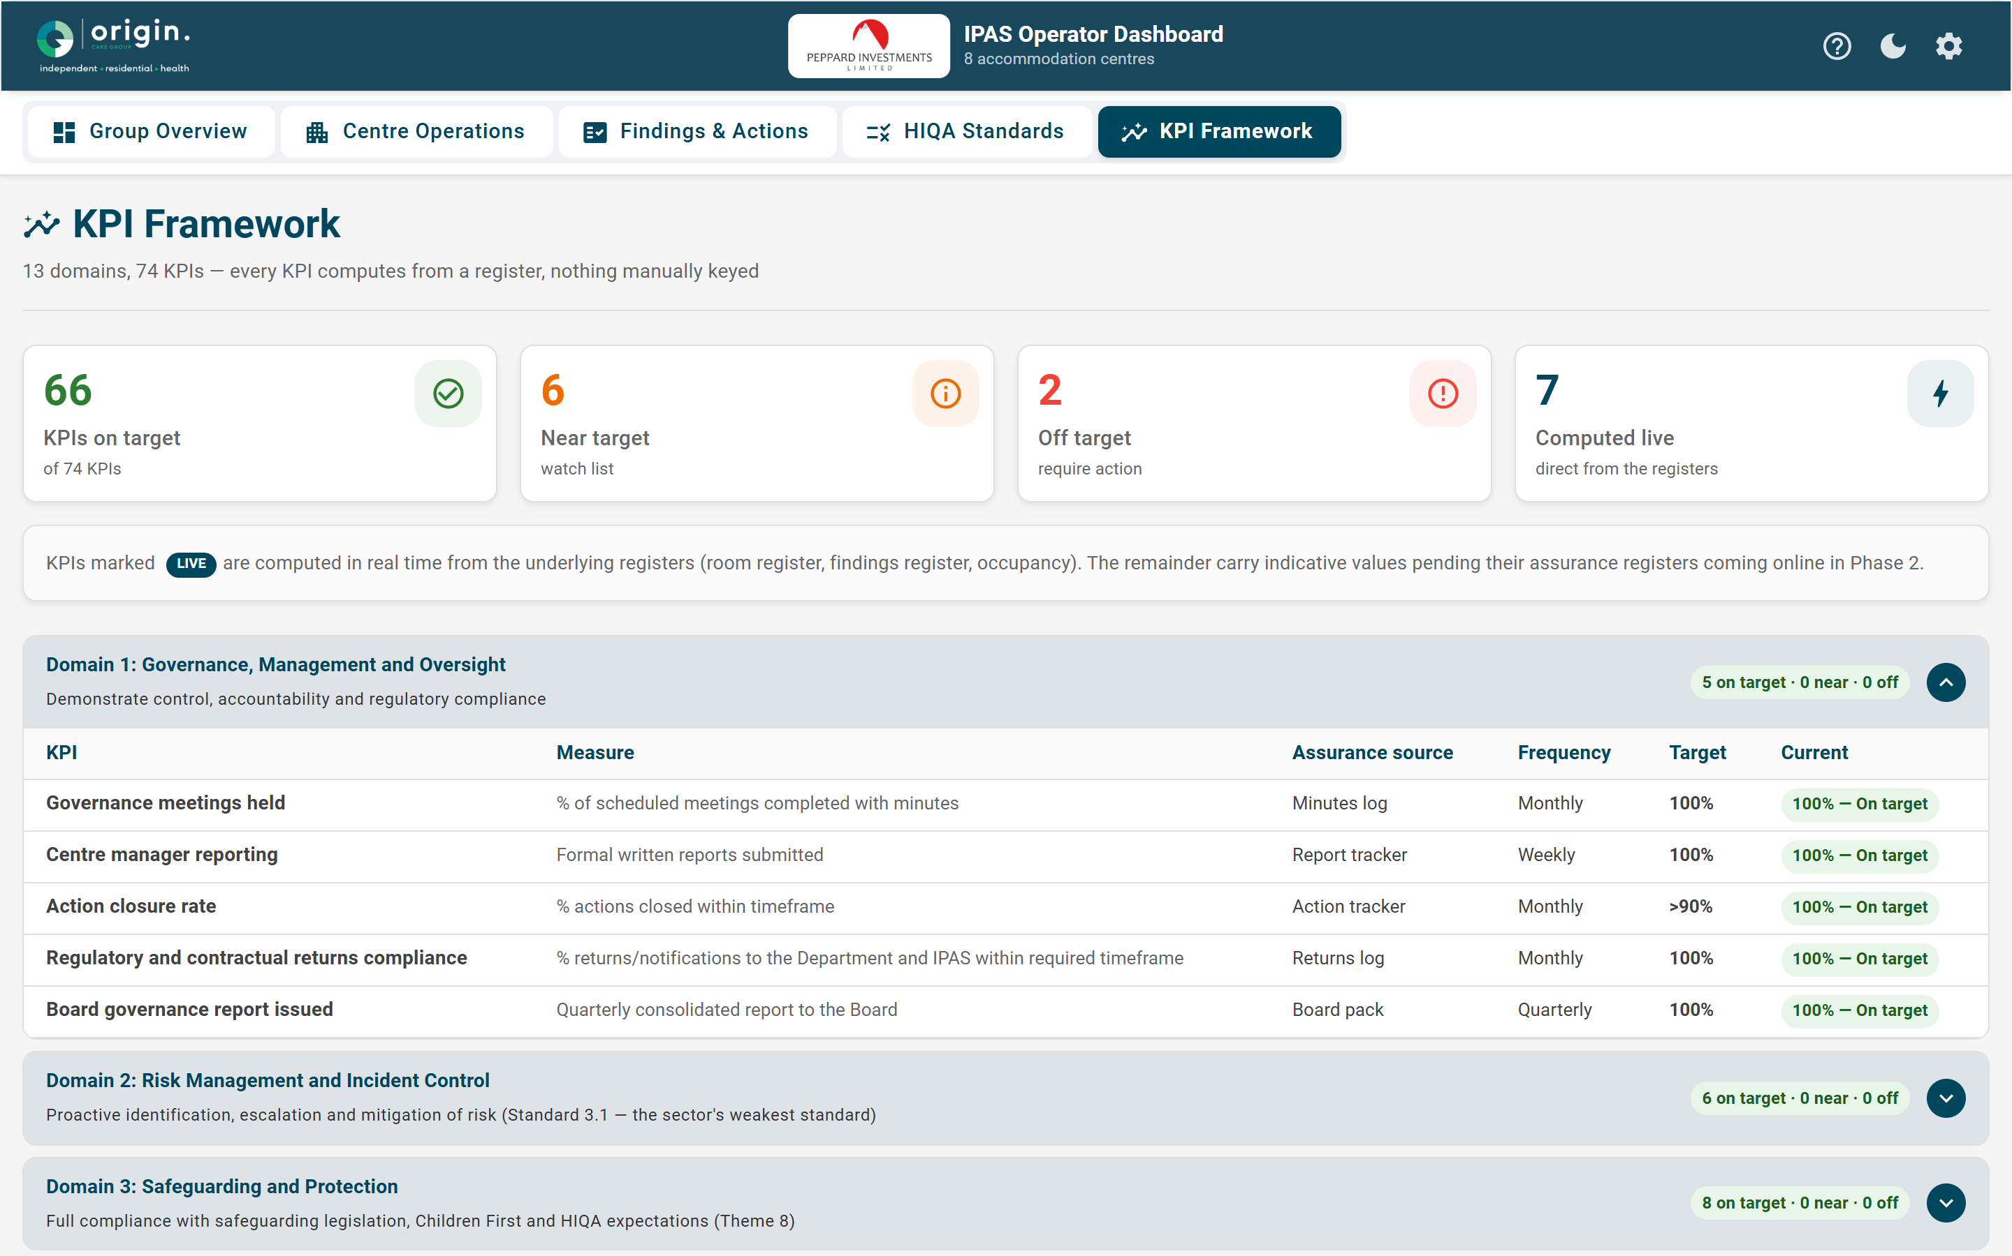
KPI FRAMEWORK
13 domains, 74 KPIs — computed from registers
7 KPIs computed live from the registers today
Every KPI maps to a register — nothing hand-keyed
Remaining KPIs phase in as registers come online
Peppard IPAS Operator Dashboard
8

Slide 9
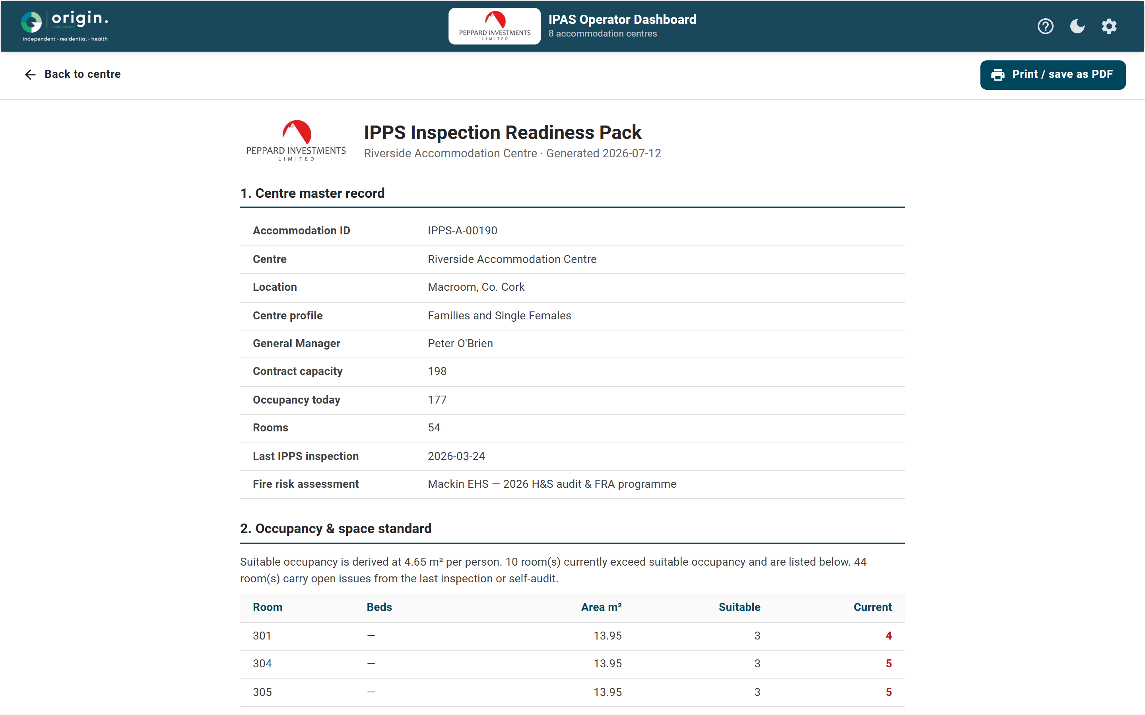
INSPECTION READINESS
One-click inspection readiness pack
Master record, occupancy, fire currency and notices
Findings register and HIQA self-assessment
Assembled from live registers — print to PDF
Peppard IPAS Operator Dashboard
9

Slide 10
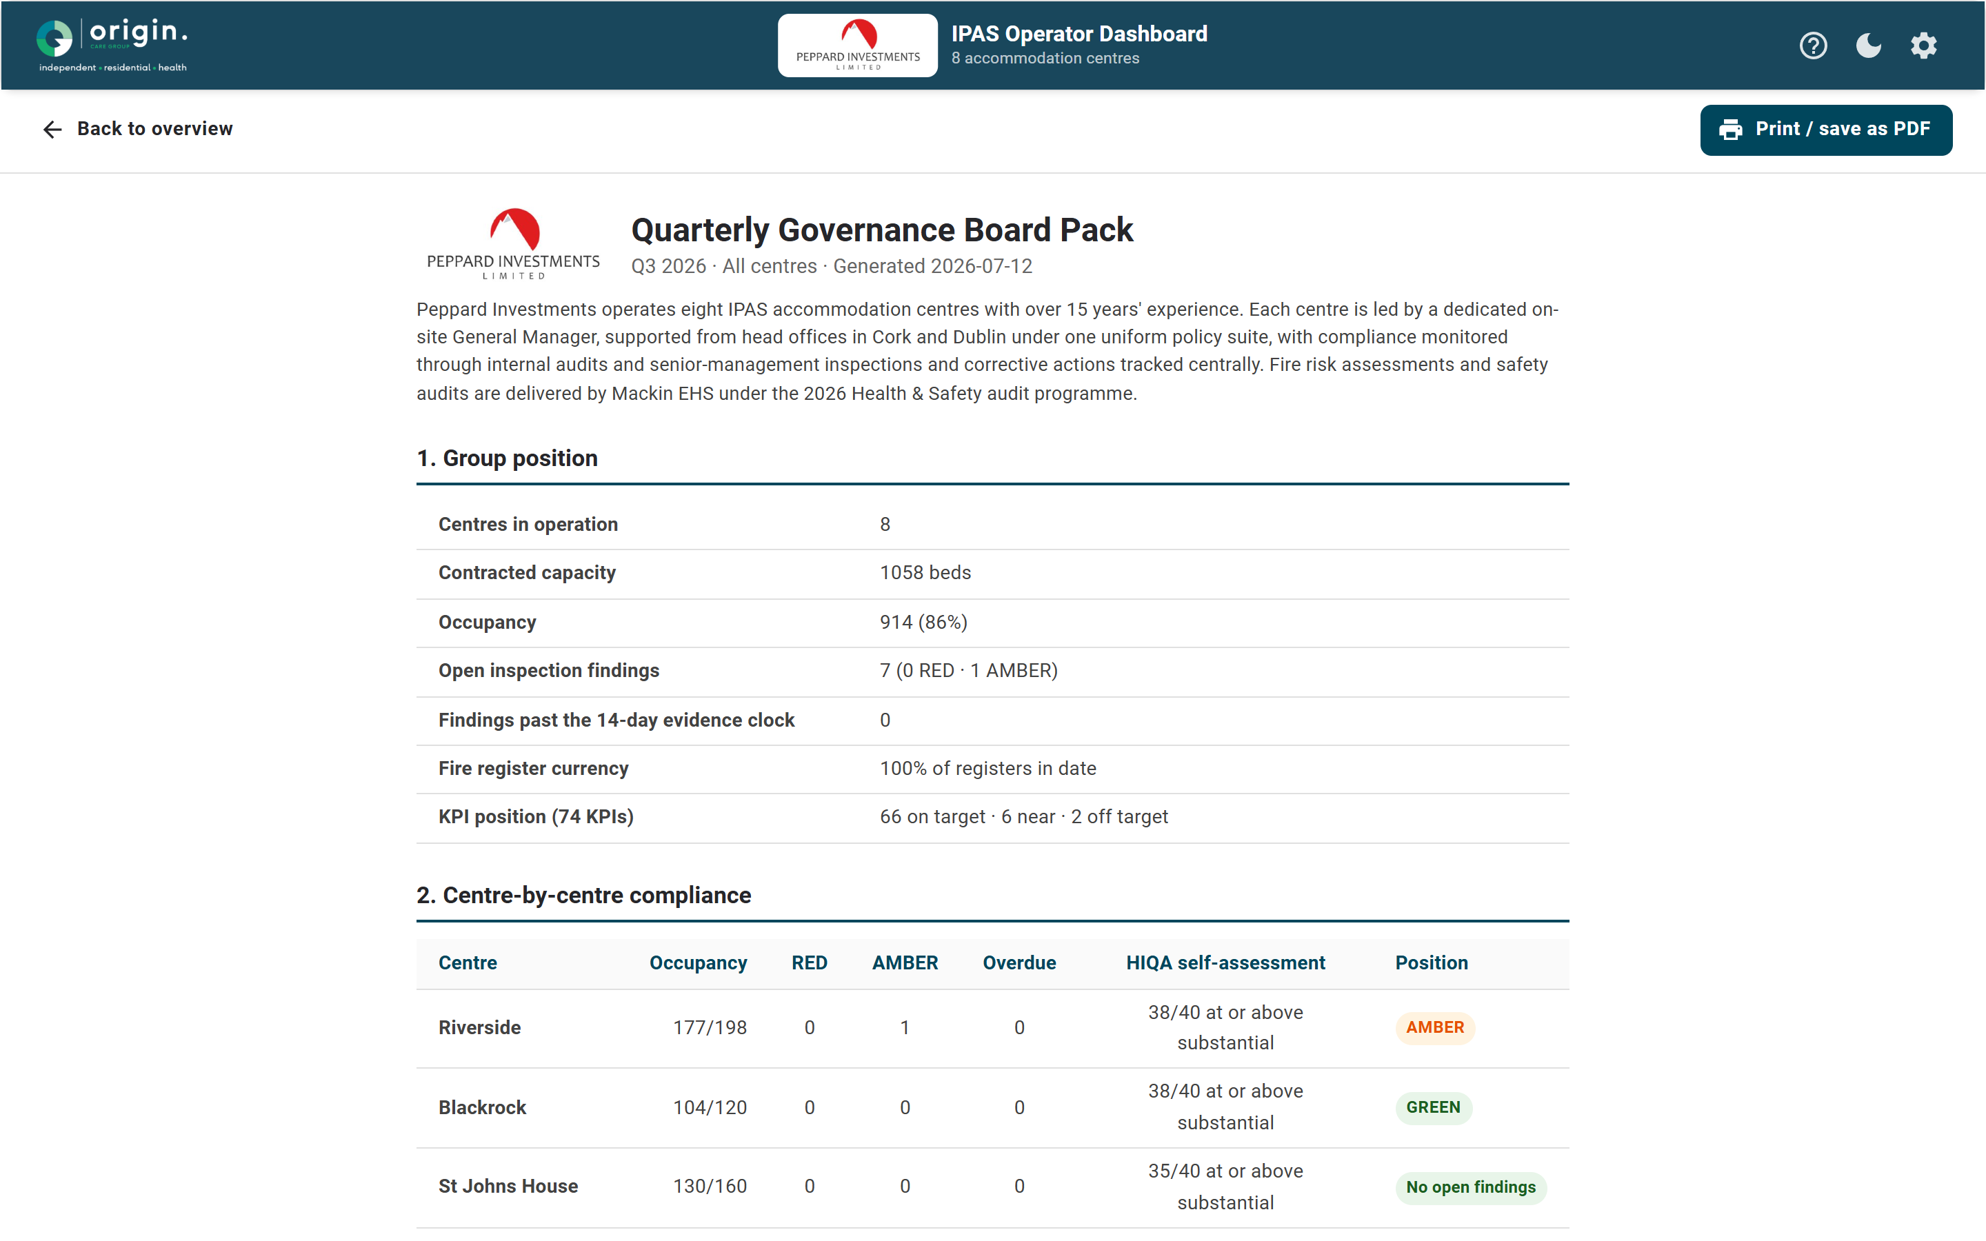
BOARD PACK
Quarterly governance, generated
Cross-centre RAG and KPI position
Thematic HIQA risks across the group
Group profile and Mackin EHS assurance
Peppard IPAS Operator Dashboard
10

Slide 11
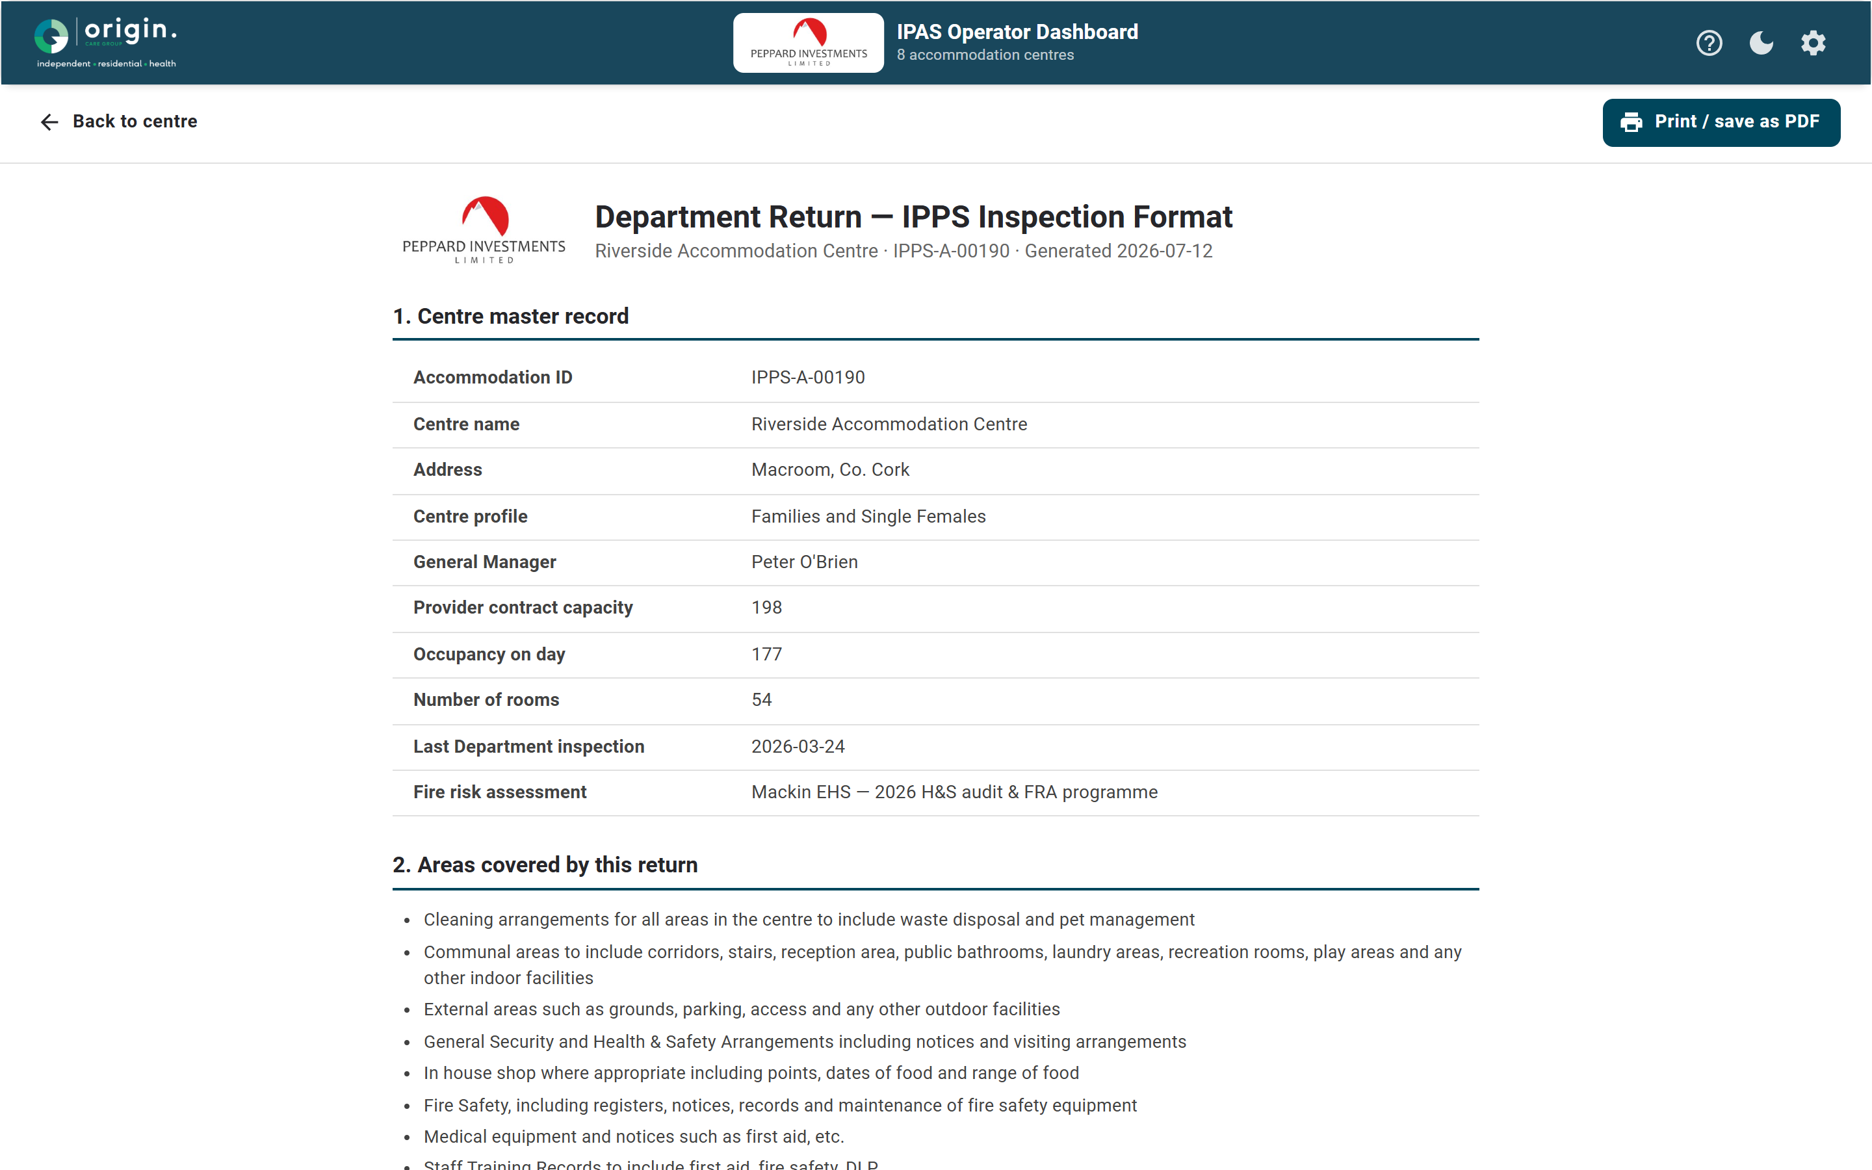
DEPARTMENT RETURN
The IPPS return — generated, not transcribed
Full room-by-room register
Regulatory mapping: IPPS § and HIQA standard
Findings, actions, evidence and contractor comment
Peppard IPAS Operator Dashboard
11

Slide 12
One dataset. Two regimes.
Nothing keyed twice.
Every KPI computes from a register — the 74-KPI framework, not a spreadsheet
Operators enter once; both regimes are served — IPPS § and HIQA standard on every record
One-click returns, readiness packs and board packs — generated from live registers
Live demo: peppard-ipas.netlify.app

