Slide 1

IPAS Operator Dashboard
One dataset. Two regulators. No double entry.
8 CENTRES
IPPS + HIQA
74 KPIs
Prepared for the Department of Justice meeting · Origin Care Group · July 2026
Notes:
Working demo exists and can be shown live. This deck is the narrative and the fallback.

Slide 2
THE PROBLEM
Two inspection regimes, one operation
Department of Justice — IPPS contract
HIQA — National Standards
Granular and physical: rooms, ratios, registers
Room-level space standard — 4.65 m² per person
Findings graded RED / AMBER / GREEN
Evidence of resolution due within 14 days
Contractual exposure — payment depends on it
Thematic: 40 standards across 10 themes
Judged on a 4-point compliance scale
Monitoring inspections published sector-wide
Peppard not yet audited — 69 sector inspections tracked
Not designated centres: obligations run to the Department and Tusla
RED
AMBER
GREEN
COMPLIANT
SUBSTANTIALLY
PARTIALLY
The design rule: every register entry carries both regulatory tags — one dataset feeds both regimes without double entry.
Notes:
The core design constraint from the descriptor: staff record once; the system answers to both the Department and HIQA.

Slide 3
THE PLATFORM
Three modules, six generated outputs
1
Department Returns
2
HIQA Standards
3
KPI Framework
Centre master record
Administration & fire registers
Room register — suitable occupancy auto-derived
Findings with the 14-day evidence loop
All 40 standards, self-assessed per centre
Evidence linked from the same registers
Benchmarked against 69 published sector inspections
13 domains, 74 KPIs — fully specified
Every KPI computes from a register
Nothing is manually keyed
Generated outputs — one click each:
DAILY CENTRE OPERATIONS
COMPLIANCE RAG
AUDIT & ASSURANCE
QUARTERLY BOARD PACK
DEPARTMENT RETURN
INSPECTION READINESS PACK
Notes:
Modules per the descriptor. Three of the six outputs are already generated in the demo: board pack, Department return, readiness pack.

Slide 4
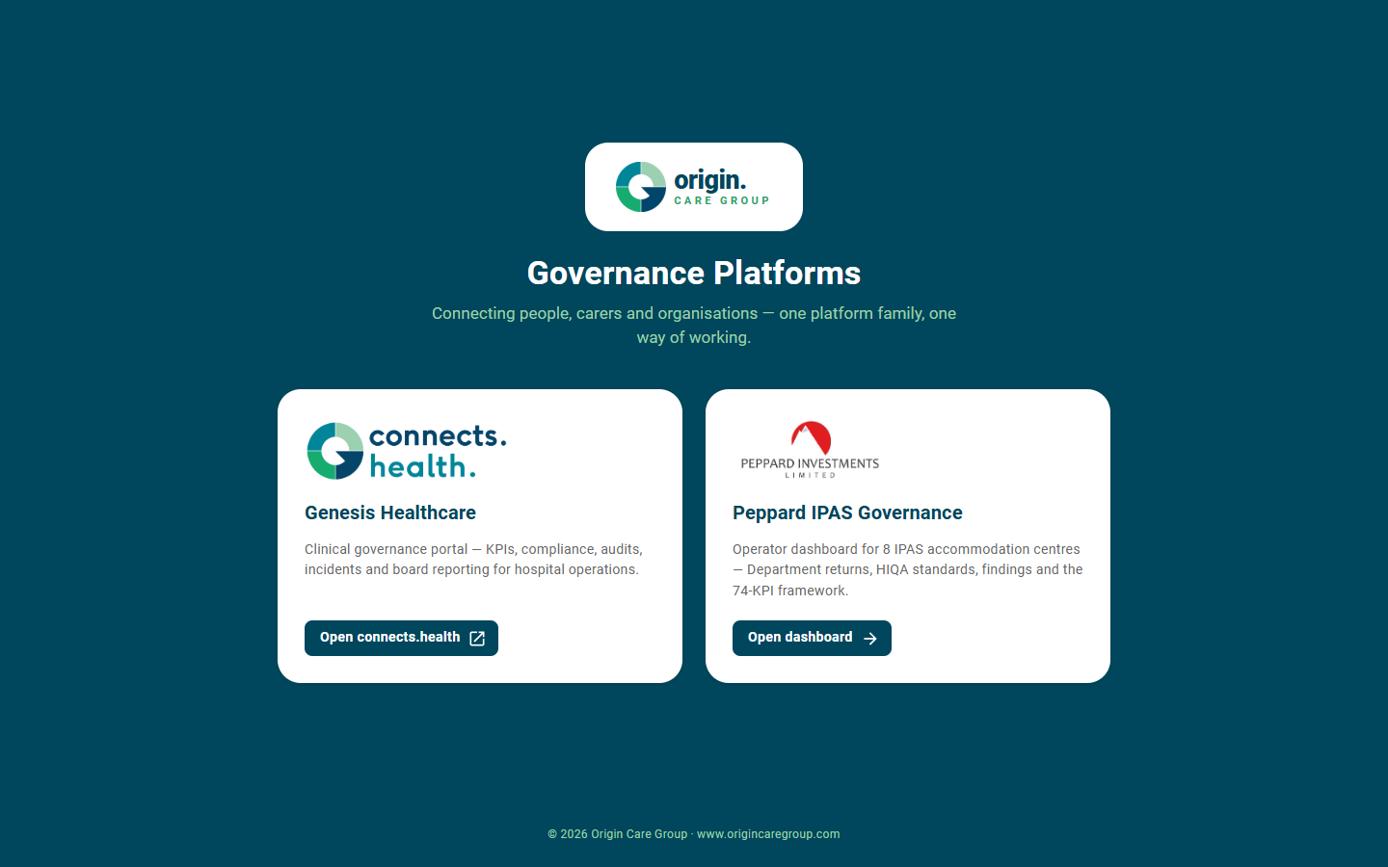
ONE FRONT DOOR
The Origin platform family
One launcher for every Origin governance platform
Genesis Healthcare — clinical governance for hospital operations
Peppard IPAS — accommodation-centre governance, same design language
Shared components, shared conventions, faster delivery
Notes:
Same platform DNA as connects.health — the Peppard dashboard is a sibling, not a one-off.

Slide 5
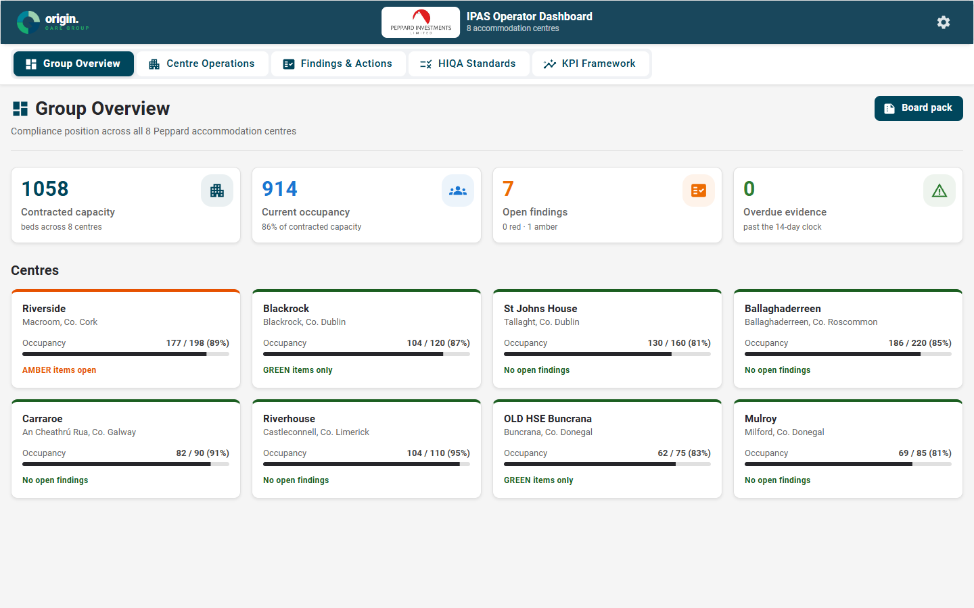
LIVE SYSTEM
Group overview — all 8 centres at a glance
Live compliance position for every centre
Occupancy against contracted capacity
Worst open finding sets each centre's RAG status
Overdue evidence surfaced group-wide, instantly
Scenario settings present the estate strong, mixed or under pressure
Notes:
Riverside carries the real 24.03.2026 inspection data; the other 7 centres carry representative sample data in the same shape.

Slide 6
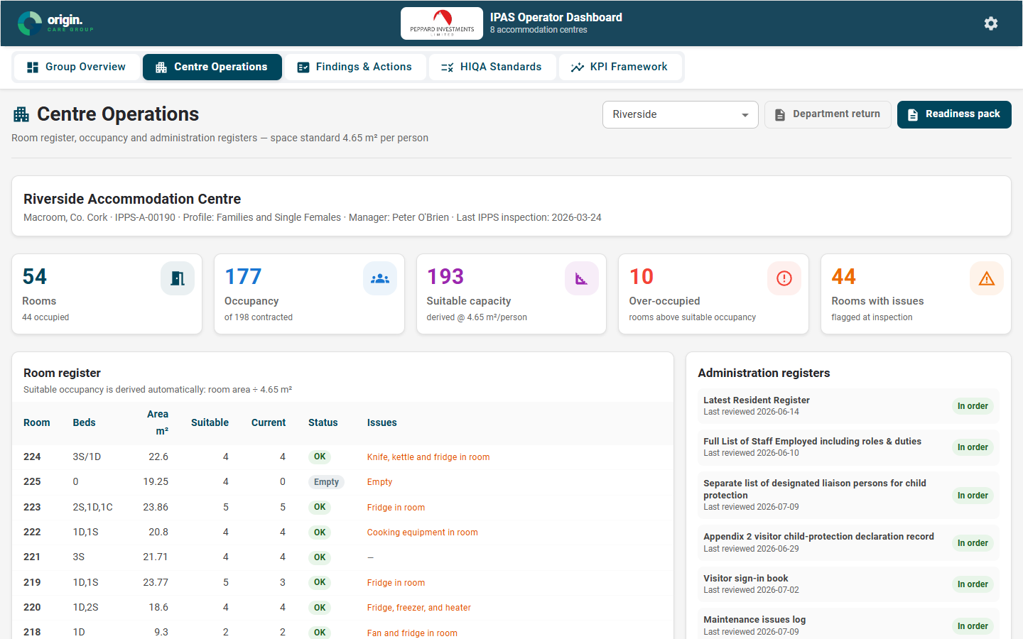
MODULE ONE
Centre operations — the room register, live
Riverside's real room register — 54 rooms from the March 2026 IPPS inspection
Suitable occupancy derived automatically at 4.65 m² per person
Over-occupancy flagged the moment it occurs
15 administration registers with review status
Notes:
The room table is the actual inspection data: bed configs, dimensions, issues like fridges in rooms.

Slide 7
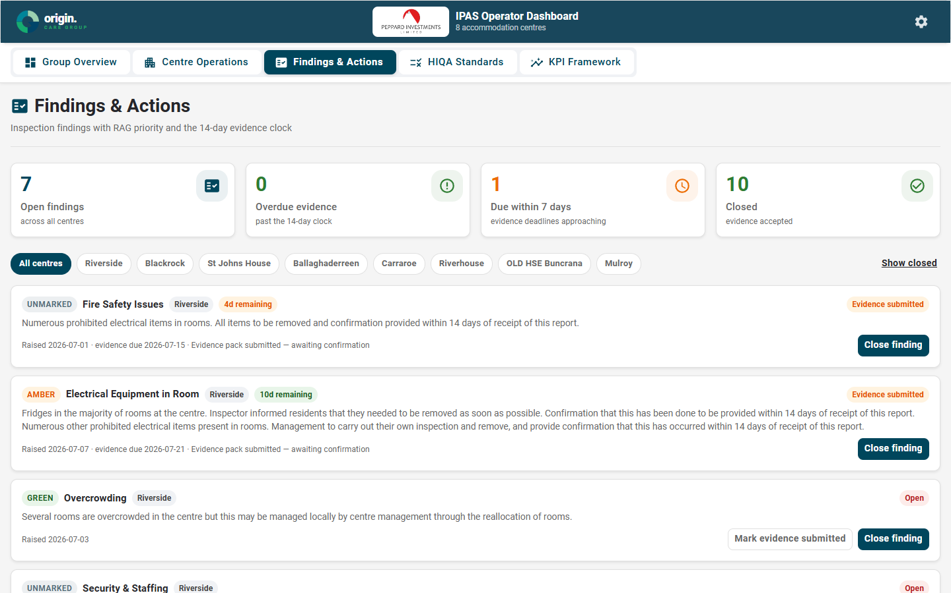
MODULE ONE
Findings & the 14-day evidence clock
Every finding carries its RAG priority
Live countdown to each 14-day evidence deadline
Overdue items escalate visually — nothing slips
Evidence workflow: submit, close, reopen — with an audit trail
Notes:
This is the contractual exposure loop. RED = contractual breach; the clock starts on report receipt.

Slide 8
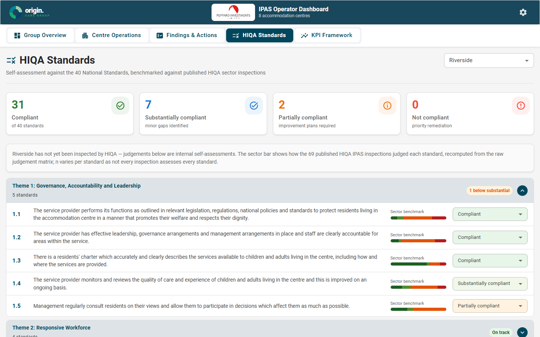
MODULE TWO
HIQA standards with sector benchmarking
All 40 National Standards across 10 themes
Self-assessment on HIQA's own 4-point scale
Each standard benchmarked against 69 published HIQA IPAS inspections
Peppard sees where the sector struggles before HIQA arrives
Notes:
Benchmark recomputed from the raw judgement matrix of published inspections — Peppard's tracker data.

Slide 9
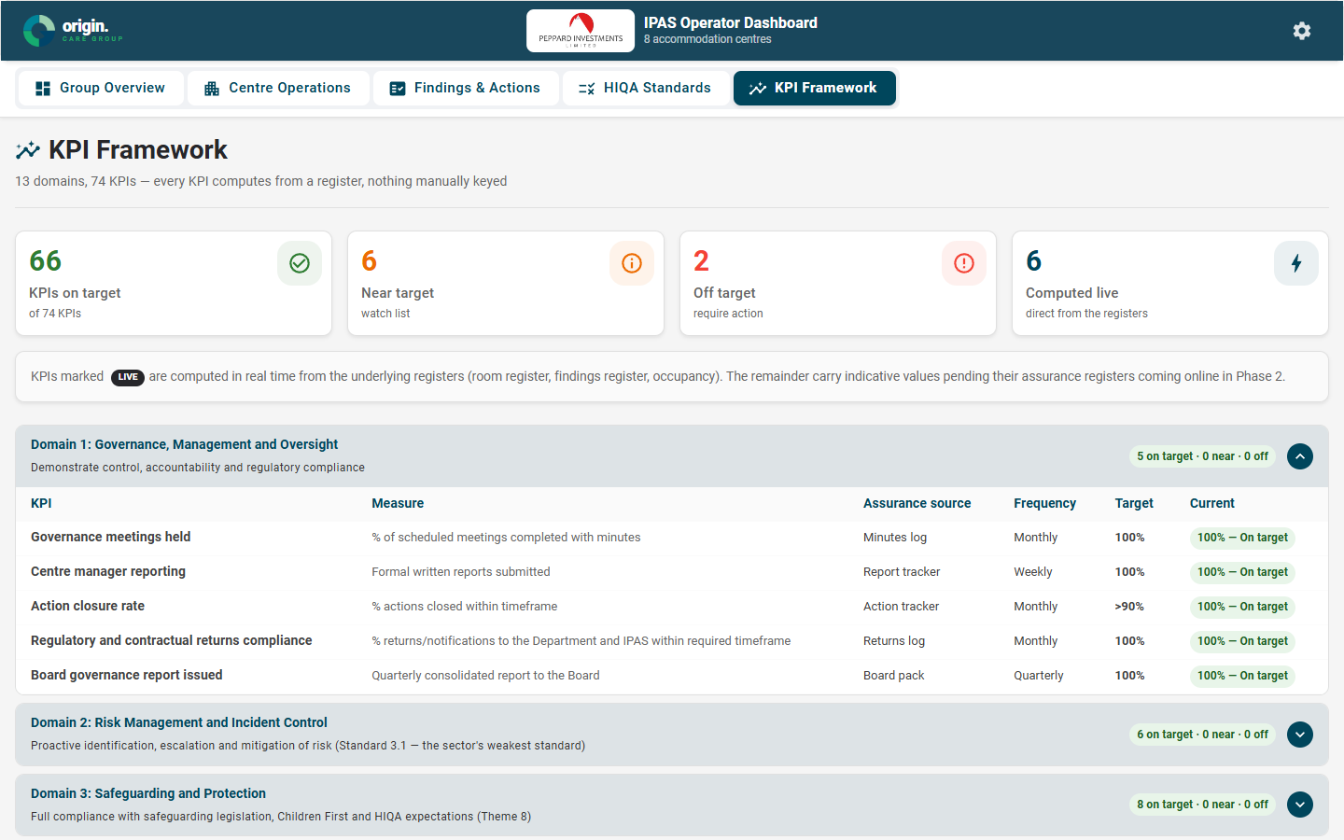
MODULE THREE
The KPI framework — 13 domains, 74 KPIs
The revised framework in full, as specified
Every KPI mapped to its assurance register
KPIs marked LIVE compute in real time from the underlying registers
The rule that matters: nothing is manually keyed
Notes:
6 KPIs compute live today (occupancy, space standard, evidence timeliness, open REDs, mould cases, prohibited items). The rest wire up in Phase 2.

Slide 10
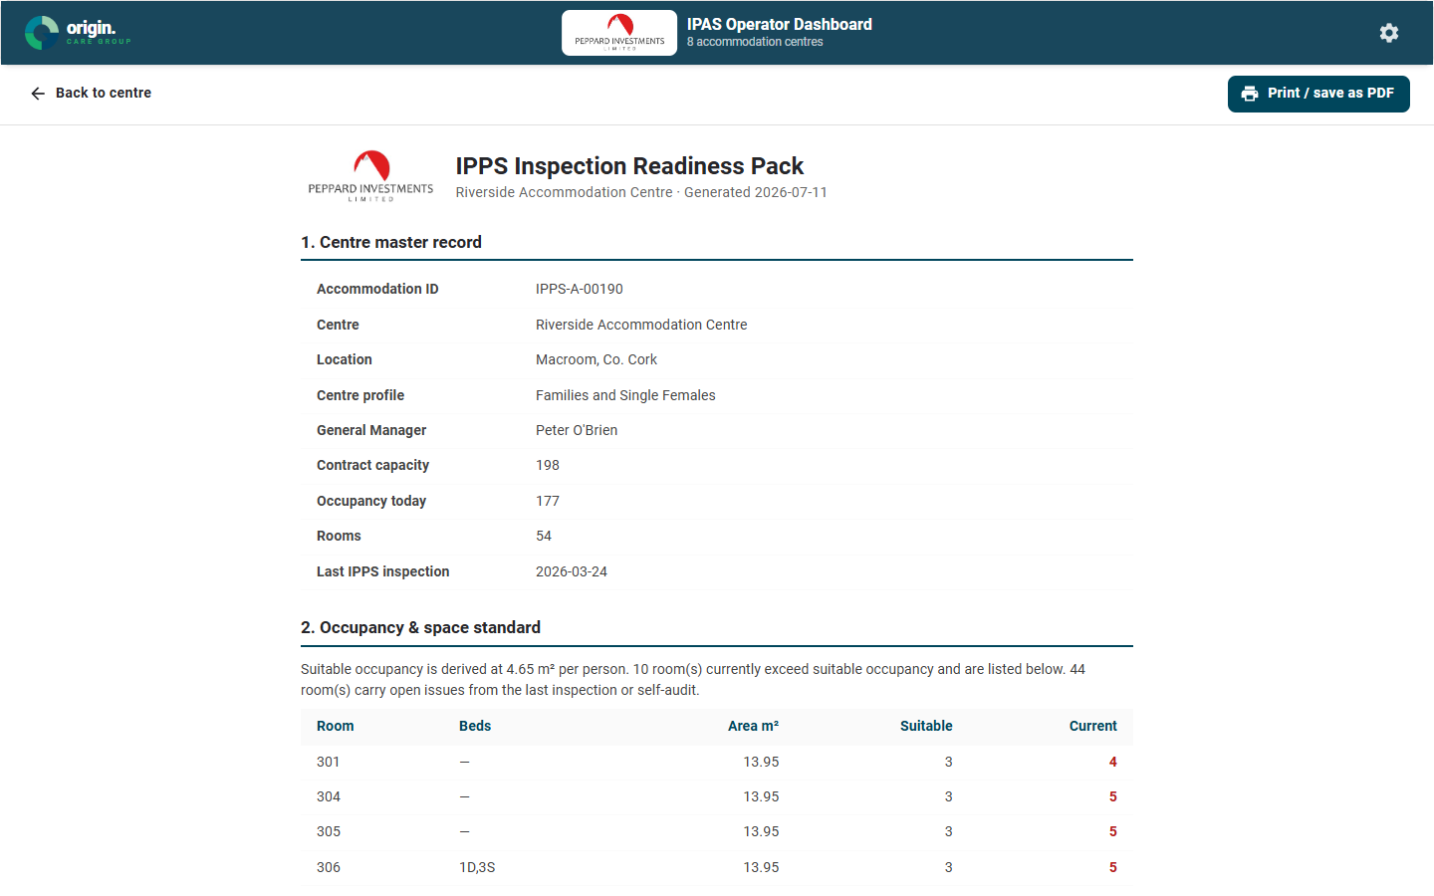
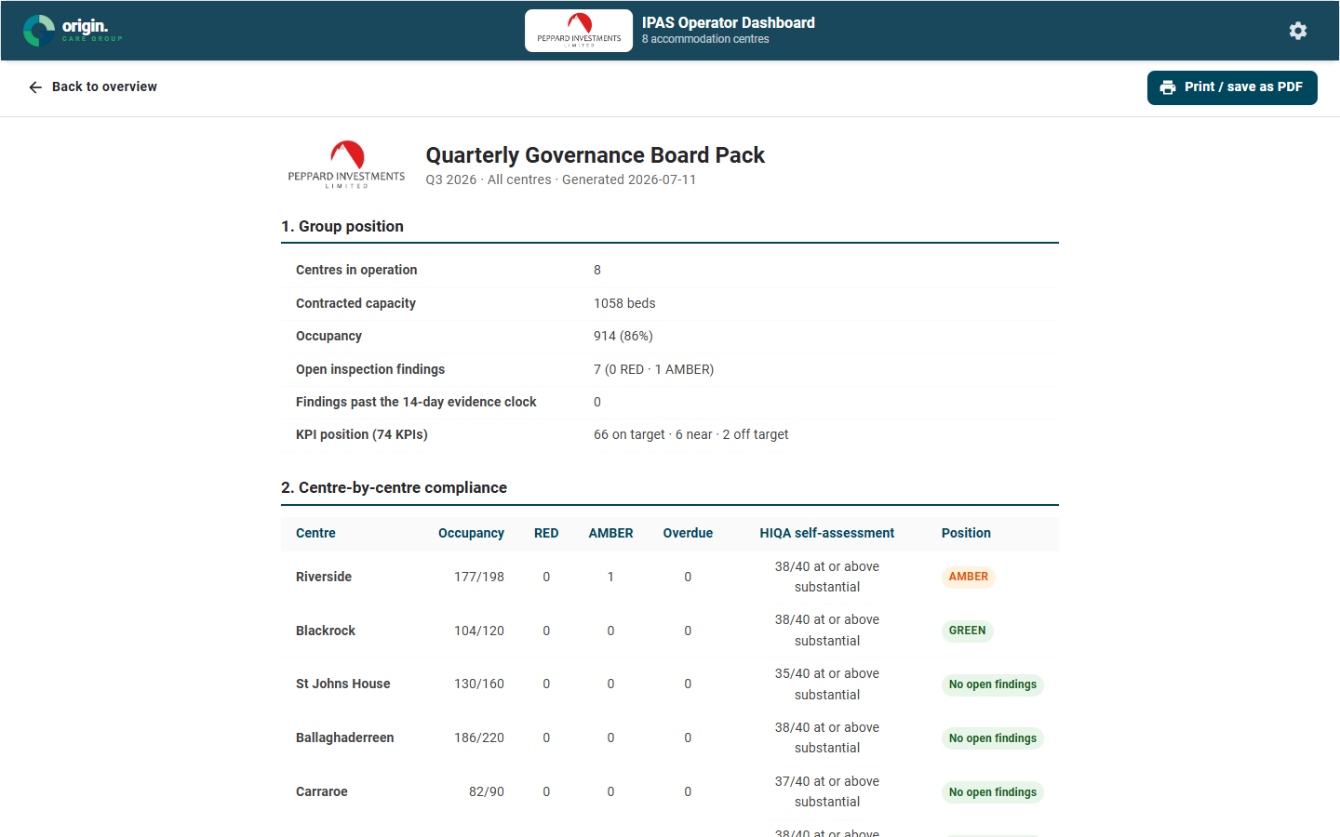
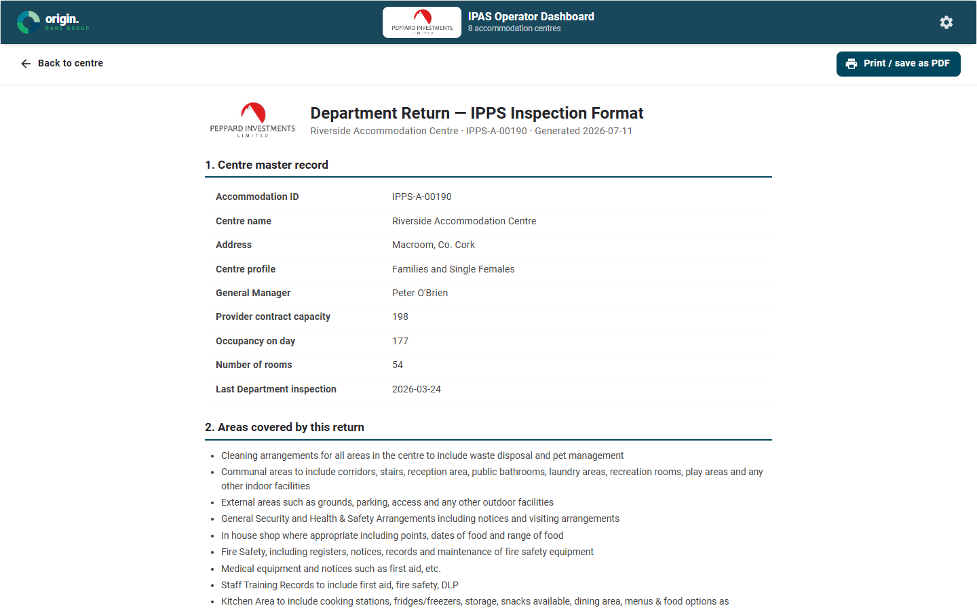
OUTPUTS
From registers to documents — one click
Inspection readiness pack
Quarterly board pack
Department return
Everything an inspector asks for, print-ready
Group position, centre RAG, thematic risks
The IPPS report format, pre-filled
Every figure in every document reconciles to the registers at generation time.
Print to PDF today; automated submission when the Department is ready.
Notes:
These three documents exist in the demo now — generated live from the same data as the screens.

Slide 11
WHERE WE ARE
What's real today, and what comes next
In the build today
Build phases
Riverside's real 24.03.2026 IPPS inspection: 54 rooms, findings, registers
The real HIQA sector benchmark — 69 published inspections
The full 74-KPI framework, 6 KPIs computing live
All three generated documents
7 sibling centres carry representative sample data in the same structures
PHASE 1
Live registers per centre + the findings/evidence loop — the contractual exposure, first
PHASE 2
Full KPI wiring + standards register + sector benchmarking
PHASE 3
Generated returns, board packs and readiness packs as submissions
Room register & return generator estimated as discrete work packages, per the descriptor.
Notes:
Honest split: real data vs demo data. Backend and hosting decisions are part of Phase 1 scoping.

Slide 12
Record once. Answer both regulators.
Peppard IPAS Operator Dashboard — built by Origin Care Group on the proven Genesis governance platform.
LIVE WALKTHROUGH AVAILABLE
Notes:
Close on the one-line pitch. Offer the live demo.

