Slide 1
Algorithms

Slide 2
Introduction
The methods of algorithm design form one of the core practical technologies of computer science.
The main aim of this lecture is to familiarize the student with the framework we shall use through the course about the design and analysis of algorithms.
We start with a discussion of the algorithms needed to solve computational problems. The problem of sorting is used as a running example.
We introduce a pseudocode to show how we shall specify the algorithms.

Slide 3
Algorithms
The word algorithm comes from the name of a Persian mathematician Abu Ja’far Mohammed ibn-i Musa al Khowarizmi.
In computer science, this word refers to a special method useable by a computer for solution of a problem. The statement of the problem specifies in general terms the desired input/output relationship.
For example, sorting a given sequence of numbers into nondecreasing order provides fertile ground for introducing many standard design techniques and analysis tools.

Slide 4
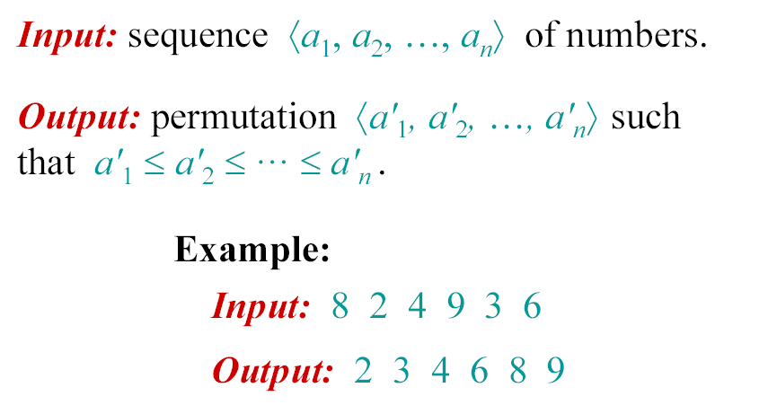
The problem of sorting

Slide 5
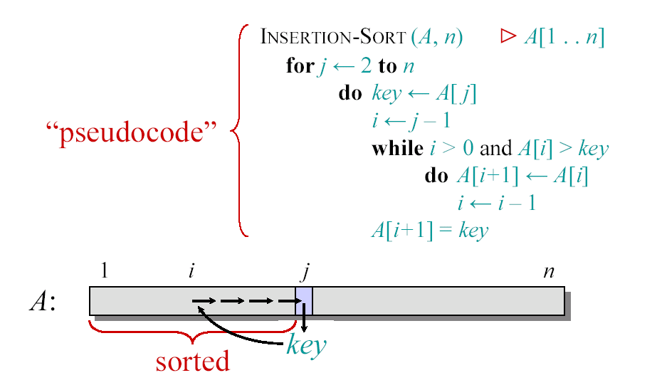
Insertion Sort

Slide 6

Example of Insertion Sort

Slide 7
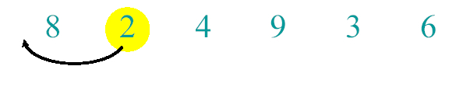
Example of Insertion Sort

Slide 8
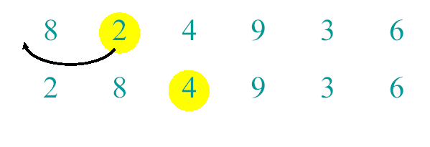
Example of Insertion Sort

Slide 9
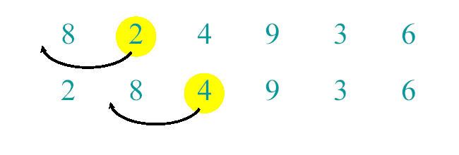
Example of Insertion Sort

Slide 10
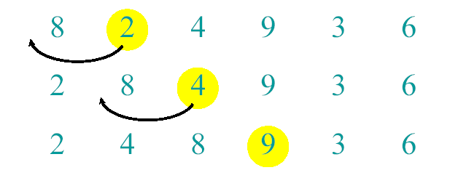
Example of Insertion Sort

Slide 11
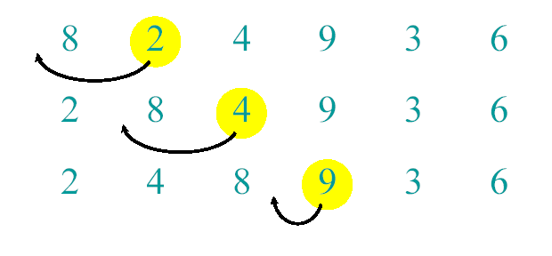
Example of Insertion Sort

Slide 12
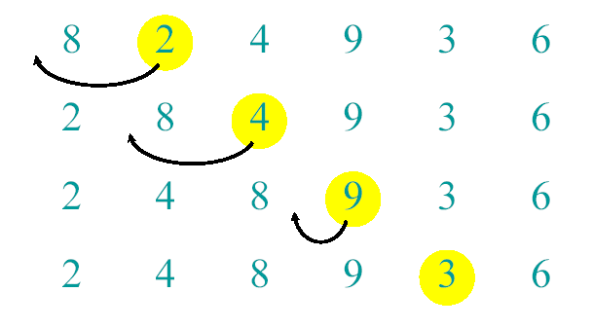
Example of Insertion Sort

Slide 13
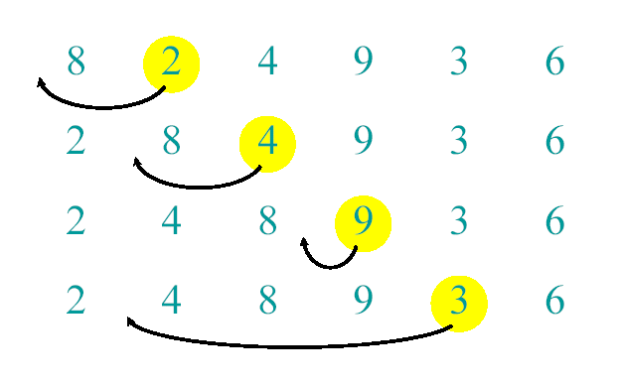
Example of Insertion Sort

Slide 14
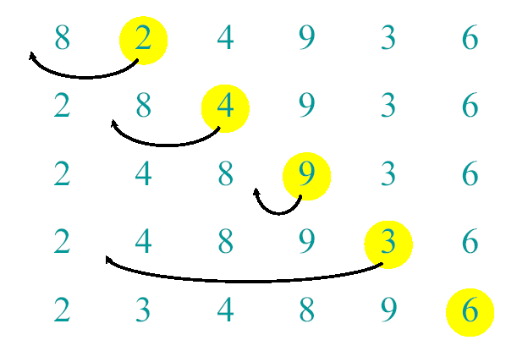
Example of Insertion Sort

Slide 15
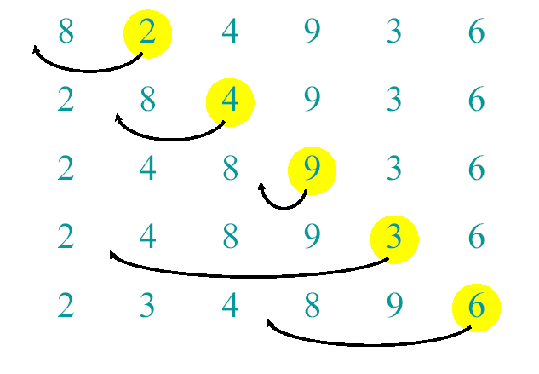
Example of Insertion Sort

Slide 16
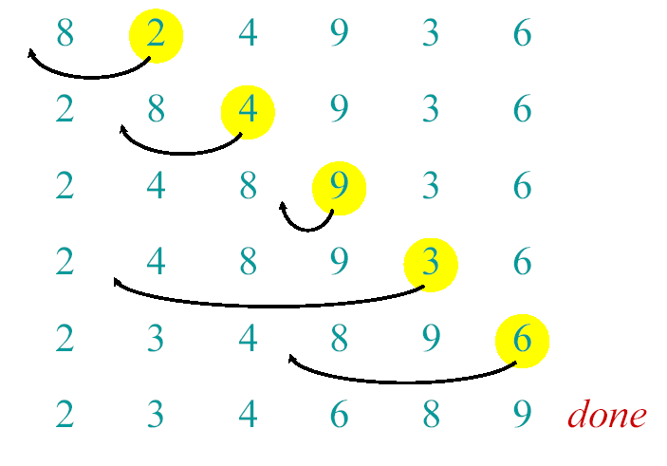
Example of Insertion Sort

Slide 17
Analysis of algorithms
The theoretical study of computer-program
performance and resource usage.
What’s more important than performance?
• modularity
• correctness
• maintainability
• functionality
• robustness
• user-friendliness
• programmer time
• simplicity
• extensibility
• reliability

Slide 18
Analysis of algorithms
Why study algorithms and performance?
• Algorithms help us to understand scalability.
• Performance often draws the line between what is feasible and what is impossible.
• Algorithmic mathematics provides a language for talking about program behavior.
• The lessons of program performance generalize to other computing resources.
• Speed is fun!

Slide 19
Running Time
• The running time depends on the input: an already sorted sequence is easier to sort.
• Parameterize the running time by the size of the input, since short sequences are easier to sort than long ones.
• Generally, we seek upper bounds on the running time, because everybody likes a guarantee.

Slide 20
Kinds of analyses
Worst-case: (usually)
• T(n) = maximum time of algorithm on any input of size n.
Average-case: (sometimes)
• T(n) = expected time of algorithm over all inputs of size n.
• Need assumption of statistical distribution of inputs.
Best-case:
• Cheat with a slow algorithm that works fast on some input.

Slide 21
Machine-Independent time
The RAM Model
Machine independent algorithm design depends on a hypothetical computer called Random Acces Machine (RAM).
Assumptions:
• Each simple operation such as +, -, if ...etc takes exactly one time step.
• Loops and subroutines are not considered simple operations.
• Each memory acces takes exactly one time step.

Slide 22

Machine-independent time
What is insertion sort’s worst-case time?
• It depends on the speed of our computer,
• relative speed (on the same machine),
• absolute speed (on different machines).
BIG IDEA:
• Ignore machine-dependent constants.
• Look at growth of
“Asymptotic Analysis”

Slide 23
Machine-independent time: An example
A pseudocode for insertion sort ( INSERTION SORT ).
INSERTION-SORT(A)
1 for j ← 2 to length [A]
2 do key ← A[ j]
3 ∇ Insert A[j] into the sortted sequence A[1,..., j-1].
4 i ← j – 1
5 while i > 0 and A[i] > key
6 do A[i+1] ← A[i]
7 i ← i – 1
8 A[i +1] ← key

Slide 24
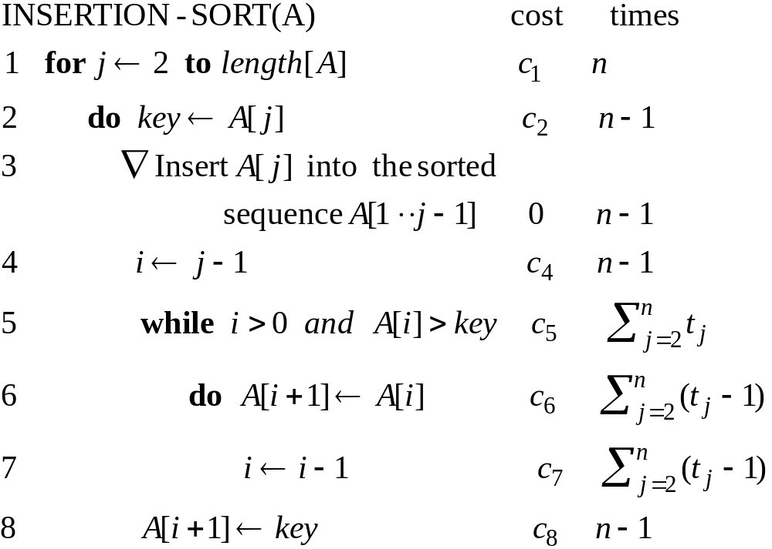
Analysis of INSERTION-SORT(contd.)

Slide 25
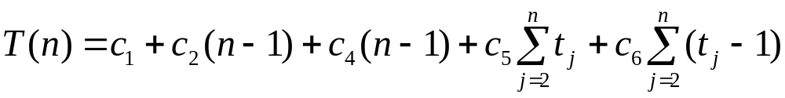
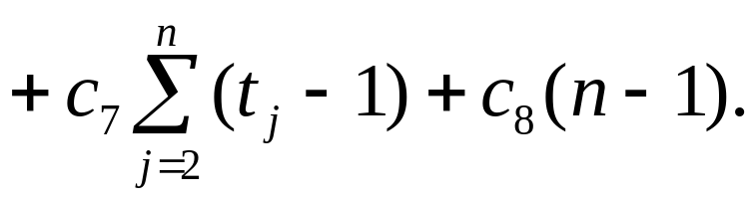
Analysis of INSERTION-SORT(contd.)
The total running time is

Slide 26
Analysis of INSERTION-SORT(contd.)
The best case: The array is already sorted.
(t_{j} =1 for j=2,3, ...,n)

Slide 27
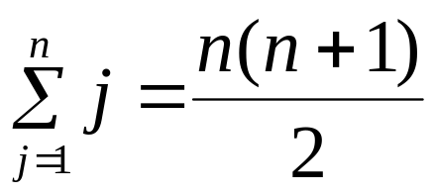
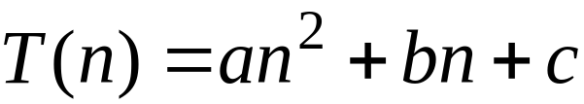
Analysis of INSERTION-SORT(contd.)
The worst case: The array is reverse sorted
(t_{j} =j for j=2,3, ...,n).

Slide 28
Growth of Functions
Although we can sometimes determine the exact running time of an algorithm, the extra precision is not usually worth the effort of computing it.
For large inputs, the multiplicative constants and lower order terms of an exact running time are dominated by the effects of the input size itself.

Slide 29
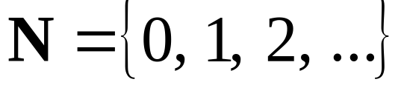
Asymptotic Notation
        The notation we use to describe the asymptotic running time of an algorithm are defined in terms of functions whose domains are the set of natural numbers

Slide 30


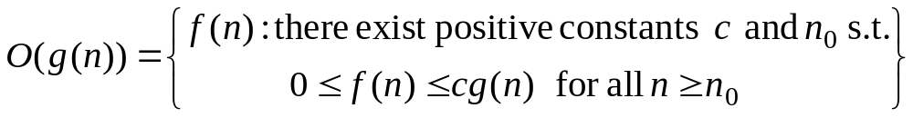



O-notation
For a given function , we denote by the set of functions
We use O-notation to give an asymptotic upper bound of a function, to within a constant factor.
means that there existes some constant c s.t. is always for large enough n.

Slide 31

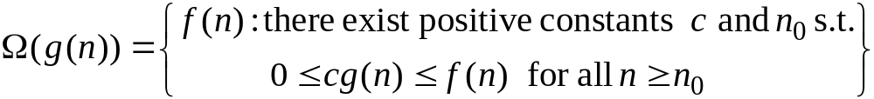


Ω-Omega notation
For a given function , we denote by the set of functions
We use Ω-notation to give an asymptotic lower bound on a function, to within a constant factor.
means that there exists some constant c s.t.
is always for large enough n.

Slide 32


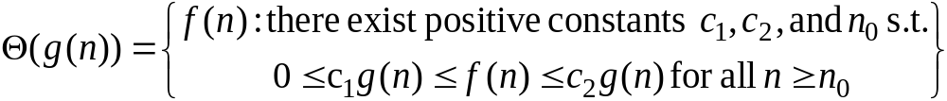







-Theta notation
For a given function , we denote by the set of functions
A function belongs to the set if there exist positive constants and such that it can be “sand- wiched” between and or sufficienly large n.
means that there exists some constant c₁ and c₂ s.t. for large enough n.

Slide 33
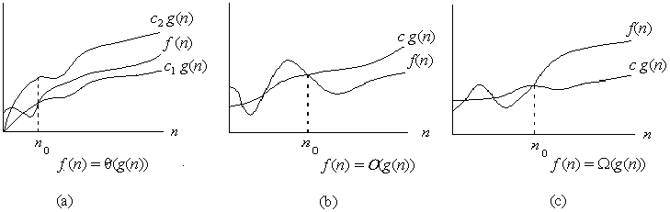

Asymptotic notation
Graphic examples of and .

Slide 34
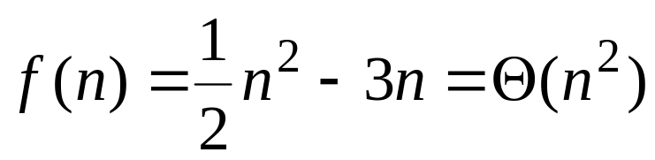
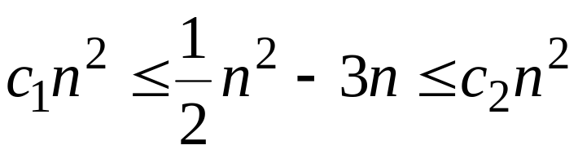
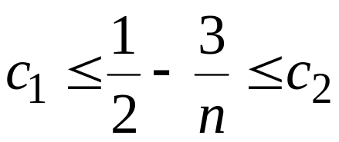
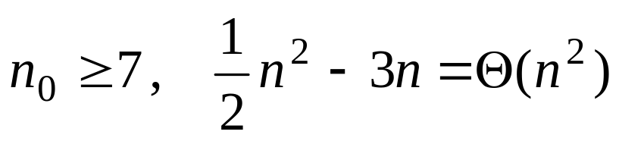
Example 1.
Show that
We must find c₁ and c₂ such that
Dividing bothsides by n² yields
For

Slide 35

Theorem
For any two functions and , we have
if and only if

Slide 36
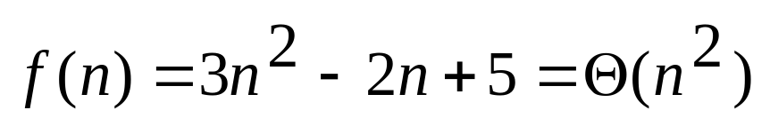
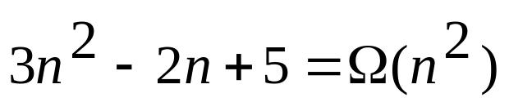
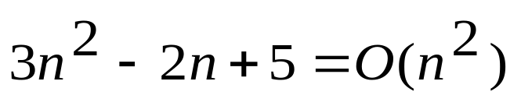
Example 2.
Because :

Slide 37
Example 3.

Slide 38
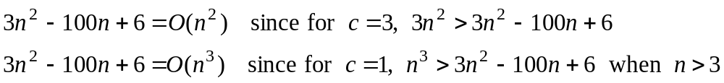
Example 3.

Slide 39
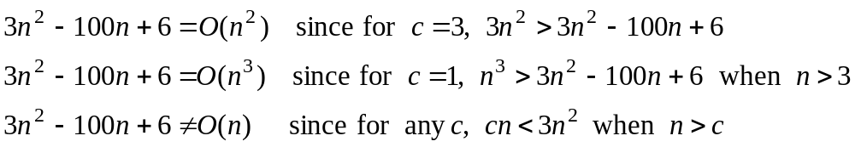
Example 3.

Slide 40
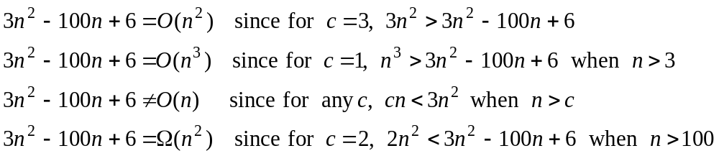
Example 3.

Slide 41
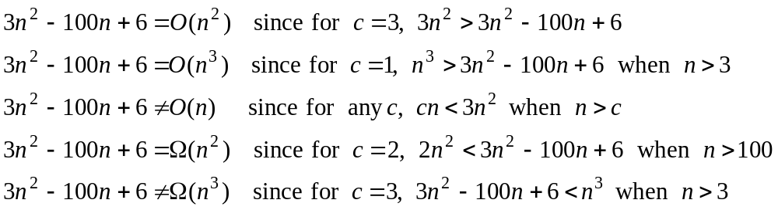
Example 3.

Slide 42
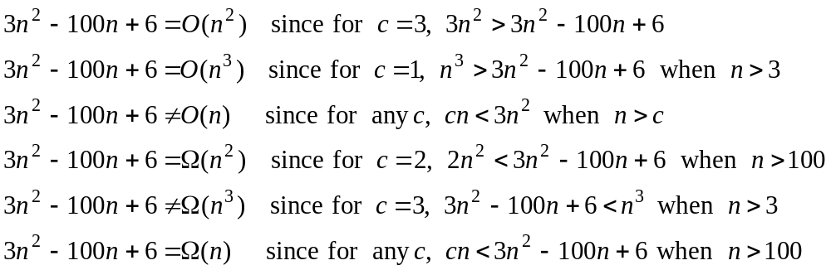
Example 3.

Slide 43
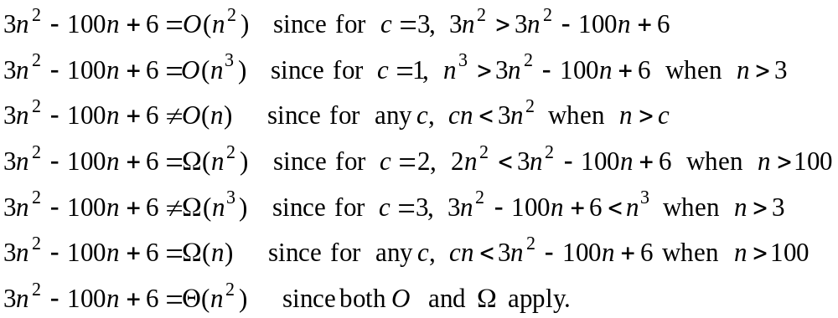
Example 3.

Slide 44
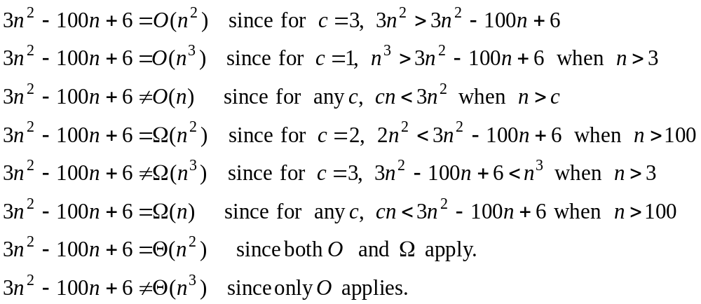
Example 3.

Slide 45
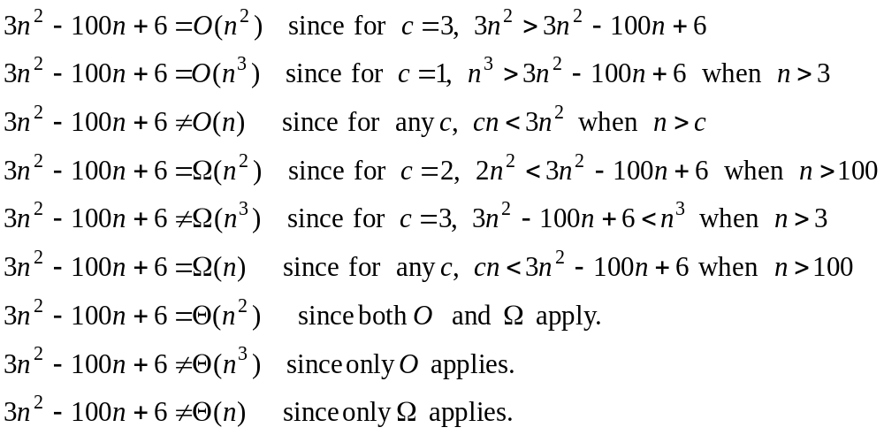
Example 3.

Slide 46
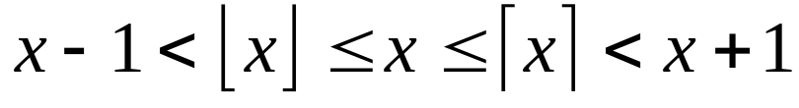
Standard notations and common functions
Floors and ceilings

Slide 47
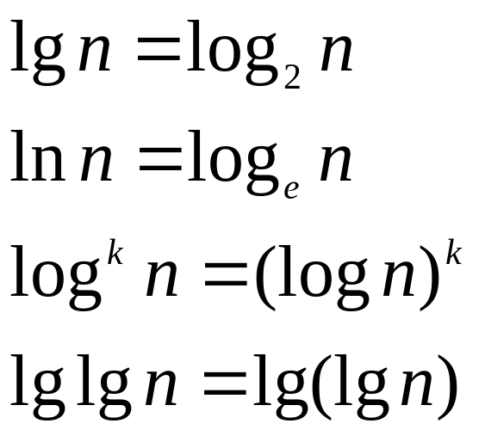
Standard notations and common functions
Logarithms:

Slide 48
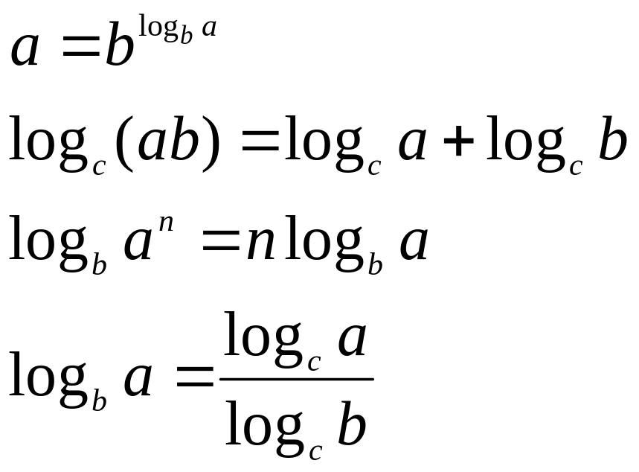
Standard notations and common functions
Logarithms:
For all real a>0, b>0, c>0, and n

Slide 49
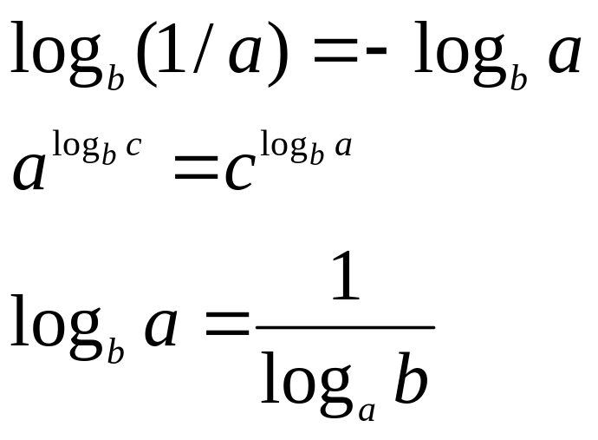
Standard notations and common functions
Logarithms:

Slide 50
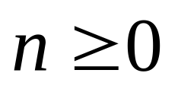
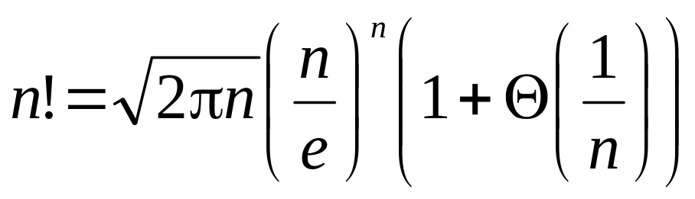
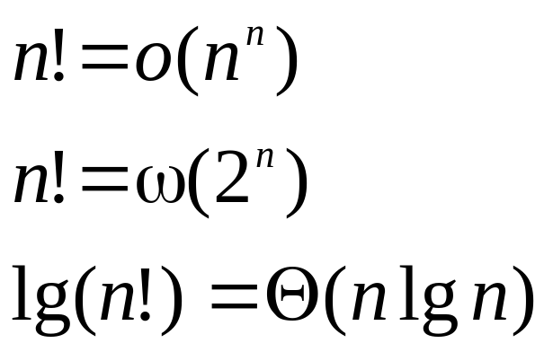
Standard notations and common functions
Factorials
For the Stirling approximation:

