Slide 1
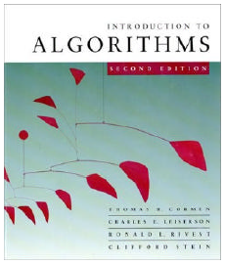
Introduction to Algorithms
Chapter 16: Greedy Algorithms

Slide 2
Greedy Algorithms
Similar to dynamic programming, but simpler approach
  Also used for optimization problems
Idea: When we have a choice to make, make the one that looks best right now
  Make a locally optimal choice in hope of getting a globally optimal solution
Greedy algorithms don’t always yield an optimal solution
Makes the choice that looks best at the moment in order to get optimal solution.

Slide 3
Fractional Knapsack Problem
Knapsack capacity: W
There are n items: the i-th item has value v_{i} and weight w_{i}
Goal:
  find x_{i} such that for all 0 ≤ x_{i} ≤ 1, i = 1, 2, .., n
  ∑ w_{i}x_{i} ≤ W and
  ∑ x_{i}v_{i} is maximum

Slide 4
Fractional Knapsack - Example
50
20
---
30
50
E.g.:
$80
+
Item 3
Item 2
30
20
$100
+
Item 1
20
10
10
$60
$60
$100
$120
$240
$6/pound
$5/pound
$4/pound

Slide 5
Fractional Knapsack Problem
Greedy strategy 1:
  Pick the item with the maximum value
E.g.:
  W = 1
  w₁ = 100, v₁ = 2
  w₂ = 1, v₂ = 1
  Taking from the item with the maximum value:
  Total value taken = v₁/w₁ = 2/100
  Smaller than what the thief can take if choosing the other item
  Total value (choose item 2) = v₂/w₂ = 1

Slide 6
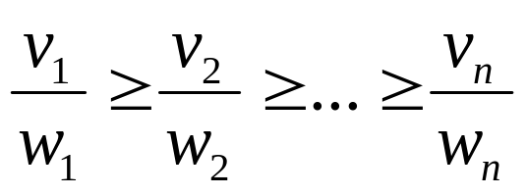
Fractional Knapsack Problem
Greedy strategy 2:
Pick the item with the maximum value per pound v_{i}/w_{i}
If the supply of that element is exhausted and the thief can carry more: take as much as possible from the item with the next greatest value per pound
It is good to order items based on their value per pound

Slide 7
Fractional Knapsack Problem
Alg.: Fractional-Knapsack (W, v[n], w[n])
While w > 0 and as long as there are items remaining
pick item with maximum v_{i}/w_{i}
x_{i} ← min (1, w/w_{i})
remove item i from list
w ← w – x_{i}w_{i}
w – the amount of space remaining in the knapsack (w = W)
Running time: Θ(n) if items already ordered; else Θ(nlgn)

Slide 8
Huffman Code Problem
Huffman’s algorithm achieves data compression by finding the best variable length binary encoding scheme for the symbols that occur in the file to be compressed.

Slide 9
Huffman Code Problem
The more frequent a symbol occurs, the shorter should be the Huffman binary word representing it.
The Huffman code is a prefix-free code.
  No prefix of a code word is equal to another codeword.

Slide 10
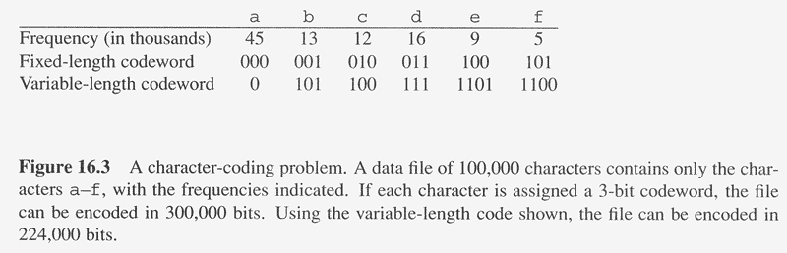
Overview
Huffman codes: compressing data (savings of 20% to 90%)
Huffman’s greedy algorithm uses a table of the frequencies of occurrence of each character to build up an optimal way of representing each character as a binary string
C: Alphabet

Slide 11
Example
Assume we are given a data file that contains only 6 symbols, namely a, b, c, d, e, f With the following frequency table:
Find a variable length prefix-free encoding scheme that compresses this data file as much as possible?

Slide 12
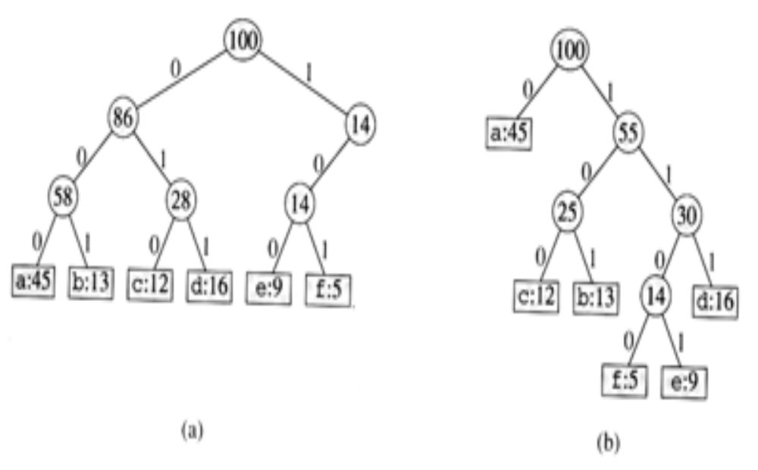
Huffman Code Problem
Left tree represents a fixed length encoding scheme
Right tree represents a Huffman encoding scheme

Slide 13
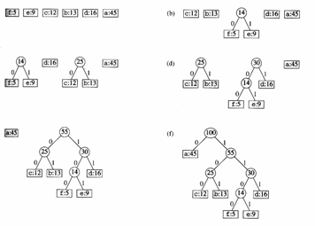
Example

Slide 14
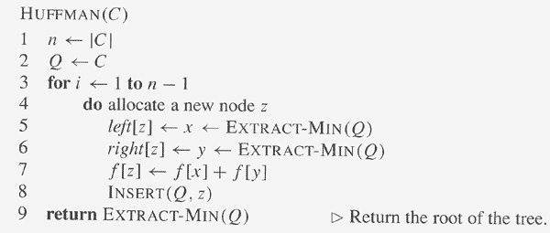
Constructing A Huffman Code
// C is a set of n characters
// Q is implemented as a binary min-heap
O(n)
Total computation time = O(n lg n)
O(lg n)
O(lg n)
O(lg n)

Slide 15
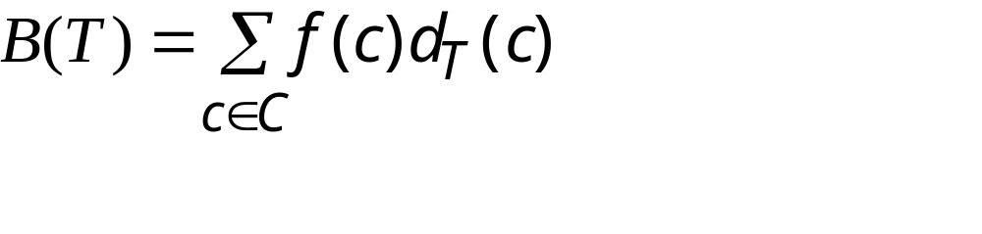
Cost of a Tree T
For each character c in the alphabet C
  let f(c) be the frequency of c in the file
  let d_{T}(c) be the depth of c in the tree
    It is also the length of the codeword. Why?
Let B(T) be the number of bits required to encode the file (called the cost of T)

Slide 16
Huffman Code Problem
In the pseudocode that follows:
we assume that C is a set of n characters and that each character c €C is an object with a defined frequency f [c].
The algorithm builds the tree T corresponding to the optimal code
A min-priority queue Q, is used to identify the two least-frequent objects to merge together.
The result of the merger of two objects is a new object whose frequency is the sum of the frequencies of the two objects that were merged.

Slide 17
Running time of Huffman's algorithm
The running time of Huffman's algorithm assumes that Q is implemented as a binary min-heap.
For a set C of n characters, the initialization of Q in line 2 can be performed in O(n) time using the BUILD-MINHEAP
The for loop in lines 3-8 is executed exactly n - 1 times, and since each heap operation requires time O(lg n), the loop contributes O(n lg n) to the running time. Thus, the total running time of HUFFMAN on a set of n characters is O(n lg n).

Slide 18
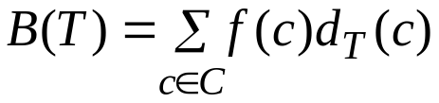
Prefix Code
Prefix(-free) code: no codeword is also a prefix of some other codewords (Un-ambiguous)
  An optimal data compression achievable by a character code can always be achieved with a prefix code
  Simplify the encoding (compression) and decoding
    Encoding: abc ➔ 0 . 101. 100 = 0101100
    Decoding: 001011101 = 0. 0. 101. 1101 ➔ aabe
      Use binary tree to represent prefix codes for easy decoding
An optimal code is always represented by a full binary tree, in which every non-leaf node has two children
  |C| leaves and |C|-1 internal nodes Cost:
Depth of c (length of the codeword)
Frequency of c

Slide 19
Huffman Code
Reduce size of data by 20%-90% in general
If no characters occur more frequently than others, then no advantage over ASCII
Encoding:
  Given the characters and their frequencies, perform the algorithm and generate a code. Write the characters using the code
Decoding:
  Given the Huffman tree, figure out what each character is (possible because of prefix property)

Slide 20
Application on Huffman code
Both the .mp3 and .jpg file formats use Huffman coding at one stage of the compression

Slide 21
Dynamic Programming vs. Greedy Algorithms
Dynamic programming
  We make a choice at each step
  The choice depends on solutions to subproblems
  Bottom up solution, from smaller to larger subproblems
Greedy algorithm
  Make the greedy choice and THEN
  Solve the subproblem arising after the choice is made
  The choice we make may depend on previous choices, but not on solutions to subproblems
  Top down solution, problems decrease in size

