Slide 1
Divide-and-Conquer
The most-well known algorithm design strategy:
Divide instance of problem into two or more smaller instances
Solve smaller instances recursively
Obtain solution to original (larger) instance by combining these solutions
Distinction between divide and conquer and decrease and conquer is somewhat vague. Dec/con typically does not solve both subproblems.

Slide 2
Divide-and-Conquer Technique (cont.)
a problem of size n
subproblem 1
of size n/2
subproblem 2
of size n/2
a solution to
subproblem 1
a solution to
subproblem 2
a solution to
the original problem

Slide 3
Divide-and-Conquer Examples
Sorting: mergesort and quicksort
Binary tree traversals

Slide 4
General Divide-and-Conquer Recurrence
T(n) = aT(n/b) + f (n) where f(n) ∈ Θ(n^{d}), d ≥ 0
Master Theorem: If a < b^{d}, T(n) ∈ Θ(n^{d})
If a = b^{d}, T(n) ∈ Θ(n^{d} log n)
If a > b^{d}, T(n) ∈ Θ(n^{log b a} )
Note: The same results hold with O instead of Θ.
Examples: T(n) = 4T(n/2) + n ⇒ T(n) ∈ ?
T(n) = 4T(n/2) + n² ⇒ T(n) ∈ ?
T(n) = 4T(n/2) + n³ ⇒ T(n) ∈ ?

Slide 5
Mergesort Example
Notes:
Go over this example in detail, then do another example of merging, something like:
(1 2 5 7 9)
(3 4 6)

Slide 6
Mergesort
Split array A[0..n-1] in two about equal halves and make copies of each half in arrays B and C
Sort arrays B and C recursively
Merge sorted arrays B and C into array A as follows:
Repeat the following until no elements remain in one of the arrays:
compare the first elements in the remaining unprocessed portions of the arrays
copy the smaller of the two into A, while incrementing the index indicating the unprocessed portion of that array
Once all elements in one of the arrays are processed, copy the remaining unprocessed elements from the other array into A.

Slide 7
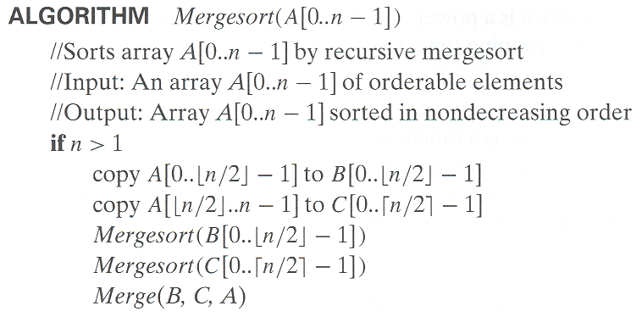
Pseudocode of Mergesort
Thinking about recursive programs: Assume recursive calls work
and ask does the whole program then work?

Slide 8
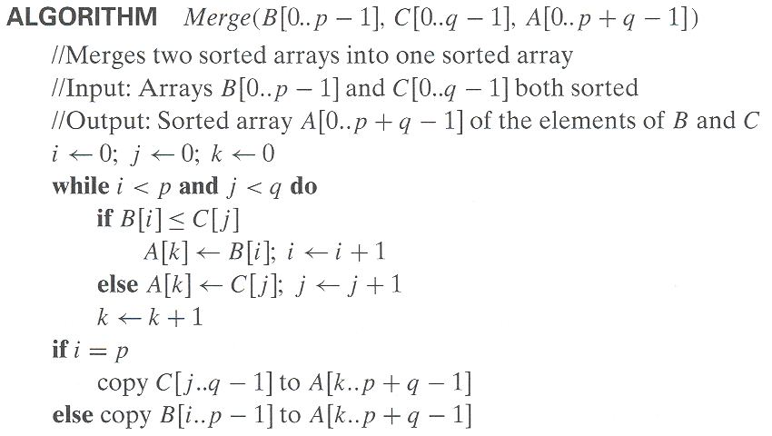
Pseudocode of Merge

Slide 9
Analysis of Mergesort
Number of key comparisons – recurrence:
C(n) = …
For merge step:
C’(n) = …
Notes:
even if not analyzing in detail, show the recurrence for mergesort in worst case:
T(n) = 2 T(n/2) + (n-1)
worst case comparisons for merge

Slide 10
Analysis of Mergesort
Number of key comparisons – recurrence:
C(n) = 2C(n/2) + C’(n) = 2C(n/2) + n-1
For merge step – worst case:
C’(n) = n-1
How to solve?
Number of calls? Number of active calls?
Notes:
even if not analyzing in detail, show the recurrence for mergesort in worst case:
T(n) = 2 T(n/2) + (n-1)
worst case comparisons for merge

Slide 11
Analysis of Mergesort
All cases have same efficiency: Θ(n log n)
Number of comparisons in the worst case is close to theoretical minimum for comparison-based sorting:
- Theoretical min: ⎡log₂ n!⎤ ≈ n log₂ n - 1.44n
Space requirement:
Book’s algorithm?
Notes:
even if not analyzing in detail, show the recurrence for mergesort in worst case:
T(n) = 2 T(n/2) + (n-1)
worst case comparisons for merge

Slide 12
Analysis of Mergesort
All cases have same efficiency: Θ(n log n)
Number of comparisons in the worst case is close to theoretical minimum for comparison-based sorting:
- Theoretical min: ⎡log₂ n!⎤ ≈ n log₂ n - 1.44n
Space requirement:
Book’s algorithm: n + n Sum(1+1/2+1/4+…) = n + n Θ(2)= Θ(3n)
Can be done Θ(2n) : Don’t copy in sort; just specify bounds, copy into extra array on merge, then copy back
Any other space required?
Can be implemented in place. How …
Can be implemented without recursion (bottom-up)
Notes:
even if not analyzing in detail, show the recurrence for mergesort in worst case:
T(n) = 2 T(n/2) + (n-1)
worst case comparisons for merge

Slide 13
Mergesort Example
Notes:
Go over this example in detail, then do another example of merging, something like:
(1 2 5 7 9)
(3 4 6)

Slide 14
Quicksort
Select a pivot (partitioning element) – here, the first element
Rearrange the list so that all the elements in the first s positions are smaller than or equal to the pivot and all the elements in the remaining n-s positions are larger than or equal to the pivot (see next slide for an algorithm)
Exchange the pivot with the last element in the first (i.e., ≤) subarray — the pivot is now in its final position
Sort the two subarrays recursively
p
A[i]≤p
A[i]≥p

Slide 15
Quicksort Algorithm
QS (A, l, r)
if l < r then
s = partition (A, l, r)
QS (A, , )
QS (A, , )

Slide 16
Quicksort Algorithm
QS (A, l, r)
if l < r then
s = partition (A, l, r)
QS (A, l , s-1)
QS (A, s+1, r )
Ask later: What if we skip final swap and
use simpler bounds for first recursive call?

Slide 17
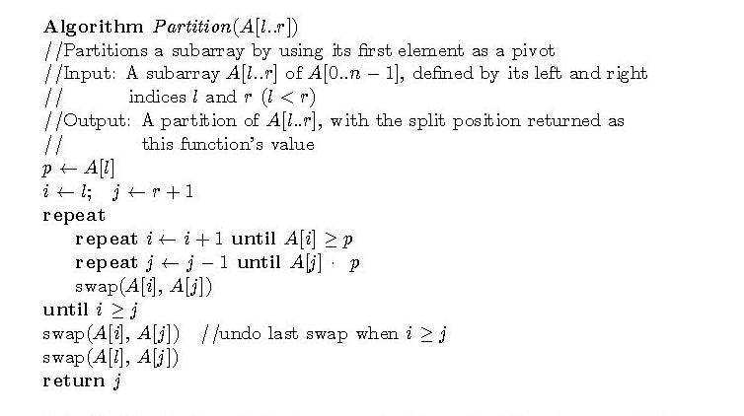
Hoare’s (Two-way) Partition Algorithm

Slide 18
Quicksort Example
5 3 1 9 8 2 4 7

Slide 19
Quicksort Recursion Tree
0 1 2 3 4 5 6 7
5 3 1 9 8 2 4 7
0 .. 7 / s=4
0 .. 3 / s=x
0 .. s-1 / s=?
s+1 .. 3
5 .. 7 / s=y
5 .. y-1 / s=?
y+1 .. 7 / s=?

Slide 20
Analysis of Quicksort
Recurrences:
Best case:
Worst case:
Average case:
Performance:
Best case:
Worst case:
Average case:

Slide 21
Analysis of Quicksort
Recurrences:
Best case: T(n) = T(n/2) + Θ (n)
Worst case: T(n) = T(n-1) + Θ (n)
Average case:
Performance:
Best case:
Worst case:
Average case:

Slide 22
Analysis of Quicksort
Recurrences:
Best case: T(n) = T(n/2) + Θ (n)
Worst case: T(n) = T(n-1) + Θ (n)
Average case:
Performance:
Best case: split in the middle — Θ(n log n)
Worst case: sorted array! — Θ(n²)
Average case: random arrays — Θ(n log n)

Slide 23
Analysis of Quicksort
Problems:
Duplicate elements
Improvements:
better pivot selection: median of three partitioning
switch to insertion sort on small sub-arrays
elimination of recursion – How?
These combine to 20-25% improvement
Improvements: Dual Pivot
Method of choice for internal sorting of large files (n ≥ 10000)

Slide 24
Binary Tree Algorithms
Binary tree is a divide-and-conquer ready structure!
Ex. 1: Classic traversals (preorder, inorder, postorder)
Algorithm Inorder(T)
a a
b c b c
d e   d e
   
Efficiency: Θ(n)

Slide 25
Binary Tree Algorithms
Binary tree is a divide-and-conquer ready structure!
Ex. 1: Classic traversals (preorder, inorder, postorder)
Algorithm Inorder(T)
if T ≠ ∅ a a
Inorder(T_{left}) b c b c
print(root of T) d e   d e
Inorder(T_{right})    
Efficiency: Θ(n)

Slide 26
Binary Tree Algorithms (cont.)
Ex. 2: Computing the height of a binary tree
h(T) = ??
Efficiency: Θ(n)

Slide 27
Binary Tree Algorithms (cont.)
Ex. 2: Computing the height of a binary tree
h(T) = max{h(T_{L}), h(T_{R})} + 1 if T ≠ ∅ and h(∅) = -1
Efficiency: Θ(n)

