Slide 1
CMPS 3130/6130 Computational Geometry
Spring 2015
Plane Sweep Algorithms I
Carola Wenk
1/20/15
CMPS 3130/6130 Computational Geometry

Slide 2
Closest Pair
Problem: Given P⊆R², |P|=n, find the distance between the closest pair in P
1/20/15
CMPS 3130/6130 Computational Geometry

Slide 3
Plane Sweep: An Algorithm Design Technique
Simulate sweeping a vertical line from left to right across the plane.
Maintain cleanliness property: At any point in time, to the left of sweep line everything is clean, i.e., properly processed.
Sweep line status: Store information along sweep line
Events: Discrete points in time when sweep line status needs to be updated
1/20/15
CMPS 3130/6130 Computational Geometry

Slide 4
Plane Sweep: An Algorithm Design Technique
Simulate sweeping a vertical line from left to right across the plane.
Maintain cleanliness property: At any point in time, to the left of sweep line everything is clean, i.e., properly processed.
Sweep line status: Store information along sweep line
Events: Discrete points in time when sweep line status needs to be updated
Algorithm Generic_Plane_Sweep:
Initialize sweep line status S at time x=-∞
Store initial events in event queue Q, a priority queue ordered by x-coordinate
while Q ≠ ∅
// extract next event e:
e = Q.extractMin();
// handle event:
Update sweep line status
Discover new upcoming events and insert them into Q
1/20/15
CMPS 3130/6130 Computational Geometry

Slide 5
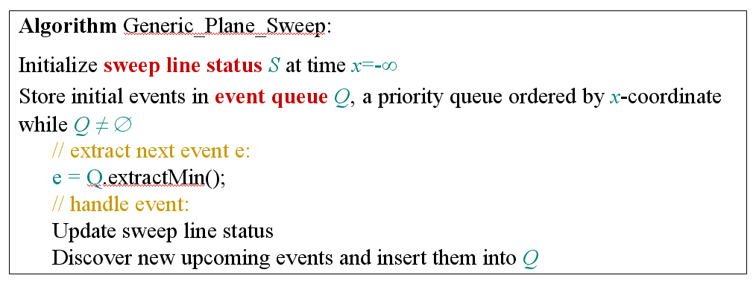
Plane sweep for
Closest Pair
Problem: Given P⊆R², |P|=n, find the distance of the closest pair in P
Sweep line status:
  Store current distance Δ of closest pair of points to the left of sweep line
  Store points in Δ-strip left of sweep line
  Store pointer to leftmost point in strip
Events: All points in P. No new events will be added during the sweep.
→ Presort P by x-coordinate.
Cleanliness property
1/20/15
CMPS 3130/6130 Computational Geometry

Slide 6
Plane sweep for
Closest Pair, II
O(n log n)
Presort P by x-coordinate
How to store points in Δ-strip?
  Store points in Δ-strip left of sweep line in a balanced binary search tree, ordered by y-coordinate
  → Add point, delete point, and search in O(log n) time
Event handling:
  New event: Sweep line advances to point p∈P
  Update sweep line status:
    Delete points outside Δ-strip from search tree by using previous leftmost point in strip and x-order on P
    Compute candidate points that may have distance ≤ Δ from p:
      Perform a search in the search tree to find points in Δ–strip whose y-coordinates are at most Δ away from p.y.
      → Δ x 2Δ rectangle
      Because of the cleanliness property each pair of these points has distance ≥Δ.
      → A Δ x 2Δ rectangle can contain at most 6 such points.
    Check distance of these points to p, and possibly update Δ
  No new events necessary to discover
O(n log n) total
1
2
O(n log n + 6n) total
O(6n) total
3
Δ
Total runtime: O(n log n)
Δ
1/20/15
CMPS 3130/6130 Computational Geometry
Δ

Slide 7
Balanced Binary Search Tree
-- a bit different
1
17
43
6
8
12
14
26
35
41
42
59
61
key[x] is the maximum key of any leaf in the left subtree of x.
1/20/15
CMPS 3130/6130 Computational Geometry

Slide 8
Balanced Binary Search Tree
-- a bit different
x
17
≤ x
> x
8
42
1
14
35
43
1
6
12
17
26
41
43
59
6
8
12
14
26
35
41
42
59
61
key[x] is the maximum key of any leaf in the left subtree of x.
1/20/15
CMPS 3130/6130 Computational Geometry

Slide 9
Balanced Binary Search Tree
-- a bit different
x
17
≤ x
> x
8
42
1
14
14
35
43
6
12
12
17
17
26
1
26
41
43
59
6
8
8
12
12
14
14
26
26
35
35
41
41
42
59
61
RANGE-QUERY([7, 41])
1/20/15
CMPS 3130/6130 Computational Geometry

Slide 10
Plane Sweep: An Algorithm Design Technique
Plane sweep algorithms (also called sweep line algorithms) are a special kind of incremental algorithms
Their correctness follows inductively by maintaining the cleanliness property
Common runtimes in the plane are O(n log n):
  n events are processed
  Update of sweep line status takes O(log n)
  Update of event queue: O(log n) per event
1/20/15
CMPS 3130/6130 Computational Geometry

