Slide 1

Getting Started
In this video, we're going to print some things to the screen, to get our first real taste of programming.
The Java Shell Tool, or JShell as it's referred to, is the tool we'll be using to achieve this, and is the one I talked about in the previous video.
Be sure to watch that previous video if you need a recap, on how to access it for your operating system.
For best results for this course, make sure you follow along as closely as you can, typing the code segments I'll be typing, into your own JShell session.
COMPLETE JAVA MASTERCLASS
Hello World

Slide 2
Getting Started
Nothing beats learning from your own mistakes, and figuring out how to get a line of code to work, when it wasn't working before.
This emulates real-world problem solving, and you'll find when you type in your own code, you'll be making all kinds of typos, or omitting or overlooking some characters that are required.
This is the best way to learn, and pick up all the nuances, of any programming language you're learning.
If you do encounter a mistake on your own, pause the video, try solving it on your own, and if that doesn't work – remember the working code segments, are always available in the resources section of every video.
COMPLETE JAVA MASTERCLASS
Hello World

Slide 3
Getting Started
In addition, I'll be trying to talk through, and demonstrate, some of the most common mistakes we all make in Java. If you're making these mistakes, and correcting them on your own, you won't forget them easily.
If you're like most programmers, figuring out how the pieces fit, and seeing the result of the code working, after a bit of a struggle, is the best part of programming.
Coding is a lot of fun, and I promise you'll feel the same way as we progress through this course.
COMPLETE JAVA MASTERCLASS
Hello World

Slide 4
Getting Started
All right – So let's get started. It's always been a tradition, when you're learning a new programming language, to create a simple program that outputs the text, "Hello World". This lets us test all the parts that are necessary, to create a successful program, with very little investment of time, or knowledge of the language.
It's the first step, and honestly, even after many years of programming, I still get that first feeling of achievement, when I've accomplished this step in a new language.
If you can print "Hello World" to the screen, you're on your way to bigger, and better things.
Lets do that now.
COMPLETE JAVA MASTERCLASS
Hello World

Slide 5
Statement
What is a statement?
It's a complete command to be executed. It can include one or more expressions, and I'll be talking about expressions and related topics, as we progress through the course.
COMPLETE JAVA MASTERCLASS
Hello World

Slide 6
Statement
What we've typed above, is a command to print some information to the screen, using syntax provided by the Java language.
We specified what we wanted Java to print in the parentheses and double quotes – in this case, the text "Hello World" – effectively we're telling Java to print out the words, as we've specified them in the quotes – "Hello World".
After we press the enter key, the program executing the code should print that text to the screen – in this case, the output is printed on the very next line.
COMPLETE JAVA MASTERCLASS
Hello World

Slide 7
Challenge
I've got a bit of a challenge for you here, and the challenge is to see whether you can modify the statement we typed below, so that instead of it printing out "Hello World", it prints, "Hello Tim".
Looking at this code, how do you think you'd go about achieving that?
Let's see if you can figure that out, and get that to run.
COMPLETE JAVA MASTERCLASS
Hello World

Slide 8
Challenge
You have a few options here. You could just retype the entire line in from scratch, with the changed text to print out. But we want to modify the statement, not type a new line in.
To modify the existing line, press the up arrow key – remember that in JShell, you can see the history of the lines you've previously typed, using the up and down arrows.
Pressing the up arrow now, will display the code we first typed in – so make the change, and then press enter to see the result printed to the screen.
COMPLETE JAVA MASTERCLASS
Hello World

Slide 9
Hello World
Congratulations if you managed to make that work! These are the first steps almost all programmers make, in almost every programming language, regardless of their experience.
If you had a problem getting it to work, don't worry, the more you work at this course, the easier things will be to understand – so hang in there!
Every video builds on some content in previous videos, and you'll have lots of opportunities to explore these concepts further, so you won't be left behind.
Next, let's look at some common errors you might get, when typing in Java code.
COMPLETE JAVA MASTERCLASS
Hello World

Slide 10
Hello World
These were a few examples, of errors that might occur, when your coding in JShell. Let me encourage you to play with this line of code in JShell, in as many ways as you can think of, to see what kind of errors you might get, or what kind of output is produced.
This is the whole point of JShell – to provide you with a safe place to test code segments.
Remember that the key combination 'control c', on windows, or 'control d' on a mac or a linux machine, should cancel what you are in the middle of, and get you back to the JShell prompt.
COMPLETE JAVA MASTERCLASS
Hello World

Slide 11
Hello World
Typing forward slash and the word 'exit', or forward slash with the shortcut text ex, will end your JShell session, if you get stuck.
An example would be /exit or /ex.
COMPLETE JAVA MASTERCLASS
Hello World

Slide 12
Variables
In the previous video, we saw how to write our first code in Java. It was pretty basic to say the least, printing out some text on the screen, but it was a good place to start.
In this video, I want to talk about variables and keywords.
COMPLETE JAVA MASTERCLASS
Variables

Slide 13
Keywords
A keyword is any one of a number of reserved words, that have a predefined meaning in the Java language.
In Java syntax, all code is case-sensitive, and this includes keywords. As we'll soon see, an int, all in lowercase, is not the same as Int, with a capital I. Here, an int, (all in lowercase) is a keyword in Java.
COMPLETE JAVA MASTERCLASS
Variables

Slide 14
Variables
So what are variables?
Well, variables are a way to store information in our computer.
Variables that we define in a program, can be accessed by a name we give them, and the computer does the hard work, of figuring out where they get stored, in the computer's random access memory, or RAM.
COMPLETE JAVA MASTERCLASS
Variables

Slide 15
Data type
There are lots of different types of data, that we can define for our variables, some of which I've shown you in the keyword list previously.
Collectively, these are known as data types.
As you may have guessed, some data types are keywords in Java. When we get to the Object Oriented features of Java, you will see that we have a lot of flexibility for creating our own data types, but in the next couple of videos, we'll explore primitive data types, which are built into the Java language.
COMPLETE JAVA MASTERCLASS
Variables

Slide 16
Declaration Statement
A declaration statement is used to define a variable by indicating the data type, and the name, then optionally to set the variable to a specific value.
COMPLETE JAVA MASTERCLASS
Variables

Slide 17
Expressions
So what is an expression?
An expression is a coding construct, that evaluates to a single value.
COMPLETE JAVA MASTERCLASS
Variables

Slide 18

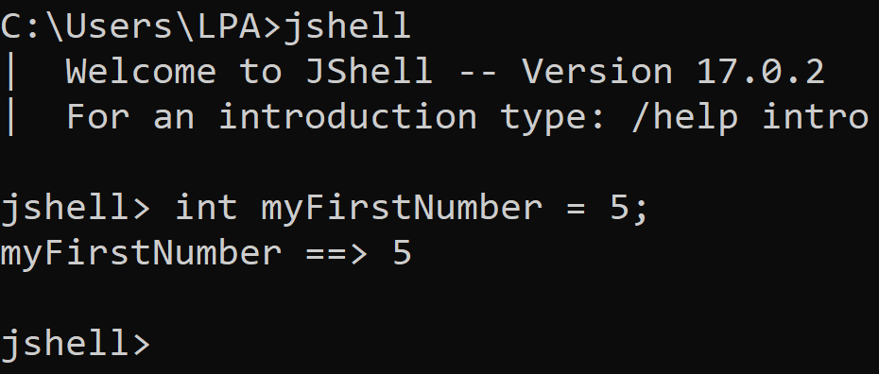
Variable Challenge 1
Your challenge is to look at creating a new System.out.print below the declaration for myFirstNumber, and to see if you can figure out how to print out the value of the myFirstNumber variable.
COMPLETE JAVA MASTERCLASS
Variables

Slide 19
Variable Challenge 2
Here's your challenge – Change the value of our existing variable from ten to one thousand, and print the new value out using the System.out.print method as we've done previously.
COMPLETE JAVA MASTERCLASS
Variables

Slide 20
Variable Declarations in JShell
By declaring a variable again, we are effectively re-declaring a variable, and in normal Java programming, that would not be allowed, and would throw an error.
Due to its interactive nature, JShell “holds our hand”, and allows the redeclaration to occur without throwing an error.
For now, just follow along, knowing that re-declaring a variable for a second, or subsequent time, is not allowed, and later in the course, when we switch to a full editor, you'll see what happens when we try and do that.
Note that we can assign a value to a variable multiple times in Java, but it’s the declaration (which includes the data type) that cannot normally be done a second time for the same variable.
COMPLETE JAVA MASTERCLASS
Variables

Slide 21
Operators
Java operators, or just operators, perform an operation (hence the term) on a variable or value.
Addition, Subtraction, Division, and Multiplication are four common ones that I feel sure you're familiar with, but there are lots more operators you will work with as we go through the course.
COMPLETE JAVA MASTERCLASS
Variables

Slide 22
Starting out with Expressions
In this video, we'll be continuing what we were working on in the last video, but here, we'll be using variables in expressions.
Remember the expression is the code segment that is on the right side of the equals sign in an assignment or declaration statement.
This code can be a simple literal value, like the number 5, or it can be a complex mathematical equation using multiple literal values and mathematical operators.
In this video, we'll talk about how to use variables to replace literal values.
COMPLETE JAVA MASTERCLASS
Starting out with Expressions

Slide 23
Review
Up until now, we've only used literal values in our expressions, and we've also used several operators, such as in the example we used in the last video – see above.
COMPLETE JAVA MASTERCLASS
Starting out with Expressions

Slide 24
Challenge
Your challenge is to create two additional variables in JShell.
Here's what we need:
One variable called mySecondNumber, which is an int, with a value of 12.
And another variable called myThirdNumber, also of type int, with a value of 6.
COMPLETE JAVA MASTERCLASS
Starting out with Expressions

Slide 25
Challenge
First, create a new variable and call it myLastOne:
Its data type should be int.
It should be set to the value of 1000, minus (or less than) the value in the myTotal variable, which we've just talked about in our previous code segment.
Next, print out the value of the myLastOne variable on the line after you declare it.
Hint: We need to use another operator that we haven't used in code before, but if you think about this, it should be easy to figure out which operator you need to use.
COMPLETE JAVA MASTERCLASS
Starting out with Expressions

Slide 26
Java code is case sensitive
Java code is case sensitive.
This includes not only keywords and language syntax, but variable names and data types as well.
myLastOne is not the same variable as MyLastOne with a capital M.
int in lowercase, is not the same as Int with the first letter capitalized, or INT, all in uppercase, etc.
COMPLETE JAVA MASTERCLASS
Starting out with Expressions

Slide 27
Java code is case sensitive
Keywords need to be in lowercase.
And variables will always be exactly as you declare them, including capitalization.
Remember that case matters in Java code!
The /vars command in JShell can help you identify any misspellings you may have made.
COMPLETE JAVA MASTERCLASS
Starting out with Expressions

Slide 28
Recap
In this video:
We used expressions to assign values to our variables, and we used variables we created, in expressions.
For now though, in our expressions, we've looked at only one data type so far, which is the type, int.
In the next video, we'll be looking at and discussing some additional data types.
COMPLETE JAVA MASTERCLASS
Starting out with Expressions

Slide 29
Introduction
We've been working only with the int data type so far in the course.
In this video, we'll continue to look at int, as well as several other primitive types.
We'll also introduce the wrapper class, a special category of data type, which offers additional functionality that primitive types don't.
COMPLETE JAVA MASTERCLASS
Primitive Types

Slide 30
Java's Primitive Types
In Java, primitive types are the most basic data types.
The eight primitive data types in Java are shown in the table below, listed by the type of data stored for each:
Whole number | Real number (floating point or decimal)
byte short int long | float double
Single character | Boolean value
char | boolean
COMPLETE JAVA MASTERCLASS
Primitive Types

Slide 31
Java's Primitive Types
Consider these types as the building blocks of data manipulation.
Remember that primitive data types are simply placeholders in memory for a value.
COMPLETE JAVA MASTERCLASS
Primitive Types

Slide 32
What actually is an integer?
An integer is a whole number, meaning it doesn't contain a fractional element, or a decimal.
COMPLETE JAVA MASTERCLASS
Primitive Types

Slide 33
What values can we store in an integer?
There's a specified range of values allowed for the int, which is true for most data types.
What this means is, that the allowable range of values is NOT infinite.
There's a defined minimum, and maximum value, for each numeric data type, meaning you can't assign a number bigger or smaller (outside of that range).
COMPLETE JAVA MASTERCLASS
Primitive Types

Slide 34
Using the + sign in System.out.print
The plus sign, +, when used in System.out.print will print different data types together as a single line of text.
In the example:
We want to print a label, before a numeric integer value.
Whatever follows the plus sign in System.out.print here, is converted to a String by Java, and concatenated to the String before it.
This is perfectly valid syntax in Java.
COMPLETE JAVA MASTERCLASS
Primitive Types

Slide 35
Classes
So what is a class?
A class is a building block for object-oriented programming, and allows us to build custom data types. We'll be talking more about classes in future videos.
COMPLETE JAVA MASTERCLASS
Primitive Types

Slide 36
Wrapper Classes
Java uses the concept of a wrapper class, for all of its eight primitive data types.
A wrapper class provides simple operations, as well as some basic information about the primitive data type, which cannot be stored on the primitive itself.
We saw that MIN_VALUE, and MAX_VALUE, are elements of this basic information, for the int data type.
COMPLETE JAVA MASTERCLASS
Primitive Types

Slide 37
Wrapper Classes
The primitive types, and their respective wrapper classes, are shown in the table below.
Primitive | Wrapper Class
byte | Byte
short | Short
char | Character
int | Integer
long | Long
float | Float
double | Double
boolean | Boolean
You can see there, that in general, it's pretty easy to remember the wrapper class name, for your primitive data type. It's the same name, but with an uppercase letter at the start.
COMPLETE JAVA MASTERCLASS
Primitive Types

Slide 38
Wrapper Classes
Primitive | Wrapper Class
byte | Byte
short | Short
char | Character
int | Integer
long | Long
float | Float
double | Double
boolean | Boolean
The wrapper classes for char and int, Character and Integer respectively, are the only two that differ in name (other than that first capitalized letter) from their primitive types.
COMPLETE JAVA MASTERCLASS
Primitive Types

Slide 39
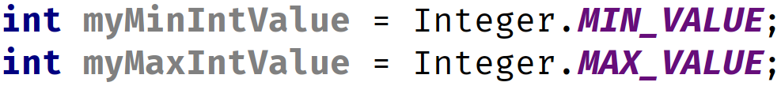
The Integer Wrapper Class
In the code we just reviewed, we were able to use MIN_VALUE, and MAX_VALUE, on the wrapper class Integer.
To discover the minimum and maximum range of numbers, that can be stored in an int, as we saw when we printed out these values previously:
COMPLETE JAVA MASTERCLASS
Primitive Types

Slide 40
Overflow and Underflow in Java
If you try and put a value larger than the maximum value into an int, you'll create something called an Overflow situation.
And similarly, if you try to put a value smaller than the minimum value into an int, you cause an Underflow to occur.
These situations are also known as integer wraparounds.
COMPLETE JAVA MASTERCLASS
Primitive Types

Slide 41
Overflow and Underflow in Java
The maximum value, when it overflows, wraps around to the minimum value, and just continues processing without an error.
The minimum value, when it underflows, wraps around to the maximum value, and continues processing.
This is not usually behavior you really want, and as a developer, you need to be aware that this can happen, and choose the appropriate data type.
COMPLETE JAVA MASTERCLASS
Primitive Types

Slide 42
When will you get an overflow? When will you get an error?
An integer wraparound event, either an overflow or underflow, can occur in Java when you are using expressions that are not a simple literal value.
The Java compiler doesn't attempt to evaluate the expression to determine its value, so it DOES NOT give you an error.
COMPLETE JAVA MASTERCLASS
Primitive Types

Slide 43
When will you get an overflow? When will you get an error?
Here are two more examples that will compile, and result in an overflow. The second example may be surprising. Even though we are using numeric literals in the expression, the compiler still won't try to evaluate this expression, and the code will compile, resulting in an overflow condition.
If you assign a numeric literal value to a data type that is outside of the range, the compiler DOES give you an error. We looked at a similar example previously.
COMPLETE JAVA MASTERCLASS
Primitive Types

Slide 44
What does an underscore mean in a numeric literal?
In Java, you cannot put commas in a numeric literal.
For example, the following is not valid syntax.
So Java provides an alternative way to improve readability, the underscore.
You can put the underscore anywhere you might want a comma, but you can't use an underscore at the start or end of the numeric literal.
COMPLETE JAVA MASTERCLASS
Primitive Types

Slide 45
Introduction
In the previous video, we saw that Java has eight primitive data types, and that the wrapper classes give us extra options.
Of these primitive types, half are used to store whole numbers (numbers without a fractional or decimal component), one of which we've explored already, the integer, or the int data type.
In this video, we'll take a look at the other three whole-number primitive data types.
COMPLETE JAVA MASTERCLASS
byte, short, long and width

Slide 46
byte, short, int, long
We've previously said that Java has four primitive data types used to store whole numbers, these are the byte, the short, the int, and the long.
Whole number Data Type | Wrapper Class | What’s noteworthy
byte | Byte | Has the smallest range
short | Short
int | Integer | Java’s default data type for whole numbers
long | Long | Has the largest range
They are listed here in this table, by the range of values the type will support, the byte supports the smallest range, and the long supports the largest range.
COMPLETE JAVA MASTERCLASS
byte, short, long and width

Slide 47
The byte data type
The minimum value of a byte is -128.
The maximum value of a byte is 127.
Given its small range, you probably won't be using the byte data type much.
The byte wrapper class is the Byte with a capital B.
COMPLETE JAVA MASTERCLASS
byte, short, long and width

Slide 48
The short data type
The minimum value of a short is -32768.
The maximum value of a short is 32767.
The short wrapper class is the Short with a capital S.
COMPLETE JAVA MASTERCLASS
byte, short, long and width

Slide 49
byte and short overflow/underflow
Both the byte and the short, have the same overflow and underflow issue as the int data type has, but obviously with their own range of numbers.
COMPLETE JAVA MASTERCLASS
Kotlin Variables and Datatypes

Slide 50
Size of Primitive Types and Width
Size, or Width, is the amount of space that determines (or limits) the range of values we've been discussing:
Data Type | Width (in bits) | Min Value | Max Value
byte | 8 | -128 | 127
short | 16 | -32768 | 32767
int | 32 | -2147483648 | 2147483647
A byte, can store 256 numbers and occupies eight bits, and has a width of 8.
A short, can store a large range of numbers and occupies 16 bits, and has a width of 16.
An int, has a much larger range as we know, and occupies 32 bits, and has a width of 32.
COMPLETE JAVA MASTERCLASS
byte, short, long and width

Slide 51
Using a numeric literal character suffix
The number 100, by default, is an int.
Java allows certain numeric literals to have a suffix appended to the value, to force it to be a different data type from the default type.
The long is one of these types and it's suffix is an 'L'.
This is one of the few instances Java is not case sensitive, a lowercase 'l' or an uppercase 'L' at the end of a whole number mean the same thing – the number is a long.
COMPLETE JAVA MASTERCLASS
byte, short, long and width

Slide 52
How big is the difference between an int and a long?
How big is the difference, in the range of values that a long can store, compared to the int?
You can see, from this table, that the difference is quite significant.
Data Type | Width (in bits) | Min Value | Max Value
int | 32 | -2147483648 | 2147483647
long | 64 | -9223372036854775808 | 9223372036854775807
COMPLETE JAVA MASTERCLASS
byte, short, long and width

Slide 53
When is L required?
A numeric literal that exceeds Integer.MAX_VALUE must use the 'L' suffix.
We cannot create a numeric literal in Java, that exceeds Integer.MAX_VALUE, without using the 'L' suffix, we'll always get the error 'integer number too large'.
COMPLETE JAVA MASTERCLASS
byte, short, long and width

Slide 54
Introduction
In the last video, I introduced you to three new data types. The byte, the short, and the long.
In this video, we'll be using these additional types in some basic arithmetic.
We've already done some math, using integers, but now, we'll be using these other data types.
We'll finish the video with a discussion about casting, which is a way to get Java to treat a variable of one type like a different data type.
I'll talk about when and why casting is sometimes necessary in Java code.
COMPLETE JAVA MASTERCLASS
Casting in Java

Slide 55
Rules for declaring multiple variables in one statement
You cannot declare variables with different data types in a single statement.
If you declare multiple variables of the same data type in a single statement, you must specify the data type only once before any variable names.
COMPLETE JAVA MASTERCLASS
Casting in Java

Slide 56
Assigning expressions to variables with data types that don't match
The Java compiler does not attempt to evaluate the value, in a variable, when it's used in a calculation, so it doesn't know if the value fits, and throws an error.
If your calculation uses literal values, Java can figure out the end result at compile time, and whether it fits into the variable, and won't throw an error if it does.
In both examples, an int result is being returned from the calculation, but in the second example, Java knows the returned value can fit into a byte.
COMPLETE JAVA MASTERCLASS
Casting in Java

Slide 57
Casting in Java
Casting means to treat or convert a number, from one type to another. We put the type we want the number to be, in parentheses like this:
Other languages have casting too, this is common practice and not just a Java thing.
COMPLETE JAVA MASTERCLASS
Casting in Java

Slide 58
What does it mean when Java defaults the data type to an int?
So, what effect does int, being the default value, have on our code?
Looking at the scenarios we just looked at in summary, we know the following:
This statement works because the result is an int, and assigning it to an int variable is fine.
This statement doesn't work, because the expression (myMinShortValue / 2) is an int, and an int can't be assigned to a short, because the compiler won't guess the result.
COMPLETE JAVA MASTERCLASS
Casting in Java

Slide 59
What does it mean when Java defaults the data type to an int?
This statement works, because the result of (-128 / 2) is an int, but when calculations use only literal values, the compiler can determine the result immediately, and knows the value fits into a short.
And finally, this code works because we tell the compiler we know what we're doing by using this cast, and the compiler doesn't give an error.
COMPLETE JAVA MASTERCLASS
Casting in Java

Slide 60
Primitive Types Challenge
Your challenge is to create four new variables:
A byte variable, set it to any valid byte number, it doesn't matter.
A short variable, set it to any valid short number.
An int variable, set it to any valid integer number.
Lastly, create a variable of type long. Make it equal to 50,000 plus 10 times the sum of the values of the first 3 variables (your byte, your short and your int values). In other words, use the variable names in your expression to calculate the sum.
COMPLETE JAVA MASTERCLASS
Primitive Types Challenge

Slide 61
Using Parentheses
Parentheses are another way to make your code more readable.
They also make it clear which calculation should be done first.
COMPLETE JAVA MASTERCLASS
Primitive Types Challenge

Slide 62
Recap
So that's it, for bytes, shorts, integers and longs, which are the first four primitive types in Java's list of available types.
We still have four left to go.
In the next video, we are going to start talking about decimal numbers, because, of course, we've only been dealing with whole numbers up until now.
COMPLETE JAVA MASTERCLASS
Primitive Types Challenge

Slide 63
Floating-point Numbers
Unlike whole numbers, floating-point numbers have fractional parts that we express with a decimal point.
In this table, you can see some examples of both whole numbers and floating point numbers, in comparison.
Whole number Examples | Floating Point Examples
3 | 3.14159
100000 | 10.0
-2147483649L | -0.666666666666666667
Floating-point numbers are also known as real numbers.
COMPLETE JAVA MASTERCLASS
Float and Double Primitives

Slide 64
Floating-point Number Data Types
We use a floating-point number when we need more precision in calculations.
There are two primitive types in Java for expressing floating-point numbers, the float and the double.
Java’s Data Types For Floating Point Numbers
float double The double is Java’s default type for any decimal or real number
The double is Java's default type for any decimal or real number.
COMPLETE JAVA MASTERCLASS
Float and Double Primitives

Slide 65
Single and Double Precision
Precision refers to the format and amount of space occupied by the relevant type.
This table shows the width of each of the floating point types and their ranges.
The ranges are shown in Java's scientific notation, which we show below in blue color.
Data Type | Width (in bits) | Min Value | Max Value
float | 32 | 1.4E-45 | 3.4028235E38
double | 64 | 4.9E-324 | 1.7976931348623157E308
You can see the e-notation followed by either a positive or negative number.
COMPLETE JAVA MASTERCLASS
Float and Double Primitives

Slide 66
Java's Scientific Notation
Scientific notation can be translated into more familiar terms, by replacing the 'E' in the number, with the phrase 'times 10 to the power of’.
1.4E-45 is the same as 1.4 x 10⁻⁴⁵ and 3.4E38 is the same as 3.4 x 10³⁸
Data Type | Min Value | Max Value
float | 1.4E-45 | 3.4028235E38
So we can say, the minimum value of a float is 1.4 * 10⁻⁴⁵ and its maximum value is approximately 3.4 * 10³⁸.
COMPLETE JAVA MASTERCLASS
Float and Double Primitives

Slide 67
Java's Scientific Notation
Think about that for a moment, using the double's minimum value shown below, remembering that 10-1 = 0.1 and 10-5 = 0.00001 for example.
Imagine writing out the double data type's minimum value in decimal format! That would be a lot of zeros after the decimal.
Data Type | Min Value | Max Value
double | 4.9E-324 | 1.7976931348623157E308
I hope you can see that a double, when compared to a float, can represent both a much smaller decimal value, and a much larger decimal value. This is why its called more precise.
Because it's more precise, the double is the default type for floating point numbers.
COMPLETE JAVA MASTERCLASS
Float and Double Primitives

Slide 68
float and double and numeric literal suffixes
Important: The double data type is Java's default type for real numbers.
          For example, any number with a decimal is a double.
          So, 10.5 is a double by default in Java.
The double data type can be specified as a numeric literal with a suffix of either lowercase 'd', or uppercase 'D', but because doubles are the default in Java, the suffix is optional to use.
On the other hand, the float data type can be specified as a numeric literal with a suffix of lowercase 'f', or uppercase 'F'. This suffix is required if you are assigning a real number to a variable that was declared with a float type.
COMPLETE JAVA MASTERCLASS
Float and Double Primitives

Slide 69
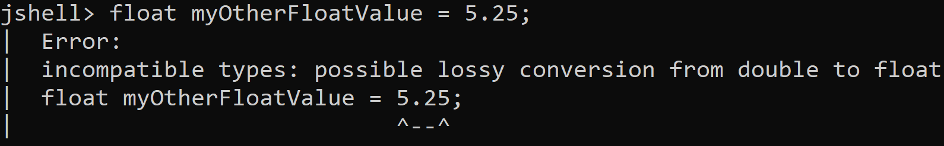
Challenge
Thinking back to our discussion on casting, how do you think you'd do the same for the float to remove this error? I am talking about using casting here, specifically, because, as you have learned, we could just use the suffix f to tell Java this is a float. Here I want you to use casting.
COMPLETE JAVA MASTERCLASS
Float and Double Primitives

Slide 70
Certification Exam Pointer
Not everyone realizes that Java's default data type for a decimal literal is a double, which is larger and more precise than a float.
Java likes to put a similar line of code in its code segments on exam questions, to what we saw earlier, omitting that 'f' suffix. Without a computer to check, this statement can look fairly innocuous.
The number 5.25 is a double, so assigning it to a float will raise an error.
This is a gift question to an exam taker, if you can easily spot this compiler error.
COMPLETE JAVA MASTERCLASS
Float and Double Primitives

Slide 71
Floating Point Data Types
Java’s Data Types For Floating Point Numbers
float double The double is Java’s default type for any decimal or real number
COMPLETE JAVA MASTERCLASS
Floating Point Precision and a Challenge

Slide 72
Default output for numeric data types
In this slide, we show default output, as it would be in JShell or by using System.out.print, for both whole and real numbers.
Whole Number Examples | Floating Point Examples
Literal Value | Default Output
5 | 5
500_000_000_000L | 500000000000
Literal Value | Default Output
5 | 5.0
5.000000 | 5.0
5f | 5.0
5d | 5.0
5e1 | 50.0
5_000_000.0 | 5000000.0
50_000_000.0 | 5.0E7
You can see from this table, that there are more ways to express a decimal real number literal, than a whole number, with the use of the 'F' or 'D' suffix, as well as using Java's scientific notation in the literal value.
COMPLETE JAVA MASTERCLASS
Floating Point Precision and a Challenge

Slide 73
Default output for numeric data types
Another interesting difference is that, for whole numbers, the output is never in scientific notation, but for real numbers, it could be, as you can see.
Whole Number Examples | Floating Point Examples
Literal Value | Default Output
5 | 5
500_000_000_000L | 500000000000
Literal Value | Default Output
5 | 5.0
5.000000 | 5.0
5f | 5.0
5d | 5.0
5e1 | 50.0
5_000_000.0 | 5000000.0
50_000_000.0 | 5.0E7
COMPLETE JAVA MASTERCLASS
Floating Point Precision and a Challenge

Slide 74
Why is the double a better choice in most circumstances?
Why should we choose double?
First, it's actually faster to process on many modern computers.
That's because computers have, at the chip level, the functionality to actually deal with these double numbers faster than the equivalent float.
Second, the Java libraries that we'll get into later in the course, particularly math functions, are often written to process doubles and not floats, and to return the result as a double.
The creators of Java selected the double because it's more precise, and it can handle a larger range of numbers.
COMPLETE JAVA MASTERCLASS
Floating Point Precision and a Challenge

Slide 75
Challenge
The objective of this challenge, is to convert a given number of pounds to kilograms.
STEPS:
Create a variable with the appropriate type, to store the number of pounds that we want to convert into kilograms.
Calculate kilograms, using the variable above, and store the result in a 2nd appropriately typed variable.
Print the result.
Don't forget to use the conversion formula shown here:
1 pound is equal to 0.45359237 of a kilogram.
COMPLETE JAVA MASTERCLASS
Floating Point Precision and a Challenge

Slide 76
Floating Point Number Precision Tips
In general, float and double are great for general floating point operations.
But neither should be used when precise calculations are required – this is due to a limitation with how floating point numbers are stored, and not a Java problem as such.
Java has a class called BigDecimal that overcomes this.
COMPLETE JAVA MASTERCLASS
Floating Point Precision and a Challenge

Slide 77
String Literal Example
If you recall, we've used literal strings before, and that's where we've typed some text in double quotes.
We haven't really used a String variable yet, but we'll be doing that in upcoming videos.
COMPLETE JAVA MASTERCLASS
The char and boolean Primitive Data Types

Slide 78
Comparing the char to the String
This table is a quick summary of the differences between the char and the String.
char | String
Holds one, and only one, character Literal enclosed in Single Quotes | Can hold multiple characters Literal enclosed in Double Quotes
COMPLETE JAVA MASTERCLASS
The char and boolean Primitive Data Types

Slide 79
Is there a good use for the char data type in today's computing world?
Why would you want to use a variable that only allows you to store one character?
One example might be to store the last key pressed by a user in a game.
Another example might be to loop programmatically through the letters in an alphabet.
COMPLETE JAVA MASTERCLASS
The char and boolean Primitive Data Types

Slide 80
char Data Type
A char occupies two bytes of memory, or 16 bits, and thus has a width of 16.
The reason it's not just a single byte, is that a char is stored as a 2 byte number, similar to the short.
This number gets mapped to a single character by Java.
So, when you print a char, you will see the mapped character, and not the representative number.
And you can use single quotes and a character literal to assign a value to a char, which is much simpler than looking up the representative number.
COMPLETE JAVA MASTERCLASS
The char and boolean Primitive Data Types

Slide 81
Unicode
Unicode is an international encoding standard for use with different languages and scripts by which each letter, digit, or symbol is assigned a unique numeric value that applies across different platforms and programs.
In the English alphabet, we've got the letters A through Z, meaning only 26 characters are needed in total to represent the entire English alphabet.
But other languages need more characters, and often a lot more.
COMPLETE JAVA MASTERCLASS
The char and boolean Primitive Data Types

Slide 82
Assigning values to a char variable
There are three ways to assign a value to a char: Each of these methods, represents storing the letter, capital D, in memory.
Assignment Type | Example Code
a literal character | char myChar = ‘D’;
a Unicode value | char myChar = ‘\u0044’;
an integer value | char myChar = 68;
COMPLETE JAVA MASTERCLASS
The char and boolean Primitive Data Types

Slide 83
The char Challenge
Create three char variables to store the character for the question-mark symbol.
mySimpleChar should be assigned the literal question-mark character ?.
myUnicodeChar should be assigned the unicode value for the question-mark ?.
myDecimalChar should be assigned the decimal value for the question-mark ?.
Print all three variables in one statement, that starts with the label “My values are”.
Hint: Use the symbl.cc website
COMPLETE JAVA MASTERCLASS
The char and boolean Primitive Data Types

Slide 84
Note on JShell and UTF-8 unicode values
There are a lot more characters, which are not on the usual keyboard, that can be output by this method, for example the copyright symbol.
But, if you are testing this out on your own, using Windows, you should be aware that JShell may give you an unexpected result, because UTF-8 is not supported, by default, for command line operations.
I point it out here, in case you are being adventurous, and do encounter this problem.
Again, this is only a problem with JShell and Windows users.
This won't be a problem in Java or IntelliJ, or if you're using MAC or Linux.
COMPLETE JAVA MASTERCLASS
The char and boolean Primitive Data Types

Slide 85
Boolean Primitive Type
A boolean value allows for two opposite choices, true or false, yes or no, one or zero.
In Java terms, we've got a boolean primitive type, and it can be set to two values only, either true or false.
The wrapper for boolean is Boolean with a capital B.
COMPLETE JAVA MASTERCLASS
The char and boolean Primitive Data Types

Slide 86
Why would you start your boolean variable name with the prefix 'is'?
Developers will often use the word, is, as a prefix for a boolean variable name.
This creates a name that seems to ask a question, which makes reading the code more intuitive.
But other prefixes can be just as valid.
COMPLETE JAVA MASTERCLASS
The char and boolean Primitive Data Types

Slide 87
Why would you start your boolean variable name with the prefix 'is'?
Here are some example boolean variable names, such as isMarried and hasChildren, that clearly define what condition is being tested:
Boolean variable name examples
isCustomerOverTwentyOne isEligibleForDiscount hasValidLicense isMarried hasChildren
COMPLETE JAVA MASTERCLASS
The char and boolean Primitive Data Types

Slide 88
Primitive Types Recap and the String Data Type
In the previous video, we looked at the char, and also the boolean types, which were Java's seventh and eighth data types.
So at this point, you should be familiar with all eight of Java's primitives.
COMPLETE JAVA MASTERCLASS
Primitive Types Recap and the String Data Type

Slide 89
Java's 8 Primitive Data Types
Whole number | Real Number (floating point or decimal)
byte short int long | float double
Single character | Boolean value
char | boolean
The int and a double are Java's default data types for numeric literals
COMPLETE JAVA MASTERCLASS
Primitive Types Recap and the String Data Type

Slide 90
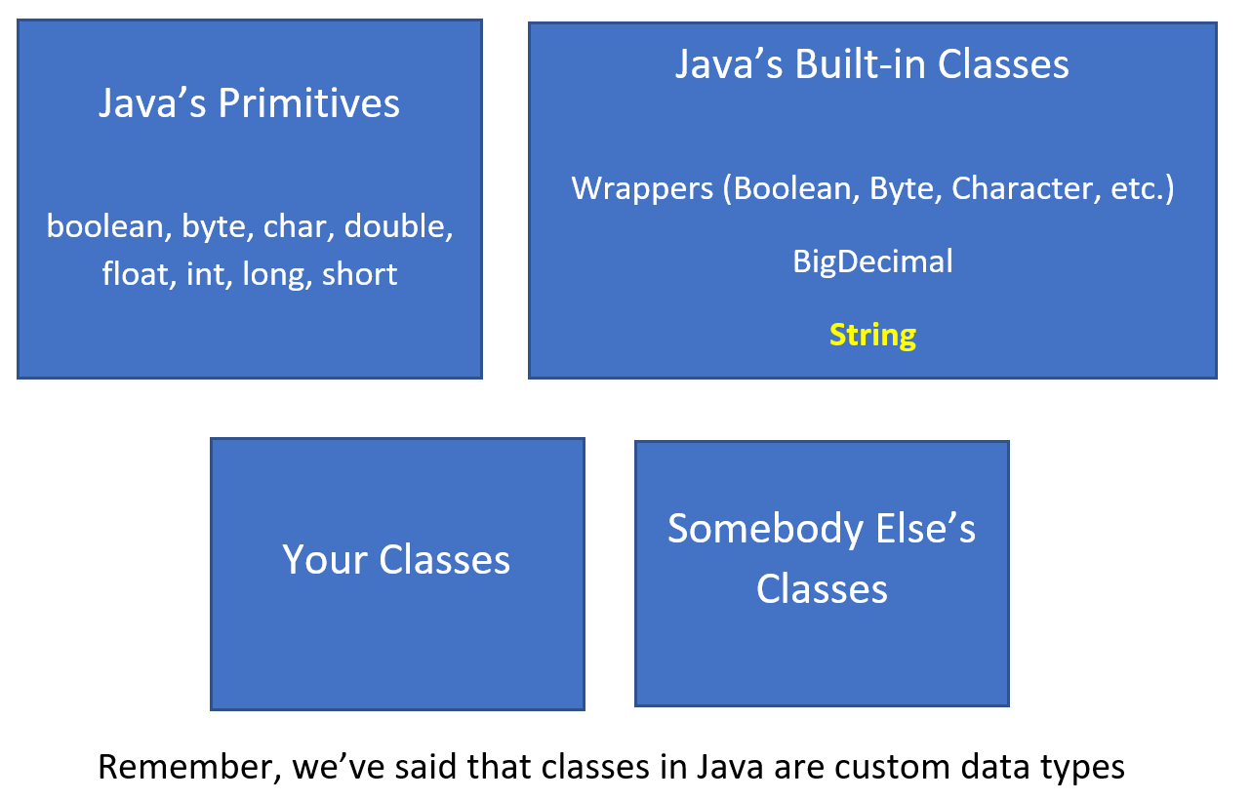
Handling Data in Java
This slide demonstrates that most Java programs use some combination of the data types shown in this diagram.
Remember, I’ve said that classes in Java are custom data types
COMPLETE JAVA MASTERCLASS
Primitive Types Recap and the String Data Type

Slide 91
Handling Data in Java
Remember, I’ve said that classes in Java are custom data types
You'll use Java's primitive data types, Java's built-in classes, and probably some combination of your own custom classes and classes created by other people.
COMPLETE JAVA MASTERCLASS
Primitive Types Recap and the String Data Type

Slide 92
So What is a String?
A String is a class that contains a sequence of characters.
COMPLETE JAVA MASTERCLASS
Primitive Types Recap and the String Data Type

Slide 93
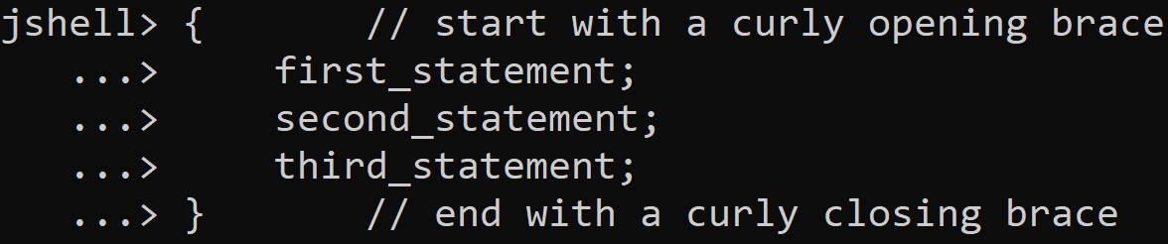
Executing multiple lines of code in JShell
To execute multiple lines of code as a set, in JShell, first start with an opening curly brace and press enter.
JShell will display an alternate prompt as you can see, three dots and a greater than sign.
You can add a statement and press enter, until you've added as many statements as you want to run.
Finally, add the closing curly brace, noting that a semicolon is not required after this brace.
Once you press enter after the closing brace, all of your statements will run in the order you put them.
COMPLETE JAVA MASTERCLASS
Primitive Types Recap and the String Data Type

Slide 94
Executing Multiple Statements In JShell
There are two ways to execute multiple statements in JShell:
Put your statements on a single line.
Or, enclose your statements in a set of curly braces {}.
COMPLETE JAVA MASTERCLASS
Primitive Types Recap and the String Data Type

Slide 95
String concatenation
In Java, the + symbol is an operator which can mean addition, if used for numbers.
But it also means concatenation when applied to a String.
A String + anything else, gives us a String as a result, concatenating anything after the String as text to the initial String.
COMPLETE JAVA MASTERCLASS
Primitive Types Recap and the String Data Type

Slide 96
Strings are Immutable
Immutable means that you can't change a String after it's created.
So in the case of the code we've written, the value 120.47 is technically not appended to the current contents of lastString.
Instead, a new String is created automatically by Java. The new String consists of the previous value of lastString, plus a textual representation of the double value 120.47.
The net result, is that our variable, lastString, has the concatenated value. However, Java created a new String in the process, and the old one will get discarded from memory automatically.
COMPLETE JAVA MASTERCLASS
Primitive Types Recap and the String Data Type

Slide 97
String vs StringBuilder
The String class is immutable, but can be used much like a primitive data type.
The StringBuilder class is mutable, meaning it can be changed, but does not share the String's special features, such as being able to assign it a String literal or use the plus operator on it.
Both are classes, but the String class is in a special category in the Java language.
COMPLETE JAVA MASTERCLASS
Primitive Types Recap and the String Data Type

Slide 98
The String
The String is so intrinsic to the Java language, it can be used like a 9th primitive type.
But it's not a primitive type at all, it's a class.
COMPLETE JAVA MASTERCLASS
Primitive Types Recap and the String Data Type

Slide 99
Operators, Operands and Expressions
In the previous video, we did a recap of the primitive data types, as well as getting a formal introduction to the String.
In this video, we're going to take a look at operators, operands, and expressions.
I've discussed very briefly what operators are, and we've used a few of them in expressions.
Let's go deeper into that now.
COMPLETE JAVA MASTERCLASS
Operators, Operands and Expressions

Slide 100
What are Operators?
So what are operators?
Operators in Java are special symbols that perform specific operations on one, two, or three operands, and then return a result.
In the example below, which we saw in a previous video, we used the addition operator, as well as the multiplication operator.
But there are many other operators in Java.
COMPLETE JAVA MASTERCLASS
Operators, Operands and Expressions

Slide 101
What are Operands?
So what is an operand?
An operand is a term used to describe any object that is manipulated by an operator.
So if we consider this:
The plus here is the operator, and 15 and 12 are the operands. Variables used instead of literals can also be operands.
Another example from a previous challenge::
In the line above, byteValue, shortValue and intValue are operands, as are the numeric literals.
COMPLETE JAVA MASTERCLASS
Operators, Operands and Expressions

Slide 102

What are Expressions?
What's an expression?
An expression is formed by combining variables, literals, method return values, which we haven't covered yet, and operators.
They are a way of forming and combining those values to produce a result.
In the line below, 15 plus 12 is the expression, which returns the value of 27.
COMPLETE JAVA MASTERCLASS
Operators, Operands and Expressions

Slide 103
What are Expressions?
In the statement below, byteValue + shortValue + intValue is the expression.
COMPLETE JAVA MASTERCLASS
Operators, Operands and Expressions

Slide 104
How may operators are in this code?
How many operators would you say, are in this statement?
Well, we've actually got two, the equal operator, and the plus operator.
COMPLETE JAVA MASTERCLASS
Operators, Operands and Expressions

Slide 105
What is a Comment?
Comments are ignored by the computer, and are added to a program, to help describe something. Comments are there for humans to read.
We use two forward slashes in front of any code, or on a blank line. Anything after the two forward slashes, right through to the end of the line, is ignored by the computer.
So aside from describing something about a program, comments can also be used to temporarily disable code.
COMPLETE JAVA MASTERCLASS
Operators, Operands and Expressions

Slide 106
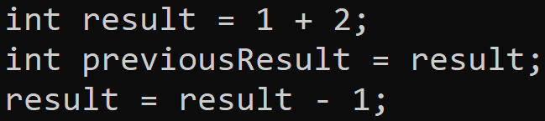
What is the effect of this code on the value in previousResult?
Before we move on, some of you may be wondering about the value that is now in the previousResult variable after the last statement.
To summarize, we assigned result to previousResult, and then we changed the value of result. But, did this also change the value in previousResult? That is a good question.
COMPLETE JAVA MASTERCLASS
Operators, Operands and Expressions

Slide 107
The + Operator on character data types
char | String
Holds one, and only one, character Literal enclosed in Single Quotes | Can hold multiple characters Literal enclosed in Double Quotes
COMPLETE JAVA MASTERCLASS
Operators, Operands and Expressions

Slide 108
The + Operator on char
You might remember that we said chars are stored as 2 byte numbers in memory.
When you use the addition operator with chars, it is these numbers in memory that get added together.
The character values don't get concatenated.
COMPLETE JAVA MASTERCLASS
Operators, Operands and Expressions

Slide 109
The Remainder Operator
The remainder operator is represented in Java by the % sign.
The remainder operator goes by several other names: modulus, modulo or just plain mod for short.
The remainder operator returns the remaining value from a division operation.
If there is no remaining value, the result is 0.
COMPLETE JAVA MASTERCLASS
Operators, Operands and Expressions

Slide 110
The Remainder Operator
This table shows some examples.
Division Result | Remainder Result | Explanation
10 / 5 = 2 | 10 % 5 = 0 | Ten can be divided evenly by 5, so there is no remainder.
10 / 2 = 5 | 10 % 2 = 0 | Ten can be divided evenly by 2, so there is no remainder.
10 / 3 = 3 | 10 % 3 = 1 | Ten cannot be divided evenly by 3, but we get 3 from the division which gives us 9 with 1 remaining.
10 / 1 = 10 | 10 % 1 = 0 | Using 1 on the right side of the remainder operate will always give a result of 0.
COMPLETE JAVA MASTERCLASS
Operators, Operands and Expressions

Slide 111
Summary of Operators
This tables shows the five operators we just reviewed. For all of the numeric types (whole numbers and decimals), the operators are mathematical operators as shown.
Operator | Numeric types | char | boolean | String
+ | Addition | Addition | n/a | Concatenation
- | Subtraction | Subtraction | n/a | n/a
* | Multiplication | Multiplication | n/a | n/a
/ | Division | Division | n/a | n/a
% | Remainder (Modulus) | Remainder (Modulus) | n/a | n/a
COMPLETE JAVA MASTERCLASS
Operators, Operands and Expressions

Slide 112
Summary of Operators
Only one operator, the + operator, is supported by String, but it means concatenation, not addition.
Operator | Numeric types | char | boolean | String
+ | Addition | Addition | n/a | Concatenation
- | Subtraction | Subtraction | n/a | n/a
* | Multiplication | Multiplication | n/a | n/a
/ | Division | Division | n/a | n/a
% | Remainder (Modulus) | Remainder (Modulus) | n/a | n/a
COMPLETE JAVA MASTERCLASS
Operators, Operands and Expressions

Slide 113
Summary of Operators
None of the operators are applicable to a boolean.
Operator | Numeric types | char | boolean | String
+ | Addition | Addition | n/a | Concatenation
- | Subtraction | Subtraction | n/a | n/a
* | Multiplication | Multiplication | n/a | n/a
/ | Division | Division | n/a | n/a
% | Remainder (Modulus) | Remainder (Modulus) | n/a | n/a
COMPLETE JAVA MASTERCLASS
Operators, Operands and Expressions

Slide 114
Summary of Operators
Because the char is stored as a whole number literal, all the operations are applicable to a char.
Operator | Numeric types | char | boolean | String
+ | Addition | Addition | n/a | Concatenation
- | Subtraction | Subtraction | n/a | n/a
* | Multiplication | Multiplication | n/a | n/a
/ | Division | Division | n/a | n/a
% | Remainder (Modulus) | Remainder (Modulus) | n/a | n/a
COMPLETE JAVA MASTERCLASS
Operators, Operands and Expressions

Slide 115
Abbreviating Operators
In the previous video, I talked about operators, operands, and expressions. In this video, I'll continue the discussion about operators, and you'll see how they can be abbreviated to simplify code.
In the next section of this course, we'll be transitioning to coding in a code editor called IntelliJ. I want to continue to prepare you for that environment by using the curly brace feature in JShell.
COMPLETE JAVA MASTERCLASS
Abbreviating Operators

Slide 116
Why do we want to use multiple statements in curly braces {}?
So, why use multiple statements in curly braces?
First, it's a way to group statements together before executing them.
It allows us to put statements on multiple lines which is more natural and readable.
We can execute the group of statements as a whole, which more closely resembles running code in Java.
COMPLETE JAVA MASTERCLASS
Abbreviating Operators

Slide 117
Incrementing by One
Incrementing by one is a very common requirement in programming.
Obviously we can do the following:
But we also have two other shorthand ways to do this same thing.
Shorthand (or Abbreviating) Operator | Code Sample
Post-fix Increment Operator | result++;
Compound Assignment Operator with + sign | result+=1;
COMPLETE JAVA MASTERCLASS
Abbreviating Operators

Slide 118
Decrementing by One
Decrementing by one is also very common.
We can decrement simply by using the equation:
But we also have two other shorthand ways to do this same thing.
Shorthand (or Abbreviating) Operator | Code Sample
Post-fix Decrement Operator | result--;
Compound Assignment Operator with - sign | result-=1;
COMPLETE JAVA MASTERCLASS
Abbreviating Operators

Slide 119
Compound Assignment Operator Challenge
Using the code we have been using, either by scrolling up and editing the group of statements, or creating a new group.
Initialize an int variable, named result, to the value of 10, rather than 1.
Next, use the compound assignment operator, with the minus sign, to subtract a number from result, using a value of your choice.
Print the result out, using the System.out.print statement.
COMPLETE JAVA MASTERCLASS
Abbreviating Operators

Slide 120

Compound Operator Assignment
When result is an int, the compound operator assignment
give us a different result from what we expected, which was
COMPLETE JAVA MASTERCLASS
Abbreviating Operators

Slide 121
Compound Assignment Operator
The compound assignment operator
x -= y
is often said to be
x = x – y
but that's not entirely true if y is not the same data type as x.
COMPLETE JAVA MASTERCLASS
Abbreviating Operators

Slide 122
Compound Assignment Operator
x -= y
is really
x = (data type of x) (x - y)
An implicit cast is done when using this operator, so no error occurs, but unexpected results may happen, as we have seen.
COMPLETE JAVA MASTERCLASS
Abbreviating Operators

Slide 123

Compound Assignment Operator
So, summarizing, for our own sample of code:
is really
COMPLETE JAVA MASTERCLASS
Abbreviating Operators

Slide 124
The abbreviating operators
The abbreviating operators we've discussed so far are:
Shorthand Operator | Code Sample
Post-fix Increment Operator | result++;
Post-fix Decrement Operator | result--;
Addition Compound Assignment | result += 5;
Subtraction Compound Assignment | result -= 5;
Multiplication Compound Assignment | result *= 5;
Division Compound Assignment | result /= 5;
COMPLETE JAVA MASTERCLASS
Abbreviating Operators

