Slide 1

Introduction
Welcome to section 7 of this course.
Tim Buchalka here, and this is part one of a two-part section, about Object-Oriented Programming.
In part one, you're going to learn the fundamentals of Object-Oriented Programming, starting with the structures you'll be using, specifically Classes, Objects, and Constructors.
Along with these structures, you'll be learning some fundamental features of Object-Oriented Programming.
Namely Inheritance, Encapsulation, Polymorphism, and Composition.
COMPLETE JAVA MASTERCLASS
Introduction

Slide 2
Introduction
In this section, I'll cover Inheritance, and in the next one, we'll explore the other 3 features.
So, let's make a start on Object-Oriented Programming.
COMPLETE JAVA MASTERCLASS
Introduction

Slide 3
Introduction to Classes and Objects
In this video, I'm going to start talking about Object-Oriented Programming.
COMPLETE JAVA MASTERCLASS
Introduction to Classes and Objects

Slide 4
What is Object Oriented Programming
What is Object-Oriented Programming?
Object-Oriented Programming is a way to model real-world objects as software objects which contain both data and code.
OOP is a common acronym for Object-Oriented Programming.
COMPLETE JAVA MASTERCLASS
Introduction to Classes and Objects

Slide 5
Class-based Programming
Class-based programming starts with classes which become the blueprints for objects.
But what does this really mean?
To start, we need to understand what objects are.
They're really the key to understanding this object-oriented terminology.
COMPLETE JAVA MASTERCLASS
Introduction to Classes and Objects

Slide 6
Real World Object Exercise
What I'd like you to do is just have a look around in the area you're sitting in right now.
And if you do that, you'll find that there's many examples of real-world objects.
For example, I'm sitting here, and I can see:
A computer.
I can see a keyboard.
I can see a microphone.
I can see shelves on the wall.
I can see a door.
All of these are examples of real-world objects.
COMPLETE JAVA MASTERCLASS
Introduction to Classes and Objects

Slide 7
State and Behavior
Real-world objects have two major components:
state.
and behavior.
COMPLETE JAVA MASTERCLASS
Introduction to Classes and Objects

Slide 8
State (computer)
State, in terms of a computer object, might be:
The amount of RAM it has.
The operating system it's running.
The hard drive size.
The size of the monitor.
These are characteristics about the item that can describe it.
COMPLETE JAVA MASTERCLASS
Introduction to Classes and Objects

Slide 9
State (ant)
I could also describe animate objects like people, or animals, or even insects like an ant.
For an ant, the state might be:
The age.
The number of legs.
The conscious state.
Whether the ant is sleeping or is awake.
COMPLETE JAVA MASTERCLASS
Introduction to Classes and Objects

Slide 10
Behavior (computer)
In addition to state, objects may also have behavior or actions that can be performed by the object, or upon the object.
Behavior, for a computer, might be things like:
Booting up.
Shutting down.
Beeping or outputting some form of sound.
Drawing something on the screen, and so on.
All of these could be described as behaviors for a computer.
COMPLETE JAVA MASTERCLASS
Introduction to Classes and Objects

Slide 11
Behavior (ant)
For an ant, behavior might be:
Eating.
Drinking.
Fighting.
Carrying food, those types of things.
COMPLETE JAVA MASTERCLASS
Introduction to Classes and Objects

Slide 12
State and Behavior
Modelling real-world objects as software objects is a fundamental part of Object-Oriented Programming.
A software object stores its state in fields, which can also be called variables or attributes.
Objects expose their behavior with methods which I've talked about before.
So, where does a class fit in?
Well, think of a class as a template or a blueprint for creating objects.
Let's take another look at the class.
COMPLETE JAVA MASTERCLASS
Introduction to Classes and Objects

Slide 13
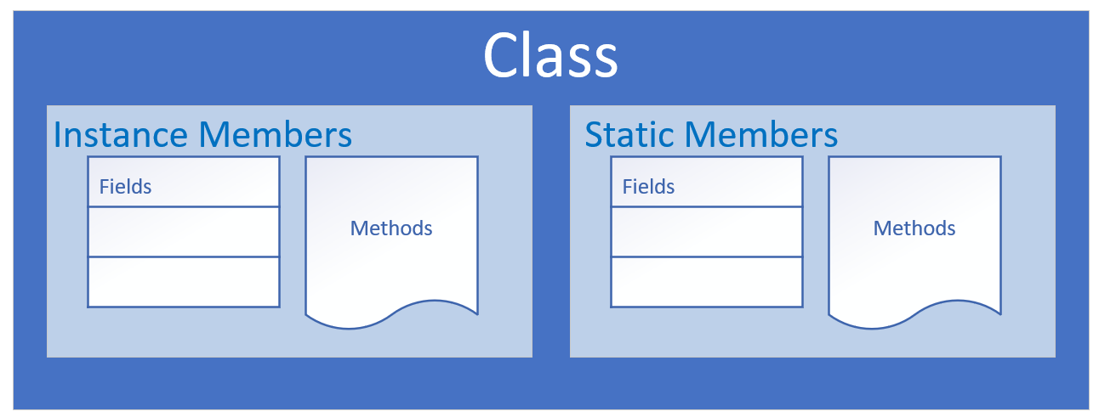
The class as the blueprint
The class describes the data (fields), and the behavior (methods), that are relevant to the real-world object we want to describe.
These are called class members.
A class member can be a field or a method, or some other type of dependent element.
If a field is static, there is only one copy in memory, and this value is associated with the class or template itself.
COMPLETE JAVA MASTERCLASS
Introduction to Classes and Objects

Slide 14
The class as the blueprint
If a field is not static, it's called an instance field, and each object may have a different value stored for this field.
A static method can't be dependent on any one object's state, so it can't reference any instance members.
In other words, any method that operates on instance fields needs to be non-static.
COMPLETE JAVA MASTERCLASS
Introduction to Classes and Objects

Slide 15
Organizing classes
Classes can be organized into logical groupings which are called packages.
You declare a package name in the class using the package statement.
If you don't declare a package, the class implicitly belongs to the default package.
COMPLETE JAVA MASTERCLASS
Introduction to Classes and Objects

Slide 16
Access modifiers for the class
A class is said to be a top-level class if it is defined in the source code file and not enclosed in the code block of another class, type, or method.
A top-level class has only two valid access modifier options: public or none.
Access keyword | Description
public | public means any other class in any package can access this class.
 | When the modifier is omitted, this has special meaning, called package access, meaning the class is accessible only to classes in the same package.
COMPLETE JAVA MASTERCLASS
Introduction to Classes and Objects

Slide 17
Access modifiers for class members
An access modifier at the member level allows granular control over class members.
The valid access modifiers are shown in this table from the least restrictive to the most restrictive.
Access keyword | Description
public | public means any other class in any package can access this class.
protected | protected allows classes in the same package, and any subclasses in other packages, to have access to the member.
 | When the modifier is omitted, this has special meaning, called package access, meaning the member is accessible only to classes in the same package
private | private means that no other class can access this member
COMPLETE JAVA MASTERCLASS
Introduction to Classes and Objects

Slide 18
Encapsulation
Encapsulation in Object-Oriented Programming usually has two meanings.
One is the bundling of behavior and attributes on a single object.
The other is the practice of hiding fields and some methods from public access.
COMPLETE JAVA MASTERCLASS
Introduction to Classes and Objects

Slide 19
What is null?
null is a special keyword in Java, meaning, the variable or attribute has a type but no reference to an object.
This means that no instance or object is assigned to the variable or field.
Fields with primitive data types are never null.
COMPLETE JAVA MASTERCLASS
Introduction to Classes, Using Getter Methods

Slide 20
Default values for fields on classes
Fields on classes are assigned default values automatically by Java, if you don't assign values yourself.
Data type | Default value assigned
boolean | false
byte short int long char | 0
double float | 0.0
COMPLETE JAVA MASTERCLASS
Introduction to Classes, Using Getter Methods

Slide 21
What are getters and setters? Why should we use them?
What are getters and setters?
A getter is a method on a class that retrieves the value of a private field and returns it.
A setter is a method on a class that sets the value of a private field.
The purpose of these methods is to control and protect access to private fields.
COMPLETE JAVA MASTERCLASS
Introduction to Classes, Using Getter Methods

Slide 22
this
this is a special keyword in Java.
What it really refers to is the instance that was created when the object was instantiated.
So, this is a special reference name for the object or instance, which it can use to describe itself.
And we can use this to access fields on the class.
COMPLETE JAVA MASTERCLASS
Kotlin Variables and Datatypes

Slide 23
Classes Challenge Exercise
In the previous videos, I've been talking about classes.
It's now challenge time. I want to challenge your understanding of those previous videos.
So, here's what I want you to do.
COMPLETE JAVA MASTERCLASS
Classes Challenge Exercise

Slide 24
Object Oriented Challenge
Create a new class for a bank account.
Create fields for account characteristics like:
account number.
account balance.
customer name.
email.
phone number.
COMPLETE JAVA MASTERCLASS
Classes Challenge Exercise

Slide 25
Object Oriented Challenge
Create getters and setters for each field.
Create two additional methods:
one for depositing funds into the account.
one for withdrawing funds from the account.
COMPLETE JAVA MASTERCLASS
Classes Challenge Exercise

Slide 26
Object Oriented Challenge
A customer should not be allowed to withdraw funds if that withdrawal takes their balance negative.
Create a new project called ClassesChallenge with the usual Main class with the usual main method.
You'll create an instance of an Account class and then test your withdraw and deposit methods.
You'll print information to the console that confirms what the balance is after the methods are called.
COMPLETE JAVA MASTERCLASS
Classes Challenge Exercise

Slide 27
Object Oriented Challenge
You want to make this class encapsulated, so you'll make all your fields private and set up getter and setter methods for your fields.
In addition, you'll have two behavioral methods. One for depositing funds, the other for withdrawing funds.
In addition to this class, you'll set up a main class with a main method that creates at least one instance of the bank account class and simulates depositing and withdrawing money from the account.
COMPLETE JAVA MASTERCLASS
Classes Challenge Exercise

Slide 28
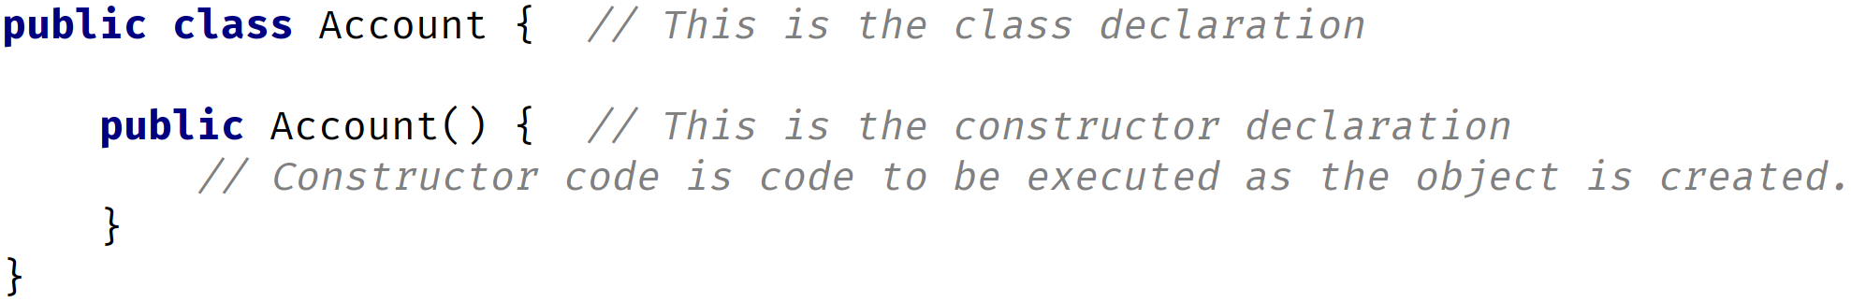
Constructor
A constructor is used in the creation of an object.
It is a special type of code block that has a specific name and parameters, much like a method.
It has the same name as the class itself, and it doesn't return any values.
You never include a return type from a constructor, not even void.
You can, and should, specify an appropriate access modifier to control who should be able to create new instances of the class, using this constructor.
COMPLETE JAVA MASTERCLASS
Constructors Part 1

Slide 29
The default constructor
If a class contains no constructor declarations, then a default constructor is implicitly declared.
This constructor has no parameters and is often called the no-args (no arguments) constructor.
If a class contains any other constructor declarations, then a default constructor is NOT implicitly declared.
COMPLETE JAVA MASTERCLASS
Constructors Part 1

Slide 30
Constructor overloading
Constructor overloading is declaring multiple constructors with different parameters.
The number of parameters can be different between constructors.
Or if the number of parameters is the same between two constructors, their types, or order of the types must differ.
COMPLETE JAVA MASTERCLASS
Constructors Part 1

Slide 31
Constructor chaining with this()
Constructor chaining is when one constructor explicitly calls another overloaded constructor.
You can only use constructor chaining, within constructors.
You must use the special statement this() to execute another constructor, passing it arguments if required.
And this() must be the first executable statement if it's used from another constructor.
COMPLETE JAVA MASTERCLASS
Constructors Part 2

Slide 32
Constructor Challenge Exercise
In this video, I'm going to give you a challenge, to review what you learned about constructors so far.
COMPLETE JAVA MASTERCLASS
Constructor Challenge Exercise

Slide 33
Constructor Challenge
So for this challenge, you'll want to:
Create a new class, called Customer, with three fields:
name
credit limit
email address.
Create the getter methods only, for each field. You don't need to create the setters.
COMPLETE JAVA MASTERCLASS
Constructor Challenge Exercise

Slide 34
Constructor Challenge
Create three constructors for this class:
First, create a constructor for all three fields which should assign the arguments directly to the instance fields.
Second, create a no args constructor that calls another constructor, passing some literal values for each argument.
And lastly, create a constructor with just the name and email parameters, which also calls another constructor.
COMPLETE JAVA MASTERCLASS
Constructor Challenge Exercise

Slide 35
Reference vs Object vs Instance vs Class
In this video, we're going to talk about references, vs. objects, vs. instances, vs. classes.
COMPLETE JAVA MASTERCLASS
Reference vs Object vs Instance vs Class

Slide 36
Reference vs Object vs Instance vs Class
We use the words, reference, object, instance and class, quite a lot when talking about Java code.
These new concepts may well be confusing at first.
COMPLETE JAVA MASTERCLASS
Reference vs Object vs Instance vs Class

Slide 37
Object vs Instance vs Class
Class
You create an object by ‘instantiating a class’
You can create many objects using a single class. Each may have unique attributes or values
Object
Instance
Object
Object
Object and instance are interchangeable terms
Instance
COMPLETE JAVA MASTERCLASS
Reference vs Object vs Instance vs Class

Slide 38
Reference vs Object vs Instance vs Class
Let's use the analogy of building a house to understand classes.
A class is basically a blueprint for the house.
Using the blueprint, we can build as many houses as we like, based on those plans.
Each house we build (in other words using the new operator) is an object.
This object can also be known as an instance, often we'll say it's an instance of the class. So we would have an instance of house in this example.
Each house we build has an address (a physical location).
In other words, if we want to tell someone where we live, we give them our address (perhaps written on a piece of paper). This is known as a reference.
COMPLETE JAVA MASTERCLASS
Reference vs Object vs Instance vs Class

Slide 39
Reference vs Object vs Instance vs Class
We can copy that reference as many times as we like, but there is still just one house that we're referring to.
In other words, we're copying the paper that has the address on it, not the house itself.
We can pass references as parameters to constructors and methods.
COMPLETE JAVA MASTERCLASS
Reference vs Object vs Instance vs Class

Slide 40
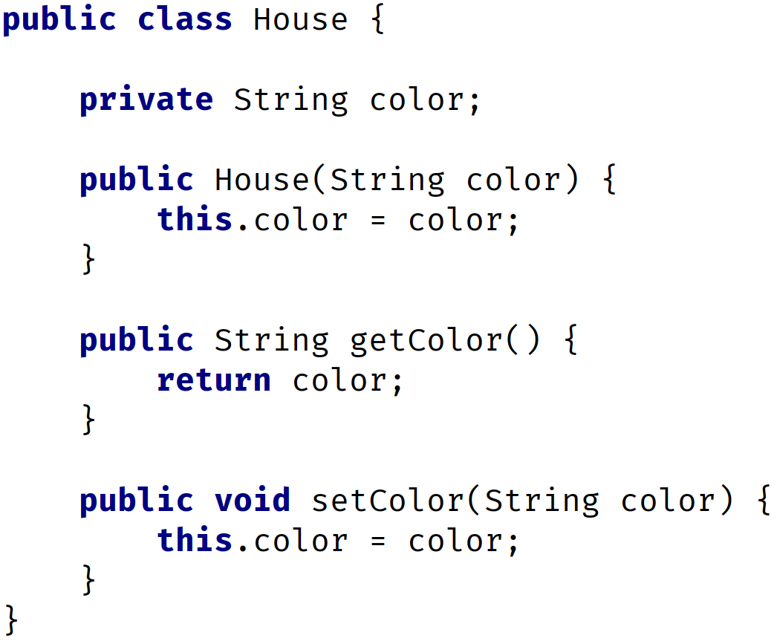
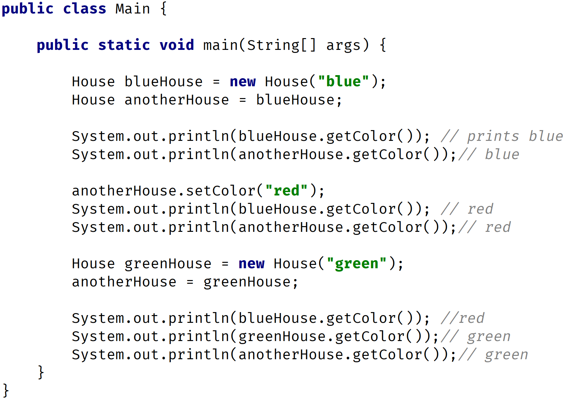
Reference vs Object vs Instance vs Class
COMPLETE JAVA MASTERCLASS
Reference vs Object vs Instance vs Class

Slide 41
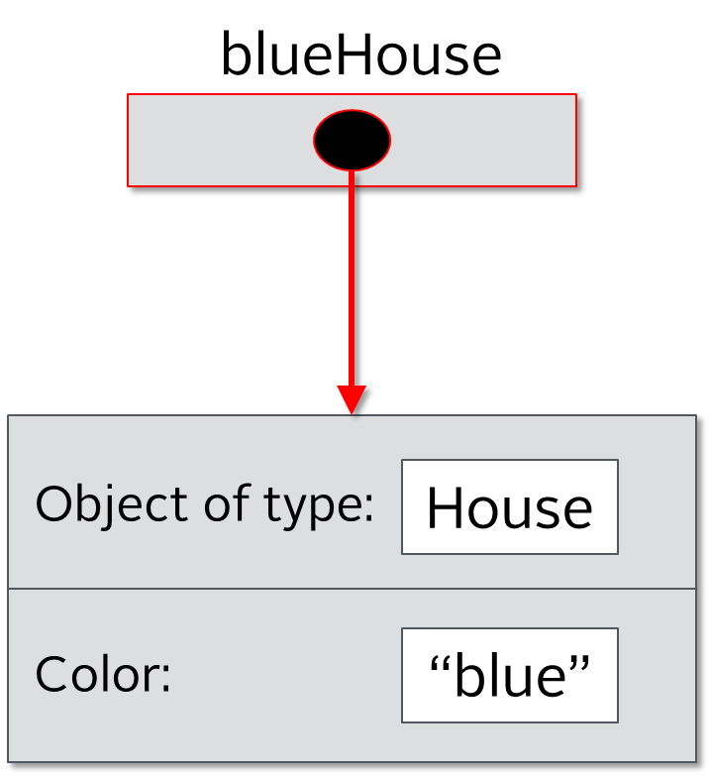
Reference vs Object vs Instance vs Class
The line House blueHouse = new House(“blue”); creates a new instance of the House class. Remember House is a blueprint, and we are assigning it to the blueHouse variable. In other words it is a reference to the object in memory. The image on the left hopefully makes sense to you now.
COMPLETE JAVA MASTERCLASS
Reference vs Object vs Instance vs Class

Slide 42
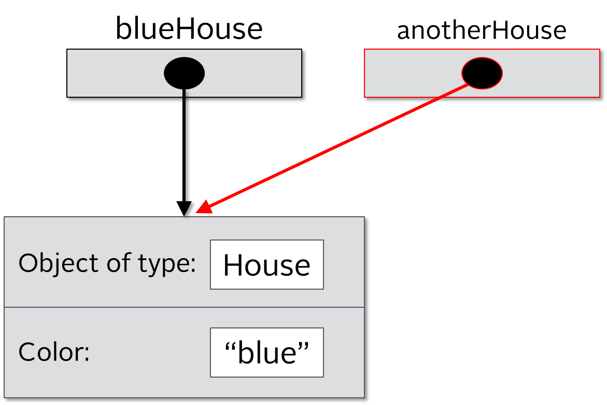
Reference vs Object vs Instance vs Class
The next line House anotherHouse = blueHouse; creates another reference to the same object in memory. Here we have two references pointing to the same object in memory. There is still one house, but two references to that one object. In other words we have two pieces of paper with the physical address of where the house is built (going back to our real world example).
COMPLETE JAVA MASTERCLASS
Reference vs Object vs Instance vs Class

Slide 43
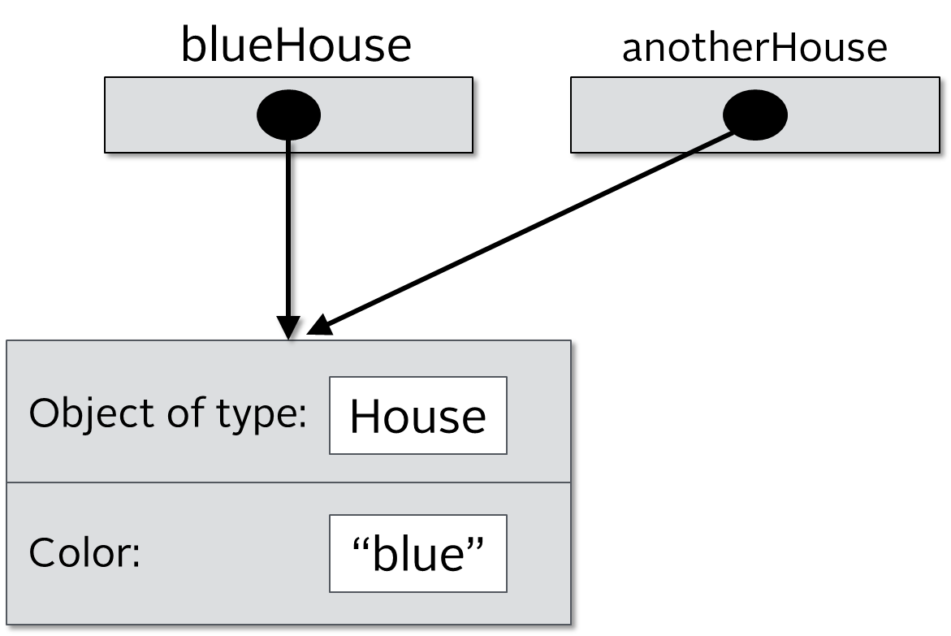
Reference vs Object vs Instance vs Class
Next we have two println statements that print the blueHouse color and anotherHouse color. Both will print “blue” since we have two references to the same object.
COMPLETE JAVA MASTERCLASS
Reference vs Object vs Instance vs Class

Slide 44
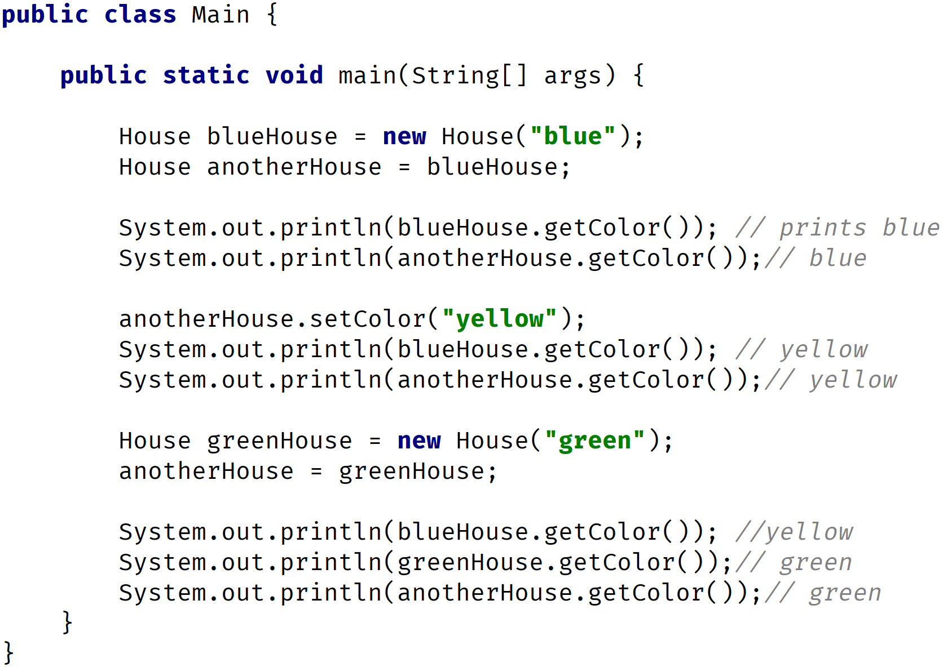
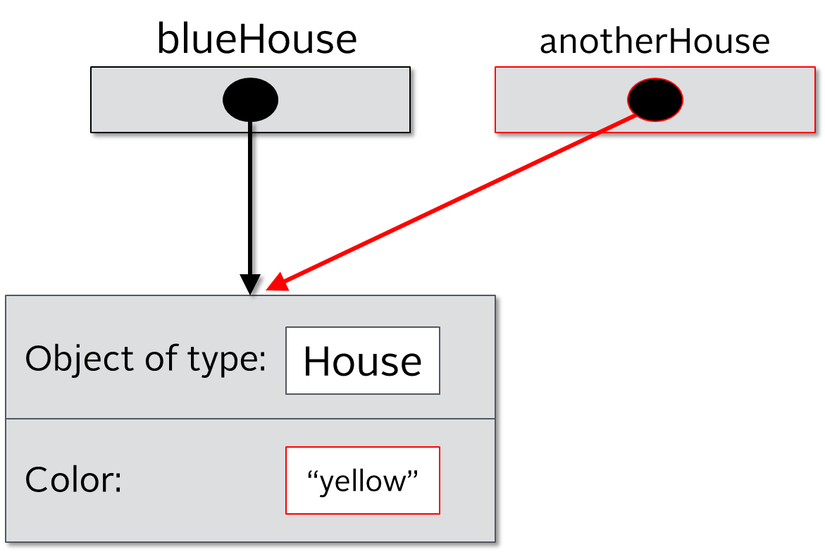
Reference vs Object vs Instance vs Class
The next line calls the method setColor and sets the color to yellow. To the left you can that both blueHouse and anotherHouse have the same color now. Why? Remember we have two references that point to the same object in memory. Once we change the color, of one, both references still point to the same object. In our real world example, there is still just one physical house at that one address, even though we have written the same address on two pieces of paper.
COMPLETE JAVA MASTERCLASS
Reference vs Object vs Instance vs Class

Slide 45

Reference vs Object vs Instance vs Class
Here we have two println statements that are printing the color. Both now print “yellow” since we still have two references that point to the same object in memory. Notice the arrows on the left hand side.
COMPLETE JAVA MASTERCLASS
Reference vs Object vs Instance vs Class

Slide 46
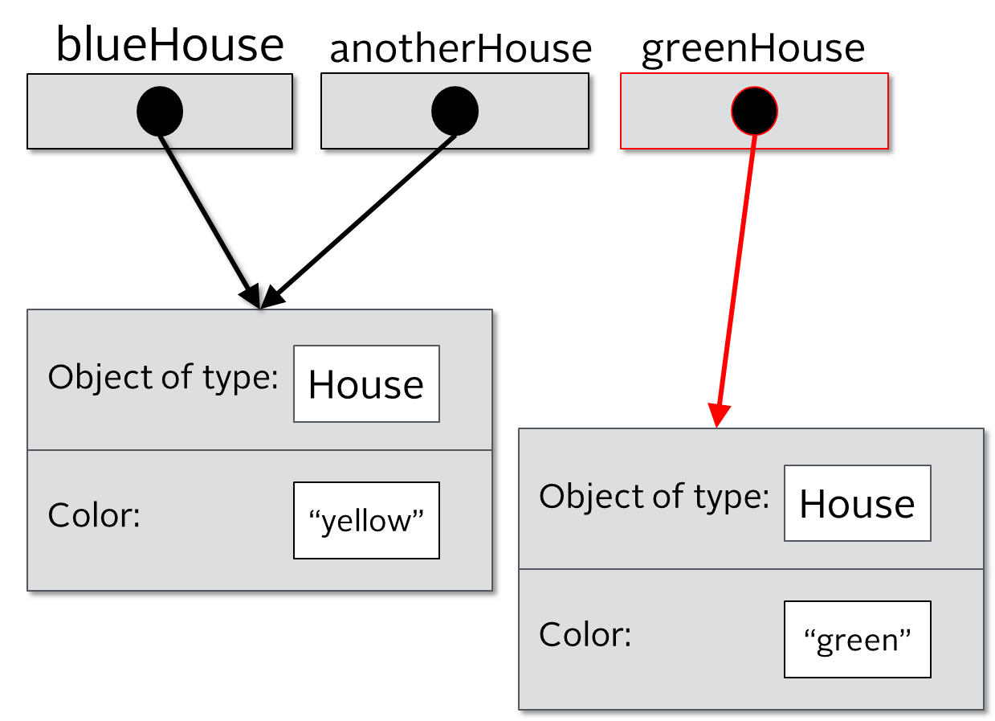
Reference vs Object vs Instance vs Class
Here we are creating another new instance of the House class with the color set to “green”. Now we have two objects in memory but we have three references which are blueHouse, anotherHouse and greenHouse. The variable (reference) greenHouse points to a different object in memory, but blueHouse and anotherHouse point to the same object in memory.
COMPLETE JAVA MASTERCLASS
Reference vs Object vs Instance vs Class

Slide 47
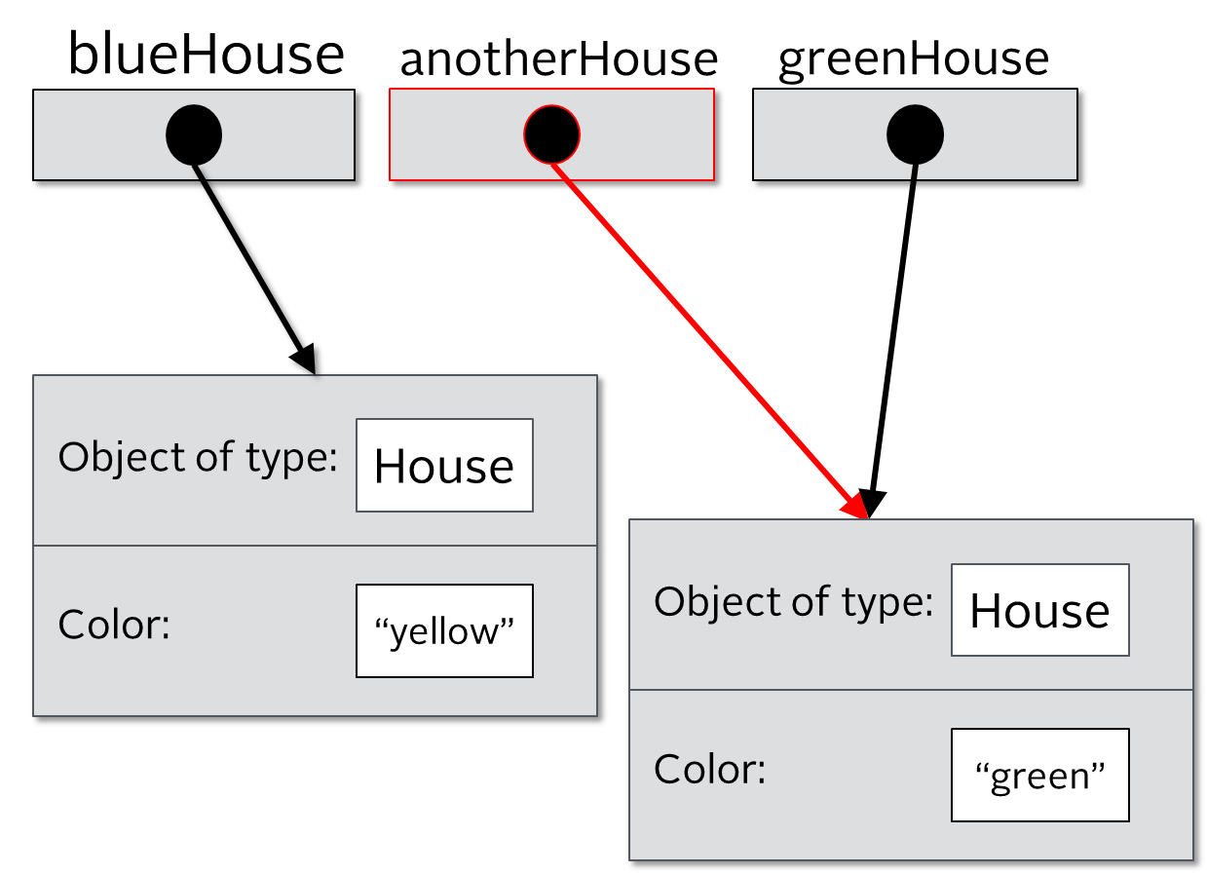
Reference vs Object vs Instance vs Class
Here we assigns greenHouse to anotherHouse. In other words we are dereferencing anotherHouse. It will now point to a different object in memory. Before it was pointing to a house that had the “yellow” color, now it points to the house that has the “green” color. In this scenario we still have three references and two objects in memory but blueHouse points to one object while anotherHouse and greenHouse point to the same object in memory.
COMPLETE JAVA MASTERCLASS
Reference vs Object vs Instance vs Class

Slide 48
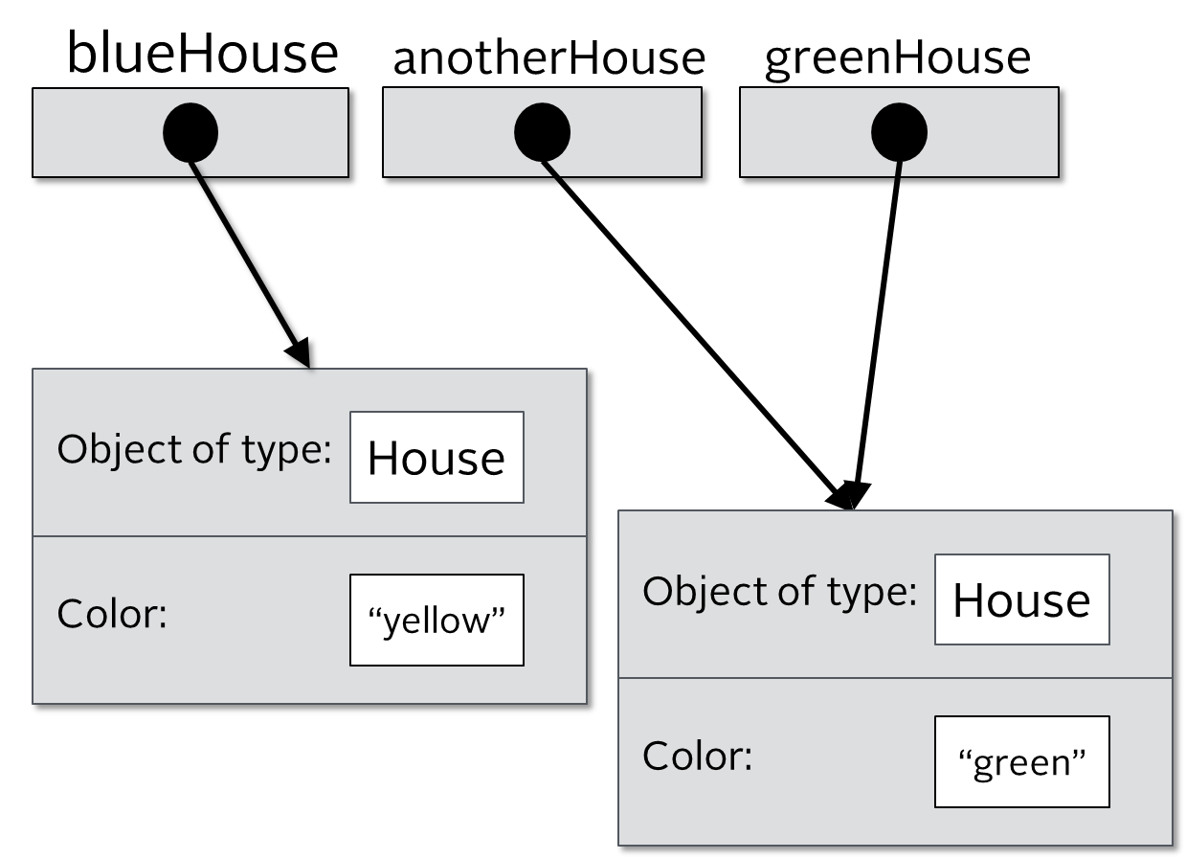
Reference vs Object vs Instance vs Class
Finally we have three println statements. The first will print “yellow” since the blueHouse variable(reference) points to the object in memory that has the “yellow” color, while the next two lines will print “green” since both anotherHouse and greenHouse point to same object in memory.
COMPLETE JAVA MASTERCLASS
Reference vs Object vs Instance vs Class

Slide 49
The reference vs The object
Consider the code on this slide.
On the first line, we create a new House, and make it red.
But we aren't assigning this to any variable.
COMPLETE JAVA MASTERCLASS
Reference vs Object vs Instance vs Class

Slide 50
The reference vs The object
This compiles fine, and you can do this.
This object is created in memory, but after that statement completes, our code has no way to access it.
The object exists in memory, but we can't communicate with it, after that statement is executed.
We didn't create a reference to it.
COMPLETE JAVA MASTERCLASS
Reference vs Object vs Instance vs Class

Slide 51
The reference vs The object
We create a reference to the house object we created.
Our reference, myHouse, lets us have access to that beige house, as long as our variable, myHouse, stays in scope.
COMPLETE JAVA MASTERCLASS
Reference vs Object vs Instance vs Class

Slide 52
The reference vs The object
We're creating a red house again, but this is a different object altogether, from the red house we created on line one.
This statement is creating another house object in memory, which has no relationship to the one we created on the first line.
COMPLETE JAVA MASTERCLASS
Reference vs Object vs Instance vs Class

Slide 53
The reference vs The object
So this code has three instances of house, but only two references.
That first object is said to be eligible for garbage collection, immediately after that first statement.
It's no longer accessible.
COMPLETE JAVA MASTERCLASS
Reference vs Object vs Instance vs Class

Slide 54
The reference vs The object
There are times we might want to instantiate an object, and immediately call a method on it.
But 99% of the time, we'll want to reference the objects we create.
COMPLETE JAVA MASTERCLASS
Reference vs Object vs Instance vs Class

Slide 55
Static vs Instance Variables
Let's discuss the differences now between static variables, and instance variables.
COMPLETE JAVA MASTERCLASS
Static vs Instance Variables

Slide 56
Static Variables
Declared by using the keyword static.
Static variables are also known as static member variables.
Every instance of the class shares the same static variable.
So if changes are made to that variable, all other instances of that class will see the effect of that change.
COMPLETE JAVA MASTERCLASS
Static vs Instance Variables

Slide 57
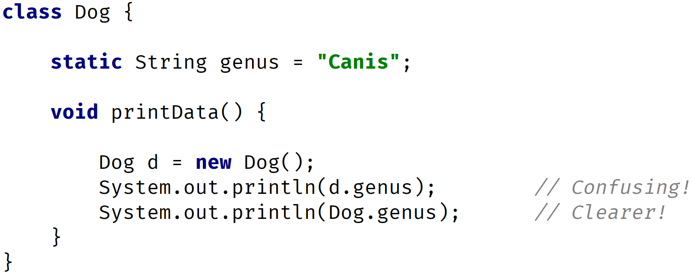
Static Variables
It is considered best practice to use the Class name, and not a reference variable to access a static variable.
COMPLETE JAVA MASTERCLASS
Static vs Instance Variables

Slide 58
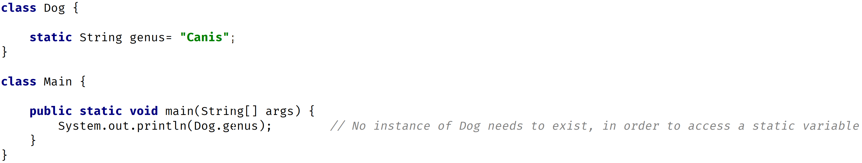
Static Variables
An instance isn't required to exist, to access the value of a static variable.
COMPLETE JAVA MASTERCLASS
Static vs Instance Variables

Slide 59
Static Variables
Static variables aren't used very often, but can sometimes be very useful.
They can be used for
Storing counters.
Generating unique ids.
Storing a constant value that doesn't change, like PI for example.
Creating, and controlling access, to a shared resource.
COMPLETE JAVA MASTERCLASS
Static vs Instance Variables

Slide 60
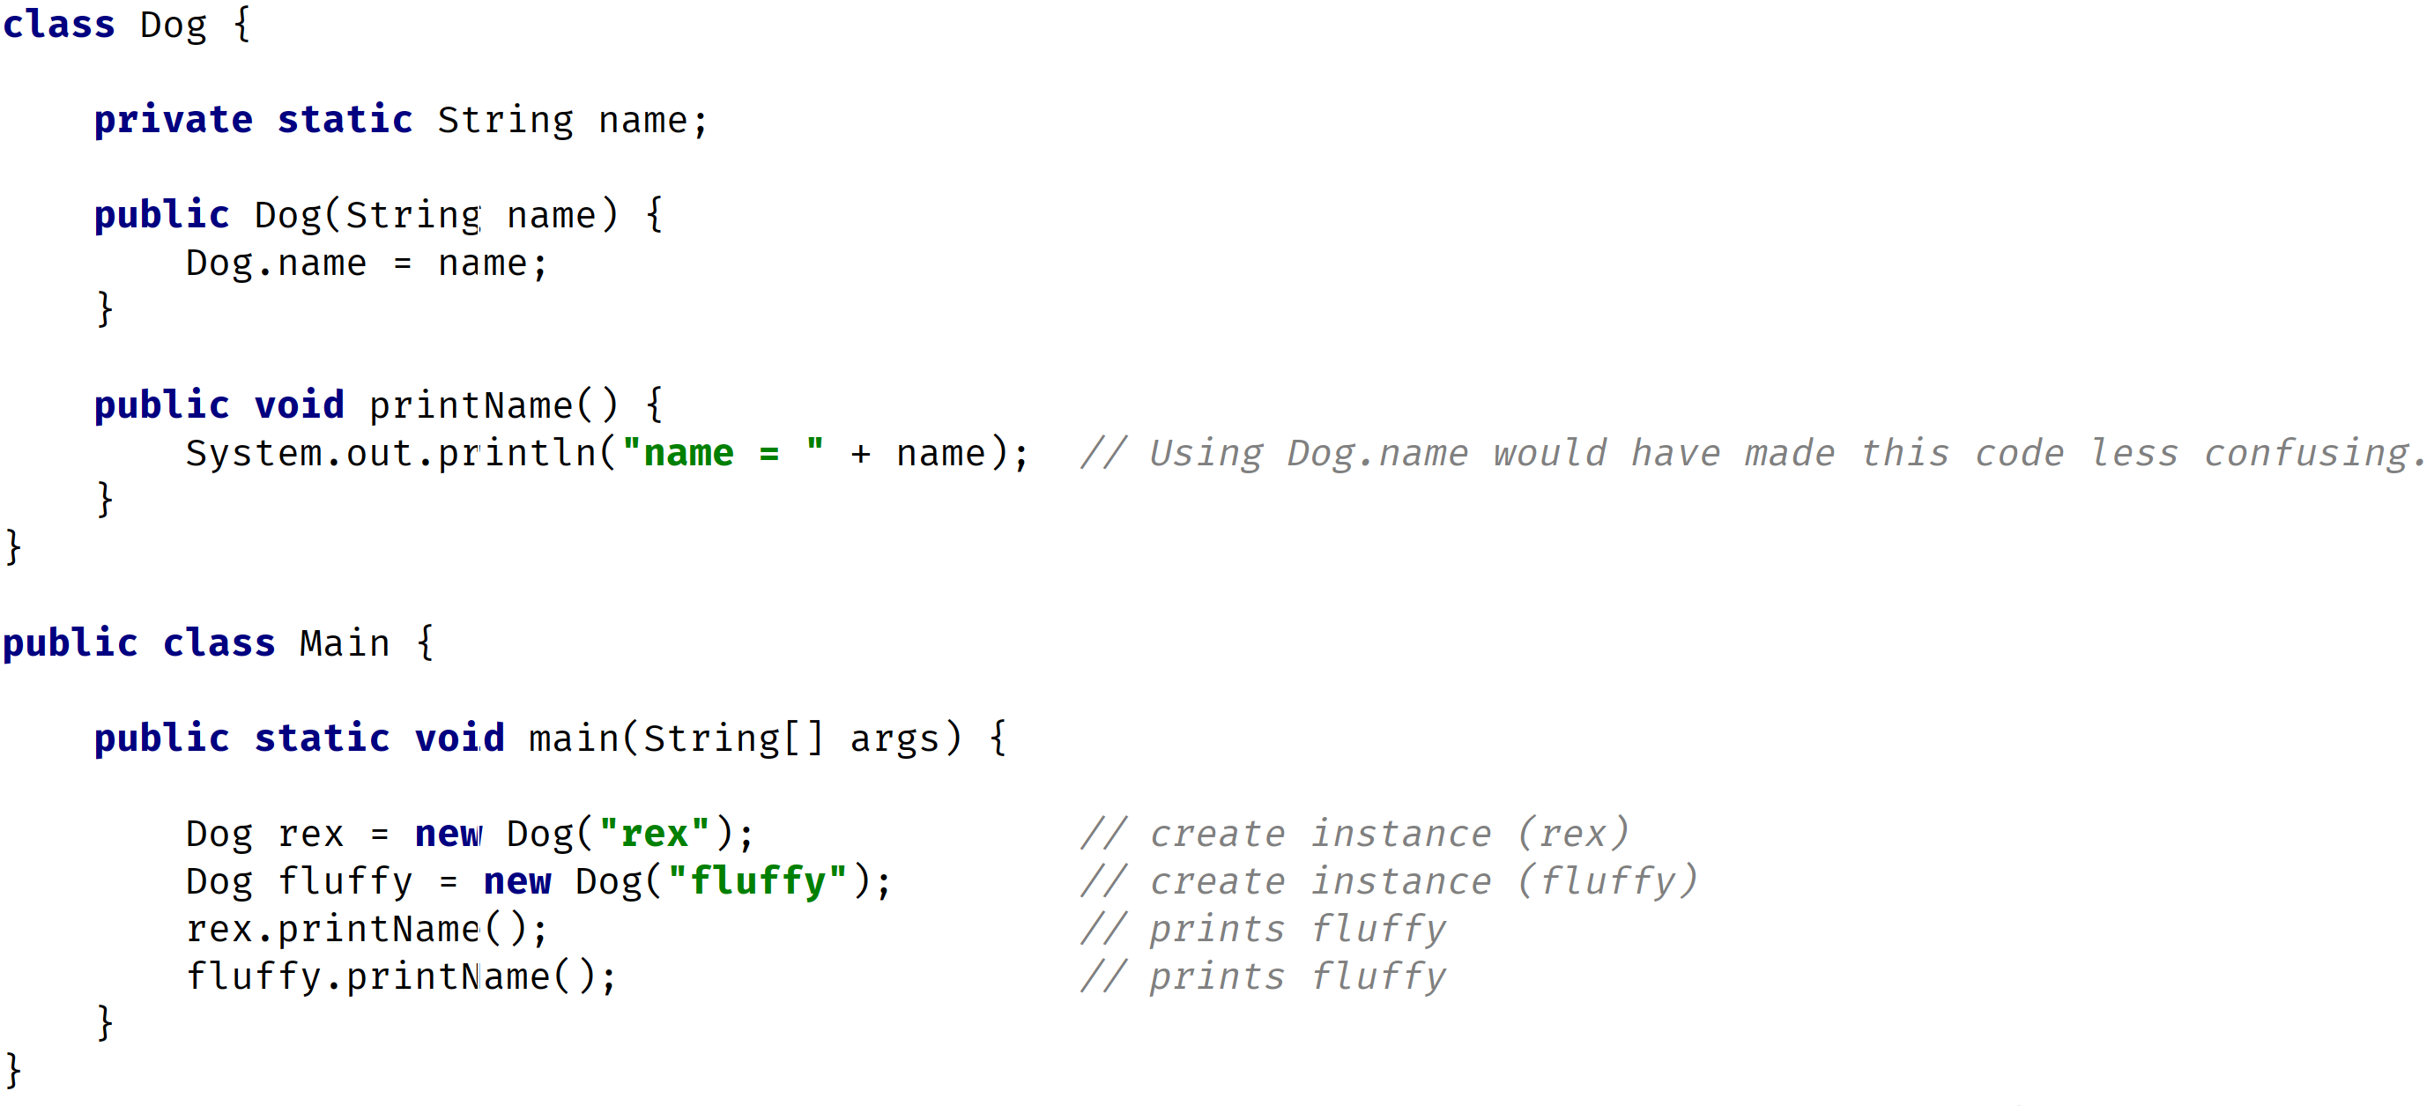
Static Variables
COMPLETE JAVA MASTERCLASS
Static vs Instance Variables

Slide 61
Instance Variables
They don't use the static keyword.
They're also known as fields, or member variables.
Instance variables belong to a specific instance of a class.
COMPLETE JAVA MASTERCLASS
Static vs Instance Variables

Slide 62
Instance Variables
Each instance has its own copy of an instance variable.
Every instance can have a different value.
Instance variables represent the state, of a specific instance of a class.
COMPLETE JAVA MASTERCLASS
Static vs Instance Variables

Slide 63
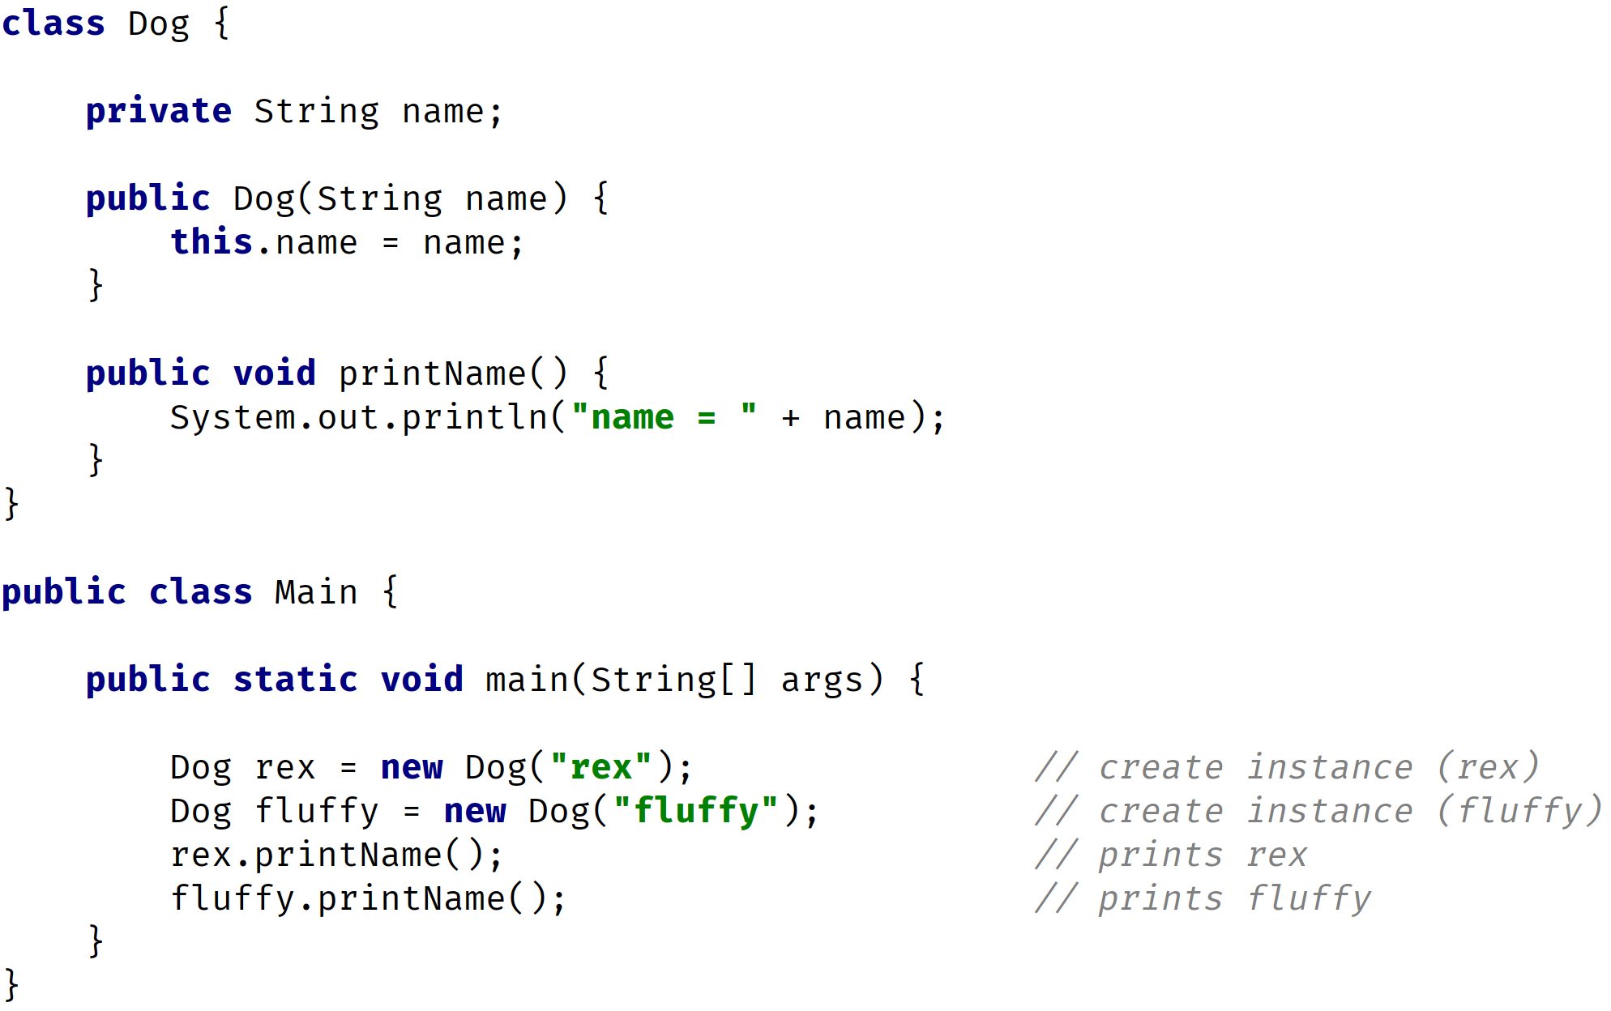
Instance Variables
COMPLETE JAVA MASTERCLASS
Static vs Instance Variables

Slide 64
Static vs. Instance Methods
Static vs. Instance Methods
COMPLETE JAVA MASTERCLASS
Static vs Instance Methods

Slide 65
Static Methods
Static methods are declared using a static modifier.
Static methods can't access instance methods and instant variables directly.
They're usually used for operations that don't require any data from an instance of the class (from 'this').
If you remember, the this keyword is the current instance of a class.
COMPLETE JAVA MASTERCLASS
Static vs Instance Methods

Slide 66
Static Methods
So inside a static method, we can't use the this keyword.
Whenever you see a method that doesn't use instance variables, that method should probably be declared as a static method.
For example, main is a static method, and it's called by the Java virtual machine when it starts the Java application.
COMPLETE JAVA MASTERCLASS
Static vs Instance Methods

Slide 67
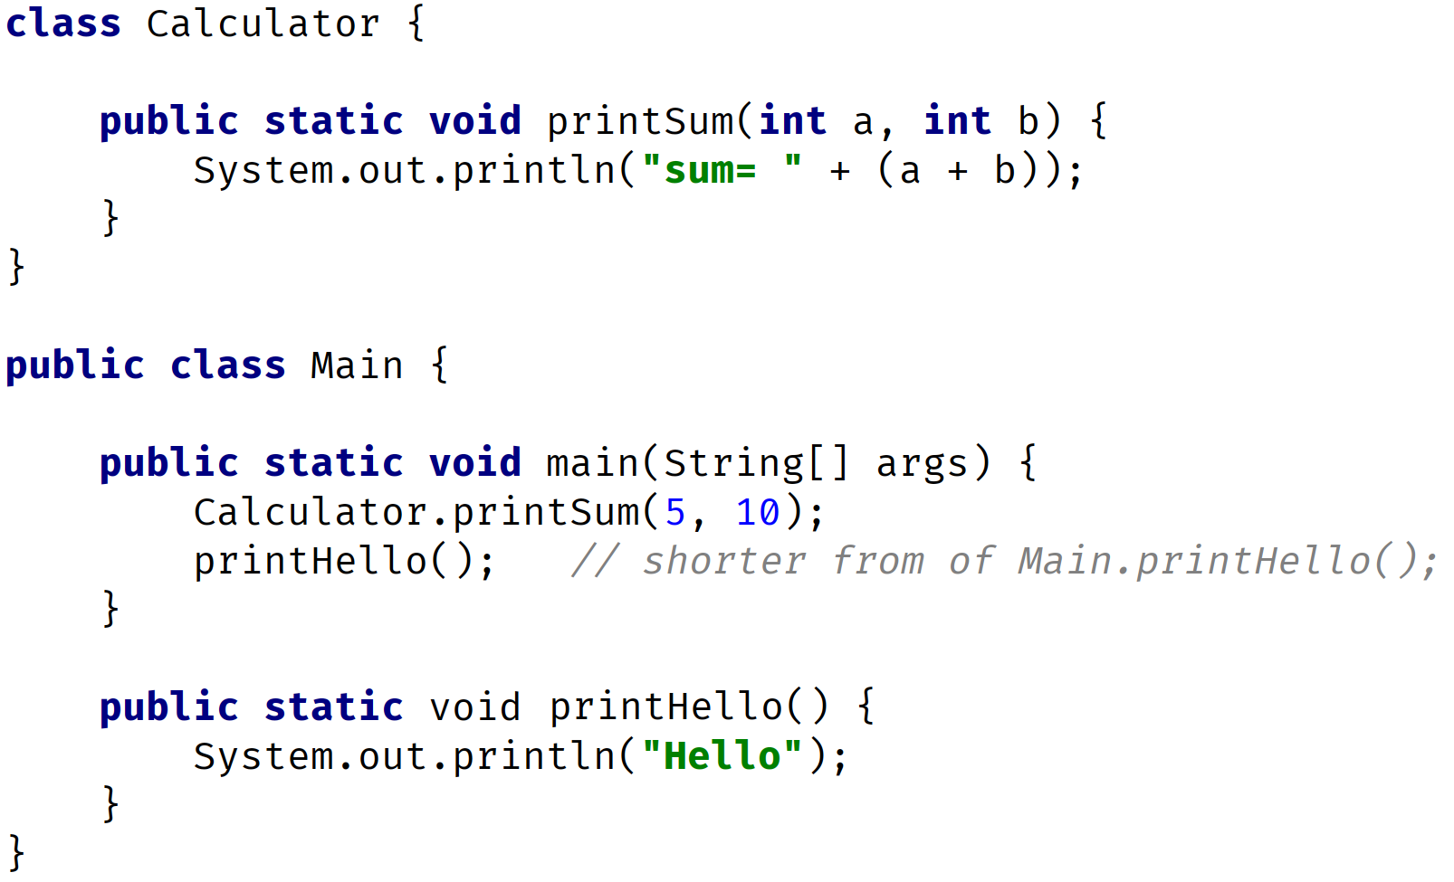
Static Methods Example
static methods are called as ClassName.methodName(); or methodName(); only if in the same class
In this example
Calculator.printSum(5,10);
printHello();
COMPLETE JAVA MASTERCLASS
Static vs Instance Methods

Slide 68
Instance Methods
Instance methods belong to an instance, of a class.
To use an instance method, we have to instantiate the class first, usually by using the new keyword.
COMPLETE JAVA MASTERCLASS
Static vs Instance Methods

Slide 69
Instance Methods
Instance methods can access instance methods and instance variables directly.
Instance methods can also access static methods and static variables directly.
COMPLETE JAVA MASTERCLASS
Static vs Instance Methods

Slide 70
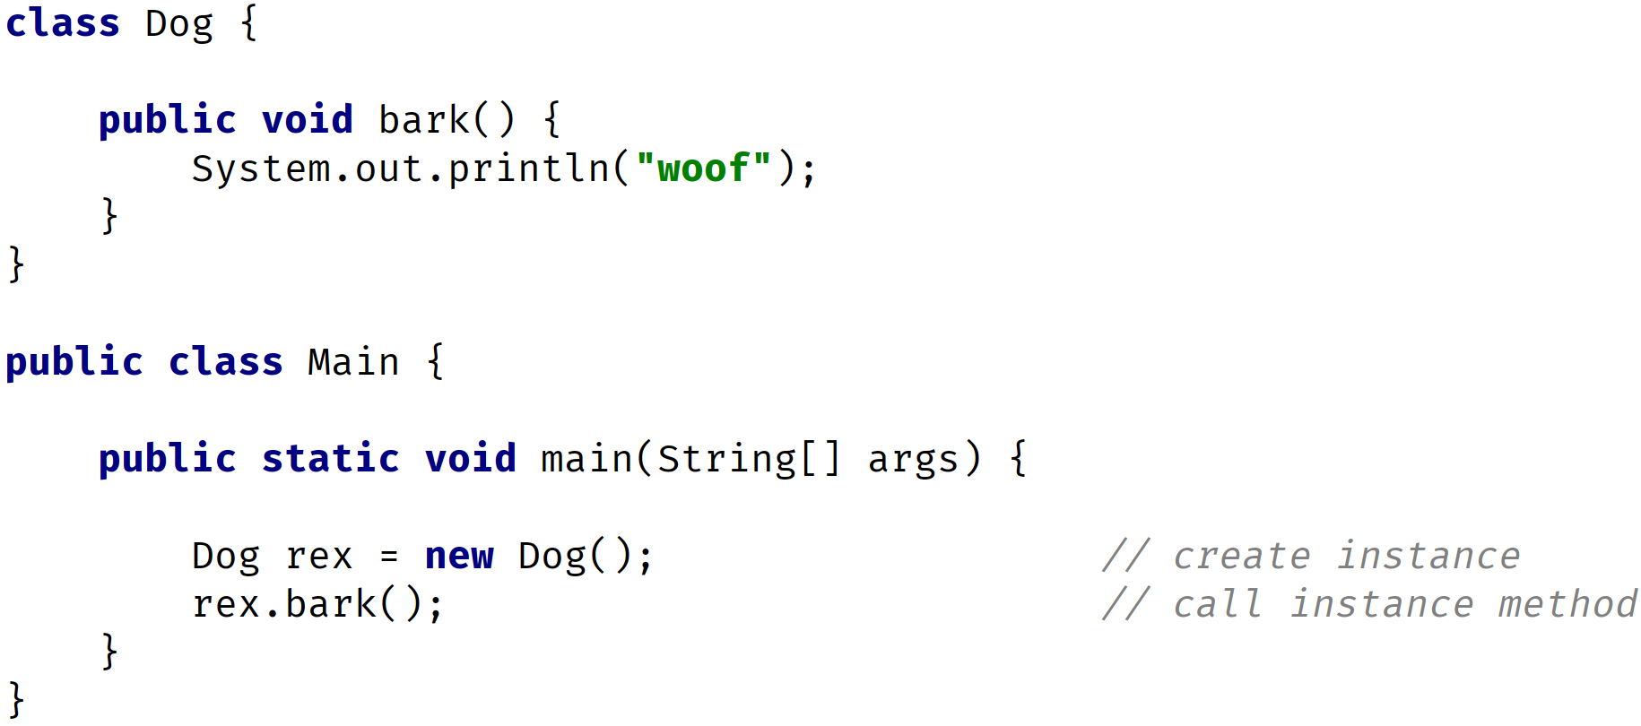
Instance Method Example
COMPLETE JAVA MASTERCLASS
Static vs Instance Methods

Slide 71
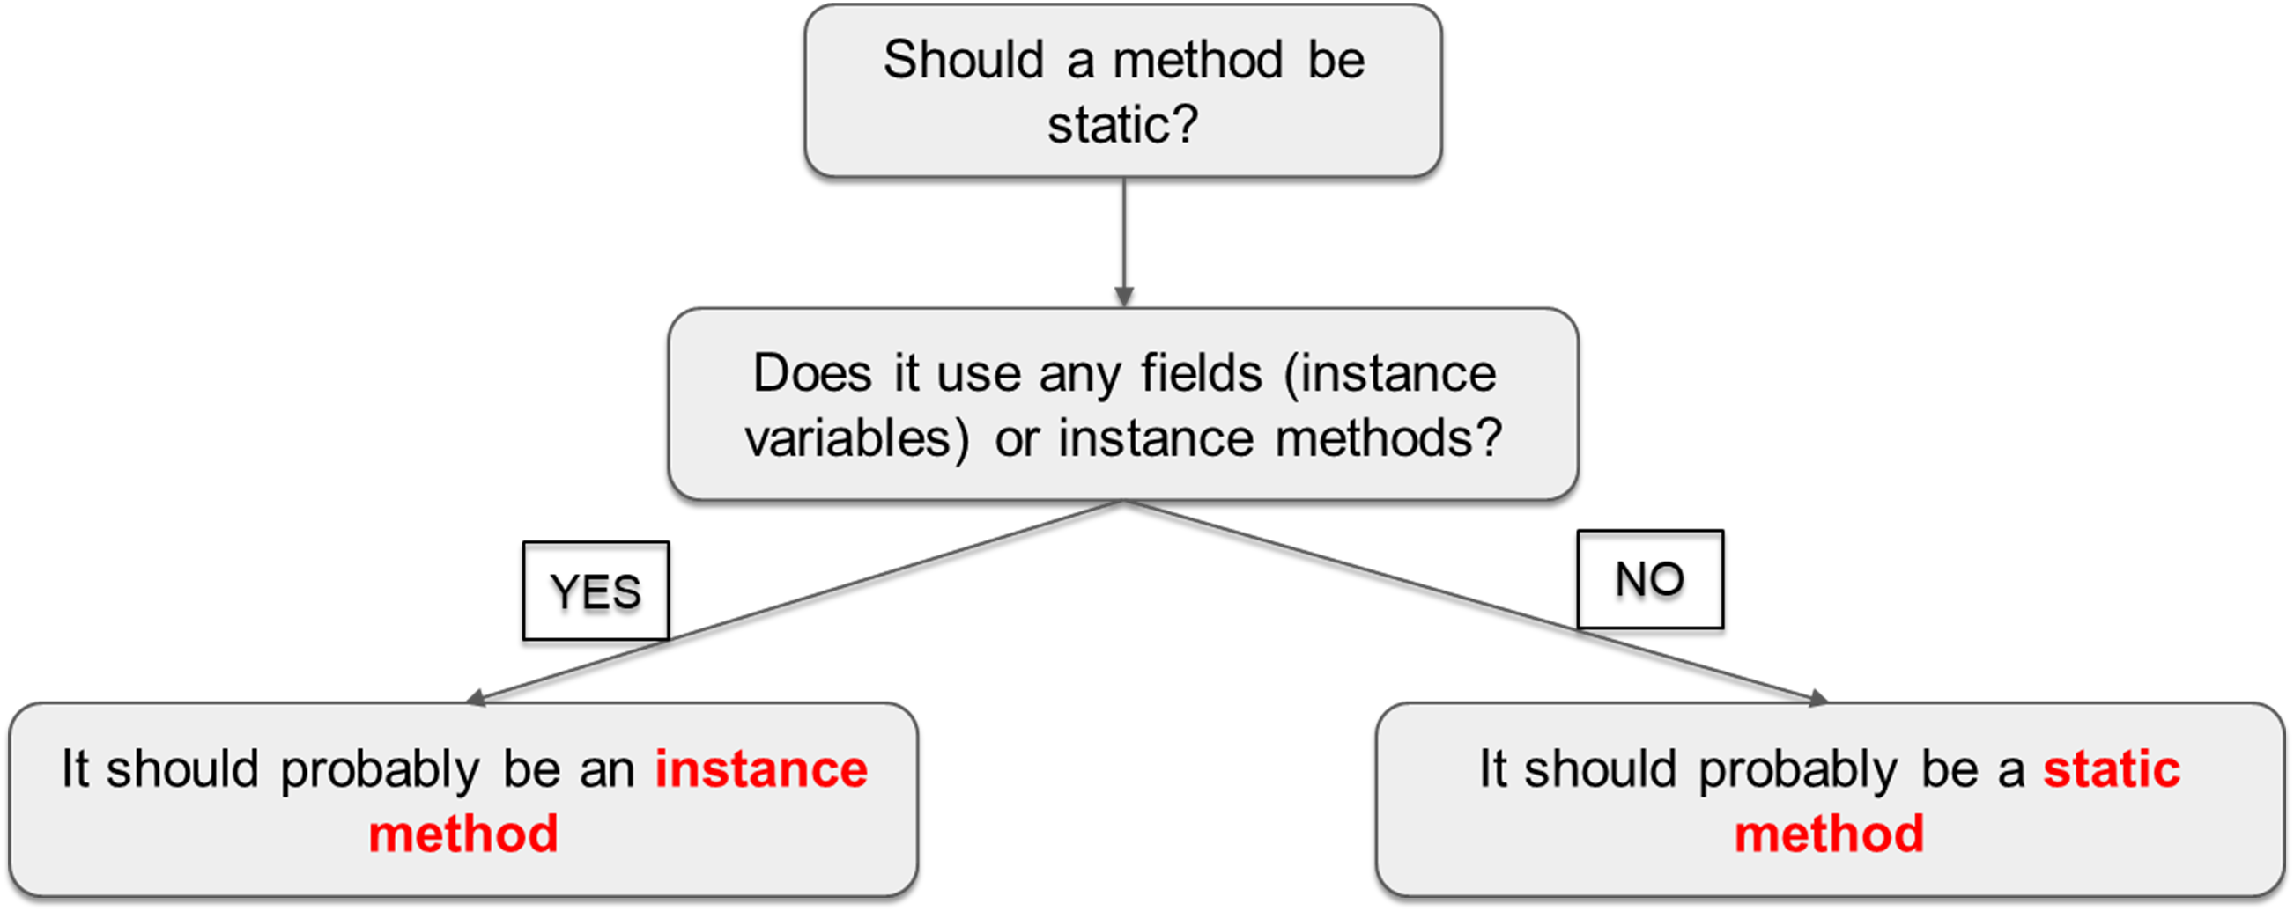
Static or Instance Method
COMPLETE JAVA MASTERCLASS
Static vs Instance Methods

Slide 72
Plain Old Java Object
A plain old Java object (whose acronym is POJO) is a class that generally only has instance fields.
It's used to house data, and pass data, between functional classes.
It usually has few, if any methods other than getters and setters.
Many database frameworks use POJO's to read data from, or to write data to, databases, files or streams.
COMPLETE JAVA MASTERCLASS
The POJO

Slide 73
Examples of POJOS
A POJO also might be called a bean, or a JavaBean.
A JavaBean is just a POJO, with some extra rules applied to it.
A POJO is sometimes called an Entity, because it mirrors database entities.
Another acronym is DTO, for Data Transfer Object.
It's a description of an object, that can be modeled as just data.
COMPLETE JAVA MASTERCLASS
The POJO

Slide 74
Support for POJO creation
There are many generation tools, that will turn a data model into generated POJO's or JavaBeans.
You've seen an example of similar code generation in IntelliJ, which allowed us to generate getters, setters, and constructors in a uniform way.
COMPLETE JAVA MASTERCLASS
The POJO

Slide 75
The Entity - The Student Table
Student
Id Name DateOfBirth ClassList
COMPLETE JAVA MASTERCLASS
The POJO

Slide 76
Annotation
Annotations are a type of metadata.
Metadata is a way of formally describing additional information about our code.
Annotations are more structured, and have more meaning, than comments.
This is because they can be used by the compiler, or other types of pre-processing functions, to get information about the code.
Metadata doesn't effect how the code runs, so this code will still run, with or without the annotation.
COMPLETE JAVA MASTERCLASS
The POJO

Slide 77
Overridden Method
An overridden method, is not the same thing as an overloaded method.
An overridden method is a special method in Java, that other classes can implement, if they use a specified method signature.
COMPLETE JAVA MASTERCLASS
The POJO

Slide 78
The POJO vs. The Record
In the last video, we talked about the Plain Old Java Object, and we showed you how it comes with a lot of what we call boilerplate code.
It's code that's repetitive and follows certain rules.
Once created, this code is rarely looked at, or modified.
In fact, there are tools that'll just regenerate all of this code, if your underlying data, or domain model changes.
COMPLETE JAVA MASTERCLASS
Java's Implicit POJO Type, The Record

Slide 79
The Record type
The record was introduced in JDK 14, and became officially part of Java in JDK 16.
It's purpose is to replace the boilerplate code of the POJO, but to be more restrictive.
Java calls them "plain data carriers".
COMPLETE JAVA MASTERCLASS
Java's Implicit POJO Type, The Record

Slide 80
The Record type
The record is a special class that contains data, that's not meant to be altered.
In other words, it seeks to achieve immutability, for the data in its members.
It contains only the most fundamental methods, such as constructors and accessors.
Best of all, you the developer, don't have to write or generate any of this code.
COMPLETE JAVA MASTERCLASS
Java's Implicit POJO Type, The Record

Slide 81
Implicit or Generated Code that Java provides
What does Java tell us about what is implicitly created, when we declare a record as we did in this code?
First, it's important to understand that the part that's in parentheses, is called the record header
The record header consists of record components, a comma delimited list of components.
COMPLETE JAVA MASTERCLASS
Java's Implicit POJO Type, The Record

Slide 82
Implicit or Generated Code that Java provides
For each component in the header, Java generates:
A field with the same name and declared type as the record component.
The field is declared private and final.
The field is sometimes referred to as a component field.
COMPLETE JAVA MASTERCLASS
Java's Implicit POJO Type, The Record

Slide 83
Implicit or Generated Code that Java provides
Java generates a toString method that prints out each attribute in a formatted String.
In addition to creating a private final field for each component, Java generates a public accessor method for each component.
This method has the same name and type of the component, but it doesn't have any kind of special prefix, no get, or is, for example.
The accessor method, for id in this example, is simply id().
COMPLETE JAVA MASTERCLASS
Java's Implicit POJO Type, The Record

Slide 84
Why have an immutable record?
Why is the record built to be immutable?
There are more use cases for immutable data transfer objects, and keeping them well encapsulated.
You want to protect the data from unintended mutations.
COMPLETE JAVA MASTERCLASS
Java's Implicit POJO Type, The Record

Slide 85
POJO vs. Record
If you want to modify data on your class, you won't be using the record.
You can use the code generation options for the POJO, as we showed in the earlier video.
But if you're reading a whole lot of records, from a database or file source, and simply passing this data around, then the record is a big improvement.
COMPLETE JAVA MASTERCLASS
Java's Implicit POJO Type, The Record

Slide 86
Java's new type, the record
We've only touched on some of the features of the record, to give you an introduction.
When we do talk more about the final keyword, and immutability of data, especially as it may be affected by concurrent threads, we'll be revisiting this type.
We'll also be showing it to you in action, when we get to the Database and I/O sections of this course.
COMPLETE JAVA MASTERCLASS
Java's Implicit POJO Type, The Record

Slide 87
Inheritance
What is Inheritance, and why is it so powerful?
We can look at Inheritance as a form of code re-use.
It's a way to organize classes into a parent-child hierarchy, which lets the child inherit (re-use), fields and methods from its parent.
COMPLETE JAVA MASTERCLASS
Inheritance - Part 1

Slide 88
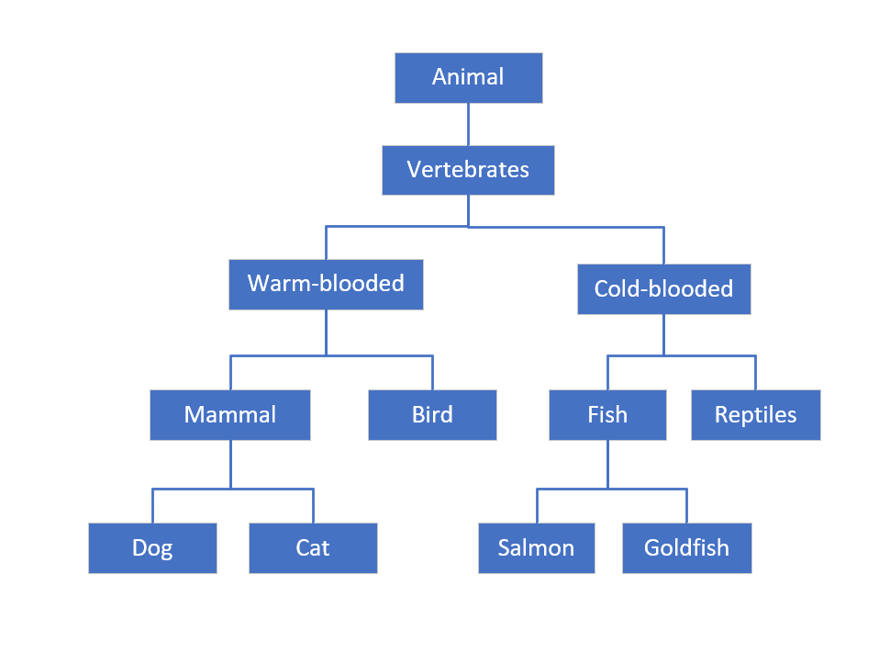
Inheritance
Each box on this diagram represents a Class.
The most generic, or base class, starts at the top of the hierarchy.
Every class below it is a subclass.
So Animal is the base class. All the other classes can be said to be subclasses of Animal.
A parent can have multiple children, as we see with Mammal, which is the parent of Dog and Cat.
A child can only have one direct parent, in Java
But it will inherit from its parent class's parent, and so on.
COMPLETE JAVA MASTERCLASS
Inheritance - Part 1

Slide 89
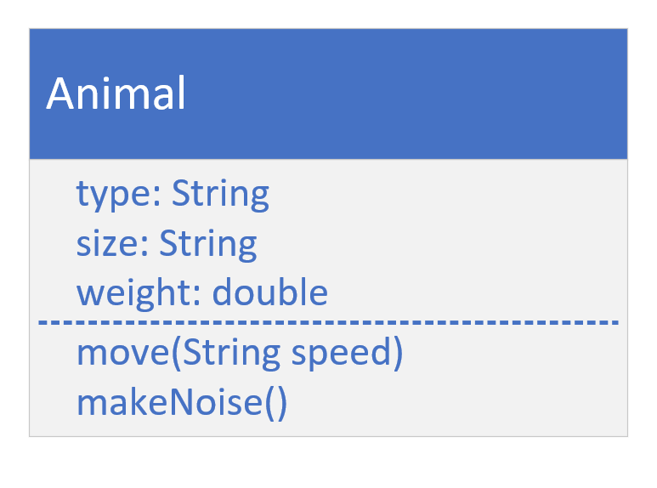
The Animal class
A class diagram, allows us to design our classes before we build them.
This diagram shows the Animal class, with the attributes we think that every kind of animal has.
Below the fields, we have the behavior that animals have in common, move, and makeNoise.
COMPLETE JAVA MASTERCLASS
Inheritance - Part 1

Slide 90
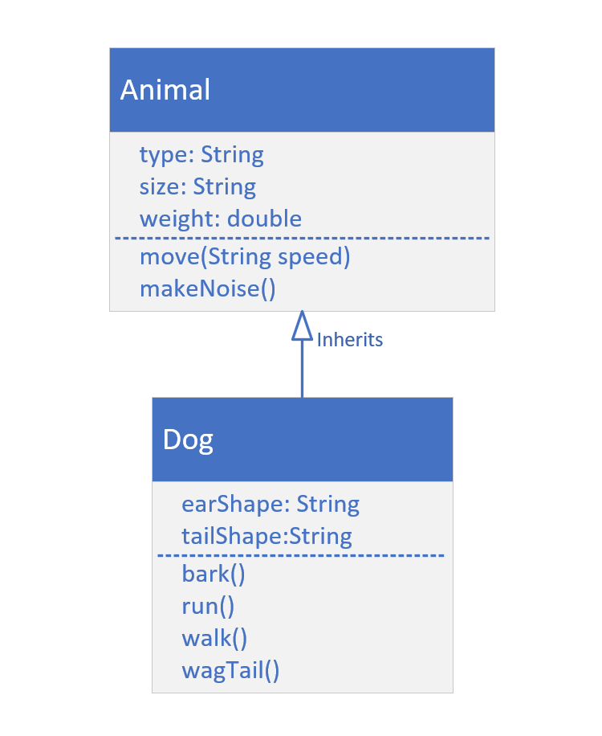
Class Model for Animal and Dog
Dog inherits from Animal.
In other words, Dog 'IS A' type of Animal.
When we create a Dog object, it will inherit Animal's attributes (type, size and weight).
This is also true for Animal's methods. Dog will inherit these as well.
We can specialize the Dog class with its own fields and behavior.
COMPLETE JAVA MASTERCLASS
Inheritance - Part 1

Slide 91
extends
Using extends specifies the superclass (or the parent class) of the class we're declaring.
We can say Dog is a subclass, or child class, of Animal.
We can say Animal is a parent, or super class, of Dog.
A class can specify one, and only one, class in its extends clause.
COMPLETE JAVA MASTERCLASS
Inheritance - Part 1

Slide 92
super()
super() is a lot like this().
It's a way to call a constructor on the super class, directly from the sub class's constructor.
Like this(), it has to be the first statement of the constructor.
Because of that rule, this() and super() can never be called from the same constructor.
COMPLETE JAVA MASTERCLASS
Inheritance - Part 1

Slide 93
super()
If you don't make a call to super(), then Java makes it for you, using super's default constructor.
If your super class doesn't have a default constructor, than you must explicitly call super() in all of your constructors, passing the right arguments to that constructor.
COMPLETE JAVA MASTERCLASS
Inheritance - Part 1

Slide 94
Inheritance in Java
We introduced you to the concept of Inheritance, and showed you how to implement it in Java, using the extends keyword.
We talked about using the statement super() to call the constructor on the super class.
COMPLETE JAVA MASTERCLASS
Inheritance - Part 2

Slide 95
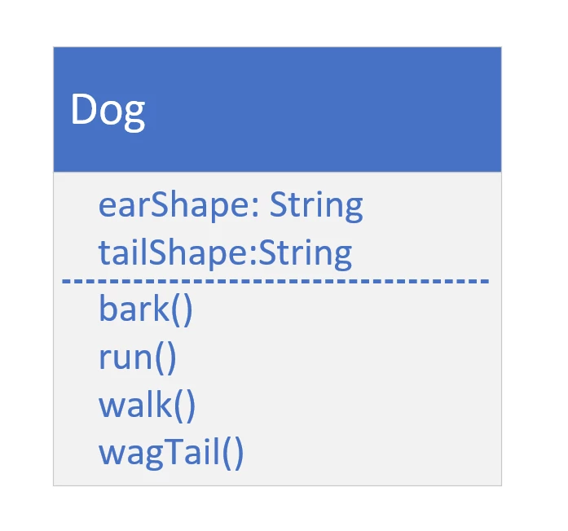
The Dog Class
COMPLETE JAVA MASTERCLASS
Inheritance - Part 2

Slide 96
Code Re-use
All subclasses can execute methods, even though the code is declared on the parent class.
The code doesn't have to be duplicated in each subclass.
We can use code, from the parent.
Or we can change that code for the subclass.
COMPLETE JAVA MASTERCLASS
Inheritance - Part 2

Slide 97
Overriding a method
Overriding a method is when you create a method on a subclass, which has the same signature as a method on a super class.
You override a parent class method, when you want the child class to show different behavior for that method.
COMPLETE JAVA MASTERCLASS
Inheritance - Part 2

Slide 98
Overridden method
The overridden method can do one of three things:
It can implement completely different behavior, overriding the behavior of the parent.
It can simply call the parent class's method, which is somewhat redundant to do.
Or the method can call the parent class's method, and include other code to run, so it can extend the functionality for the Dog, for that behavior.
COMPLETE JAVA MASTERCLASS
Inheritance - Part 2

Slide 99

Class Diagram for Dog and Animal
COMPLETE JAVA MASTERCLASS
Inheritance - Part 3

Slide 100
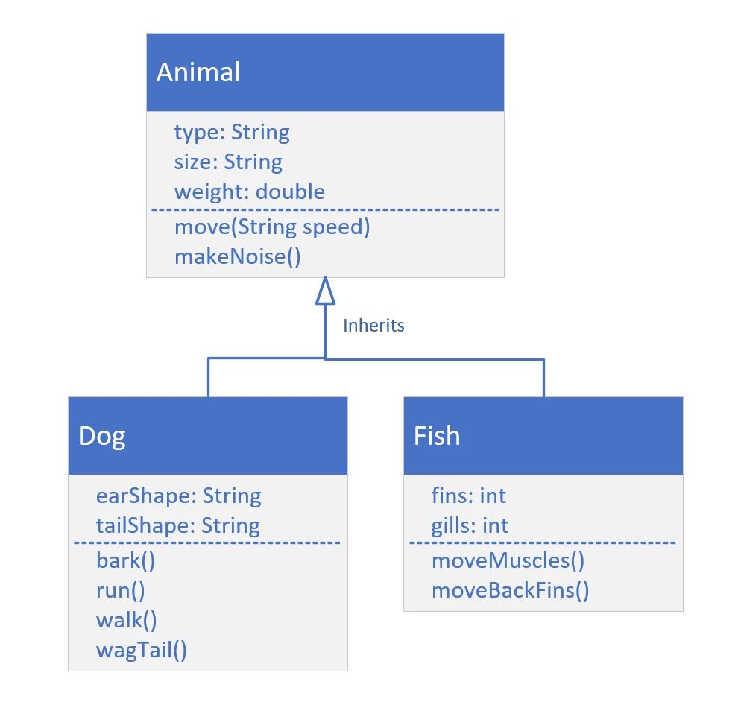
Class Diagram with additional class, Fish
COMPLETE JAVA MASTERCLASS
Inheritance - Part 3

Slide 101
Polymorphism
Polymorphism simply means 'many forms’.
And as you've seen, some advantages of Polymorphism are:
It makes code simpler.
It encourages code extensibility.
COMPLETE JAVA MASTERCLASS
Inheritance - Part 3

Slide 102
Inheritance
Inheritance looks kind of interesting, but when would we really use it?
Well, it turns out, in Java, we've been using Inheritance all along.
COMPLETE JAVA MASTERCLASS
What is java.lang.Object?

Slide 103
java.lang.Object
This is because every class you create in Java, intrinsically extends a special Java class.
This class is named Object, and it's in the java.lang package.
Ok, that's confusing, a class called Object?
Let's see what Java has to say about this class.
We'll use the link to Java's Application Programming Interface (API) for this class, which you can find in the resources section of this video.
COMPLETE JAVA MASTERCLASS
What is java.lang.Object?

Slide 104
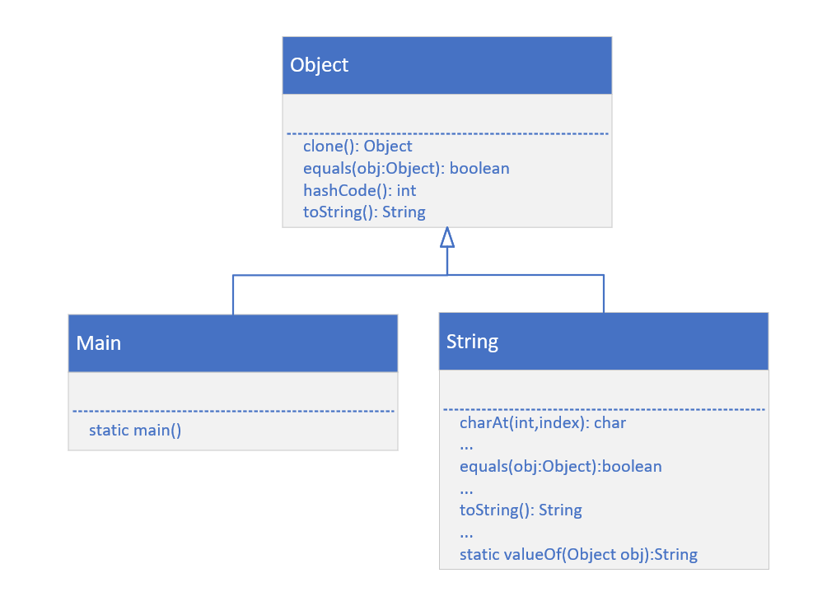
Every Class inherits from Object
This slide shows that our Main class inherits from, or is a subclass of Object, as also is String.
The String class has over 60 methods!
The String class overrides several methods on Object, two of which are equals(), and toString().
COMPLETE JAVA MASTERCLASS
What is java.lang.Object?

Slide 105
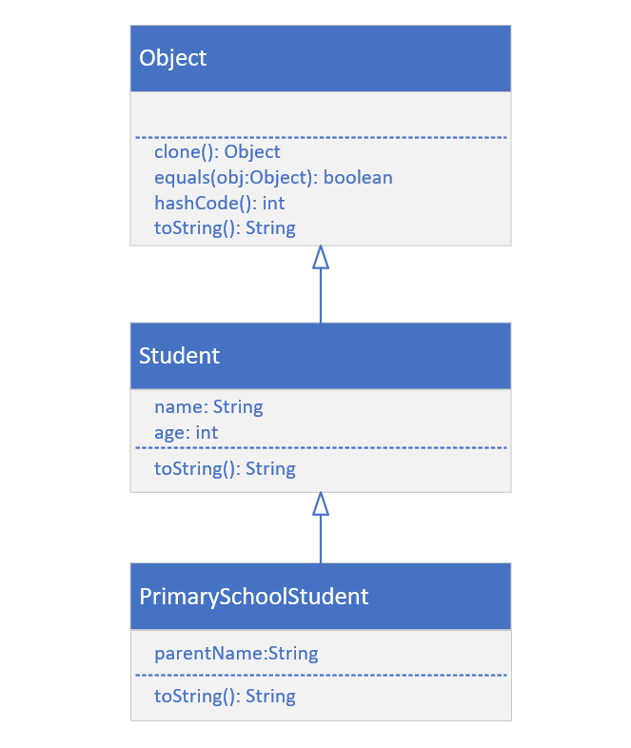
Class Diagram for Student and PrimarySchoolStudent
We've already built Student, which inherits from Object implicitly.
Next, we'll build PrimarySchoolStudent, which will inherit from Student.
COMPLETE JAVA MASTERCLASS
What is java.lang.Object?

Slide 106
Inheritance Challenge
Now it's time for a challenge, to solidify your understanding, of what inheritance is.
For this challenge, I'm going to show you a class diagram, like we worked with in the previous videos.
COMPLETE JAVA MASTERCLASS
Inheritance Challenge - Part 1

Slide 107
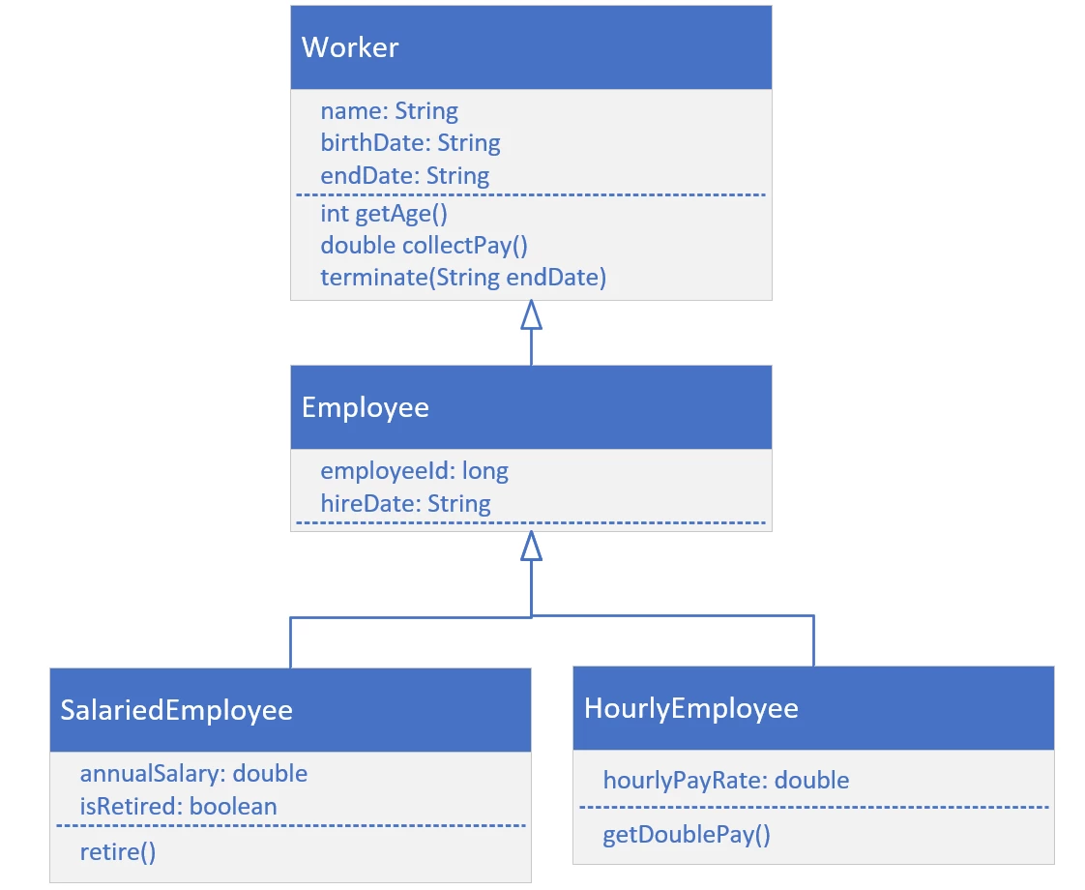
Inheritance Challenge
Your challenge is to create the Worker class, the Employee class, and either the SalariedEmployee, or the HourlyEmployee class.
For each class, create the attributes and methods shown on this diagram.
Create a main method that will create either a SalariedEmployee or HourlyEmployee, and call the methods, getAge, collectPay, and the method shown for the specific type of class you decide to implement.
COMPLETE JAVA MASTERCLASS
Inheritance Challenge - Part 1

Slide 108
Inheritance Challenge
So if you implement SalariedEmployee, then execute retire().
If you implement HourlyEmployee, then execute getDoublePay().
COMPLETE JAVA MASTERCLASS
Inheritance Challenge - Part 1

Slide 109
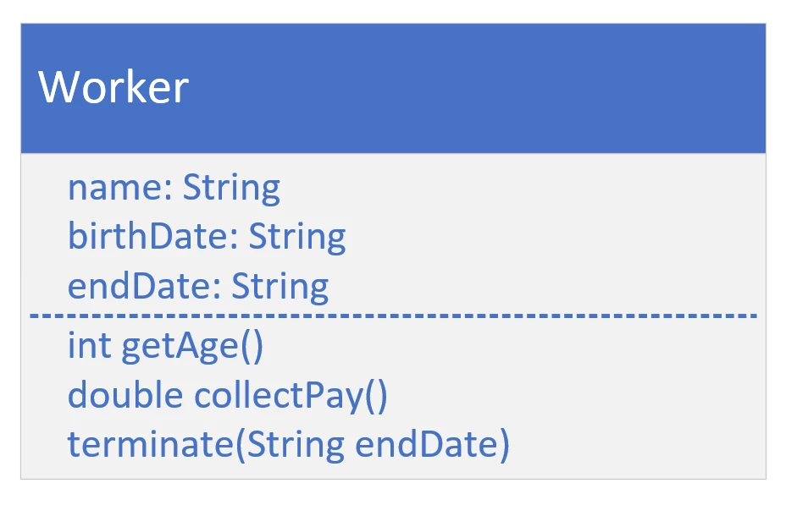
Worker class
COMPLETE JAVA MASTERCLASS
Inheritance Challenge - Part 1

Slide 110
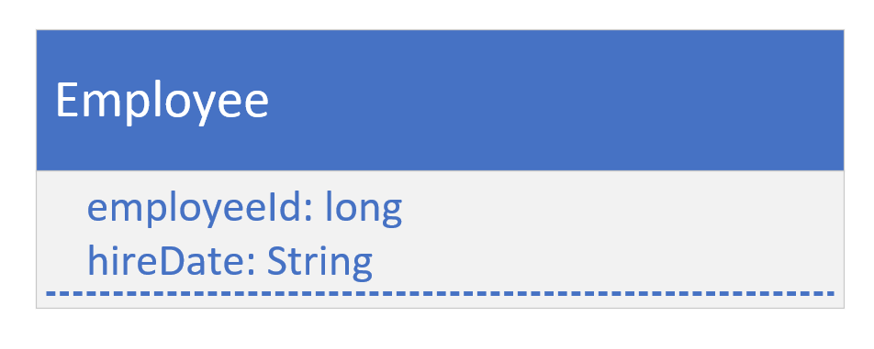
the Employee Class
For this class, we have specific Employee attributes, employeeId, and hireDate.
For simplicity's sake, we haven't included any methods specific to an Employee.
COMPLETE JAVA MASTERCLASS
Inheritance Challenge - Part 1

Slide 111
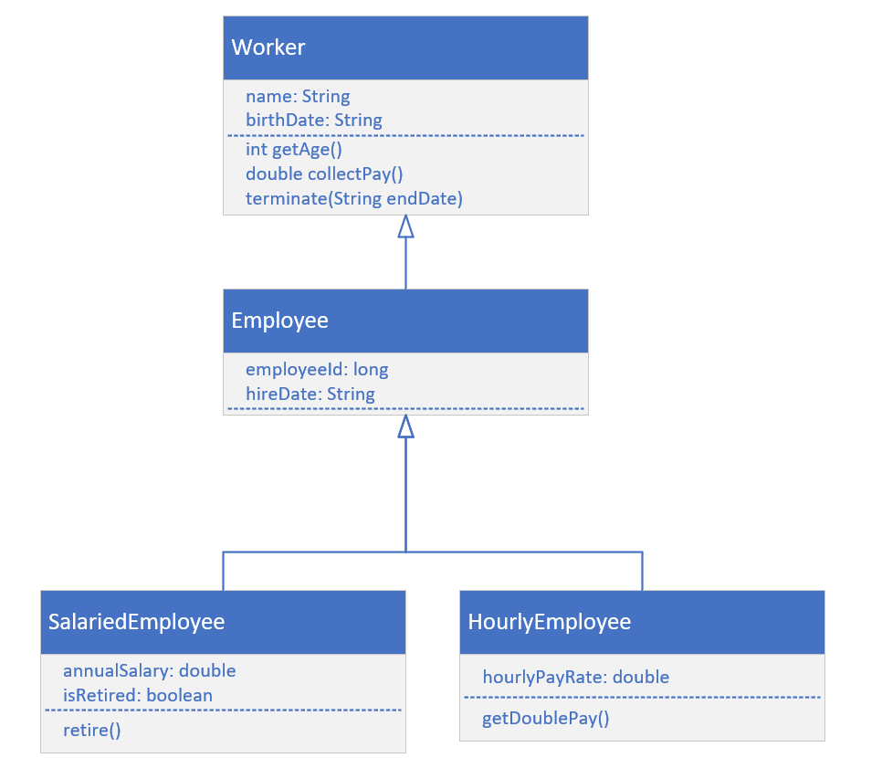
Inheritance Challenge, Continued
It's time to build a more specific type of Employee, one that's Salaried, or one that's Hourly.
A salaried employee, is paid based on some percentage of his or her salary.
It this person is retired, then the salary may be 100 percent, but it is generally reduced somewhat.
An hourly employee, is paid by the hours worked, and the hourly rate they agreed to work for.
An hourly employee may also get double pay, if they work over a certain amount of hours.
COMPLETE JAVA MASTERCLASS
Inheritance Challenge Part 2

Slide 112
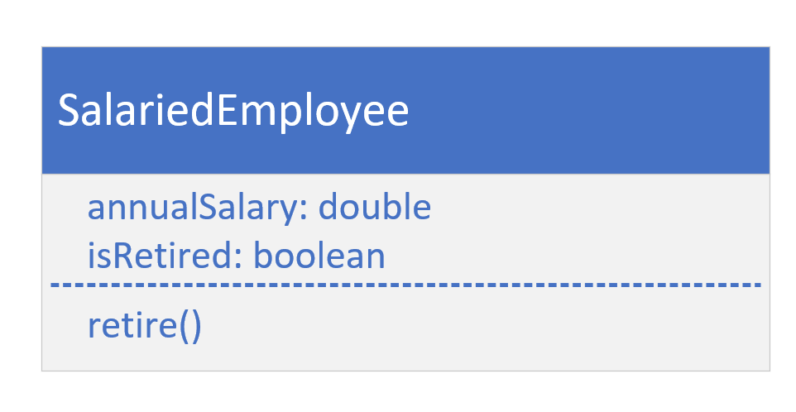
SalariedEmployee
COMPLETE JAVA MASTERCLASS
Inheritance Challenge Part 2

Slide 113
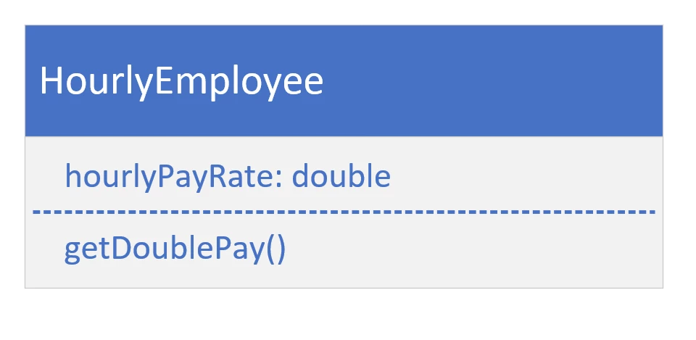
HourlyEmployee class
COMPLETE JAVA MASTERCLASS
Inheritance Challenge Part 2

Slide 114
Making the call
Each method call, made on these objects, points to the code that will actually be executed.
When joe or mary call getAge(), the method's implementation is on Worker, and not overridden by any other class, so the getAge method on Worker is executed.
Joe
A SalariedEmployee
Mary
An HourlyEmployee
Object
toString()
Worker
getAge
collectPay
@Override toString()
getAge()
getAge()
toString()
Employee
@Override toString()
getJobReview
toString()
collectPay()
collectPay()
SalariedEmployee
@Override collectPay
retire
HourlyEmployee
@Override collectPay
getDoublePay()
retire()
getDoubePay()
COMPLETE JAVA MASTERCLASS
Inheritance Challenge Part 2

Slide 115
Making the call
When joe or mary call toString(), this method has been overridden twice, first by Worker, and then by Employee. But it wasn't overridden by either SalariedEmployee, or HourlyEmployee, so the method from the Employee class is the one that's used.
Joe
A SalariedEmployee
Mary
An HourlyEmployee
Object
toString()
Worker
getAge
collectPay
@Override toString()
getAge()
getAge()
toString()
Employee
@Override toString()
getJobReview
toString()
collectPay()
collectPay()
SalariedEmployee
@Override collectPay
retire
HourlyEmployee
@Override collectPay
getDoublePay()
retire()
getDoubePay()
COMPLETE JAVA MASTERCLASS
Inheritance Challenge Part 2

Slide 116
Making the call
Looking at the collectPay method, this method was overridden by both SalariedEmployee, and HourlyEmployee.
Joe will execute the method on SalariedEmployee.
Mary will execute the one on HourlyEmployee.
Joe
A SalariedEmployee
Mary
An HourlyEmployee
Object
toString()
Worker
getAge
collectPay
@Override toString()
getAge()
getAge()
toString()
Employee
@Override toString()
getJobReview
toString()
collectPay()
collectPay()
SalariedEmployee
@Override collectPay
retire
HourlyEmployee
@Override collectPay
getDoublePay()
retire()
getDoubePay()
COMPLETE JAVA MASTERCLASS
Inheritance Challenge Part 2

Slide 117
Making the call
SalariedEmployee has a method, retire, that's not overridden, meaning it's only on that class, it's a method specific to a Salaried employee.
HourlyEmployee has its own method, getDoublePay, which wouldn't apply to a Salaried employee, so we declared it on this class, and not in any super class.
Joe
A SalariedEmployee
Mary
An HourlyEmployee
Object
toString()
Worker
getAge
collectPay
@Override toString()
getAge()
getAge()
toString()
Employee
@Override toString()
getJobReview
toString()
collectPay()
collectPay()
SalariedEmployee
@Override collectPay
retire
HourlyEmployee
@Override collectPay
getDoublePay()
retire()
getDoubePay()
COMPLETE JAVA MASTERCLASS
Inheritance Challenge Part 2

Slide 118
this vs super
Let's discuss the difference between the this, and the super keywords.
We'll also find out about the differences between the this(), and super(), method calls.
COMPLETE JAVA MASTERCLASS
this vs super

Slide 119
this vs super
Let's start with the super, and the this keywords first.
The keyword super is used to access or call the parent class members (variables and methods).
The keyword this is used to call the current class members (variables and methods).
this is required, when we have a parameter with the same name, as an instance variable or field.
NOTE: We can use either of them anywhere in a class, except for static elements, like a static method. Any attempt to do so there, will lead to compile time errors.
COMPLETE JAVA MASTERCLASS
this vs super

Slide 120
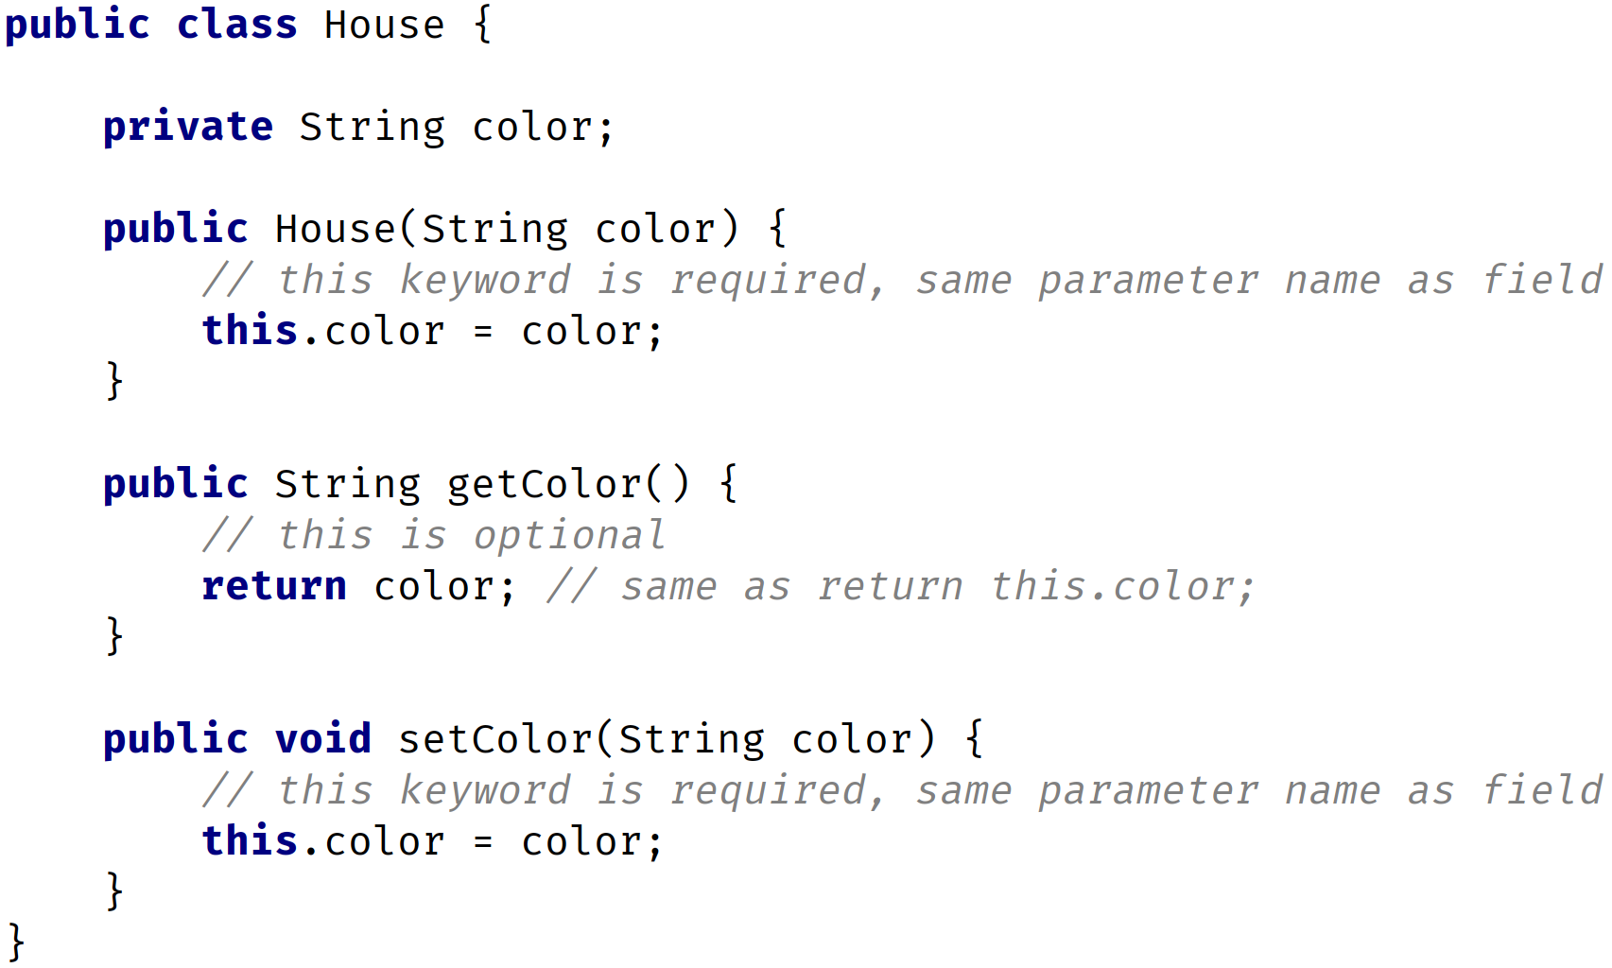
Keyword this
The keyword this, is commonly used with constructors and setters, and optionally used in getters.
In this example, we're using the this keyword in the constructor and setter, since there's a parameter with the same name, as the instance or field.
In the getter we don't have any parameters, so there's no conflict, so therefore the this keyword is optional there.
COMPLETE JAVA MASTERCLASS
this vs super

Slide 121
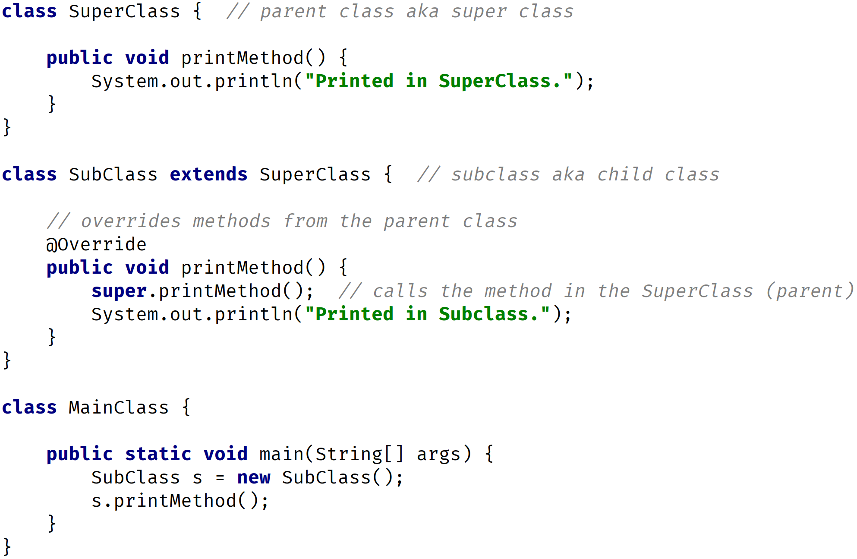
Keyword super
The keyword super, is commonly used with method overriding, when we call a method with the same name, from the parent class.
In this example, we have a method called printMethod, that calls super.printMethod.
COMPLETE JAVA MASTERCLASS
this vs super

Slide 122
this() vs super() call
In Java we've got the this() and super() call. Notice the parentheses.
These are known as calls, since it looks like a regular method call, although we're calling certain constructors.
Use this() to call a constructor, from another overloaded constructor in the same class.
The call to this() can only be used in a constructor, and it must be the first statement in a constructor.
It's used with constructor chaining, in other words when one constructor calls another constructor, and it helps to reduce duplicated code.
The only way to call a parent constructor, is by calling super(), which calls the parent constructor.
COMPLETE JAVA MASTERCLASS
this vs super

Slide 123
this() vs super() call
The Java compiler puts a default call to super(), if we don't add it, and it's always a call to the no argument constructor, which is inserted by the compiler.
The call to super() must be the first statement in each constructor.
A constructor can have a call to super() or this(), but never both.
COMPLETE JAVA MASTERCLASS
this vs super

Slide 124
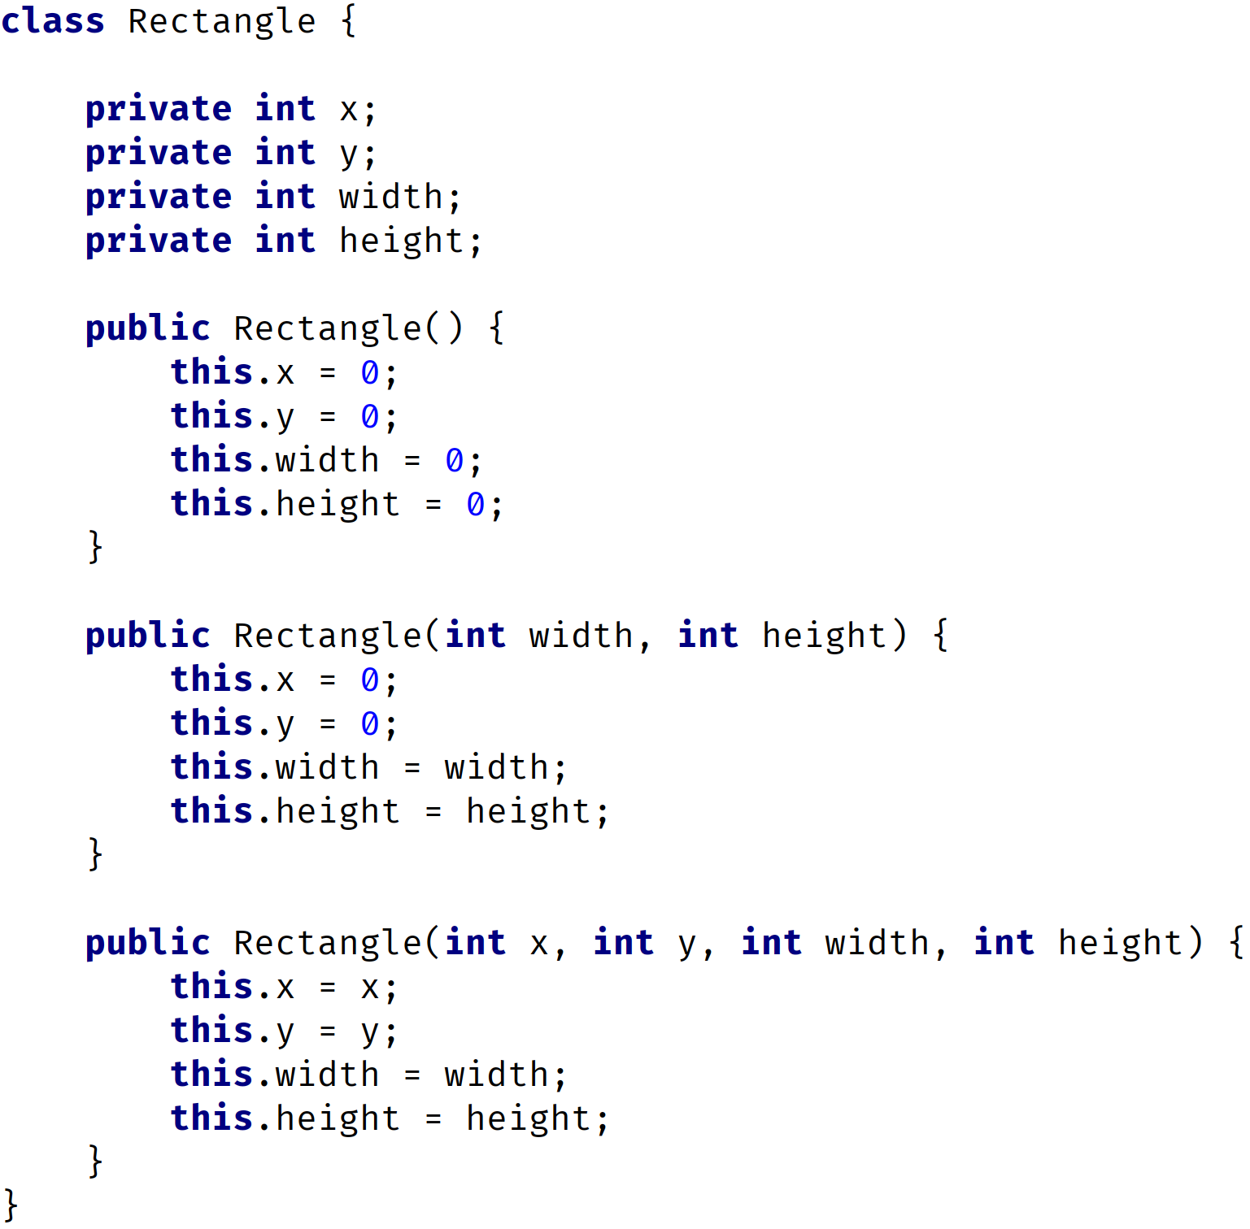
Constructors Bad Example
Here, we have three constructors.
All three constructors initialize variables.
There's repeated code in each constructor.
We're initializing variables in each constructor, with some default values.
You should never write constructors like this.
Let's look at the right way to do this, by using a this() call.
COMPLETE JAVA MASTERCLASS
this vs super

Slide 125
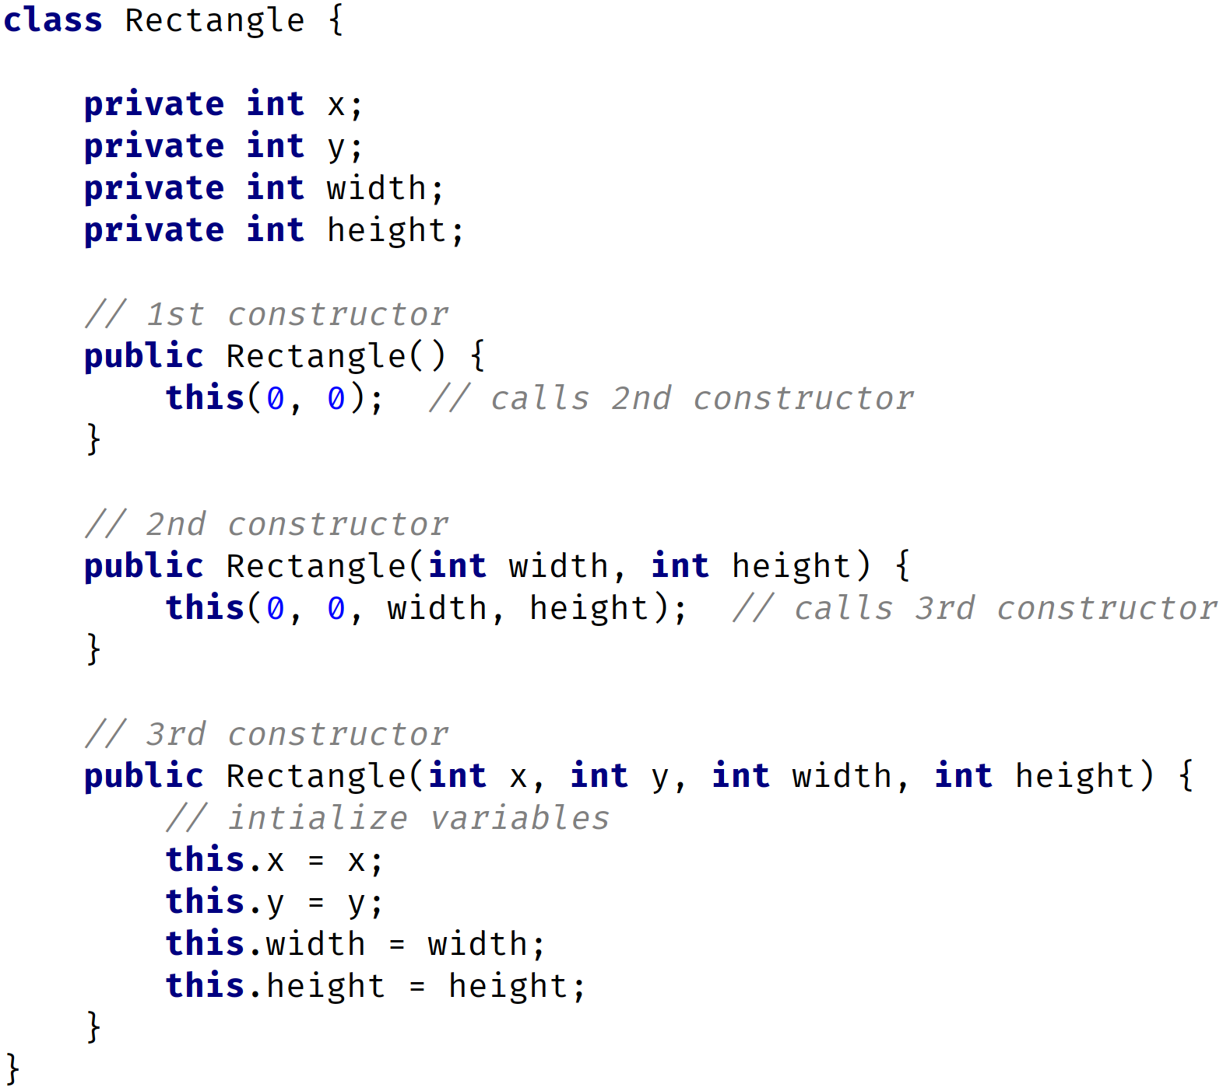
Constructors Good Example
In this example, we still have three constructors.
The 1st constructor calls the 2nd constructor, the 2nd constructor calls the 3rd constructor, and the 3rd constructor initializes the instance variables.
The 3rd constructor does all the work.
No matter what constructor we call, the variables will always be initialized in the 3rd constructor.
This is known as constructor chaining, the last constructor has the responsibility to initialize the variables.
COMPLETE JAVA MASTERCLASS
this vs super

Slide 126
Comparing Both Examples
BAD
GOOD
COMPLETE JAVA MASTERCLASS
this vs super

Slide 127
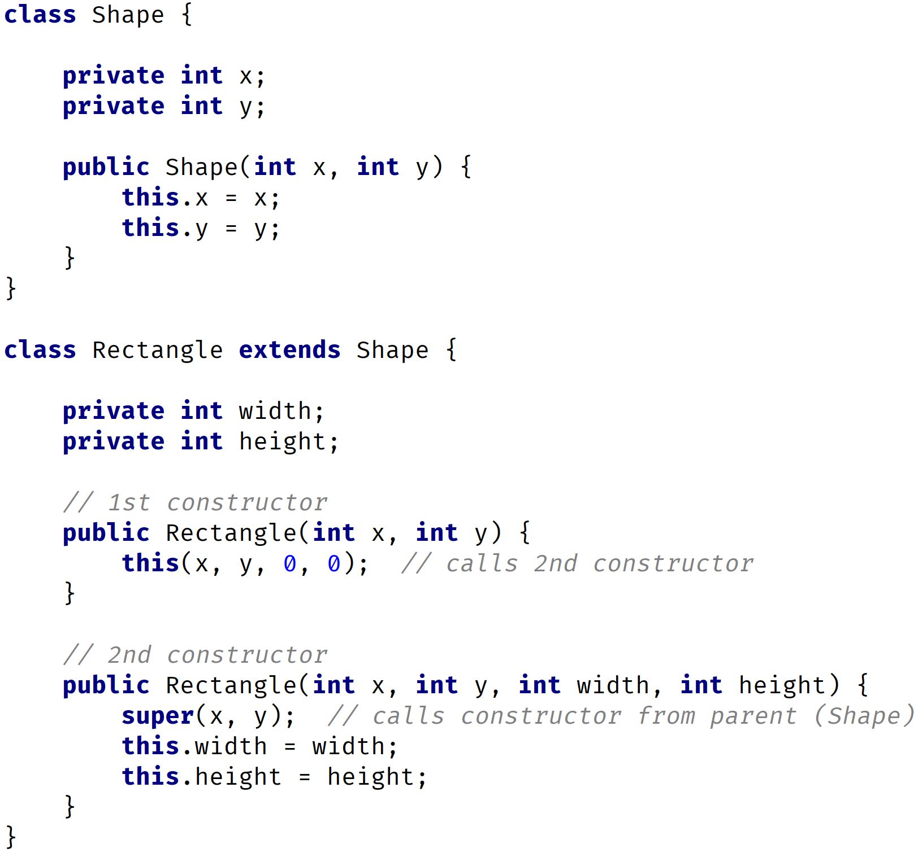
super() call example
In this example, we have a class Shape, with x and y variables, and a class Rectangle that extends Shape, with variables width and height.
In the Rectangle class, the 1st constructor is calling the 2nd constructor.
The 2nd constructor calls the parent constructor, with parameters x and y.
The parent constructor will initialize the x and y variables, while the 2nd Rectangle constructor will initialize the width and height variables.
Here, we have both the super() and this() calls.
COMPLETE JAVA MASTERCLASS
this vs super

Slide 128
Method Overriding vs Overloading
Let's review the main differences between method overriding and method overloading.
COMPLETE JAVA MASTERCLASS
Method Overloading vs Overriding Recap

Slide 129
Method Overloading
Method overloading means providing two or more separate methods, in a class, with the same name, but different parameters.
Method return type may or may not be different, and that allows us to reuse the same method name.
Overloading is very handy, it reduces duplicated code, and we don't have to remember multiple method names.
We can overload static, or instance methods.
COMPLETE JAVA MASTERCLASS
Method Overloading vs Overriding Recap

Slide 130
Method Overloading
To the code calling an overloaded method, it looks like a single method can be called, with different sets of arguments.
In actuality, each call that's made with a different set of arguments, is calling a separate method.
Java developers often refer to method overloading, as compile-time polymorphism.
This means the compiler is determining the right method to call, based on the method name and argument list.
COMPLETE JAVA MASTERCLASS
Method Overloading vs Overriding Recap

Slide 131
Method Overloading
Usually overloading happens within a single class.
But methods can also be overloaded by subclasses.
That's because, a subclass inherits one version of the method from the parent class, and then the subclass can have another overloaded version of that method.
COMPLETE JAVA MASTERCLASS
Method Overloading vs Overriding Recap

Slide 132
Method Overloading Rules
Methods will be considered overloaded if both methods follow the following rules:
Methods must have the same method name.
Methods must have different parameters.
If methods follow the rules above:
They may or may not have different return types.
They may or may not have different access modifiers.
They may or may not throw different checked or unchecked exceptions.
COMPLETE JAVA MASTERCLASS
Method Overloading vs Overriding Recap

Slide 133
Method Overriding
Method overriding, means defining a method in a child class, that already exists in the parent class, with the same signature (the same name, same arguments).
By extending the parent class, the child class gets all the methods defined in the parent class (those methods are also known as derived methods).
Method overriding is also known as Runtime Polymorphism, or Dynamic Method Dispatch, because the method that is going to be called, is decided at runtime, by the Java virtual machine.
COMPLETE JAVA MASTERCLASS
Method Overloading vs Overriding Recap

Slide 134
Method Overriding
When we override a method, it's recommended to put @Override, immediately above the method definition.
The @Override statement is not required, but it's a way to get the compiler to flag an error, if you don't actually properly override this method.
We'll get an error, if we don't follow the overriding rules correctly.
We can't override static methods, only instance methods can be overridden.
COMPLETE JAVA MASTERCLASS
Method Overloading vs Overriding Recap

Slide 135
Method Overriding Rules
A method will be considered overridden, if we follow these rules.
It must have the same name and same arguments.
The return type can be a subclass of the return type in the parent class.
It can't have a lower access modifier. In other words, it can't have more restrictive access privileges.
For example, if the parent's method is protected, then using private in the child's overridden method is not allowed. However, using public for the child's method would be allowed, in this example.
COMPLETE JAVA MASTERCLASS
Method Overloading vs Overriding Recap

Slide 136
Method Overriding Rules
There's also some important points about method overriding to keep in mind.
Only inherited methods can be overridden, in other words, methods can be overridden only in child classes.
Constructors and private methods cannot be overridden.
Methods that are final cannot be overridden.
A subclass can use super.methodName() to call the superclass version of an overridden method.
COMPLETE JAVA MASTERCLASS
Method Overloading vs Overriding Recap

Slide 137
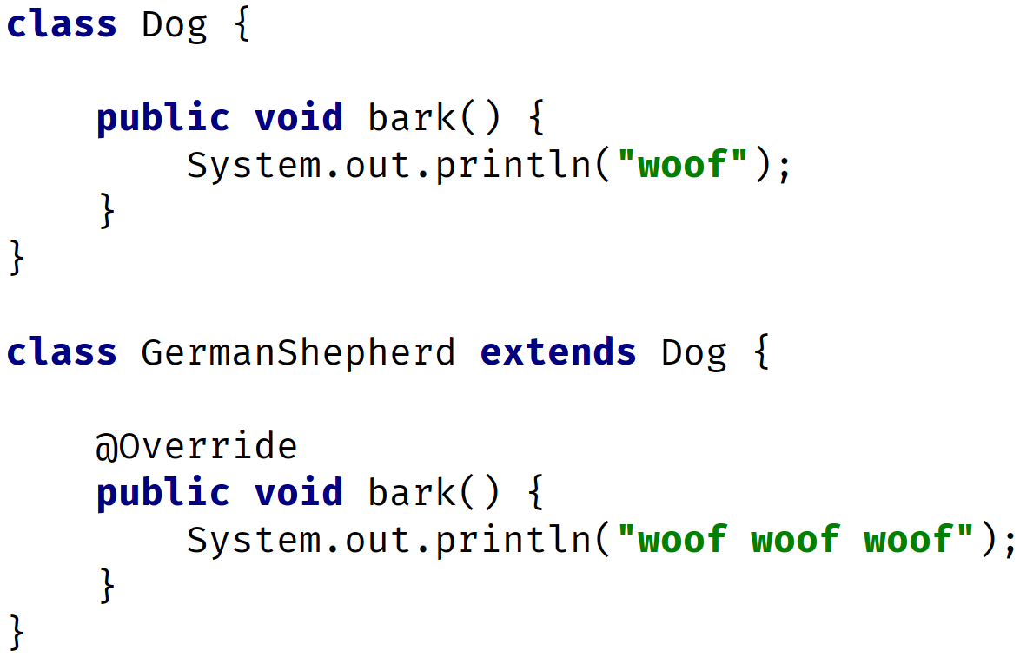
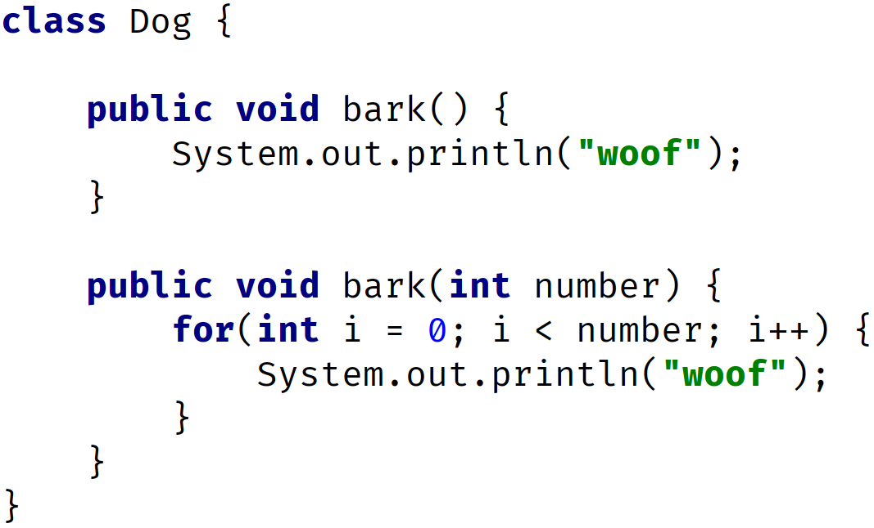
Method Overriding vs. Overloading
OVERRIDING
same name
same parameters
OVERLOADING
same name
different parameters
COMPLETE JAVA MASTERCLASS
Method Overloading vs Overriding Recap

Slide 138
Method Overriding vs. Overloading
Method Overloading | Method Overriding
Provides functionality to reuse a method name with different parameters. | Used to override a behavior which the class has inherited from the parent class.
Usually in a single class but may also be used in a child class. | Always in two classes that have a child-parent or IS-A relationship.
Must have different parameters. | Must have the same parameters and same name.
May have different return types. | Must have the same return type or covariant return type(child class).
May have different access modifiers(private, protected, public). | Must NOT have a lower modifier but may have a higher modifier.
May throw different exceptions. | Must NOT throw a new or broader checked exception.
COMPLETE JAVA MASTERCLASS
Method Overloading vs Overriding Recap

Slide 139
Covariant Return Type
The return type of an overridden method can be the same type as the parent method's declaration.
But it can also be a subclass.
The term, covariant return type, is more appropriate.
COMPLETE JAVA MASTERCLASS
Method Overloading vs Overriding Recap

Slide 140
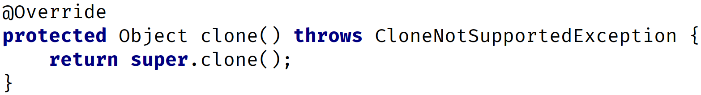
Covariant Return Type
We briefly mentioned, in a previous video, that there's a clone method on the class Object, that all classes inherit from.
A simplified look at this declaration, for our purposes, is shown below.
And if you overrode this method, by using IntelliJ's code generation tools, it would generate this code in your class:
COMPLETE JAVA MASTERCLASS
Method Overloading vs Overriding Recap

Slide 141
Covariant Return Type
But in general, when you're cloning an instance, you're going to want to return an Object, that's the same type as the Object you are cloning.
Remember, we said all classes ultimately have Object as a base class, so every class can be said to be a covariant of Object.
COMPLETE JAVA MASTERCLASS
Method Overloading vs Overriding Recap

Slide 142
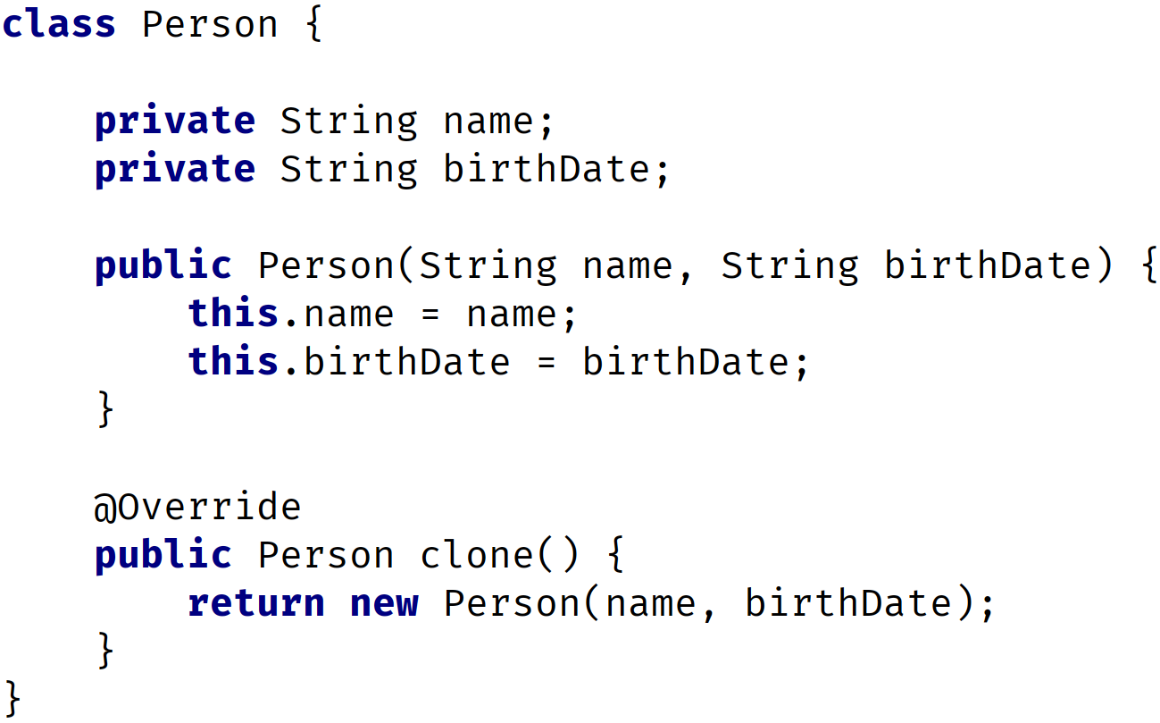
Covariant Return Type
The clone method (generated by IntelliJ) override (from Object)
The clone method overridden in a Person class.
This is a valid override of Object's clone method.
COMPLETE JAVA MASTERCLASS
Method Overloading vs Overriding Recap

Slide 143
What's a Text Block?
A Text Block is just a special format for multi-line String literals.
It's simply a String, with a new representation in the source code.
It became part of the official language as of JDK 15.
COMPLETE JAVA MASTERCLASS
The Text Block and other Formatting Options

Slide 144
Some Common Escape Sequences
An escape sequence starts with a backslash. Java has several, but the most common ones, are shown on this slide.
These can insert a tab, a newline, a double quote character, or a backslash character if you need it, in your text.
Escape Sequence | Description
\t | Insert a tab character.
\n | Insert a new line character.
\" | Insert a double quote character.
\\ | Insert a backslash character.
COMPLETE JAVA MASTERCLASS
The Text Block and other Formatting Options

Slide 145
Format Specifiers
At their most complex, format specifiers take the form shown here.
%[argument_index$][flags][width][.precision]conversion
They start with a percent sign, and end with a conversion symbol, and have lots of options in between.
We've looked at one conversion type, d, which is the symbol used for a decimal integer value.
COMPLETE JAVA MASTERCLASS
The Text Block and other Formatting Options

Slide 146
The String
The String has over 60 methods available.
The String is a sequence of characters, meaning its characters are ordered and indexed.
The index starts at 0, and not 1.
In the table below, we show the indices above each character for the String, "Hello World".
We can say the character, 'H', is at index 0, and 'W', is at index 6.
The length of this String is 11, but its last index is 10.
Index | 0 | 1 | 2 | 3 | 4 | 5 | 6 | 7 | 8 | 9 | 10
Character | H | e | l | l | o |  | W | o | r | l | d
COMPLETE JAVA MASTERCLASS
Another Look at the String

Slide 147
The purpose of String methods
We can split String's methods up into three basic categories:
String Inspection Methods.
Methods for Comparing String values.
String Manipulation Methods.
Let's start with a look at some of the String Inspection Methods.
COMPLETE JAVA MASTERCLASS
Another Look at the String

Slide 148
String Inspection Methods
method | description
length | Returns the number of characters in the String.
charAt | Returns the character at the index that's passed.
indexOf lastIndexOf | Returns an integer, representing the index in the sequence where the String or character passed, can be located in the String.
isEmpty | Returns true if length is zero.
isBlank | Returns true if length is zero OR the string only contains whitespace characters, added in JDK 11.
COMPLETE JAVA MASTERCLASS
Another Look at the String

Slide 149
String Comparison Methods
method | description
contentEquals | Returns a boolean if the String's value is equal to the value of the argument passed. This method allows for arguments other than String, for any type that is a character sequence.
equals | Return a boolean if the String's value is equal to the value of the argument passed.
equalsIgnoreCase | Return a boolean if the String's value is equal (ignoring case), to the value of the argument passed.
COMPLETE JAVA MASTERCLASS
Another Look at the String

Slide 150
String Comparison Methods
method | description
contains | Returns a boolean if the String contains the argument passed.
endsWith startsWith | These return a boolean, and are much like the contains method, but more specific to the placement of the argument in the String.
regionMatches | Returns a boolean, if defined sub-regions are matched.
COMPLETE JAVA MASTERCLASS
Another Look at the String

Slide 151
String Comparison Methods
The first set of methods, don't actually change the underlying meaning of the text value, but perform some kind of clean up.
method | description
indent | This method was added in JDK 15, and adds or removes spaces from the beginning of lines in multi-line text.
strip stripLeading stripTrailing trim | The difference between the strip method and trim method is that the strip() supports a larger set of white space characters. It and the corresponding stripLeading and stripTrailing methods were added in JDK 11.
toLowerCase toUpperCase | Returns a new String, either in a lower case or in upper case
COMPLETE JAVA MASTERCLASS
String Manipulation Methods

Slide 152
The second set of string manipulation methods, transform the String value, and return a String with a different meaning, than the original String.
method | description
concat | Similar to the plus operator for strings, it concatenates text to the String and returns a new String as the result.
join | Allows multiple strings to be concatenated together in a single method, specifying a delimiter.
repeat | Returns the String repeated by the number of times specified in the argument.
replace replaceAll replaceFirst | These methods replace characters or strings in the string, returning a new String with replacements made.
substring subSequence | These return a part of the String, its range defined by the start and end index specified.
COMPLETE JAVA MASTERCLASS
String Manipulation Methods

Slide 153
String vs StringBuilder
Java provides a mutable class that lets us change its text value.
This is the StringBuilder Class.
COMPLETE JAVA MASTERCLASS
The StringBuilder class

Slide 154
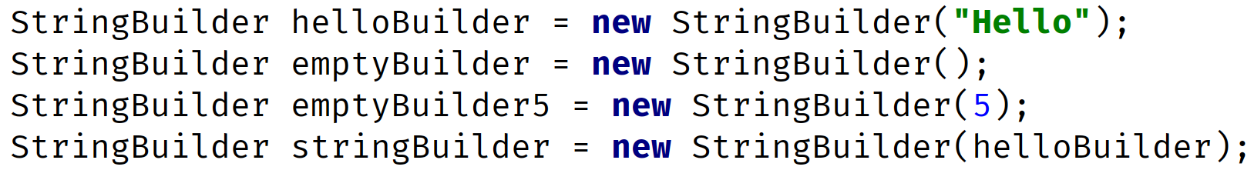
Creating Instances
Instantiating String Objects
Instantiating StringBuilder Objects
There are four ways to create a new StringBuilder object, using the new keyword:
Pass a String.
Pass no arguments at all.
Pass an integer value.
Pass some other type of character sequence (like StringBuilder).
COMPLETE JAVA MASTERCLASS
The StringBuilder class

Slide 155
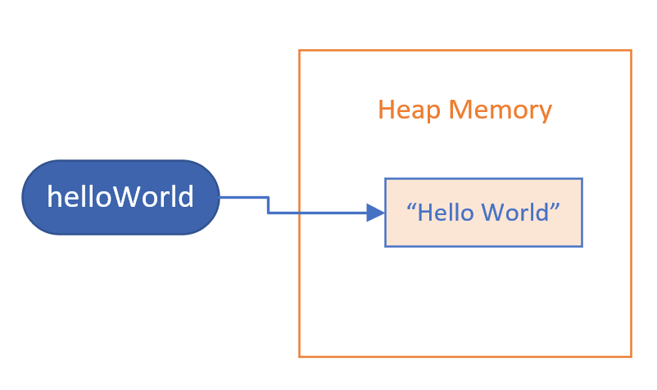
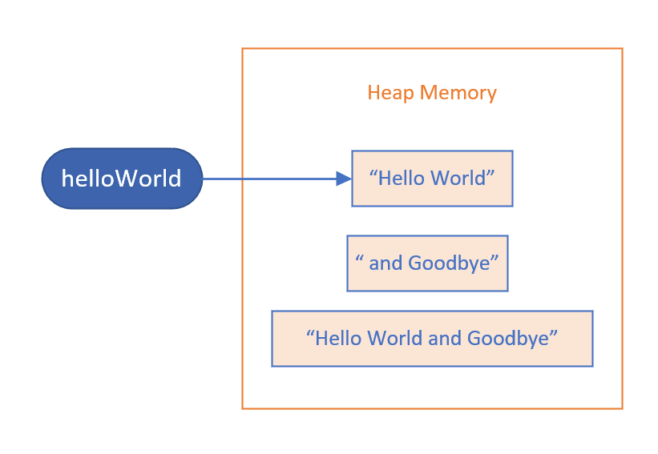
String
Memory before executing helloWorld.concat method
Memory after executing helloWorld.concat method
When we passed the String literal, "and Goodbye", to the concat method, this created an Object in memory for that literal, "and Goodbye".
It also created the result of the concat method, the object, the String, that has the value, "Hello World and Goodbye".
COMPLETE JAVA MASTERCLASS
The StringBuilder class

Slide 156
String
Memory before executing helloWorld.concat method
Memory after executing helloWorld.concat method
These methods don't change the internals of the existing String object.
The String referenced by the helloWorld variable never changed, instead a new String was created by the method call.
COMPLETE JAVA MASTERCLASS
The StringBuilder class

Slide 157
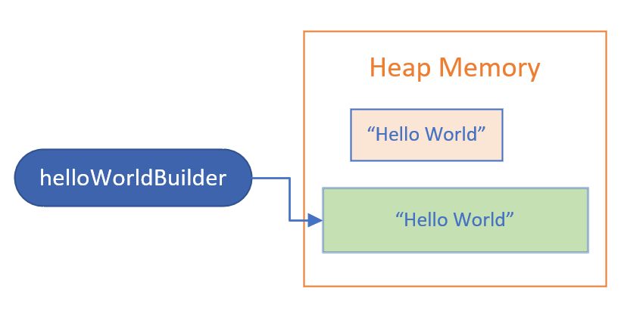
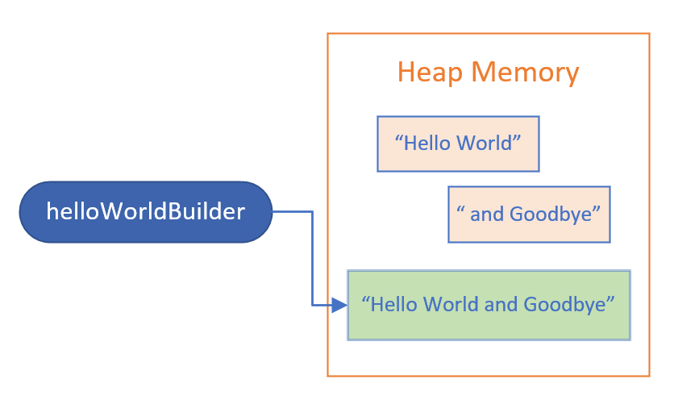
StringBuilder
Memory before executing helloWorldBuilder.append method
Memory after executing helloWorldBuilder.append method
On this slide, Strings and StringBuilders are shown in different colors, with the StringBuilder object in green.
After the call to the append method, we still only have one StringBuilder object.
COMPLETE JAVA MASTERCLASS
The StringBuilder class

Slide 158
StringBuilder
Memory before executing helloWorldBuilder.append method
Memory after executing helloWorldBuilder.append method
The variable helloWorldBuilder, is still referencing the same object, but the value of that object changed.
This is important, because it means the character sequence in the StringBuilder changed.
COMPLETE JAVA MASTERCLASS
The StringBuilder class

Slide 159
String methods vs. StringBuilder methods
String methods create a new object in memory, and return a reference to this new object.
StringBuilder methods return a StringBuilder reference, but it's really a self-reference.
COMPLETE JAVA MASTERCLASS
The StringBuilder class

Slide 160
Some methods unique to the StringBuilder class
A StringBuilder class has many similar methods to Strings.
But it also has methods to remove and insert characters or Strings, and truncate it's size.
But it also has methods to remove and insert characters or Strings, and truncate it's size.
method | description
delete deleteCharAt | You can delete a substring using indices to specify a range, or delete a single character at an index.
insert | You can insert text at a specified position.
reverse | You can reverse the order of the characters in the sequence.
setLength | setLength can be used to truncate the sequence, or include null sequences to 'fill out' the sequence to that length.
COMPLETE JAVA MASTERCLASS
The StringBuilder class

