Slide 1
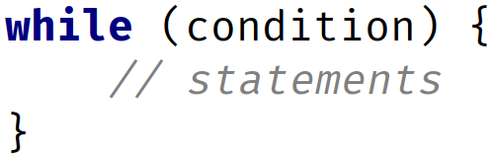

The while Statement Recap
Curly braces to define loop code block (body)
COMPLETE JAVA MASTERCLASS
While Loop and Do While Recap

Slide 2
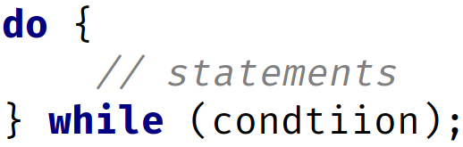
The while Statement Recap
Semicolon is required!
Curly braces to define loop code block (body)
COMPLETE JAVA MASTERCLASS
While Loop and Do While Recap

Slide 3
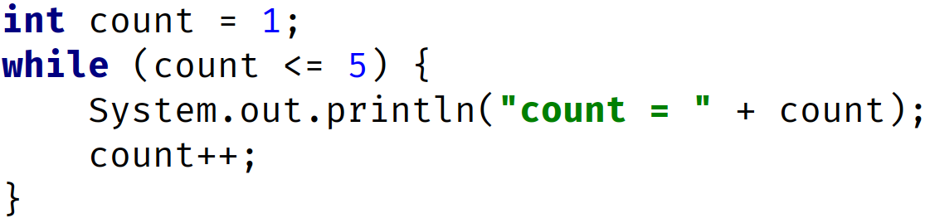
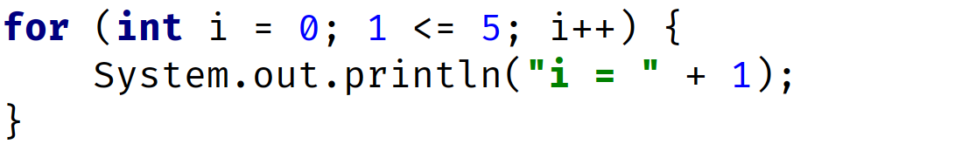
The while Statement Recap
init
condition
increment
init
condition
increment
COMPLETE JAVA MASTERCLASS
While Loop and Do While Recap

Slide 4
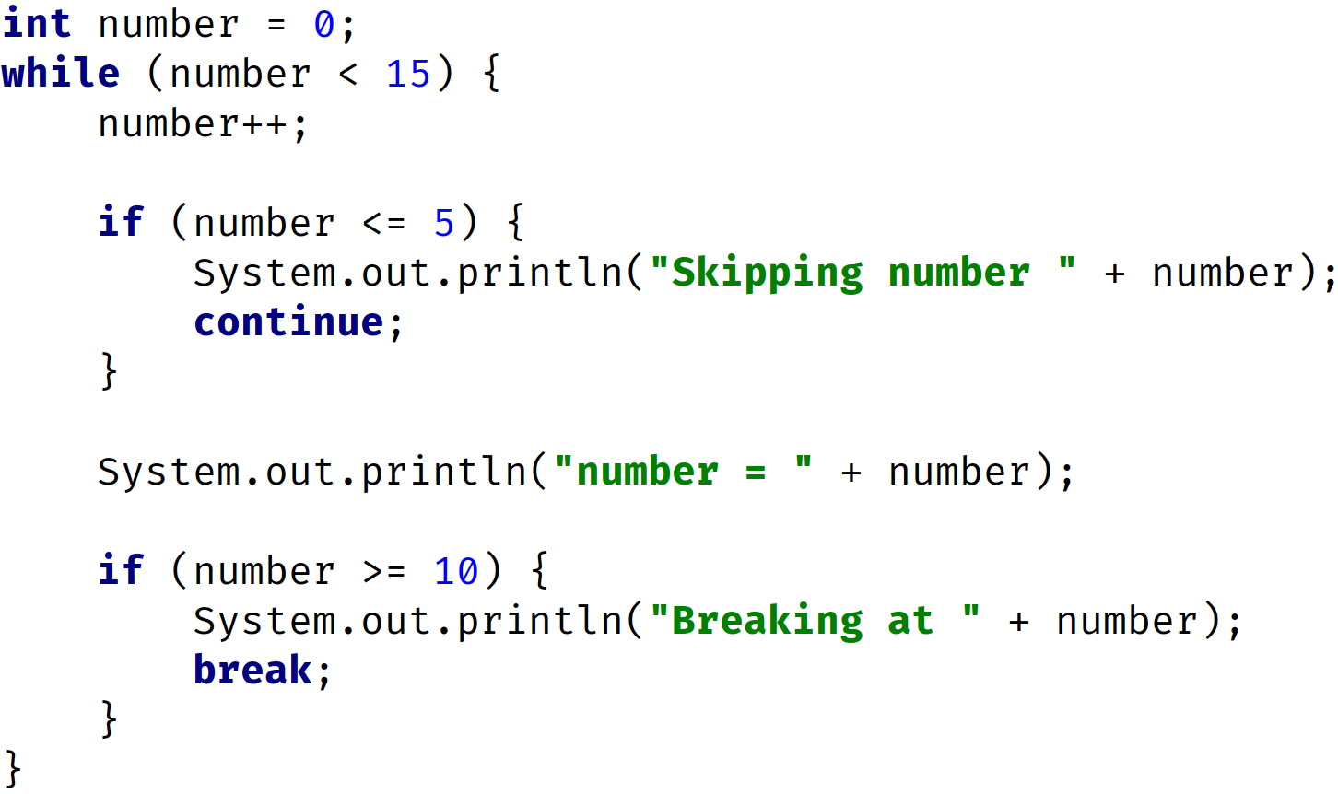
The while Statement Recap
1
init
2
check condition 0 < 15 is true
3
number = 1
COMPLETE JAVA MASTERCLASS
While Loop and Do While Recap

Slide 5
The while Statement Recap
4
check condition 1 < 15 is true
1
check condition 1 <= 5 is true
2
execute code block
3
Continue with a loop (bypass all other code in the block/body)
COMPLETE JAVA MASTERCLASS
While Loop and Do While Recap

Slide 6
The while Statement Recap
number = 5
1
check condition 5 < 15 is true
2
number = 6
3
check condition 6 <= 5 is false
4
execute code block
5
check condition 6 >= 10 is false
COMPLETE JAVA MASTERCLASS
While Loop and Do While Recap

Slide 7
The while Statement Recap
number = 9
1
check condition 9 < 15 is true
2
number = 10
3
check condition 10 <= 5 is false
4
execute code block
5
check condition 10 >= 10 is true
6
execute code then break exits the loop
COMPLETE JAVA MASTERCLASS
While Loop and Do While Recap

Slide 8
The while and the do while
Now firstly, the while loop checks the condition at the start, before executing the block.
Compare that to the do while loop, where the code is executed at least once, and then the condition is checked.
COMPLETE JAVA MASTERCLASS
While Loop and Do While Recap

Slide 9
Examine loop conditions carefully
When using loops, you want to carefully examine the conditions for terminating, or continuing a loop.
Check for endless, or infinite loops.
Check for conditions where a loop will never execute.
COMPLETE JAVA MASTERCLASS
While Loop and Do While Recap

Slide 10
Continue and Break
The continue and break statements both interrupt normal loop processing.
The continue statement starts a new iteration, but continues to iterate through the loop.
The break statement exits the loop, at the point it's executed, and no longer completes any code in the loop, and won't continue iterating any longer.
COMPLETE JAVA MASTERCLASS
While Loop and Do While Recap

