Slide 1

Local Variables and Scope
In the past couple of videos, we've looked at many of Java's flow statements, the switch statement, the for statement, the while statement, as well as the do while statement.
In previous videos, we covered the if then else statement.
All of these statements may, and probably will, have their own code blocks.
We've talked about code blocks quite a bit, but we haven't really talked about variables declared locally to many of these code blocks.
COMPLETE JAVA MASTERCLASS
Local Variables and Scope

Slide 2
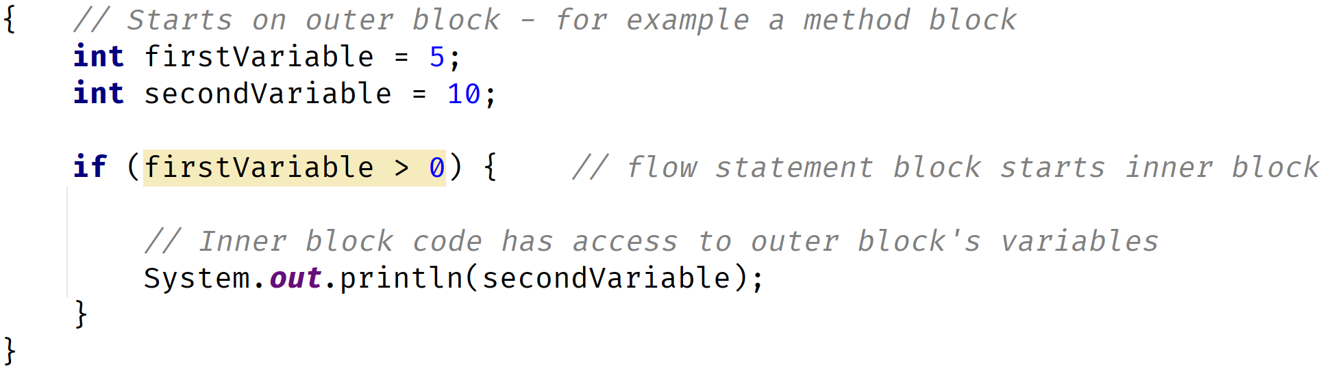
Local Variable
A local variable is called local, because it is available for use by the code block in which it was declared.
It is also available to code blocks that are contained by a declaring block.
COMPLETE JAVA MASTERCLASS
Local Variables and Scope

Slide 3
Scope
Scope describes the accessibility of a variable.
'In scope' means the variable can be used by an executing block or any nested blocks.
'Out of scope' means the variable is no longer available.
COMPLETE JAVA MASTERCLASS
Local Variables and Scope

Slide 4
When are Local Variables in Scope?
Local variables are always in scope, in the block they are declared.
They are also in scope for any nested blocks, or blocks contained within the outer block.
COMPLETE JAVA MASTERCLASS
Local Variables and Scope

Slide 5
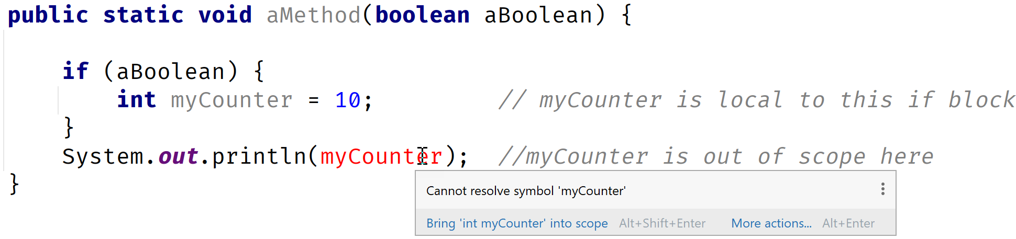
When are Local Variables out of Scope?
Local variables are always out of scope, for outer blocks, or the containing blocks they are declared in.
Let's look at an example:
COMPLETE JAVA MASTERCLASS
Local Variables and Scope

Slide 6
Scope Best Practices
It is considered best practice:
To declare and initialize variables in the same place if possible.
And to declare variables in the narrowest scope possible.
COMPLETE JAVA MASTERCLASS
Local Variables and Scope

Slide 7
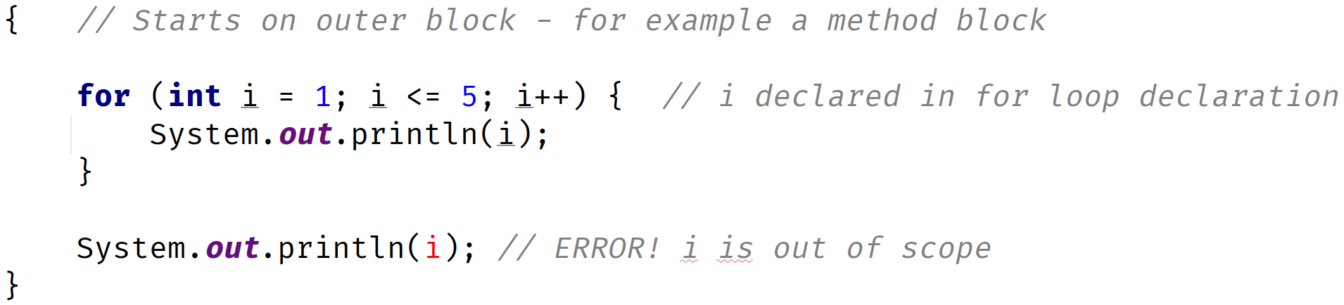
Local Variables and the For Statement
In this for statement, as part of the declaration, there is an initialization part, as we've described.
In this case, we declared a variable, i, that isn't accessible outside of the loop.
This is because any variables declared in the init section, are local to the loop, meaning they exist and are accessible in memory, only while the loop is executing, and only to the loop code block.
COMPLETE JAVA MASTERCLASS
Local Variables and Scope

Slide 8
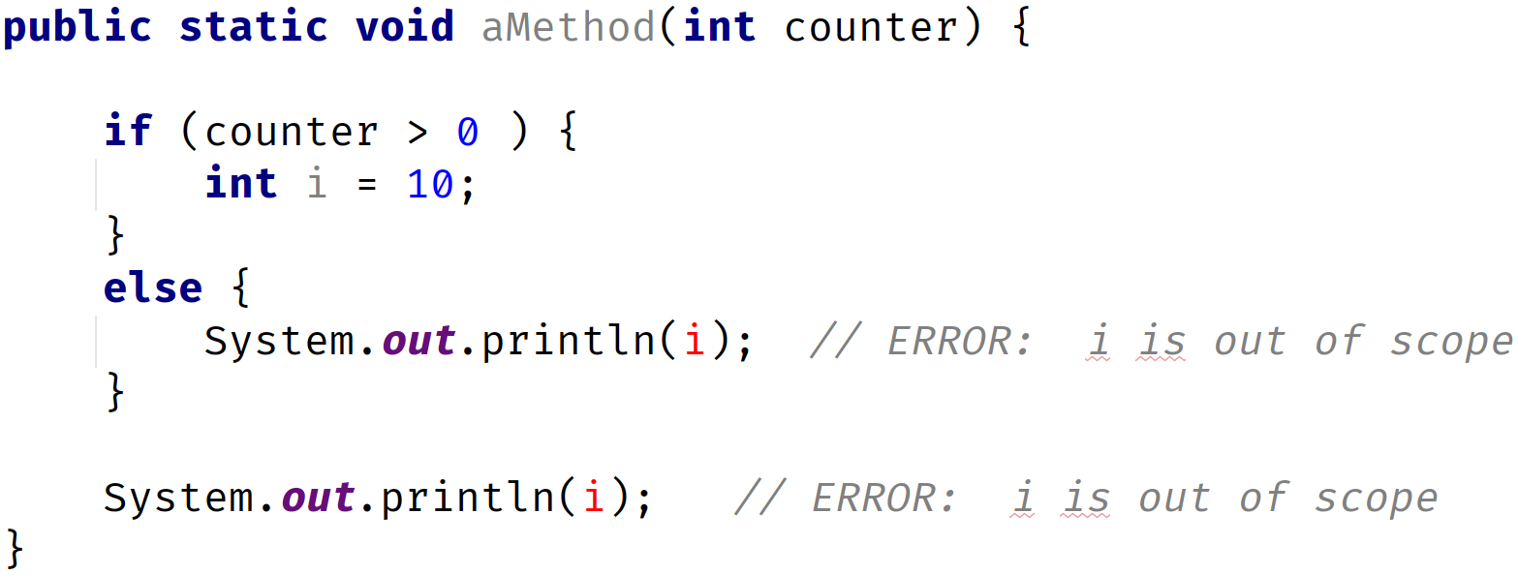
Declaring variables in a switch statement block
Local Variables declared in an if statement block, are not accessible outside of that block.
This also includes other parts of the if statement, like the else if block, or the else block.
COMPLETE JAVA MASTERCLASS
Local Variables and Scope

Slide 9
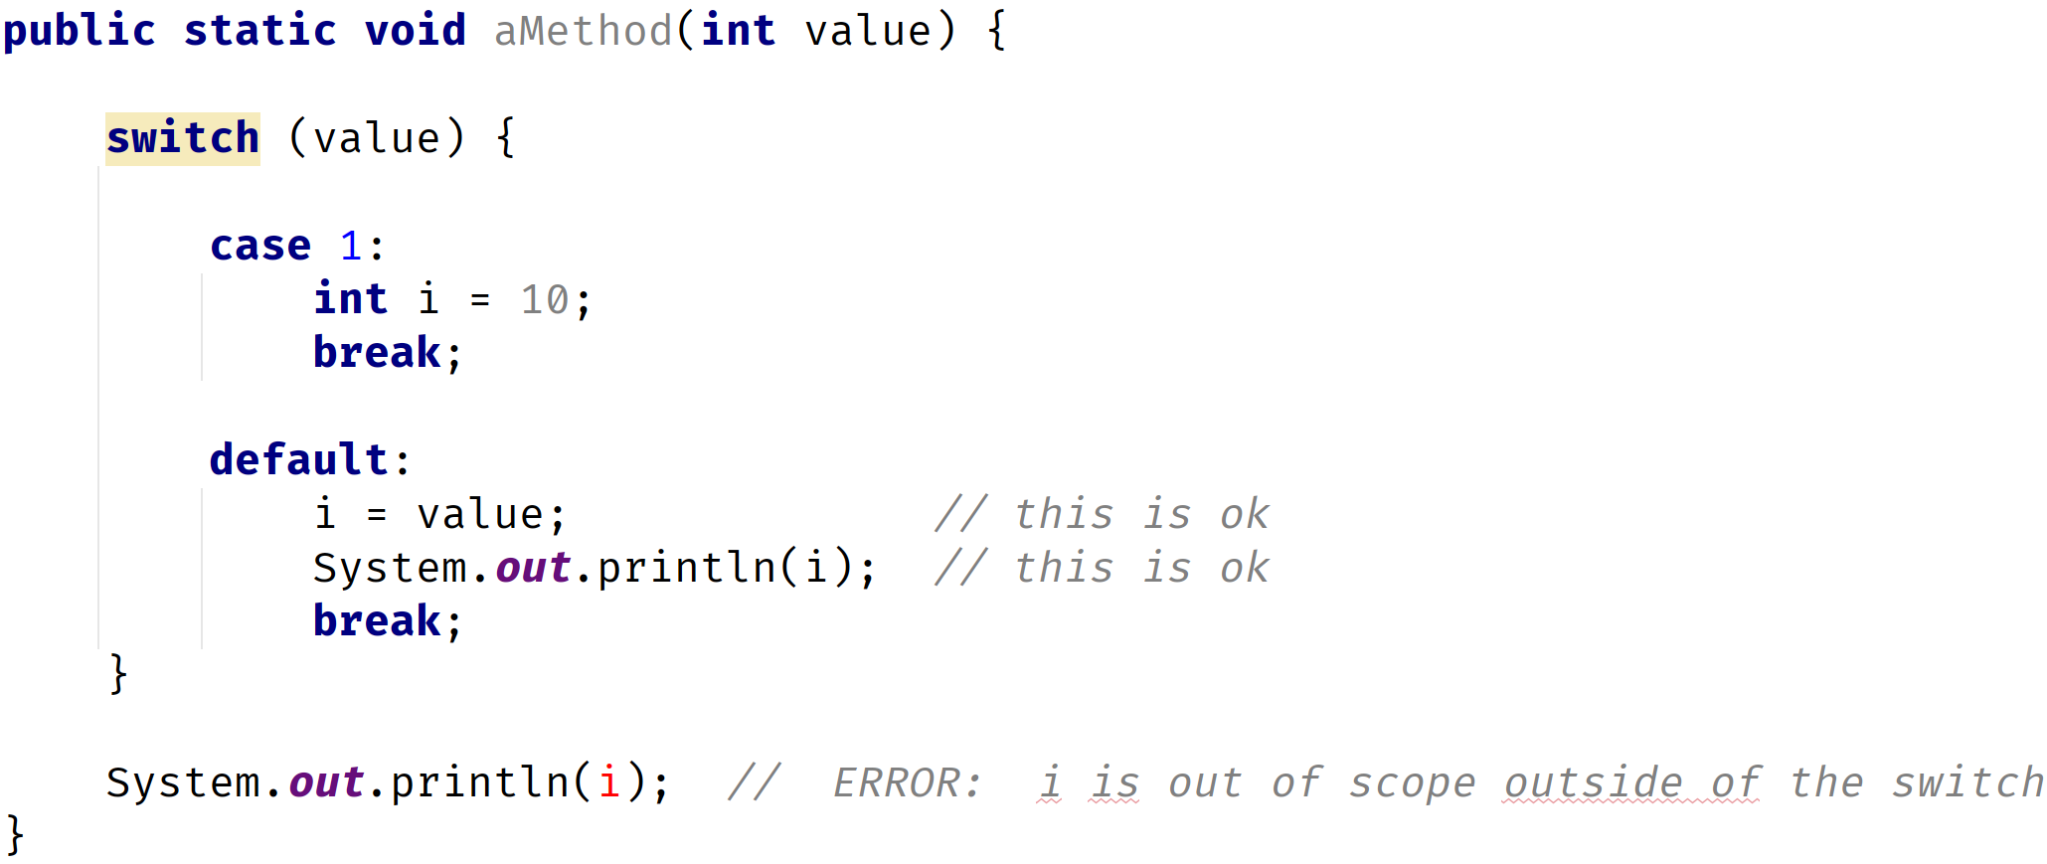
Declaring variables in a switch statement block
However, the switch statement is different from the if then else statement blocks.
Consider the code below:
COMPLETE JAVA MASTERCLASS
Local Variables and Scope

Slide 10
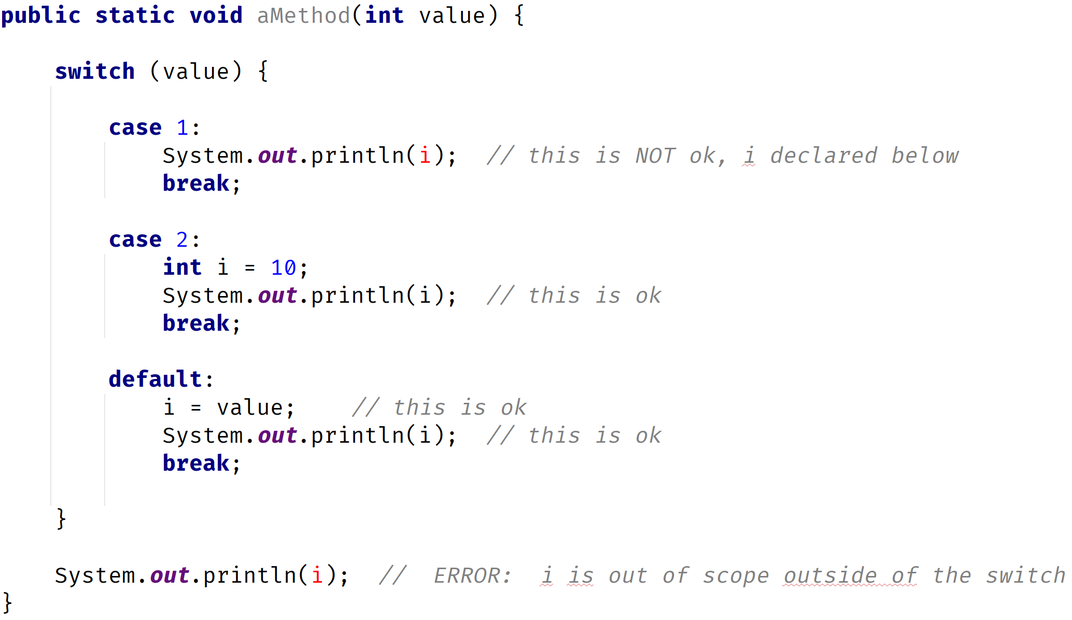
Declaring variables in a switch statement block
Let's look at another example, of code blocks and local variables, in the switch statement.
COMPLETE JAVA MASTERCLASS
Local Variables and Scope

