Slide 1
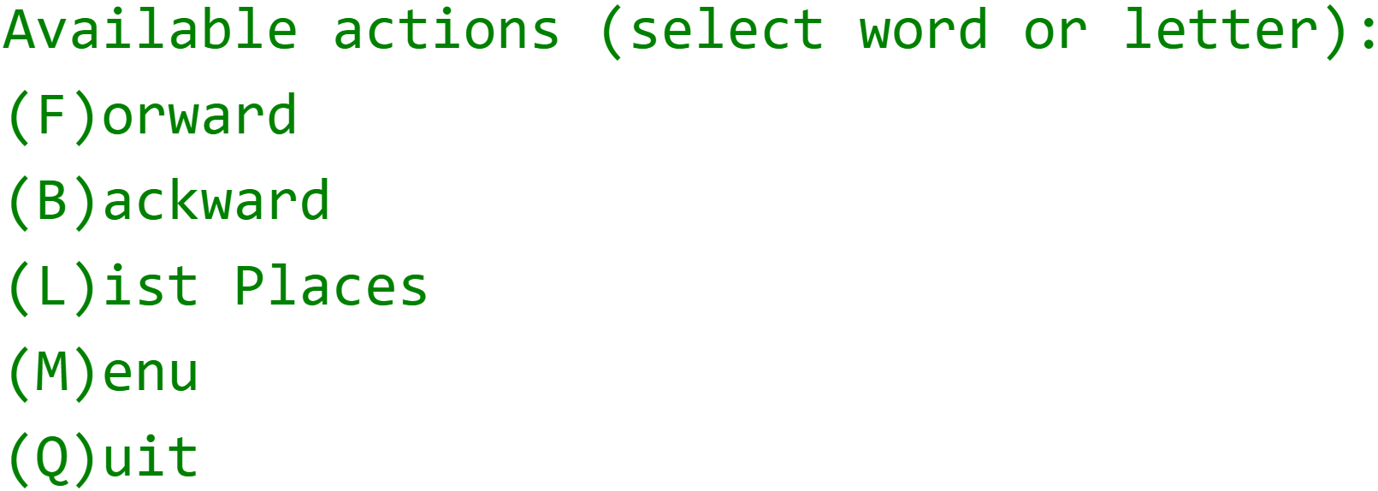

LinkedList Challenge
Now, we'll create the interactive part of our program, with the menu items shown here.
We'll use a Scanner, to get input from the user, and we'll use a ListIterator, to move back and forth, through the itinerary.
COMPLETE JAVA MASTERCLASS
LinkedList Challenge, Continued

Slide 2
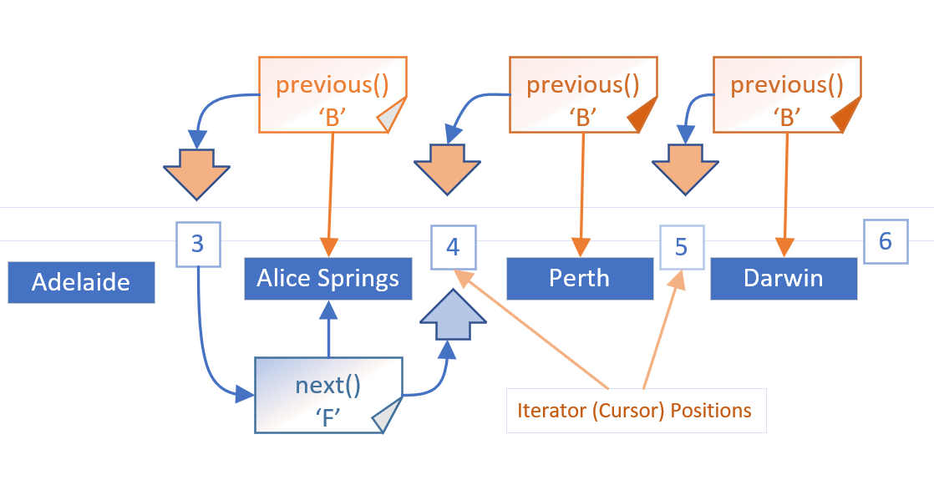
Reversing Directions in a List Iterator
Here, we show the three B or back menu items, each calling the previous method.
This leaves our cursor position, shown as an orange arrow, positioned, between Adelaide and Alice Springs.
When we decided to go forward, we called the next method from this cursor position, and that gave us Alice Springs.
COMPLETE JAVA MASTERCLASS
LinkedList Challenge, Continued

Slide 3
Reversing Directions in a List Iterator
When we change directions, we have to compensate for the cursor being ahead of where we want it to be.
So we have to make the call, either next or previous, twice, the first time to adjust the cursor, and the second time to get the element.
COMPLETE JAVA MASTERCLASS
LinkedList Challenge, Continued

