Slide 1

Introduction
Welcome to section six of the course.
Tim Buchalka here again, and in this section, we're dealing with control flow statements.
These are essential for programming to determine the flow of your program.
In other words, what should be executed and under what conditions.
But also, how often a code segment should be executed.
COMPLETE JAVA MASTERCLASS
Introduction

Slide 2
Introduction
In this section, you'll be learning about the switch statement, which like the if then else statement, allows you to execute different code blocks based on different conditions.
We'll also be looking at three additional statements. The for statement, the while statement, and the do while statement, which are used to repeat code segments based on conditions you set.
These three statements, in addition to the if then else statement, are what you need to understand to get the most out of Java, so let's get started.
COMPLETE JAVA MASTERCLASS
Introduction

Slide 3
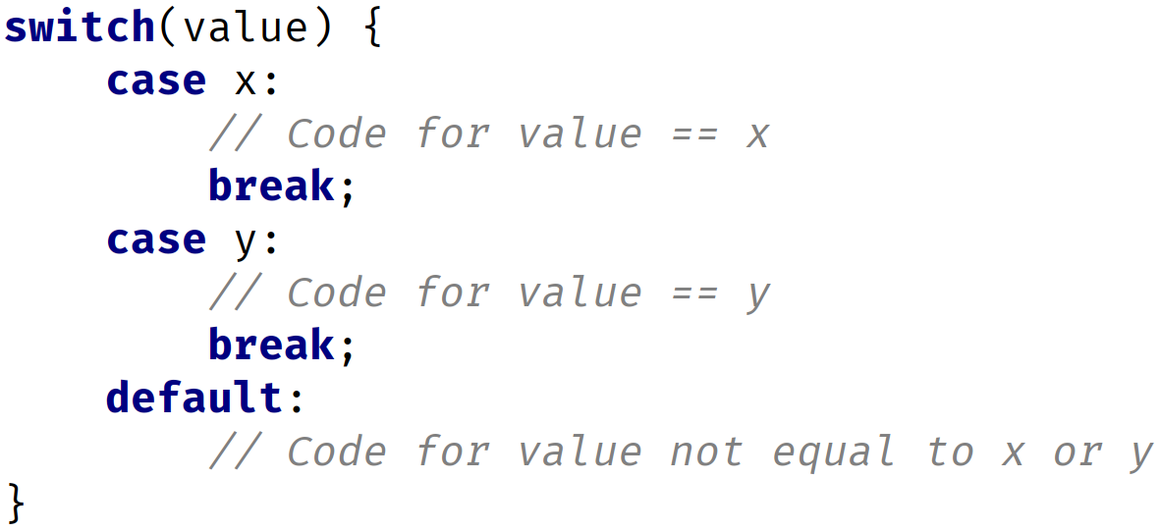
The switch statement
COMPLETE JAVA MASTERCLASS
The switch statement

Slide 4
Switch Value Types
Valid Switch Value Types
byte, short, int, char Byte, Short, Integer, Character String enum
Important: Cannot use long, float, double or boolean or their wrappers.
COMPLETE JAVA MASTERCLASS
The switch statement

Slide 5
Fall through in switch statement
Once a switch case label matches the switch variable, no more cases are checked.
Any code after the case label where there was a match found, will be executed, until a break statement, or the end of the switch statement occurs.
Without a break statement, execution will continue to fall through any case labels declared below the matching one, and execute each case's code.
COMPLETE JAVA MASTERCLASS
The switch statement

Slide 6
Traditional Switch Challenge
In the previous couple of videos, we looked at the switch statement, and how we can use it in a similar way, to an "if" statement.
We talked about the traditional version, which you'll see in older applications.
We've also looked at the enhanced version, which I would recommend if you're using JDK 14 or greater, and if you also have the luxury of not having to be compatible with older versions.
In this video, we'll give you a chance to work out a challenge, using the traditional switch statement.
Let's look at the slide we saw in the last video, which describes the syntax of both:
COMPLETE JAVA MASTERCLASS
Traditional Switch Challenge

Slide 7
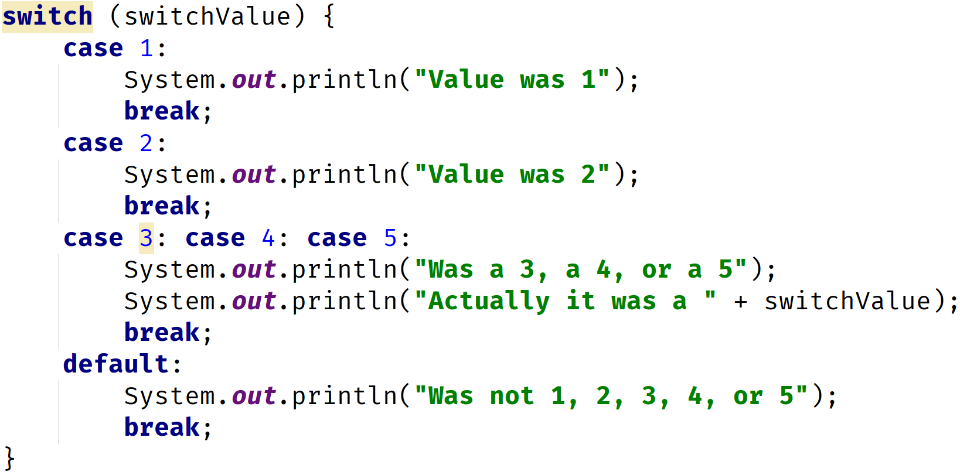
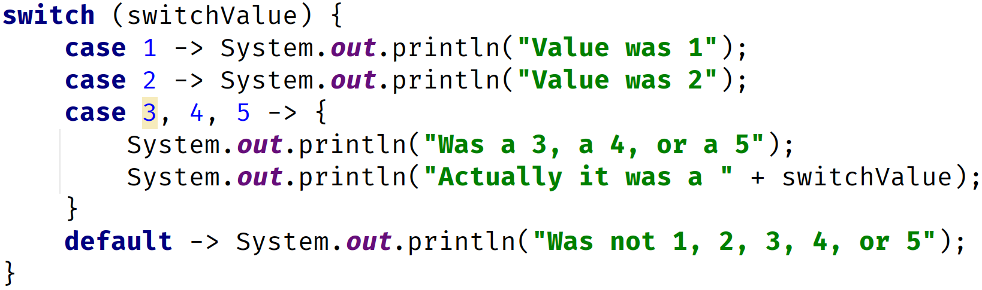
Traditional Switch Statement vs. Enhanced Switch Statement
Traditional Switch Statement | Enhanced Switch Statement
COMPLETE JAVA MASTERCLASS
Traditional Switch Challenge

Slide 8
Switch Challenge
In this challenge, we'll be using the NATO alphabet to replace a character or letter, with NATO's standardized word for that letter.
In radio transmissions, the word car, "C", "A", "R", would be read, "Charlie Able Roger", for clarity.
We'll take a single character, and return the matching word from the NATO phonetic alphabet, shown on this slide.
We'll just do this for the letters A, through E.
NATO phonetic alphabet A = Able, B = Baker, C = Charlie, D = Dog, E = Easy F = Fox, G = George, H = How, I = Item, J = Jig K = King, L = Love, M = Mike, N = Nan, O = Oboe P = Peter, Q = Queen, R = Roger, S = Sugar, T = Tare U = Uncle, V = Victor, W = William, X = X-ray, Y = Yoke, Z = Zebra
COMPLETE JAVA MASTERCLASS
Traditional Switch Challenge

Slide 9
Switch Challenge
To do this:
Create a new char variable.
Use the traditional switch statement (with a colon in case labels) that tests the value in the variable from Step 1.
Create cases for the characters, A, B, C, D, and E.
NATO phonetic alphabet A = Able, B = Baker, C = Charlie, D = Dog, E = Easy F = Fox, G = George, H = How, I = Item, J = Jig K = King, L = Love, M = Mike, N = Nan, O = Oboe P = Peter, Q = Queen, R = Roger, S = Sugar, T = Tare U = Uncle, V = Victor, W = William, X = X-ray, Y = Yoke, Z = Zebra
COMPLETE JAVA MASTERCLASS
Traditional Switch Challenge

Slide 10
Switch Challenge
To do this:
Display a message in each case block, with the letter and the NATO word, then break.
Add a default block, which displays the letter with a message saying not found.
NATO phonetic alphabet A = Able, B = Baker, C = Charlie, D = Dog, E = Easy F = Fox, G = George, H = How, I = Item, J = Jig K = King, L = Love, M = Mike, N = Nan, O = Oboe P = Peter, Q = Queen, R = Roger, S = Sugar, T = Tare U = Uncle, V = Victor, W = William, X = X-ray, Y = Yoke, Z = Zebra
COMPLETE JAVA MASTERCLASS
Traditional Switch Challenge

Slide 11
A Switch Expression Challenge
So, in the last challenge, we used a traditional switch statement, to translate a letter into NATO's keyword, that represented that letter.
In this next challenge, we're going to use the enhanced switch expression.
Let's look at these statements side by side again, but this time, we're going to make the enhanced switch an expression, by assigning it to a variable.
COMPLETE JAVA MASTERCLASS
A Switch Expression Challenge

Slide 12
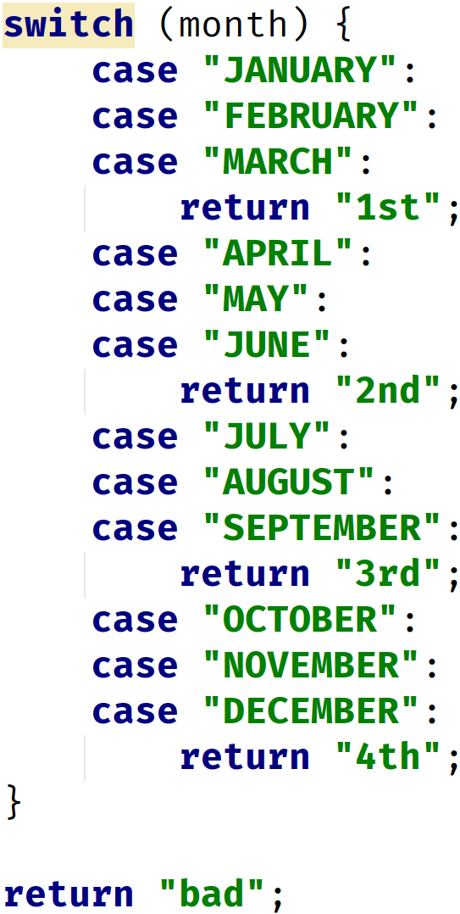
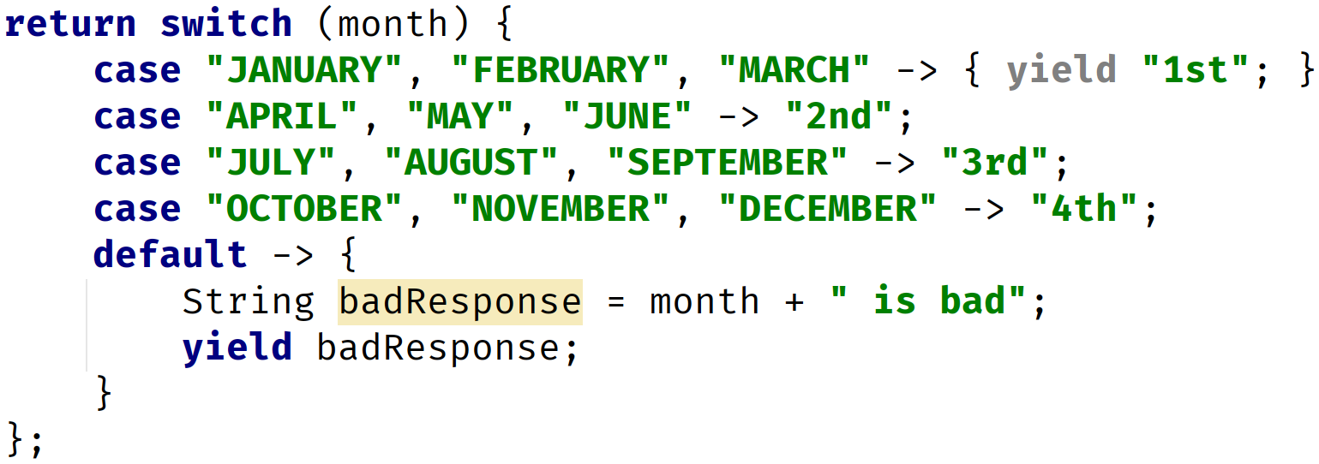
Traditional Switch Statement vs. Enhanced Switch Expression
Traditional Switch Statement used in a method, returning values | Enhanced Switch Expression
COMPLETE JAVA MASTERCLASS
A Switch Expression Challenge

Slide 13
Day of the Week Challenge
Create a method called printDayOfWeek, that takes an int parameter called day, but doesn't return any values.
Use the enhanced switch statement, to return the name of the day, based on the parameter passed to the switch statement, so that 0 will return "Sunday", 1 will return "Monday", and so on. Any number not between 0 and 6, should return "Invalid Day".
Use the enhanced switch statement as an expression, returning the result to a String named dayOfTheWeek.
Print both the day variable and the dayOfTheWeek variable.
COMPLETE JAVA MASTERCLASS
A Switch Expression Challenge

Slide 14
Day of the Week Challenge
In the main method, call this method for the values 0 through 7.
Bonus: Create a second method called printWeekDay, that uses an if then else statement, instead of a switch, to produce the same output.
COMPLETE JAVA MASTERCLASS
A Switch Expression Challenge

Slide 15
Looping
Looping lets us execute the code a multiple number of times.
Java supports several statements for looping, or executing code repetitively.
COMPLETE JAVA MASTERCLASS
The for Statement

Slide 16
Java supports three statements for looping
Statements | Explanation
for | The for loop is more complex to set up but is commonly used when you are iterating over a set of values.
while | The while loop executes until a specified condition becomes false.
do while | The do while loop always executes at least one and continues until a specified condition becomes false.
COMPLETE JAVA MASTERCLASS
The for Statement

Slide 17
The for statement
The for statement is often referred to as the for loop.
It repeatedly loops something until a condition is satisfied.
COMPLETE JAVA MASTERCLASS
The for Statement

Slide 18
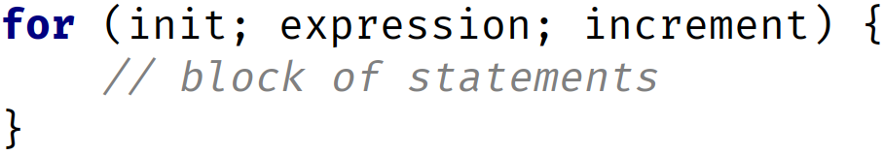
The for statement
There are three parts to the basic for statement's declaration.
These are declared in parentheses, after the for keyword, and are separated by semi-colons.
COMPLETE JAVA MASTERCLASS
The for Statement

Slide 19
The for statement
These parts are all optional and consist of the following:
The initialization section declares or sets state, usually declaring and initializing a loop variable, before the loop begins processing.
The expression section, once it becomes false, will end the loop processing.
The increment section is executed after the expression is tested, and is generally the place where the loop variable is incremented.
COMPLETE JAVA MASTERCLASS
The for Statement

Slide 20
Mini Challenge
Using a new for statement, call the calculateInterest method with the dollar amount of 100.
And this time, use the interest rates between 7.5 and 10, but increment by a quarter of a percent each time, meaning 0.25 percent.
And print the results to the console window.
COMPLETE JAVA MASTERCLASS
The for Statement

Slide 21
The break statement
A break statement transfers control out of an enclosing statement.
We've seen the break statement in the switch statement, but it can also be used in a loop.
COMPLETE JAVA MASTERCLASS
The for Statement

Slide 22
The for Statement Challenge Exercise
In the previous video, we talked about the for statement, and in this video, I want to give you another challenge to work out on your own first, then we'll get back together and work through the solution.
This challenge will use prime numbers, so if you need a refresher, let's quickly look at a web site, called math is fun.
The link to this page will be in the resources section of this video.
COMPLETE JAVA MASTERCLASS
The for Statement Challenge Exercise

Slide 23
The For Loop Challenge
Create a prime number counter variable, that will keep count of how many prime numbers were found.
Create a for statement, using any range of numbers, where the maximum number is <= 1000.
For each number in the range:
Check to see if it's a prime number using the isPrime method.
If the number is prime, print it out and increment the prime number counter variable.
Once the prime number counter equals three, exit the loop (Hint, use the break statement to exit).
COMPLETE JAVA MASTERCLASS
The for Statement Challenge Exercise

Slide 24
Sum 3 and 5 Challenge
Create a for loop using a range of numbers from 1 to 1000 inclusive.
Sum all the numbers that can be divided by both 3 and 5.
Print out the numbers that have met the above conditions.
Break out of the loop once you have found 5 numbers that met the conditions above.
After breaking out of the loop, print the sum of the numbers that met the conditions above.
Note: type all code in the main method.
COMPLETE JAVA MASTERCLASS
Sum 3 and 5 Challenge And Using IntelliJ's Debugger

Slide 25
IntelliJ's Java Debugger
IntelliJ IDEA provides a debugger for Java code, which lets you see what's happening under the hood:
For information: https://www.jetbrains.com/help/idea/debugging-code.html
COMPLETE JAVA MASTERCLASS
Sum 3 and 5 Challenge And Using IntelliJ's Debugger

Slide 26
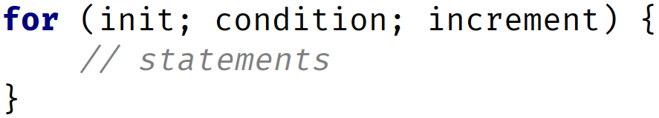
The for Statement Recap
semicolons are required!
known as iterator or iteration step
curly braces to define loop code block (body)
COMPLETE JAVA MASTERCLASS
For Loop Recap

Slide 27
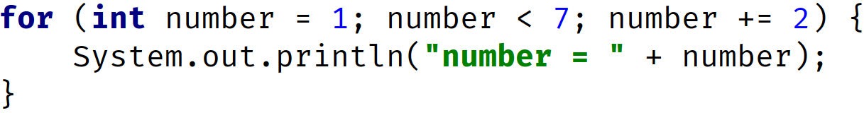
The for Statement Recap
increment (iteration step)
init
condition
OUTPUT:
number = 1
number = 3
number = 5
COMPLETE JAVA MASTERCLASS
For Loop Recap

Slide 28
The for Statement Recap
1
2
4
execute iteration step
1 + 2 = 3
number = 3
initialize number variable to 1
check condition
1 < 7 is true
CURRENT OUTPUT:
number = 1
3
execute line (code block)
COMPLETE JAVA MASTERCLASS
For Loop Recap

Slide 29
The for Statement Recap
1
3
execute iteration step
3 + 2 = 5
number = 5
number = 3
check condition
3 < 7 is true
CURRENT OUTPUT:
number = 1
number = 3
2
execute line (code block)
COMPLETE JAVA MASTERCLASS
For Loop Recap

Slide 30
The for Statement Recap
1
3
execute iteration step
5 + 2 = 7
number = 7
number = 5
check condition
5 < 7 is true
CURRENT OUTPUT:
number = 1
number = 3
number = 5
2
execute line (code block)
COMPLETE JAVA MASTERCLASS
For Loop Recap

Slide 31
The for Statement Recap
1
number = 7
check condition
7 < 7 is false
CURRENT OUTPUT:
number = 1
number = 3
number = 5
2
jump here
COMPLETE JAVA MASTERCLASS
For Loop Recap

Slide 32
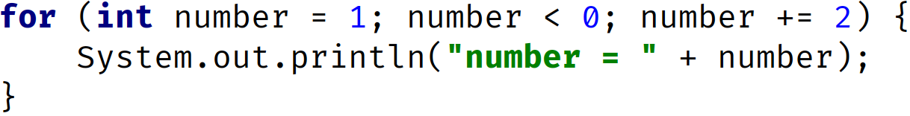
The for Statement Recap
OUTPUT:
COMPLETE JAVA MASTERCLASS
For Loop Recap

Slide 33
The for Statement Recap
1
2
initialize number variable to 1
check condition
1 < 0 is false!
NO OUTPUT!
3
jump here
COMPLETE JAVA MASTERCLASS
For Loop Recap

Slide 34
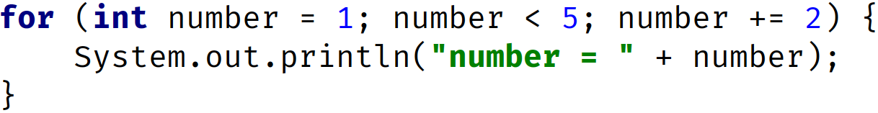
The for Statement Recap
Example Fix:
change condition to number < 5
before it was number < 0
OUTPUT:
number = 1
number = 3
COMPLETE JAVA MASTERCLASS
For Loop Recap

Slide 35
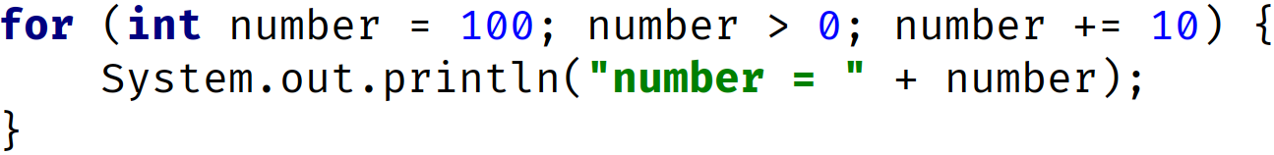
The for Statement Recap
OUTPUT:
COMPLETE JAVA MASTERCLASS
For Loop Recap

Slide 36
The for Statement Recap
condition is true, incrementing by 10
every number above 100 is also > 0
loop never ends (endless loop)
OUTPUT:
COMPLETE JAVA MASTERCLASS
For Loop Recap

Slide 37
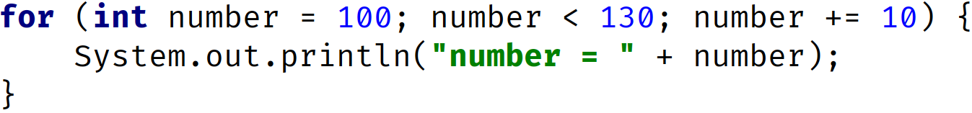
The for Statement Recap
Example fix:
change condition to number < 130
before it was number > 0
OUTPUT:
number = 100
number = 110
number = 120
COMPLETE JAVA MASTERCLASS
For Loop Recap

Slide 38
Other ways to Loop
What if you want to loop until some condition is met, that's not associated with a known range of values?
COMPLETE JAVA MASTERCLASS
The while and do while statements

Slide 39
Java has two types of while loops
While Loops | Explanation
while | Continue executing code block until the loop expression becomes false.
do while | Execute the code block once, then continue executing until the loop condition becomes false.
COMPLETE JAVA MASTERCLASS
The while and do while statements

Slide 40

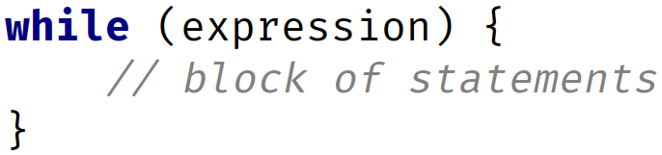
The for statement and the while statement
So we've also stated several times, that the for loop has three declaration parts in the parentheses, separated by semicolons.
But looking at the while loop in comparison:
The for statement | The while statement
COMPLETE JAVA MASTERCLASS
The while and do while statements

Slide 41
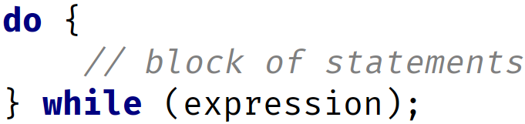
The for statement and the while statement
The while statement | The do while statement
COMPLETE JAVA MASTERCLASS
The while and do while statements

Slide 42
continue
The continue statement, in its simplest form, will stop executing the current iteration of a block of code in a loop, and start a new iteration.
COMPLETE JAVA MASTERCLASS
The while and do while statements

Slide 43
The while loop challenge - Step 1
So Step 1 is to create a method called isEvenNumber, that takes a parameter of type int.
Its purpose is to determine if the argument passed to the method is an even number or not.
Return true from the method, if it's an even number, otherwise return false.
Next, use a while loop to test a range of numbers, from 5, up to and including 20, but printing out only the even numbers, determined by the call to the isEvenNumber method.
COMPLETE JAVA MASTERCLASS
The while Loop Challenge Exercise

Slide 44
The while loop challenge - Step 2
So, Step 2 is to modify the while code.
Make it also record the total number of even numbers it has found.
Break out of the loop, once 5 even numbers are found.
Finally, display the total number of odd and even numbers found.
COMPLETE JAVA MASTERCLASS
The while Loop Challenge Exercise

Slide 45
Digit Sum Challenge
In this challenge, your task is to write a method, with the name sumDigits, that has a single parameter named number, of type int, and it should return an int.
The method should only take a number that is a positive number.
If a negative number is passed, it should return -1, meaning an invalid value was passed.
The method should parse out each digit from the number, and sum the digits up.
So if 125 is the value passed to the method, the code should sum each digit, in this case, 1 + 2 + 5, and return 8, as a value.
And another example, if the value is 1000, the code should sum each digit, 1 + 0 + 0 + 0, and return 1 as a value.
If the number is a single digit number, simply return the number itself as the result.
COMPLETE JAVA MASTERCLASS
Kotlin Variables and Datatypes

Slide 46
Digit Sum Challenge Process, Step 1
At the start of the process:
number = 1234, and our variable, sum = 0.
If we use the remainder operator, getting the remainder of the number divided by 10, this will give us the most right digit in the number:
1234 % 10 = 4
And 4 is the last digit, or most right digit.
COMPLETE JAVA MASTERCLASS
Kotlin Variables and Datatypes

Slide 47
Digit Sum Challenge Process, Step 1
Since we'll be working through the digits, from right to left, we'll add this to sum:
sum = 4
Next, we want to drop the most right digit, 4, and just have the other 3 digits to process.
We can do this by dividing by 10:
1234 / 10 = 123
COMPLETE JAVA MASTERCLASS
Kotlin Variables and Datatypes

Slide 48
Digit Sum Challenge Process, Step 2 and 3
So in the second iteration of the loop:
number = 123, and sum = 4
And again we use the remainder operator, getting the remainder of the number divided by 10, which gives us the right most digit:
123 % 10 = 3
And we'll add 3 to sum, which was 4:
sum = 7
And now we divide 123 by 10:
123 / 10 = 12
COMPLETE JAVA MASTERCLASS
Kotlin Variables and Datatypes

Slide 49
Digit Sum Challenge Process, Step 2 and 3
So in the third iteration of the loop:
number = 12, and sum = 7
And we again take number mod 10:
12 % 10 = 2
and 2 gets added to sum:
sum = 9
And we again divide now by 10:
12 / 10 = 1
Now our number is a single digit, (number < 10), and here we'll break out of the loop.
COMPLETE JAVA MASTERCLASS
Kotlin Variables and Datatypes

Slide 50
Digit Sum Challenge Process, Final Step
So, in this final step, after we've broken out of the loop:
number = 1, and sum = 9.
Now we can just add this last single digit to sum, and we'll have a final sum of 10.
COMPLETE JAVA MASTERCLASS
Kotlin Variables and Datatypes

Slide 51
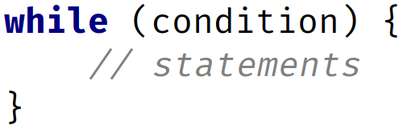
The while Statement Recap
Curly braces to define loop code block (body)
COMPLETE JAVA MASTERCLASS
While Loop and Do While Recap

Slide 52
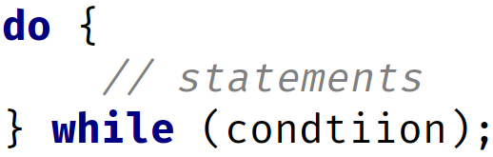
The while Statement Recap
Semicolon is required!
Curly braces to define loop code block (body)
COMPLETE JAVA MASTERCLASS
While Loop and Do While Recap

Slide 53
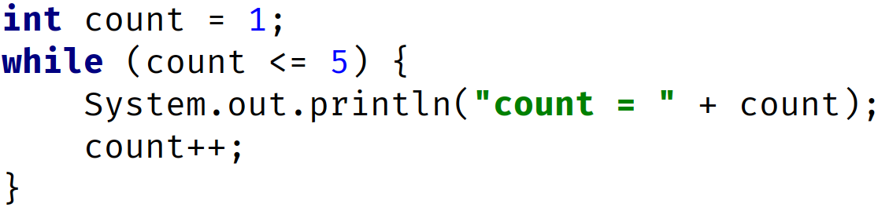
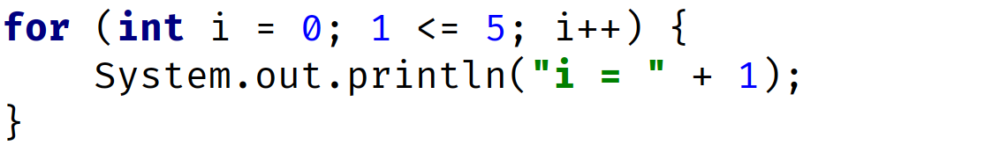
The while Statement Recap
init
condition
increment
init
condition
increment
COMPLETE JAVA MASTERCLASS
While Loop and Do While Recap

Slide 54
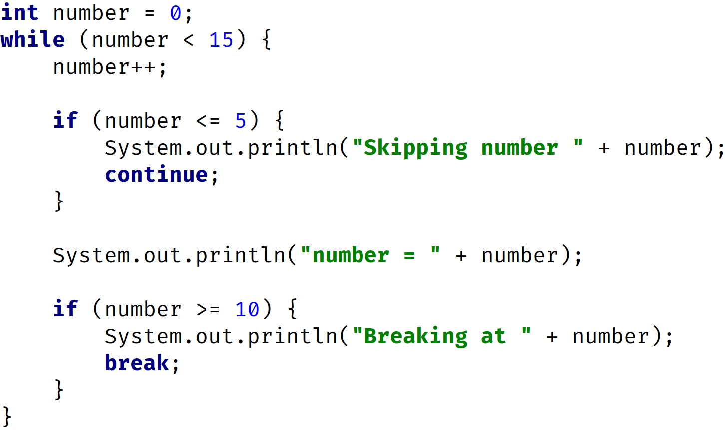
The while Statement Recap
1
init
2
check condition 0 < 15 is true
3
number = 1
COMPLETE JAVA MASTERCLASS
While Loop and Do While Recap

Slide 55
The while Statement Recap
4
check condition 1 < 15 is true
1
check condition 1 <= 5 is true
2
execute code block
3
Continue with a loop (bypass all other code in the block/body)
COMPLETE JAVA MASTERCLASS
While Loop and Do While Recap

Slide 56
The while Statement Recap
number = 5
1
check condition 5 < 15 is true
2
number = 6
3
check condition 6 <= 5 is false
4
execute code block
5
check condition 6 >= 10 is false
COMPLETE JAVA MASTERCLASS
While Loop and Do While Recap

Slide 57
The while Statement Recap
number = 9
1
check condition 9 < 15 is true
2
number = 10
3
check condition 10 <= 5 is false
4
execute code block
5
check condition 10 >= 10 is true
6
execute code then break exits the loop
COMPLETE JAVA MASTERCLASS
While Loop and Do While Recap

Slide 58
The while and the do while
Now firstly, the while loop checks the condition at the start, before executing the block.
Compare that to the do while loop, where the code is executed at least once, and then the condition is checked.
COMPLETE JAVA MASTERCLASS
While Loop and Do While Recap

Slide 59
Examine loop conditions carefully
When using loops, you want to carefully examine the conditions for terminating, or continuing a loop.
Check for endless, or infinite loops.
Check for conditions where a loop will never execute.
COMPLETE JAVA MASTERCLASS
While Loop and Do While Recap

Slide 60
Continue and Break
The continue and break statements both interrupt normal loop processing.
The continue statement starts a new iteration, but continues to iterate through the loop.
The break statement exits the loop, at the point it's executed, and no longer completes any code in the loop, and won't continue iterating any longer.
COMPLETE JAVA MASTERCLASS
While Loop and Do While Recap

Slide 61
Local Variables and Scope
In the past couple of videos, we've looked at many of Java's flow statements, the switch statement, the for statement, the while statement, as well as the do while statement.
In previous videos, we covered the if then else statement.
All of these statements may, and probably will, have their own code blocks.
We've talked about code blocks quite a bit, but we haven't really talked about variables declared locally to many of these code blocks.
COMPLETE JAVA MASTERCLASS
Local Variables and Scope

Slide 62
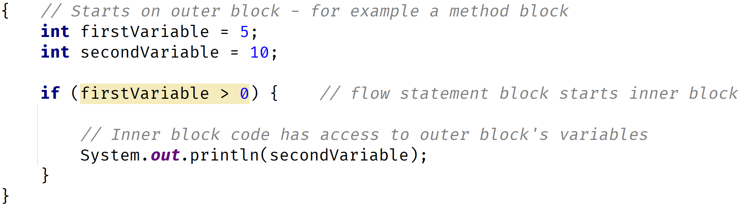
Local Variable
A local variable is called local, because it is available for use by the code block in which it was declared.
It is also available to code blocks that are contained by a declaring block.
COMPLETE JAVA MASTERCLASS
Local Variables and Scope

Slide 63
Scope
Scope describes the accessibility of a variable.
'In scope' means the variable can be used by an executing block or any nested blocks.
'Out of scope' means the variable is no longer available.
COMPLETE JAVA MASTERCLASS
Local Variables and Scope

Slide 64
When are Local Variables in Scope?
Local variables are always in scope, in the block they are declared.
They are also in scope for any nested blocks, or blocks contained within the outer block.
COMPLETE JAVA MASTERCLASS
Local Variables and Scope

Slide 65
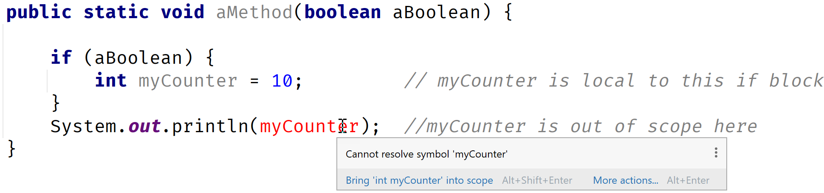
When are Local Variables out of Scope?
Local variables are always out of scope, for outer blocks, or the containing blocks they are declared in.
Let's look at an example:
COMPLETE JAVA MASTERCLASS
Local Variables and Scope

Slide 66
Scope Best Practices
It is considered best practice:
To declare and initialize variables in the same place if possible.
And to declare variables in the narrowest scope possible.
COMPLETE JAVA MASTERCLASS
Local Variables and Scope

Slide 67
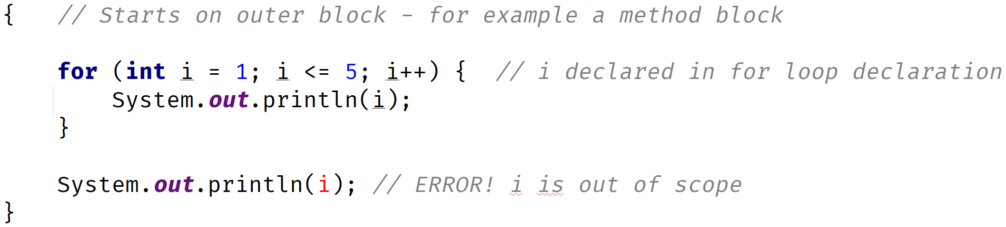
Local Variables and the For Statement
In this for statement, as part of the declaration, there is an initialization part, as we've described.
In this case, we declared a variable, i, that isn't accessible outside of the loop.
This is because any variables declared in the init section, are local to the loop, meaning they exist and are accessible in memory, only while the loop is executing, and only to the loop code block.
COMPLETE JAVA MASTERCLASS
Local Variables and Scope

Slide 68
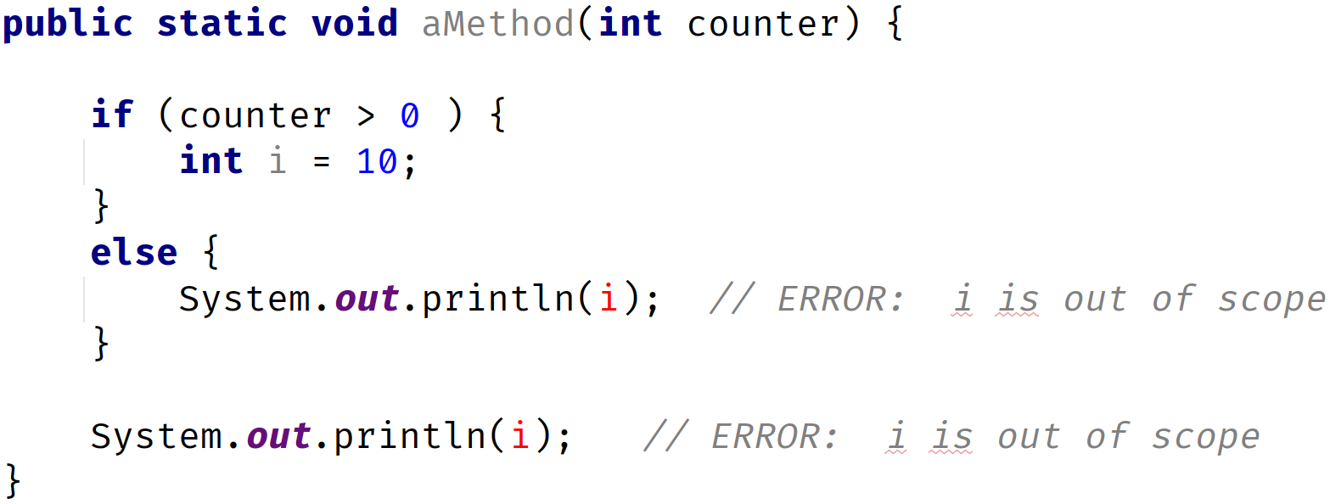
Declaring variables in a switch statement block
Local Variables declared in an if statement block, are not accessible outside of that block.
This also includes other parts of the if statement, like the else if block, or the else block.
COMPLETE JAVA MASTERCLASS
Local Variables and Scope

Slide 69
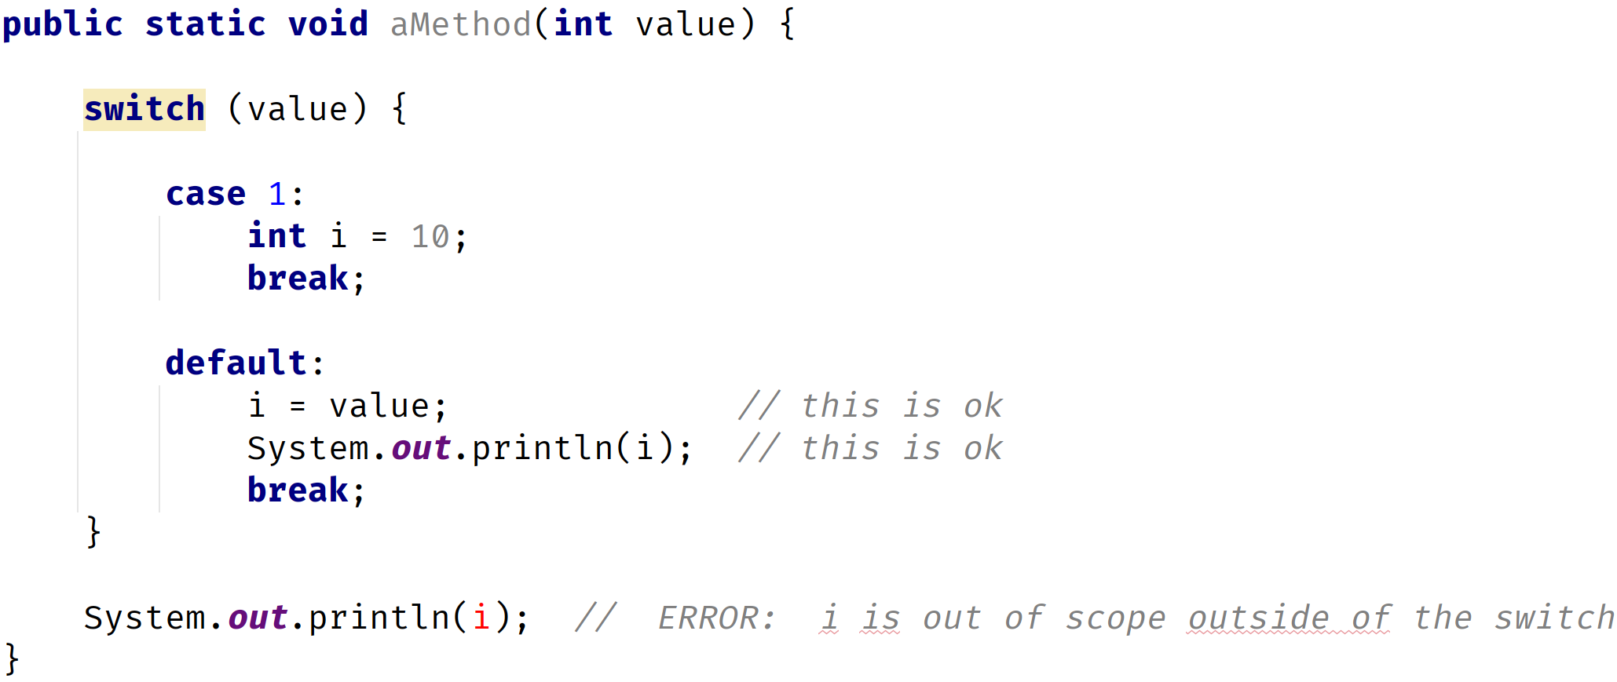
Declaring variables in a switch statement block
However, the switch statement is different from the if then else statement blocks.
Consider the code below:
COMPLETE JAVA MASTERCLASS
Local Variables and Scope

Slide 70
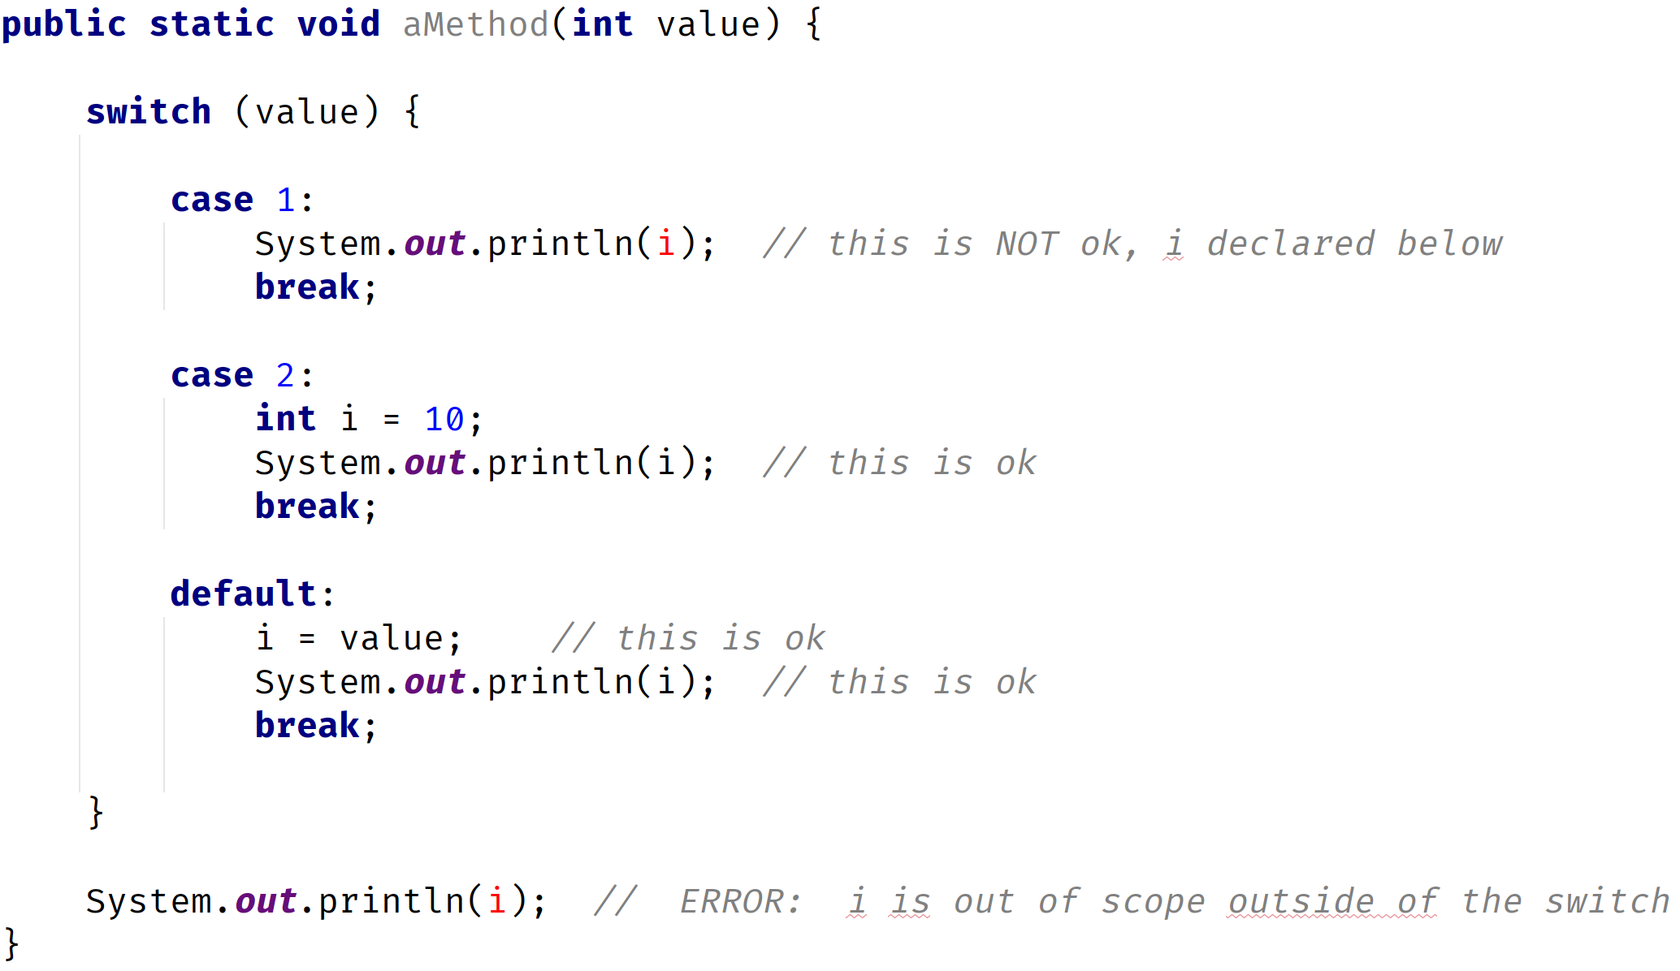
Declaring variables in a switch statement block
Let's look at another example, of code blocks and local variables, in the switch statement.
COMPLETE JAVA MASTERCLASS
Local Variables and Scope

Slide 71
The class, the object, static & instance fields and methods
In the previous video, we talked about local variables and scope.
Local variables are a way to store and manipulate temporary data.
In addition to local variables, we can set up data to be defined, and used as part of a class, or an object.
We'll be discussing these concepts now, at a cursory level, for several reasons.
COMPLETE JAVA MASTERCLASS
The class, the object, static & instance fields and methods

Slide 72
The class, the object, static & instance fields and methods
First, attributes on classes is another way to store data.
Second, I want to introduce you to some static methods on the wrapper classes, which are classes we previously looked at, but we haven't used any methods on these classes yet.
These methods will help parse strings into numeric values.
And finally, I want to introduce you to a special class for reading input, which we'll be using in the last part of this section, to create an interactive program.
Before we use that class, it will help if we understand some very basic concepts with classes.
COMPLETE JAVA MASTERCLASS
The class, the object, static & instance fields and methods

Slide 73
A class
A class can be described as:
a custom data type.
a special code block that contains methods.
COMPLETE JAVA MASTERCLASS
The class, the object, static & instance fields and methods

Slide 74
The class is a template for creating objects
Name: ____ Address: ____
_____________
A class is like an empty form that gets copied and handed out
Name: ____ Address: ____
_____________
Form is copied and handed out So this is like Object Creation from the Class
Name: Owen
Address: 16 Maple Ave
Name: Carole
Address: 50 Oak Lane
Name: George
Address: 2 Cedar Drive
An object is like the form once it’s been handed out and filed in
Each object will have unique values for the form data being collected
COMPLETE JAVA MASTERCLASS
The class, the object, static & instance fields and methods

Slide 75
An Object
An object is called an instance of a particular class.
COMPLETE JAVA MASTERCLASS
The class, the object, static & instance fields and methods

Slide 76
A class and objects
Class
You create an object by ‘instantiating a class’
You can create many objects using a single class. Each may have unique attributes or values
Object
Instance
Object
Object
Object and instance are interchangeable terms
Instance
COMPLETE JAVA MASTERCLASS
The class, the object, static & instance fields and methods

Slide 77

Declaring and instantiating a new object from a Class
The most common way to create an object, is to use the new keyword.
The new keyword creates an instance, and you can sometimes pass data, when creating an instance, to set up data on that object.
The String is special because we can create a String, just by using a literal which we've seen.
But we could also use new:
COMPLETE JAVA MASTERCLASS
The class, the object, static & instance fields and methods

Slide 78
static and instance fields
Static Field | Instance Field
Requires ‘static’ keyword when declared on the class. | Omits ‘static’ keyword when declared on the class.
Value of the field is stored in special memory location and only in one place. | Value of the field is not allocated any memory and has no value until the object is created.
Value is accessed by ClassName.fieldname Example: Integer.MAX_VALUE | Value is accessed by ObjectVariable.fieldname Example my Object.myFieldName (myObject is our variable name for an object we create and myFieldName is an attribute on the class.
COMPLETE JAVA MASTERCLASS
The class, the object, static & instance fields and methods

Slide 79
static and instance methods
Static Method | Instance Method
Requires ‘static’ keyword when declared on the class. | Omits ‘static’ keyword when declared on the class.
Method is accessed by ClassName.methodName Example: Integer.parseInt(“123”); A method called parseInt is called directly from the Class, Integer. | Method is accessed by ObjectVariable.methodName Example: “hello”.toUpperCase(); A method called toUpperCase is called on the instance of a String with value “hello”.
COMPLETE JAVA MASTERCLASS
The class, the object, static & instance fields and methods

Slide 80
Parsing Values and Reading Input using System.console()
In the last video, I talked about static and instance fields, and methods on the class.
I also talked about a concept called instantiating a class, which creates an object or instance.
I'll be using both of these features in this video.
I'm going to create an interactive application where a user will enter their name and year of birth, and then the application will calculate the current age of the user.
Before we start though, let's talk about parsing data.
COMPLETE JAVA MASTERCLASS
Parsing Values and Reading Input using System.console()

Slide 81
Parsing Values and Reading Input using System.console()
When we read data in from either a file or from user input, it's common for the data to be initially stored as a String, which we'll need to convert to a numeric value.
Let's review what happens when our numeric data is really a String.
You might remember I talked about this previously when I talked about operators in Java, and how the plus symbol means something different for numeric values than it does for Strings.
You might also remember that many of the other operators aren't applicable to Strings.
Let's look at a slide we've seen before.
COMPLETE JAVA MASTERCLASS
Parsing Values and Reading Input using System.console()

Slide 82
Summary of Operators
Operator | Numeric types | char | boolean | String
+ | Addition | Addition | n/a | Concatenation
- | Subtraction | Subtraction | n/a | n/a
* | Multiplication | Multiplication | n/a | n/a
/ | Division | Division | n/a | n/a
% | Remainder (Modulus) | Remainder (Modulus) | n/a | n/a
COMPLETE JAVA MASTERCLASS
Parsing Values and Reading Input using System.console()

Slide 83
Wrapper methods to parse strings to numeric values
If you recall, I used the wrapper classes to get min and max values.
In this case, I'm going to use a static method on the wrapper class to let that class do the transformation for us.
Wrapper | Wrapper Method
Integer | parseInt(String)
Double | parseDouble(String)
COMPLETE JAVA MASTERCLASS
Parsing Values and Reading Input using System.console()

Slide 84
Reading data from the console
Technique | Description
System.in | Like System.out, Java provides System.in which can read input from the console or terminal. It’s not easy to use for beginners, and lots of code has been built around it, to make it easier.
System.console | This is Java’s solution for easier support for reading a single line and prompting user for information. Although this is easy to use, it doesn’t work with IDE’s because these environments disable it.
Command Line Arguments | This is calling the Java program and specifying data in the call. This is very commonly used but doesn’t let us create an interactive application in a loop in Java.
Scanner | The Scanner class was built to be a common way to read input, either using System.in or a file. For beginners, it’s much easier to understand than the bare bones System.in
COMPLETE JAVA MASTERCLASS
Parsing Values and Reading Input using System.console()

Slide 85
What's an exception?
An exception is an error that happens in code.
Some types of errors can be predicted and named.
COMPLETE JAVA MASTERCLASS
Exception Handling, and Introduction to Scanner

Slide 86
Catching an exception
An exception is caught first by creating a code block around the code that gets the error.
This is done with the try statement code block.
COMPLETE JAVA MASTERCLASS
Exception Handling, and Introduction to Scanner

Slide 87
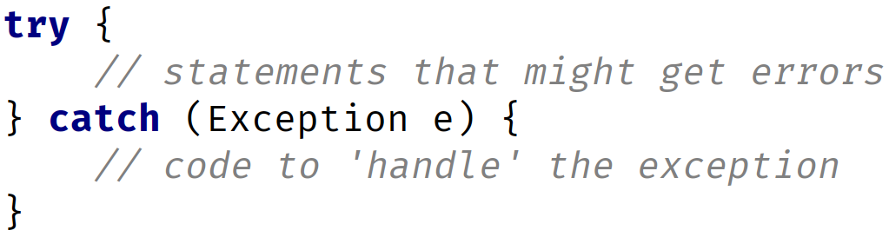
The try statement
The try statement actually has two code blocks.
The first is declared directly after the try keyword, and this code block ends, and is followed by the declaration of the catch keyword.
The catch keyword includes the declaration of variables, in parentheses, and then has its own code block.
COMPLETE JAVA MASTERCLASS
Exception Handling, and Introduction to Scanner

Slide 88
The Scanner class
The Scanner class is described as a simple text scanner, which can parse primitive types and strings.
To use the Scanner class, we have to create an instance of Scanner.
This means we're creating an object of type Scanner.
We'll use the keyword, new, to do it.
COMPLETE JAVA MASTERCLASS
Exception Handling, and Introduction to Scanner

Slide 89
new keyword
The new keyword is used in what Java calls a Class Instance Creation Expression.
In its simplest form, it's the word new, followed by the class name, and empty parentheses.
We can optionally pass arguments in those parentheses, as we saw with methods.
We saw that we could do this with the String class, passing the text in the parentheses.
COMPLETE JAVA MASTERCLASS
Exception Handling, and Introduction to Scanner

Slide 90
Instantiating Scanner
For reading input from the console or terminal, we instantiate a scanner object using new, followed by the Scanner class name, and passing System.in, as an argument, in the parentheses.
For reading input from a file, we instantiate a scanner object using new, again with the Scanner class name, but pass a File object, as an argument, in the parentheses.
File is another class provided by Java, for reading and writing files.
COMPLETE JAVA MASTERCLASS
Exception Handling, and Introduction to Scanner

Slide 91
Using the import statement
I haven't talked about the import statement yet, but this statement lets us use classes from other people's code.
In this case, Java provides a library of code, which includes the Scanner class in a library called java.util.
COMPLETE JAVA MASTERCLASS
Exception Handling, and Introduction to Scanner

Slide 92
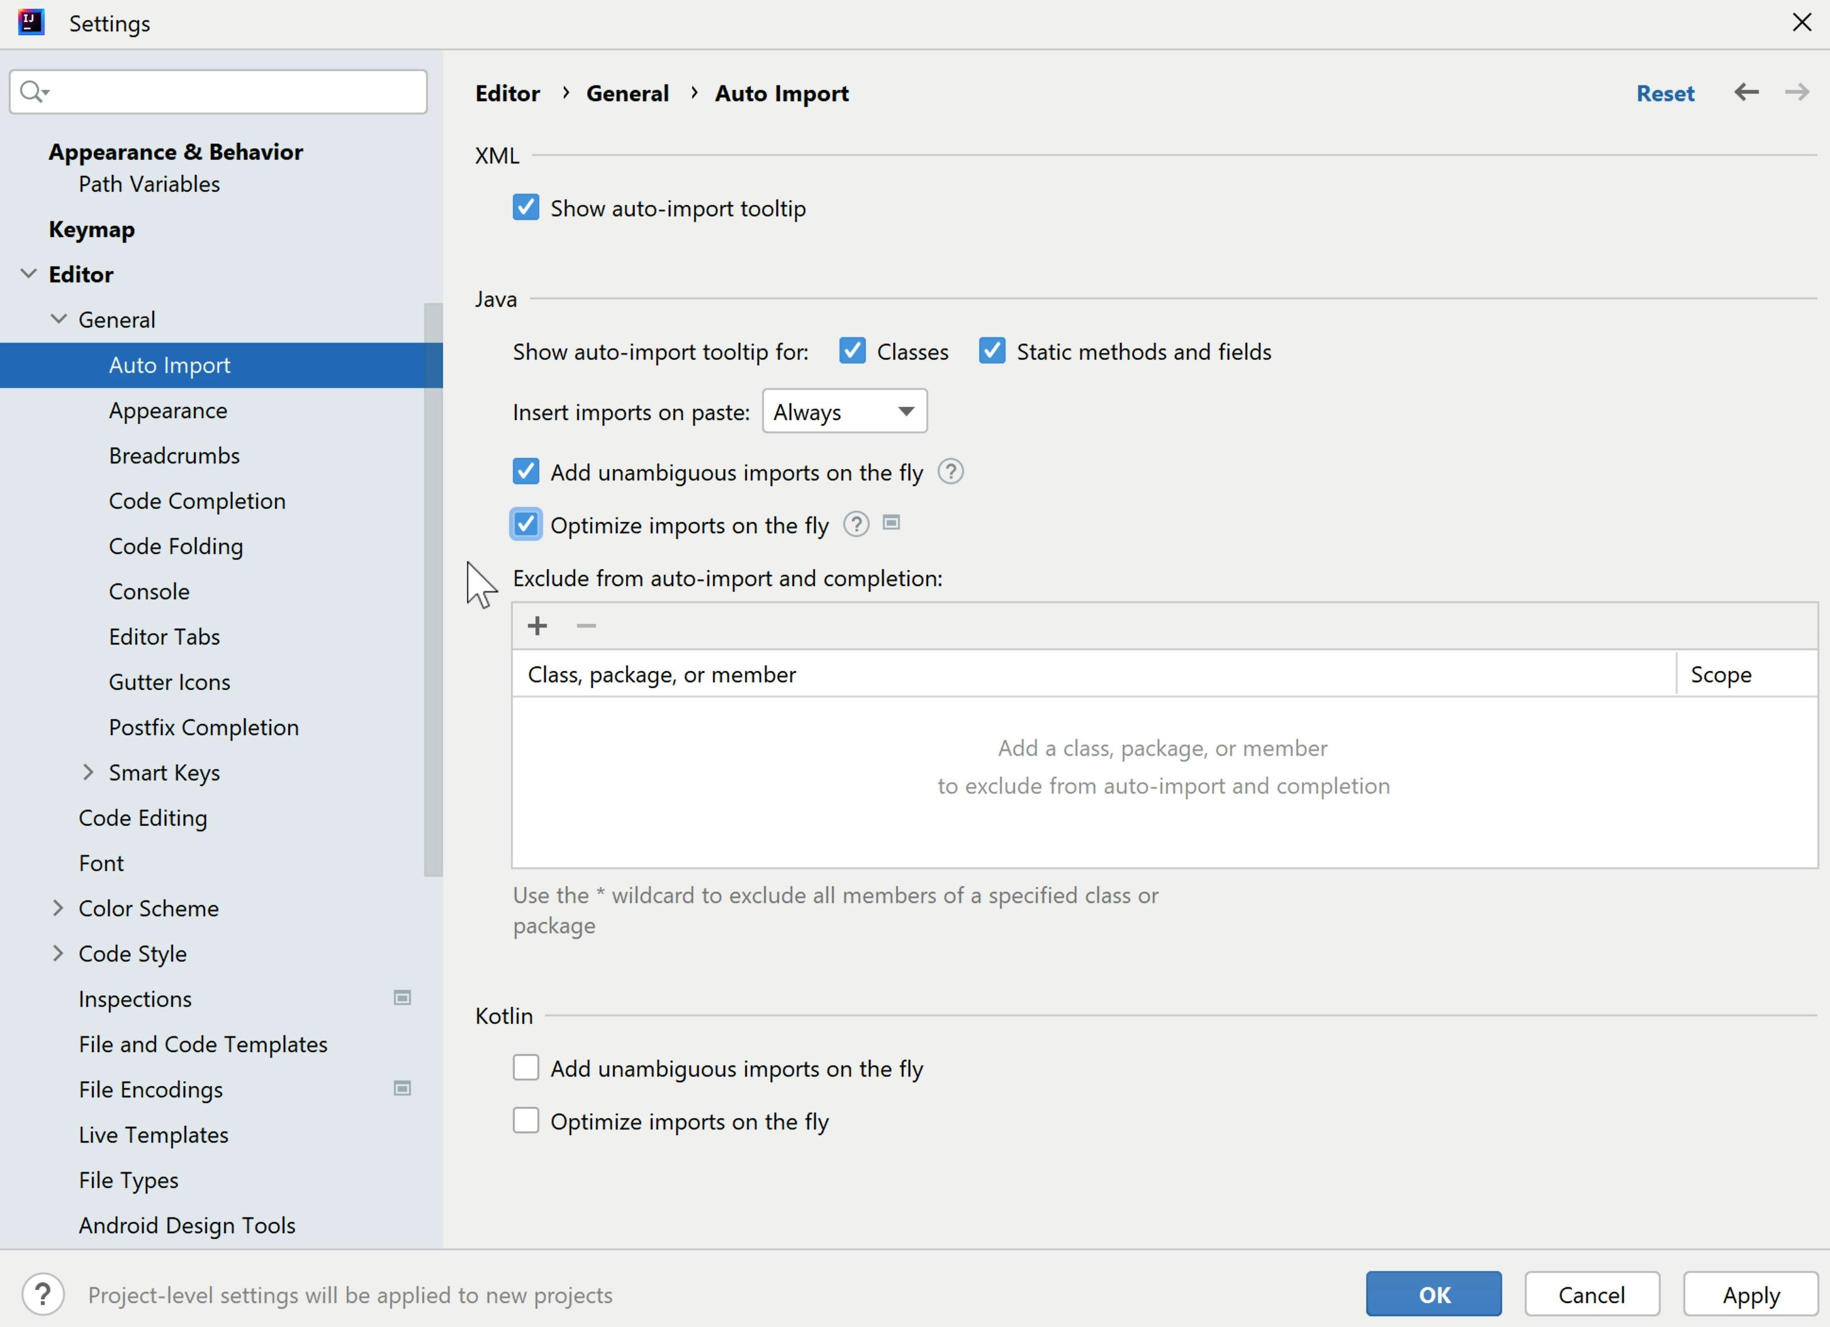
IntelliJ Auto-import setting
Earlier in the course, when I configured IntelliJ with a number of different settings, I recommended that you enable these two options in the Auto Import menu.
Add unambiguous imports on the fly and Optimise imports on the fly.
If you enable these options, then IntelliJ will automatically add and/or remove import statements as required. You almost always want to enable these options.
Let's go back to the code so I can show you what I mean.
COMPLETE JAVA MASTERCLASS
Exception Handling, and Introduction to Scanner

Slide 93
Reading User Input Challenge
Alright, so we've covered a lot of ground in the last few videos.
It's time now for a challenge.
This is the Reading User Input Challenge.
COMPLETE JAVA MASTERCLASS
Reading User Input Challenge

Slide 94
Reading User Input Challenge
In this challenge, you'll read 5 valid numbers from the console entered by the user and print the sum of those ten numbers.
By valid numbers, I mean you need to check that the numbers entered are valid integers.
If they are not, print out the message "Invalid number" to the console, but continue looping until you do have 5 valid numbers.
Before the user enters each number, prompt them with the message, "Enter number #x:", where x represents the count 1, 2, 3, etc.
As an example, the first message would look something like, "Enter number #1:", the next, "Enter number #2:", and so on.
COMPLETE JAVA MASTERCLASS
Reading User Input Challenge

Slide 95
Min and Max Challenge
Alright. So, it's time for your next challenge.
This is the minimum and maximum challenge.
The challenge is similar to the last one in some ways.
COMPLETE JAVA MASTERCLASS
Min and Max Challenge

Slide 96
Min and Max Challenge
You'll be using an endless loop which:
Prompts the user to enter a number or any character to quit.
Validates if the user-entered data really is a number. You can choose either an integer or double validation method.
If the user-entered data is not a number, quit the loop.
Keep track of the minimum number entered.
Keep track of the maximum number entered.
If the user has previously entered a set of numbers (or even just one), display the minimum and maximum number that the user entered.
COMPLETE JAVA MASTERCLASS
Min and Max Challenge

