Slide 1

Composition, Encapsulation, and Polymorphism
As promised, this is part 2 of the object-oriented programming section of the course.
We've now covered the basics of object-oriented programming.
It's now time, to look at the remaining 3 major components of object-oriented programming.
COMPLETE JAVA MASTERCLASS
Introduction

Slide 2
Composition, Encapsulation, and Polymorphism
These are Composition, Polymorphism, and also Encapsulation.
By the end of this section, you should have a solid overview of what these concepts are, and also how to apply them to your programs.
Let's make a start on that right now.
COMPLETE JAVA MASTERCLASS
Introduction

Slide 3
Composition
It's time now to talk about composition.
Composition is another component of object-oriented programming.
COMPLETE JAVA MASTERCLASS
Composition Part 1

Slide 4
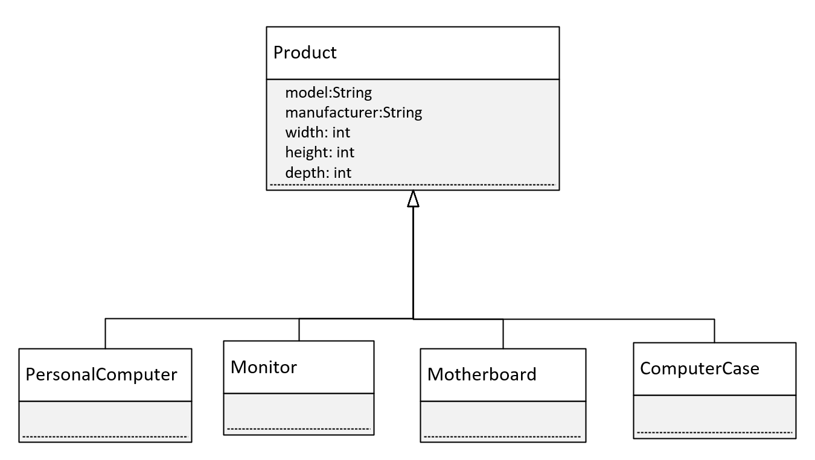
Inheritance
In this instance, we have a base class called Product.
All of our computer parts are going to inherit from Product.
All our parts will then have the same set of attributes, a manufacturer and model, and dimensions, the width, height, and depth in other words.
All of these items are products, a particular type of Product.
COMPLETE JAVA MASTERCLASS
Composition Part 1

Slide 5
Inheritance vs. Composition
Inheritance defines an IS A relationship.
Composition defines a HAS A relationship.
COMPLETE JAVA MASTERCLASS
Composition Part 1

Slide 6
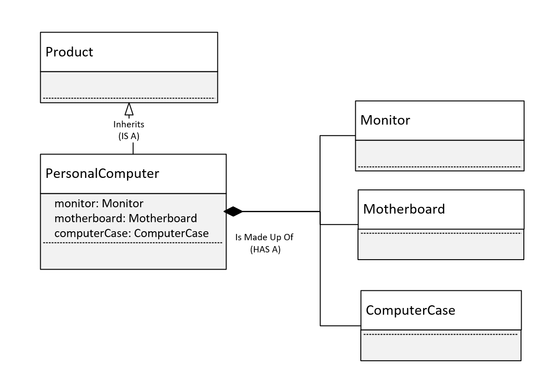
Inheritance vs Composition
To keep this diagram simple, PersonalComputer inherits from Product.
But a Personal Computer, in addition to being a product, is actually made up of other parts.
Composition is actually modeling parts, and those parts make up a greater whole.
In this case we're going to model the personal computer.
And we're modeling the has a relationship, with the motherboard, the case, and the monitor.
COMPLETE JAVA MASTERCLASS
Composition Part 1

Slide 7
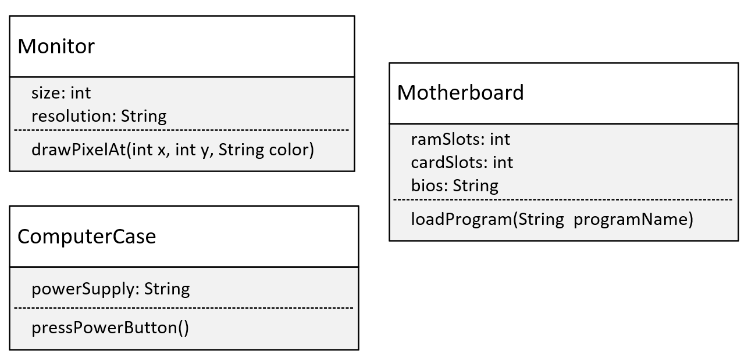
The Parts
This diagram shows the 3 classes that will make up the personal computer.
COMPLETE JAVA MASTERCLASS
Composition Part 1

Slide 8
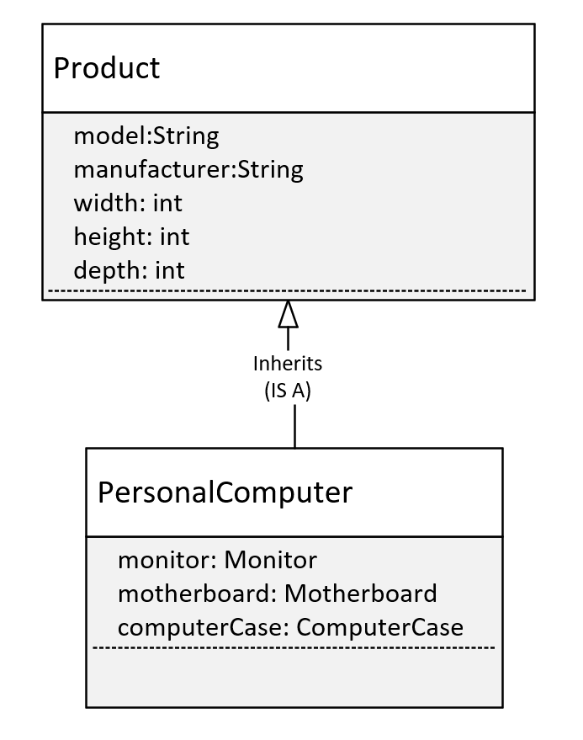
PersonalComputer
This will be our personal computer, and we've said it inherits from Product.
But it also has 3 fields, which are classes, these are Monitor, Motherboard, and ComputerCase.
COMPLETE JAVA MASTERCLASS
Composition Part 1

Slide 9
Composition
We started talking about composition, and compared it to inheritance.
Inheritance is a way to reuse functionality and attributes.
Composition is a way to make the combination of classes, act like a single coherent object.
COMPLETE JAVA MASTERCLASS
Composition Part 2

Slide 10
Composition is creating a whole from different parts
We built this personal computer, by passing objects, to the constructor, like assembling the computer.
We can actually hide the functionality further.
In this case, we're not going to allow the calling program, to access those objects, the parts, directly.
We don't want anybody to access the Monitor, Motherboard, or ComputerCase directly.
COMPLETE JAVA MASTERCLASS
Composition Part 2

Slide 11
Use Composition or Inheritance or Both?
As a general rule, when you're designing your programs in Java, you probably want to look at composition first.
Most of the experts will tell you, that as a rule, look at using composition before implementing inheritance.
You saw in this example, we actually used both.
All of our parts were able to inherit a set of attributes, like the manufacturer and model.
The calling code didn't have to know anything about these parts, to get Personal Computer to do something.
COMPLETE JAVA MASTERCLASS
Composition Part 2

Slide 12
Why is Composition preferred over Inheritance in many designs?
The reasons composition is preferred over inheritance:
Composition is more flexible. You can add parts in, or remove them, and these changes are less likely to have a downstream effect.
Composition provides functional reuse outside of the class hierarchy, meaning classes can share attributes & behavior, by having similar components, instead of inheriting functionality from a parent or base class.
Java's inheritance breaks encapsulation, because subclasses may need direct access to a parent's state or behavior.
COMPLETE JAVA MASTERCLASS
Composition Part 2

Slide 13
Why is Inheritance less flexible?
Inheritance is less flexible.
Adding a class to, or removing a class from, a class hierarchy, may impact all subclasses from that point.
In addition, a new subclass may not need all the functionality or attributes of its parent class.
COMPLETE JAVA MASTERCLASS
Composition Part 2

Slide 14
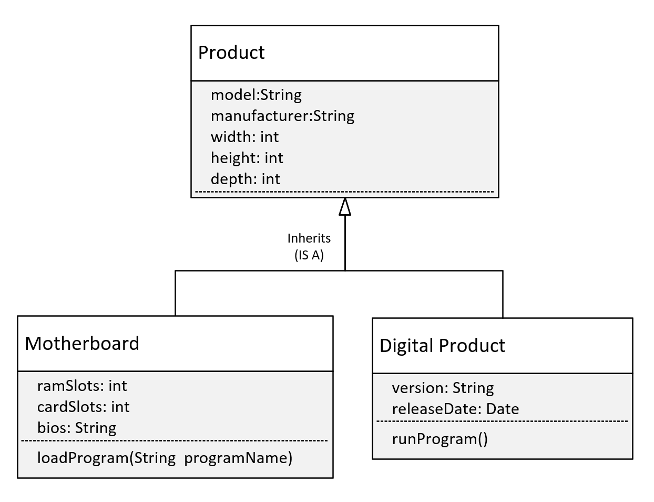
Adding a Digital Product
Let's say we want to include digital products, like software products, in our product inventory.
Should Digital Product inherit from Product?
Here we show the model with Digital Product, inheriting from our current definition of Product.
If we do this, this should mean Digital Product has Product's attributes, but this isn't true now.
COMPLETE JAVA MASTERCLASS
Composition Part 2

Slide 15
Adding a Digital Product
A digital product wouldn't really have width, height, and depth, so this model isn't a good representation of what we want to build.
It would be better if we didn't have those three attributes on Product, but instead used composition to include them on certain products, but not all products.
COMPLETE JAVA MASTERCLASS
Composition Part 2

Slide 16
Revised Class Diagram
Consider this revised class diagram.
We haven't completely removed the class hierarchy, but we've made the base class, Product more generic.
Product
model: String
manufacturer: String
Inherits
(IS A)
Motherboard
Dimensions
(HAS A)
ramSlots: int
cardSlots: int
bios: String
dimensions:Dimensions
width: int
height: int
depth: int
loadProgram(String programName)
COMPLETE JAVA MASTERCLASS
Composition Part 2

Slide 17
Revised Class Diagram
We've removed the width, height, and depth attributes from Product, and made a new class, Dimensions, with those attributes.
And we've added an attribute to Motherboard, which is dimensions, which has those attributes.
Product
model: String
manufacturer: String
Inherits
(IS A)
Motherboard
Dimensions
(HAS A)
ramSlots: int
cardSlots: int
bios: String
dimensions:Dimensions
width: int
height: int
depth: int
loadProgram(String programName)
COMPLETE JAVA MASTERCLASS
Composition Part 2

Slide 18
Revised Class Diagram
Is this a better model?
Well, it's more flexible.
This design allows for future enhancements to be made, like the addition of the subclass Digital Product, without causing problems for existing code, that may already be extending Product.
By pulling width, height, and depth, into a dimension class, we can use composition, to apply those attributes to any product.
Product
model: String
manufacturer: String
Inherits
(IS A)
Motherboard
Dimensions
(HAS A)
ramSlots: int
cardSlots: int
bios: String
dimensions:Dimensions
width: int
height: int
depth: int
loadProgram(String programName)
COMPLETE JAVA MASTERCLASS
Composition Part 2

Slide 19
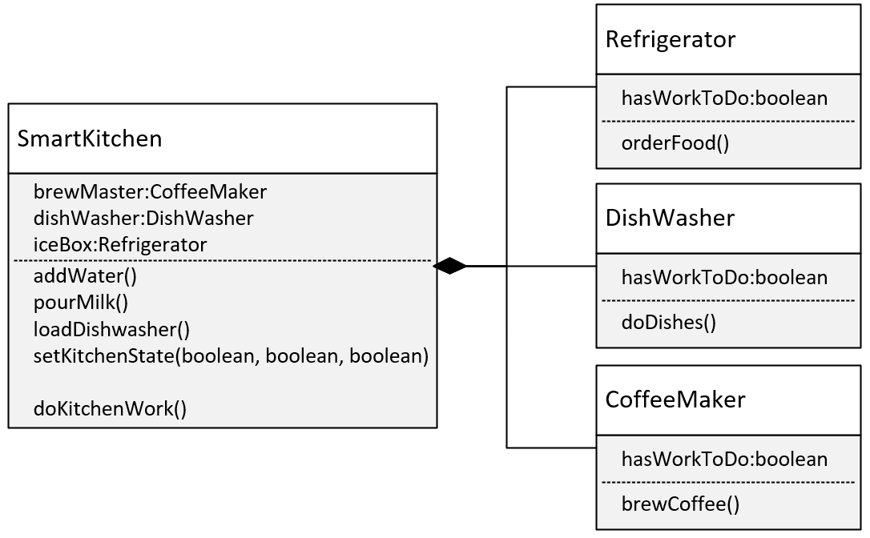
The Composition Challenge
In this challenge, you need to create an application for controlling a smart kitchen.
Your smart kitchen will have several appliances.
Your appliances will be Internet Of Things (IoT) devices, which can be programmed.
COMPLETE JAVA MASTERCLASS
Composition Challenge

Slide 20
The Composition Challenge
It's your job to write the code, to enable your Smart Kitchen application, to execute certain jobs.
Methods on your SmartKitchen class, will determine what work needs to be done:
addWater() will set the Coffee Maker's hasWorkToDo field to true.
pourMilk() will set Refrigerator's hasWorkToDo to true.
loadDishwasher() will set the hasWorkToDo flag to true, on that appliance.
Alternately, you could have a single method, called setKitchenState, that takes three boolean values, which could combine the three methods above.
COMPLETE JAVA MASTERCLASS
Composition Challenge

Slide 21
The Composition Challenge
To execute the work needed to be done by the appliances, you'll implement this in two ways:
First, your application will access each appliance (by using a getter), and execute a method.
The appliance methods are orderFood() on Refrigerator, doDishes() on DishWasher, and brewCoffee() on CoffeeMaker.
These methods should check the hasWorkToDo flag, and if true, print a message out, about what work is being done.
Second, your application won't access the appliances directly.
It should call doKitchenWork(), which delegates the work, to any of its appliances.
COMPLETE JAVA MASTERCLASS
Composition Challenge

Slide 22
What does Encapsulation Mean?
In Java, encapsulation means hiding things, by making them private, or inaccessible.
COMPLETE JAVA MASTERCLASS
Encapsulation, Part 1

Slide 23
Why hide things?
Why would we want to hide things in Java?
To make the interface simpler, we may want to hide unnecessary details.
To protect the integrity of data on an object, we may hide or restrict access to some of the data and operations.
To decouple the published interface from the internal details of the class, we may hide actual names and types of class members.
COMPLETE JAVA MASTERCLASS
Encapsulation, Part 1

Slide 24
What do we mean by interface here?
Although Java has a type called interface, that's not what we're talking about here.
When we talk about a class's public or published interface, we're really talking about the class members that are exposed to, or can be accessed by, the calling code.
Everything else in the class is internal, or private to it.
An application programming interface, or API, is the public contract, that tells others how to use the class.
COMPLETE JAVA MASTERCLASS
Encapsulation, Part 1

Slide 25
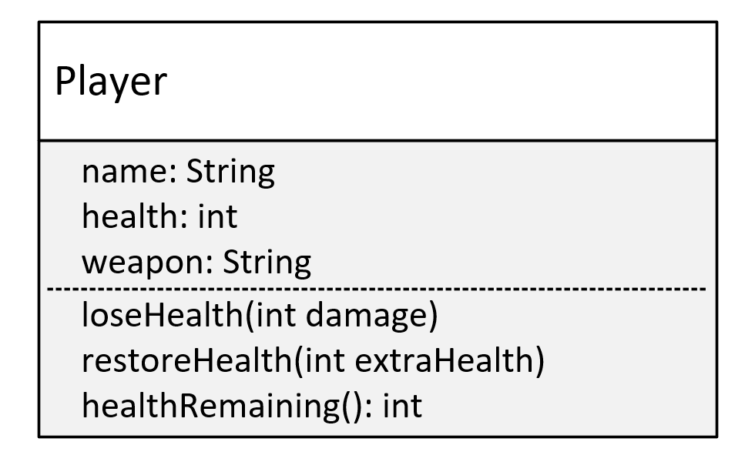
The Player Class
This is the model for a Player class.
The Player will have three variables: name, health, and weapon.
And this class will have three methods, loseHealth(), restoreHealth(), and healthRemaining(), which I'll explain in a bit.
And we're going to create this class without using encapsulation.
COMPLETE JAVA MASTERCLASS
Encapsulation, Part 1

Slide 26
Problem One
Allowing direct access to data on an object, can potentially bypass checks, and additional processing, your class has in place to manage the data.
COMPLETE JAVA MASTERCLASS
Encapsulation, Part 1

Slide 27
Problem Two
Allowing direct access to fields, means calling code would need to change, when you edit any of the fields.
COMPLETE JAVA MASTERCLASS
Encapsulation, Part 1

Slide 28
Problem Three
Omitting a constructor, that would accept initialization data, may mean the calling code is responsible for setting up this data, on the new object.
COMPLETE JAVA MASTERCLASS
Encapsulation, Part 1

Slide 29
The problems when classes aren't properly encapsulated
Allowing direct access to data on an object, can bypass checks and operations.
It encourages an interdependency, or coupling, between the calling code and the class.
For the previous example, we showed that changing a field name, broke the calling code.
And we also showed, that the calling code had to take on the responsibility, for properly initializing a new Player.
COMPLETE JAVA MASTERCLASS
Encapsulation, Part 2

Slide 30
Benefits of Encapsulation
That's really one of the huge benefits of encapsulation, is that you're not actually affecting any other code.
It's sort of like a black box in many ways.
But the EnhancedPlayer class has more control over it's data.
COMPLETE JAVA MASTERCLASS
Encapsulation, Part 2

Slide 31
Staying in Control
This is why we want to use encapsulation.
We protect the members of the class, and some methods, from external access.
This prevents calling code from bypassing the rules and constraints, we've built into the class.
When we create a new instance, it's initialized with valid data.
But likewise, we're also making sure that there's no direct access to the fields.
That's why you want to always use encapsulation.
It's something that you should really get used to.
COMPLETE JAVA MASTERCLASS
Encapsulation, Part 2

Slide 32
Encapsulation Principles
To create an encapsulated class, you want to:
Create constructors for object initialization, which enforces that only objects with valid data will get created.
Use the private access modifier for your fields.
Use setter and getter methods sparingly, and only as needed.
Use access modifiers that aren't private, only for the methods that the calling code needs to use.
COMPLETE JAVA MASTERCLASS
Encapsulation, Part 2

Slide 33
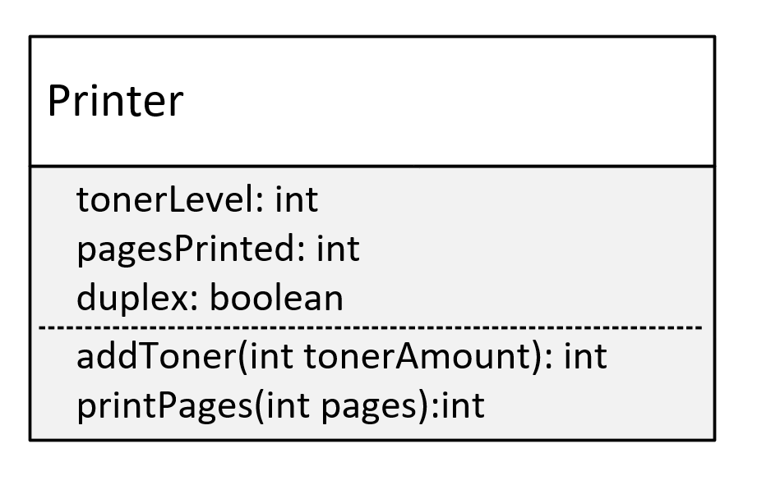
Encapsulation Challenge
In this challenge, you need to create a class named Printer.
The fields on this class are going to be:
tonerLevel, which is the percentage of how much toner level is left.
pagesPrinted, which is the count of total pages printed by the Printer.
duplex, which is a boolean indicator. If true, it can print on 2 sides of a single sheet of paper.
You'll want to initialize your printer, by specifying a starting toner amount, and whether the printer is duplex or not.
COMPLETE JAVA MASTERCLASS
Encapsulation Challenge

Slide 34
Encapsulation Challenge
On the Printer class, you want to create two methods, which the calling code should be able to access.
These methods are:
addToner() which takes a tonerAmount argument.
tonerAmount is added to the tonerLevel field.
The tonerLevel should never exceed 100 percent, or ever get below 0 percent.
If the amount being added makes the level fall outside that range, return a -1 from the method, otherwise return the actual toner level.
COMPLETE JAVA MASTERCLASS
Encapsulation Challenge

Slide 35
Encapsulation Challenge
printPages() which should take pages to be printed as the argument.
It should determine how many sheets of paper, will be printed based on the duplex value, and return this sheet number from the method.
The sheet number should also be added to the pagesPrinted variable.
If it's a duplex printer, print a message that it's a duplex printer.
COMPLETE JAVA MASTERCLASS
Encapsulation Challenge

Slide 36
Polymorphism
Simply stated, polymorphism, means many forms.
How does this apply to code?
COMPLETE JAVA MASTERCLASS
Polymorphism, Part 1

Slide 37
Polymorphism
Polymorphism lets us write code to call a method, but at runtime, this method's behavior can be different, for different objects.
This means the behavior that occurs, while the program is executing, depends on the runtime type of the object.
And the runtime type, might be different from the declared type in the code.
The declared type has to have some kind of relationship to the runtime type, and inheritance is one way to establish this relationship.
There are other ways, but in this video, we'll talk about how to use inheritance, to support polymorphism.
COMPLETE JAVA MASTERCLASS
Polymorphism, Part 1

Slide 38
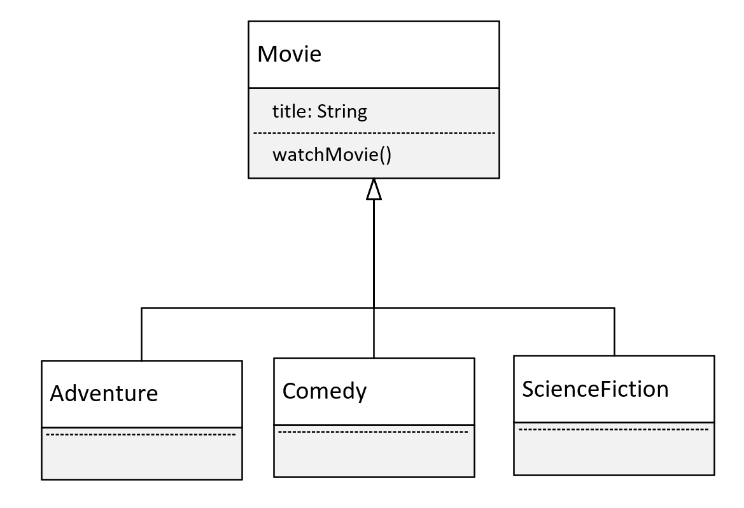
Movie Genres
This time, we're going to look at a polymorphism example, using movies.
We'll have a base class of Movie, which has the title of the movie.
And Movie will have one method, watchMovie.
COMPLETE JAVA MASTERCLASS
Polymorphism, Part 1

Slide 39
Movie Genres
We'll have 3 subclasses, each a different kind of movie.
We'll have an Adventure film, a Comedy, and a Science Fiction movie.
These are the different categories, so we'll use these as the subclasses.
All of these will override, and implement unique behavior, for the watchMovie method.
COMPLETE JAVA MASTERCLASS
Polymorphism, Part 1

Slide 40
Imports
In the Exception handling video in section 6, I showed you how to manually add import lines.
Because I still have Auto Imports enabled, you just saw how IntelliJ added the import for me automatically. Pretty nice, right?
COMPLETE JAVA MASTERCLASS
Polymorphism, Part 2

Slide 41
Polymorphism in action
That was polymorphism in action.
It's the ability to execute different behavior, for different types, which are determined at runtime.
And yet we did it with just two statements, in the main method, as shown here.
Polymorphism enables you to write generic code, based on the base class, or a parent class.
And this code, in the main method, is extendable, meaning it doesn't have to change, as new subclasses become available.
This code can handle any instances that are a Movie, or a subclass of movie, that are returned from the factory method.
COMPLETE JAVA MASTERCLASS
Polymorphism, Part 2

Slide 42
What is var?
var, is a special contextual keyword in Java, that lets our code take advantage of Local Variable Type Inference.
By using var as the type, we're telling Java to figure out the compile-time type for us.
COMPLETE JAVA MASTERCLASS
Casting with classes, and using Object and var references

Slide 43
Local Variable Type Inference (LVTI)
Local Variable Type Inference was introduced in Java 10.
One of the benefits is to help with the readability of the code, and to reduce boilerplate code.
It's called Local Variable Type Inference for a reason, because:
It can't be used in field declarations on a class.
It can't be used in method signatures, either as a parameter type or a return type.
It can't be used without an assignment, because the type can't be inferred in that case.
It can't be assigned a null literal, again because a type can't be inferred in that case.
COMPLETE JAVA MASTERCLASS
Casting with classes, and using Object and var references

Slide 44
Run Time vs. Compile Time Typing
Are you still confused about the difference between run time and compile time typing?
You can think of the compile time type as the declared type.
This type is declared either as a variable reference, or a method return type, or a method parameter, for example.
In the case of LVTI, we don't declare a type for the compiled reference type, it gets inferred, but the byte code is the same, as if we had declared it.
COMPLETE JAVA MASTERCLASS
Casting with classes, and using Object and var references

Slide 45
Run Time vs. Compile Time Typing
In many cases, the compile time type, is the declared type to the left of the assignment operator.
What is returned on the right side of the assignment operator, from whatever expression or method is executed, sometimes can only be determined at runtime, when the code is executing conditionally, through the statements in the code.
You can assign a runtime instance, to a different compile time type, only if certain rules are followed.
In this course, up to now, we've looked at only one rule that applies, and that's the inheritance rule.
We can assign an instance to a variable of the same type, or a parent type, or a parent's parent type, including java.lang.Object, the ultimate base class.
COMPLETE JAVA MASTERCLASS
Casting with classes, and using Object and var references

Slide 46
Run Time vs. Compile Time Typing
Why are runtime types different than compile time types?
Because of polymorphism.
Polymorphism lets us write code once, in a more generic fashion, like the code we started this lecture with.
We saw that those two lines of code, using a single compile time type of Movie, actually supported four different runtime types.
Each type was able to execute behavior unique to the class.
COMPLETE JAVA MASTERCLASS
Casting with classes, and using Object and var references

Slide 47
Evaluating what the runtime type is
And how do we test what the runtime type, of a variable really is at runtime, if the declared type is something else?
We can test to see what type the actual object is, at runtime, in several different ways.
COMPLETE JAVA MASTERCLASS
Testing the runtime type using the instanceof operator

Slide 48
instanceof operator
The instanceof operator, lets you test the type of an object or instance.
The reference variable you are testing, is the left operand.
The type you are testing for, is the right operand.
It's important to see that Adventure is not in quotes, meaning we're not testing the type name, but the actual type.
This operator returns true, if unknownObject is an instance of Adventure.
COMPLETE JAVA MASTERCLASS
Testing the runtime type using the instanceof operator

Slide 49
Pattern Matching for the instanceof Operator
If the JVM can identify that the object matches the type, it can extract data from the object, without casting.
For this operator, the object can be assigned to a binding variable, which here is called syfy.
From our example:
The variable syfy (if the instanceof method returns true) is already typed as a ScienceFiction variable.
COMPLETE JAVA MASTERCLASS
Testing the runtime type using the instanceof operator

Slide 50
Polymorphism Challenge
Welcome to the Polymorphism Challenge video.
We've said, that polymorphism really just means many forms.
What we want to do in this challenge, is have our runtime code execute different behavior, for different objects.
COMPLETE JAVA MASTERCLASS
Polymorphism Challenge Exercise

Slide 51
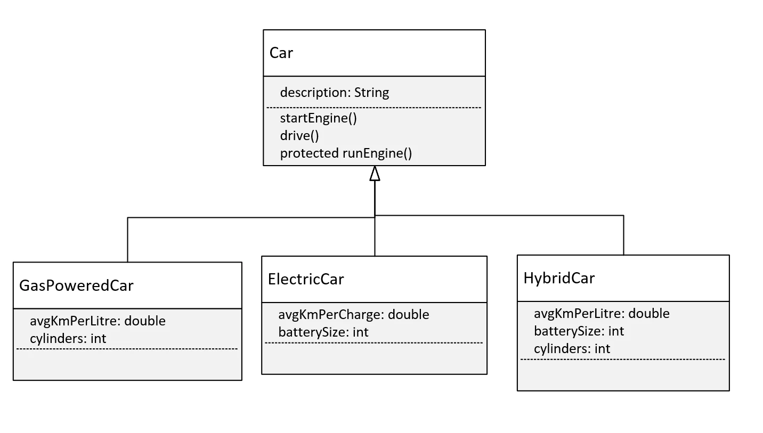
The Challenge, the Car Class Diagram
Let's talk about what I want you to do in this challenge.
This diagram shows a base class, Car, with one field, description, and three methods, startEngine(), drive() and runEngine().
The first two methods should be declared as public.
The method runEngine however, is protected, and it will only get called from the drive method in Car.
COMPLETE JAVA MASTERCLASS
Polymorphism Challenge Exercise

Slide 52
The Challenge, the Car Class Diagram
And here, we've given you three types of subclasses, or three types of cars that you might find on the road.
We have the GasPoweredCar, the ElectricCar, and the HybridCar.
You can imagine that these three subclasses, might have different ways to start their engine, or drive, depending on their engine type.
And each of these classes might have different variables or fields, that might be used in those methods.
COMPLETE JAVA MASTERCLASS
Polymorphism Challenge Exercise

Slide 53
The Challenge, the Car Class Diagram
It's your job, to create this class structure in Java, and override some, or maybe all, of these methods appropriately.
And you'll write code in a Main class and main method, that creates an instance of each of these classes, and that executes different behavior for each instance.
At least one method should print the type of the runtime object.
COMPLETE JAVA MASTERCLASS
Polymorphism Challenge Exercise

Slide 54

The Challenge, the Car Class Diagram
COMPLETE JAVA MASTERCLASS
Polymorphism Challenge Exercise, Part 2

Slide 55
Welcome to the Object-Oriented Programming Master Challenge!
Congratulations, you've made it to the object-oriented programming master challenge.
In this challenge, we're going to build a complete application, using all the principles of object-oriented programming, we've covered in the last two sections of this course.
COMPLETE JAVA MASTERCLASS
OOP Master Challenge Exercise, Part 1

Slide 56
Bill's Burger Challenge
Bill runs a fast food hamburger restaurant, and sells hamburger meals.
His meal orders are composed of three items, the hamburger, the drink, and the side item.
Your application lets Bill select the type of burgers, and some of the additional items, or extras, that can be added to the burgers, as well as the actual pricing.
COMPLETE JAVA MASTERCLASS
OOP Master Challenge Exercise, Part 1

Slide 57
Bill's Burger Challenge - The objects
You need a meal order.
This should be composed of exactly one burger, one drink, and one side item.
The most common meal order should be created without any arguments, like a regular burger, a small coke, and fries, for example.
You should be able to create other meal orders, by specifying different burgers, drinks, and side items.
You need a drink, and side item.
The drink should have at least a type, size and price, and the price of the drink should change for each size.
The side item needs at least a type and price.
COMPLETE JAVA MASTERCLASS
OOP Master Challenge Exercise, Part 1

Slide 58
Bill's Burger Challenge - The objects
You need burgers.
Every hamburger should have a burger type, a base price, and up to a maximum of three extra toppings.
The constructor should include only the burger type and price.
Extra Toppings on a burger need to be added somehow, and priced according to their type.
The deluxe burger bonus.
Create a deluxe burger meal, with a deluxe burger, that has a set price, so that any additional toppings do not change the price.
The deluxe burger should have room for an additional two toppings.
COMPLETE JAVA MASTERCLASS
OOP Master Challenge Exercise, Part 1

Slide 59
Bill's Burger Challenge - The functionality
Your main method should have code to do the following:
Create a default meal, that uses the no arguments constructor.
Create a meal with a burger, and the drink and side item of your choice, with up to 3 extra toppings.
Create a meal with a deluxe burger, where all items, drink, side item and toppings up to 5 extra toppings, are included in the burger price.
COMPLETE JAVA MASTERCLASS
OOP Master Challenge Exercise, Part 1

Slide 60
Bill's Burger Challenge - The functionality
For each meal order, you'll want to perform these functions:
Add some additional toppings to the burger.
Change the size of the drink.
Print the itemized list. This should include the price of the burger, any extra toppings, the drink price based on size, and the side item price.
Print the total due amount for the meal.
COMPLETE JAVA MASTERCLASS
OOP Master Challenge Exercise, Part 1

Slide 61
Bill's Burger Challenge - The objects
You need a meal order.
This should be composed of exactly one burger, one drink, and one side item.
The most common meal order should be created without any arguments, like a regular burger, a small coke, and fries, for example.
You should be able to create other meal orders, by specifying different burgers, drinks, and side items.
You need a drink, and side item.
The drink should have at least a type, size and price, and the price of the drink should change for each size.
The side item needs at least a type and price.
COMPLETE JAVA MASTERCLASS
OOP Master Challenge Exercise, Part 1

Slide 62
Bill's Burger Challenge - The objects
You need burgers.
Every hamburger should have a burger type, a base price, and up to a maximum of three extra toppings.
The constructor should include only the burger type and price.
Extra Toppings on a burger need to be added somehow, and priced according to their type.
The deluxe burger bonus.
Create a deluxe burger meal, with a deluxe burger, that has a set price, so that any additional toppings do not change the price.
The deluxe burger should have room for an additional two toppings.
COMPLETE JAVA MASTERCLASS
OOP Master Challenge Exercise, Part 1

Slide 63
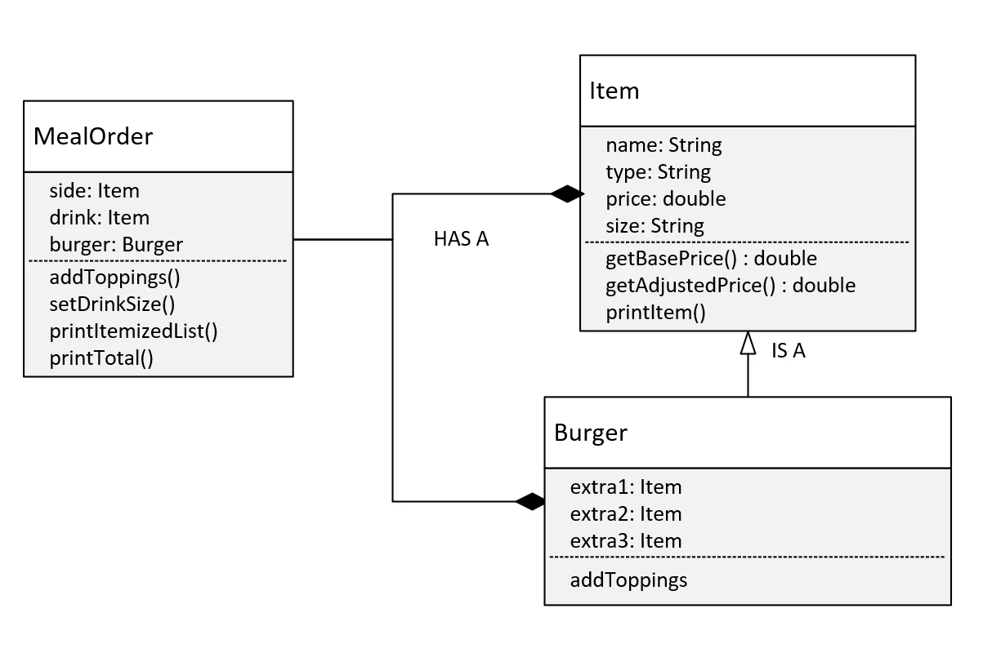
Initial Design Considerations
So here is the diagram of my design.
This diagram doesn't include the DeluxeBurger class. We'll look at that a bit later.
The MealOrder class uses composition in this design. It's composed of a burger, as well as drink and side, which will just be Items.
I've used inheritance for the Item and Burger relationships, which means Burger is an Item.
Every Item has a name, type, price or base price, and a size.
COMPLETE JAVA MASTERCLASS
OOP Master Challenge Exercise, Part 1

Slide 64
Initial Design Considerations
Item has the method getBasePrice, which is really just a getter method for the price, but the name is more descriptive.
Item also has getAdjustedPrice, and the printItem method.
These methods will exhibit different behavior, based on the runtime type, and we know that's polymorphism.
COMPLETE JAVA MASTERCLASS
OOP Master Challenge Exercise, Part 1

Slide 65
Initial Design Considerations
For the burger, the toppings or extras are individual attributes, and also have the type Item.
We're going to use the MealOrder class, to hide some of the implementation details from the calling code.
This means we're going to use encapsulation techniques on MealOrder and Item.
COMPLETE JAVA MASTERCLASS
OOP Master Challenge Exercise, Part 1

Slide 66
Bills Burger Challenge
We'll want to build out the Burger class, which we are saying extends the Item class.
COMPLETE JAVA MASTERCLASS
OOP Master Challenge Exercise, Part 2

Slide 67
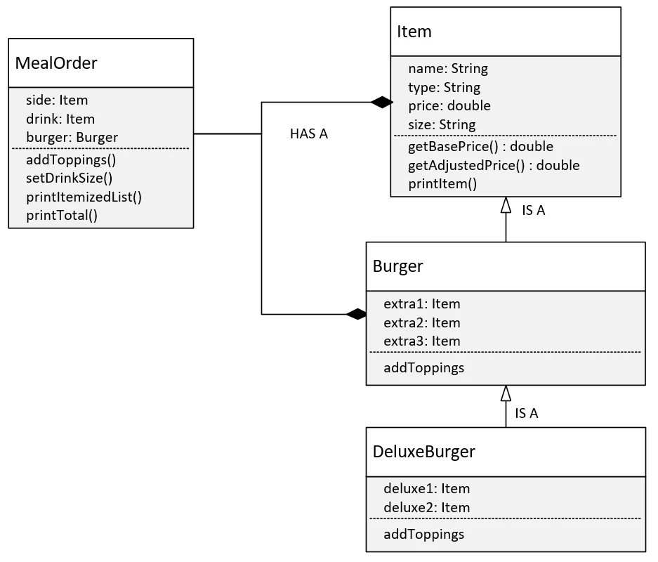
Bills Burger Challenge with the Bonus - the DeluxeBurger
Ok, so in the last video, we created all the classes for a default meal order, and provided methods for adding toppings and customizing a drink size.
Now, we want to create a burger subclass, the DeluxeBurger, which has two additional toppings, so a total of five.
COMPLETE JAVA MASTERCLASS
OOP Master Challenge Exercise, The Bonus

Slide 68
Organizing Java Classes
Up until this point in the class, we haven't created a lot of classes, so we haven't had to think much about organizing those classes.
As the course progresses, we're going to be using more and more of Java's libraries, and our applications are going to get more complex.
This feels like a good time to talk about the package and import statements, in more detail.
We've talked briefly about import statements, when we used the Scanner class, and we mentioned packages when we talked about access modifiers.
In this video, I want to focus on what a package is, why we'll be switching to using it from this period forward, and how to access classes in different packages.
COMPLETE JAVA MASTERCLASS
Organizing Java Classes, Packages and Import Statements

Slide 69
package
As per the Oracle Java Documentation:
A package is a namespace that organizes a set of related types.
In general, a package corresponds to a folder or directory, on the operating system, but this isn't a requirement.
When using an IDE, like IntelliJ, we don't have to worry about how packages and classes are stored on the file system.
COMPLETE JAVA MASTERCLASS
Organizing Java Classes, Packages and Import Statements

Slide 70
package
The package structure is hierarchical, meaning you group types in a tree fashion.
You can use any legal Java identifier for your package names, but common practice has package names as all lower case.
The period separates the hierarchical level of the package.
COMPLETE JAVA MASTERCLASS
Organizing Java Classes, Packages and Import Statements

Slide 71
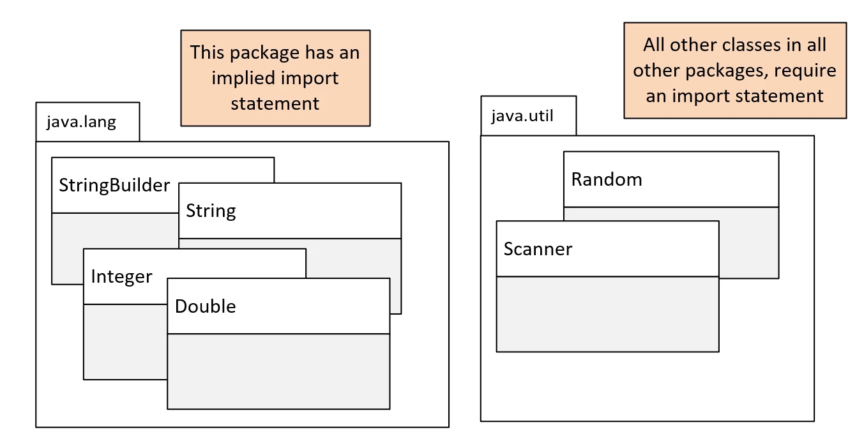
Java packages
By now, you're familiar with two of Java's packages, java.lang, and java.util.
On this slide, we show these two packages, with some of the classes we've used to date, or will use shortly, shown within these packages.
COMPLETE JAVA MASTERCLASS
Organizing Java Classes, Packages and Import Statements

Slide 72
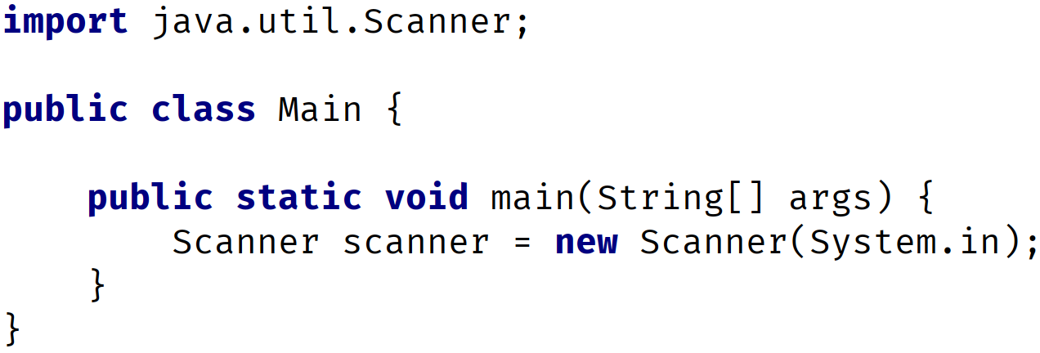
Using classes from packages other than java.lang - the import statement
You may remember, when we used the Scanner class or the Random class, we were required to use an import statement.
We show you an example of using the Scanner class in this code.
The import statement has to be declared before any class or type declarations, but after any package statement.
In this code, we don't have a package statement, so the import statement must be the first statement in the code.
COMPLETE JAVA MASTERCLASS
Organizing Java Classes, Packages and Import Statements

Slide 73
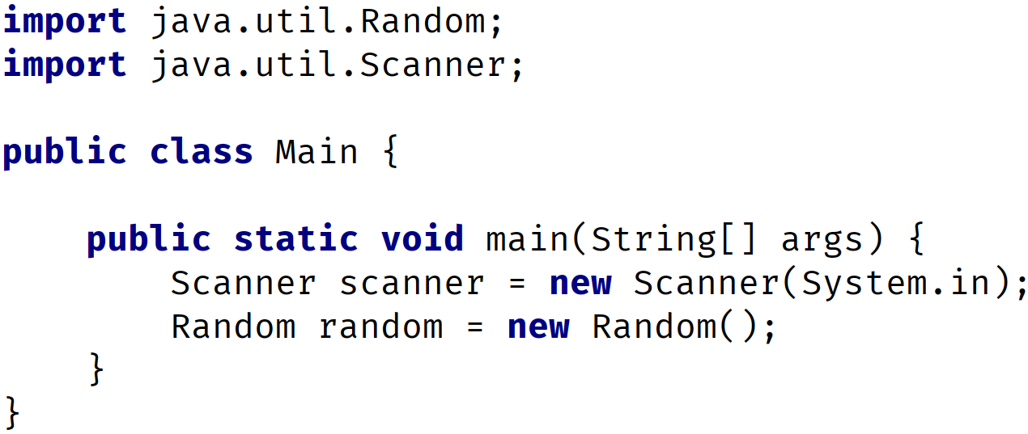
Multiple import statements
There is no limit to the number of import statements you can have.
This code shows two import statements, one for the Random class, and one for the Scanner class.
COMPLETE JAVA MASTERCLASS
Organizing Java Classes, Packages and Import Statements

Slide 74
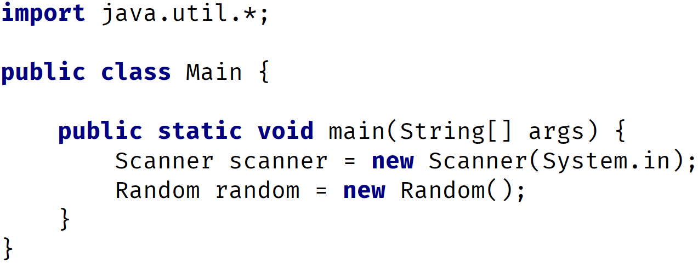
Using import statements with wildcards
Alternately, we could use a wildcard, with the asterisks character, with the import statement.
In the following code, we're telling Java to import all classes from the java.util package, with the use of the asterisks, after the java.util package reference.
COMPLETE JAVA MASTERCLASS
Organizing Java Classes, Packages and Import Statements

Slide 75
What is the purpose of packages?
Packages let us re-use common class names across different libraries or applications, and provide a way to identify the correct class, either with an import statement, or a qualifying name.
For example, you might have a package for utility classes, that can provide common functionality, for all of your classes to access.
Packages let us organize our classes by functionality, or relationships.
Packages also let us encapsulate our classes, from classes in other packages.
So you might have a package of tightly coupled classes, that should only be accessed by each other, but not by the outside world, as an example.
COMPLETE JAVA MASTERCLASS
Organizing Java Classes, Packages and Import Statements

Slide 76
What would a package name look like?
We've seen that Java starts their package names with java, in some of the examples we've looked at.
However, it is common practice, to use the reverse domain name to start your own package naming conventions.
If your company is abccompany.com for example, your package prefixes would be com.abccompany.
For the rest of the course, I'll be using dev.lpa, which is the reverse domain, of my Learn Programming Academy development company.
The package name hierarchy is separated by periods.
COMPLETE JAVA MASTERCLASS
Organizing Java Classes, Packages and Import Statements

Slide 77
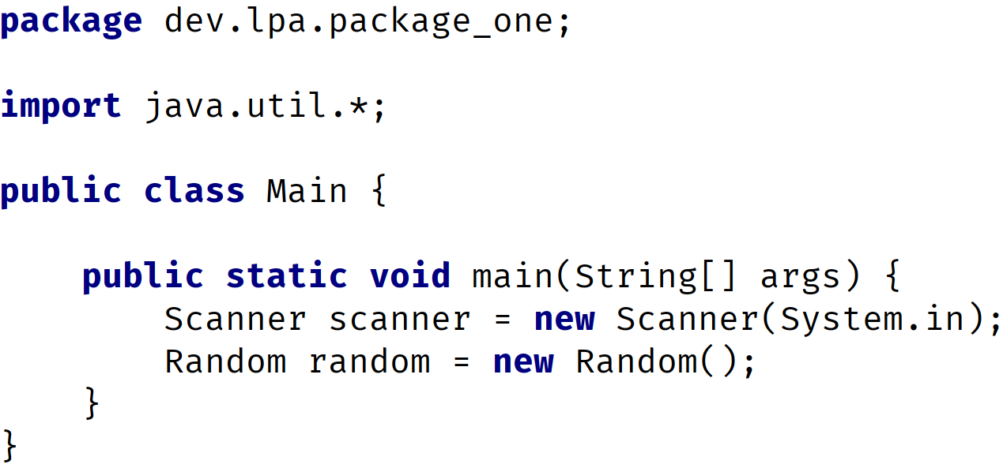
using the package statement
The package statement needs to be the first statement in the code, with the exception of comments.
The package statement comes before any import statements.
There can be only one package statement, because a class or type can only be in a single package.
COMPLETE JAVA MASTERCLASS
Organizing Java Classes, Packages and Import Statements

Slide 78
The Fully Qualified Class Name (FQCN)
In this code, we created a class called Main.
A class's fully qualified class name (FQCN) consists of the package name and the class name.
So this class's fully qualified name is, dev.lpa.package_one.Main.
COMPLETE JAVA MASTERCLASS
Organizing Java Classes, Packages and Import Statements

Slide 79
The Fully Qualified Class Name (FQCN)
It's unlikely this class, with it's fully qualified name, will have a naming conflict, with a Main class in another package.
As another example, the fully qualified class name of the Scanner class in this code, is java.util.Scanner.
COMPLETE JAVA MASTERCLASS
Organizing Java Classes, Packages and Import Statements

Slide 80
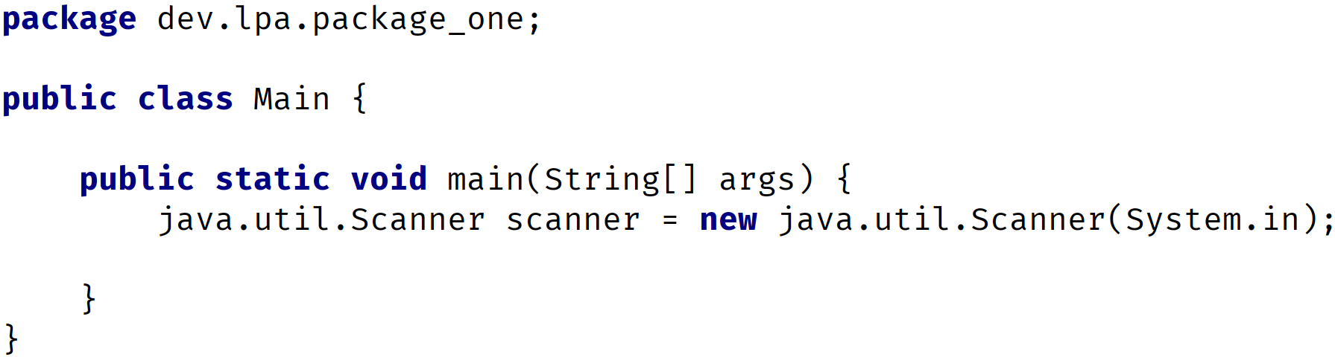
The Fully Qualified Class Name vs the import statement
You can use the fully qualified class name, instead of the import statement as we show you here, on this slide.
This code does not use the import statement, but instead, where the Scanner class is referenced, the fully qualified class name is used.
COMPLETE JAVA MASTERCLASS
Organizing Java Classes, Packages and Import Statements

Slide 81
The Fully Qualified Class Name vs the import statement
You can imagine this could get tedious, if you have to use the type often in your code.
Later in the course, we'll talk about using a combination of the import statement, and the fully qualified class name, to resolve conflicts.
COMPLETE JAVA MASTERCLASS
Organizing Java Classes, Packages and Import Statements

Slide 82
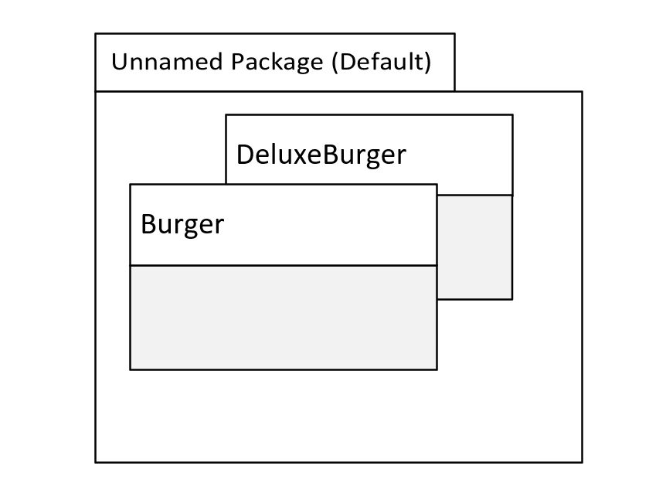
Using the package statement
In this slide, we're showing two classes from our previous challenge, in the unnamed or default package.
This is where classes are implicitly placed, if we don't specify a package statement.
For your applications, you should always specify a package statement, and avoid using the default or unnamed package.
Although that's all we've been using up until now, it has some disadvantages when you work in a true development environment.
COMPLETE JAVA MASTERCLASS
Organizing Java Classes, Packages and Import Statements

Slide 83
Using the package statement
The main disadvantage is you can't import types from the default package into other classes, outside of the default package.
In other words, you can't qualify the name, if it's in the default package, and you can't import classes from the default package.
COMPLETE JAVA MASTERCLASS
Organizing Java Classes, Packages and Import Statements

