Slide 1

Arrays Introduction
Welcome to the Arrays section of the Java Master Class, and congratulations for making it this far.
I hope that as you are progressing through more and more of the course, that your feeling more confident, and getting better at writing Java code.
There's still a lot to learn, and I'll admit, that some of my most favorite features of Java, are still ahead.
In the last two sections, we learned about different ways to create classes, which can have any number and type of data elements.
COMPLETE JAVA MASTERCLASS
Introduction

Slide 2
Arrays Introduction
What we haven't really discussed though, is a way to have multiple values, all of the same type.
We had a taste of this kind of problem, in the Bills Burger challenge.
We had several toppings for our burger, and we had to create individual attributes. This led to inefficient code and other limitations. For example, what if we needed ten toppings? There are much better ways to handle this.
Java provides us with many types of containers, to store multiple values of the same type.
These start with the most basic, which is the array, and that's what this section will cover.
COMPLETE JAVA MASTERCLASS
Introduction

Slide 3
Arrays
Lets look at ways to store, and manipulate, multiple values of the same type.
The most common way to do this, in Java, is with an array.
COMPLETE JAVA MASTERCLASS
Arrays Part 1

Slide 4
Arrays
An array is a data structure, that allows you to store a sequence of values, all of the same type.
You can have arrays for any primitive type, like ints, doubles, booleans, or any of the 8 primitives we've learned about.
You can also have arrays for any class.
COMPLETE JAVA MASTERCLASS
Arrays Part 1

Slide 5
Arrays
Elements in an array are indexed, starting at 0.
If we have an array, storing five names, conceptually it looks as shown here.
e.
The first element is at index 0, and is Andy.
The last element in this array is at index 4, and has the String value Eve.
Index | 0 | 1 | 2 | 3 | 4
Stored values in an array with 5 elements | "Andy" | "Bob" | "Charlie" | "David" | "Eve"
COMPLETE JAVA MASTERCLASS
Arrays Part 1

Slide 6



Declaring an Array
When you declare an array, you first specify the type of the elements you want in the array.
Then you include square brackets in the declaration, which is the key for Java, to identify the variable as an array.
The square brackets can follow the type as shown in the first two examples.
This is much more common.
The brackets can also be after the variable name, as shown in the last example.
You don't specify a size, in the array declaration itself.
Array Variable Declaration
COMPLETE JAVA MASTERCLASS
Arrays Part 1

Slide 7
Instantiating an Array
Array Creation | Object Creation
One way to instantiate the array, is with the new keyword, much as we've seen, with most of the classes we've used to date, with the exception of String.
On this slide, we have an array declaration on the left of the equals sign, and then an array creation expression on the right side.
For comparison, I'm showing you a typical array variable declaration, and a class instance, or object creation expression, using the StringBuilder class.
COMPLETE JAVA MASTERCLASS
Arrays Part 1

Slide 8
Instantiating an Array
Array Creation | Object Creation
They look pretty similar, but there are two major differences.
Square brackets are required when using the new keyword, and a size is specified between them. So in this example, there will be 10 elements in the array.
An array instantiation doesn't have a set of parentheses, meaning we can't pass data to a constructor for an array.
In fact, using parentheses with an array instantiation, gives you a compiler error.
Invalid Array Creation – Compile Error because of ()
COMPLETE JAVA MASTERCLASS
Arrays Part 1

Slide 9
An Array is NOT Resizable.
The size of an array, once created, is fixed.
In this case, integerArray will have 10 elements.
You can't change the size of an array, after the array is instantiated.
We can't add or delete elements, we can only assign values to one of the ten elements in this array, in this example.
Array Creation
COMPLETE JAVA MASTERCLASS
Arrays Part 1

Slide 10
The array initializer
An array initializer, makes the job of instantiating and initializing a small array, much easier.
In this example, you can see we still use the new keyword, and have int, with the square brackets.
But here we specify the values, we want the array to be initialized to, in a comma delimited list, in curly braces.
Because these values are specified, the length of the array can be determined, so we don't specify the size in the square brackets.
And actually, Java provides an even simpler way to do this.
The array initializer
COMPLETE JAVA MASTERCLASS
Arrays Part 1

Slide 11
The array initializer as an anonymous array
Java allows us to drop new int[], from the expression, as we show here.
This is known as an anonymous array.
Here we're showing examples for both an int array, as well as a String array.
An anonymous array initializer, can only be used in a declaration statement.
The array initializer
COMPLETE JAVA MASTERCLASS
Arrays Part 1

Slide 12
What is an array, really?
An array is a special class in Java.
It's still a class.
The array, like all other classes, ultimately inherits from java.lang.Object.
COMPLETE JAVA MASTERCLASS
Arrays Part 2

Slide 13
Array initialization and default element values
When you don't use an array initializer statement, all array elements get initialized to the default value for that type.
For primitive types, this is zero for any kind of numeric primitive, like int, double or short.
For booleans, the default value will be false.
And for any class type, the elements will be initialized to null.
COMPLETE JAVA MASTERCLASS
Arrays Part 2

Slide 14
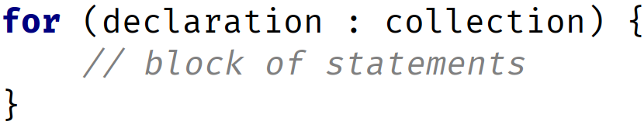
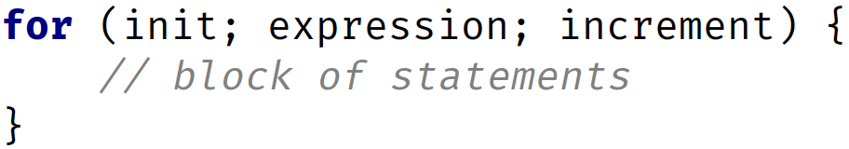
The Enhanced For Loop, the For Each Loop
This loop was designed to walk through elements in an array, or some other type of collection.
It processes one element at a time, from the first element to the last.
Here I show you the syntax for the two types of for loop statements, side by side.
The enhanced for loop only has two components, vs. 3, defined in the parentheses after the for keyword.
Enhanced For Loop | Basic For Loop
COMPLETE JAVA MASTERCLASS
Arrays Part 2

Slide 15
The Enhanced For Loop, the For Each Loop
Enhanced For Loop | Basic For Loop
It's important to notice, that the separator character between components, is a colon, and not a semi-colon, for the Enhanced For Loop.
The first part is a declaration expression, which includes the type and a variable name. This is usually a local variable with the same type as an element in the array.
And the second component is the array, or some other collection variable.
COMPLETE JAVA MASTERCLASS
Arrays Part 2

Slide 16
java.util.Arrays
Java's array type is very basic, it comes with very little built-in functionality.
It has a single property or field, named length.
And it inherits java.util.Object's functionality.
Java provides a helper class named java.util.Arrays, providing common functionality, you'd want for many array operations.
These are static methods on Arrays, so are class methods, not instance methods.
COMPLETE JAVA MASTERCLASS
Arrays Part 2

Slide 17
Printing elements in an array using Arrays.toString()
The toString method on this helper class, prints out all the array elements, comma delimited, and contained in square brackets.
The output from this method is shown here, conceptually.
It prints the element at index 0 first, followed by a comma, then element at index 1 next, comma, and so on, until all elements are printed.
COMPLETE JAVA MASTERCLASS
Arrays Part 2

Slide 18
Why use arrays?
We use arrays to manage many items of the same type.
Some common behavior for arrays would be sorting, initializing values, copying the array, and finding an element.
For an array, this behavior isn't on the array instance itself, but it's provided on a helper class, java.util.Arrays.
COMPLETE JAVA MASTERCLASS
Using java.util.Arrays (sort, fill, copyOf )

Slide 19
Finding a match
There are different algorithms for searching and matching elements in lists.
COMPLETE JAVA MASTERCLASS
Finding a Match, Using a Binary Search and testing equality of arrays

Slide 20
Searching Sequentially
You can hopefully imagine if you were going to start writing code to do this, you might start looping from start to finish, and check each element, to see it it equals what you're looking for.
If you find a match, you'd stop looping, and return that a match was found, either with the position you found the element at, or just a boolean value, true if it was found, and false if not.
This is called a linear search, or sequential, because you're stepping through the elements, one after another.
If your elements are sorted though, using this type of linear search, is unnecessarily inefficient.
COMPLETE JAVA MASTERCLASS
Finding a Match, Using a Binary Search and testing equality of arrays

Slide 21
Using intervals to Search
You split each section up, testing the values at the boundaries, and based on that, split again into smaller sections, narrowing the number of elements to test, each time.
This type of searching, in software, is called interval searching.
Within these two categories, sequential and interval, there are numerous existing algorithms in each.
One of the most common interval searches, is the binary search, which is why Java provides this search, on so many of it's collection classes.
In this search, intervals are continually split into two, hence the word binary.
COMPLETE JAVA MASTERCLASS
Finding a Match, Using a Binary Search and testing equality of arrays

Slide 22
Arrays.binarySearch
The static method, binarySearch, is on the Arrays class.
We can use this method, to test if a value is already in our array, but there are some important things to remember.
First, the array has to be sorted.
Second, if there are duplicate values in the array, there's no guarantee which one it'll match on.
Finally, elements must be comparable. Trying to compare instances of different types, may lead to errors and invalid results.
COMPLETE JAVA MASTERCLASS
Finding a Match, Using a Binary Search and testing equality of arrays

Slide 23
Arrays.binarySearch
This method returns:
The position of a match if found.
It returns a -1 when no match was found.
It's important to remember, that a positive number may not be the position of the first match.
If your array has duplicate values, and you need to find the first element, other methods should be used.
COMPLETE JAVA MASTERCLASS
Finding a Match, Using a Binary Search and testing equality of arrays

Slide 24
The Array Challenge
Create a program using arrays, that sorts a list of integers, in descending order. Descending order means from highest value to lowest.
In other words, if the array has the values 50, 25, 80, 5, and 15, your program should return an array, with the values in the descending order: 80, 50, 25, 15, and 5.
First, create an array of randomly generated integers.
Print the array before you sort it.
And print the array after you sort it.
You can choose to create a new sorted array, or just sort the current array.
COMPLETE JAVA MASTERCLASS
Arrays Challenge Exercise

Slide 25
Arrays Recap
Alright, I want to recap what we've learned so far about arrays, and discuss some of the common errors, that occur using arrays.
COMPLETE JAVA MASTERCLASS
Arrays Recap

Slide 26
Arrays Recap
An array is a data structure that allows us to store multiple values, of the same type, in a single variable.
The default values of numeric array elements are set to zero.
Arrays are zero indexed, so an array with n elements, is indexed from 0 to n - 1, for example, 10 elements would have the index range from 0 through 9.
If we try to access an index that is out of range, Java will give us an ArrayIndexOutOfBoundsException, which indicates that the index is out of range, in other words, out of bounds.
To access array elements, we use square braces. This is also known as the array access operator.
COMPLETE JAVA MASTERCLASS
Arrays Recap

Slide 27
Arrays Recap - Creating a New Array
This array contains the elements from array[0], through to array[4].
It has 5 elements, and an index range, from 0 to 4.
The new operator or keyword, is used to create the array, and initialize the array elements to their default values.
In this example, all the array elements will default to zero, because it is an int array.
For boolean arrays, elements would be initialized to false.
If you use String or other objects, they would be set to null, or a null reference.
COMPLETE JAVA MASTERCLASS
Arrays Recap

Slide 28
Arrays Recap - Creating a new Array
We can also initialize an array inline, using an array initializer block, as we show here.
We define the values for the array, in curly braces, in the order we want them assigned, each value separated by a comma.
This way of initializing array elements, is also known as an anonymous array.
It has 5 elements, and an index range from 0 to 4.
In this example, the array elements are initialized to 5 down to 1.
COMPLETE JAVA MASTERCLASS
Arrays Recap

Slide 29
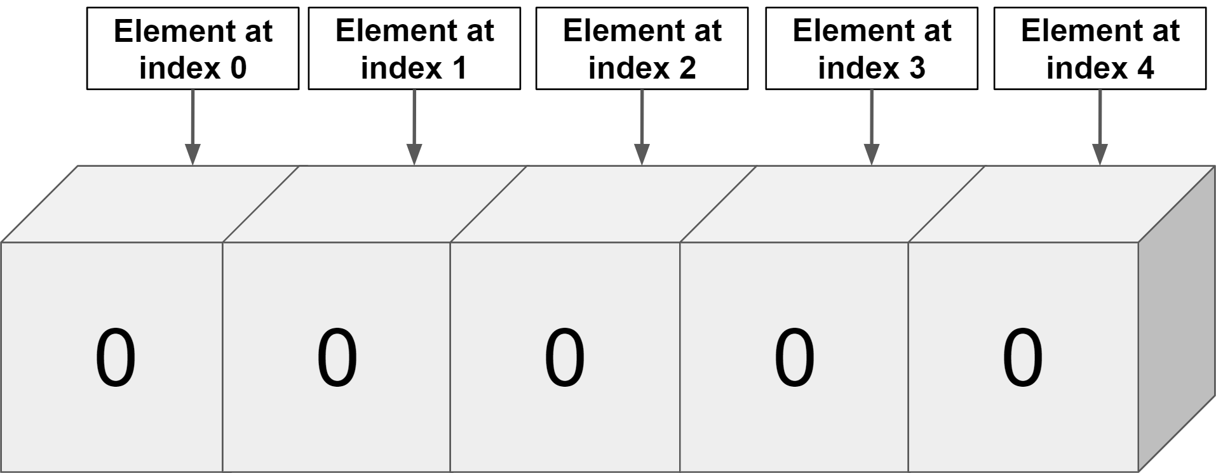
Arrays Recap
COMPLETE JAVA MASTERCLASS
Arrays Recap

Slide 30
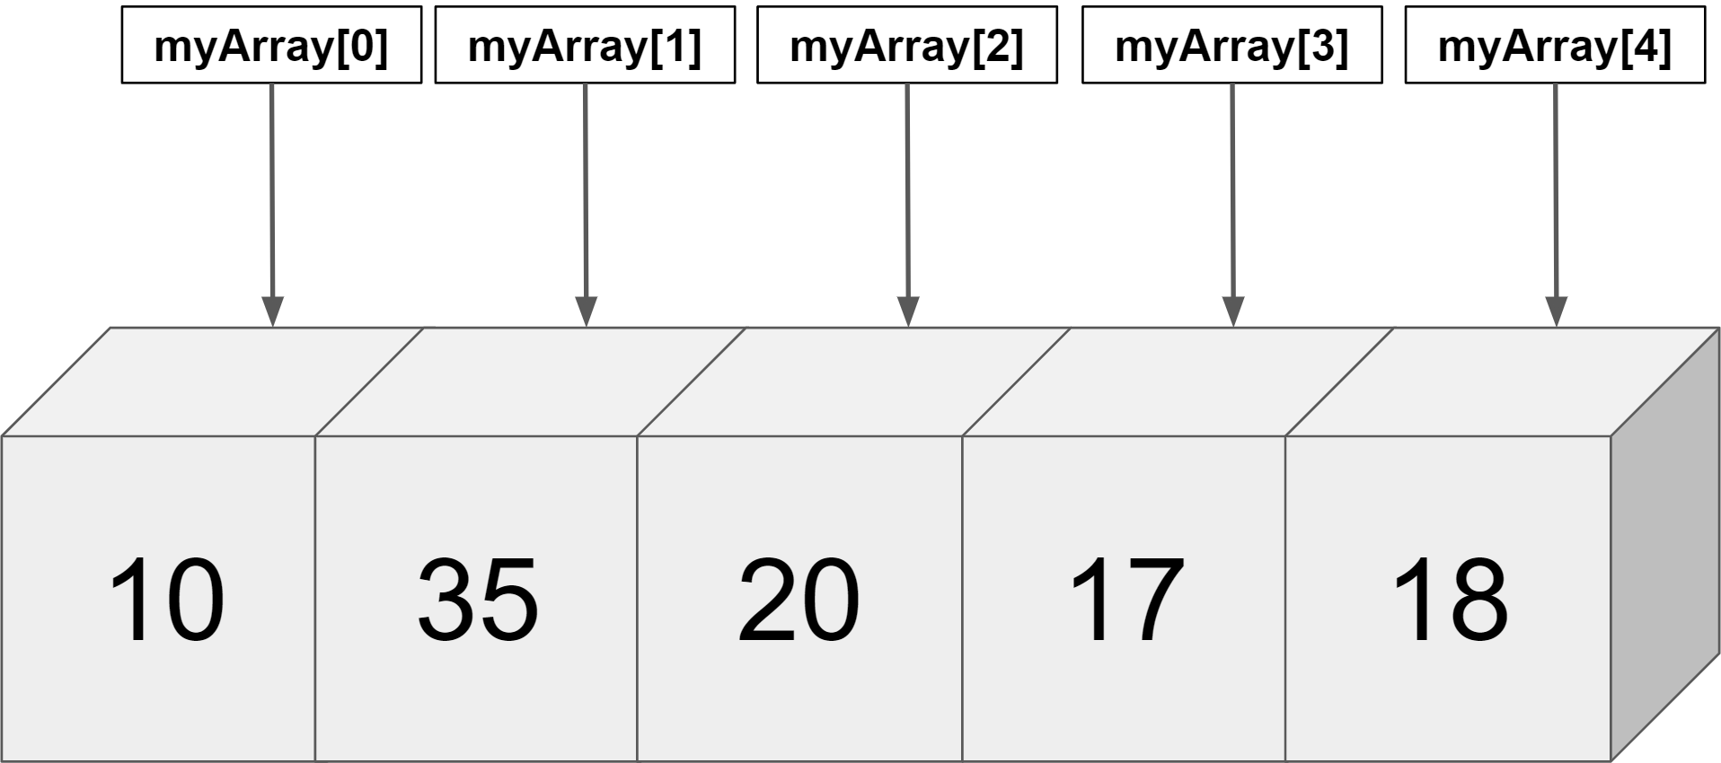
Arrays Recap
COMPLETE JAVA MASTERCLASS
Arrays Recap

Slide 31
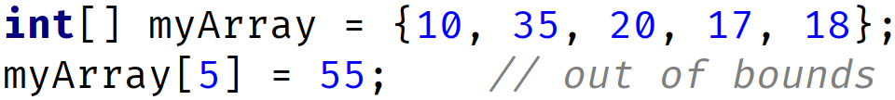
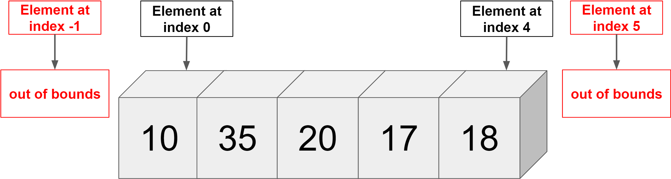
First Common Error
Accessing index out of range will cause error in other words ArrayIndexOutOfBoundsException
We have 5 elements and index range is 0 to 4
COMPLETE JAVA MASTERCLASS
Arrays Recap

Slide 32
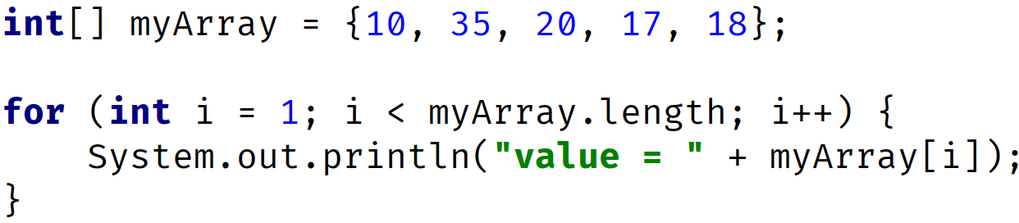
Second Common Error
OUTPUT: value= 35 value= 20 value= 17 value= 18
COMPLETE JAVA MASTERCLASS
Arrays Recap

Slide 33
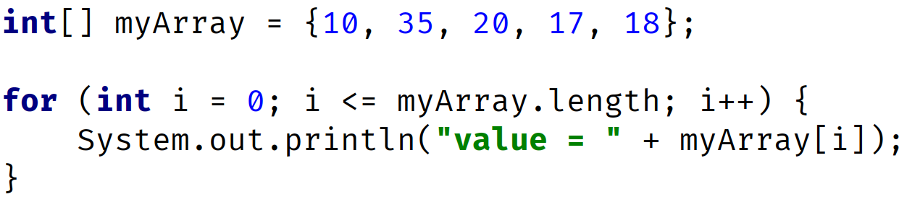
Third Common Error
OUTPUT: value = 10 // printed when i = 0 -> condition 0 <= 5 is true value = 35 // printed when i = 1 -> condition 1 <= 5 is true value = 20 // printed when i = 2 -> condition 2 <= 5 is true value = 17 // printed when i = 3 -> condition 3 <= 5 is true value = 18 // printed when i = 4 -> condition 4 <= 5 is true ArrayIndexOutOfBoundsException when i = 5 since condition 5 <= 5 is true
COMPLETE JAVA MASTERCLASS
Arrays Recap

Slide 34
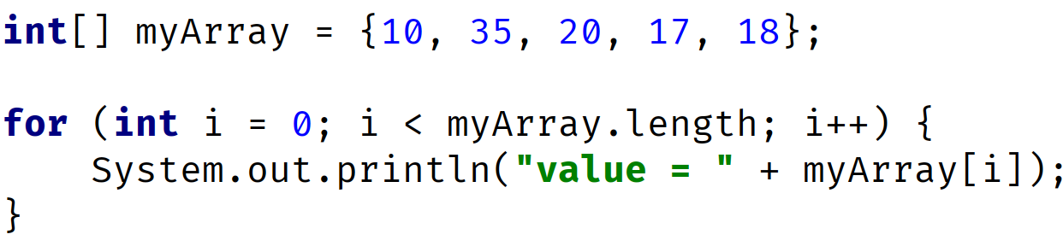
Third Common Error
OUTPUT: value = 10 // printed when i = 0 -> condition 0 <= 5 is true value = 35 // printed when i = 1 -> condition 1 <= 5 is true value = 20 // printed when i = 2 -> condition 2 <= 5 is true value = 17 // printed when i = 3 -> condition 3 <= 5 is true value = 18 // printed when i = 4 -> condition 4 <= 5 is true
COMPLETE JAVA MASTERCLASS
Arrays Recap

Slide 35
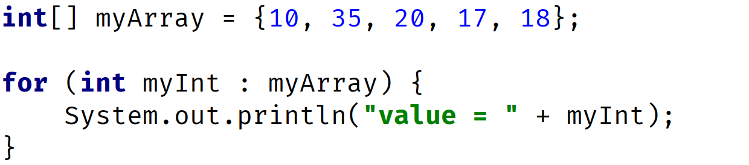
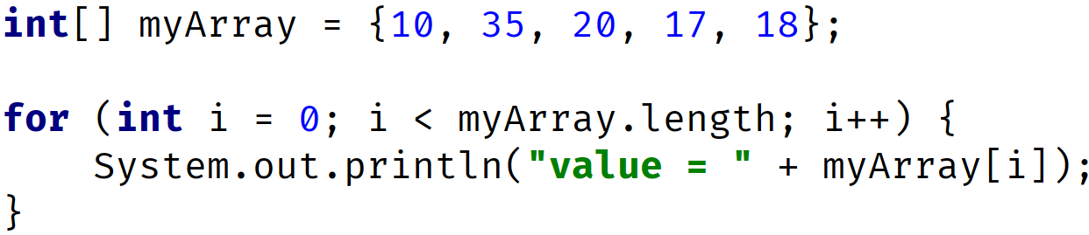
Use Enhanced For Loop to avoid some of these errors
Use the enhanced for loop, if you're looping through elements from first to last, and want to process them one at a time, and you're not setting or assigning values to elements.
Enhanced For Loop (Preferred for this kind of processing)
Traditional For Loop
COMPLETE JAVA MASTERCLASS
Arrays Recap

Slide 36
Reference Types vs. Value Types
In a previous video, I talked about the differences between a Reference vs. an Object, vs. an Instance, vs. a Class.
I want to revisit this a little, and talk about why this matters, when we're talking about arrays.
When you assign an object to a variable, the variable becomes a reference to that object.
This is true of arrays, but the array has yet another level of indirection, if it's an array of objects.
This means every array element is also a reference.
COMPLETE JAVA MASTERCLASS
References Types vs Value Types

Slide 37
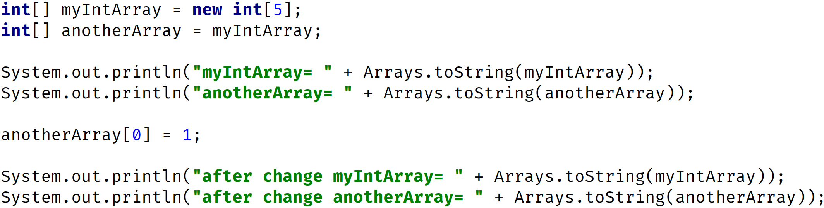
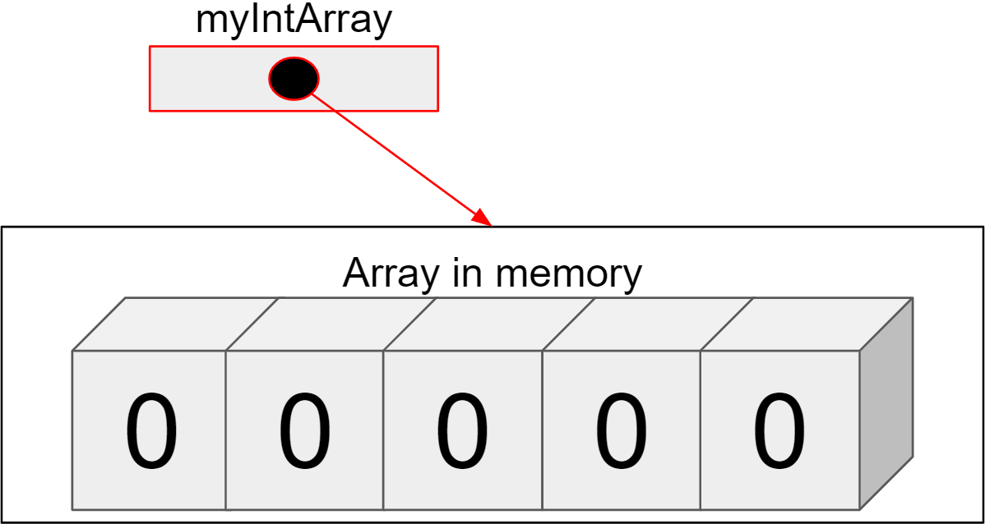
Reference Types vs. Value Types
COMPLETE JAVA MASTERCLASS
References Types vs Value Types

Slide 38
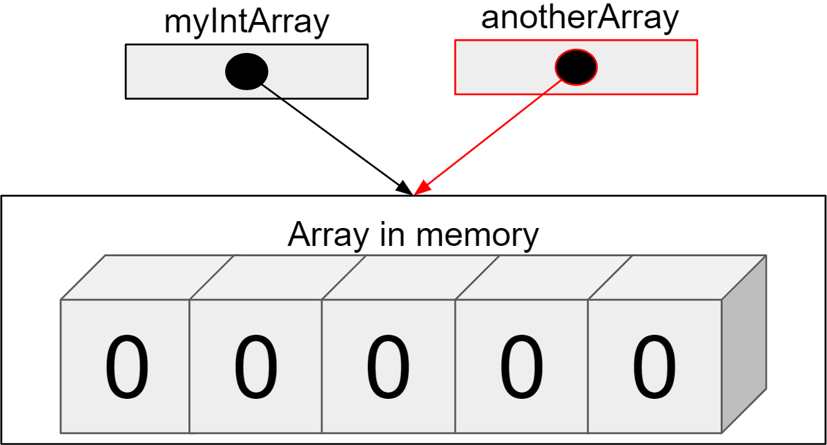
Reference Types vs. Value Types
COMPLETE JAVA MASTERCLASS
References Types vs Value Types

Slide 39
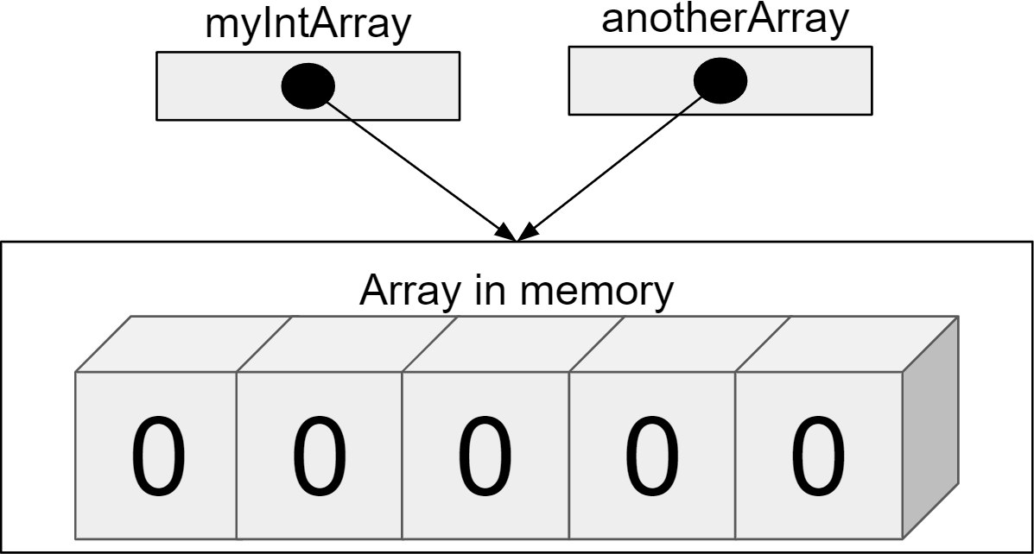
Reference Types vs. Value Types
OUTPUT: myIntArray= 0 0 0 0 0 anotherArray= 0 0 0 0 0
COMPLETE JAVA MASTERCLASS
References Types vs Value Types

Slide 40
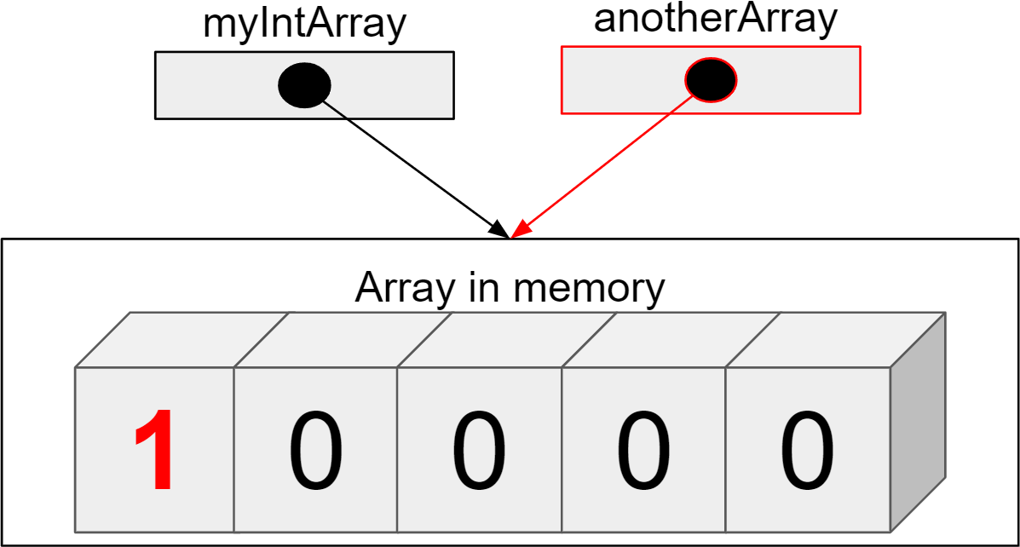
Reference Types vs. Value Types
OUTPUT: myIntArray= 0 0 0 0 0 anotherArray= 0 0 0 0 0
COMPLETE JAVA MASTERCLASS
References Types vs Value Types

Slide 41
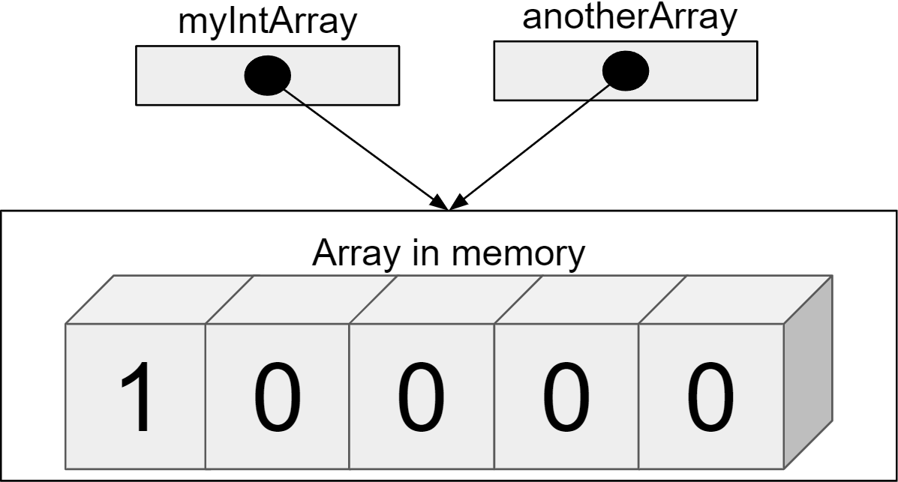
Reference Types vs. Value Types
OUTPUT: myIntArray= 0 0 0 0 0 anotherArray= 0 0 0 0 0 after change myIntArray= 1 0 0 0 0 after change anotherArray= 1 0 0 0 0
COMPLETE JAVA MASTERCLASS
References Types vs Value Types

Slide 42
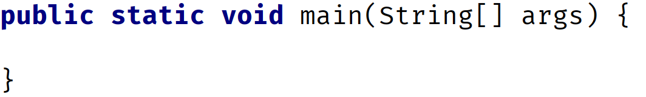
Arrays as method parameters
Notice here that the parameter to the main method, is an array of String.
This means we can pass an array of Strings to this method, when it's called.
Or, if we use this method as the entry point to our application, we can pass data on the command line to this method.
Up until now, I've only shown you this particular method signature.
COMPLETE JAVA MASTERCLASS
Variable Arguments (Varargs)

Slide 43
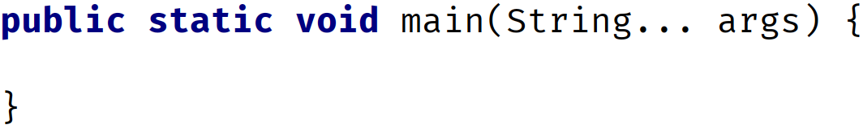
Variable arguments (varargs)
But this signature can be written in a slightly different way.
We can replace the brackets after the String type, which we know tells us this method will take an array of String.
And we can instead replace that with three periods.
This is a special designation for Java, that means, Java will take zero, one, or many Strings, as arguments to this method, and create an array with which to process them, in the method.
COMPLETE JAVA MASTERCLASS
Variable Arguments (Varargs)

Slide 44
Variable arguments (varargs)
The array will be called args, and be of type String.
So what's the difference then?
The difference is minor within the method body, but significant to the code that calls the method.
COMPLETE JAVA MASTERCLASS
Variable Arguments (Varargs)

Slide 45
When can you use variable arguments (varargs) ?
There can be only one variable argument in a method.
The variable argument must be the last argument.
COMPLETE JAVA MASTERCLASS
Variable Arguments (Varargs)

Slide 46
Minimum Element Challenge
Write a method called readIntegers, that reads a comma delimited list of numbers, entered by the user from the console, and then returns an array, containing those numbers that were entered.
Next, write a method called findMin, that takes the array as an argument, and returns the minimum value found in that array.
COMPLETE JAVA MASTERCLASS
Minimum Element Challenge

Slide 47
Minimum Element Challenge
In the main method
Call the method readIntegers, to get the array of integers from the user, and print these out, using a method found in java.util.Arrays.
Next, call the findMin method, passing the array, returned from the call to the readIntegers method.
Print the minimum element in the array, which should be returned from the findMin method.
A tip here. Assume that the user will only enter numbers - so you don't need to do any validation for the console input.
COMPLETE JAVA MASTERCLASS
Minimum Element Challenge

Slide 48
The Reverse Array Challenge
The challenge is to write a method called reverse, that takes an int array as a parameter.
In the main method, call the reverse method, and print the array both before and after the reverse method is called.
To reverse the array, you have to swap the elements, so that the first element is swapped with the last element, and so on.
So for example, if the array contains the numbers 1,2,3,4,5, then the reversed array should be, 5,4,3,2,1.
COMPLETE JAVA MASTERCLASS
Reverse Array Challenge

Slide 49
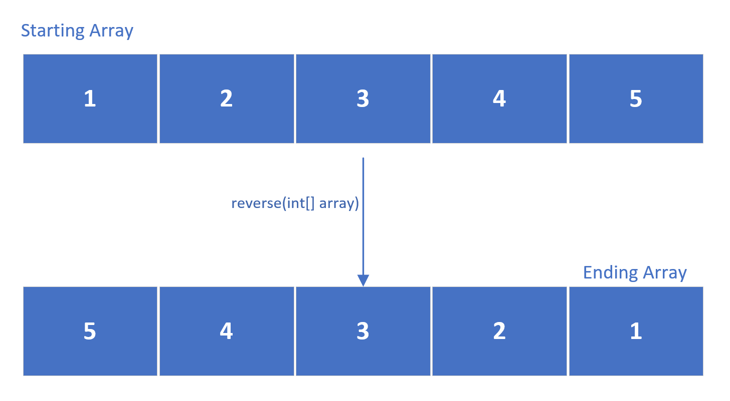
The Reverse Array Challenge
This shows the array, before we start reversing the values, and the end result we want to achieve:
COMPLETE JAVA MASTERCLASS
Reverse Array Challenge

Slide 50
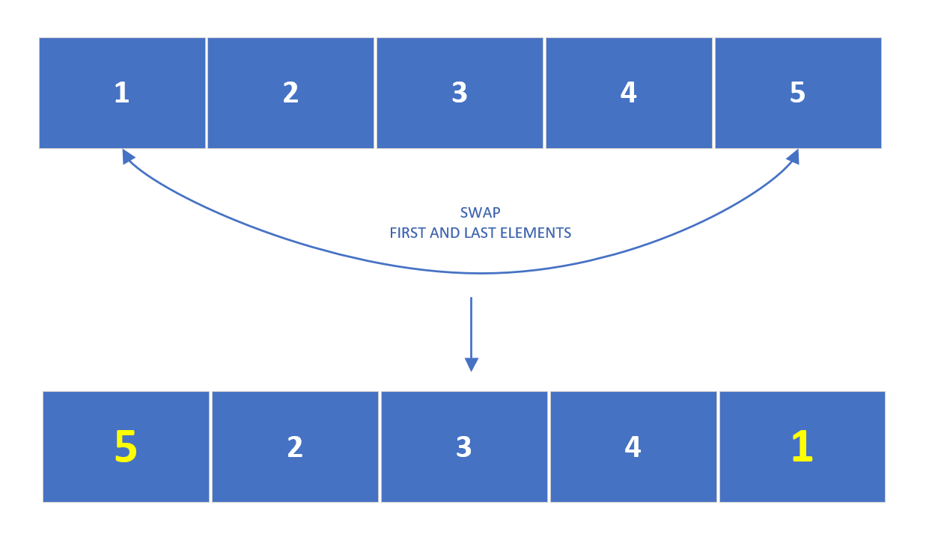
The Reverse Array Challenge
How would we go about doing this?
We could start swapping the elements at positions 0 and 4, to get this interim result, after the first iteration.
COMPLETE JAVA MASTERCLASS
Reverse Array Challenge

Slide 51
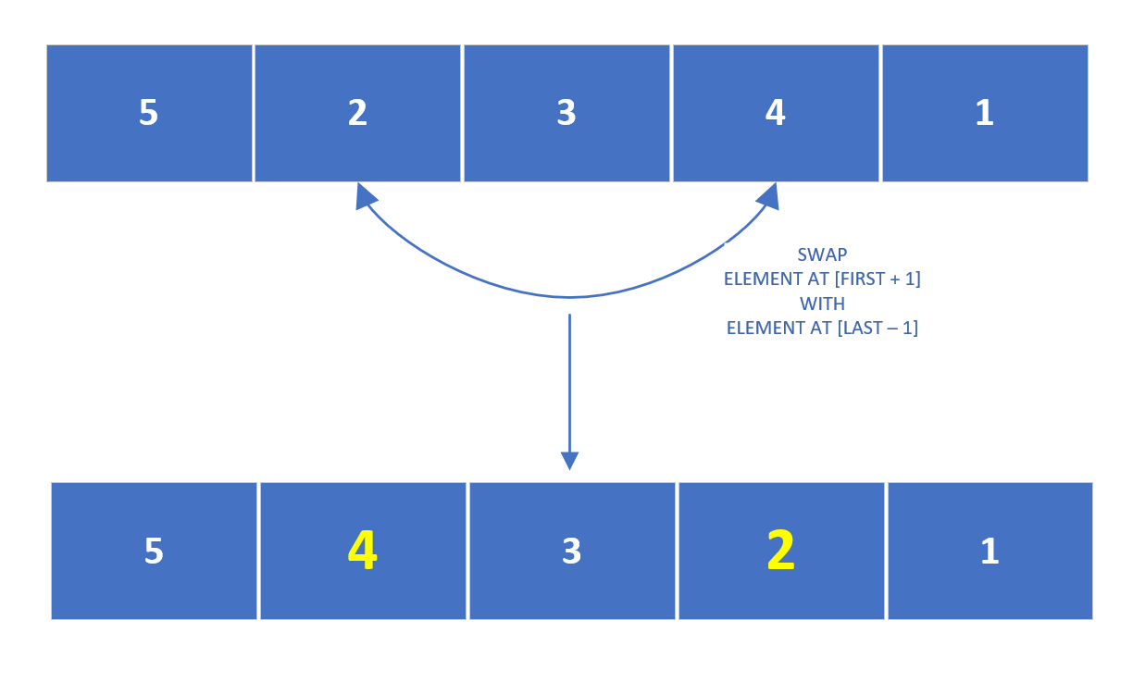
The Reverse Array Challenge
Then swap the elements at the next positions, which we could describe as:
Swapping the element at first plus one position, with the element at the last minus one position.
At this point, for a 5 element array, you'd actually be done with the reverse process.
Notice the middle element never had to be swapped at all.
COMPLETE JAVA MASTERCLASS
Reverse Array Challenge

Slide 52
The Reverse Array Challenge
This process would take only two iterations to complete, for five numbers.
It would take three iterations for seven numbers, etc.
We start with the outermost elements, swapping them, and work our way towards the center item.
If the number of elements is odd, we can leave the middle element unswapped.
We can think of the middle element, as the pivot point.
COMPLETE JAVA MASTERCLASS
Reverse Array Challenge

Slide 53
Java's nested Arrays
An array element can actually be an array. It's known as a nested array, or an array assigned to an outer array's element.
This is how Java supports two and three dimensional arrays, of varying dimensions.
COMPLETE JAVA MASTERCLASS
Two-Dimensional Arrays

Slide 54
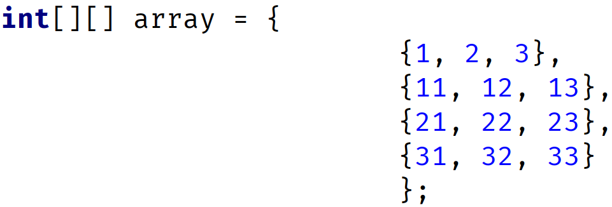
Two-Dimensional Array
A two-dimensional array can be thought of, as a table or matrix of values, with rows and columns.
You can use an array initializer for this, which I'm showing on this slide.
Array Initializer formatted over multiple lines
Array Initializer declared on one line
COMPLETE JAVA MASTERCLASS
Two-Dimensional Arrays

Slide 55
Two-Dimensional Array
Notice the two sets of square brackets on the left side of the assignment, in the declaration.
Using this type of declaration, tells Java we want a two dimensional array of integers.
Array Initializer formatted over multiple lines
Array Initializer declared on one line
COMPLETE JAVA MASTERCLASS
Two-Dimensional Arrays

Slide 56
Two-Dimensional Array
Here we show the same declaration with array initializers, that mean the same thing.
The first example, just uses white space to make it more readable.
In this example, all the nested arrays, have the same length.
Array Initializer formatted over multiple lines
Array Initializer declared on one line
COMPLETE JAVA MASTERCLASS
Two-Dimensional Arrays

Slide 57
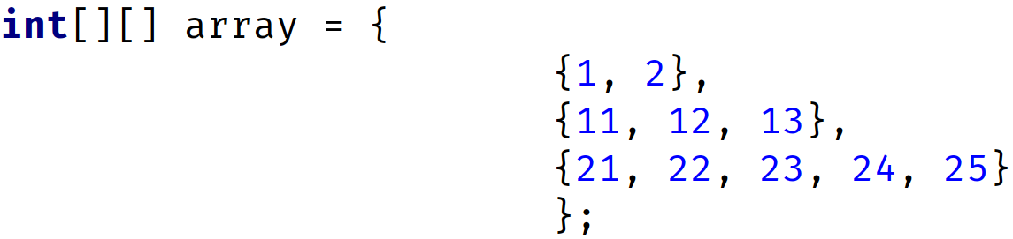
Two-dimensional Array
A 2-dimensional array doesn't have to be a uniform matrix though.
This means the nested arrays can be different sizes, as we show with this next initialization statement.
Here, we have an array with 3 elements.
Each element is an array of integers (a nested array).
Each nested array is a different length.
If you find that confusing, don't worry. It should all make sense shortly.
COMPLETE JAVA MASTERCLASS
Two-Dimensional Arrays

Slide 58
Two-dimensional Array
You can initialize a two-dimensional array, and define the size of the nested arrays, as shown here.
This statement says we have an array of 3 nested arrays, and each nested array will have three ints.
COMPLETE JAVA MASTERCLASS
Two-Dimensional Arrays

Slide 59
Two-dimensional Array
The result of this initialization is shown in the table on this slide.
Java knows we want a 3x3 matrix of ints, and defaults the values of the nested arrays to zeros, as it would for any array.
 | 0 | 1 | 2
0 | 0 | 0 | 0
1 | 0 | 0 | 0
2 | 0 | 0 | 0
COMPLETE JAVA MASTERCLASS
Two-Dimensional Arrays

Slide 60
Two-dimensional Array
You can initialize a two-dimensional array, without specifying the size of the nested arrays.
Here, we're specifying only the outer array size, by specifying the length, only in the first set of square brackets.
We've left the second set of square brackets empty.
The result of this initialization is an array of 3 null elements.
We are limited to assigning integer arrays to these elements, but they can be any length.
COMPLETE JAVA MASTERCLASS
Two-Dimensional Arrays

Slide 61
Two-dimensional Array
There are a lot of ways to declare a two-dimensional array.
I'll just cover the two most common ways here.
The most common, and in my opinion, clearest way, to declare a two-dimensional array, is to stack the square brackets as shown in the first example.
You can also split up the brackets as shown in the second example, and you'll likely come across this in Java code out in the wild.
COMPLETE JAVA MASTERCLASS
Two-Dimensional Arrays

Slide 62

Accessing elements in multi-dimensional arrays
When we access a one dimensional array element, we do it with square brackets, and an index value.
So this code sets the first element in the array to 50:
To access elements in a two-dimensional array, we use two indices, so this code sets the first element in the first array to 50.
This next code sets the second element, in the second array to 10.
COMPLETE JAVA MASTERCLASS
Two-Dimensional Arrays

Slide 63
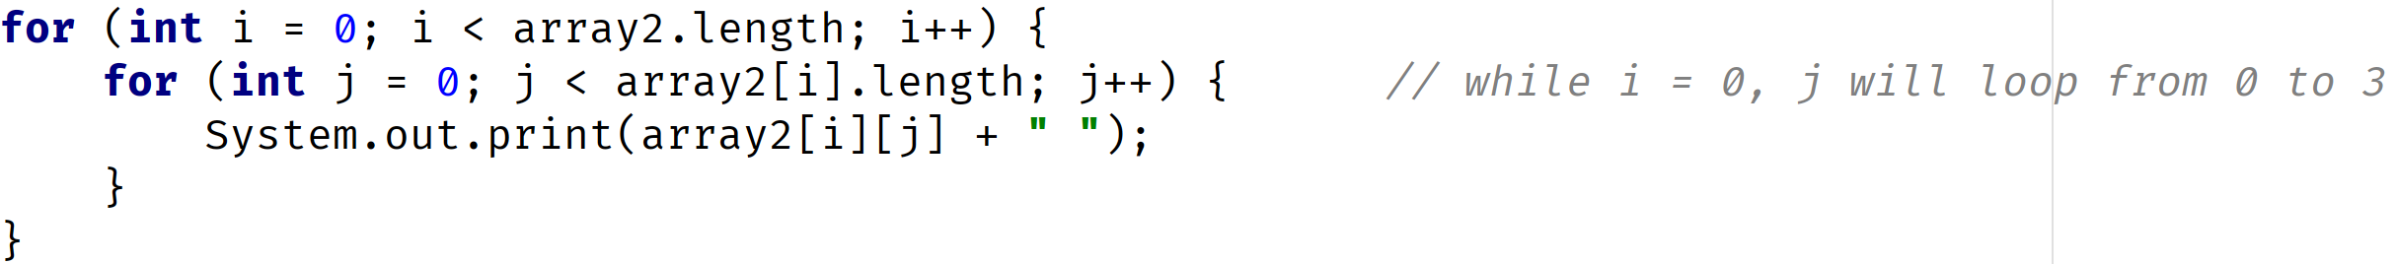
Accessing elements in multi-dimensional arrays
The code on this slide is similar to the code we have in our class, using nested traditional for loops.
In this case, we're not using any local variables, but accessing array elements and variables directly.
COMPLETE JAVA MASTERCLASS
Two-Dimensional Arrays

Slide 64
Accessing elements in multi-dimensional arrays
This table shows the indices, which are used, to access the elements in the two-dimensional array in our code sample.
When we loop through the outer loop, we're accessing each row of elements.
We've highlighted the first row, which would be the elements accessed, when i = 0 for the outer for loop.
When we loop through the inner loop, we're accessing each cell in the array.
A cell in this matrix can be any type.
In our code, each is an integer value, and we know they've all been initialized to zero.
 | j = 0 | j = 1 | j = 2 | j = 3
i = 0 | [ 0 ][ 0 ] | [ 0 ][ 1 ] | [ 0 ][ 2 ] | [ 0 ][ 3 ]
i = 1 | [ 1 ][ 0 ] | [ 1 ][ 1 ] | [ 1 ][ 2 ] | [ 1 ][ 3 ]
i = 2 | [ 2 ][ 0 ] | [ 2 ][ 1 ] | [ 2 ][ 2 ] | [ 2 ][ 3 ]
COMPLETE JAVA MASTERCLASS
Two-Dimensional Arrays

Slide 65
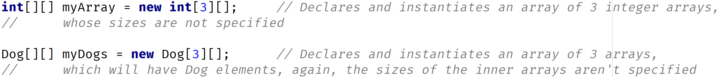
Two Dimensional Array
When we declare multi-dimensional arrays, the declared type can itself be an array, and this is how Java supports two-dimensional arrays:
Type and length of array | Possible Element Values (each element is an array and can be any length)
int[3][] | [5, 7, 9, 10] [3, 6] [11, 21, 31]
Dog[3][] | [pug, rottweiler] [germanShephard, poodle, cavapoo] [beagle, boxer, bulldog, yorkie]
COMPLETE JAVA MASTERCLASS
Multi-dimensional Arrays

Slide 66
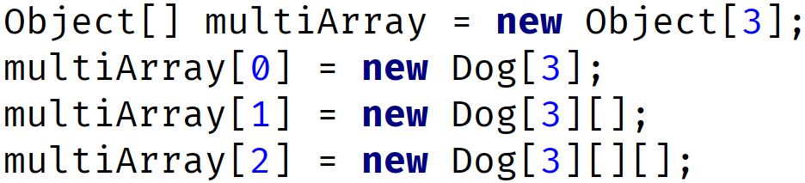
Multi Dimensional Array
We can take that even further, the outer array can have references to any kind of array itself.
In this example, we have an outer array with three elements.
The first element is itself a single-dimension array.
The second element is a two-dimensional array.
And lastly, the third element is a three-dimensional array.
COMPLETE JAVA MASTERCLASS
Multi-dimensional Arrays

