Slide 1

Introduction
Welcome to the List Section of the Java Masterclass.
In the last section, I talked about the array, as a way to manage a list of items, all having the same type.
Arrays were a massive improvement if you needed to store items of the same type, but as you saw, Arrays have some limitations. Not being able to change the number of elements in an Array being one.
Fortunately, Java also includes an entire library for Java containers, which they call Collections.
COMPLETE JAVA MASTERCLASS
Introduction

Slide 2
Introduction
They take the arrays we worked with to the next level. They allow you to change the number of elements defined in an array for one, but there are many other improvements as well.
In this section, we'll be talking about lists, which are Java containers, and explain what they are, and how to use them.
Two of the most common classes for lists, are ArrayList and LinkedList. We will start by looking at these.
COMPLETE JAVA MASTERCLASS
Introduction

Slide 3
Introduction
In addition, I'll be covering important concepts related to these topics, like Big O Notation, Iterators, Autoboxing and Unboxing, and the enum type. If you are unfamiliar with any of these terms, by the end of this section, they will make sense.
There's a lot to cover in the section, so let's get started.
COMPLETE JAVA MASTERCLASS
Introduction

Slide 4
Java Array vs Java List
An array is mutable, and we saw, that we could set or change values in the array, but we could not resize it.
Java gives us several classes that let us add and remove items, and resize a sequence of elements.
These classes are said to implement a List's behavior.
So what is a list?
COMPLETE JAVA MASTERCLASS
List and ArrayList Part 1

Slide 5
So what is a List?
In our everyday life, we use lists all the time.
When we're going to the grocery store, we've got a list.
We have a list of things we need to do, a list of addresses, a list of contact numbers, etc.
It wouldn't be a very useful list however, if we started with 10 items we could change, but never add or remove an item.
COMPLETE JAVA MASTERCLASS
List and ArrayList Part 1

Slide 6
So what is a List?
List is a special type in Java, called an Interface.
For now, I'll say a List Interface describes a set of method signatures, that all List classes are expected to have.
Let's look at some of these methods. I'm going to pull up the List methods in Java's API.
COMPLETE JAVA MASTERCLASS
List and ArrayList Part 1

Slide 7
The ArrayList
The ArrayList is a class, that really maintains an array in memory, that's actually bigger than what we need, in most cases.
It keeps track of the capacity, which is the actual size of the array in memory.
But it also keeps track of the elements that've been assigned or set, which is the size of the ArrayList.
As elements are added to an ArrayList, its capacity may need to grow. This all happens automatically, behind the scenes.
This is why the ArrayList is resizeable.
COMPLETE JAVA MASTERCLASS
List and ArrayList Part 1

Slide 8
Arrays vs ArrayLists
This slide demonstrates that arrays and ArrayLists have more in common, than they don't.
Feature | array | ArrayList
primitives types supported | Yes | No
indexed | Yes | Yes
ordered by index | Yes | Yes
duplicates allowed | Yes | Yes
nulls allowed | Yes, for non-primitive types | Yes
resizable | No | Yes
mutable | Yes | Yes
inherits from java.util.Object | Yes | Yes
implements List interface | No | Yes
COMPLETE JAVA MASTERCLASS
Arrays vs. ArrayLists

Slide 9
Instantiating without Values
Instantiating Arrays | Instantiating ArrayLists
An array of 10 elements is created, all with null references. The compiler will only permit Strings to be assigned to the elements.
An empty ArrayList is created.
The compiler will check that only Strings are added to the ArrayList.
On this slide, I show the differences, when creating a new instance of an array, compared to a new instance of an ArrayList.
An array requires square brackets in the declaration.
In the new instance, square brackets are also required, with a size specified inside
An ArrayList should be declared, with the type of element in the ArrayList, in angle brackets.
COMPLETE JAVA MASTERCLASS
Arrays vs. ArrayLists

Slide 10
Instantiating without Values
Instantiating Arrays | Instantiating ArrayLists
An array of 10 elements is created, all with null references. The compiler will only permit Strings to be assigned to the elements.
An empty ArrayList is created.
The compiler will check that only Strings are added to the ArrayList.
We can use the diamond operator, when creating a new instance in a declaration statement.
You should use a specific type, rather than just the Object class, because Java can then perform compile-time type checking.
COMPLETE JAVA MASTERCLASS
Arrays vs. ArrayLists

Slide 11
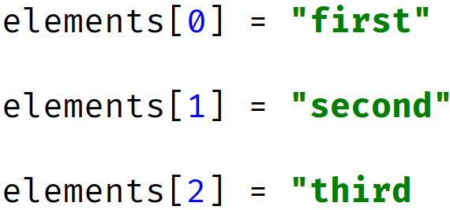
Instantiating with Values
Instantiating Arrays | Instantiating Lists and Array Lists
An array of 3 elements is created, with
An ArrayList can be instantiated by passing another list to it as we show here.
We can use the List.of() factory method, which uses variable arguments, to create a pass through immutable list.
Alternately, we can use this array initializer (anonymous array).
You can use an array initializer, to populate array elements, during array creation.
This feature lets you pass all the values in the array, as a comma delimited list, in curly braces.
COMPLETE JAVA MASTERCLASS
Arrays vs. ArrayLists

Slide 12
Instantiating with Values
Instantiating Arrays | Instantiating Lists and Array Lists
An array of 3 elements is created, with
An ArrayList can be instantiated by passing another list to it as we show here.
We can use the List.of() factory method, which uses variable arguments, to create a pass through immutable list.
Alternately, we can use this array initializer (anonymous array).
When you use an array initializer in a declaration statement, you can use what's called the anonymous version, as I show here.
You can use an ArrayList constructor, that takes a collection, or a list of values, during ArrayList creation.
COMPLETE JAVA MASTERCLASS
Arrays vs. ArrayLists

Slide 13
Instantiating with Values
Instantiating Arrays | Instantiating Lists and Array Lists
An array of 3 elements is created, with
An ArrayList can be instantiated by passing another list to it as we show here.
We can use the List.of() factory method, which uses variable arguments, to create a pass through immutable list.
Alternately, we can use this array initializer (anonymous array).
The List.of method can be used to create such a list, with a variable argument list of elements.
COMPLETE JAVA MASTERCLASS
Arrays vs. ArrayLists

Slide 14



Element information
 | Accessing Array Element data | Accessing ArrayList Element data
Index value of first element
Index value of last element
Retrieving number of elements:
Setting (assigning an element)
Getting an element
Example Array:
Example ArrayList:
The number of elements is fixed, when an array is created.
We can get the size of the array from the attribute, length, on the array instance.
Array elements are accessed with the use of square brackets, and an index, that ranges from 0, to one less than the number of elements.
COMPLETE JAVA MASTERCLASS
Arrays vs. ArrayLists

Slide 15
Element information
 | Accessing Array Element data | Accessing ArrayList Element data
Index value of first element
Index value of last element
Retrieving number of elements:
Setting (assigning an element)
Getting an element
Example Array:
Example ArrayList:
The number of elements in an ArrayList may vary, and can be retrieved with a method on the instance, named size().
ArrayList elements are accessed with get and set methods, also using an index ranging from 0, to one less than the number of elements.
COMPLETE JAVA MASTERCLASS
Arrays vs. ArrayLists

Slide 16
Getting a String representation for Single Dimension Arrays and ArrayLists
Array | ArrayList
Array Creation Code
ArrayList Creation Code
Printing Array Elements
Printing ArrayList elements
ArrayLists come with built-in support, for printing out elements, including nested lists.
Arrays don't though, so you need to call Arrays.toString, passing the array as an argument.
This slide shows examples of single dimension arrays and ArrayLists.
COMPLETE JAVA MASTERCLASS
Arrays vs. ArrayLists

Slide 17
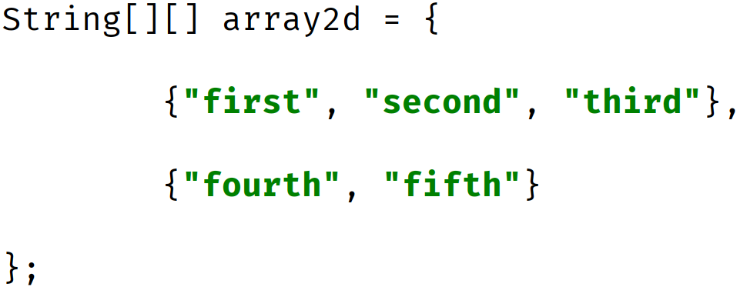
Getting a String representation for Multi-Dimensional Arrays and ArrayLists
Array | ArrayList
Array Creation Code
ArrayList Creation Code
Printing ArrayList elements
Printing Array Elements
Here I show examples of multi-dimensional arrays and ArrayLists, and how to print the elements in each.
A multi-dimensional ArrayList simply has a type, which in itself is an ArrayList.
COMPLETE JAVA MASTERCLASS
Arrays vs. ArrayLists

Slide 18
Getting a String representation for Multi-Dimensional Arrays and ArrayLists
Array | ArrayList
Array Creation Code
ArrayList Creation Code
Printing ArrayList elements
Printing Array Elements
For a multi-dimensional array, you need to call the Arrays.deepToString method, passing the array as an argument.
For nested ArrayLists, we can still just pass the ArrayList instance directly, to System.out.println, as shown here.
COMPLETE JAVA MASTERCLASS
Arrays vs. ArrayLists

Slide 19
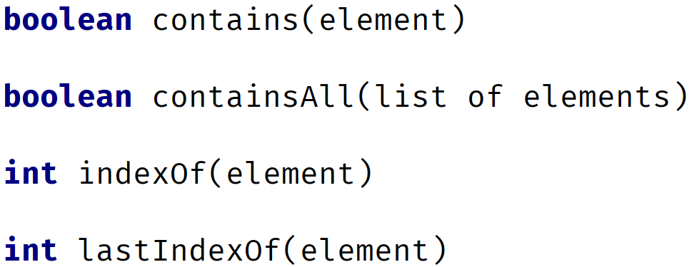
Finding an element in an Array or ArrayList
Arrays methods for finding elements | ArrayList methods for finding elements
** Array MUST BE SORTED
Not guaranteed to return index of first element if there are duplicates
For arrays, we can use the binarySearch method, to find a matching element, although this method requires that the array be sorted first.
In addition, if the array contains duplicate elements, the index returned from this search is not guaranteed, to be position of the first element.
For the ArrayList, we have several methods.
COMPLETE JAVA MASTERCLASS
Arrays vs. ArrayLists

Slide 20
Finding an element in an Array or ArrayList
Arrays methods for finding elements | ArrayList methods for finding elements
** Array MUST BE SORTED
Not guaranteed to return index of first element if there are duplicates
We can use contains or containsAll, which simply returns a boolean, if a match or matches were found.
In addition, like the String and StringBuilder, we have the methods, indexOf and lastIndexOf, which will return the index of the first or last match.
When a -1 is returned from these methods, no matching entry was found.
COMPLETE JAVA MASTERCLASS
Arrays vs. ArrayLists

Slide 21
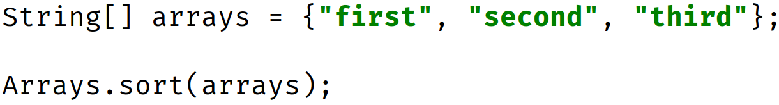
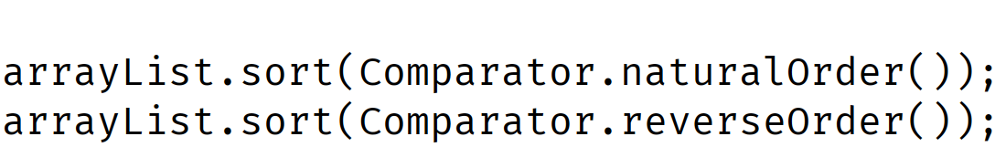
Sorting
Array | ArrayList
You can only sort arrays of elements that implement Comparable.
We'll be discussing this in a future section. Character Sequence classes, like String and StringBuilder meet this requirement.
You can use the sort method with static factory methods to get Comparators.
Sorting seems like a simple concept, when you think about sorting numbers and Strings.
We know there is a natural order, for numbers, and even for Strings.
COMPLETE JAVA MASTERCLASS
Arrays vs. ArrayLists

Slide 22
Sorting
Array | ArrayList
You can only sort arrays of elements that implement Comparable.
We'll be discussing this in a future section. Character Sequence classes, like String and StringBuilder meet this requirement.
You can use the sort method with static factory methods to get Comparators.
We can use the Arrays.sort method, for arrays with numeric primitive types and wrapper classes, as well as Strings and StringBuilders.
For the ArrayList, we can use the sort method, again for numeric wrapper classes, Strings and StringBuilders.
COMPLETE JAVA MASTERCLASS
Arrays vs. ArrayLists

Slide 23
Sorting
Array | ArrayList
You can only sort arrays of elements that implement Comparable.
We'll be discussing this in a future section. Character Sequence classes, like String and StringBuilder meet this requirement.
You can use the sort method with static factory methods to get Comparators.
We pass ArrayList's sort method, a Comparator type argument, that specifies just how to sort.
We call static methods on the Comparator type, to get a Comparator for either a natural order, or reverse order sort.
COMPLETE JAVA MASTERCLASS
Arrays vs. ArrayLists

Slide 24
array as an ArrayList
There are times, when you'll want to switch between an Array, and an ArrayList, and we find support for this, on both the Arrays class, and the ArrayList class.
The Arrays.asList method returns an ArrayList, backed by an array.
Here, I show the creation of a three element array.
Then the code uses the Arrays.asList method, passing it the array, and assign it to a variable, using the var keyword, to a variable named originalList.
COMPLETE JAVA MASTERCLASS
Arrays vs. ArrayLists

Slide 25
array as an ArrayList
You can think of this conceptually, as putting an ArrayList wrapper of sorts, around an existing array.
Any change made to the List, is a change to the array that backs it.
This also means that an ArrayList, created by this method, is not resizable.
COMPLETE JAVA MASTERCLASS
Arrays vs. ArrayLists

Slide 26
Creating Special Kinds of Lists
Using Arrays.asList | Using List.of
Returned List is NOT resizeable, but is mutable. | Returned List is IMMUTABLE.
This slide demonstrates two ways to create a list from elements, or from an array of elements.
Both are static factory methods on types.
The first is the asList method on the Arrays class, and it returns a special instance of a List, that is not resizable, but is mutable.
The second is the of method on the List interface, and it returns a special instance of a List, that is immutable.
COMPLETE JAVA MASTERCLASS
Arrays vs. ArrayLists

Slide 27
Creating Special Kinds of Lists
Using Arrays.asList | Using List.of
Returned List is NOT resizeable, but is mutable. | Returned List is IMMUTABLE.
Both support variable arguments, so you can pass a set of arguments of one type, or you can pass an array.
We show examples of both here, first using variable arguments, and second, passing an array.
COMPLETE JAVA MASTERCLASS
Arrays vs. ArrayLists

Slide 28
Creating Arrays from ArrayLists
This slide shows the most common method to create an array, from an ArrayList, using the method toArray().
This method takes one argument, which should be an instance of a typed array.
This method returns an array of that same type.
If the length of the array you pass, has more elements than the list, extra elements will be filled with the default values for that type.
If the length of the array you pass, has less elements than the list, the method will still return an array, with the same number of elements in it, as the list.
In the example shown here, we pass a String array with zero as the size, but the array returned has three elements, which is the number of elements in the list.
COMPLETE JAVA MASTERCLASS
Arrays vs. ArrayLists

Slide 29
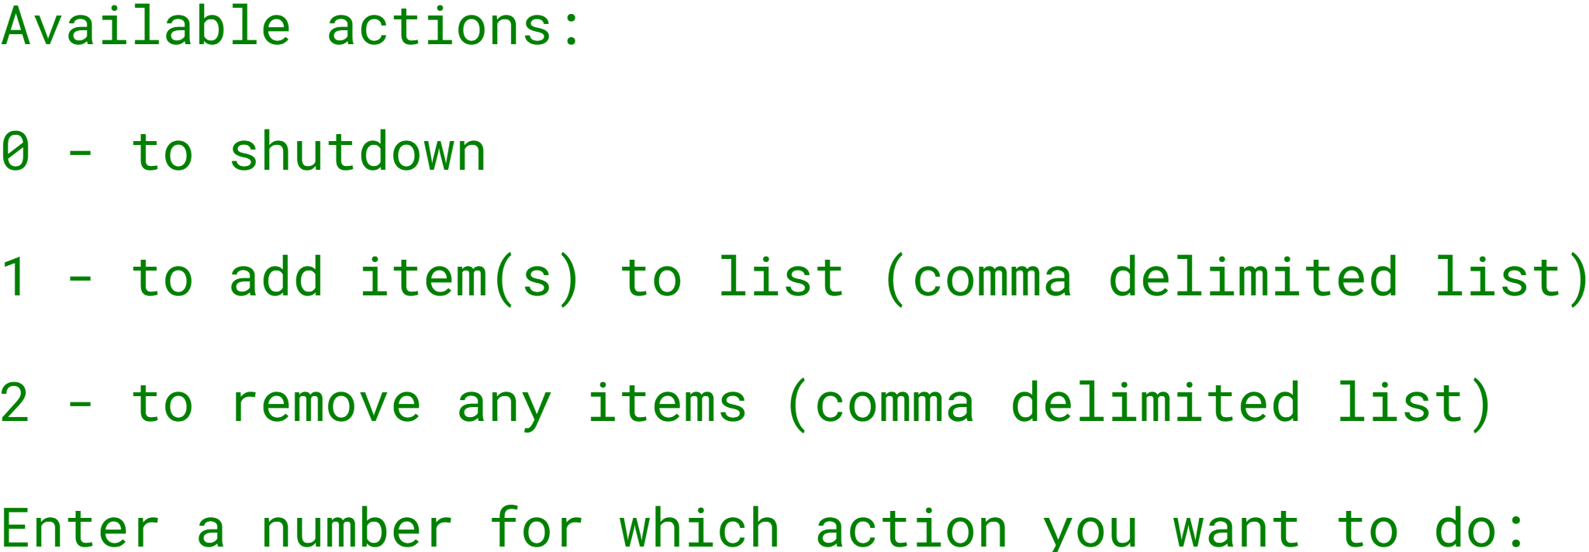
The ArrayList Challenge
The challenge is to create an interactive console program.
And give the user a menu of options as shown here:
Using the Scanner class, solicit a menu item, 0, 1 or 2, and process the item accordingly.
COMPLETE JAVA MASTERCLASS
ArrayList Challenge Part 1

Slide 30
The ArrayList Challenge
Your grocery list should be an ArrayList.
You should use methods on the ArrayList, to add items, remove items, check if an item is already in the list, and print a sorted list.
You should print the list, sorted alphabetically, after each operation.
You shouldn't allow duplicate items in the list.
COMPLETE JAVA MASTERCLASS
ArrayList Challenge Part 1

Slide 31
Array of primitive values
When an array of primitive types is allocated, space is allocated for all of it's elements contiguously, as shown here.
You can see from this slide, that we have an array of seven integers.
The index position is in the left column, and that's the number we use, to access a specific array value.
So the first element, when we use index position 0, this will retrieve the value 34.
When we use index position 1, this gets the value of 18, and so on.
The addresses we show here are memory addresses, represented by these numbers.
Index | Value | Address
0 | 34 | 100
1 | 18 | 104
2 | 91 | 108
3 | 57 | 112
4 | 453 | 116
5 | 68 | 120
6 | 6 | 124
COMPLETE JAVA MASTERCLASS
Arrays, ArrayList & LinkedList - (Memory and Big O Notation)

Slide 32
Array of primitive values
If 100 is the address of an integer, and we know an integer is 4 bytes, then the address of the next integer, if it's contiguous would be 104, as we show here, for the second element.
Java can use simple math, using the index, and the address of the initial element in the array, to get the address, and retrieve the value of the element.
Index | Value | Address
0 | 34 | 100
1 | 18 | 104
2 | 91 | 108
3 | 57 | 112
4 | 453 | 116
5 | 68 | 120
6 | 6 | 124
COMPLETE JAVA MASTERCLASS
Arrays, ArrayList & LinkedList - (Memory and Big O Notation)

Slide 33
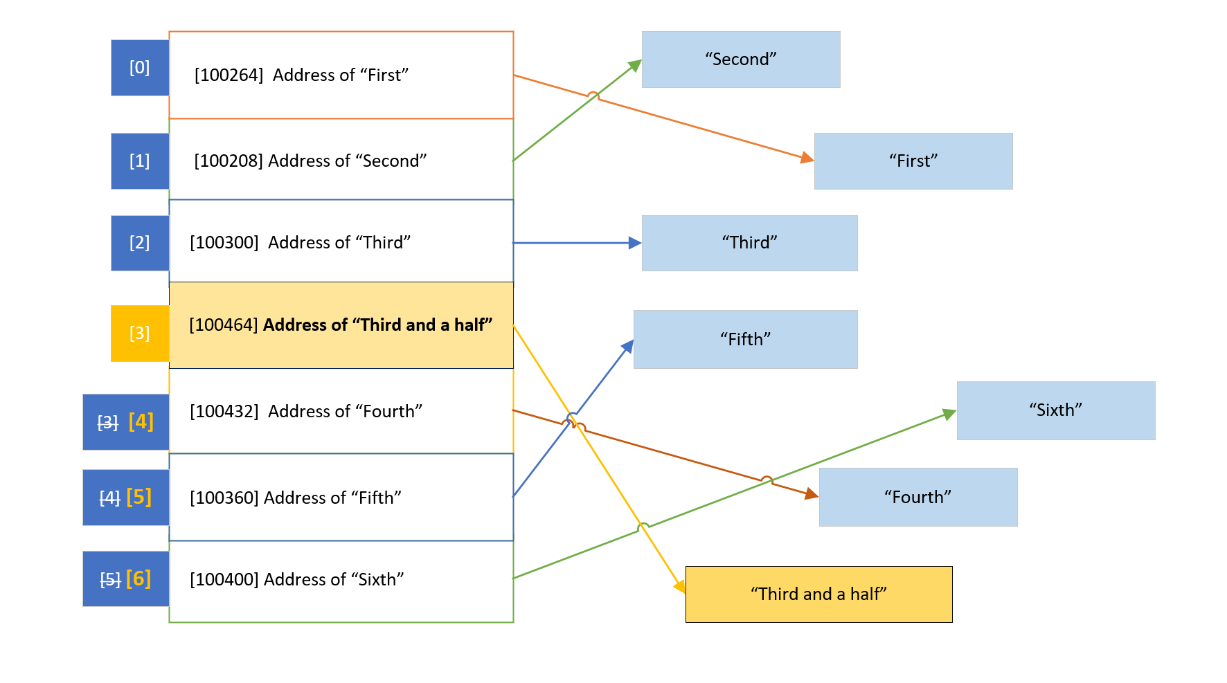
Arrays and ArrayLists of reference types
For reference types (meaning anything that's not a primitive type), like a String, or any other object, the array elements aren't the values, but the addresses of the referenced object or String.
COMPLETE JAVA MASTERCLASS
Arrays, ArrayList & LinkedList - (Memory and Big O Notation)

Slide 34
Arrays and ArrayLists of reference types
There's a level of indirection as I show on this slide.
We've learned that ArrayLists are really implemented with arrays, under the covers.
COMPLETE JAVA MASTERCLASS
Arrays, ArrayList & LinkedList - (Memory and Big O Notation)

Slide 35
Arrays and ArrayLists of reference types
This means our objects aren't stored contiguously in memory, but their addresses are, in the array behind the ArrayList.
And again, the addresses can be easily retrieved with a bit of math, if we know the index of the element.
COMPLETE JAVA MASTERCLASS
Arrays, ArrayList & LinkedList - (Memory and Big O Notation)

Slide 36
Arrays and ArrayLists of reference types
This is a cheap lookup, and doesn't change, no matter what size the ArrayList is.
But to remove an element, the referenced addresses have to be re-indexed, or shifted, to remove an empty space.
COMPLETE JAVA MASTERCLASS
Arrays, ArrayList & LinkedList - (Memory and Big O Notation)

Slide 37
Arrays and ArrayLists of reference types
And when adding an element, the array that backs the ArrayList might be too small, and might need to be reallocated.
Either of these operations can be an expensive process, if the number of elements is large.
COMPLETE JAVA MASTERCLASS
Arrays, ArrayList & LinkedList - (Memory and Big O Notation)

Slide 38
Arrays and ArrayLists of reference types
In this slide, the String, "Third and a half', represents a new element we want inserted, at index position 3.
This means all the elements below this point, need to be moved and re-indexed.
COMPLETE JAVA MASTERCLASS
Arrays, ArrayList & LinkedList - (Memory and Big O Notation)

Slide 39
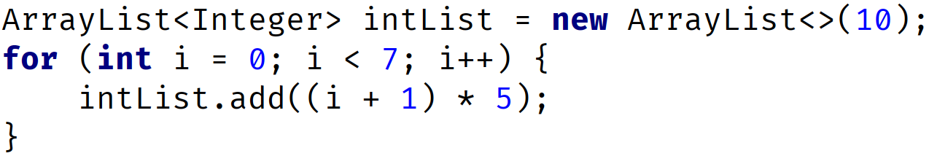
ArrayList capacity
An ArrayList is created with an initial capacity, depending on how many elements we create the list with, or if you specify a capacity when creating the list.
On this slide, I show an ArrayList that has a capacity of 10, because we're passing 10 in the constructor of this list.
We then add 7 elements.
Index | 0 | 1 | 2 | 3 | 4 | 5 | 6 | 7 | 8 | 9
Value | 5 | 10 | 15 | 20 | 25 | 30 | 35
COMPLETE JAVA MASTERCLASS
Arrays, ArrayList & LinkedList - (Memory and Big O Notation)

Slide 40
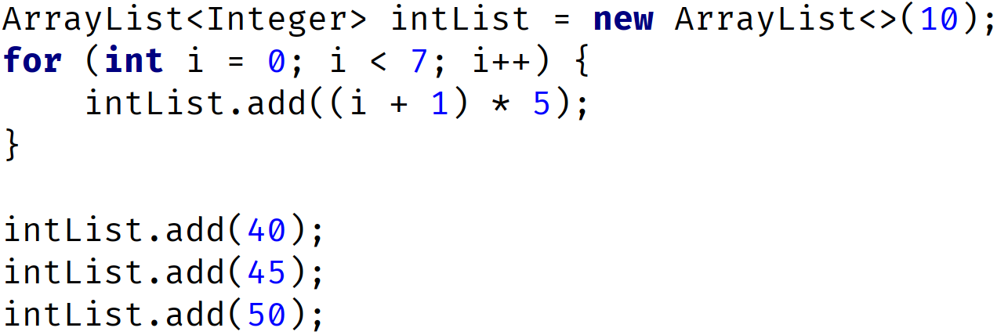
ArrayList capacity
We can add 3 more elements, using the ArrayList add method, and the array that is used to store the data, doesn't need to change.
The elements at indices 7, 8, and 9, get populated.
Index | 0 | 1 | 2 | 3 | 4 | 5 | 6 | 7 | 8 | 9
Value | 5 | 10 | 15 | 20 | 25 | 30 | 35 | 40 | 45 | 50
COMPLETE JAVA MASTERCLASS
Arrays, ArrayList & LinkedList - (Memory and Big O Notation)

Slide 41
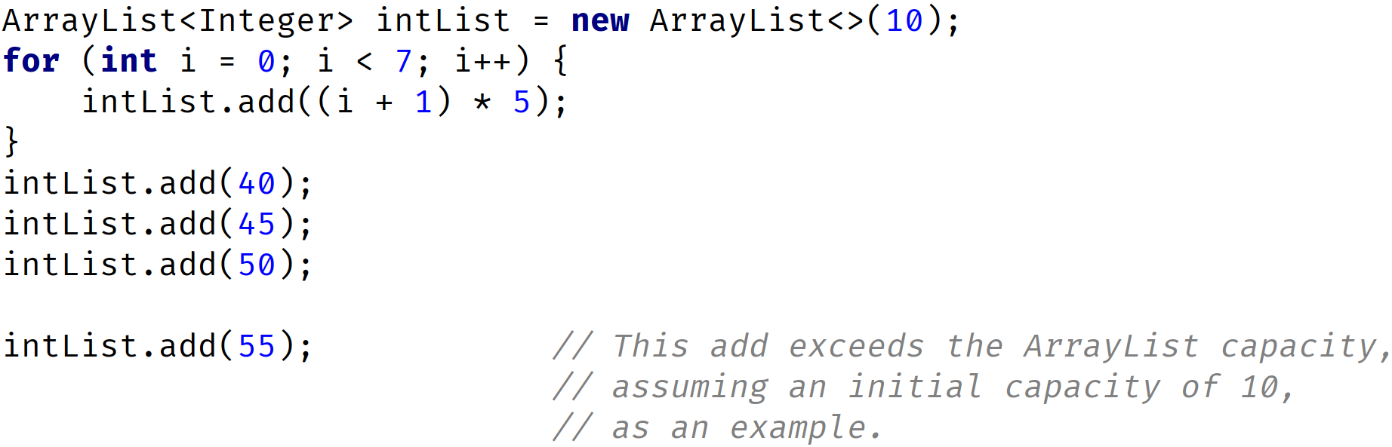
ArrayList capacity is reached
But if the number of elements exceeds the current capacity, Java needs to reallocate memory, to fit all the elements, and this can be a costly operation, especially if your ArrayList contains a lot of items.
Index | 0 | 1 | 2 | 3 | 4 | 5 | 6 | 7 | 8 | 9 | 10 | 11 | 12 | 13 | 14
Value | 5 | 10 | 15 | 20 | 25 | 30 | 35 | 40 | 45 | 50 | 55
COMPLETE JAVA MASTERCLASS
Arrays, ArrayList & LinkedList - (Memory and Big O Notation)

Slide 42
ArrayList capacity is reached
So now, if our code simply calls add on this ArrayList, the next operation is going to create a new array, with more elements, but copy the existing 10 elements over.
Then the new element is added. You can imagine this add operation costs more, in both time and memory, than the previous add methods did.
When Java re-allocates new memory for the ArrayList, it automatically sets the capacity to a greater capacity.
But the Java language doesn't really specify exactly how it determines the new capacity, or promise that it will continue to increase the capacity in the same way in future versions.
We can't actually get this capacity size, from the ArrayList.
Index | 0 | 1 | 2 | 3 | 4 | 5 | 6 | 7 | 8 | 9 | 10 | 11 | 12 | 13 | 14
Value | 5 | 10 | 15 | 20 | 25 | 30 | 35 | 40 | 45 | 50 | 55
COMPLETE JAVA MASTERCLASS
Arrays, ArrayList & LinkedList - (Memory and Big O Notation)

Slide 43
ArrayList capacity is reached
From their own documentation, Java states that, "The details of the growth policy, are not specified beyond the fact that adding an element, has constant amortized time cost".
Ok, maybe you're interested in what constant amortized time is.
Let's start with how to determine cost, which in this case is generally considered in terms of time, but may include memory usage and processing costs, etc.
Index | 0 | 1 | 2 | 3 | 4 | 5 | 6 | 7 | 8 | 9 | 10 | 11 | 12 | 13 | 14
Value | 5 | 10 | 15 | 20 | 25 | 30 | 35 | 40 | 45 | 50 | 55
COMPLETE JAVA MASTERCLASS
Arrays, ArrayList & LinkedList - (Memory and Big O Notation)

Slide 44
Big O Notation
Maybe you've heard people talking about Big O Notation, or Big O, and wondered what this means.
I won't get too deep into it, but there are a couple of concepts that are fairly easy to grasp, and will help us understand how cheap or expensive an operation is, in terms of time and memory usage, as the operation scales.
This means it's a way to express how well the operation performs, when applied to more and more elements.
Big O approximates the cost of an operation, for a certain number of elements, called n.
Cost is usually determined by the time it takes, but it can include memory usage, and complexity for example.
COMPLETE JAVA MASTERCLASS
Arrays, ArrayList & LinkedList - (Memory and Big O Notation)

Slide 45
Big O Notation
As n (the number of elements) gets bigger, an operation's cost can stay the same.
But cost often grows, as the number of elements grow.
Costs can grow linearly, meaning the cost stays in step, with the magnitude of the number of elements.
Or costs can grow exponentially, or by some other non-linear fashion.
In a perfect world, an operation's time and complexity would never change. This ideal world, in Big O Notation is O(1), sometimes called constant time.
In many situations, an operation's cost is in direct correlation to the number of elements, n. In Big O Notation this is O(n), sometimes called linear time.
COMPLETE JAVA MASTERCLASS
Arrays, ArrayList & LinkedList - (Memory and Big O Notation)

Slide 46
Big O Notation
So if we have 10 elements, the cost is 10 times what it would be for 1 element, because the operation may have to execute some functions, up to 10 times vs. just once, and 100 times for 100 elements, for example.
O(n) is generally our worst case scenario for List operations, but there are Big O Notations, for worse performers.
COMPLETE JAVA MASTERCLASS
Arrays, ArrayList & LinkedList - (Memory and Big O Notation)

Slide 47
Constant Amortized Time Cost
Another scenario, is the one the Java docs declared for the growth of the ArrayList, that adding an element has constant amortized time cost.
In our case, we'll designate this constant amortized time as O(1)*.
This means that in the majority of cases, the cost is close to O(1), but at certain intervals, the cost is O(n).
If we add an element to an ArrayList, where the capacity of the List is already allocated, and space is available, the cost is the same each time, regardless of how many elements we add.
COMPLETE JAVA MASTERCLASS
Arrays, ArrayList & LinkedList - (Memory and Big O Notation)

Slide 48
Constant Amortized Time Cost
But as soon as we reach the capacity, and all the elements (all n elements) need to be copied in memory, this single add would have a maximum cost of O(n).
After this operation, that forced a reallocation, any additional add operations go back to O(1), until the capacity is reached again.
As the expensive intervals decrease, the cost gets closer to O(1), so we give it the notation O(1)*.
COMPLETE JAVA MASTERCLASS
Arrays, ArrayList & LinkedList - (Memory and Big O Notation)

Slide 49
ArrayList Operations - Big O
This slide shows the Big O values, for the most common ArrayList operations or methods.
Let's just talk about one example, the contains method, which looks for a matching element, and needs to traverse through the ArrayList to find a match.
It could find a match at the very first index, this is the best case scenario, so it's O(1).
It might not find a match until the last index, this is the worst case scenario, so it's O(n).
Operation | Worst Case | Best Case
add(E element) | O(1)*
add(int index, E element) | O(n) | O(1)*
contains(E element) | O(n) | O(1)
get(int index) | O(1)
indexOf(E Element) | O(n) | O(1)
remove(int index) | O(n) | O(1)
remove(E element) | O(n)
set(int index, E element) | O(1)
O(1) - constant time - operation's cost (time) should be constant regardless of number of elements.
O(n) - linear time - operation's cost (time) will increase linearly with the number of elements n.
O(1)* - constant amortized time - somewhere between O(1) and O(n), but closer to O(1) as efficiencies are gained.
COMPLETE JAVA MASTERCLASS
Arrays, ArrayList & LinkedList - (Memory and Big O Notation)

Slide 50
ArrayList Operations - Big O
In general, the cost will be something in between, for the contains method, because the element will be found somewhere between the first and nth (or last) element.
You'll notice that the indexed methods are usually O(1), remembering that finding an element by its index, is a simple calculation.
It only gets costly with indexed add or remove methods, if the ArrayList needs to be re-indexed, or re-sized.
Operation | Worst Case | Best Case
add(E element) | O(1)*
add(int index, E element) | O(n) | O(1)*
contains(E element) | O(n) | O(1)
get(int index) | O(1)
indexOf(E Element) | O(n) | O(1)
remove(int index) | O(n) | O(1)
remove(E element) | O(n)
set(int index, E element) | O(1)
O(1) - constant time - operation's cost (time) should be constant regardless of number of elements.
O(n) - linear time - operation's cost (time) will increase linearly with the number of elements n.
O(1)* - constant amortized time - somewhere between O(1) and O(n), but closer to O(1) as efficiencies are gained.
COMPLETE JAVA MASTERCLASS
Arrays, ArrayList & LinkedList - (Memory and Big O Notation)

Slide 51
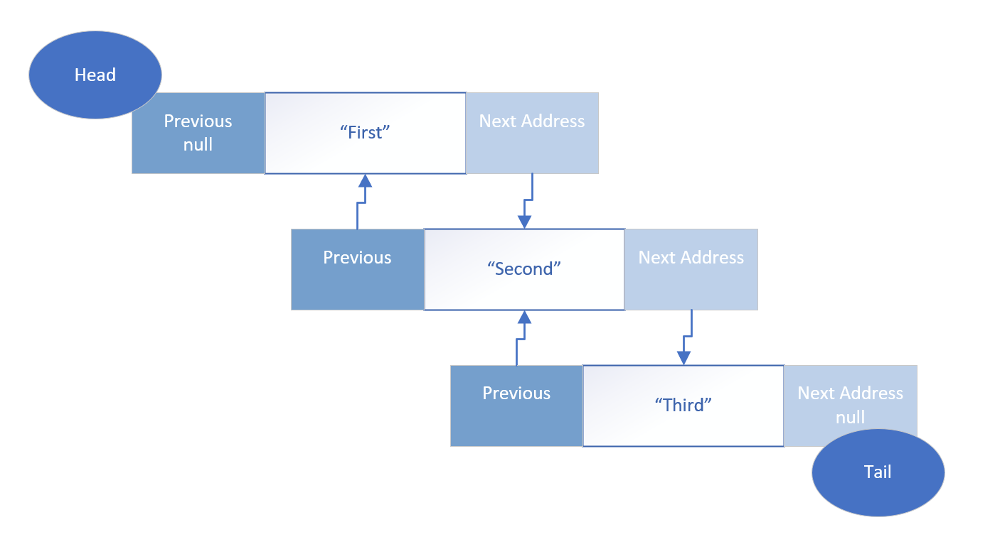
LinkedList
The LinkedList is not indexed at all.
There is no array, storing the addresses in a neat ordered way, as we saw with the ArrayList.
Instead, each element that's added to a linked list, forms a chain, and the chain has links to the previous element, and the next element.
COMPLETE JAVA MASTERCLASS
Arrays, ArrayList & LinkedList - (Memory and Big O Notation)

Slide 52
LinkedList
This architecture is called a doubly linked list, meaning an element is linked to the next element, but it's also linked to a previous element, in this chain of elements.
The beginning of the chain is called the head of the list, and the end is called the tail.
This can also be considered a queue, in this case, a double ended queue, because we can traverse both backwards and forwards, through these elements.
COMPLETE JAVA MASTERCLASS
Arrays, ArrayList & LinkedList - (Memory and Big O Notation)

Slide 53
LinkedList - Retrieval of an Element costs more than an ArrayList retrieval
Getting an element from the list, or setting a value of element, isn't just simple math anymore, with the LinkedList type.
To find an element, we'd need to start at the head or tail, and check if the element matches, or keep track of the number of elements traversed, if we are matching by an index, because the index isn't stored as part of the list.
For example, even if you know, you want to find the 5th element, you'd still have to traverse the chain this way, to get that fifth element.
This type of retrieval is considered expensive in computer currency, which is processing time and memory usage.
On the other hand, inserting and removing an element, is much simpler for this type of collection.
COMPLETE JAVA MASTERCLASS
Arrays, ArrayList & LinkedList - (Memory and Big O Notation)

Slide 54
LinkedList - Inserting or Removing an Element may be less costly than using an ArrayList
In contrast to an ArrayList, inserting or removing an item in a LinkedList, is just a matter of breaking two links in the chain, and re-establishing two different links.
No new array needs to be created, and elements don't need to be shifted into different positions.
A reallocation of memory to accommodate all existing elements, is never required.
So for a LinkedList, inserting and removing elements, is generally considered cheap in computer currency, compared to doing these functions in an ArrayList.
COMPLETE JAVA MASTERCLASS
Arrays, ArrayList & LinkedList - (Memory and Big O Notation)

Slide 55
LinkedList and ArrayList Operations - Big O
This slide shows the Big O values, for the most common shared List operations or methods, for both types.
For a LinkedList, adding elements to the start or end of the List, will almost always be more efficient than an ArrayList.
 | Linked List |  | ArrayList
Operation | Worst Case | Best Case | Worst Case | Best Case
add() | O(1) |  | O(1)*
add(int index, E element) | O(n) | O(1) | O(n) | O(1)*
contains(E element) | O(n) | O(1) | O(n) | O(1)
get(int index) | O(n) | O(1) | O(1)
indexOf(E Element) | O(n) | O(1) | O(n) | O(1)
remove(int index) | O(n) | O(1) | O(n) | O(1)
remove(E element) | O(n) | O(1) | O(n)
set(int index, E element) | O(n) | O(1) | O(1)
O(1) - constant time - operation's cost (time) should be constant regardless of number of elements.
O(n) - linear time - operation's cost (time) will increase linearly with the number of elements n.
O(1)* - constant amortized time - somewhere between O(1) and O(n), but closer to O(1) as efficiencies are gained.
COMPLETE JAVA MASTERCLASS
Arrays, ArrayList & LinkedList - (Memory and Big O Notation)

Slide 56
LinkedList and ArrayList Operations - Big O
When removing elements, a LinkedList will be more efficient, because it doesn't require re-indexing, but the element still needs to be found, using the traversal mechanism, which is why it is O(n), as the worst case.
Removing elements from the start or end of the List, will be more efficient for a LinkedList.
 | Linked List |  | ArrayList
Operation | Worst Case | Best Case | Worst Case | Best Case
add() | O(1) |  | O(1)*
add(int index, E element) | O(n) | O(1) | O(n) | O(1)*
contains(E element) | O(n) | O(1) | O(n) | O(1)
get(int index) | O(n) | O(1) | O(1)
indexOf(E Element) | O(n) | O(1) | O(n) | O(1)
remove(int index) | O(n) | O(1) | O(n) | O(1)
remove(E element) | O(n) | O(1) | O(n)
set(int index, E element) | O(n) | O(1) | O(1)
O(1) - constant time - operation's cost (time) should be constant regardless of number of elements.
O(n) - linear time - operation's cost (time) will increase linearly with the number of elements n.
O(1)* - constant amortized time - somewhere between O(1) and O(n), but closer to O(1) as efficiencies are gained.
COMPLETE JAVA MASTERCLASS
Arrays, ArrayList & LinkedList - (Memory and Big O Notation)

Slide 57
Things to Remember when considering whether to use an ArrayList vs LinkedList
The ArrayList is usually the better default choice for a List, especially if the List is used predominantly for storing and reading data.
If you know the maximum number of possible items, then it's probably better to use an ArrayList, but set it's capacity.
This code demonstrates how to set the capacity of your ArrayList to 500,000.
COMPLETE JAVA MASTERCLASS
Arrays, ArrayList & LinkedList - (Memory and Big O Notation)

Slide 58
Things to Remember when considering whether to use an ArrayList vs LinkedList
An ArrayList's index is an int type, so an ArrayList's capacity is limited to the maximum number of elements an int can hold, Integer.MAX_VALUE = 2,147,483,647.
You may want to consider using a LinkedList if you're adding and processing or manipulating a large amount of elements, and the maximum elements isn't known, but may be great, or if your number of elements may exceed Integer.MAX_VALUE.
A LinkedList can be more efficient, when items are being processed predominantly from either the head or tail of the list.
COMPLETE JAVA MASTERCLASS
Arrays, ArrayList & LinkedList - (Memory and Big O Notation)

Slide 59
LinkedList
I've just talked a lot about how the LinkedList, and the ArrayList, are different under the covers.
An ArrayList is implemented on top of an array, but a LinkedList is a doubly linked list.
Both implement all of List's methods, but the LinkedList also implements the Queue and Stack methods as well.
COMPLETE JAVA MASTERCLASS
LinkedList Part 1

Slide 60
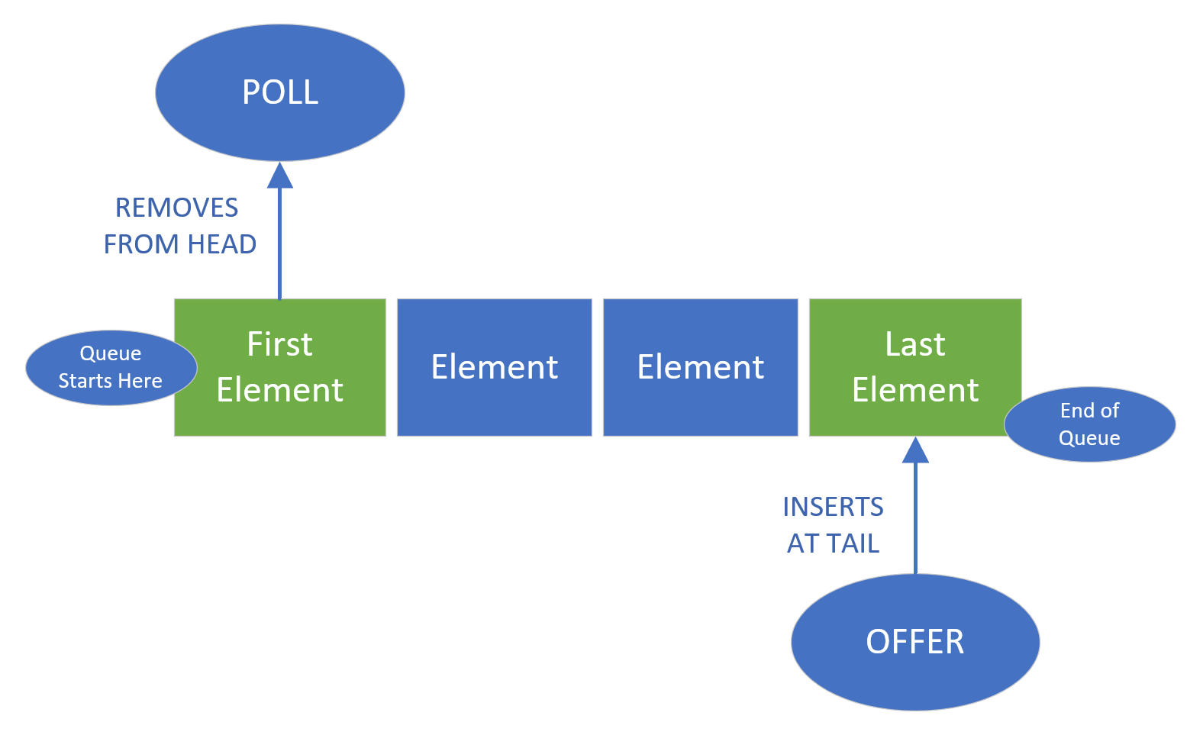
A Queue is a First-In, First-Out (FIFO) Data Collection
When you think of a queue, you might think of standing in line.
When you get in a line or a queue, you expect that you'll be processed, in relationship to the first person in line.
We call this a First-in First-out, or FIFO data collection.
COMPLETE JAVA MASTERCLASS
LinkedList Part 1

Slide 61
A Queue is a First-In, First-Out (FIFO) Data Collection
If you want to remove an item, you poll the queue, getting the first element or person in the line.
If you want to add an item, you offer it onto the queue, sending it to the back of the line.
Single-ended queues always process elements from the start of the queue.
COMPLETE JAVA MASTERCLASS
LinkedList Part 1

Slide 62
A Queue is a First-In, First-Out (FIFO) Data Collection
A double-ended queue allows access to both the start and end of the queue.
A LinkedList can be used as a double ended queue.
COMPLETE JAVA MASTERCLASS
LinkedList Part 1

Slide 63
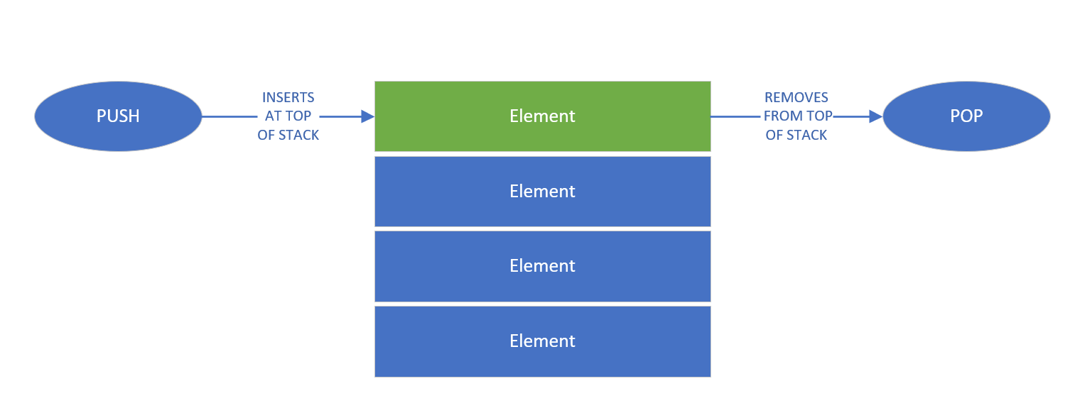
A Stack a is Last-In, First-Out (LIFO) Data Collection
When you think of a stack, you can think of a vertical pile of elements, one on top of another, as we show on this slide.
When you add an item, you push it onto the stack.
If you want to get an item, you'll take the top item, or pop it from the stack.
We call this a Last-In First-out, or LIFO data collection.
A LinkedList can be used as a stack as well.
COMPLETE JAVA MASTERCLASS
LinkedList Part 1

Slide 64
What's an Iterator?
So far, we've mainly used for loops to traverse, or step through elements, in an array or list.
We can use the traditional for loop and an index, to index into a list.
We can use the enhanced for loop and a collection, to step through the elements, one at a time.
But Java provides other means to traverse lists.
Two alternatives are the Iterator, and the ListIterator.
COMPLETE JAVA MASTERCLASS
Iterators

Slide 65
How does an Iterator work?
If you're familiar with databases, you might be familiar with a database cursor, which is a mechanism that enables traversal, over records in a database.
An iterator can be thought of as similar to a database cursor.
The kind of cursor we're referring to here, can be described as an object, that allows traversal over records in a collection.
COMPLETE JAVA MASTERCLASS
Iterators

Slide 66
How does an Iterator work?
The Iterator is pretty simple.
When you get an instance of an iterator, you can call the next method, to get the next element in the list.
You can use the hasNext method, to check if any elements remain to be processed.
In the code, you can see a while loop, which uses the iterator's hasNext method, to determine if it should continue looping.
In the loop, the next method is called, and its value assigned to a local variable, and the local variable printed out.
This would just print each element in a list, but do it through the iterator object.
COMPLETE JAVA MASTERCLASS
Iterators

Slide 67
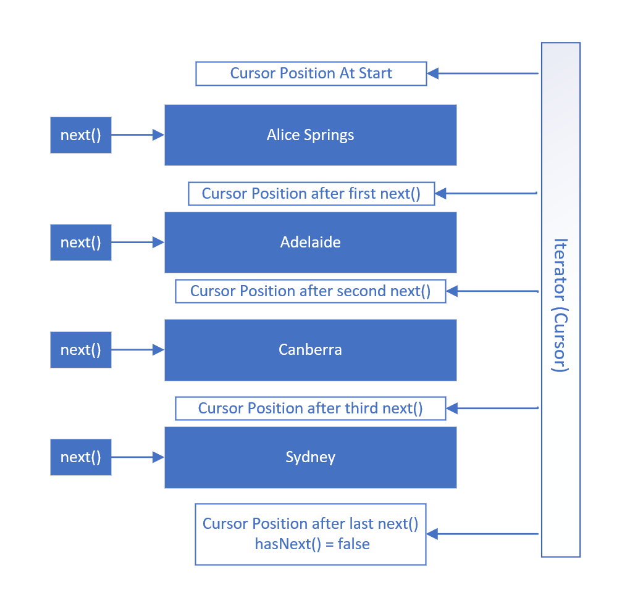
How does an Iterator work?
This slide shows visually how an Iterator works, using the PlacesToVisit List.
When an iterator is created, its cursor position is pointed at a position before the first element.
The first call to the next method gets the first element, and moves the cursor position, to be between the first and second elements.
Subsequent calls to the next method moves the iterator's position through the list, as shown, until there are no elements left, meaning hasNext = false.
At this point, the iterator or cursor position is below the last element.
COMPLETE JAVA MASTERCLASS
Iterators

Slide 68
Iterator vs. ListIterator
An Iterator is forwards only, and only supports the remove method.
A ListIterator can be used to go both forwards and backwards, and in addition to the remove method, it also supports the add and set methods.
COMPLETE JAVA MASTERCLASS
Iterators

Slide 69
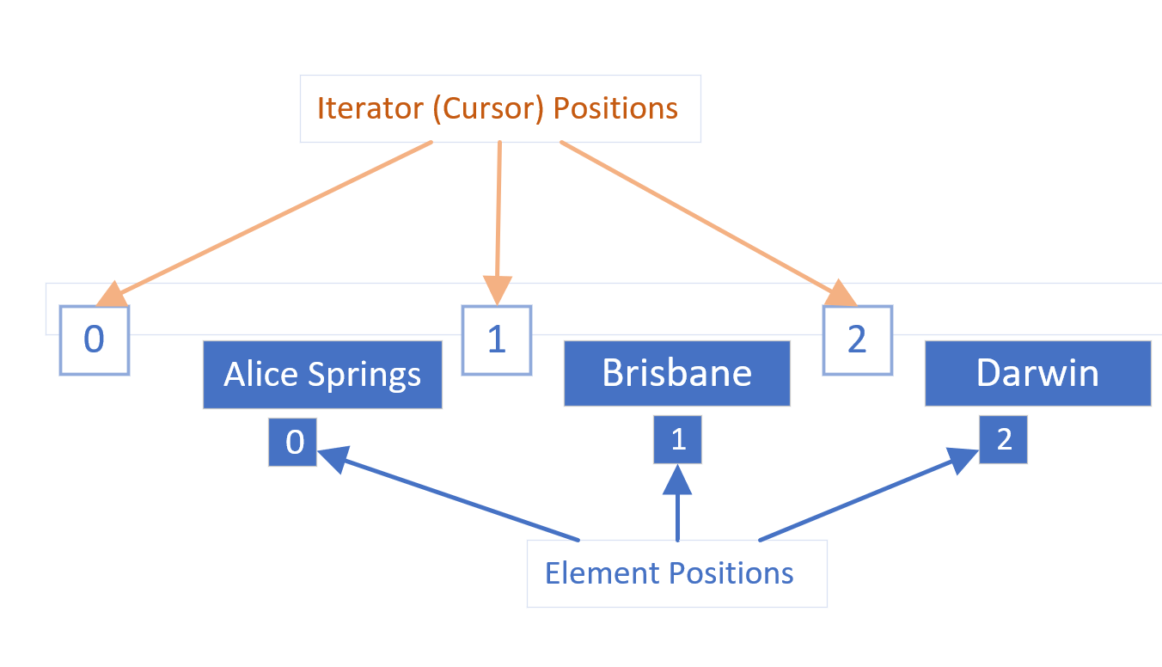
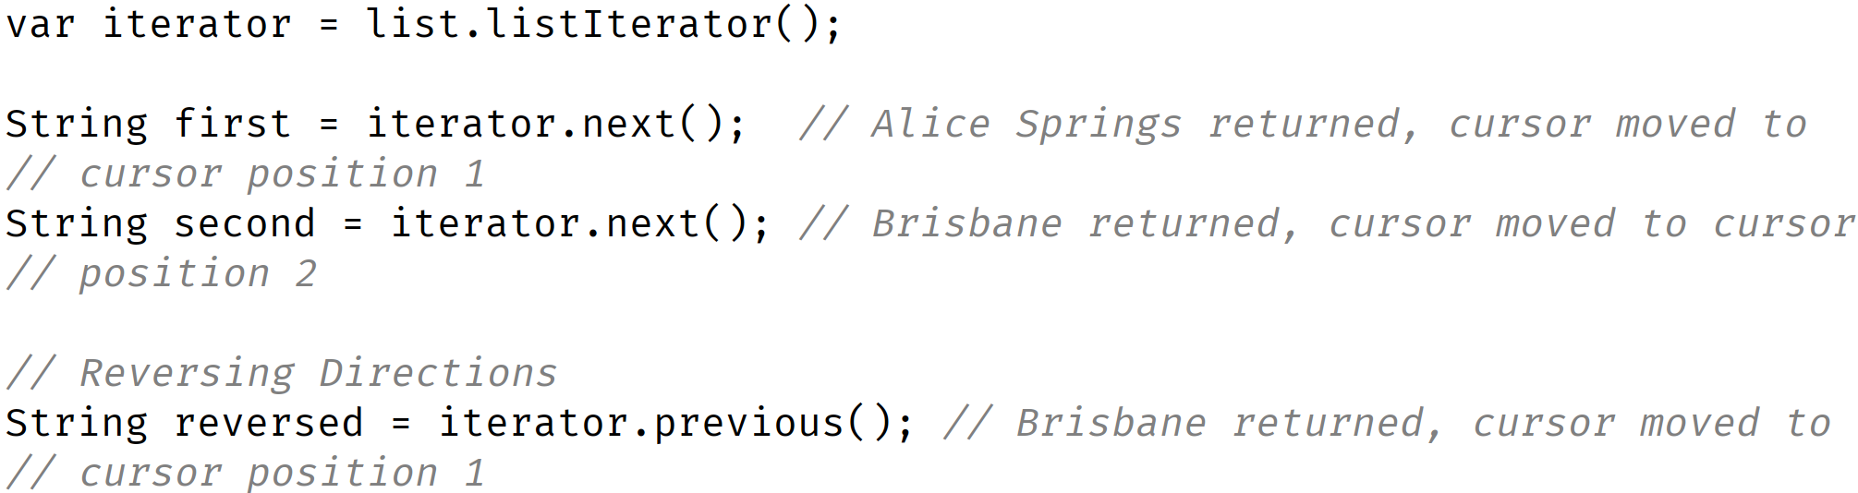
Iterator positions vs. Element positions
It's really important to understand that the iterator's cursor positions, are between the elements.
COMPLETE JAVA MASTERCLASS
Iterators

Slide 70
LinkedList Challenge
It's now time for a LinkedList challenge.
I'm going to ask you to use LinkedList functionality, to create a list of places, ordered by distance from the starting point.
And we want to use a ListIterator, to move, both backwards and forwards, through this ordered itinerary of places.
COMPLETE JAVA MASTERCLASS
LinkedList Challenge

Slide 71
LinkedList Challenge
First, create a type that has a town or place name, and a field for storing the distance from the start.
Next, create an itinerary of places or towns to visit, much like we've been doing in the last few videos.
Town | Distance from Sydney (in km)
Adelaide | 1374
Alice Springs | 2771
Brisbane | 917
Darwin | 3972
Melbourne | 877
Perth | 3923
COMPLETE JAVA MASTERCLASS
LinkedList Challenge

Slide 72
LinkedList Challenge
But this time, instead of Strings, you'll want to create a LinkedList of your place or town type.
Here we show a list of a few places in Australia, and their distances from Sydney.
Town | Distance from Sydney (in km)
Adelaide | 1374
Alice Springs | 2771
Brisbane | 917
Darwin | 3972
Melbourne | 877
Perth | 3923
COMPLETE JAVA MASTERCLASS
LinkedList Challenge

Slide 73
LinkedList Challenge
You'll create a LinkedList, ordered by the distance from the starting point, in this case Sydney.
Sydney should be the first element in your list.
You don't want to allow duplicate places to be in your list, for this data set.
Town | Distance from Sydney (in km)
Adelaide | 1374
Alice Springs | 2771
Brisbane | 917
Darwin | 3972
Melbourne | 877
Perth | 3923
COMPLETE JAVA MASTERCLASS
LinkedList Challenge

Slide 74
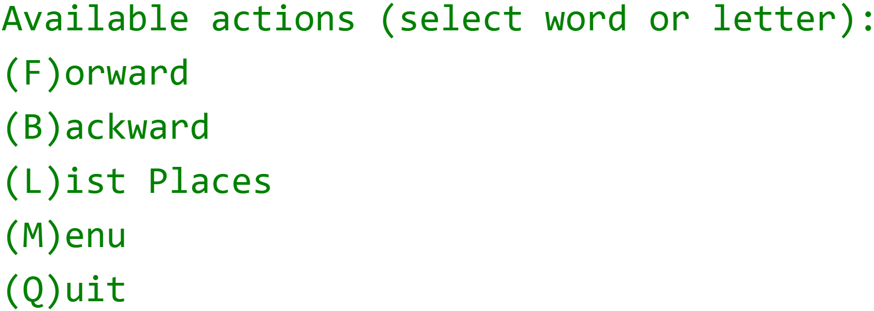
LinkedList Challenge
In addition, you'll create an interactive program with the following menu item options.
You'll want to use a Scanner, and the nextLine method, to get input from the console.
You'll use a ListIterator, to move forwards and backwards, through the list of places on your itinerary.
COMPLETE JAVA MASTERCLASS
LinkedList Challenge

Slide 75
LinkedList Challenge
Now, we'll create the interactive part of our program, with the menu items shown here.
We'll use a Scanner, to get input from the user, and we'll use a ListIterator, to move back and forth, through the itinerary.
COMPLETE JAVA MASTERCLASS
LinkedList Challenge, Continued

Slide 76
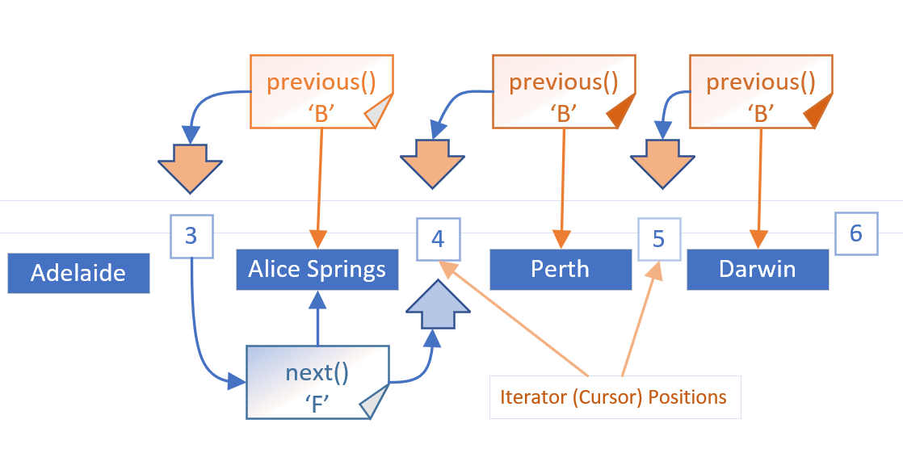
Reversing Directions in a List Iterator
Here, we show the three B or back menu items, each calling the previous method.
This leaves our cursor position, shown as an orange arrow, positioned, between Adelaide and Alice Springs.
When we decided to go forward, we called the next method from this cursor position, and that gave us Alice Springs.
COMPLETE JAVA MASTERCLASS
LinkedList Challenge, Continued

Slide 77
Reversing Directions in a List Iterator
When we change directions, we have to compensate for the cursor being ahead of where we want it to be.
So we have to make the call, either next or previous, twice, the first time to adjust the cursor, and the second time to get the element.
COMPLETE JAVA MASTERCLASS
LinkedList Challenge, Continued

Slide 78
Why does Java have primitive data types?
Some object-oriented languages, don't support any primitive data types at all, meaning everything is an object.
But most of the more popular object oriented languages of the day, support both primitive types and objects, as does Java.
Primitive types generally represent the way data is stored on an operating system.
Primitives have some advantages over objects, especially as the magnitude, or number of elements increase.
Objects take up additional memory, and may require a bit more processing power.
We know we can create objects, with primitive data types as field types, for example, and we can also return primitive types from methods.
COMPLETE JAVA MASTERCLASS
Introduction to Autoboxing and Unboxing

Slide 79
Why don't all of Java's collection types support primitives?
But when we look at classes like the ArrayList, or the LinkedList, which we've reviewed in a lot of detail in this section, these classes don't support primitive data types, as the collection type.
In other words we can't do the following, creating a LinkedList, using the int primitive type.
This code won't compile.
This means, we can't use all the great functions Lists provide, with primitive values.
COMPLETE JAVA MASTERCLASS
Introduction to Autoboxing and Unboxing

Slide 80
Why don't all of Java's collection types support primitives?
More importantly, we can't easily use primitives, in some of the features we'll be learning about in the future, like generics.
But Java, as we know, gives us wrapper classes for each primitive type.
And we can go from a primitive to a wrapper, which is called boxing, or a wrapper to a primitive, which is called unboxing, with relative ease in Java.
COMPLETE JAVA MASTERCLASS
Introduction to Autoboxing and Unboxing

Slide 81
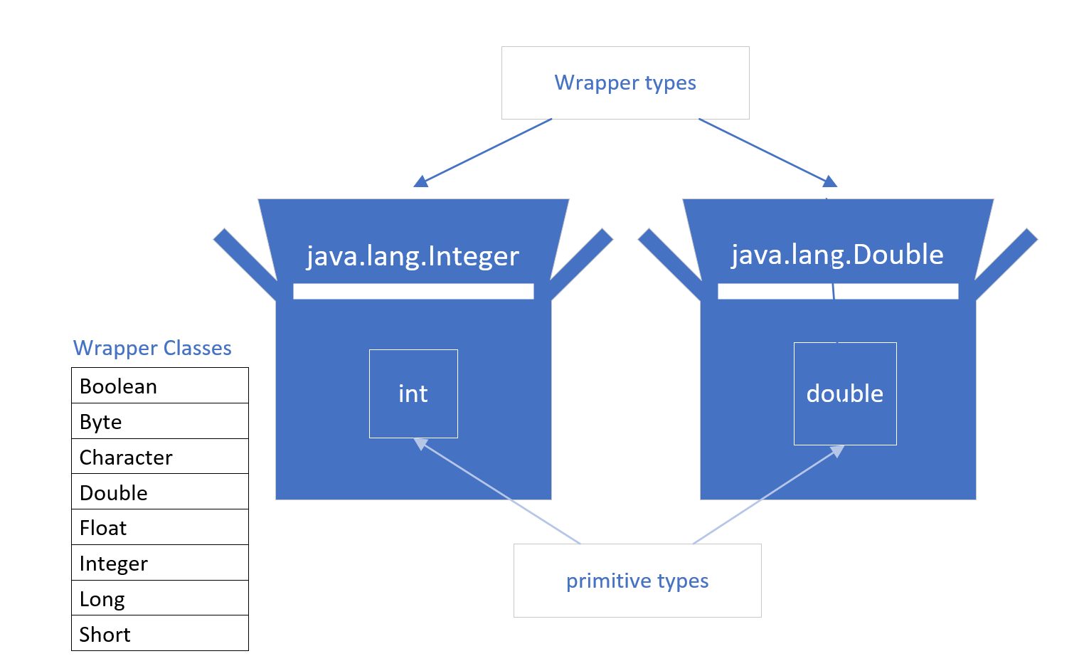
What is Boxing?
A primitive is boxed, or wrapped, in a containing class, whose main data is the primitive value.
Each primitive data type has a wrapper class, as shown on the list, which we've seen before.
Each wrapper type boxes a specific primitive value.
COMPLETE JAVA MASTERCLASS
Introduction to Autoboxing and Unboxing

Slide 82
How do we box?
Each wrapper has a static overloaded factory method, valueOf(), which takes a primitive, and returns an instance of the wrapper class.
The code shown on this slide, returns an instance of the java.lang.Integer class, to the boxedInt variable, with the value 15 in it.
We can say this code manually boxes a primitive integer.
COMPLETE JAVA MASTERCLASS
Introduction to Autoboxing and Unboxing

Slide 83
Deprecated Boxing using the wrapper constructor
Another manual way of boxing, which you'll see in older code, is by creating a new instance of the wrapper class, using the new keyword, and passing the primitive value to the constructor.
We show an example of this here.
If you try this in IntelliJ, with any Java version greater than JDK-9, IntelliJ will tell you, this is deprecated code.
COMPLETE JAVA MASTERCLASS
Introduction to Autoboxing and Unboxing

Slide 84
Deprecated Code
Deprecated code means it's older, and it may not be supported in a future version.
In other words, you should start looking for an alternate way of doing something, if it's been deprecated.
COMPLETE JAVA MASTERCLASS
Introduction to Autoboxing and Unboxing

Slide 85
Using new (with a constructor) is deprecated for wrappers
Java's own documentation states the following:
It is rarely appropriate to use this constructor.
The static factory valueOf(int) is generally a better choice, as it is likely to yield significantly better space and time performance.
This deprecation applies to all the constructors of the wrapper classes, not just the Integer class.
In truth, we rarely have to manually box primitives, because Java supports something called autoboxing.
COMPLETE JAVA MASTERCLASS
Introduction to Autoboxing and Unboxing

Slide 86
What is autoboxing?
We can simply assign a primitive to a wrapper variable, as we show on this slide.
Java allows this code, and it's actually preferred, to manually boxing.
Underneath the covers, Java is doing the boxing. In other words, an instance of Integer is created, and it's value is set to 15.
Allowing Java to autobox, is preferred to any other method, because Java will provide the best mechanism to do it.
COMPLETE JAVA MASTERCLASS
Introduction to Autoboxing and Unboxing

Slide 87
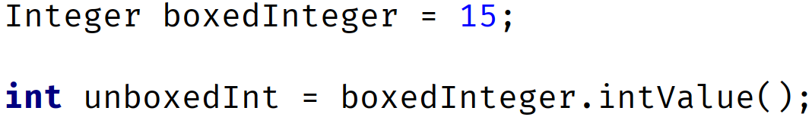
What is autoboxing?
Every wrapper class supports a method to return the primitive value it contains.
This is called unboxing.
In the example on this slide, we've autoboxed the integer value 15, to a variable called boxedInteger.
This gives us an object which is an Integer wrapper class, and has the valueof 15.
To unbox this, on an Integer class, we can use the intValue method, which returns the boxed value, the primitive int.
COMPLETE JAVA MASTERCLASS
Introduction to Autoboxing and Unboxing

Slide 88
What is autoboxing?
This method is called manually unboxing.
And like boxing, it's unnecessary to manually unbox.
COMPLETE JAVA MASTERCLASS
Introduction to Autoboxing and Unboxing

Slide 89
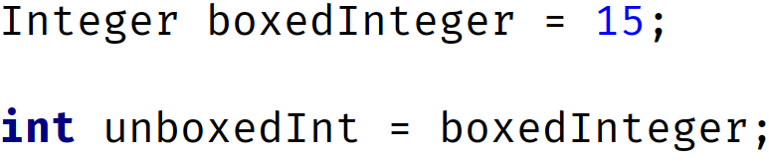
Automatic unboxing
Automatic unboxing is really just referred to as unboxing in most cases.
We can assign an instance of a wrapper class, directly to a primitive variable.
The code on this slide shows an example.
We're assigning an object instance to a primitive variable, in the second statement.
COMPLETE JAVA MASTERCLASS
Introduction to Autoboxing and Unboxing

Slide 90
Automatic unboxing
This is allowed, because the object instance is an Integer wrapper, and we're assigning it to an int primitive type variable.
Again, this is the preferred way to unbox a wrapper instance.
Let's get back to some code now, and show different examples of when this feature can be used.
COMPLETE JAVA MASTERCLASS
Introduction to Autoboxing and Unboxing

Slide 91
Autoboxing Challenge with ArrayLists
Okay, so it's time for a challenge on autoboxing and unboxing.
In this challenge, you will need to create a simple banking application, with a Customer and Bank type.
The Customer will have a name, and an ArrayList of transactions containing Double wrapper elements.
A customer's transaction can be a credit, which means a positive amount, or it can be a debit, a negative amount.
COMPLETE JAVA MASTERCLASS
Autoboxing & Unboxing Challenge

Slide 92
Autoboxing Challenge with ArrayLists
The Bank will have a name, and an ArrayList of customers.
The bank should add a new customer, if they're not yet already in the list.
The bank class should allow a customer to add a transaction, to an existing Customer.
This class should also print a statement, that includes the customer name, and the transaction amounts. This method should use unboxing.
COMPLETE JAVA MASTERCLASS
Autoboxing & Unboxing Challenge

Slide 93
Enumeration
The enum type is Java's type to support something called an enumeration.
Wikipedia defines enumeration as, “A complete ordered listing of all the items in a collection."
COMPLETE JAVA MASTERCLASS
Introduction to the enum type

Slide 94
The enum type
Java describes the enum type as: A special data type that contains predefined constants.
A constant is a variable whose value can't be changed, once it's value has been assigned.
So an enum is a little like an array, except it's elements are known, not changeable, and each element can be referred to by a constant name, instead of an index position.
COMPLETE JAVA MASTERCLASS
Introduction to the enum type

Slide 95
The enum type
An enum, in its simplest form, is described like a class, but the keyword enum, replaces the keyword class.
You can name the enum with any valid identifier, but like a class, Upper CamelCase is the preferred style.
Within the enum body, you declare a list of constant identifiers, separated by commas. By convention, these are all uppercase labels.
One example of an enum, is the days of the week, as shown here.
COMPLETE JAVA MASTERCLASS
Introduction to the enum type

Slide 96
The enum type
An enum is ordered, by the way you declare the constants.
This means that SUNDAY is considered the first day of the week, and SATURDAY is the last day of the week.
COMPLETE JAVA MASTERCLASS
Introduction to the enum type

Slide 97
The enum type
The enum type is used to declare a limited set of constants, and sometimes, there is a natural order to the listing, as in the case of days of the week.
Some other examples of possible enum declarations might be:
The months in the year: JANUARY, FEBRUARY, MARCH, etc.
The directions in a compass: EAST, NORTH, WEST, SOUTH.
A set of sizes: EXTRA_SMALL, SMALL, MEDIUM, LARGE, EXTRA_LARGE.
COMPLETE JAVA MASTERCLASS
Introduction to the enum type

Slide 98
The enum type
Underneath the covers, the enum type is a special type of class, which contains fields to support the constants, but we'll get into that, in a later discussion.
You don't have to understand all the internals of an enum, to derive the benefits of using this type.
Once you get used to how this type works, you may find many places to use an enum.
They simplify your code, and make it more readable in many ways.
COMPLETE JAVA MASTERCLASS
Introduction to the enum type

