Slide 1

Introduction
In this section, we'll be talking about abstraction and generalization.
These concepts, in action, reduce the amount of code we have to write, and encourage extensible and flexible code.
When I say code is extensible, I mean it can support future enhancements and changes, with little or no effort.
An extensible application is designed with change in mind.
In this section of the course, we'll be looking at Java's support for these two concepts.
COMPLETE JAVA MASTERCLASS
Introduction

Slide 2
Generalization and Abstraction
We use the terms Abstraction and Generalization, when we start trying to model real world things in software.
Before I launch into interface types and abstract classes, I want to talk about what these concepts mean.
COMPLETE JAVA MASTERCLASS
Abstraction & Generalization (with overview of abstract and other modifiers)

Slide 3
Generalization
When you start modeling objects for your application, you start by identifying what features and behavior your objects have in common.
We generalize when we create a class hierarchy.
A base class is the most general class, the most basic building block, which everything can be said to have in common.
COMPLETE JAVA MASTERCLASS
Abstraction & Generalization (with overview of abstract and other modifiers)

Slide 4
Abstraction
Part of generalizing is using abstraction.
You can generalize a set of characteristics and behavior into an abstract type.
If you consider an octopus, a dog, and a penguin, you would probably say they're all animals.
An animal is really an abstract concept.
An animal doesn't really exist, except as a way to describe a set of more specific things.
If you can't draw it on a piece of paper, it's probably abstract.
Abstraction simplifies the view of a set of items' traits and behavior, so we can talk about them as a group, as well as generalize their functionality.
COMPLETE JAVA MASTERCLASS
Abstraction & Generalization (with overview of abstract and other modifiers)

Slide 5
Java's support for Abstraction
Java supports abstraction in several different ways.
Java allows us to create a class hierarchy, where the top of the hierarchy, the base class, is usually an abstract concept, whether it's an abstract class or not.
Java let's us create abstract classes.
Java gives us a way to create interfaces.
COMPLETE JAVA MASTERCLASS
Abstraction & Generalization (with overview of abstract and other modifiers)

Slide 6
Abstract method
In the videos that follow, I'll be talking a lot about abstract and concrete methods.
An abstract method has a method signature, and a return type, but doesn't have a method body.
Because of this, we say an abstract method is unimplemented.
It's purpose is to describe behavior, which any object of that type will always have.
Conceptually, we can understand behaviors like move or eat on an Animal, so we might include those as abstract methods, on an abstract type.
You can think of an abstract method as a contract.
This contract promises that all subtypes will provide the promised functionality, with the agreed upon name and arguments.
COMPLETE JAVA MASTERCLASS
Abstraction & Generalization (with overview of abstract and other modifiers)

Slide 7
Concrete method
A concrete method has a method body, usually with at least one statement.
This means it has operational code, that gets executed, under the right conditions.
A concrete method is said to implement an abstract method, if it overrides one.
Abstract classes and interfaces, can have a mix of abstract and concrete methods.
COMPLETE JAVA MASTERCLASS
Abstraction & Generalization (with overview of abstract and other modifiers)

Slide 8
Method Modifiers
I've already covered access modifiers and what they mean for types, as well as members of types.
And we know we have public, protected, package, and private access modifiers, as options for the members.
COMPLETE JAVA MASTERCLASS
Abstraction & Generalization (with overview of abstract and other modifiers)

Slide 9
Method Modifiers
In addition to access modifiers, methods have other modifiers, which we'll list here, as a high-level introduction.
Modifier | Purpose
abstract | When you declare a method abstract, a method body is always omitted. An abstract method can only be declared on an abstract class or an interface.
static | Sometimes called a class method, rather than an instance method, because it's called directly on the Class instance.
final | A method that is final cannot be overridden by subclasses.
default | This modifier is only applicable to an interface, and we'll talk about it in our interface videos.
native | This is another method with no body, but it's very different from the abstract modifier. The method body will be implemented in platform-dependent code, typically written in another programming language such as C. This is an advanced topic and not generally commonly used, and we won't be covering it in this course.
synchronized | This modifier manages how multiple threads will access the code in this method. We'll cover this in a later section on multi-threaded code.
COMPLETE JAVA MASTERCLASS
Abstraction & Generalization (with overview of abstract and other modifiers)

Slide 10
what is 'it'?
Now consider these sentences.
We adopted a new pet this weekend.
I ordered something I really wanted from the store.
I bought a ticket and won a prize.
If we said any of these things to a friend or coworker, it might be frustrating for them.
We haven't given them enough information in any of these cases.
In other words, they can't paint a picture in their head, because they lack details.
New pet, something ordered, and a ticket, are too general when talking about one item.
COMPLETE JAVA MASTERCLASS
Abstract Classes Part 1

Slide 11
what is 'it'?
On the other hand, when we talk about groups of things, we don't usually need too many specifics.
Consider these sentences.
I need to get home to feed the animals.
I'm waiting for my box of stuff from an online store to be delivered.
So here, 'animals', and 'stuff', are probably enough information, to fully describe the situation.
COMPLETE JAVA MASTERCLASS
Abstract Classes Part 1

Slide 12
The abstract class
The abstract class is declared with the abstract modifier.
Here we are declaring an abstract class called Animal.
An abstract class is a class that's incomplete.
You can't create an instance of an abstract class.
An abstract class can still have a constructor, which will be called by its subclasses, during their construction.
COMPLETE JAVA MASTERCLASS
Abstract Classes Part 1

Slide 13
The abstract class
An abstract class's purpose, is to define the behavior it's subclasses are required to have, so it always participates in inheritance.
For the examples on this slide, assume that Animal is an abstract class.
Classes extend abstract classes, and can be concrete.
Here, Dog extends Animal, Animal is abstract, but Dog is concrete.
COMPLETE JAVA MASTERCLASS
Abstract Classes Part 1

Slide 14
The abstract class
A class that extends an abstract class, can also be abstract itself, as I show with this next example.
Mammal is declared abstract and it extends Animal, which is also abstract.
And finally an abstract class can extend a concrete class.
Here we have BestOfBreed, an abstract class, extending Dog, which is concrete.
COMPLETE JAVA MASTERCLASS
Abstract Classes Part 1

Slide 15
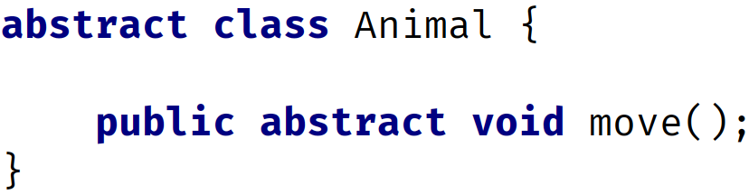
What's an abstract method?
An abstract method is declared with the modifier abstract.
You can see on this slide, that we're declaring an abstract method called move, with a void return type.
It simply ends with a semi-colon.
It doesn't have a body, not even curly braces.
Abstract methods can only be declared on an abstract class or interface.
COMPLETE JAVA MASTERCLASS
Abstract Classes Part 1

Slide 16
What good is an abstract method, if it doesn't have any code in it?
An abstract method tells the outside world, that all Animals will move, in the example we show here.
Any code that uses a subtype of Animal, knows it can call the move method, and the subtype will implement this method with this signature.
This is also true for a concrete class, and a concrete method that's overridden.
You might be asking, what's the difference, and when would you use an abstract class.
COMPLETE JAVA MASTERCLASS
Abstract Classes Part 1

Slide 17
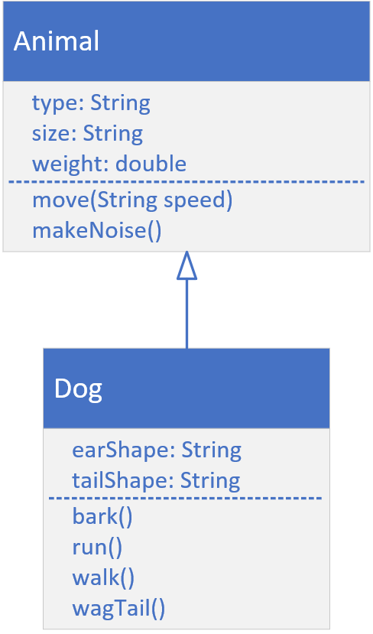
Animal and Dog Class Diagram from our Inheritance example
In the videos on inheritance, we created a very basic Animal class, and then we extended it to create a Dog.
Here, I show you the class diagram from that lecture again.
 | In that example, Animal was a concrete class, so the move and makeNoise methods had code in their method bodies. Subclasses have choices when they extend a concrete class with concrete methods. They can inherit the same behavior from their parent. This means they don't have to even declare the methods in their class bodies. They can override the behavior from their parent. This means they have a method with the same signature, but with their own code in there, ignoring the parent's code altogether. They can also override the behavior but leverage the parent's method code, by calling the parent's method, using super in their overridden code.
COMPLETE JAVA MASTERCLASS
Abstract Classes Part 1

Slide 18
Animal and Dog Class Diagram, What if Animal were abstract?
But what happens if Animal is declared as abstract, and the move and makeNoise methods are also abstract?
 | If Animal is abstract and it's methods are abstract, subclasses no longer have the options we just talked about. There is no concrete method for a subclass to inherit code from. Instead, the subclass must provide a concrete method for any abstract method declared on its parent. The subclass won't compile if it doesn't implement the abstract methods.
COMPLETE JAVA MASTERCLASS
Abstract Classes Part 1

Slide 19
An Abstract class doesn't have to implement abstract methods
An abstract class that extends another abstract class has some flexibility.
It can implement all of the parent's abstract methods.
It can implement some of them.
Or it can implement none of them.
It can also include additional abstract methods, which will force subclasses to implement both Animal's abstract methods, as well as Mammal's.
COMPLETE JAVA MASTERCLASS
Abstract Classes Part 3

Slide 20
Why use an abstract class?
In truth, you may never need to use an abstract class in your design, but there are some good arguments for using them.
An abstract class in your hierarchy forces the designers of subclasses, to think about, and create unique and targeted implementations, for the abstracted methods.
It may not always make sense to provide a default, or inherited implementation, of a particular method.
An abstract class can't be instantiated, so if you're using abstract classes to design a framework for implementation, this is definitely an advantage.
COMPLETE JAVA MASTERCLASS
Abstract Classes Part 3

Slide 21
Why use an abstract class?
In our example, we don't really want people creating instances of Animals or Mammals.
We used those classes to abstract behavior, at different classification levels.
All Animals have to implement the move and makeNoise methods, but only Mammals needed to implement shedHair, as we demonstrated.
COMPLETE JAVA MASTERCLASS
Abstract Classes Part 3

Slide 22
Abstract Class Challenge
In this challenge, you need to build an application, that can be a store front, for any imaginable item for sale.
Instead of the Main class we usually create, create a Store class, with a main method.
The Store class should:
manage a list of products for sale, including displaying the product details.
manage an order, which can just be a list of OrderItem objects.
have methods to add an item to the order, and print the ordered items, so it looks like a sales receipt.
COMPLETE JAVA MASTERCLASS
Abstract Class Challenge Part 1

Slide 23
Abstract Class Challenge
Create a ProductForSale class that should have at least three fields: a type, price, and a description, and should have methods to:
get a Sales Price, a concrete method, which takes a quantity, and returns the quantity times the price.
print a Priced Line Item, a concrete method, which takes a quantity, and should print an itemized line item for an order, with quantity and line item price.
show Details, an abstract method, which represents what might be displayed on a product page, product type, description, price, and so on.
Create an OrderItem type, that has at a minimum 2 fields, quantity and a Product for Sale.
You should create two or three classes that extend the ProductForSale class, that will be products in your store.
COMPLETE JAVA MASTERCLASS
Abstract Class Challenge Part 1

Slide 24
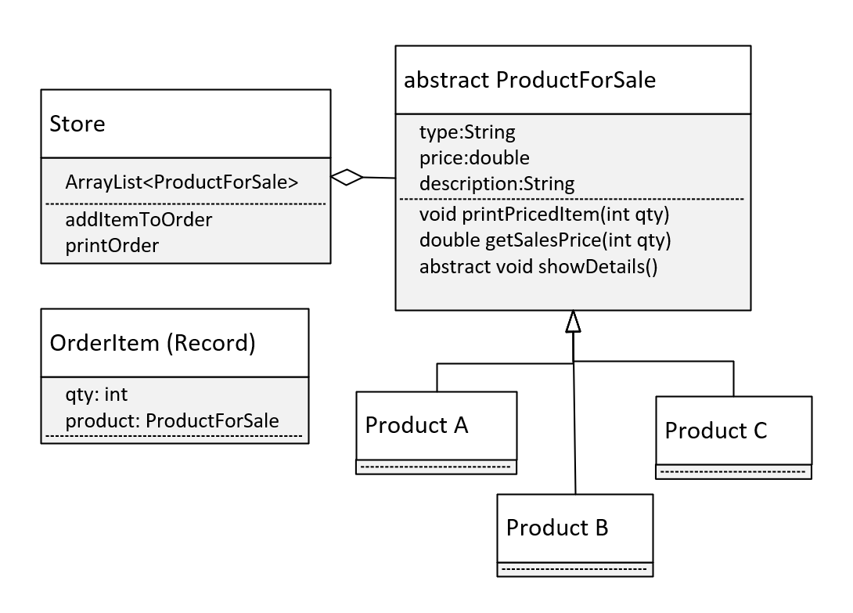
The Design
Let's look at my approach.
First, let me show you a class diagram, of what we'll be building.
This covers all the requirements we talked about.
You'll notice I'm specifying that OrderItem will be a record, and this is just to keep the code simple.
And I'm not really specifying what our store products are, we can really put anything there.
COMPLETE JAVA MASTERCLASS
Abstract Class Challenge Part 1

Slide 25
Interface vs. Abstract Class
We saw that an abstract class requires its subclasses, to implement its abstract methods.
An interface is similar to an abstract class, although it isn't a class at all.
It's a special type, that's more like a contract between the class and client code, that the compiler enforces.
By declaring it's using an interface, your class must implement all the abstract methods, on the interface.
A class agrees to this, because it wants to be known by that type, by the outside world, or the client code.
An interface lets classes that might have little else in common, be recognized as a special reference type.
COMPLETE JAVA MASTERCLASS
Interfaces Part 1

Slide 26
Declaring an interface
Declaring an interface is similar to declaring a class, using the keyword interface, where you would use class.
On this slide, I'm declaring a public interface named FlightEnabled.
An interface is usually named, according to the set of behaviors it describes.
Many interfaces will end in 'able', like Comparable, and Iterable, again meaning something is capable, or can do, a given set of behaviors.
COMPLETE JAVA MASTERCLASS
Interfaces Part 1

Slide 27
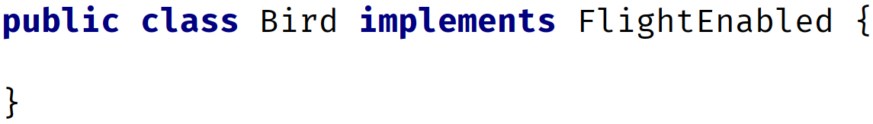
Using an interface
A class is associated to an interface, by using the implements clause in the class declaration.
In this example, the class Bird implements the FlightEnabled interface.
Because of this declaration, we can use FlightEnabled as the reference type, and assign it an instance of bird.
In this code sample, we create a new Bird object, but we assign it to the FlightEnabled variable named flier.
COMPLETE JAVA MASTERCLASS
Interfaces Part 1

Slide 28
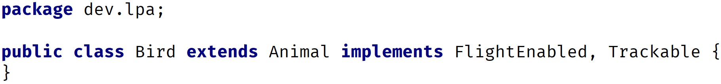
A class can use extends and implements in same declaration
A class can only extend a single class, which is why Java is called single inheritance.
But a class can implement many interfaces. This gives us plug and play functionality, which is what makes them so powerful.
A class can both extend another class, and implement one or more interfaces.
In this example, the Bird class extends, or inherits from Animal, but it's implementing both a FlightEnabled, and Trackable interface.
We can describe Bird by what it is, and what it does.
COMPLETE JAVA MASTERCLASS
Interfaces Part 1

Slide 29
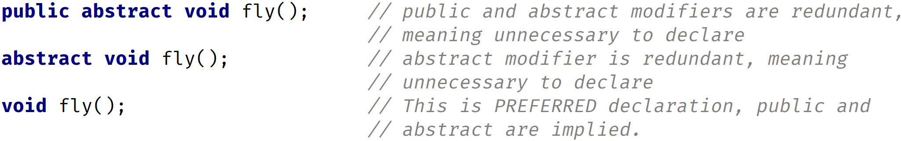
The abstract modifier is implied on an interface
We don't have to declare the interface type abstract, because this modifier is implicitly declared, for all interfaces.
Likewise, we don't have to declare any method abstract.
In fact, any method declared without a body, is really implicitly declared both public and abstract.
The three declarations shown on this slide, result in the same thing, under the covers:
COMPLETE JAVA MASTERCLASS
Interfaces Part 1

Slide 30
All members on an interface are implicitly public
If we omit an access modifier on a class member, it's implicitly package private.
If we omit an access modifier on an interface member, it's implicitly public.
This is an important difference, and one you need to remember.
Changing the access modifier of a method to protected, on an interface, is a compiler error, whether the method is concrete or abstract.
Only a concrete method can have private access.
COMPLETE JAVA MASTERCLASS
Interfaces Part 1

Slide 31
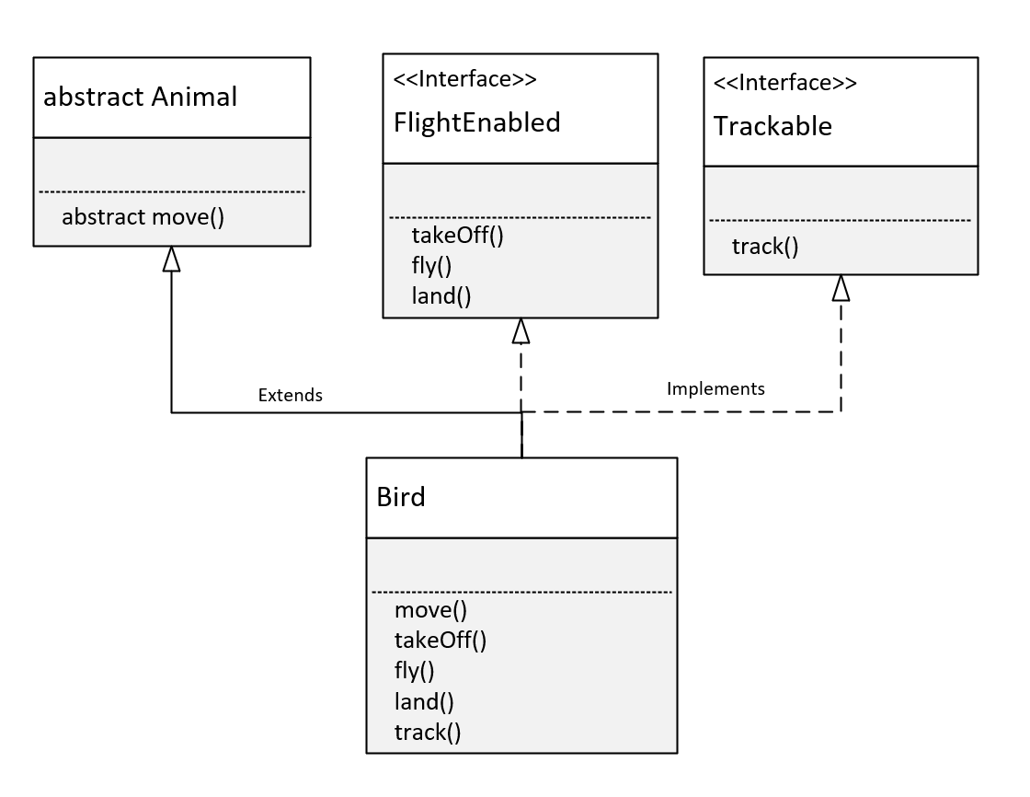
The Bird Class
An interface lets us treat an instance of a single class as many different types.
The Bird Class inherits behavior and attributes from Animal, because we used the extends keyword in the declaration of Bird.
Because the move method was abstract on Animal, Bird was required to implement it.
The Bird Class implements the FlightEnabled interface.
This required the Bird class to implement the takeOff, fly, and land methods, the abstract methods on FlightEnabled.
COMPLETE JAVA MASTERCLASS
Interfaces Part 2

Slide 32
The Bird Class
The Bird Class also implements the Trackable interface.
This required the Bird class to implement the track method, which was the abstract method declared on Trackable.
Because of these declarations, any instance of the Bird class can be treated as a Bird.
This means it has access to all of bird's methods, including all those from Animal, FlightEnabled, and Trackable.
An instance of Bird can be treated like, or declared as an Animal, with access to the Animal functionality, described in that class, but customized to Bird.
COMPLETE JAVA MASTERCLASS
Interfaces Part 2

Slide 33
The Bird Class
It can be used as a FlightEnabled type, with just the methods a FlightEnabled type needs, but again customized for the Bird.
Or it can take the form of a Trackable object, and be tracked, with specifics for the Bird class.
COMPLETE JAVA MASTERCLASS
Interfaces Part 2

Slide 34
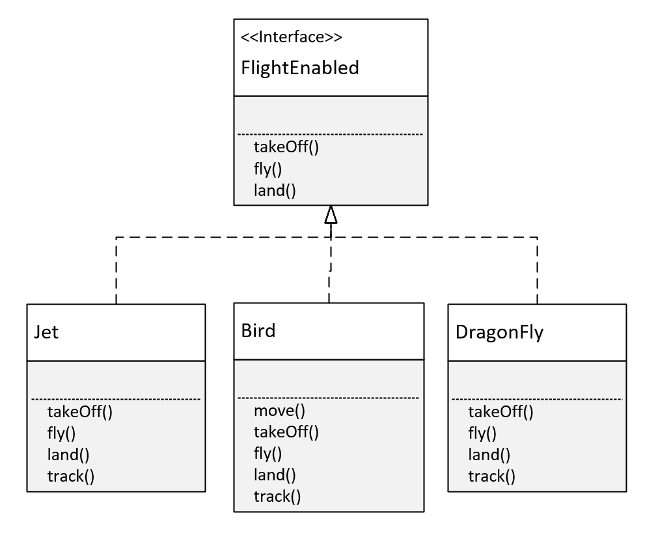
The FlightEnabled Interface
Interfaces let us take objects, that may have almost nothing in common, and write reusable code, so we can process them all in a like manner.
On this slide, you can see that a Jet, a Bird, and a DragonFly, are very different entities.
But because they implement FlightEnabled, we can treat them all as the same type, as something that flies, and ignore the differences in the classes.
Interfaces allow us to type our objects differently, by behavior only.
COMPLETE JAVA MASTERCLASS
Interfaces Part 2

Slide 35
The final modifier in Java
When we use the final modifier, we prevent any further modifications to that component.
a final method means it can't be overridden by a subclass.
a final field means an object's field can't be reassigned or given a different value, after its initialization.
a final static field is a class field that can't be reassigned, or given a different value, after the class's initialization process.
a final class can't be overridden, meaning no class can use it, in the extends clause.
COMPLETE JAVA MASTERCLASS
Interfaces Part 2

Slide 36
The final modifier in Java
a final variable, in a block of code, means that once it's assigned a value, any remaining code in the block can't change it.
a final method parameter means, we can't assign a different value to that parameter in the method code block.
The final static field, is what you're really creating, when you declare a field on an interface.
COMPLETE JAVA MASTERCLASS
Interfaces Part 2

Slide 37
Constants in Java
A constant in Java is a variable that can't be changed.
A constant variable is a final variable of primitive type, or type String, that is initialized with a constant expression .
Constants in Java, are usually named with all uppercase letters, and with underscores between words.
A static constant means we access it via the type name.
We saw this with the INTEGER.MAX_VALUE, and the INTEGER.MIN_VALUE fields.
COMPLETE JAVA MASTERCLASS
Interfaces Part 2

Slide 38
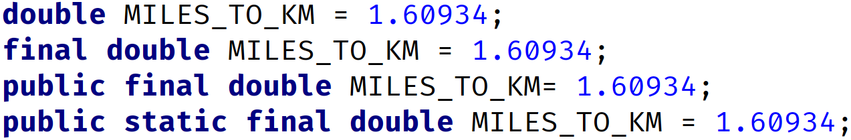
A field declared on an Interface is always public, static and final
Java let's us specify these like an ordinary field on an interface, which might be kind of confusing, and misleading to a new Java programmer.
But we can declare them with any combination of those modifiers, or none at all, with the same result.
These all mean the same thing on an interface.
COMPLETE JAVA MASTERCLASS
Interfaces Part 2

Slide 39
Extending Interfaces
Interfaces can be extended, similar to classes, using the extends keyword.
On this slide, I show an interface, OrbitEarth, that extends the FlightEnabled interface.
This interface requires all classes to implement both the OrbitEarth, and the FlightEnabled abstract methods.
Unlike a class, an interface can use the extends expression with multiple interfaces:
COMPLETE JAVA MASTERCLASS
Interfaces Part 3

Slide 40
Implements is invalid on an interface
An interface doesn't implement another interface, so the code on this slide won't compile.
In other words, implements is an invalid clause in an interface declaration.
COMPLETE JAVA MASTERCLASS
Interfaces Part 3

Slide 41
Abstracted Types - Coding to an Interface
Both interfaces and abstract classes are abstracted reference types.
Reference types can be used in code, as variable types, method parameters, and return types, list types, and so on.
When you use an abstracted reference type, this is referred to as coding to an interface.
This means your code doesn't use specific types, but more generalized ones, usually an interface type.
This technique is preferred, because it allows many runtime instances of various classes, to be processed uniformly, by the same code.
It also allows for substitutions of some other class or object, that still implements the same interface, without forcing a major refactor of your code.
Using interface types as the reference type, is considered a best practice.
COMPLETE JAVA MASTERCLASS
Interfaces Part 3

Slide 42
Coding to an Interface
Coding to an interface scales well, to support new subtypes, and it helps when refactoring code.
The downside though, is that alterations to the interface may wreak havoc, on the client code.
Imagine that you have 50 classes using your interface, and you want to add an extra abstract method, to support new functionality.
As soon as you add a new abstract method, all 50 classes won't compile.
Your code isn't backwards compatible, with this kind of change to an interface.
Interfaces haven't been easily extensible in the past.
But Java has made several changes to the Interface type over time, to try to address this last problem.
COMPLETE JAVA MASTERCLASS
Interfaces Part 3

Slide 43
What's happened to the Interface since JDK 8
Before JDK 8, the interface type could only have public abstract methods.
JDK 8 introduced the default method and public static methods, and JDK 9 introduced private methods, both static and non-static.
All of these new method types (on the interface) are concrete methods.
COMPLETE JAVA MASTERCLASS
Interfaces, what's new since JDK 8 (default methods & public static methods)

Slide 44
The Interface Extension Method - the default method (as of JDK8)
An extension method is identified by the modifier default, so it's more commonly known as the default method.
This method is a concrete method, meaning it has a code block, and we can add statements to it.
In fact, it has to have a method body, even just an empty set of curly braces.
It's a lot like a method on a superclass, because we can override it.
Adding a default method doesn't break any classes currently implementing the interface.
COMPLETE JAVA MASTERCLASS
Interfaces, what's new since JDK 8 (default methods & public static methods)

Slide 45
Overriding a default method
So like overriding a method on a class, you have three choices, when you override a default method on an interface.
You can choose not to override it at all.
You can override the method and write code for it, so that the interface method isn't executed.
Or you can write your own code, and invoke the method on the interface, as part of your implementation.
COMPLETE JAVA MASTERCLASS
Interfaces, what's new since JDK 8 (default methods & public static methods)

Slide 46
public static methods on an interface (as of JDK8)
Another enhancement that Java included in JDK 8, was support for public static methods on the interface.
Static methods don't need to specify a public access modifier, because it's implied.
When you call a public static method on an interface, you must use the interface name as a qualifier.
In the ArrayList lectures, you may remember I used two static helper methods, on the Comparator interface, which were added in JDK 8.
These were Comparator.naturalOrder() and Comparator.reverseOrder().
COMPLETE JAVA MASTERCLASS
Interfaces, new since JDK8 (public static & private methods)

Slide 47
Private methods (JDK 9)
JDK 9 gave us private methods, both static and not static.
This enhancement primarily addresses the problem of re-use of code, within concrete methods on an interface.
A private static method can be accessed by either a public static method, a default method, or a private non-static method.
A private non-static method is used to support default methods, and other private methods.
COMPLETE JAVA MASTERCLASS
Interfaces, new since JDK8 (public static & private methods)

Slide 48
Abstract Class
Abstract classes are very similar to interfaces. You can't instantiate either of them. Both types may contain a mix of methods declared with, or without a method block.
With abstract classes, you can declare fields that aren't static and final, instance fields in other words.
Also with abstract classes, you can use any of the four access modifiers for its concrete methods.
You can also use all but the private access modifier, for its abstract methods.
An abstract class can extend only one parent class, but it can implement multiple interfaces.
When an abstract class is subclassed, the subclass usually provides implementations for all of the abstract methods in its parent class.
However, if it doesn't, then the subclass must also be declared abstract.
COMPLETE JAVA MASTERCLASS
Interface vs Abstract Class

Slide 49
Use an Abstract class when...
You want to share code, among several closely related classes (Animal for example, with fields, name, age...).
You expect classes that extend your abstract class, to have many common methods or fields, or require access modifiers other than public.
You want to declare non-static or non-final fields (for example, name, age), so this enables you to define methods, that can access and modify the state of an object (getName, setName).
You have a requirement for your base class, to provide a default implementation of certain methods, but other methods should be open to being overridden by child classes.
Summary: An abstract class provides a common definition, as a base class, that multiple, derived classes can share.
COMPLETE JAVA MASTERCLASS
Interface vs Abstract Class

Slide 50
Interface
An interface is just the declaration of methods, which you want some classes to have, it's not the implementation.
In an interface, we define what kind of operation an object can perform. These operations are defined by the classes that implement the interface.
Interfaces form a contract between the class, and the outside world, and this contract is enforced at build time, by the Java compiler.
You can't instantiate interfaces, but they may contain a mix of methods declared with, or without an implementation.
All methods on interfaces, declared without a method body, are automatically public and abstract.
An interface can extend another interface.
COMPLETE JAVA MASTERCLASS
Interface vs Abstract Class

Slide 51
Interface
Interfaces are more flexible, and can deal with a lot more stress on the design of your program, because they aren't part of the class hierarchy.
A best practice way of coding, is commonly called Coding to an Interface.
By introducing interfaces into your program, you're really introducing points of variation, at which you can plug in different implementations for that interface.
Summary: The interface decouples the "what", from the "how", and is used to make different types, behave in similar ways.
Since Java 8, interfaces can now contain default methods, so in other words methods with implementation. The keyword default is used mostly for backwards compatibility. Public static methods were also introduced in Java 8.
Since Java 9, an interface can also contain private methods, commonly used when default methods share common code.
COMPLETE JAVA MASTERCLASS
Interface vs Abstract Class

Slide 52
Use an Interface when...
You expect that unrelated classes will implement your interface. For example, two of Java's own interfaces, Comparable and Cloneable, can be implemented by many unrelated classes.
You want to specify the behavior of a particular data type, but you're not concerned about who implements its behavior.
You want to separate different behavior.
COMPLETE JAVA MASTERCLASS
Interface vs Abstract Class

Slide 53
Interfaces are the used in many of Java's own features
I've briefly discussed some interfaces, like List and Queue, and their implementations, ArrayList and LinkedList. These are part of what Java calls it's Collections Framework.
Interfaces are also the basis for many of the features that are coming up, for example lambda expressions, which were introduced in JDK8.
Another example is Java's database connectivity support, or JDBC, built almost entirely with interfaces. The concrete implementation of methods, is different for each database vendor, and comes in the form of JDBC drivers. This enables you to write all database code, without being concerned about the details of the database, you're connected to.
COMPLETE JAVA MASTERCLASS
Interface vs Abstract Class

Slide 54
Interface vs. Abstract Class
I've said that interfaces and abstract classes are both abstracted types, and abstracted types are used as reference types in code.
The table on this slide is a summary of the similarities and differences.
 | Abstract Class | Interface
An instance can be created from it | No | No
Has a constructor | Yes | No
Implemented as part of the Class Hierarchy. Uses Inheritance | Yes (in extends clause) | No (in implements clause)
records and enums can extend or implement? | No | Yes
Inherits from java.lang.Object | Yes | No
Can have both abstract methods and concrete methods | Yes | Yes (as of JDK 8)
Abstract methods must include abstract modifier | Yes | No (Implicit)
Supports default modifier for it's methods | No | Yes (as of JDK 8)
Can have instance fields (non-static instance fields) | Yes | No
Can have static fields (class fields) | Yes | Yes - (implicitly public static final)
COMPLETE JAVA MASTERCLASS
Interface vs Abstract Class

Slide 55
The interface Challenge
In this challenge, we'll be working on creating some mappable output.
In the past decade or so, maps have become part of so many applications.
Most things, when drawn on a map, fall into three categories, a point, a line, or a polygon or geometric shape.
The result of your code, will be text that could be printed out to a file, for exchanging data with a mapping application.
One such file is a specially formatted file, called geojson, which is a JSON file extended for geographical elements.
You don't have to know JSON or geojson to be successful at this challenge.
COMPLETE JAVA MASTERCLASS
Interface Challenge Part 1

Slide 56
The interface Challenge
For this challenge, you'll simply create a String for every feature that will be mapped.
An example of such a String is shown on this slide.
COMPLETE JAVA MASTERCLASS
Interface Challenge Part 1

Slide 57
The interface Challenge
First, Create a Mappable Interface.
The interface should force classes to implement three methods.
One method should return a label (how the item will be described on the map).
One should return a geometry type (POINT or LINE) which is what the type will look like on the map.
The last should return an icon type (sometimes called a map marker).
COMPLETE JAVA MASTERCLASS
Interface Challenge Part 1

Slide 58
The interface Challenge
In addition to the three methods described, the interface should also include:
A constant String value called JSON_PROPERTY, which is equal to: "properties":{%s}. A hint here, using a text block will help maintain quotation marks in your output.
Include a default method called toJSON() that prints out the type, label, and marker. I'll show examples shortly.
A static method, that takes a Mappable instance as an argument. This method should print out the properties for each mappable type, including those mentioned above, but also any other fields on the business classes.
COMPLETE JAVA MASTERCLASS
Interface Challenge Part 1

Slide 59
The interface Challenge
You'll also want to create two classes that implement this interface, a Building and UtilityLine.
One class, in my case the Building, should have a geometry type of POINT, and One class should have a geometry type of Line. The UtilityLine class will be my example for a class that will be a LINE on a map.
The Building will be shown on a city map, as a point with the icon and label specified, and the Utility Line will be a line on the map.
COMPLETE JAVA MASTERCLASS
Interface Challenge Part 1

Slide 60
The interface Challenge
Your final output should look something like I show on this slide.
You should output the geometry type, the icon information, and the label.
Here is an example for a building, including type, label, and marker, but also the building name and usage, which are fields on building.
And here is an example for a fiber optic Utility line, so a LINE, a green dotted line, would get drawn for a fiber optic cable on College Street.
You can see that the properties are a comma delimited list, in curly braces, with the property or field name in quotes, then a colon, followed by the property value or field value, and that's also in double quotes.
COMPLETE JAVA MASTERCLASS
Interface Challenge Part 1

Slide 61
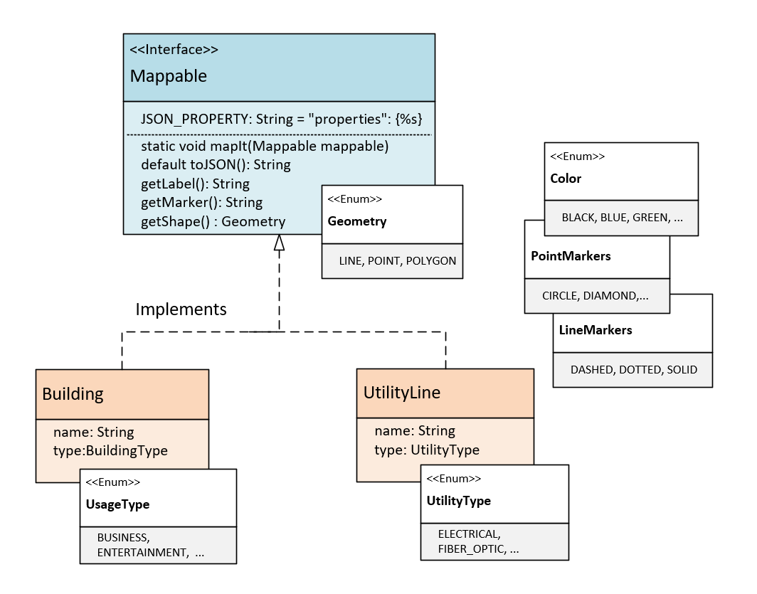
The Class Diagram
On the Mappable interface, I have one constant, JSON_PROPERTY, and 3 abstract methods, getLabel, getMarker, and getShape.
I'm also including a default method, toJSON, which is going to return a String.
The getShape method returns an enum type, Geometry, and the valid types on this enum are LINE, POINT, and POLYGON.
Use enums for Color, and the PointMarker and LineMarker types.
COMPLETE JAVA MASTERCLASS
Interface Challenge Part 1

Slide 62
The Class Diagram
Two business classes to be mapped, Building and UtilityLine.
For building, use an enum to describe the building type.
For the UtilityLine, Use enum to describe the type of utility it is.
COMPLETE JAVA MASTERCLASS
Interface Challenge Part 1

