Slide 1

Generics Introduction
Welcome to another new section, on another important topic in Java.
This one is on generics.
By now, if you've been doing this course in order, you're familiar with generalizing, conceptually, your own class design.
You pull out what things your classes have in common, so that you can think about them generally.
Generics allow us to create classes, to design them, in a general way, without really worrying about the specific details of the elements they might contain.
Java's ArrayLists are an example of a generic class.
COMPLETE JAVA MASTERCLASS
Introduction to Generics

Slide 2
Generics Introduction
We can use an ArrayList for any type of object, because many of the methods on that class can be applied to any type.
Let's jump in, and see how to create generic types, and examine how to use them and when you might choose to use them.
COMPLETE JAVA MASTERCLASS
Introduction to Generics

Slide 3
What are Generics?
Java supports generic types, such as classes, records and interfaces.
It also supports generic methods. Sound confusing?
COMPLETE JAVA MASTERCLASS
Generics Part 1

Slide 4
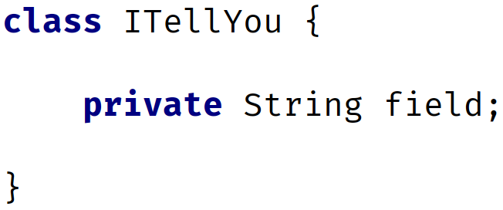
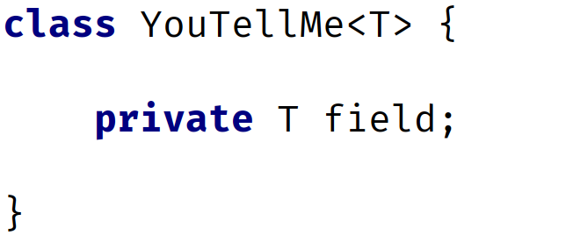
Declaring a Class vs. Declaring a generic Class
On this slide, I'm showing you a regular class declaration, next to a generic class.
The thing to notice with the generic class, is that the class declaration has angle brackets with a T in them, directly after the class name.
T is the placeholder for a type that will be specified later.
This is called a type identifier, and it can be any letter or word, but T which is short for Type is commonly used.
Regular Class | Generic Class
COMPLETE JAVA MASTERCLASS
Generics Part 1

Slide 5
Declaring a Class vs. Declaring a generic Class
For the generic class, the field's type is that placeholder, just T, and this means it can be any type at all.
The T in the angle brackets means it's the same type as the T, specified as the type of the field.
Regular Class | Generic Class
COMPLETE JAVA MASTERCLASS
Generics Part 1

Slide 6
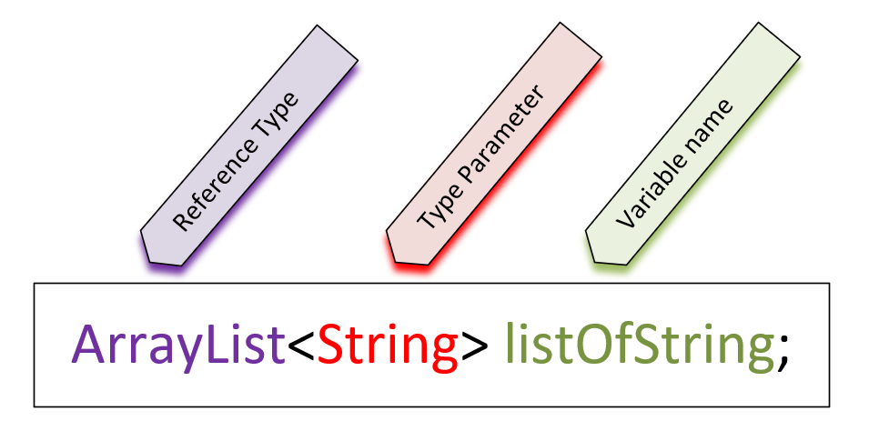
Using a generic class as a reference type
On this slide, I have a variable declaration of the generic ArrayList.
In the declaration of a reference type that uses generics, the type parameter is declared in angle brackets.
The reference type is ArrayList, the type parameter (or parameterized type) is String, which is declared in angle brackets, and listOfString is the variable name.
COMPLETE JAVA MASTERCLASS
Generics Part 1

Slide 7
Using a generic class as a reference type
Many of Java's libraries are written using generic classes and interfaces, so we'll be using them a lot moving forward.
But it's still a good idea to learn to write your own generic class, to help you understand the concept.
COMPLETE JAVA MASTERCLASS
Generics Part 1

Slide 8
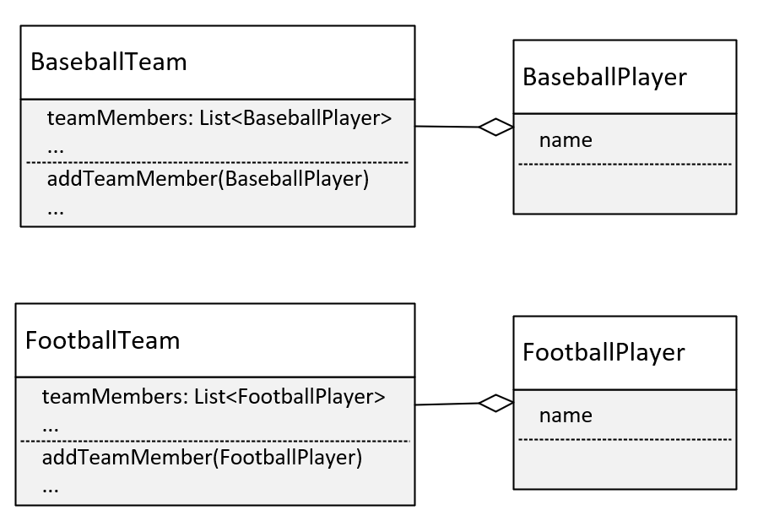
Solution 1: Duplicate code
We could copy and paste the BaseballTeam, and rename everything for FootballTeam, and create a FootballPlayer, as I'm showing on this slide.
This means you'd have to make sure any changes you made to one team or player, that made sense for the other team and player, had to be made in both sets of code.
This is rarely a recommended approach, unless team operations are significantly different.
COMPLETE JAVA MASTERCLASS
Generics Part 2

Slide 9
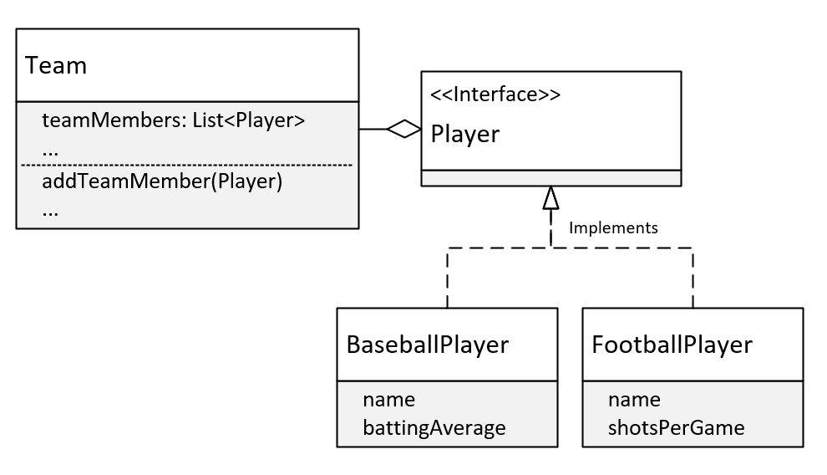
Solution 2: Use a Player Interface or abstract class to support different types of players
We could change Baseball team to simply Team, and use an interface type (or abstract or base class) called Player.
On this slide, I show a Team Class, and on this class, the members are a List of Players.
I've made Player an interface, and have BaseballPlayer and FootballPlayer implementing that interface.
This is a better design than the previous one, but it's still got problems.
COMPLETE JAVA MASTERCLASS
Generics Part 2

Slide 10
Generic Type Parameters
I've already shown you that one way to declare a generic class, is to include a type parameter which I show here, in the angle brackets.
Now, using T is just a convention, short for whatever type you want to use this Team class for.
But you can put anything you want in there.
Single letter types are the convention however, and they're a lot easier to spot in the class code, so let me encourage you to stick to this convention.
COMPLETE JAVA MASTERCLASS
Generics Part 2

Slide 11
Generic Type Parameters
You can have more than one type parameter, so we could do T1, T2, T3.
But again convention says, that instead of using type parameters like this, it's easier to read the code with alternate letter selections.
And these are usually S, U, and V, in that order.
If we had three types, we'd probably want to declare this class as shown here, with T, S, and U.
COMPLETE JAVA MASTERCLASS
Generics Part 2

Slide 12
Generic Type Parameters
A few letters are reserved for special use cases.
The most commonly used type parameter identifiers are:
E for Element (used extensively by the Java Collections Framework).
K for Key (used for mapped types).
N for Number.
T for Type.
V for Value.
S, U, V etc. for 2nd, 3rd, 4th types.
COMPLETE JAVA MASTERCLASS
Generics Part 2

Slide 13
Raw usage of generic classes.
When you use generic classes, either referencing them or instantiating them, it's definitely recommended that you include a type parameter.
But you can still use them without specifying one. This is called the Raw Use of the reference type.
The raw use of these classes is still available, for backwards compatibility, but it's discouraged for several reasons.
Generics allow the compiler to do compile-time type checking, when adding and processing elements in the list.
Generics simplify code, because we don't have to do our own type checking and casting, as we would, if the type of our elements was Object.
COMPLETE JAVA MASTERCLASS
Generics Part 2

Slide 14
Generic classes can be bounded, limiting the types that can use it.
On this slide, I'm showing the code from my class.
This extends keyword doesn't have the same meaning as extends, when it's used in a class declaration.
This isn't saying our type T extends Player, although it could.
This is saying the prameterized type T, has to be a Player, or a subtype of Player.
Now Player in this case could have been either a class or an interface, the syntax would be the same.
This declaration establishes what is called an upper bound, on the types that are allowed to be used with this class
COMPLETE JAVA MASTERCLASS
Generics Part 3

Slide 15
Why specify an upper bound?
An upper bound permits access to the bounded type's functionality.
An upper bound limits the kind of type parameters you can use when using a generic class. The type used must be equal to, or a subtype of the bounded type.
COMPLETE JAVA MASTERCLASS
Generics Part 3

Slide 16
Generic Class Challenge
Now it's your turn to create your own generic class.
In the Interface Challenge, we created a Mappable Interface, and I introduced you to different Map geometry types, POINT, LINE, and POLYGON.
The challenge then created a map marker or icon, and a map label, but didn't do anything with locations.
In this challenge, you'll use another Mapping example, but use location data in the output.
As you are probably aware, you can use Google Maps to determine the location of any point on a map.
COMPLETE JAVA MASTERCLASS
Generic Class Challenge

Slide 17
The Generic Class challenge
You'll start with a Mappable Interface, that has one abstract method, render.
You'll create two classes Point and Line, that implement this interface.
You'll create two specific classes that extend each of these, for a mappable item of interest.
COMPLETE JAVA MASTERCLASS
Generic Class Challenge

Slide 18
The Generic Class challenge
I'll be mapping US National Parks, and a couple of major rivers in the US, so the parks will be points, and the rivers will be lines.
The data I'll be using is shown here.
I'll be creating a Park class that extends Point, and a River class that extends Line, to support this data.
US National Parks & selected locations | US Rivers & selected locations
Name | Type | Googled Locations
Yellowstone | National Park | 44.4882, -110.5916
Grand Canyon | National Park | 36.0636, -112.1079
Yosemite | National Park | 37.8855, -119.5360
Name | Type | Googled Locations
Mississippi | River | 47.2160, -95.2348 35.1556, -90.0659 29.1566, -89.2495
Missouri | River | 45.9239, -111.4983 38.8146, -90.1218
Colorado | River | 40.4708, -105.8286 36.1015, -112.0892 34.2964, -114.1148 31.7811, -114.7724
Delaware | River | 42.2026, -75.00836 39.4955, -75.5592
COMPLETE JAVA MASTERCLASS
Generic Class Challenge

Slide 19
The Generic Class challenge
You should have constructors or methods, to support adding a couple of attributes, and some location data, to your two specific classes.
You can pass the location data of a point type, as a String, or a set of double values, representing latitude and longitude.
You can pass the multiple locations of a line, as a set of strings, or a two dimensional array of doubles, that represents the multiple points on your line.
Name | Googled Location of a Point
Yellowstone National Park | 44.4882, -110.5916
Name | Googled Locations of Points in a River
Mississippi River | 47.2160, -95.2348 35.1556, -90.0659 29.1566, -89.2495
COMPLETE JAVA MASTERCLASS
Generic Class Challenge

Slide 20
The Generic Class challenge
In addition to these classes, you'll create a generic class called Layer.
Your Layer class should have one type parameter, and should only allow Mappable elements as that type.
This generic class should have a single private field, a list of elements to be mapped.
This class should have a method or constructor, or both, to add elements.
You should create a method, called renderLayer, that loops through all elements, and executes the method render, on each element.
COMPLETE JAVA MASTERCLASS
Generic Class Challenge

Slide 21
The Generic Class challenge
Your main method should create some instances of your specific classes, which include some location data.
These should get added to a typed Layer, and the render Layer method called on that.
Sample output is shown here:
COMPLETE JAVA MASTERCLASS
Generic Class Challenge

Slide 22
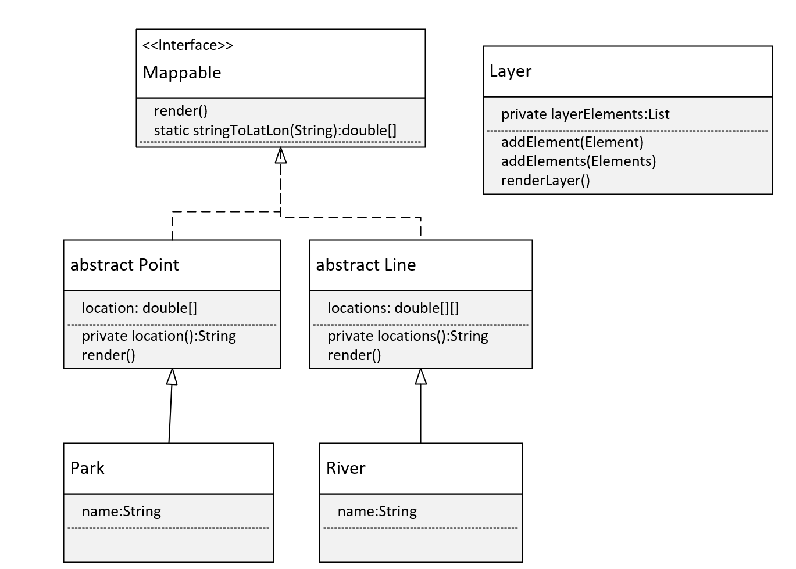
The plan - the class diagram
This diagram shows how I plan to build this.
You can see my Mappable interface has the method render on it, and by default that's both public and abstract.
I've also added a static method, that will take a String, and split it into a double array, which will have the latitude and longitude values in them.
I've made two classes, Point and Line, abstract, because I don't really want anyone to instantiate these classes.
Point has a location field, which is a double array, and will just have two doubles, the latitude and longitude.
COMPLETE JAVA MASTERCLASS
Generic Class Challenge

Slide 23
The plan - the class diagram
And I have a method that will print that array to a string, called location.
And then the render method is implemented.
And the same with abstract Line, except a line will have multiple latitude, longitude pairs, and these will be represented as a two-dimensional array.
And then I'm going to have a Park class extend Point, with just a name field.
COMPLETE JAVA MASTERCLASS
Generic Class Challenge

Slide 24
The plan - the class diagram
River will extend Line, and that has just a name as well, for simplicity.
Lastly, there's the Layer class, this is the generic class, and it has a list of layerElements, and methods to add one or more of these.
It also has the method, renderLayer.
COMPLETE JAVA MASTERCLASS
Generic Class Challenge

Slide 25
Interfaces used for sorting
Now that I've covered interfaces and generic classes, I want to review in more detail, interfaces I mentioned in previous lectures.
The first is Comparable.
For an array, we can simply call Arrays.sort, and pass it an array, but as I have previously mentioned, the elements in the array, need to implement Comparable.
Types like String, or primitive wrapper classes like Integer or Character are sortable, and this is because they do implement this interface.
COMPLETE JAVA MASTERCLASS
Revisiting Comparable

Slide 26
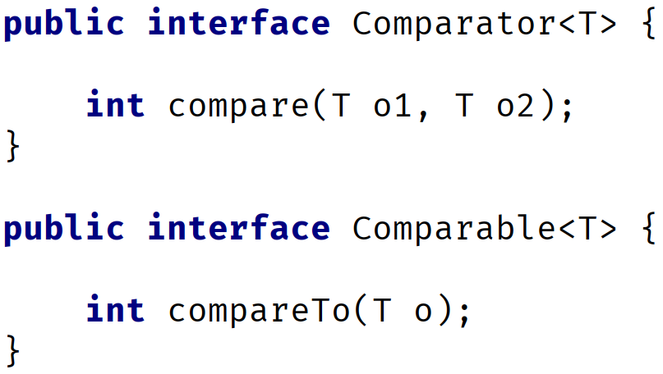
Comparable Interface
The interface declaration in Java.
It's a generic type, meaning it's parameterized.
Any class that implements this interface, needs to implement the compareTo method.
COMPLETE JAVA MASTERCLASS
Revisiting Comparable

Slide 27
Comparable Interface
This method takes one object as an argument, shown on this slide as the letter o, and compares it to the current instance, shown as this.
The table on this slide shows what the results of the compareTo method should mean, when implemented.
resulting Value | Meaning
zero | O == this
negative value | this < o
positive value | this > o
COMPLETE JAVA MASTERCLASS
Revisiting Comparable

Slide 28
The Comparator Interface
The Comparator interface is similar to the Comparable interface, and the two can often be confused with each other.
Its declaration and primary abstract method are shown here, in comparison to Comparable.
You'll notice that the method names are different, compare vs. compareTo.
Comparator | Comparable
COMPLETE JAVA MASTERCLASS
Comparable vs. Comparator

Slide 29
The Comparator Interface
The compare method takes two arguments vs. one for compareTo, meaning that it will compare the two arguments to one another, and not one object to the instance itself.
We'll review Comparator in code, but in a slightly manufactured way.
It's common practice to include a Comparator as a nested class.
Comparator | Comparable
COMPLETE JAVA MASTERCLASS
Comparable vs. Comparator

Slide 30
Summary of Differences
Comparable | Comparator
Compares the argument with the current instance.
Called from the instance of the class that implements Comparable.
Best practice is to have this.compareTo(o) == 0 result in this.equals(o) being true.
Arrays.sort(T[] elements) requires T to implement Comparable.
Compares two arguments of the same type with each other.
Called from an instance of Comparator.
Does not require the class itself to implement Comparator, though you could also implement it this way.
Array.sort(T[] elements, Comparator<T>) does not require T to implement Comparable.
COMPLETE JAVA MASTERCLASS Comparable vs. Comparator

Slide 31
What's left to know about Generics?
In the next few videos, I want to cover the following topics.
Using generic references that use type arguments, declared in method parameters and local variables.
Creating generic methods, apart from generic classes.
Using wildcards in the type argument.
Understanding static methods with generic types.
Using multiple upper bounds.
COMPLETE JAVA MASTERCLASS
Generic classes as reference types

Slide 32
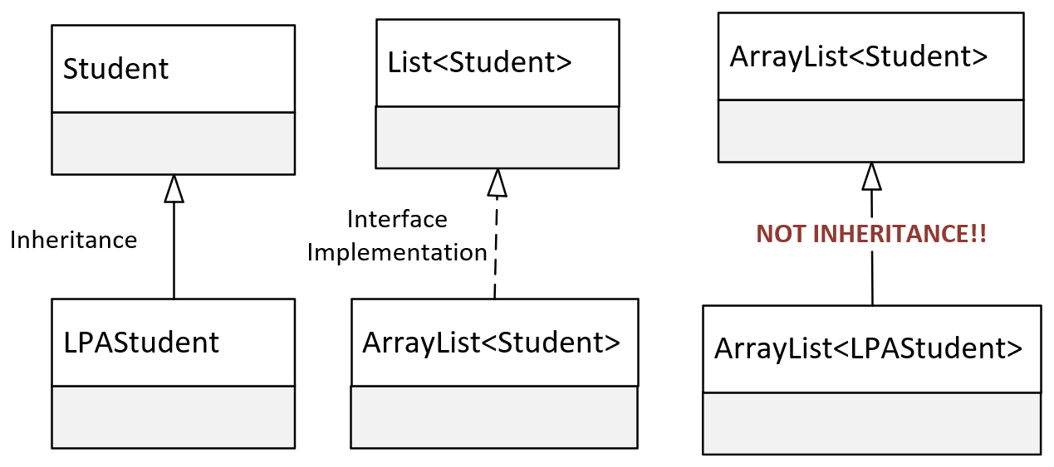
This isn't inheritance
We know LPAStudent inherits from Student, and we can pass an instance of LPA Student to any method, or assign it to any reference type, declared with the type Student.
We also know that ArrayList implements List, and we can pass an ArrayList to a method or assign it to a reference of the List type.
Why can't we pass an ArrayList of LPA Student, to the method parameter that's declared as a List of Student?
COMPLETE JAVA MASTERCLASS
Generic classes as reference types

Slide 33
This isn't inheritance
Surely, if an LPAStudent is a Student, a List of LPAStudent is ultimately a List of Student.
It's very natural to assume that a method that takes a List with Students should accept a List with LPAStudents, because LPAStudent is a Student after all.
But that's not how it works.
When used as reference types, a container of one type has no relationship to the same container of another type, even if the contained types do have a relationship.
COMPLETE JAVA MASTERCLASS
Generic classes as reference types

Slide 34
Limitation of a reference of generic class with a list argument
When we declare a variable or method parameter with:
List<Student>
Only List subtypes with Student elements can be assigned to this variable or method argument.
We can't assign a list of Student subtypes to this!
COMPLETE JAVA MASTERCLASS
Generics methods, wildcards, and type erasure

Slide 35
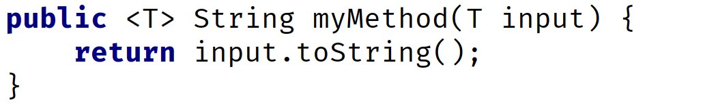
The generic method
For a method, type parameters are placed after any modifiers and before the method's return type.
The type parameter can be referenced in method parameters, or as the method return type, or in the method code block, much as we saw a class's type parameter can be used.
A generic method can be used for collections with type arguments, as we just saw, to allow for variability of the elements in the collection, without using a raw version of the collection.
COMPLETE JAVA MASTERCLASS
Generics methods, wildcards, and type erasure

Slide 36
The generic method
A generic method can be used for static methods on a generic class, because static methods can't use class type parameters.
A generic method can be used on a non-generic class, to enforce type rules on a specific method.
The generic method type parameter is separate from a generic class type parameter.
In fact, if you've used T for both, the T declared on the method means a different type, than the T for the class.
COMPLETE JAVA MASTERCLASS
Generics methods, wildcards, and type erasure

Slide 37
Type Parameters, Type Arguments and using a Wildcard
A type parameter is a generic class, or generic method's declaration of the type.
In both of these examples, T is said to be the type parameter.
You can bind a type parameter with the use of the extends keyword, to specify an upper bound.
Generic class | Generic Method
COMPLETE JAVA MASTERCLASS
Generics methods, wildcards, and type erasure

Slide 38
Type Parameters, Type Arguments and using a Wildcard
A type argument declares the type to be used, and is specified in a type reference, such as a local variable reference, method parameter declaration, or field declaration.
In this example, BaseballPlayer is the type argument for the Team class.
Generic class
COMPLETE JAVA MASTERCLASS
Generics methods, wildcards, and type erasure

Slide 39
Type Parameters, Type Arguments and using a Wildcard
A wildcard can only be used in a type argument, not in the type parameter declaration.
A wildcard is represented with the ? character.
A wildcard means the type is unknown.
For this reason, a wildcard limits what you can do, when you specify a type this way.
List declaration using a wildcard
COMPLETE JAVA MASTERCLASS
Generics methods, wildcards, and type erasure

Slide 40
Type Parameters, Type Arguments and using a Wildcard
A wild card can't be used in an instantiation of a generic class.
The code shown here is invalid.
Invalid! You can’t use a wildcard in an instantiation expression
COMPLETE JAVA MASTERCLASS
Generics methods, wildcards, and type erasure

Slide 41

Type Parameters, Type Arguments and using a Wildcard
A wildcard can be unbounded, or alternately, specify either an upper bound or lower bound.
You can't specify both an upper bound and a lower bound, in the same declaration.
Argument | Example | Description
unbounded |  | A List of any type can be passed or assigned to a List using this wildcard.
upper bound |  | A list containing any type that is a Student or a sub type of Student can be assigned or passed to an argument specifying this wildcard.
lower bound |  | A list containing any type that is an LPAStudent or a super type of LPAStudent, so in our case, that would be Student AND Object.
COMPLETE JAVA MASTERCLASS
Generics methods, wildcards, and type erasure

Slide 42
Type Erasure
Generics exist to enforce tighter type checks, at compile time.
The compiler transforms a generic class into a typed class, meaning the byte code, or class file, contains no type parameters.
Everywhere a type parameter is used in a class, it gets replaced with either the type Object, if no upper bound was specified, or the upper bound type itself.
This transformation process is called type erasure, because the T parameter (or S, U, V), is erased, or replaced with a true type.
Why is this important?
Understanding how type erasure works for overloaded methods, may be important.
COMPLETE JAVA MASTERCLASS
Generics methods, wildcards, and type erasure

Slide 43
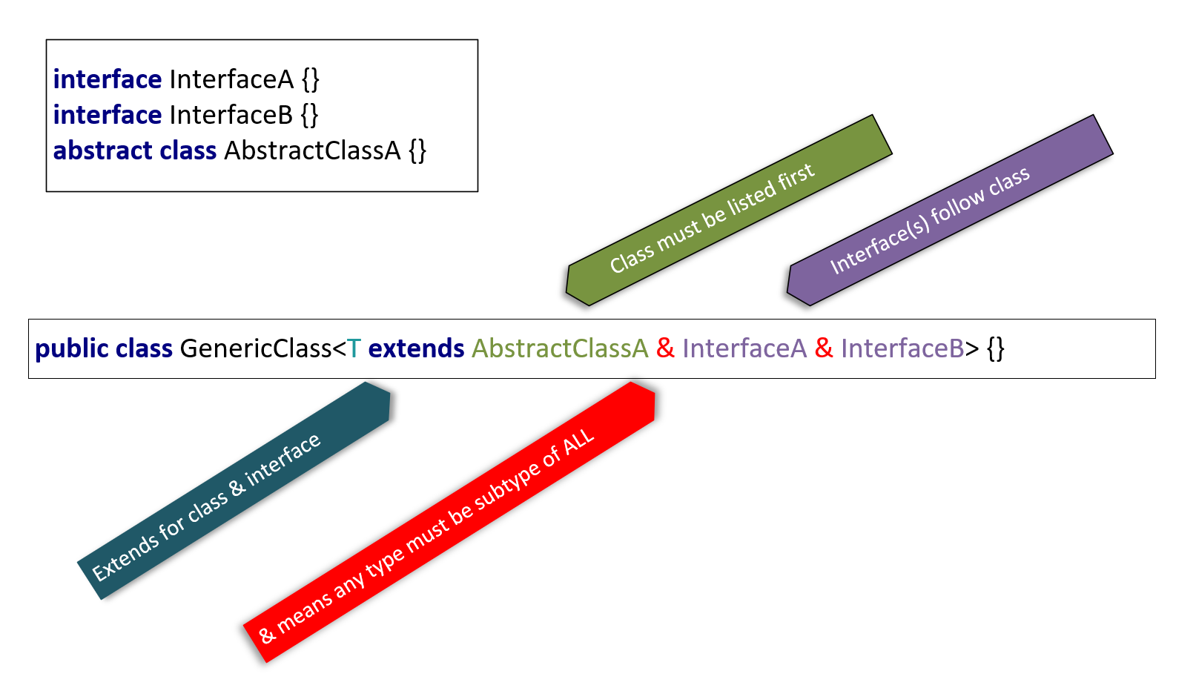
Using Multiple types to declare an Upper Bound
You can use multiple types to set a more restrictive upper bound, with the use of an ampersand between types.
The conditions require a type argument, to implement all interfaces declared, and to be a subtype of any class specified.
You can extend only one class at most, and zero to many interfaces.
You use extends for either a class or an interface or both.
If you do extend a class as well as an interface or two, the class must be the first type listed.
COMPLETE JAVA MASTERCLASS
Static methods & multiple upper bounds

Slide 44
Putting it all together, Final Section Challenge
In this challenge, I want you to start with some of the code we just talked about in the last video.
Be sure to start with the Student and LPAStudent classes, and the QueryItem interface and QueryList class.
COMPLETE JAVA MASTERCLASS
Putting it all together, Final Section Challenge

Slide 45
Putting it all together, Final Section Challenge
In this challenge, you'll want to do the following items:
Change QueryList to extend ArrayList, removing the items field.
Add a student id field to the Student class, and Implement a way to compare Students, so that students are naturally ordered by a student id.
Implement at least one other mechanism for comparing Students by course or year, or for LPA Students, by percent complete.
COMPLETE JAVA MASTERCLASS
Putting it all together, Final Section Challenge

Slide 46
Putting it all together, Final Section Challenge
In this challenge, you'll want to do the following items:
Override the matchFieldValue method on the LPAStudent class, so that you return students, not matched on percent complete equal to a value, but on percent less than or equal to a submitted value. Note: an LPA Student should be searchable by the same fields as Student as well.
Run your code for 25 random students, selecting students who are less than or equal to 50% done their course, and print out the list, sorted in at least two ways, first by using List.sort with the Comparator.naturalOrder() comparator, and then using your own Comparator, so first by student id, as well as one of the other ways you selected.
And be sure to have some fun!
COMPLETE JAVA MASTERCLASS
Putting it all together, Final Section Challenge

