Slide 1

Introduction to Lambda Expressions
Welcome to the Lambda Expression Section of the course.
I wanted to introduce you to this section a little earlier in the course than here, because many methods supporting these expressions, have been introduced on Java's interfaces and classes, since JDK 8.
Lambda expressions let you pass around snippets of custom code, giving you so much more functionality than you might otherwise be able to achieve, and with very little effort.
It's sometimes confusing to understand these expressions, or how much power is in their punch, and sometimes with just a single statement.
COMPLETE JAVA MASTERCLASS
Introduction to Lambda Expressions

Slide 2
Introduction to Lambda Expressions
I hope that by the end of this section, you'll be kind of excited about what you can do with them, and be ready to use them a lot.
A lambda expression can be thought of as implicit code for an anonymous class, using a special kind of interface, as the mechanics to do this.
The method reference goes even further, and is a short cut for the lambda expression syntax, for existing methods.
To conclude this section, I'll introduce you to convenient methods available on many interfaces. Don't miss out on this part of the section, as it will simplify some of the repetitive work you may encounter.
Ok, so let's get started.
COMPLETE JAVA MASTERCLASS
Introduction to Lambda Expressions

Slide 3
The Lambda Expression
The syntax of this lambda expression is on the left below.
This was passed directly as a method argument, for a parameter type that was a Comparator.
The Comparator's abstract method, compare, is shown here on the right side.
The lambda expression parameters are determined by the associated interface's method, the functional method.
In the case of a Comparator, and it's compare method, there are two arguments.
This is why we get o1, and o2 in parentheses, in the generated lambda expression.
These arguments can be used in the expression, which is on the right of the arrow token.
The generated Lambda Expression | Comparator’s Abstract Method
COMPLETE JAVA MASTERCLASS
Introduction to the Lambda Expression, and Functional Interfaces

Slide 4
The Syntax of a Lambda Expression
A lambda expression consists of a formal parameter list, usually but not always declared in parentheses; the arrow token; and either an expression or a code block after the arrow token.
Because lambda expressions are usually simple expressions, it's more common to see them written as shown on this slide.
The expression should return a value, if the associated interface's method returns a value.
In the case of our generated expression, it returns an int, which is the result of the compare method on Comparator.
COMPLETE JAVA MASTERCLASS
Introduction to the Lambda Expression, and Functional Interfaces

Slide 5
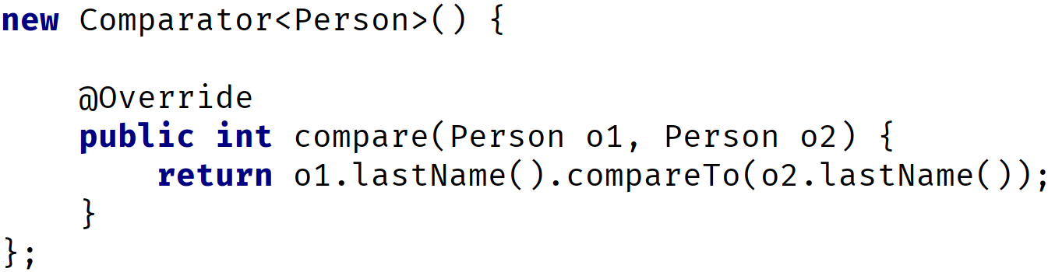
Comparing the anonymous class and the lambda expression
Are you asking, where's the link between the compare method, and this lambda expression?
It's obvious in the anonymous class, because we override the compare method, and return the result of that expression.
Anonymous Class | Lambda Expression
COMPLETE JAVA MASTERCLASS
Introduction to the Lambda Expression, and Functional Interfaces

Slide 6
Comparing the anonymous class and the lambda expression
We can see the two parameters and their types, and what the return value should be, in the anonymous class.
But the lambda expression has no reference to an enclosing method, as far as we can see from this code.
Anonymous Class | Lambda Expression
COMPLETE JAVA MASTERCLASS
Introduction to the Lambda Expression, and Functional Interfaces

Slide 7
Where's the method in the lambda expression?
For a lambda expression, the method is inferred by Java!
COMPLETE JAVA MASTERCLASS
Introduction to the Lambda Expression, and Functional Interfaces

Slide 8
How can Java infer the method?
Java takes its clue from the reference type, in the context of the lambda expression usage.
Here, I show a simplified view, of the sort method on List.
And here is the call to that method passing the lambda expression.
From this, Java can infer that this lambda expression, resolves to a Comparator type, because of the method declaration.
This means the lambda expression passed, should represent code for a specific method on the Comparator interface.
COMPLETE JAVA MASTERCLASS
Introduction to the Lambda Expression, and Functional Interfaces

Slide 9
How can Java infer the method?
But which method?
Well, there's only one the lambda expression cares about, and that's the abstract method on Comparator.
Java requires types which support lambda expressions, to be something called a functional interface.
COMPLETE JAVA MASTERCLASS
Introduction to the Lambda Expression, and Functional Interfaces

Slide 10
What's a functional interface?
A functional interface is an interface that has one, and only one, abstract method.
This is how Java can infer the method, to derive the parameters and return type, for the lambda expression.
You may also see this referred to as SAM, which is short for Single Abstract Method, which is called the functional method.
A functional interface is the target type for a lambda expression.
COMPLETE JAVA MASTERCLASS
Introduction to the Lambda Expression, and Functional Interfaces

Slide 11
The Lambda Expression
The functional interface is the framework that lets a lambda expression be used.
Lambda expressions are also called lambdas for short.
Many of Java's classes, use functional interfaces in their method signatures, which allows us to pass lambdas as arguments to them.
You'll soon discover that lambdas will reduce the amount of code you write.
In an upcoming video, I'm going to cover many of Java's built-in functional interfaces.
COMPLETE JAVA MASTERCLASS
Lambda Expressions, syntax, & additional examples

Slide 12

The Consumer Interface
The Consumer interface is in the java.util.function package.
It has one abstract method, that takes a single argument, and doesn't return anything.
This doesn't seem like a very interesting interface at first, but let's see what this means in practice, as far as the lambda expressions we can use with it.
COMPLETE JAVA MASTERCLASS
Lambda Expressions, syntax, & additional examples

Slide 13
lambda expression variations, for a single parameter
This slide shows the different ways to declare a single parameter in a lambda expression.
Lambda Expression | Description
 | A single parameter without a type can omit the parentheses.
 | Parentheses are optional.
 | Parentheses required if a reference type is specified.
 | A reference type can be var.
COMPLETE JAVA MASTERCLASS
Lambda Expressions, syntax, & additional examples

Slide 14
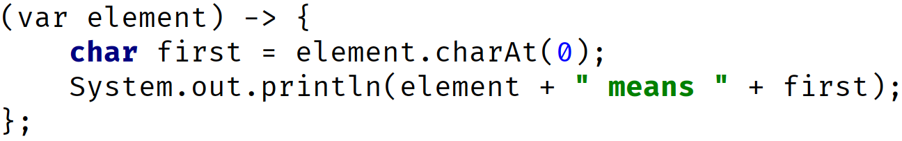
lambda expression variations, the lambda body
The lambda body can be a single expression, or can contain a lambda body in opening and closing curly brackets.
Lambda Expression | Description
 | An expression can be a single statement. Like a switch expression, that does not require yield for a single statement result, the use of return is not needed and would result in a compiler error.
 | An expression can be a code block. Like a switch expression, that requires yield, a lambda that returns a value, would require a final return statement. All statements in the block must end with semi-colons.
COMPLETE JAVA MASTERCLASS
Lambda Expressions, syntax, & additional examples

Slide 15
Functional Programming
Lambdas are Java's first step into functional programming.
This is a programming paradigm that focuses on computing and returning results.
And just for more information about functional programming, there's a good wikipedia article here.
https://en.wikipedia.org/wiki/Functional_programming
Check that out to find out a bit more about functional programming.
COMPLETE JAVA MASTERCLASS
Lambda Expressions, syntax, & additional examples

Slide 16
Streams
Another feature of Java, makes extensive use of lambda expressions, and that's streams.
Streams are exciting, because they create a pipeline of work that can be formed into a chain.
Many of the stream operations take functional interfaces as parameters, meaning we can code them with lambda expressions.
COMPLETE JAVA MASTERCLASS
Lambda Expressions, syntax, & additional examples

Slide 17

Lambda expressions with multiple parameters
The rules for multiple parameters used in a lambda expression are shown here.
Lambda Expression | Description
 | Parentheses are always required. Explicit types are not.
 | If you use an explicit type for one parameter, you must use explicit types for all the parameters.
 | If you use var for one parameter, you must use var for all parameters.
COMPLETE JAVA MASTERCLASS
Lambda Expressions, Continued

Slide 18

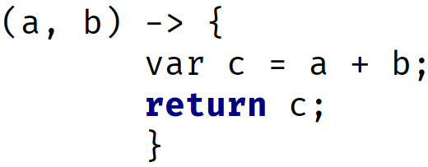
Lambda expressions that return values
This slide shows the two rules for returning values from a lambda expression.
Lambda Expression | Description
 | when not using curly braces, the return keyword is unnecessary, and will throw a compiler error.
 | If you use a statement block, meaning you use the curly braces, a return is required.
COMPLETE JAVA MASTERCLASS
Lambda Expressions, Continued

Slide 19
java.util.function
Java provides a library of functional interfaces in the java.util.function package.
We looked at one already, the Consumer interface.
I'll look at another of these interfaces now, the BinaryOperator, in code.
COMPLETE JAVA MASTERCLASS
Java's Functional Interfaces, Consumer & Predicate

Slide 20




The Four basic categories of Functional Interfaces in java.util.function package
It's a good idea to know the four basic types of functional interfaces in the java.util.function package.
There are over forty interfaces in this package.
These can all be categorized as one of the following types.
This slide shows the four categories, with the simplest method shown.
Interface Category | Basic Method Signature | Purpose
Consumer |  | execute code without returning data
Function |  | return a result of an operation or function
Predicate |  | test if a condition is true or false
Supplier |  | return an instance of something
COMPLETE JAVA MASTERCLASS
Java's Functional Interfaces, Consumer & Predicate

Slide 21

The Consumer interface
On this slide, I'm showing the two most common Consumer interfaces, and the functional method on each.
The Consumer interface takes one argument of any type.
The BiConsumer interface takes two arguments, of two different types.
Interface Name | Method Signature
Consumer
BiConsumer
COMPLETE JAVA MASTERCLASS
Java's Functional Interfaces, Consumer & Predicate

Slide 22

A Consumer Lambda Expression Example
This slide shows an example consumer lambda expression. It takes one argument and executes a single statement.
No result is returned.
Example Lambda Expression for Consumer | Consumer Method
COMPLETE JAVA MASTERCLASS
Java's Functional Interfaces, Consumer & Predicate

Slide 23

The Predicate Interface
The predicate interfaces take one or two arguments, and always returns a boolean value.
They are used to test a condition, and if the condition is true, some operation will be performed.
Interface Name | Method Signature
Predicate
BiPredicate
COMPLETE JAVA MASTERCLASS
Java's Functional Interfaces, Consumer & Predicate

Slide 24
A Predicate Lambda Expression Example
In this example, the expression takes a String, and tests if it's equal to the literal text, “Hello” here, ignoring case, so it returns either true or false.
Example Lambda Expression for Consumer
COMPLETE JAVA MASTERCLASS
Java's Functional Interfaces, Consumer & Predicate

Slide 25







The Function interface
On this slide, I'm showing four of the most common interfaces in this category.
Each has a return type, shown here as either T, or R, which stands for result, meaning a result is expected for any of these.
In addition to Function and BiFunction, there is also UnaryOperator and BinaryOperator.
You can think of the UnaryOperator as a Function Interface, but where the argument type is the same as the result type.
Interface Name | Method Signature | Interface Name | Method Signature
COMPLETE JAVA MASTERCLASS
Java's Functional Interfaces, Function & Supplier

Slide 26
The Function interface
The Binary Operator is a BiFunction interface, where both arguments have the same type, as does the result, which is why the result is shown as T, and not R.
This reminds us that the result will be the same type as the arguments to the methods.
I've also included the type parameters with each interface name on this slide, because I wanted you to see that the result, for a Function or BiFunction, is declared as the last type argument.
For UnaryOperator and BinaryOperator, there is only one type argument declared, because the types of the arguments and results, will be the same.
Interface Name | Method Signature | Interface Name | Method Signature
COMPLETE JAVA MASTERCLASS
Java's Functional Interfaces, Function & Supplier

Slide 27


A Function Interface Lambda Expression Example
On this slide, I'm showing an example of a lambda expression which targets a Function interface.
This lambda expression takes a String, s, and splits that String on commas, returning an array of String.
In this case, the argument type, T, is a String, and the result, R, is an array of String.
To demonstrate how to declare a variable of this type, I'm showing a variable declaration as well, for this specific example.
Example Lambda Expression for Function | Function Method | Variable Declaration for this example
COMPLETE JAVA MASTERCLASS
Java's Functional Interfaces, Function & Supplier

Slide 28

The Supplier Interface
The supplier interface takes no arguments but returns an instance of some type, T.
You can think of this as kind of like a factory method code.
It will produce an instance of some object.
However, this doesn't have to be a new or distinct result returned.
Interface Name | Method Signature
Supplier
COMPLETE JAVA MASTERCLASS
Java's Functional Interfaces, Function & Supplier

Slide 29
A Supplier Lambda Expression Example
In the example I'm showing you on this slide, I'm using the Random class to generate a random Integer.
This method takes no argument, but lambda expressions can use final or effectively final variables in their expressions, which I'm demonstrating here.
The variable random is an example of a variable, from the enclosing code.
Example Lambda Expression for Consumer
COMPLETE JAVA MASTERCLASS
Java's Functional Interfaces, Function & Supplier

Slide 30

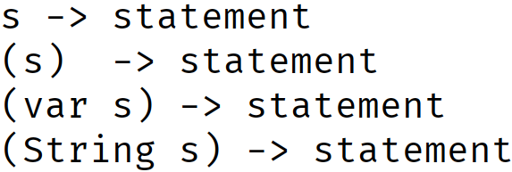
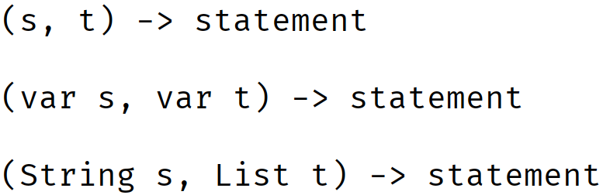
Valid Lambda Declarations for different number of arguments
This slide shows the many varieties of declaring a parameter type in a lambda expression.
Parentheses are required in all but the one case, where the functional method has a single argument, and you don't specify a type, or use var.
Arguments in Functional Method | Valid lambda syntax
None
One
Two When using var, all arguments must use var. When specifying explicit types, all arguments must specify explicit types.
COMPLETE JAVA MASTERCLASS
Java's Functional Interfaces, Function & Supplier

Slide 31
Valid Lambda Declarations for different number of arguments
When using var as the type, every argument must use var.
When specifying explicit types, every argument must include a specific type.
Arguments in Functional Method | Valid lambda syntax
None
One
Two When using var, all arguments must use var. When specifying explicit types, all arguments must specify explicit types.
COMPLETE JAVA MASTERCLASS
Java's Functional Interfaces, Function & Supplier

Slide 32
Lambda Mini Challenges
This challenge video is going to be a little different, and consist of several small tasks, to help you really practice creating and using lambda expressions.
I'll assign a task for you to try on your own, and then we can solve it together.
Then I'll present the next one.
COMPLETE JAVA MASTERCLASS
Lambda Mini Challenges

Slide 33
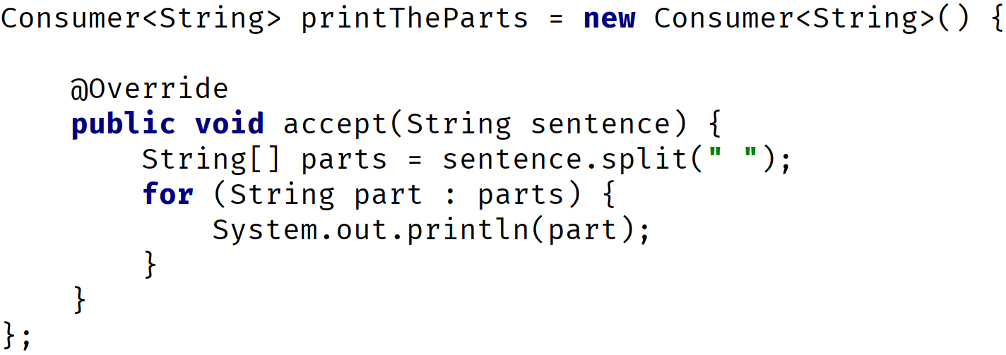
Mini Challenge 1
Write the following anonymous class that you can see on screen, as a lambda expression.
Try to do it manually on your own, and don't rely on IntelliJ's tools to do it for you.
This will help you understand lambdas better.
COMPLETE JAVA MASTERCLASS
Lambda Mini Challenges

Slide 34
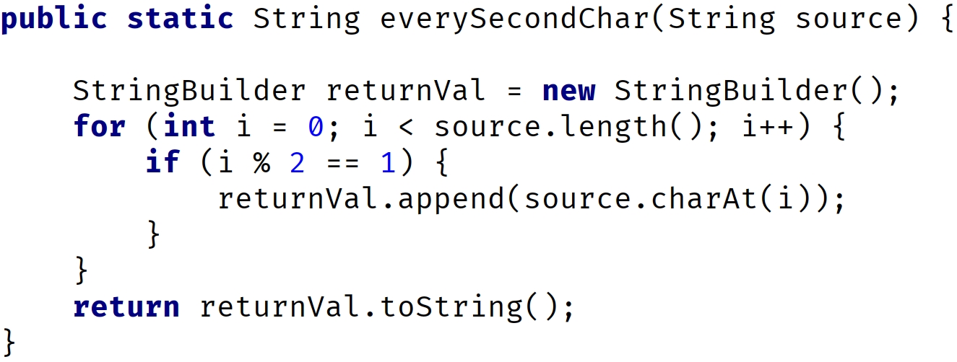
Mini Challenge 2
Write the following method as a lambda expression.
In other words, create a variable, using a type that makes sense for this method.
Don't worry about executing it though.
COMPLETE JAVA MASTERCLASS
Lambda Mini Challenges

Slide 35
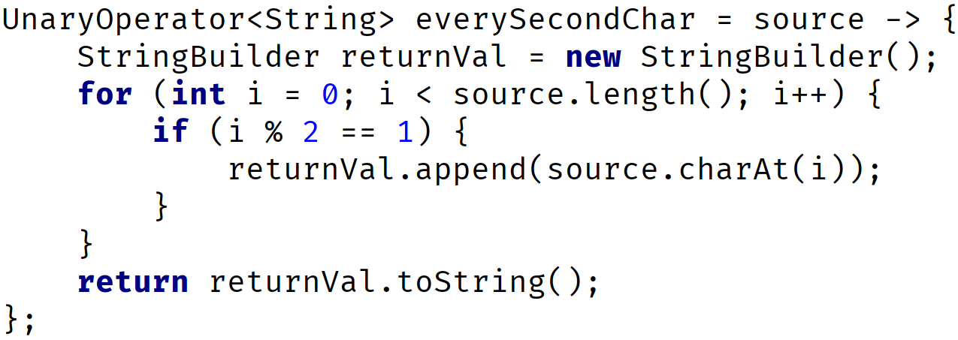
Mini Challenge 3
The lambda expression we created in Challenge 2 doesn't do anything right now.
I want you to write the code to execute this lambda expression's functional method, using 1234567890, as the argument to that method, and print the result out.
COMPLETE JAVA MASTERCLASS
Lambda Mini Challenges

Slide 36
Mini Challenge 4
Instead of executing this function directly, suppose that we want to pass it to a method.
Write another method on your class, called everySecondCharacter.
This method should accept a Function, or UnaryOperator, as a parameter, as well as a second parameter that lets us pass, "1234567890".
In other words, don't hard code that string in your method code.
The method code should execute the functional method on the first argument, passing it the value of the string passed, from the enclosing method.
It should return the result of the call to the functional method.
COMPLETE JAVA MASTERCLASS
Lambda Mini Challenges

Slide 37
Lambda Expressions, What you need to understand
1) Declare lambda variables, or pass lambdas directly to methods that are targets.
I show two examples here.
2) Create methods that can be targets for lambda expressions.
Local Variable Declaration | Method argument
COMPLETE JAVA MASTERCLASS
Lambda Mini Challenges

Slide 38
Mini Challenge 5
Call the method you created from Challenge 4, passing the lambda variable we created earlier, and the string 1234567890, then print the result returned from the method.
COMPLETE JAVA MASTERCLASS
Lambda Mini Challenges

Slide 39
Mini Challenge 6
Write a lambda expression that is declared with the Supplier interface.
This lambda should return the String, "I love Java", and assign it to a variable called, iLoveJava.
COMPLETE JAVA MASTERCLASS
Lambda Mini Challenges

Slide 40
Mini Challenge 7
As with the Function example, the Supplier lambda won't do anything until we use it.
Remember, lambdas represent deferred execution of snippets of code.
Use this Supplier to assign a String, "I love Java", to a variable called supplierResult.
Print that variable to the console.
COMPLETE JAVA MASTERCLASS
Lambda Mini Challenges

Slide 41
Lambda Expression Challenge
This challenge, is to exercise your skills with Arrays, ArrayLists, and the methods on these, which are targets for lambda expressions.
First, I want you to create an array of String, which is populated with first names, in mixed case.
Include at least one name, which is spelled the same backwards, and forwards, like Bob, or Anna.
Use Arrays.setAll, or List.replaceAll, to change the values in this array.
If you use List methods, you'll need a list backed by the array, so that changes get made to the initial array.
COMPLETE JAVA MASTERCLASS
Lambda Expression Challenge, Put it all together

Slide 42
Lambda Expression Challenge
Using one of those two methods, perform the following functions on the elements in the array, with appropriate lambda expressions.
Transform names to all uppercase.
Add a randomly generated middle initial, and include a period.
Add a last name that is the reverse of the first name.
Print your array or the array elements, after each change, using the forEach method, at least once.
Finally, create a new modifiable ArrayList from your names array, removing any names where the last name equals the first name.
Use removeIf with a lambda expression to do this last operation.
COMPLETE JAVA MASTERCLASS
Lambda Expression Challenge, Put it all together

Slide 43
What's a Method Reference?
Java gives us an alternative syntax to use for this second kind of lambda, that uses named methods.
These are called method references.
These provide a more compact, easier-to-read lambda expression, for methods that are already defined on a class.
For the last couple of videos for example, I've been ignoring Intelli-J's warnings and hints, whenever I've used System.out.println in a lambda expression.
That's because it can be replaced with a method reference.
COMPLETE JAVA MASTERCLASS
What's a Method Reference?

Slide 44

Why are these statements equal?
At first glance, it's not really obvious why a method reference has this syntax.
A method reference abstracts the lambda expression even further, eliminating the need to declare formal parameters.
We also don't have to pass arguments to the method in question, in this case println.
A method reference has double colons, between the qualifying type, or object, and the method name.
In this example of a Consumer interface, not only is the method inferred, but the parameters are as well.
Lambda Expression | Method Reference
COMPLETE JAVA MASTERCLASS
What's a Method Reference?

Slide 45
What methods can be used in method references?
Methods which can be used, are based on the context of the lambda expression.
This means the method reference, is again dependent on the targeted interface's method.
You can reference a static method on a class.
You can reference an instance method from either an instance external to the expression, or an instance passed as one of the arguments.
Or you can reference a constructor, by using new as the method.
Method references can be used to increase the readability of your code.
COMPLETE JAVA MASTERCLASS
What's a Method Reference?

Slide 46
Deferred Method Invocation
When you create variables that are lambda expressions or method references, it's important to remember that the code isn't invoked at that point.
The statement or code block gets invoked at the point in the code that the targeted functional method is called.
COMPLETE JAVA MASTERCLASS
What's a Method Reference?

Slide 47
Some Terminology for the next couple of Slides
A Type Reference refers to a class name, an interface name, an enum name, or a record name.
Remember that static methods are usually called using Type References, but can also be called by instances in our code.
This is NOT true however for method references.
Static methods, in method references and lambda expressions, must be invoked using a reference type only.
COMPLETE JAVA MASTERCLASS
The Most Confusing of the Method References

Slide 48
Some Terminology for the next couple of Slides
There are two ways to call an instance method.
The first is when you refer to the method with an instance derived from the enclosing code.
This instance is declared outside of the method reference.
The System.out::println method reference is an example.
You'll find that some web sites call this instance a bounded receiver, and I actually like that terminology as a differentiator.
A Bounded Receiver is an instance derived from the enclosing code, used in the lambda expression, on which the method will be invoked.
COMPLETE JAVA MASTERCLASS
The Most Confusing of the Method References

Slide 49
Some Terminology for the next couple of Slides
The second way is where the confusion starts.
The instance used to invoke the method, will be the first argument passed to the lambda expression or method reference when executed.
This is known in some places as the Unbounded Receiver.
It gets dynamically bound to the first argument, which is passed to the lambda expression, when the method is executed.
Unfortunately this looks an awful lot like a static method reference, using a reference type.
COMPLETE JAVA MASTERCLASS
The Most Confusing of the Method References

Slide 50

Some Terminology for the next couple of Slides
This means there are two method references that resemble each other, but have two very different meanings.
The first actually does call a static method, and uses a reference type to do it.
We saw this earlier, when we used the sum method on the Integer wrapper class.
This is a Type Reference (Integer is the type), which will invoke a static method.
This is easy to understand.
COMPLETE JAVA MASTERCLASS
The Most Confusing of the Method References

Slide 51

Some Terminology for the next couple of Slides
But there is another, which you'll see when we start working with String method references in particular.
Here, I show a method reference for the concat method on String.
Now, we know by now I hope, that the concat method, isn't a static method on String.
Why is this method reference even valid?
We could never call concat from the String class directly, because it needs to be called on a specific instance.
COMPLETE JAVA MASTERCLASS
The Most Confusing of the Method References

Slide 52
Some Terminology for the next couple of Slides
I just said, not two slides ago, that instance methods, can't be called using Reference Types.
But the example shown here, is a special syntax, when its declared in the right context, meaning when it's associated to the right type of interface.
This is valid when we use a method reference in the context of an unbounded receiver.
COMPLETE JAVA MASTERCLASS
The Most Confusing of the Method References

Slide 53
Some Terminology for the next couple of Slides
Remember, the unbounded receiver means, the first argument becomes the instance used, on which the method gets invoked.
Any method reference that uses String::concat, must be in the context of a two parameter functional method.
The first parameter is the String instance on which the concat method gets invoked, and the second argument is the String argument passed to the concat method.
COMPLETE JAVA MASTERCLASS
The Most Confusing of the Method References

Slide 54





Four Types of Method References
This chart shows the four different types of method references, with method reference examples, and a corresponding lambda expression.
Type | Syntax | Method Reference Example | Corresponding Lambda Expression
static method
instance method of a particular (Bounded) object
instance method of an arbitrary (Unbounded) object (as determined by p1)
constructor
COMPLETE JAVA MASTERCLASS
The Most Confusing of the Method References

Slide 55






Method Reference Examples (No arguments and one argument)
This chart shows some of the valid ways to use method references when assigned to different interface types.
These interface types have no arguments in the case of a Supplier, and one argument for the other interfaces.
 | No Args | One Argument | One Argument
Types of Method References | Supplier | Predicate | Consumer | Function UnaryOperator et. al.
Reference Type (Static)
Reference Type (Constructor) |  |  | n/a
Bounded Retriever (Instance)
Unbounded Retriever (Instance) | n/a
COMPLETE JAVA MASTERCLASS
The Most Confusing of the Method References

Slide 56
Method Reference Examples (No arguments and one argument)
If a cell is empty, it's not because it's not valid, but there are many possibilities.
n/a means not applicable, so a Supplier or an interface method that has no arguments, can never be a target for the unbounded receiver type of method reference.
 | No Args | One Argument | One Argument
Types of Method References | Supplier | Predicate | Consumer | Function UnaryOperator et. al.
Reference Type (Static)
Reference Type (Constructor) |  |  | n/a
Bounded Retriever (Instance)
Unbounded Retriever (Instance) | n/a
COMPLETE JAVA MASTERCLASS
The Most Confusing of the Method References

Slide 57





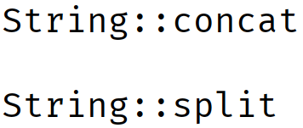
Method Reference Examples (Two Arguments)
This chart shows some of the valid ways to use method references when assigned to different interface types.
These interface types have two arguments, and therefore it's more common to see the unbounded retriever method references used for these.
 | Two Arguments | Two Arguments
Types of Method References | BiPredicate | BiConsumer | BiFunction BinaryOperator et. al.
Reference Type (Static)
Reference Type (Constructor)
Bounded Retriever (Instance)
Unbounded Retriever (Instance)
COMPLETE JAVA MASTERCLASS
The Most Confusing of the Method References

Slide 58
Method and Lambda Challenge
First, create an array of names, in mixed case, as you did in the Lambda Expression Challenge.
Create a list of Function interfaces, or alternately UnaryOperator, which will contain all the operations you want executed on each name in your array.
Do something similar to what we did in the Lambda Expression challenge:
Make each name upper case,
Add a random middle initial,
Add a last name, which should be the reverse of the first.
In addition to this, add some custom transformations of your own.
COMPLETE JAVA MASTERCLASS
Method Reference Challenge

Slide 59
Method and Lambda Challenge
Use a mix of lambda expressions, and method references.
Create a method that takes the name array, and the function list, and applies each function to each name, using the transform method on String, to do this.
All changes should be applied to the original array.
Make sure you explore as many transformations as you can, trying as many different types of method references as you can think of.
COMPLETE JAVA MASTERCLASS
Method Reference Challenge

Slide 60
Convenience Methods
In this video, we'll learn how to do something similar, using what are called convenience methods.
These are default methods on some of the functional interfaces I've been covering in the last few videos.
The Consumer, Predicate, and Function interface all come with these methods, as does the Comparator, which I'll also include here.
COMPLETE JAVA MASTERCLASS
Convenience Methods on Functional Interfaces (Chaining lambdas)

Slide 61
Convenience Methods on functional interfaces in java.util.function package
Category of Interface | Convenience method example | Notes
Function | function1.andThen(function2) | Not implemented on IntFunction, DoubleFunction, LongFunction
Function | function2.compose(function1) | Only implemented on Function & UnaryOperator
Consumer | consumer1.andThen(consumer2)
Predicate | predicate1.and(predicate2)
Predicate | predicate1.or(predicate2)
Predicate | predicate1.negate()
For andThen, and compose, on the function category of interfaces, any Interim Functions are not required to have the same type arguments.
Instead, one function's output becomes the next function's input, and the next function's output is not constrained to any specific type, except the last function executed.
COMPLETE JAVA MASTERCLASS
Convenience Methods, Continued, with the Comparator

Slide 62
Convenience Methods on functional interfaces in java.util.function package
Category of Interface | Convenience method example | Notes
Function | function1.andThen(function2) | Not implemented on IntFunction, DoubleFunction, LongFunction
Function | function2.compose(function1) | Only implemented on Function & UnaryOperator
Consumer | consumer1.andThen(consumer2)
Predicate | predicate1.and(predicate2)
Predicate | predicate1.or(predicate2)
Predicate | predicate1.negate()
The Consumer's andThen method is different, because it never returns a result, so you use this when you're chaining methods independent of one another.
The Predicate methods always return a boolean, which will combine the output of the two expressions, to obtain a final boolean result.
COMPLETE JAVA MASTERCLASS
Convenience Methods, Continued, with the Comparator

Slide 63
Comparator's additional helper methods
Now, I want to cover the additional convenience methods, since as you can see from this table, many take a functional interface instance, as an argument.
Type of Method | Method Signature
static | Comparator comparing(Function keyExtractor)
static | Comparator naturalOrder()
static | Comparator reverseOrder()
default | Comparator thenComparing(Comparator other)
default | Comparator thenComparing(Function keyExtractor)
default | Comparator reversed()
There is a comparing static method, and an overloaded default method named, thenComparing, and finally a default reversed method.
COMPLETE JAVA MASTERCLASS
Convenience Methods, Continued, with the Comparator

