Slide 1

Introduction to the Collections Framework
Welcome to the Collections Framework section of the course!
The List and Iterator interfaces, and the ArrayList and LinkedList classes belong to this framework.
In this section, I'll revisit these types a little bit, to demonstrate how they fit into the big picture of this series of interfaces and classes.
I'll also cover some other very important types of collection objects, such as sets and maps.
By the end of this section, you'll have a few more classes in your tool box, for groups of many objects.
Let’s get started.
COMPLETE JAVA MASTERCLASS
Introduction to Java's Collections Framework

Slide 2
A Collection
A collection is just an object that represents a group of objects.
In general, the group of objects have some relationship to each other.
Computer science has common names, and an expected set of behavior, for different types of collection objects.
Collection objects, in various languages, include arrays, lists, vectors, sets, queues, tables, dictionaries, and maps.
These are differentiated by the way they store the objects in memory, how objects are retrieved and ordered, and whether nulls and duplicate entries are permitted.
COMPLETE JAVA MASTERCLASS
Collections: Understanding the Big Picture

Slide 3
A Collections Framework
Oracle's Java documentation describes it's collections framework as:
"A unified architecture for representing and manipulating collections, enabling collections to be manipulated independently of implementation details.”
If you're interested in reading the Oracle documentation, they have a good overview at the following link
https://docs.oracle.com/javase/8/docs/technotes/guides/collections/overview.html
This was written for JDK-8, but it still applies.
COMPLETE JAVA MASTERCLASS
Collections: Understanding the Big Picture

Slide 4
What's in the framework, what's not?
Strictly speaking, arrays and the array utilities in the java.util.Arrays class are not considered part of this framework.
All collection objects implement the Collection interface, with the exception of maps, and I'll explain why in this section.
COMPLETE JAVA MASTERCLASS
Collections: Understanding the Big Picture

Slide 5
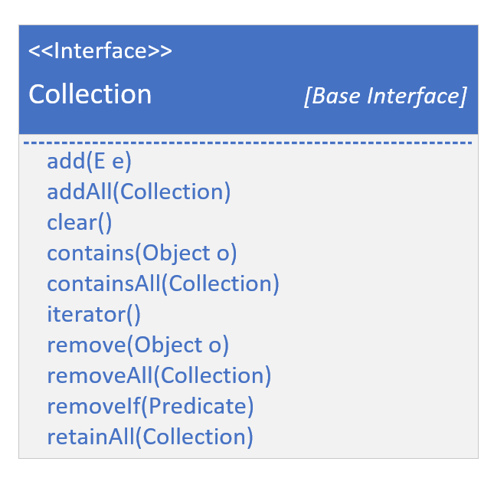
The Collection Interface
The Collection interface is the root of the collection hierarchy.
Like most roots in software hierarchies, it's an abstract representation of the behavior you'd need, for managing a group of objects.
This type is typically used to pass collections around, and manipulate them where maximum generality is desired.
Remember, the interface let's us describe objects by what they can do, rather than what they really look like, or how they're ultimately constructed.
If you look at the methods on this interface, you can see the basic operations a collection of any shape, or type, would need to support.
COMPLETE JAVA MASTERCLASS
Collections: Understanding the Big Picture

Slide 6
The Collection Interface
We've already looked at every one of these operations, in our study of ArrayLists and LinkedLists.
When managing a group, you'll be adding and removing elements, checking if an element is in the group, and iterating through the elements.
There are some others, but these are the ones that describe nearly everything you'd want to do to manage a group.
Java uses the term Element for a member of the group being managed.
COMPLETE JAVA MASTERCLASS
Collections: Understanding the Big Picture

Slide 7
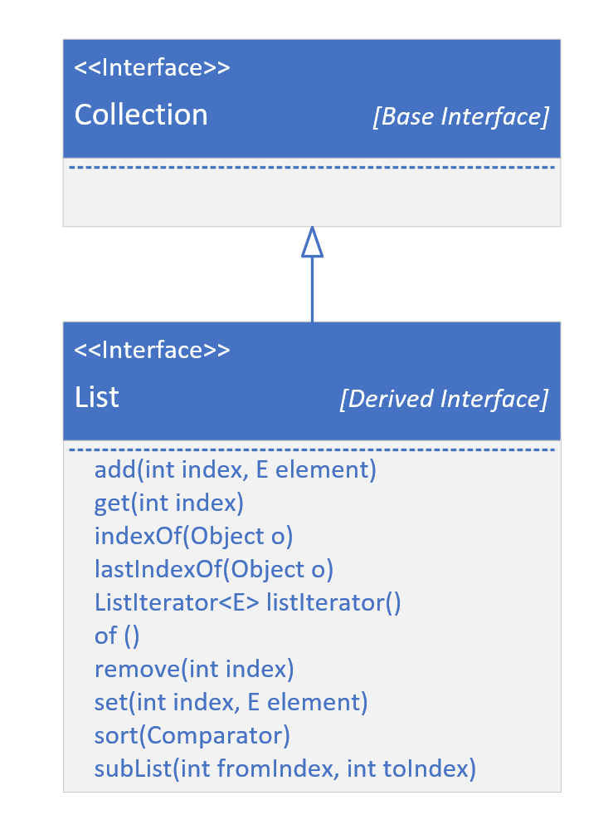
The Collection Interface
This slide shows the List interface extending Collection.
For simplicity, I'm not showing the Collection methods that I showed on the previous slide.
I'm only showing additional methods specifically declared on the List interface.
COMPLETE JAVA MASTERCLASS
Collections: Understanding the Big Picture

Slide 8
The Collection Interface
We covered most of these methods, but I wanted you to see here, that most of these are dealing with an index.
A list can be either indexed, as an ArrayList, or not, like a LinkedList, but a LinkedList is implemented to support all of these methods as well.
Derived interfaces may have specific ways to add, remove, get, and sort elements for their specific type of collection, in addition to those defined on the Collection Interface itself.
Now, let's look at the big picture of interfaces, and some specific implementations.
COMPLETE JAVA MASTERCLASS
Collections: Understanding the Big Picture

Slide 9
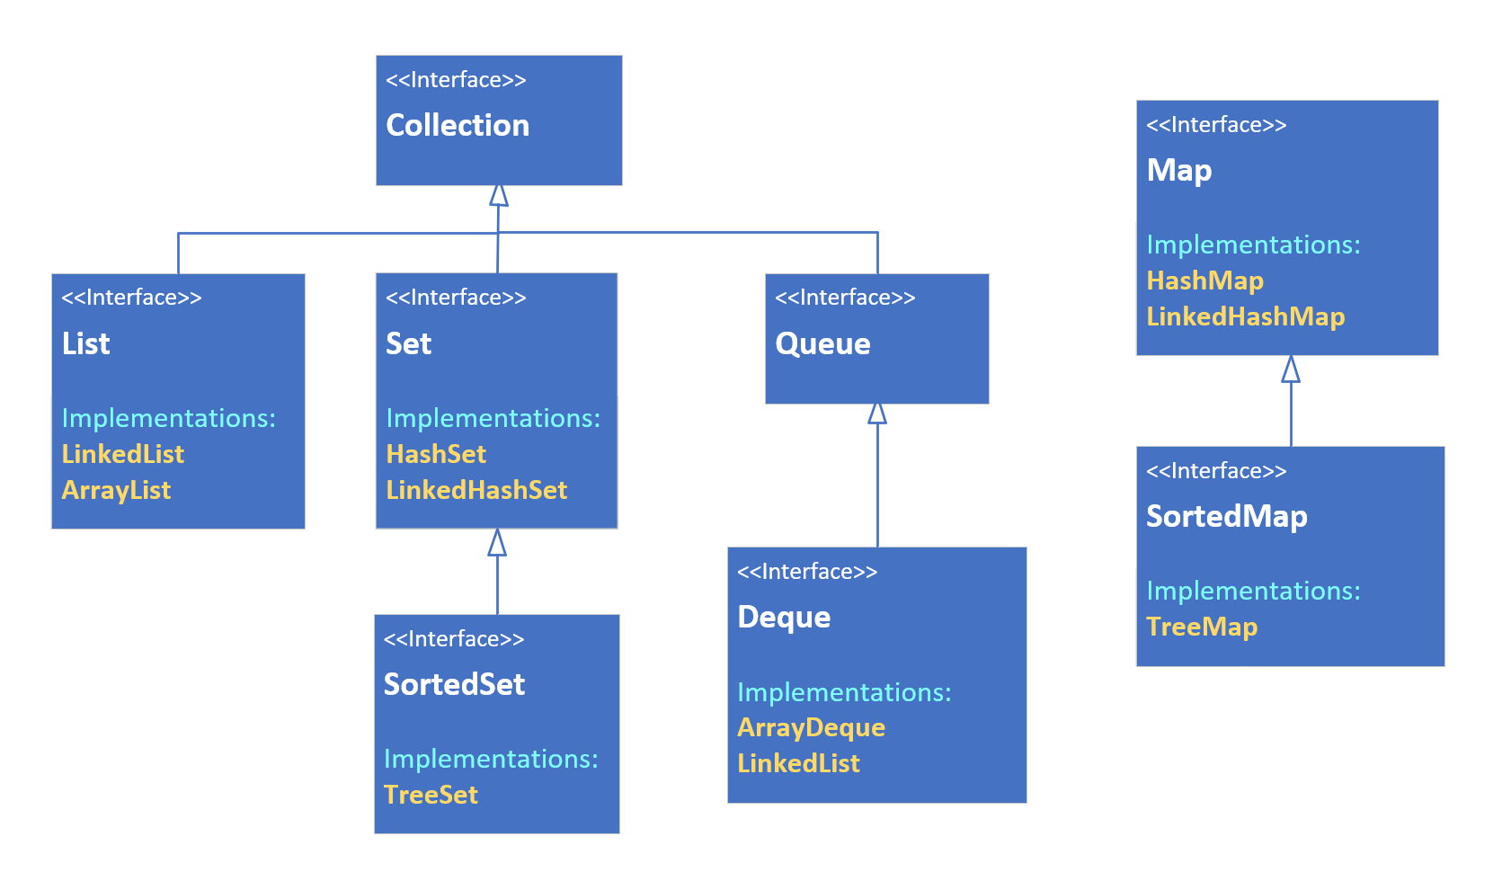
Collections - The Big Picture
This slide shows the interface hierarchy.
It's also showing the implementations or concrete classes, that implement these interfaces, in yellow font.
Notice that Map does not extend Collection, although still part of this framework.
COMPLETE JAVA MASTERCLASS
Collections: Understanding the Big Picture

Slide 10
Collections - The Big Picture
Maps are uniquely different, which I'll be explaining when I cover Maps in this section.
You can see that LinkedList implements both List and Deque, and I discussed this in detail when I covered LinkedLists.
COMPLETE JAVA MASTERCLASS
Collections: Understanding the Big Picture

Slide 11
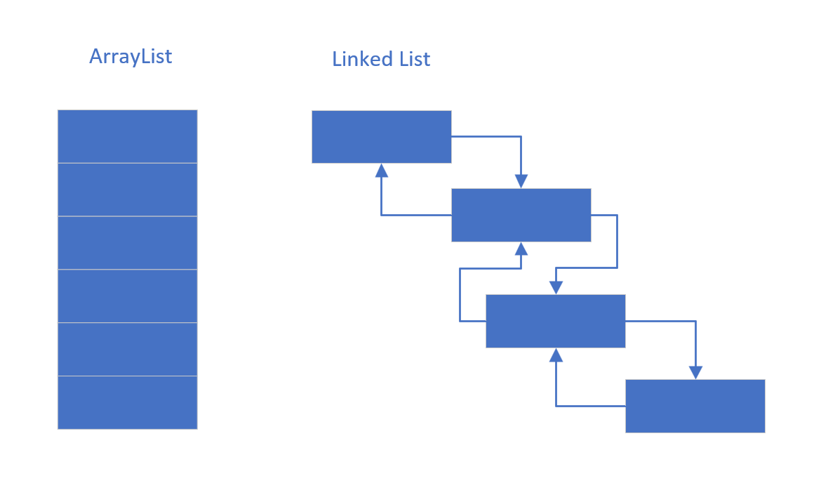
The List
A List is An ordered collection (also known as a sequence).
These can be sequenced in memory like an ArrayList, or maintain links to the next and previous values, as a LinkedList.
COMPLETE JAVA MASTERCLASS
Collections: Understanding the Big Picture

Slide 12
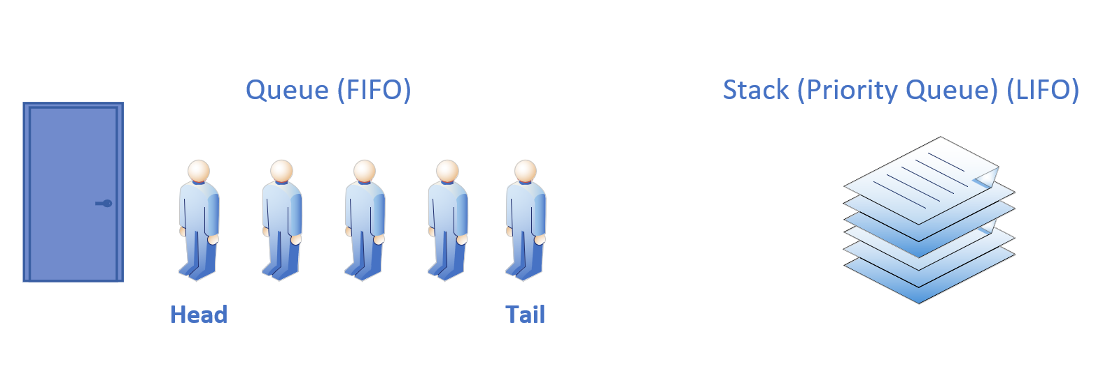
The Queue
A Queue is a collection designed for holding elements prior to processing, in other words the processing order matters, so the first and last positions, or the head and tail, are prioritized.
Most often these may be implemented as First In, First Out (FIFO), but can be implemented like a Stack, as Last In First Out (LIFO) which we've discussed.
Remember a Deque supports both.
COMPLETE JAVA MASTERCLASS
Collections: Understanding the Big Picture

Slide 13
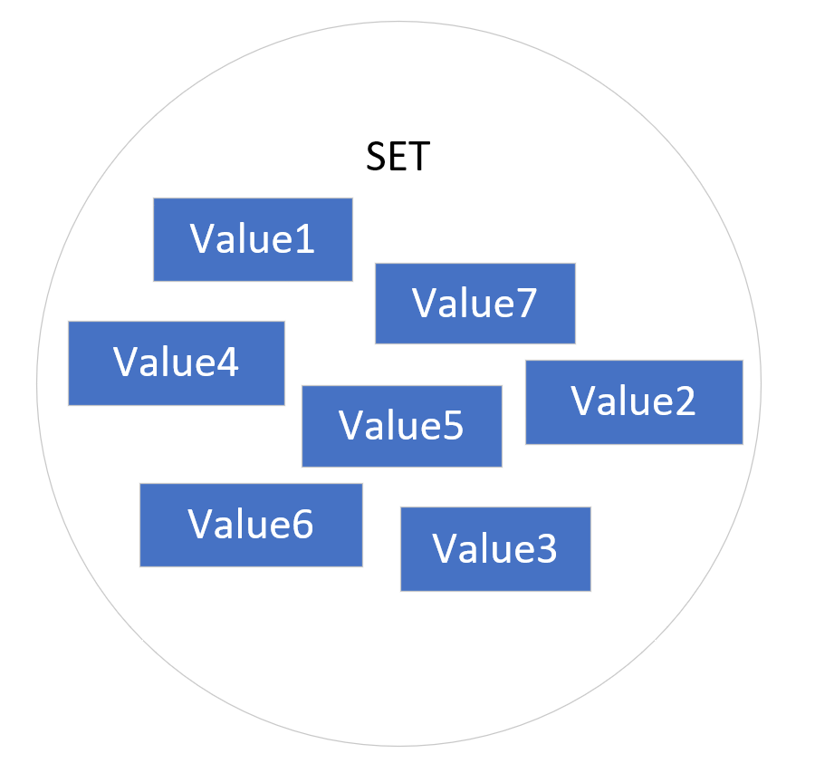
The Set
A Set is a collection conceptually based off of a mathematical set.
Importantly, it contains no duplicate elements, and isn't naturally sequenced or ordered.
You can think of a set as a kind of penned in chaotic grouping of objects.
Java has three implementations, which I'll be reviewing in this section of the course in detail, the HashSet, the TreeSet and the LinkedHashSet.
These are distinguished by the underlying way they store the elements in the set.
A Sorted Set is a set that provides a total ordering of the elements.
COMPLETE JAVA MASTERCLASS
Collections: Understanding the Big Picture

Slide 14
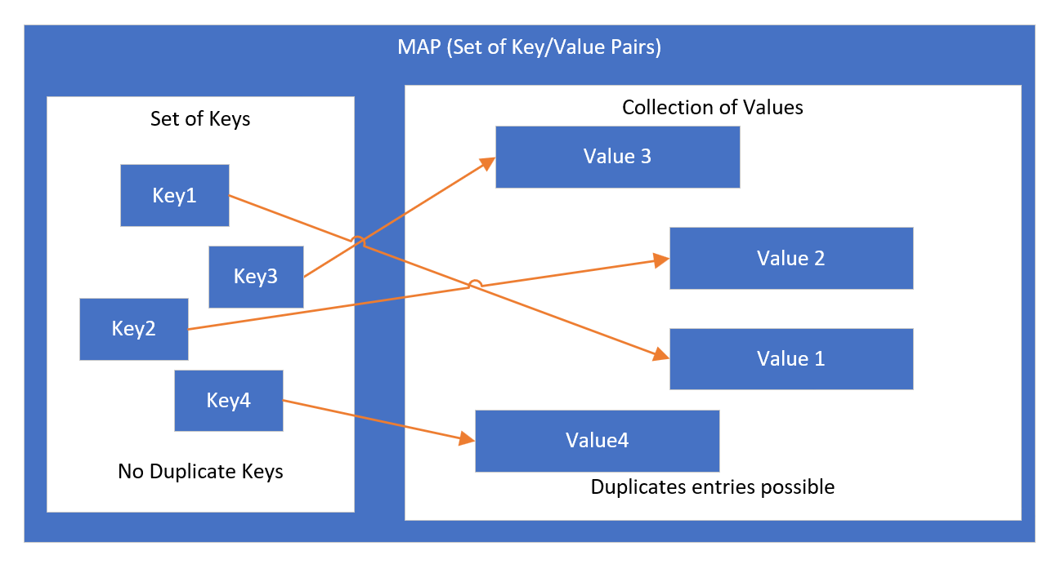
The Map
A Map is a collection that stores key and value pairs.
The keys are a set, and the values are a separate collection, where the key keeps a reference to a value.
Keys need to be unique, but values don't.
Elements in a tree are stored in a key value Node, also called an Entry.
COMPLETE JAVA MASTERCLASS
Collections: Understanding the Big Picture

Slide 15
The Map
In the videos coming up, we'll be looking at Set and Map, and how they resemble and differ from List.
But before that, I want to talk about polymorphic algorithms.
COMPLETE JAVA MASTERCLASS
Collections: Understanding the Big Picture

Slide 16
What's a polymorphic algorithm?
Oracle's documentation describes a polymorphic algorithm as a piece of reusable functionality.
At one time, most of these methods were provided to us, as static methods, on a class called java.util.Collections.
Since JDK-8, and the advent of multiple interface enhancements, some of these methods are now on the interfaces themselves, as default or static methods.
But not all, so I'll be discussing this class, and what it has to offer, in comparison to what's available on each collection class.
It's also important to understand that legacy code will be using this class for some operations, that can be done from the class itself.
COMPLETE JAVA MASTERCLASS
Collections: Understanding the Big Picture

Slide 17
The Setup
I want to start doing something a little bit different.
Moving forward, I'll try to do this setup work, in a separate video, when it makes sense to do so.
I'll introduce this code as an optional challenge, for those who really like the independent work.
If you feel like you need extra time with some of the basics, definitely take the challenge.
If you feel like you don't need this review, and aren't interested in the challenge, then feel free to skip this video.
COMPLETE JAVA MASTERCLASS
Code Setup (Deck of Cards) for java.util.Collections methods

Slide 18
The Setup
I'll review this code in much briefer detail, at the start of the video where I introduce it, and the source will be available as a download for you, in the resources section of that video.
My code will include the use of a record, a nested enum on that record, and the use of List functions you've already been exposed to.
I'll be using ascii codes to display the suits of the cards.
COMPLETE JAVA MASTERCLASS
Code Setup (Deck of Cards) for java.util.Collections methods

Slide 19
The Setup
In this video, I want to set up a Card class, which will be used to create a deck of playing cards.
I'll be using these cards, and decks of cards, to demonstrate many of the methods on java.util.Collections.
The Card will have three fields:
a Suit, meaning Club, Diamond, Heart, or Spade.
a face field, which will be a String, containing either the number of the card, or the face value of the card, Jack, Queen, King or Ace.
a rank, an integer.
COMPLETE JAVA MASTERCLASS
Code Setup (Deck of Cards) for java.util.Collections methods

Slide 20
The Setup
The Card should override the toString method, and print the card with the face value (abbreviated, if a face card), the ascii character of the suit, and the rank in parentheses.
I'm including the ascii characters that will print out each suit as a printable character.
CLUB = 9827
DIAMOND = 9830
HEART = 9829
SPADE = 9824
COMPLETE JAVA MASTERCLASS
Code Setup (Deck of Cards) for java.util.Collections methods

Slide 21
The Setup
The output shown here, shows all the cards in a standard deck of playing cards, sorted by suit and rank.
2♣(0) 3♣(1) 4♣(2) 5♣(3) 6♣(4) 7♣(5) 8♣(6) 9♣(7) 10♣(8) J♣(9) Q♣(10) K♣(11) A♣(12)
2♦(0) 3♦(1) 4♦(2) 5♦(3) 6♦(4) 7♦(5) 8♦(6) 9♦(7) 10♦(8) J♦(9) Q♦(10) K♦(11) A♦(12)
2♥(0) 3♥(1) 4♥(2) 5♥(3) 6♥(4) 7♥(5) 8♥(6) 9♥(7) 10♥(8) J♥(9) Q♥(10) K♥(11) A♥(12)
2♠(0) 3♠(1) 4♠(2) 5♠(3) 6♠(4) 7♠(5) 8♠(6) 9♠(7) 10♠(8) J♠(9) Q♠(10) K♠(11) A♠(12)
COMPLETE JAVA MASTERCLASS
Code Setup (Deck of Cards) for java.util.Collections methods

Slide 22
The Setup
The card should have the following public static methods to assist anyone using this class:
getNumericCard which should return an instance of a Card, based on the suit and number passed to it.
getFaceCard which should return an instance of a Card, based on the suit and abbreviation (J, Q, K, A) passed to it.
getStandardDeck which should return a list of cards you'd find in a standard deck. See the previous slide for a full set of cards.
COMPLETE JAVA MASTERCLASS
Code Setup (Deck of Cards) for java.util.Collections methods

Slide 23
The Setup
printDeck, which should take a description, a list of card, and a row count. This method will print the cards out in the number of rows passed.
Finally, the card should have an overloaded printDeck method, that will print "Current Deck" as the description, and use 4, as the number of rows to be printed.
I'll introduce it with a brief overview in the next video, and it will be in the resources section of that video, as well as this one.
COMPLETE JAVA MASTERCLASS
Code Setup (Deck of Cards) for java.util.Collections methods

Slide 24
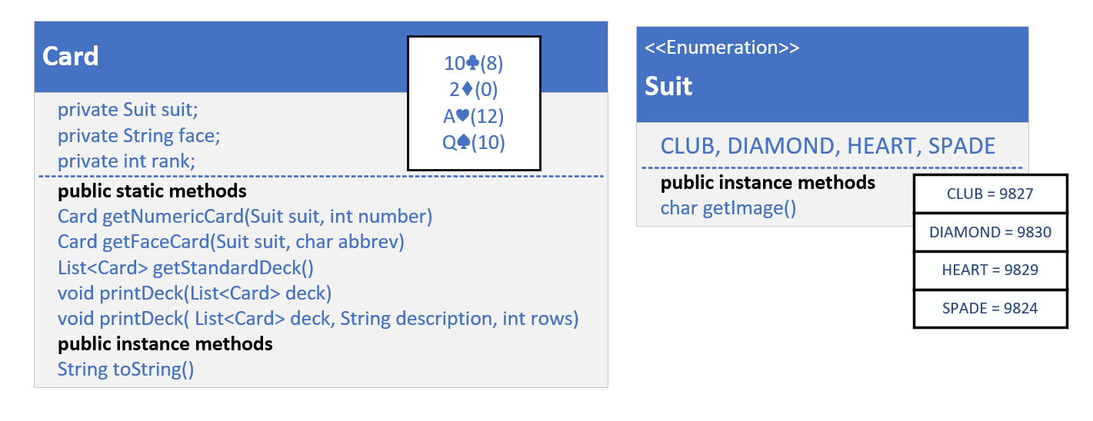
The class diagram for my solution
This slide shows my own plan, or the class diagram I'll be coding towards.
I'm going to create a Card class.
In my case I'm just going to make it a record.
COMPLETE JAVA MASTERCLASS
Code Setup (Deck of Cards) for java.util.Collections methods

Slide 25
The class diagram for my solution
Using a record gives me built in immutability, if all my attributes are simple data types, like primitives and Strings.
Maybe you decided to create a Deck class, to contain your cards, and that's a good idea too.
For the examples ahead, I'm just going to use List as my Deck container.
COMPLETE JAVA MASTERCLASS
Code Setup (Deck of Cards) for java.util.Collections methods

Slide 26
What's a Collections Class?
It's important to understand that the Collections class is not the Collections Framework.
The framework contains many interfaces and implemented classes, as well as helper classes, which this Collections class is just one example.
At one time, Java had interfaces, but no support for static or default methods on them, so useful methods were packaged in these helper classes.
Some of these methods have since been implemented on the interfaces themselves, but there's still some functionality on the Collections class you might find useful.
I'll examine some of these in code, and compare them to the methods on the interfaces now available.
COMPLETE JAVA MASTERCLASS
Introduction to java.util.Collections

Slide 27
The Setup - a Quick Review
This code has Card, a record, with a nested enum, named Suit, declared in it.
Suit is either a Club, Diamond, Heart or Spade, and this enum has a helper function, getImage, that returns a printable character value for that suit.
I overrode the toString method on Card, to print that character along with what I call the face, or face value of the card, so 2 through 10, or Jack, Queen, King, or Ace.
COMPLETE JAVA MASTERCLASS
Introduction to java.util.Collections

Slide 28
The Setup - a Quick Review
Each card will also have a rank, starting with 0 for the lowest card.
In a standard deck, the lowest card, a two, is 0, because an Ace is usually the highest value card, though an ace can represent a one sometimes.
The Card has static helper functions I'll be using in the code in this video, one to get an instance of a numeric card, one to get an instance of a face card.
COMPLETE JAVA MASTERCLASS
Introduction to java.util.Collections

Slide 29
The Setup - a Quick Review
In addition, I can get a list of cards, that represents a standard deck of cards.
And there's functions to print the deck of cards.
COMPLETE JAVA MASTERCLASS
Introduction to java.util.Collections

Slide 30
The Card Game Challenge
In the last video, I introduced you to quite a few methods on the java.util.Collections class, and showed you examples, using a deck of cards.
Now, it's your turn.
Think for a moment about a card game that you'd enjoy building, and one you know some of the rules for.
Create a deck of cards, either a standard deck, or a deck that's specialized to the card game you want to create.
Shuffle your deck.
COMPLETE JAVA MASTERCLASS
Collections methods Challenge, Your own Card Game

Slide 31
The Card Game Challenge
Deal your players' hands. Pick the number of players playing, and figure out how you'll deal the cards, one at a time to each hand, or some other way.
Evaluate your players' hands for card combinations that are important to the game.
Use a combination of java.util.Collections and List methods, to achieve your results.
COMPLETE JAVA MASTERCLASS
Collections methods Challenge, Your own Card Game

Slide 32
Poker: Five Card Draw
This game usually has four or more players.
The dealer shuffles the deck, and asks another player to cut the deck.
The dealer deals the cards one at a time to each player, starting with the player on the dealer's left, until each player has 5 cards.
Each player evaluates his hand for certain card combinations, called card ranks.
Each player can discard up to 3 cards.
The dealer will replace discarded cards from the remaining pile, in the order they've been shuffled.
Each player reevaluates his hand if he drew new cards, and bets on his hand.
This gives us quite a bit to work on, so let's get going.
COMPLETE JAVA MASTERCLASS
Collections methods Challenge, Your own Card Game

Slide 33
Understanding the importance of the hash code
HashSet and HashMap, are based on the hash codes of objects.
This can be a confusing topic for new programmers, so I want to spend some extra time explaining it.
Since sets are unique because they don't support duplicates, adding an element always incurs the cost of first checking for a match.
If your set is large or very large, this becomes a costly operation, O(n), or linear time, if you remember the Big O notations I covered previously.
A mechanism to reduce this cost, is introduced by something called hashing.
If we created two buckets of elements, and the element could consistently identify which bucket it was stored in, then the lookup could be reduced by half.
If we created four buckets, we could reduce the cost by a quarter.
COMPLETE JAVA MASTERCLASS
Understanding the importance of the hash code

Slide 34
Understanding the importance of the hash code
A hashed collection will optimally create a limited set of buckets, to provide an even distribution of the objects across the buckets in a full set.
A hash code can be any valid integer, so it could be one of 4.2 billion valid numbers.
If your collection only contains 100,000 elements, you don't want to back it with a storage mechanism of 4 billion possible placeholders.
And you don't want to have to iterate through 100,000 elements one at a time to find a match or a duplicate.
COMPLETE JAVA MASTERCLASS
Understanding the importance of the hash code

Slide 35
Understanding the importance of the hash code
A hashing mechanism will take an integer hash code, and a capacity declaration which specifies the number of buckets to distribute the objects over.
It then translates the range of hash codes into a range of bucket identifiers.
Hashed implementations use a combination of the hash code and other means, to provide the most efficient bucketing system, to achieve this desired uniform distribution of the objects.
COMPLETE JAVA MASTERCLASS
Understanding the importance of the hash code

Slide 36
Hashing starts with understanding equality
To understand hashing in Java, I think it helps to first understand the equality of objects.
I've touched on this in previous videos, but now I want to be sure you thoroughly understand this subject, because it matters when dealing with any hashed collections.
There are two methods on java.util.Object, that all objects inherit.
These are equals, and hashCode, and I show the method signatures from Object here.
Testing for equality | The hashcode method
COMPLETE JAVA MASTERCLASS
Understanding the importance of the hash code

Slide 37
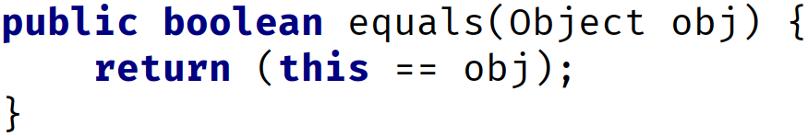
The equals method on Object
The implementation of equals on Object is shown here.
It simply returns this == obj.
COMPLETE JAVA MASTERCLASS
Understanding the importance of the hash code

Slide 38
Do you remember what == means for Objects?
Do you remember what == means for objects?
It means two variables have the same reference to a single object in memory.
Because both references are pointing to the same object, then this is obviously a good equality test.
COMPLETE JAVA MASTERCLASS
Understanding the importance of the hash code

Slide 39
Equality of Objects
Objects can be considered equal in other instances as well, if their attribute values are equal, for example.
The String class overrides this method, so that it compares all the characters in each String, to confirm that two Strings are equal.
COMPLETE JAVA MASTERCLASS
Understanding the importance of the hash code

Slide 40
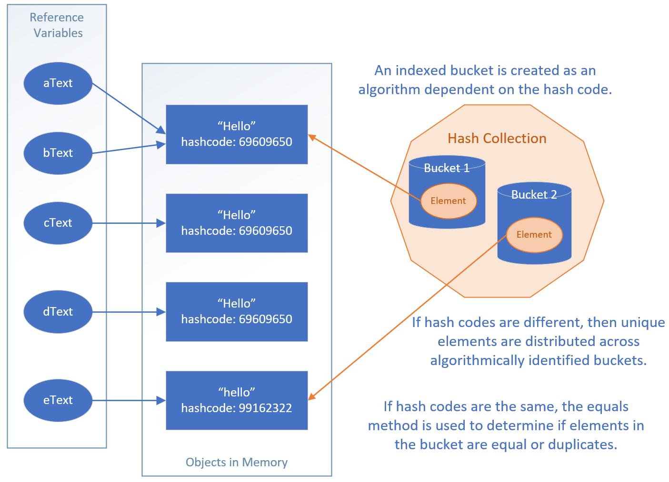
The visual representation of the code
Our code set up five String reference variables, but two of these, referenced the same string object in memory, as shown here with aText and bText pointing to the same string instance.
When we passed our list of five strings to the HashSet, it added only unique instances to its collection.
COMPLETE JAVA MASTERCLASS
Understanding the importance of the hash code

Slide 41
The visual representation of the code
It locates elements to match, by first deriving which bucket to look through, based on the hash code.
It then compares those elements to the next element to be added, with other elements in that bucket, using the equals method.
COMPLETE JAVA MASTERCLASS
Understanding the importance of the hash code

Slide 42
Creating the hashCode method
You don't have to use the generated algorithm as I did here.
You could create your own, but your code should stick to the following rules.
It should be very fast to compute.
It should produce a consistent result each time it's called. For example, you wouldn't want to use a random number generator, or a date time based algorithm that would return a different value each time the method is called.
Objects that are considered equal should produce the same hashCode.
Values used in the calculation should not be mutable.
COMPLETE JAVA MASTERCLASS
Understanding the importance of the hash code

Slide 43
Creating the hashCode method
It is common practice to include a small prime number as a multiplicative factor (although some non-prime numbers also provide good distributions).
This helps ensure a more even distribution for the bucket identifier algorithm, especially if your data might exhibit clustering in some way.
IntelliJ and other code generation tools use 31, but other good options could be 29, 33 (not prime but shown to have good results), 37, 43 and so on.
You want to avoid the single digit primes, because more numbers will be divisible by those, and may not produce the even distribution that will lend itself to improved performance.
COMPLETE JAVA MASTERCLASS
Understanding the importance of the hash code

Slide 44
Creating the hashCode method
For those who like to understand how things really work, let me encourage you to do some research on this topic.
For the rest of you, remember that if you are using your own classes in hashed collections, you'll want to override both the equals and the hashCode methods.
I'll be covering this quite a bit over the next couple of videos, so you'll have more time to get exposed to these concepts.
COMPLETE JAVA MASTERCLASS
Understanding the importance of the hash code

Slide 45
Java's Hashed Collection Types
Java supports four hashed collections implementation, which we'll be looking at coming up.
These are the HashSet, LinkedHashSet, the HashMap, and LinkedHashMap.
In addition there's one legacy implementation, the HashTable, which I won't be covering, since there are more efficient implementations which replace this legacy class.
COMPLETE JAVA MASTERCLASS
Understanding the importance of the hash code

Slide 46
The Setup
In this example, I'll be using HashSets as fields, and I'll use the Scanner class, which I've used many times before, always passing System.in to the constructor.
I'll be using Scanner with just a String passed to the constructor.
It works similarly. If you want to see this in action, be sure to follow along.
Eventually I'll cover reading input from files, although this code won't be doing that.
Using scanner this way, gives you a taste for a way to do this.
Again the purpose of having a separate video here, to set up a bit of code, is to keep the new topic material more on point later.
COMPLETE JAVA MASTERCLASS
Code Setup (Phone and Email Contacts) for Sets and Maps

Slide 47
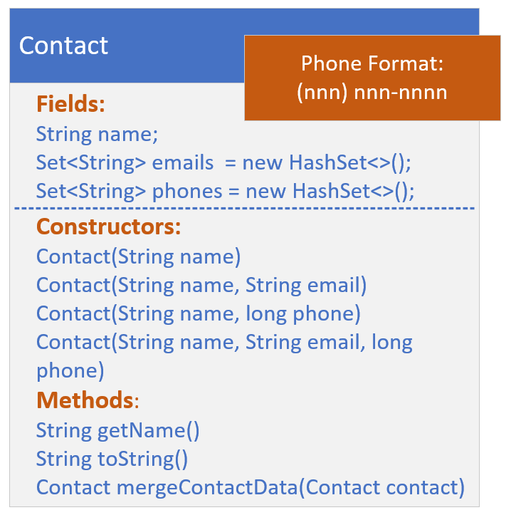
The Setup Challenge - The Contact Class
This last constructor should do the following:
Add the email argument to the emails set, if email is not null.
Transform the phone argument, a long, (if it's not zero), to a string in the format (123) 456-7890, for example.
Add the transformed phone to the phones set.
Finally, include a method called mergeContactData, that takes a contact, and returns a new Contact instance, which merges the current instance with the Contact passed.
COMPLETE JAVA MASTERCLASS
Code Setup (Phone and Email Contacts) for Sets and Maps

Slide 48
The Setup Challenge - The Data (ContactData class)
The ContactData class is going to emulate getting data from an external source, but instead of an external source, I just want you to set this data up with two different text blocks, in the format shown on this slide.
This data purposely has duplicates.
Phone Data | Email Data
Charlie Brown, 3334445555 Maid Marion, 1234567890 Mickey Mouse, 9998887777 Mickey Mouse, 1247489758 Minnie Mouse, 4567805666 Robin Hood, 5647893000 Robin Hood, 7899028222 Lucy Van Pelt, 5642086852 Mickey Mouse, 9998887777 | Mickey Mouse, mckmouse@gmail.com Mickey Mouse, micky1@aws.com Minnie Mouse, minnie@verizon.net Robin Hood, rhood@gmail.com Linus Van Pelt, lvpelt2015@gmail.com Daffy Duck, daffy@google.com
COMPLETE JAVA MASTERCLASS
Code Setup (Phone and Email Contacts) for Sets and Maps

Slide 49
The Setup Challenge - The Data (ContactData class)
Create a Method named getData, that takes a String type (either “phone” or “email”), and returns a List of Contact.
Now, I'm going to use Scanner to parse the data in these text blocks.
You're welcome to try another approach.
Don't worry, you won't be missing any content I haven't already covered or won't cover shortly.
COMPLETE JAVA MASTERCLASS
Code Setup (Phone and Email Contacts) for Sets and Maps

Slide 50
The Set
A Set is not implicitly ordered.
A Set contains no duplicates.
A Set may contain a single null element.
Sets can be useful because operations on them are very fast.
COMPLETE JAVA MASTERCLASS
Introduction to Sets & HashSet

Slide 51
Set Methods
The set interface defines the basic methods add, remove and clear, to maintain the items in the set.
We can also check if a specific item is in the set using the contains method.
Interestingly enough, there's no way to retrieve an item from a set.
You can check if something exists, using contains, and you can iterate over all the elements in the set, but attempting to get the 10th element, for example, from a set isn't possible, with a single method.
COMPLETE JAVA MASTERCLASS
Introduction to Sets & HashSet

Slide 52
The HashSet class
The best-performing implementation of the Set interface is the HashSet class.
This class uses hashing mechanisms to store the items.
Oracle describes this class as offering constant time performance for the basic operations (add, remove, contains and size).
Constant time has the Big O Notation O(1).
Although I haven't covered the Map and HashMap types yet, the HashSet actually uses a HashMap in it's own implementation, as of JDK 8.
COMPLETE JAVA MASTERCLASS
Introduction to Sets & HashSet

Slide 53
Set Operations
In this video, I'll be explaining a little bit about Set Math, or Set Operations, first what they are, and second, why you'd want to use them.
When you're trying to understand data in multiple sets, you might want to get the data that's in all the sets, that's in every set, or the data where there's no overlap.
The collection interface's bulk operations (addAll, retainAll, removeAll, and containAll) can be used to perform these set operations.
COMPLETE JAVA MASTERCLASS
Set Operations, Symmetric and Asymmetric results

Slide 54
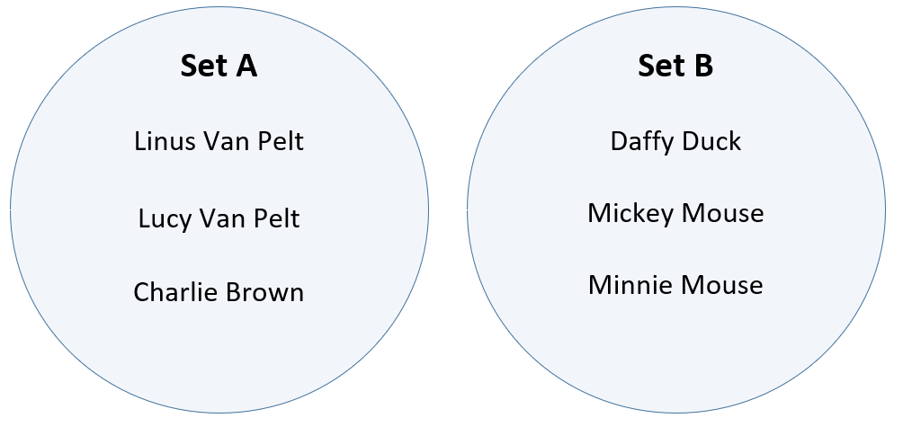
Representing Sets in a Venn Diagram
Sets are often represented as circles or ovals, with elements inside, on what is called a Venn Diagram.
Here, I'm showing two sets that have no elements in common.
This venn diagram shows some of the cartoon characters of the Peanuts and Mickey Mouse cartoons.
Because the characters are distinct for each set, the circles representing the sets don't overlap, or intersect.
COMPLETE JAVA MASTERCLASS
Set Operations, Symmetric and Asymmetric results

Slide 55
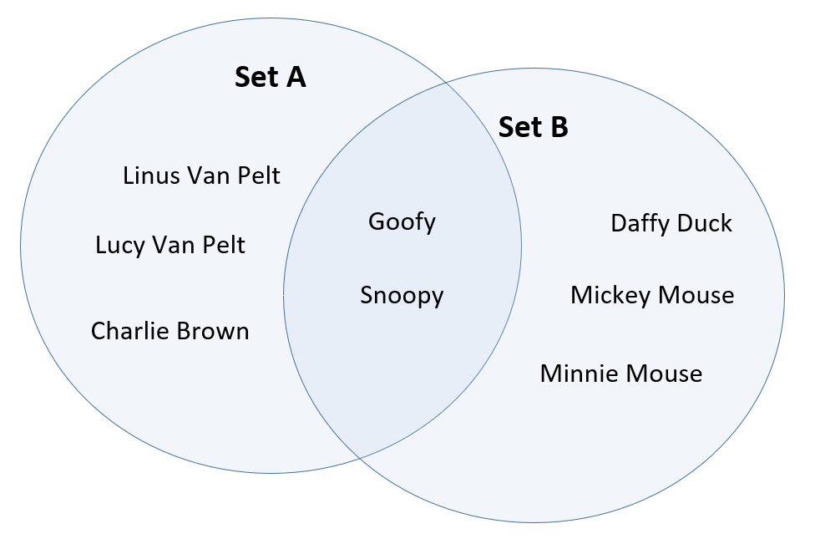
Representing Sets in a Venn Diagram
This diagram shows two sets of characters that do overlap.
Let's say that Goofy and Snoopy, have guest appearances in the other's holiday special show.
The intersection of these sets is represented by the area where the two circles (sets) overlap, and contains the elements that are shared by both sets.
COMPLETE JAVA MASTERCLASS
Set Operations, Symmetric and Asymmetric results

Slide 56
Representing Sets in a Venn Diagram
Goofy and Snoopy are both in Set A and Set B, in other words.
Venn Diagrams are an easy way to quickly see how elements in multiple sets relate to each other.
COMPLETE JAVA MASTERCLASS
Set Operations, Symmetric and Asymmetric results

Slide 57
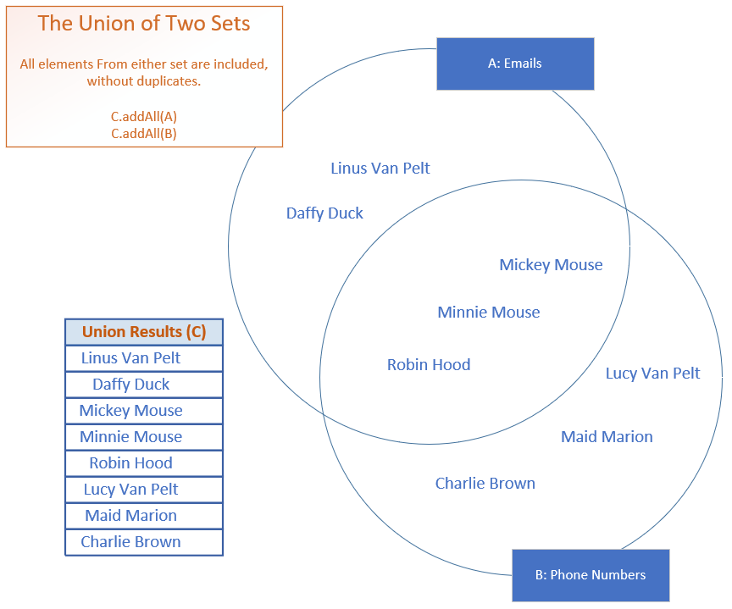
Set Operations - Union A ∪ B
The union of two or more sets will return elements that are in any or all of the sets, removing any duplicates.
The slide shown here is showing my two sets, names on an email list, and names on a phone numbers list.
The overlap are names that are on both lists.
COMPLETE JAVA MASTERCLASS
Set Operations, Symmetric and Asymmetric results

Slide 58
Set Operations - Union A ∪ B
In the example shown on this slide, all names on the email list and phone list will be included in a union of the two sets, but Minnie, Mickie and Robin Hood, which are the only elements included in both sets, are included in the resulting set only once.
Java doesn't have a union method on Collections, but the addAll bulk function, when used on a Set, can be used to create a union of multiple sets.
COMPLETE JAVA MASTERCLASS
Set Operations, Symmetric and Asymmetric results

Slide 59
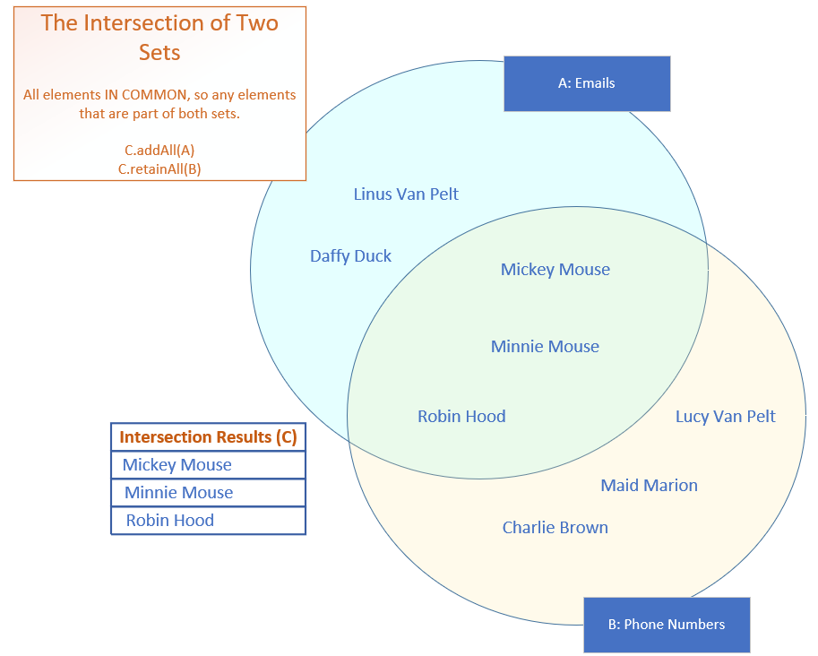
Set Operations - Intersect - A ∩ B
The intersection of two or more sets, will return only the elements the sets have in common.
These are shown in the overlapping area of the sets on this slide, the intersect, shown in green, and includes Mickey and Minnie Mouse, and Robin Hood.
COMPLETE JAVA MASTERCLASS
Set Operations, Symmetric and Asymmetric results

Slide 60
Set Operations - Symmetric Operations
The ability to evaluate sets, A intersect B and get the same result as B intersect A, means that the intersect operation is a symmetric set operation.
Union is also a symmetric operation.
It doesn't matter if you do A Union B, or B union A, the final set of elements will all be the same set of names.
COMPLETE JAVA MASTERCLASS
Set Operations, Symmetric and Asymmetric results

Slide 61
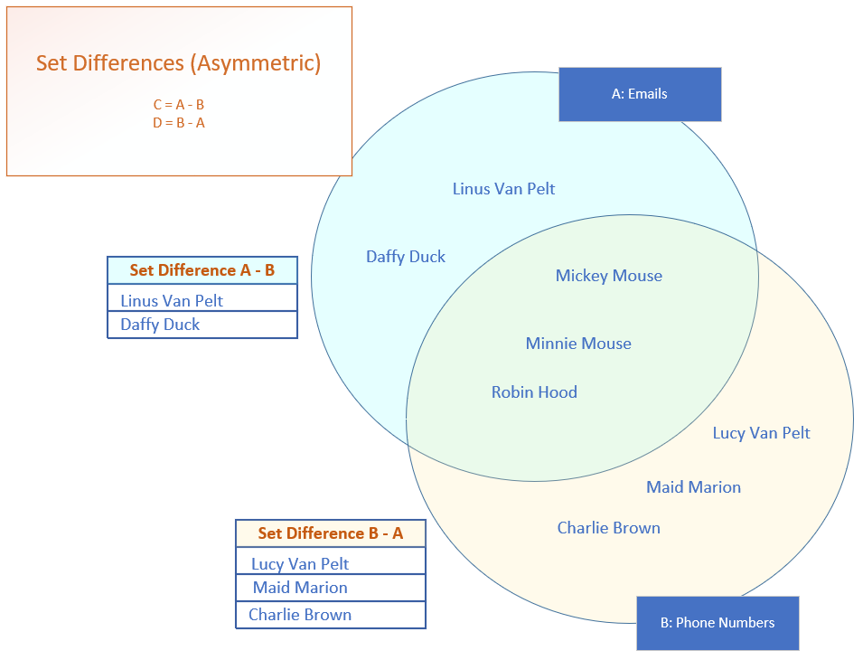
Set Operations - Asymmetric Differences
A difference subtracts elements in common from one set and another, leaving only the distinct elements from the first set as the result.
This is an asymmetric operation because if we take Set A and subtract Set B from it, we'll end up with a different set of elements than if we take Set B and subtract Set A.
The sets from these two operations won't result in the same elements.
COMPLETE JAVA MASTERCLASS
Set Operations, Symmetric and Asymmetric results

Slide 62
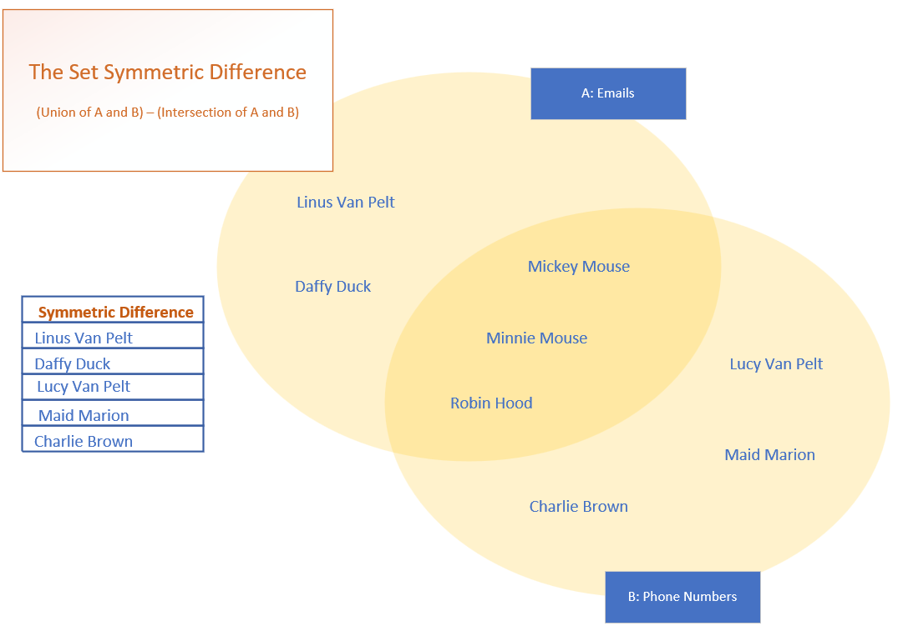
Set Operations - Symmetric Differences
You can think of the set symmetric difference, as the elements from all sets that don't intersect.
On this slide, these are the elements that are represented in the paler yellow areas.
COMPLETE JAVA MASTERCLASS
Set Operations, Symmetric and Asymmetric results

Slide 63
Set Operations Challenge - Task Class
You'll want to create a class that represents a Task.
It should have
an assignee.
a project name.
a task description.
a status (assigned, in progress, or not yet assigned).
a priority, High, Low, or Medium.
Each of these attributes should be editable.
COMPLETE JAVA MASTERCLASS
Code Setup (Tasks and TaskData)

Slide 64
Set Operations Challenge - Task Class
A task is uniquely identified by its project name and description.
The task should implement Comparable, so that tasks are sorted by project name and description.
COMPLETE JAVA MASTERCLASS
Code Setup (Tasks and TaskData)

Slide 65
Set Operations Challenge - TaskData Class
The TaskData class will be used to set up, and return some test data.
If you want to use my data, it can be found in a csv file in the resources folder of this section, and consists of the following:
All tasks identified by the manager.
Tasks identified by Ann, that she's working on or plans to work on.
Tasks which Bob says have been assigned to him.
Tasks Carol is doing, as reported by herself.
This class should have a getData method, that returns a Set of Task. This method should take a String, either the name of one of the employees to get a specific set, or 'all' to get the full task set.
COMPLETE JAVA MASTERCLASS
Code Setup (Tasks and TaskData)

Slide 66
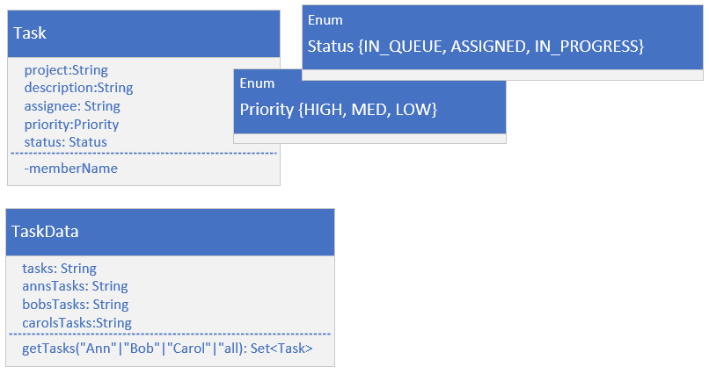
Set Operations Challenge - Task and Task Data
This class diagram shows you the two classes.
Task has five fields, two with enum types shown.
Task is unique by the project and description fields combined.
Task implements comparable, and is sorted by project then description.
Some test data was set up on the TaskData class, and you can get this data by calling TaskData.getData, passing it the names, Ann, Bob, or Carol, or some other string, like "all", to get all tasks.
COMPLETE JAVA MASTERCLASS
Set Operations Challenge

Slide 67
Set Operations Challenge
Let's say you're a new manager, of a team that consists of three team members working under you, Ann, Bob, and Carol.
Each of these developers is working on a set of tasks.
You've asked all your developers to submit what they're working on to you.
You also have a master set of tasks, which your own boss sent to you.
COMPLETE JAVA MASTERCLASS
Set Operations Challenge

Slide 68
Set Operations Challenge - Answer these questions
You'll be using that data, to answer the following questions.
What is the full task list? This is the list of all tasks described by your manager or boss, and any additional tasks the employees have, that may not be on that list.
Which tasks are assigned to at least one of your 3 team members?
Which tasks still need to be assigned?
Which tasks are assigned to multiple employees?
To do some of this work, create three methods on your Main class.
COMPLETE JAVA MASTERCLASS
Set Operations Challenge

Slide 69
Set Operations Challenge - Answer these questions
Be sure the sets you pass to these methods, don't mutate in these methods. In other words, return a new set.
Create a getUnion method, that takes a List of Sets, and will return the union of all the sets.
Create a getIntersect method, that takes two Sets, and returns the intersection of the sets.
Create a getDifference method, that takes two Sets, and removes the second argument's set from the first.
COMPLETE JAVA MASTERCLASS
Set Operations Challenge

Slide 70
Ordered Sets
If you need an ordered set, you'll want to consider either the LinkedHashSet or the TreeSet.
A LinkedHashSet maintains the insertion order of the elements.
The TreeSet is a sorted collection, sorted by the natural order of the elements, or by specifying the sort during the creation of the set.
COMPLETE JAVA MASTERCLASS
LinkedHashSet and TreeSet

Slide 71
The LinkedHashSet
The LinkedHashSet extends the HashSet class.
It maintains relationships between elements with the use of a doubly linked list between entries.
The iteration order is therefore the same as the insertion order of the elements, meaning the order is predictable.
All the methods for the LinkedHashSet are the same as those for the HashSet.
Like HashSet, it provides constant-time performance, O(1), for the add, contains and remove operations.
COMPLETE JAVA MASTERCLASS
LinkedHashSet and TreeSet

Slide 72
TreeSet
A TreeSet's class, uses a data structure that's a derivative of what's called a binary search tree, or Btree for short, which is based on the concept and efficiencies of the binary search.
I've discussed the binarySearch method on the List, as well as the java.util.Collections class, and shown that this type of search is very fast, if the elements are sorted.
This search iteratively tests the mid range of a group of elements to be searched, to quickly find its element, in a collection.
COMPLETE JAVA MASTERCLASS
LinkedHashSet and TreeSet

Slide 73
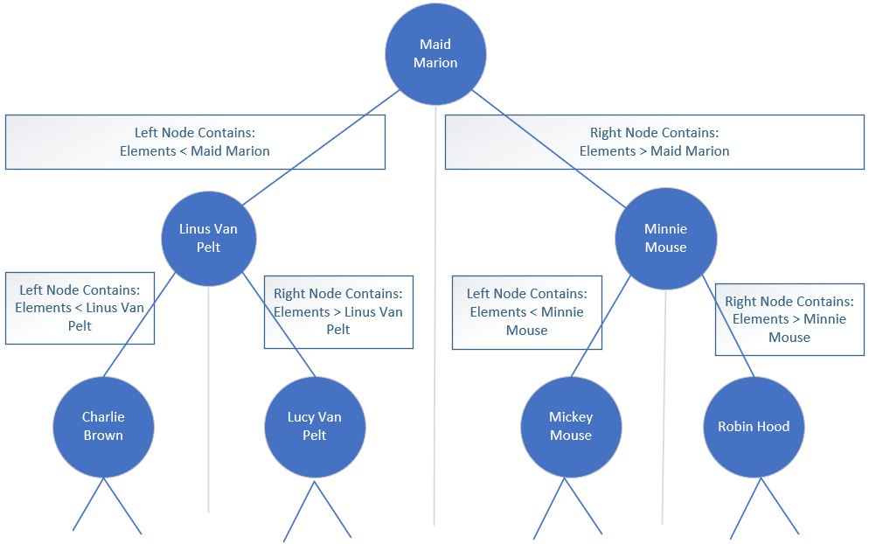
TreeSet
As elements are added to a TreeSet, they're organized in the form of a tree, where the top of the tree represents that mid point of the elements.
This slide shows a conceptual example, using some of the character contacts from my last samples of code.
COMPLETE JAVA MASTERCLASS
LinkedHashSet and TreeSet

Slide 74
TreeSet
Further binary divisions become nodes under that.
The left node and its children are elements that are less than the parent node.
The right node and its children are elements that are greater than the parent node.
COMPLETE JAVA MASTERCLASS
LinkedHashSet and TreeSet

Slide 75
TreeSet
Instead of looking through all the elements in the collection to locate a match, this allows the tree to be quickly traversed, each node a simple decision point.
The main point is the tree remains balanced as elements are added.
COMPLETE JAVA MASTERCLASS
LinkedHashSet and TreeSet

Slide 76
TreeSet O Notation
You'll remember that O(1) is constant time, meaning the time or cost of an operation doesn't change, regardless of how many elements are processed.
O(n) is linear time, meaning it grows in line with the way the collection grows.
Another notation, is O(log(n)), which means the cost falls somewhere in between constant and linear time.
The TreeSet promises O(log(n)) for the add, remove, and contains operations, compared to the HashSet which has constant time O(1) for those same operations.
COMPLETE JAVA MASTERCLASS
LinkedHashSet and TreeSet

Slide 77
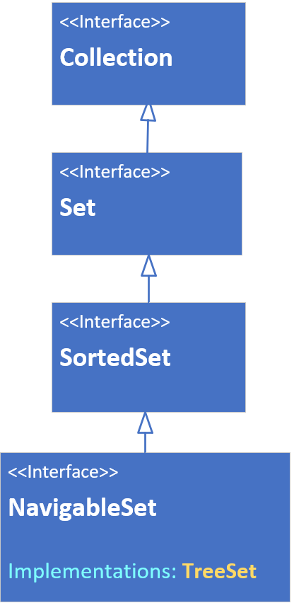
The TreeSet interface hierarchy
A TreeSet can be declared or passed to arguments typed with any of the interfaces shown on this slide.
This class is sorted, and implements the SortedSet interface, which has such methods as first, last, headSet and tailSet, and comparator.
This set also implements the NavigableSet Interface, so it has methods such as ceiling, floor, higher, lower, descendingSet and others.
COMPLETE JAVA MASTERCLASS
LinkedHashSet and TreeSet

Slide 78
The TreeSet relies on Comparable or Comparator methods
Elements which implement Comparable (said to have a natural order sort, like Strings and numbers) can be elements of a TreeSet.
If your elements don't implement Comparable, you must pass a Comparator to the constructor.
COMPLETE JAVA MASTERCLASS
LinkedHashSet and TreeSet

Slide 79
NavigableSet methods to get closest matches
All the methods shown on this slide take an element as an argument, and return an element in the set, the closest match to the element passed.
Element passed as the argument | Result From Methods
 | floor(E) (<=) | lower(E) (<) | ceiling(E) (>=) | higher(E) (>)
In Set | Matched Element | Next Element < Element or null if none found | Matched Element | Next Element > Element or null if none found
Not in Set | Next Element < Element | Next Element < Element or null if none found | Next Element > Element | Next Element > Element or null if none found
COMPLETE JAVA MASTERCLASS
TreeSet, Closest match and subset methods

Slide 80
Getting subsets from a TreeSet.
All three methods, headSet, tailSet and subSet return a subset of elements, backed by the original set.
sub set methods | inclusive | description
headSet(E toElement) headSet(E toElement, boolean inclusive) | toElement is exclusive if not specified | returns all elements less than the passed toElement (unless inclusive is specifically included).
tailSet(E fromElement) tailSet(E toElement, boolean inclusive) | fromElement is inclusive if not specified | returns all elements greater than or equal to the fromElement (unless inclusive is specifically included).
subSet(E fromElement, E toElement) subSet(E fromElement, boolean fromInclusive, E toElement, boolean toInclusive) | fromElement is inclusive if not specified, toElement is exclusive if not specified | returns elements greater than or equal to fromElement and less than toElement.
COMPLETE JAVA MASTERCLASS
TreeSet, Closest match and subset methods

Slide 81
When would you use a TreeSet?
The TreeSet does offer many advantages, in terms of built-in functionality over the other two Set implementations, but it does come at a higher cost.
If your number of elements is not large, or you want a collection that's sorted, and continuously re-sorted as you add and remove elements, and that shouldn't contain duplicate elements, the TreeSet is a good alternative to the ArrayList.
COMPLETE JAVA MASTERCLASS
TreeSet, Closest match and subset methods

Slide 82
The TreeSet Challenge (Theatre Seating)
In this challenge, you'll be creating a Theatre class, that has a set of seats.
The Seat class should be a nested class on the Theatre class.
A Seat should be constructed with a row character and an integer, that represents the seat number within the row.
Each Seat should have a string, a seat number, in the format 'A005', where A is the row number, and 005 is the seat number within the row, It should be zero padded up to three digits.
Seat should also have a field, a boolean, indicating if the seat is reserved or not.
COMPLETE JAVA MASTERCLASS
TreeSet Challenge (Theatre Seats)

Slide 83
The TreeSet Challenge (Theatre Seating)
The theatre class should have three fields, theatre name, an integer for seats in row, how many seats are in a single row in other words, and a field for the seats themselves.
This last field should be a TreeSet.
A Theatre instance should be constructed with the theatre name, the number of rows in the theatre, and the number of seats total in the theatre.
For simplicity, assume there are a uniform number of seats in every row, and the number of rows should never exceed 26, so the rows will be labeled A through Z.
COMPLETE JAVA MASTERCLASS
TreeSet Challenge (Theatre Seats)

Slide 84
The TreeSet Challenge (Theatre Seating)
You should create the seats, and number them, as part of the initialization of a theatre class.
The theatre class should also have a printSeatMap method, that prints each seat, with each row printed on a separate line.
You should allow a booking agent to reserve a single seat, and the printed seat map should show which seats are reserved.
COMPLETE JAVA MASTERCLASS
TreeSet Challenge (Theatre Seats)

Slide 85
The Theatre Challenge Bonus
If you want an extra challenge, create a second method on theatre, that lets an agent specify.
the number of reservations being requested.
a range of rows (from A to C for example, for front row seats).
a range of seats (a number greater than or equal to 1, and less than or equal to the rows per seat).
The seats that get reserved, should be contiguous within a row.
COMPLETE JAVA MASTERCLASS
TreeSet Challenge (Theatre Seats)

Slide 86
The Theatre Challenge Bonus
Create a second method on the Theatre class, that lets an agent reserve a number of seats, contiguous within a row.
The parameters should be:
the number of reservations being requested.
a range of rows (from A to C for example, for front row seats).
a range of seats (a number greater than or equal to 1, and less than or equal to the rows per seat).
COMPLETE JAVA MASTERCLASS
TreeSet Challenge (Theatre Seat Bonus)

Slide 87
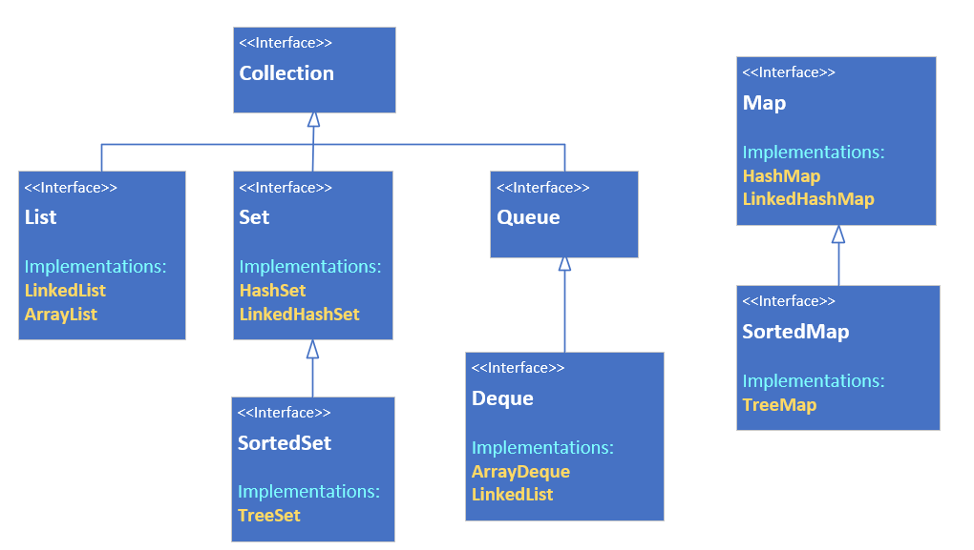
The Map Interface, why is it different?
From this diagram on the slide, you can obviously see the Map is out here on its own.
COMPLETE JAVA MASTERCLASS
The Map Interface and functionality

Slide 88
The Map Interface, why is it different?
A map in the collections framework is another data structure.
Although it's still a grouping of elements, it's different, because elements are stored with keyed references.
This means a Map requires two type arguments, as you can see on this slide, where I'm showing the root interface, Collection, compared to the Map interface.
The Map has K for it's key type, and V for the value type.
As with any generic classes, the only restriction on these types is, they must be reference types, and not primitives.
Collection Interface | Map Interface
COMPLETE JAVA MASTERCLASS
The Map Interface and functionality

Slide 89
Map characteristics
A Java Map can't contain duplicate keys.
Each key can only map to a single value.
COMPLETE JAVA MASTERCLASS
The Map Interface and functionality

Slide 90
Map Implementations (the classes that implement Map)
In the next few lectures, I'll be looking at 3 of the Java classes that implement the map interface, the HashMap, the LinkedHashMap, and the TreeMap.
The HashMap is unordered, the LinkedHashMap is ordered by insertion order, and the TreeMap is a sorted map.
COMPLETE JAVA MASTERCLASS
The Map Interface and functionality

Slide 91
What's a view?
The view, or view collection as Java calls it, doesn't store elements, but depends on a backing collection that stores the data elements.
You saw this with the headSet, tailSet and subSet methods on Sets.
You're also very familiar now, with a list backed by an array, a view we get back, when we use the Arrays.asList method, to get an array in the form of a list.
You'll remember when we make changes to that list, the changes are reflected in the underlying array, and vice versa.
The functionality available to us on the list, is limited to features supported by the backing storage, so for a list backed by an array, we can't add or remove elements as an example.
COMPLETE JAVA MASTERCLASS
Working with Map's view collections (keySet, values, entrySet)

Slide 92
The purpose of view collections
Some of you might be familiar with database views which hide the details of the underlying data structures, to make it easier for clients to use the data.
These view collections serve a similar purpose.
They let us manipulate the collections, without really having to know exact details, about the storage of the data.
In other words, we don't have to keep learning new methods, to manipulate data.
As long as we can get a collection view of the data, we can use many of the collection methods, to simplify our work.
COMPLETE JAVA MASTERCLASS
Working with Map's view collections (keySet, values, entrySet)

Slide 93
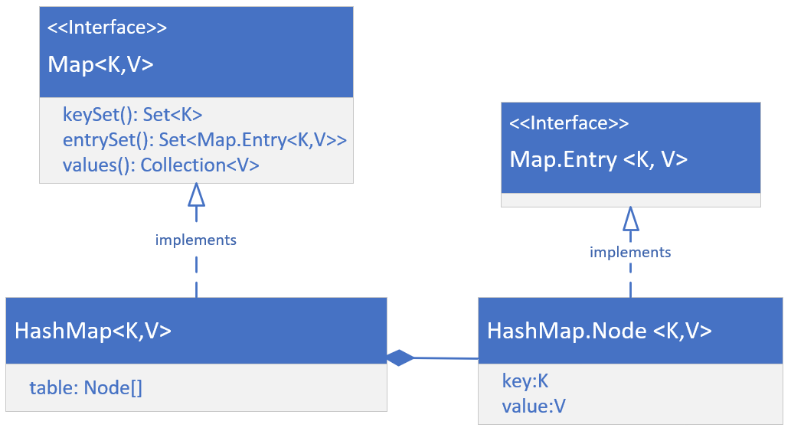
The HashMap's implementation
On this slide, I'm showing you a high level overview of the structure of the HashMap class.
First, it's important to know that there's a static nested interface on the Map interface, and it's name is Entry.
COMPLETE JAVA MASTERCLASS
Working with Map's view collections (keySet, values, entrySet)

Slide 94
The HashMap's implementation
Concrete classes, implement both the Map interface, and the Map.Entry interface.
The HashMap implements Map, and has a static nested class, Node, that implements the Map.Entry interface.
The HashMap maintains an array of these Nodes, in a field called table, whose size is managed by Java, and whose indices are determined by hashing functions.
For this reason, a HashMap is not ordered.
COMPLETE JAVA MASTERCLASS
Working with Map's view collections (keySet, values, entrySet)

Slide 95
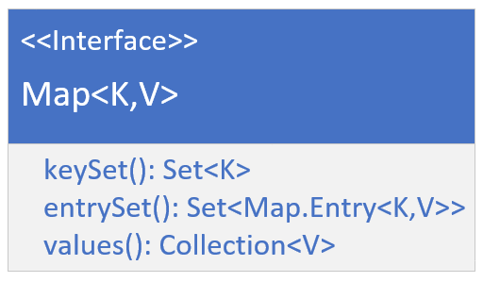
The Map's view collections
I want to focus now on the three view collections we can get from the map, which are the key set, the entry set, and the values.
We know a map has keys, and these can't contain duplicates.
These keys can be retrieved as a Set view, by calling the keySet method on any map object.
Each key value pair is stored as an instance of an Entry, and the combination of the key and value will be unique, because the key is unique.
COMPLETE JAVA MASTERCLASS
Working with Map's view collections (keySet, values, entrySet)

Slide 96
The Map's view collections
A Set view of these entries, or nodes in the case of the HashMap, can be retrieved from the method entrySet.
Finally, values are stored, and referenced by the key, and values can have duplicates, meaning multiple keys could reference a single value.
You can get a Collection view of these, from the values method, on a map instance.
COMPLETE JAVA MASTERCLASS
Working with Map's view collections (keySet, values, entrySet)

Slide 97
Functionality available to set returned from keySet()
The set returned from the keySet method, is backed by the map.
This means changes to the map are reflected in the set, and vice-versa.
The set supports element removal, which removes the corresponding mapping from the map.
You can use the methods remove, removeAll, retainAll, and clear.
It does not support the add or addAll operations.
COMPLETE JAVA MASTERCLASS
Working with Map's view collections (keySet, values, entrySet)

Slide 98
The Adventure Game
In this challenge, you'll be creating a text based game, using a HashMap.
This game will be loosely based on the original Colossal Cave Adventure, which was one of the first adventure games, that came out years and years ago.
COMPLETE JAVA MASTERCLASS
HashMap Challenge, A Text-Based Adventure Game

Slide 99
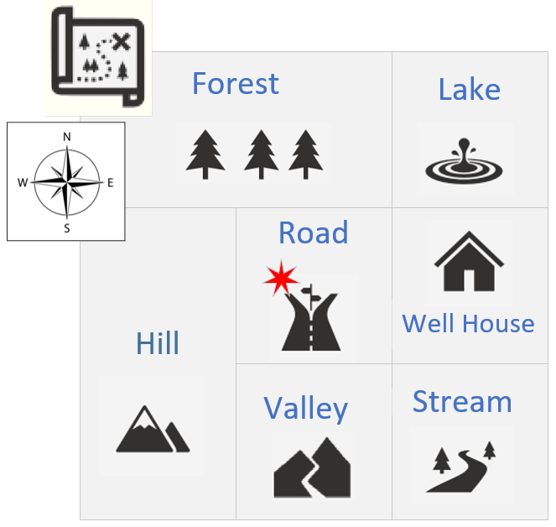
The Adventure Game's Conceptual Map
This slide shows a conceptual map of the game I want you to build.
The game starts, with the user standing in a road, in the center of the map.
North would take the user to the Forest, South would take the user to the Valley, East would be the well house, and West would be the Hill.
COMPLETE JAVA MASTERCLASS
HashMap Challenge, A Text-Based Adventure Game

Slide 100
The Adventure Game
You'll want to use two HashMaps in this challenge, one for the board locations, and one for the next places data.
This slide shows one way to structure your data.
key (String) | value (Location)
String | Description: String | Next Places: Map
"stream" | "near a stream with a rocky bed" | key | value
 |  | W | "valley"
 |  | N | "well house"
"well house" | "inside a well house for a small spring" | key | value
 |  | W | "road"
 |  | N | "lake"
 |  | S | "stream"
COMPLETE JAVA MASTERCLASS
HashMap Challenge, A Text-Based Adventure Game

Slide 101
The Adventure Game
Use a HashMap for the game board locations, keyed on a short descriptor, road or stream, for example, or some other key of your choice.
Your Location class should have a location description, and could also have a field, a HashMap, to store next places to go from there.
key (String) | value (Location)
String | Description: String | Next Places: Map
"stream" | "near a stream with a rocky bed" | key | value
 |  | W | "valley"
 |  | N | "well house"
"well house" | "inside a well house for a small spring" | key | value
 |  | W | "road"
 |  | N | "lake"
 |  | S | "stream"
COMPLETE JAVA MASTERCLASS
HashMap Challenge, A Text-Based Adventure Game

Slide 102
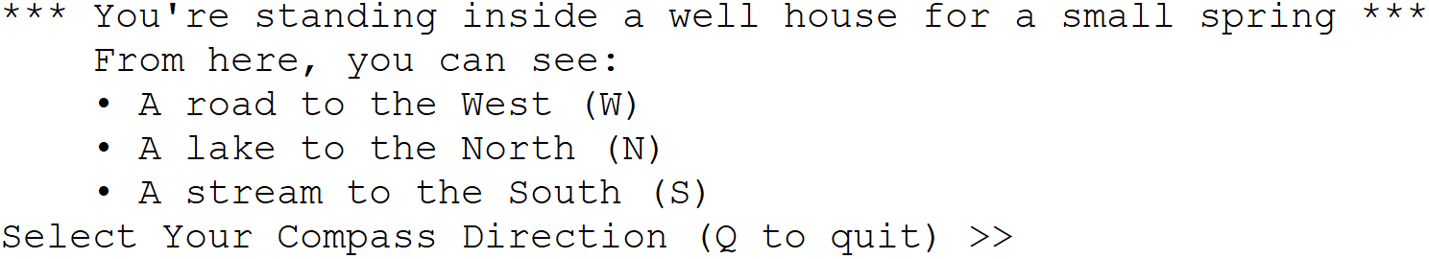
The Adventure Game
Use the console to describe to the player what their current location is, (starting at the road), and show them what options they have to go from here.
Prompt the player to enter the direction they want to go next.
Continue to play until the user quits, Q for quit for example.
COMPLETE JAVA MASTERCLASS
HashMap Challenge, A Text-Based Adventure Game

Slide 103
The Adventure Game Bonus
A bonus part of the challenge is to allow customizations to the board locations, as well as the next place directions.
COMPLETE JAVA MASTERCLASS
HashMap Challenge, A Text-Based Adventure Game

Slide 104
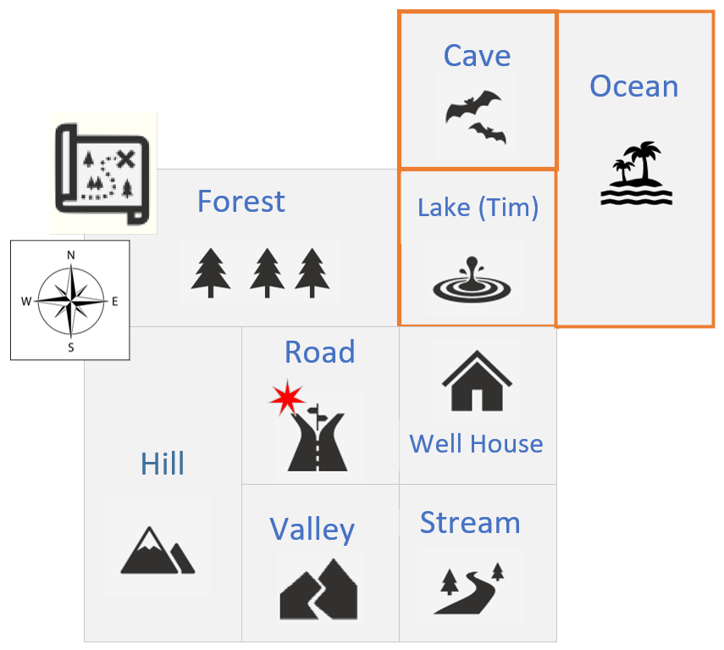
My Custom Board Locations
Lake is already in my map, but I want to customize it, first by describing it, naming it Lake Tim, and then adding two additional destinations from there, a cave to the north, and an ocean to the east.
The cave and ocean will be additional board locations.
Right now, from the lake, I can only go west to the forest, or south to the well house.
COMPLETE JAVA MASTERCLASS
Adventure Game, Continued

Slide 105
Ordered and Sorted Map implementations
The Map interface has the LinkedHashMap and TreeMap classes.
The LinkedHashMap is a key value entry collection, whose keys are ordered by insertion order.
The TreeMap is sorted by it's keys, so a key needs to implement Comparable, or be initialized, with a specified Comparator.
COMPLETE JAVA MASTERCLASS
LinkedHashMap and TreeMap

Slide 106
TreeMap's View collections
View collection methods | Notes
entrySet(), keySet(), values() | Provides views of mappings, keys and values. These are views available to any map, and not just the TreeMap. I include them here, to remind you, These are views.
descendingKeySet() descendingKeyMap() | Provides reversed order key set or map, reversed by the key values.
headMap(K key) headMap(K key, boolean inclusive) tailMap(K key) tailMap(K key, boolean inclusive) | Provides views of either the first or last parts of the map, divided by the key passed. The head map is by default EXCLUSIVE of all elements higher or equal to the key. The tail map is by default INCLUSIVE of all elements higher or equal to the key.
subMap(K fromKey, K toKey) subMap(K fromKey, boolean inclusive, K toKey, boolean inclusive). | Provides a view of a contiguous section of the map, higher or equal to the fromkey and lower than the toKey, so the toKey is EXCLUSIVE. The overloaded version allows you to determine the inclusivity you want for both keys.
COMPLETE JAVA MASTERCLASS
Working with TreeMap (NavigableMap) methods

Slide 107
EnumSet and EnumMap
Before we move on, I want to talk about two more classes in the collections framework, specifically created to support enum types more efficiently.
You can use any List, Set, or Map, with an enum constant.
The EnumSet, and EnumMap, each has a special implementation that differs from the HashSet or HashMap.
These implementations make these two types extremely compact and efficient.
There's no special list implementation for enum types.
COMPLETE JAVA MASTERCLASS
Targeted Collections for enum types

Slide 108
The EnumSet
The EnumSet is a specialized Set implementation for use with enum values.
All of the elements in an EnumSet must come from a single enum type.
The EnumSet is abstract, meaning we can't instantiate it directly.
It comes with many factory methods to create instances.
In general, this set has much better performance than using a HashSet, with an enum type.
Bulk operations (such as containsAll and retainAll) should run very quickly, in constant time, O(1), if they're run on an enumSet, and their argument is an EnumSet.
COMPLETE JAVA MASTERCLASS
Targeted Collections for enum types

Slide 109
The EnumMap
The Enum Map is a specialized Map implementation for use with enum type keys.
The keys must all come from the same enum type, and they're ordered naturally by the ordinal value of the enum constants.
This map has the same functionality as a HashMap, with O(1) for basic operations.
The enum key type is specified during construction of the EnumMap, either explicitly by passing the key type's class, or implicitly by passing another EnumSet.
In general, this map has better performance than using a HashMap, with an enum type.
COMPLETE JAVA MASTERCLASS
Targeted Collections for enum types

Slide 110
Two Types of EnumSet implementations
Enum sets are represented internally as bit vectors, which is just a series of ones and zeros.
A one indicates that the enum constant (with an ordinal value that is equal to the index of the bit) is in the set.
A zero indicates the enum constant is not in the set.
Using a bit vector allows all set operations to use bit math, which makes it very fast.
A RegularEnumSet uses a single long as its bit vector, which means it can contain a maximum of 64 bits, representing 64 enum values.
A JumboEnumSet gets returned if you have more than 64 enums.
COMPLETE JAVA MASTERCLASS
Targeted Collections for enum types

Slide 111
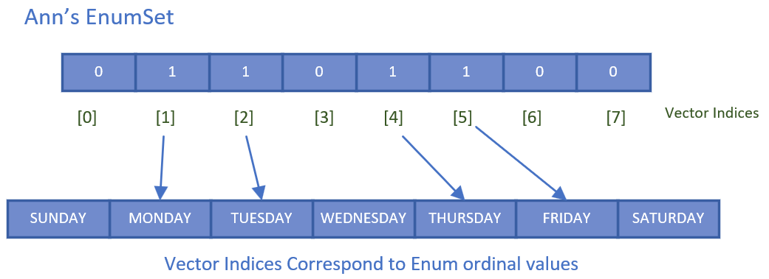
Ann's Work Day EnumSet
This slide is a visual representation of the EnumSet for Ann's work days.
It's size is 7, for the 7 possible values (based on the number of constants in the WeekDay Enum).
Any weekday that's part of her set, will be set to 1, at the index that corresponds to, the weekday ordinal value.
COMPLETE JAVA MASTERCLASS
Targeted Collections for enum types

Slide 112
Ann's Work Day EnumSet
MONDAY has an ordinal value of 1 in our WeekDays enum, and the value in the underlying bit vector, at position 1, is a 1.
This means MONDAY is part of Ann's EnumSet.
COMPLETE JAVA MASTERCLASS
Targeted Collections for enum types

Slide 113
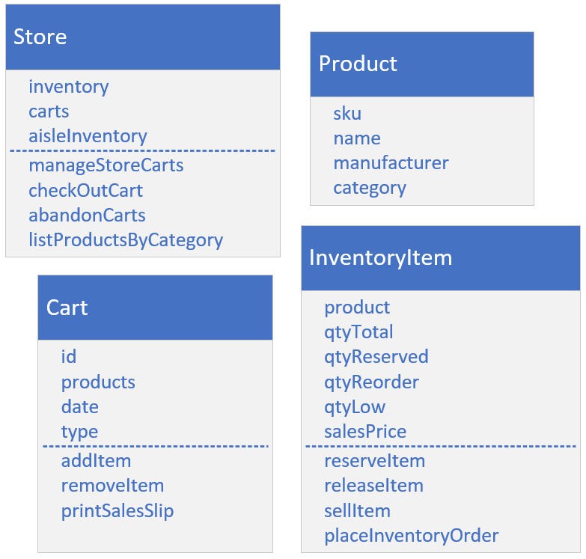
Build a Store's Inventory System
Using some combination of the classes in the Collections Framework, see if you can create the classes and methods shown on this slide.
I'm purposely excluding types and relationships here.
This is called a conceptual model, where you start by drawing the needs of the system, and identifying fields and methods.
COMPLETE JAVA MASTERCLASS
Collections Framework Final Challenge (The Setup)

Slide 114
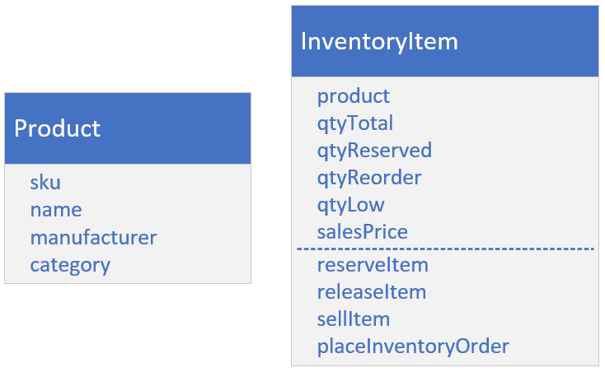
Product and InventoryItem
A product's information is defined by its manufacturer, so assume the information on Product isn't mutable.
A sku is short for stock keeping unit, and is a unique identifier for the product.
The category should be one of a defined set of categories, like product or dairy for example, for a grocery item.
The inventory item is the store's information specific to the product, like price and quantities of each product in stock.
COMPLETE JAVA MASTERCLASS
Collections Framework Final Challenge (The Setup)

Slide 115
Product and InventoryItem
The total quantity is the amount that's still in stock, so it could be in any of your carts, on your aisles, or in your warehouse.
The qty that's reserved is the product that's in the carts, but not yet sold.
The qty reorder amount is what you'd use to order more product.
The low quantity is the trigger, or threshold, to order more product.
When the low qty is reached, your system should order more product.
COMPLETE JAVA MASTERCLASS
Collections Framework Final Challenge (The Setup)

Slide 116
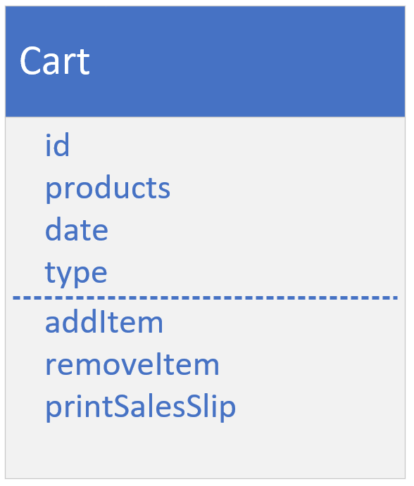
The Cart
The cart type has an id, and a collection of products, that changes as a shopper puts in new items, or removes them from their cart.
The cart will have a date, and also a type, to indicate if the type is physical or virtual.
COMPLETE JAVA MASTERCLASS
Collections Framework Final Challenge (The Setup)

Slide 117
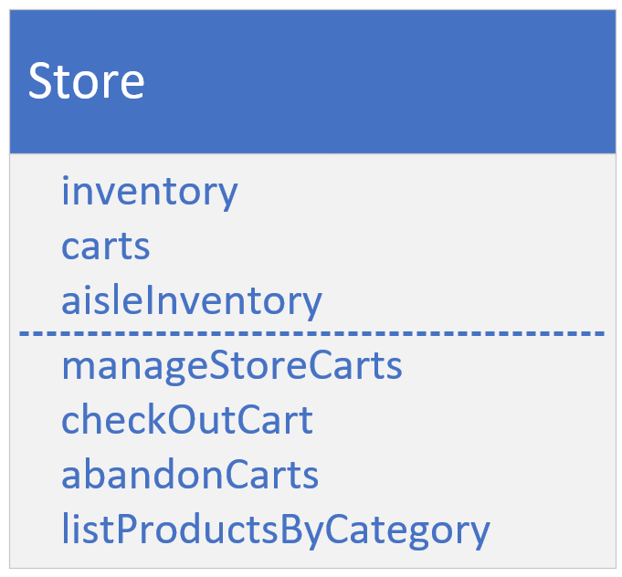
The Store
Each of the fields on the Store class are collections.
Which you choose is up to you.
Inventory is a collection of Inventory Items.
Carts is a collection of carts.
The aisle Inventory is the inventory that's displayed physically on store shelves.
You can assume aisles can be keyed by the product category.
Your store should have a method to abandon physical and virtual carts, if the date associated with the cart, is different than the current date.
COMPLETE JAVA MASTERCLASS
Collections Framework Final Challenge (The Setup)

Slide 118
Try to use a variety of Collections Framework implementations and methods
Think about the fields that would use collections, and the types you have to choose from.
You can also use collections to help you manage some of the functionality in the methods.
Remember the three interfaces, List, Set, and Map, and the classes that implement these interfaces.
Do you need to allow duplicates in the collection?
Do you need things to be sorted?
Is insertion order good enough?
Do you need a way to organize the data into a key value system, to make some of the operations easier?
COMPLETE JAVA MASTERCLASS
Collections Framework Final Challenge (The Setup)

Slide 119
Try to use a variety of Collections Framework implementations and methods
What methods on the Collections classes might be useful for some of this functionality?
Would set math be useful?
Or would navigational methods be simpler?
Are there any methods on the Collections class that would make sense to use here?
COMPLETE JAVA MASTERCLASS
Collections Framework Final Challenge (The Setup)

