Slide 1

Mutable vs Immutable
Objects have state, which is the data stored in instance fields.
State can change after an object is created, either intentionally or unintentionally.
When state remains constant throughout the lifetime of the object, and code is prevented from changing the state, this object is called an immutable object.
An immutable object is an object whose internal state remains constant.
A mutable object is an object whose internal state does not remain constant.
Which is better?
Well, like anything else, that depends.
COMPLETE JAVA MASTERCLASS
Introduction

Slide 2
Immutable Objects - Advantages
Working with immutable objects has some advantages.
An immutable object isn't subject to unwanted, unplanned and unintended modifications, known as side-effects.
An immutable class is inherently thread-safe, because no threads at all can change it, once it's been constructed.
This allows us to use more efficient collections and operations, which don't have to manage synchronization of access to this object.
These are two of the most important advantages.
COMPLETE JAVA MASTERCLASS
Introduction

Slide 3
Immutable Objects - Disadvantages
Working with immutable objects has some disadvantages.
An immutable object can’t be modified after it's been created.
This means that when a new value is needed, you're probably going to need to make a copy of the object with the new value.
Hopefully, you'll remember the discussion comparing String vs. StringBuilder from earlier in the course.
If you're constantly needing to alter text values, it's more efficient to use a mutable object like a StringBuilder instance, then generating a lot of new String objects.
COMPLETE JAVA MASTERCLASS
Introduction

Slide 4
Classes must be designed to produce Immutable Objects
I'll be talking about immutable class design coming up.
It's important to understand that POJOs and Java Beans, which many code generation tools create, are not by design, immutable, and therefore this architecture may not be the preferred design for your class.
This all sounds rather simple, yet there are many topics related to it.
One of the most useful tools in our arsenal to build immutable classes, is the final access modifier.
I'll be revisiting this modifier in much more detail in the next video, so let's get going.
COMPLETE JAVA MASTERCLASS
Introduction

Slide 5
The final modifier in Java
When you use the final modifier, you prevent any further modifications to that component.
A final method means it can't be overridden by a subclass.
A final field means an object's field can't be reassigned or given a different value, after its initialization.
A final static field is a class field that can't be reassigned, or given a different value, after the class's initialization process. A field declared on an Interface is always public, static and final.
A final class can't be overridden, meaning no class can use it in the extends clause.
A final variable in a block of code, means that once it's assigned a value, any remaining code in the block can't change it.
A final method parameter means that you can't assign a different value to that parameter in the method code block.
COMPLETE JAVA MASTERCLASS
Revisiting the final modifier

Slide 6
The final modifier in Java
When you use the final modifier, you prevent any further modifications to that component.
A final method means it can't be overridden by a subclass.
A final field means an object's field can't be reassigned or given a different value, after its initialization.
A final static field is a class field that can't be reassigned, or given a different value, after the class's initialization process. A field declared on an Interface is always public, static and final.
A final class can't be overridden, meaning no class can use it in the extends clause.
A final variable in a block of code, means that once it's assigned a value, any remaining code in the block can't change it.
A final method parameter means that you can't assign a different value to that parameter in the method code block.
COMPLETE JAVA MASTERCLASS
Revisiting the final modifier

Slide 7
The final modifier in Java
When you use the final modifier, you prevent any further modifications to that component.
A final method means it can't be overridden by a subclass.
A final field means an object's field can't be reassigned or given a different value, after its initialization.
A final static field is a class field that can't be reassigned, or given a different value, after the class's initialization process. A field declared on an Interface is always public, static and final.
A final class can't be overridden, meaning no class can use it in the extends clause.
A final variable in a block of code, means that once it's assigned a value, any remaining code in the block can't change it.
A final method parameter means that you can't assign a different value to that parameter in the method code block.
COMPLETE JAVA MASTERCLASS
Revisiting the final modifier

Slide 8
The final modifier in Java
When you use the final modifier, you prevent any further modifications to that component.
A final method means it can't be overridden by a subclass.
A final field means an object's field can't be reassigned or given a different value, after its initialization.
A final static field is a class field that can't be reassigned, or given a different value, after the class's initialization process. A field declared on an Interface is always public, static and final.
A final class can't be overridden, meaning no class can use it in the extends clause.
A final variable in a block of code, means that once it's assigned a value, any remaining code in the block can't change it.
A final method parameter means that you can't assign a different value to that parameter in the method code block.
COMPLETE JAVA MASTERCLASS
Revisiting the final modifier

Slide 9
The final modifier in Java
When you use the final modifier, you prevent any further modifications to that component.
A final method means it can't be overridden by a subclass.
A final field means an object's field can't be reassigned or given a different value, after its initialization.
A final static field is a class field that can't be reassigned, or given a different value, after the class's initialization process. A field declared on an Interface is always public, static and final.
A final class can't be overridden, meaning no class can use it in the extends clause.
A final variable in a block of code, means that once it's assigned a value, any remaining code in the block can't change it.
A final method parameter means that you can't assign a different value to that parameter in the method code block.
COMPLETE JAVA MASTERCLASS
Revisiting the final modifier

Slide 10
The final modifier in Java
When you use the final modifier, you prevent any further modifications to that component.
A final method means it can't be overridden by a subclass.
A final field means an object's field can't be reassigned or given a different value, after its initialization.
A final static field is a class field that can't be reassigned, or given a different value, after the class's initialization process. A field declared on an Interface is always public, static and final.
A final class can't be overridden, meaning no class can use it in the extends clause.
A final variable in a block of code, means that once it's assigned a value, any remaining code in the block can't change it.
A final method parameter means that you can't assign a different value to that parameter in the method code block.
COMPLETE JAVA MASTERCLASS
Revisiting the final modifier

Slide 11
The final modifier in Java
When you use the final modifier, you prevent any further modifications to that component.
A final method means it can't be overridden by a subclass.
A final field means an object's field can't be reassigned or given a different value, after its initialization.
A final static field is a class field that can't be reassigned, or given a different value, after the class's initialization process. A field declared on an Interface is always public, static and final.
A final class can't be overridden, meaning no class can use it in the extends clause.
A final variable in a block of code, means that once it's assigned a value, any remaining code in the block can't change it.
A final method parameter means that you can't assign a different value to that parameter in the method code block.
COMPLETE JAVA MASTERCLASS
Revisiting the final modifier

Slide 12
The final modifier in Java
When you use the final modifier, you prevent any further modifications to that component.
A final method means it can't be overridden by a subclass.
A final field means an object's field can't be reassigned or given a different value, after its initialization.
A final static field is a class field that can't be reassigned, or given a different value, after the class's initialization process. A field declared on an Interface is always public, static and final.
A final class can't be overridden, meaning no class can use it in the extends clause.
A final variable in a block of code, means that once it's assigned a value, any remaining code in the block can't change it.
A final method parameter means that you can't assign a different value to that parameter in the method code block.
COMPLETE JAVA MASTERCLASS
Revisiting the final modifier

Slide 13
Using the final modifier on methods
You can use the final modifier on methods.
Using final with methods only makes sense in the context of wanting to restrict what your subclasses can override or hide.
Using final on an instance method means subclasses can't override it.
Using final on a class (static) method means subclasses can't hide it.
COMPLETE JAVA MASTERCLASS
Revisiting the final modifier

Slide 14
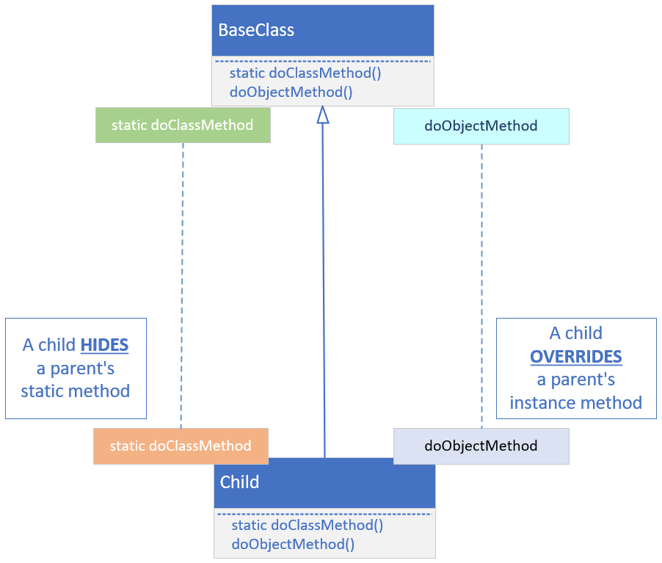
Hiding vs. Overriding
COMPLETE JAVA MASTERCLASS
The final modifier applied to methods, and local variables

Slide 15
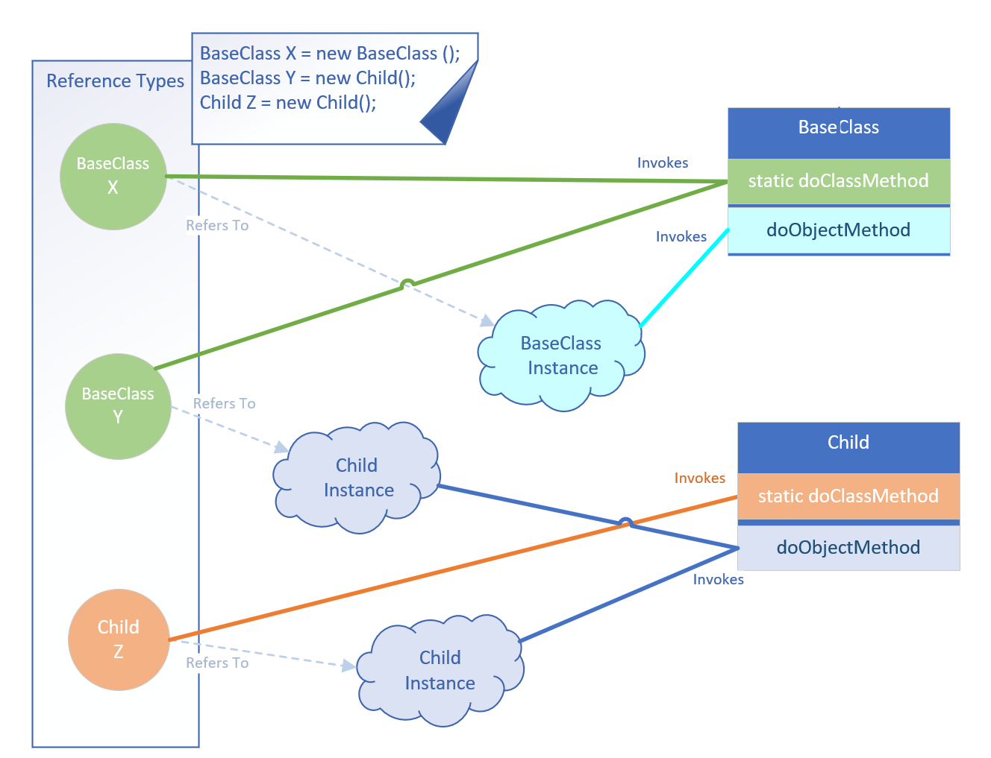
Hiding vs. Overriding
COMPLETE JAVA MASTERCLASS
The final modifier applied to methods, and local variables

Slide 16
Recommendation: Always use the type, to invoke the static method
Best practice recommends always using the type reference when executing a static method.
If you're hiding a static method on a parent class, make sure you understand what the implications are for doing this.
If you stick to using a qualifier, the type reference, to execute the specific static method, you'll avoid the confusion shown on the previous slide.
COMPLETE JAVA MASTERCLASS
The final modifier applied to methods, and local variables

Slide 17
Using final for variables
It's important to understand that when you use final, it doesn't mean the variable is immutable at that point.
It means you can't assign or reassign a new instance or variable or expression to it, after the initialization.
If you use final for a local variable in a code block, you can only initialize it fully, or assign it a value, just once.
Any other additional assignments will result in a compiler error.
If you use final for method parameters, this means you cannot assign any values to the method parameters in the code.
COMPLETE JAVA MASTERCLASS
The final modifier applied to methods, and local variables

Slide 18
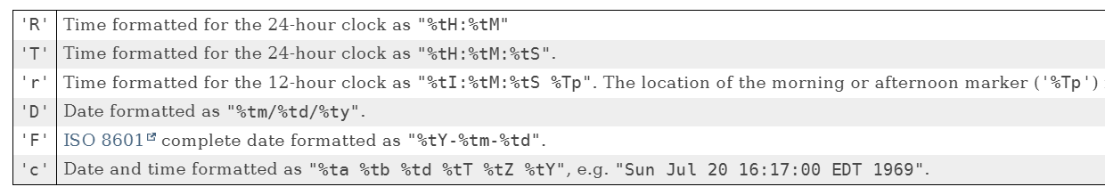
Formatting Date Time
There are many ways to format date and time.
A couple of standardized ones are shown here.
These apply to the formatted method on String, as well as the printf method.
This information was retrieved from the link I show here.
https://docs.oracle.com/en/java/javase/17/docs/api/java.base/java/util/Formatter.html#dt
COMPLETE JAVA MASTERCLASS
When Change isn't good

Slide 19
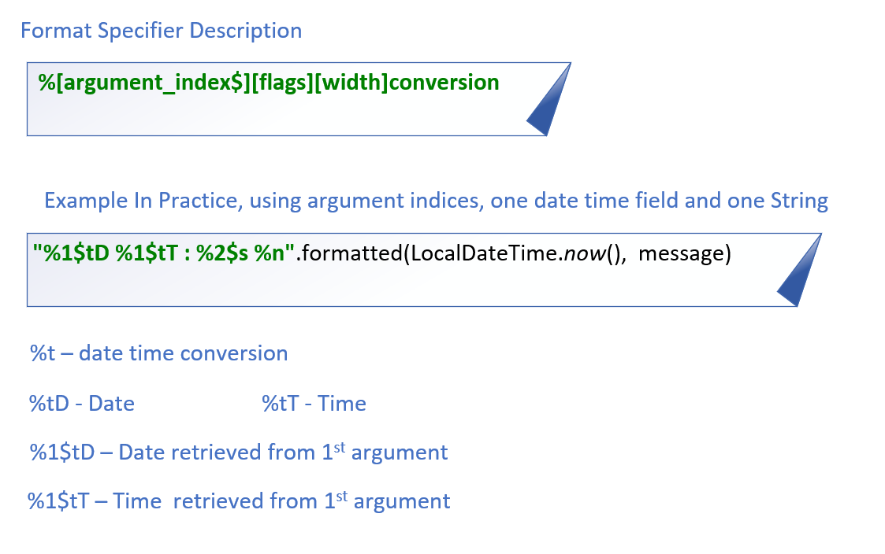
Formatting Date and Time
This slide explains the code I'm using in a bit more detail.
It's common when using date time conversions, to use the argument index feature, which is called Explicit Indexing.
COMPLETE JAVA MASTERCLASS
When Change isn't good

Slide 20
Controlling Change
Java provides mechanisms to control changes, and extensibility of your code, at many different levels.
You can prevent:
Changes to data in Instance fields, which is called the state of the object, by not allowing clients or subclasses to have access to these fields.
Changes to methods, by not allowing code to override or hide existing functionality.
Your classes from being extended.
Instantiation of your classes.
COMPLETE JAVA MASTERCLASS
When Change isn't good

Slide 21
Immutable Object
An immutable object doesn't change state, once it's created.
An immutable object is a secure object, meaning that calling code can't maliciously or mistakenly alter it.
An immutable object simplifies concurrency design.
COMPLETE JAVA MASTERCLASS
Declaring immutable classes to produce immutable objects, Part 1

Slide 22
Strategies for Declaring a Class, to produce immutable objects
This slide describes the strategies of creating a class, that when used, produces immutable objects.
Make instance fields private and final.
Do not define any setter methods.
Create defensive copies in any getters.
Use a constructor or factory method to set data, making copies of mutable reference data.
Mark the class final or make all constructors private.
COMPLETE JAVA MASTERCLASS
Declaring immutable classes to produce immutable objects, Part 1

Slide 23
Need your objects to be mutable?
If your class must be mutable, you should still use some of these techniques to minimize mutability!
COMPLETE JAVA MASTERCLASS
Declaring immutable classes to produce immutable objects, Part 1

Slide 24
Strategies for Declaring a Class, to produce immutable objects
This slide describes the strategies of creating a class, that when used, produces immutable objects.
Make instance fields private and final.
Do not define any setter methods.
Create defensive copies in any getters.
Use a constructor or factory method to set data, making copies of mutable reference data.
Mark the class final, or make all constructors private.
COMPLETE JAVA MASTERCLASS
Declaring immutable classes to produce immutable objects

Slide 25
Challenge: Write Immutable classes for a Bank Account and a Bank Customer.
In this challenge, you should create a BankAccount class.
This should have a type, indicating the type of account, like Checking or Savings or some other type.
It should have a balance, the initial dollar amount in the account.
You should also create a BankCustomer that has a customer name, a customer id, and a List of accounts.
You should use the techniques I discussed in the last videos, to design these classes.
Create a couple of instances of bank customers, confirming that you can't change a Customer's data at all, after it's initialized.
Create a subclass of the bank customer, and confirm that the subclass can't tamper with the customer's data as well.
COMPLETE JAVA MASTERCLASS
Challenge: Write your own immutable classes

Slide 26
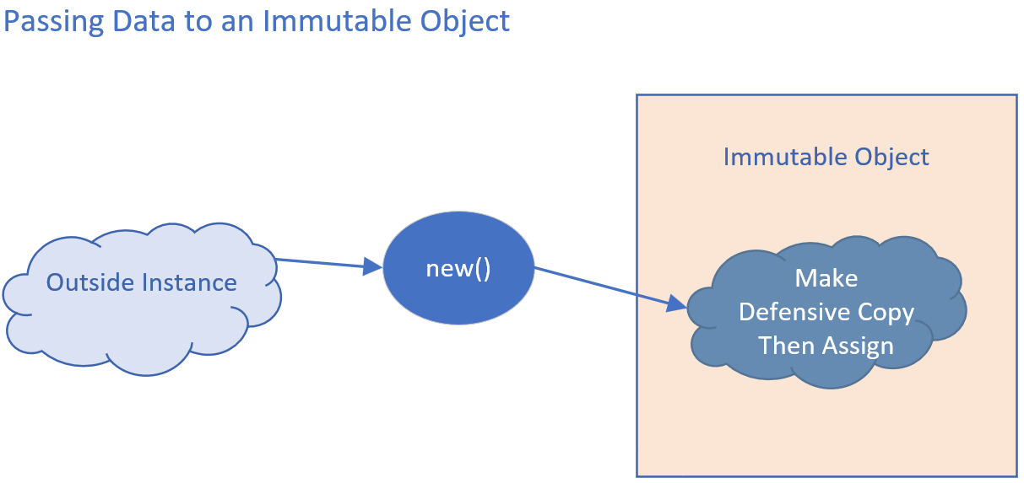
Defensive Copies as input
When you pass mutable types to an immutable object, a defensive copy should be made.
The defensive copy should then be assigned to the instance field.
COMPLETE JAVA MASTERCLASS
Defensive Copies, Shallow and Deep Copies

Slide 27
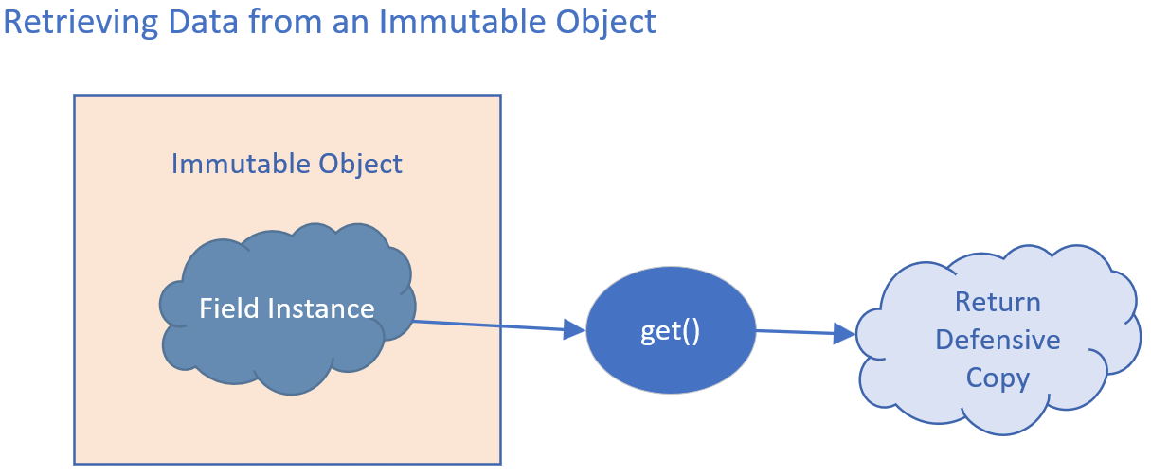
Defensive Copies as output
When you retrieve data, you should first make a defensive copy, and pass the defensive copy back to the calling code.
COMPLETE JAVA MASTERCLASS
Defensive Copies, Shallow and Deep Copies

Slide 28
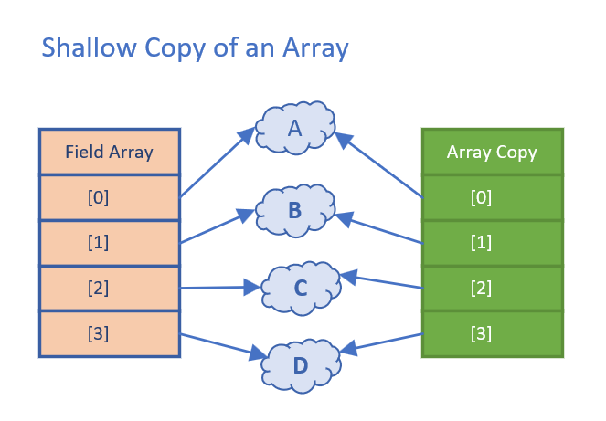
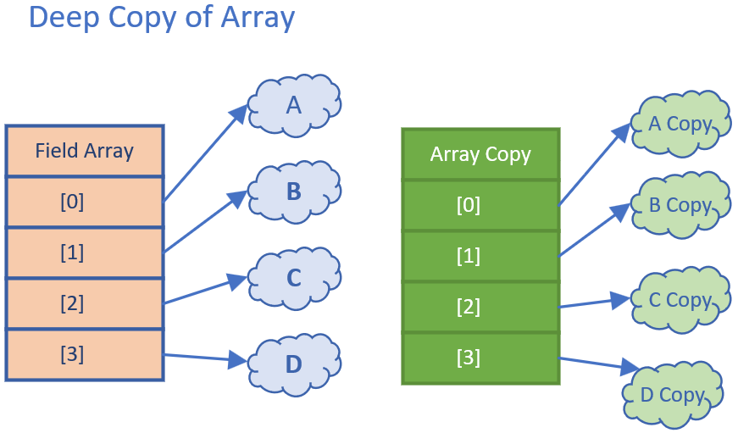
What's a copy? Shallow Copy vs Deep Copy
This slide is showing you two very different copies of an array.
A shallow copy only makes a copy of the structure, and not a copy of the elements in the structure.
A deep copy makes a copy of both the structure, and copies of each element in that structure.
COMPLETE JAVA MASTERCLASS
Defensive Copies, Shallow and Deep Copies

Slide 29
Shallow Copy
When you use copy methods on interfaces and helper classes, the copy that's made will probably be a shallow copy.
A shallow copy of an array, means a new array structure is created, with the same number of indexed positions.
Each indexed position is assigned the same value that was in the previous array, at that same position.
A copy of the referenced element isn't made.
You can see in this diagram, that both arrays, have indexed references, pointing to the same set of instances in memory.
COMPLETE JAVA MASTERCLASS
Defensive Copies, Shallow and Deep Copies

Slide 30
Deep Copy
Deep copies usually have to be manually implemented if you need it.
This slide demonstrates a deep copy of an array.
Each array element has been cloned for the array copy.
Deep copies may need to be applied to arrays and collections, as well as composite classes, to ensure immutability.
COMPLETE JAVA MASTERCLASS
Defensive Copies, Shallow and Deep Copies

Slide 31
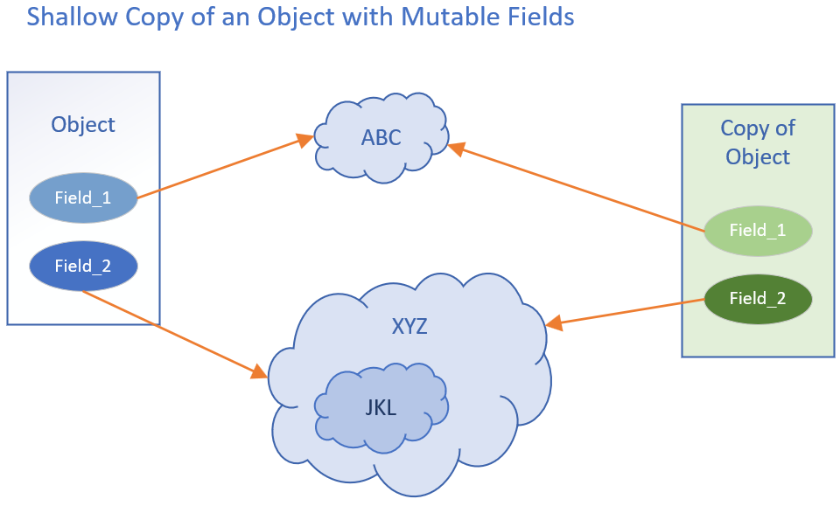
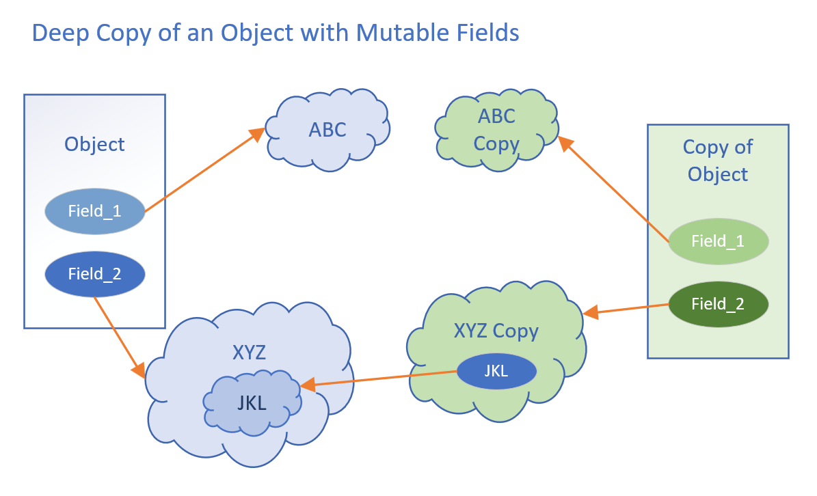
Shallow Copy vs Deep Copy of a composite object
It's not just arrays and collections you need to worry about.
A class can be composed of other classes, meaning its fields are instances of classes.
COMPLETE JAVA MASTERCLASS
Defensive Copies, Shallow and Deep Copies

Slide 32
Shallow Copy vs Deep Copy of a composite object
When you clone or copy this type of object, you may also need to copy or clone the class's more complex fields.
This slide shows a shallow copy of an instance of a composite class, comparing it to a deep copy.
COMPLETE JAVA MASTERCLASS
Defensive Copies, Shallow and Deep Copies

Slide 33
Shallow Copy vs Deep Copy of a composite object
Nesting of a composite class can be multi-leveled, as I show here with the JKL instance.
JKL is a field on XYZ, which is a field on our Object.
The deep copy created new instances of ABC, and XYZ, the fields on the object, as well as a copy Object.
It didn't however make a deep copy of XYZ, which is why JKL is still referencing the same instance, in the original xyz.
COMPLETE JAVA MASTERCLASS
Defensive Copies, Shallow and Deep Copies

Slide 34
Unmodifiable Collections are NOT immutable collections
It is very important to understand that unmodifiable collections are NOT immutable collections.
They become immutable collections, if the elements in the collections themselves are fully immutable.
They are collections with limited functionality that can help us minimize mutability.
You can't remove, add or clear elements from an immutable collection.
You also can't replace or sort elements.
Mutator methods will throw an UnsupportedOperationException.
You can't create this type of collection with nulls.
COMPLETE JAVA MASTERCLASS
Immutable, Unmodifiable Collections and Views

Slide 35
Unmodifiable Collections vs. Unmodifiable Collection Views
The three primary Collection interfaces, List, Set or Map, have methods to get an unmodifiable copy on the specific interface, related to the collection type, as shown,
In addition, the java.util.Collections class offers methods, to get unmodifiable views as shown.
These methods allow us to get closer to the ideal of immutability, if it's needed.
 | Unmodifiable Copy of Collection | Unmodifiable View of Collection
List | List.copyOf List.of | Collections.unmodifiableList
Set | Set.copyOf Set.of | Collections.unmodifiableSet Collections.unmodifiableNavigableSet Collections.unmodifiableSortedSet
Map | Map.copyOf Map.entry(K k, V v) Map.of Map.ofEntries | Collections.unmodifiableMap Collections.unmodifiableNavigableMap Collections. unmodifiableSortedMap
COMPLETE JAVA MASTERCLASS
Immutable, Unmodifiable Collections and Views

Slide 36
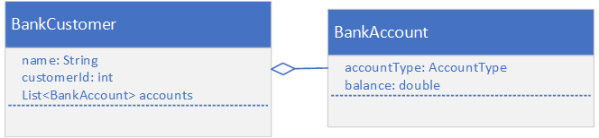
The Banking Account Application from the Immutable Class Challenge
These are the classes we'll be starting with, in this challenge.
COMPLETE JAVA MASTERCLASS
Challenge: Use unmodifiable collections

Slide 37
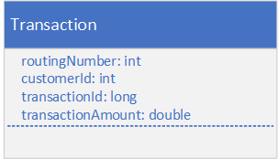
Modify the Banking Account Application from the Immutable Class Challenge
Create a Transaction class in a dev dto package, that might mirror a data table.
This class should have the fields shown here.
Include getters and setters for all fields.
Include a constructor that takes all fields, for ease of use.
COMPLETE JAVA MASTERCLASS
Challenge: Use unmodifiable collections

Slide 38
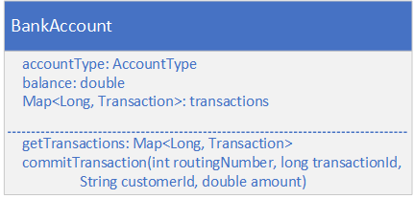
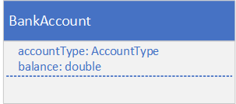
Modify the BankAccount class
For this challenge, you'll modify your BankAccount class.
First, you'll want to change the balance so that it's mutable.
Include a Transaction Collection.
Current | After Modifications (An Example)
COMPLETE JAVA MASTERCLASS
Challenge: Use unmodifiable collections

Slide 39
Modify the BankAccount class
For this challenge, you'll modify your BankAccount class.
Provide a getter, or accessor method, for the transaction data.
Provide a method to adjust the balance, and add the transaction data to the transaction collection.
Current | After Modifications (An Example)
COMPLETE JAVA MASTERCLASS
Challenge: Use unmodifiable collections

Slide 40
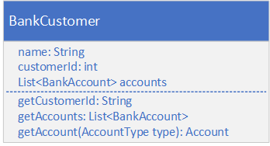
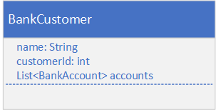
Modify the BankCustomer class
Modify your BankCustomer class.
Return the customer id as a 15 digit string, with leading zeros.
Design this class, so that code in other packages can't instantiate a new Bank Customer.
Return a defensive copy of the accounts, from the getAccounts method.
Current | After Modifications (An Example)
COMPLETE JAVA MASTERCLASS
Challenge: Use unmodifiable collections

Slide 41
Modify the BankCustomer class
Modify your BankCustomer class.
Include a getAccount method to return just one account, based on account type, either savings or checking.
Assume a customer will have one checking account and one savings account.
Current | After Modifications (An Example)
COMPLETE JAVA MASTERCLASS
Challenge: Use unmodifiable collections

Slide 42
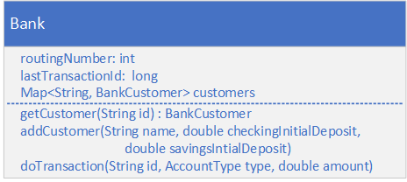
Implement a Bank
Next, you want to create a Bank class, that has a routing number, and a collection of customers, as well as an integer that holds the next transaction id to be assigned.
You should be able to look up a customer by a customer id, a 15 character String.
Transaction id's should be assigned, by using the lastTransactionId field, on this instance of the bank.
A negative amount is a withdrawal, and a positive amount is a deposit.
Don't let the customer's account balance go below zero.
COMPLETE JAVA MASTERCLASS
Challenge: Use unmodifiable collections

Slide 43
Create and use a Bank in the Main's main method
In the Main class's main method.
Create a bank instance, and add a customer.
Let a client get a BankCustomer instance by a customer id, and review transactions from a single selected account. These transactions should not be modifiable, or susceptible to side effects.
You should only be able to perform a withdrawal or deposit of funds, through the Bank Instance, passing the customer id as a String, the type of account this transaction will be against, and the amount. In other words, the main method should not have access to the commit transaction code on the Bank Account itself.
COMPLETE JAVA MASTERCLASS
Challenge: Use unmodifiable collections

Slide 44
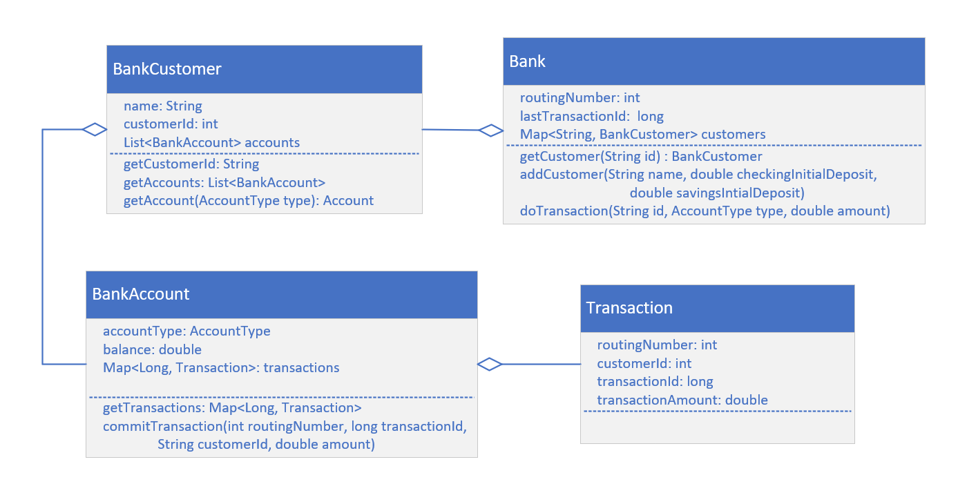
The Class Diagram (as I'll be coding it)
You might want to leave this diagram up as you're coding your own solution, to help you see the big picture.
COMPLETE JAVA MASTERCLASS
Challenge: Use unmodifiable collections

Slide 45
The Class Diagram (as I'll be coding it)
In the last video, I built, and modified the code to support this diagram, with the exception of the Bank class, which I'll be working on now.
COMPLETE JAVA MASTERCLASS
Challenge, Continued: Using unmodifiable collections

Slide 46
Why are we going to talk about constructors again?
These topics are a bit more advanced, and now that you've mastered the basics, it's time to look at these additional features.
In the next couple of videos, I'll be covering.
Initializing final fields.
Initializers, both static and instance.
Record and enum constructors.
COMPLETE JAVA MASTERCLASS
Constructor review, final field initializations, Introduction to Initializers

Slide 47
The instance initializer block
An instance initializer is a block of code declared directly in a class body.
This code gets executed when an instance of the class is created.
Instance initializers are executed, before any code in class constructors is executed.
You can have multiple initializer blocks.
They will be executed in the order they are declared.
COMPLETE JAVA MASTERCLASS
Constructor review, final field initializations, Introduction to Initializers

Slide 48
Static Initializers
A static initializer is called the first time a class is referenced or constructed.
A class can have any number of static initialization blocks.
They can be declared anywhere in the class body.
They're called in the order they appear in the source code.
You might use this to set up some environment data or log information, that's related to the class before it can be used.
Remember, this will get executed only during the class's construction and not each instance's construction.
COMPLETE JAVA MASTERCLASS
Constructor review, final field initializations, Introduction to Initializers

Slide 49
Record Constructors come in three flavors
The Canonical, or Long constructor is the implicitly generated constructor. You can explicitly declare your own, which means the implicit one won't get generated. If you do declare your own, you must make sure fields all get assigned a value.
The Custom constructor is just an overloaded constructor. It must explicitly call the canonical constructor as it's first statement.
The Compact, or Short constructor is a special kind of constructor, used only on records. It's a succinct way of explicitly declaring a canonical constructor.
COMPLETE JAVA MASTERCLASS
Record Constructors (and javap)

Slide 50
The compact constructor
You can't have both a compact constructor and an explicit canonical constructor.
This constructor is declared with no parentheses, so no arguments.
It has access to all the arguments of the canonical constructor. Don't confuse the arguments with the instance fields!
You can't do assignments to the instance fields in this constructor.
The implicit canonical constructor's assignments occur after the execution of this code.
COMPLETE JAVA MASTERCLASS
Record Constructors (and javap)

Slide 51
The Java Class File Disassembler
This is javap.
It lists class members, by default just public and protected members in the class file.
This helps us 'see' implicit code in the compiled class file.
COMPLETE JAVA MASTERCLASS
Record Constructors (and javap)

Slide 52
Creating A Game Console
The game console will be a container to execute some scanner code, to drive a text based game's play.
It'll collect a user name, creating a player from that.
It will start a while loop, displaying a menu of options for a user, then solicit a user's response.
It'll execute a game or player method, based on a user's selected action, and end the game if the action indicates the game is over.
COMPLETE JAVA MASTERCLASS
Game Console Setup, Part 1

Slide 53
GameConsole
This GameConsole class is a container for a game, so it needs a type argument for a game field.
It should also have static scanner field, which uses System.in to get keyboard input.
You should implement two methods on this class.
The addPlayer method will prompt a user for their name, read in the response from the scanner, and delegate to the Game's addPlayer method.
The playGame method will display all available game options, soliciting user input in a while loop, then calling execute the action associated to the input.
The constructor should take a new instance of a Game.
COMPLETE JAVA MASTERCLASS
Game Console Setup, Part 1

Slide 54
The GameAction record
You'll also want to create a GameAction record with three fields.
There should be a key, a char field, which is the key a user would press to select the action.
Next, include a prompt, which is displayed to the user to describe the specific action.
There should be an action field, for a lambda expression or method reference. I'll be using Predicate with an Integer type argument. The integer is the player's index in the player list. A predicate always returns a boolean result. This will be used to continue or end the play.
COMPLETE JAVA MASTERCLASS
Game Console Setup, Part 1

Slide 55
The Player Interface
Next, you'll want to create a Player interface..
The Player interface will have a single abstract method, name, that returns a String.
A game's player should implement this type.
Use this type as a type parameter for Game.
COMPLETE JAVA MASTERCLASS
Game Console Setup, Part 1

Slide 56
The Game Class
The Game class should be abstract and generic, the type parameter should be a type of Player.
This class should have three fields, a gameName, a list of players, and a map of game actions.
Your Game class should have two abstract methods you want any custom game to implement.
The method createNewPlayer will return a new instance of the type used for a player.
The method getGameActions will return a map that associates a character a user would enter, with a prompt and an action to be taken. For example, if a user selects 'Q', this should map to a GameAction record, that has "Quit Program" as the prompt, and a lambda expression, calling the quit method on the game, with a method reference, this::quitGame.
COMPLETE JAVA MASTERCLASS
Game Console Setup, Part 1

Slide 57
The Game Class
This class should have concrete methods, some of which might be overridden by subclasses.
The addPlayer method takes a string for name, creates a player instance, adding it to the Game's player list, and returns that index.
The executeGameAction will call the Predicate's test method, on the lambda expression in the action field, returning the boolean result.
The printPlayer and quitGame methods, are the methods referenced in the GameAction records.
Include getter and helper methods as appropriate.
Finally, create your own simple game, and player type, and test some of the methods on the GameConsole.
COMPLETE JAVA MASTERCLASS
Game Console Setup, Part 1

Slide 58
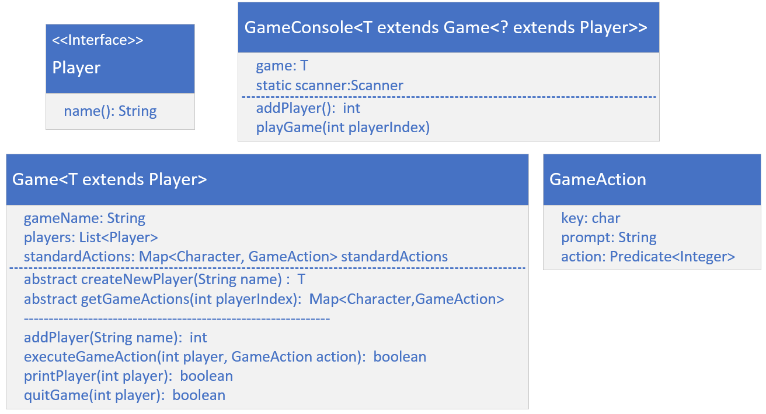
The Conceptual Game Console Application
Here is a model of the types I just explained, which I'll be building.
COMPLETE JAVA MASTERCLASS
Game Console Setup, Part 1

Slide 59
The Initializer Challenge, Pirate Invasion Game
This game will be a Pirate Game, and should extend the Game class we created previously.
It should have a Pirate class, which implements the Player interface.
Your game will have different levels, and each level will have a list of towns, which can be Strings for now.
COMPLETE JAVA MASTERCLASS
Challenge: Initializers and Constructors, A Pirate Game

Slide 60
The Initializer Challenge, Pirate Invasion Game
Use an enum for the Weapon options.
Weapon should have two fields.
Hit points will get deducted from a player hit by this weapon.
Level will be the minimum level needed, to be able to use the weapon.
Use an enum constructor to set this up.
I also want you to think about how you could use instance or static initializers, as you build these types.
COMPLETE JAVA MASTERCLASS
Challenge: Initializers and Constructors, A Pirate Game

Slide 61
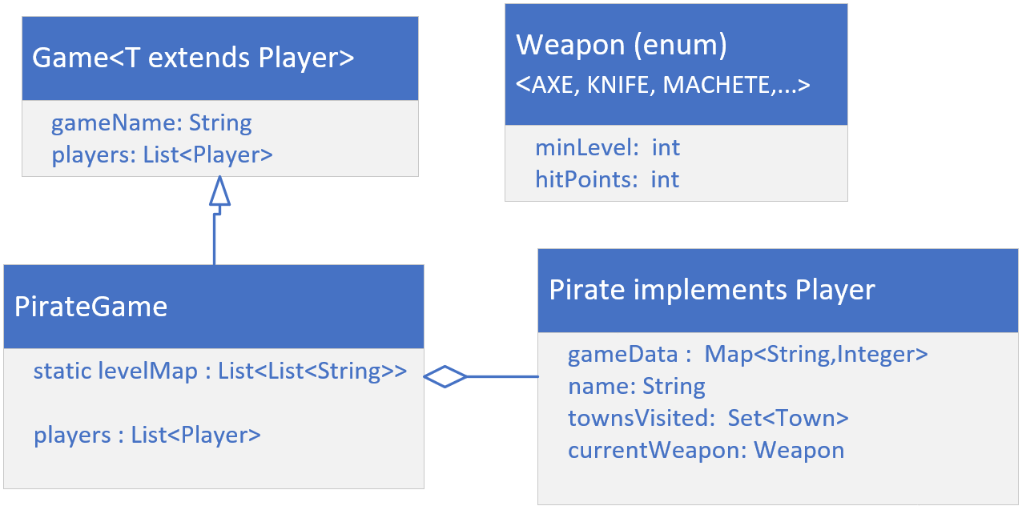
Class Diagram
This diagram shows a model of the main entities, for my own Pirate game.
I'm going to create Weapon, as an enum, as suggested.
The Pirate class will implement the Player interface, from the last video.
Finally, I'll create a PirateGame class, that extends Game.
COMPLETE JAVA MASTERCLASS
Challenge: Initializers and Constructors, A Pirate Game

Slide 62
Final Classes
Using the final keyword on a class means it can't be extended.
You declare a class final if its definition is complete, and no subclasses are desired or required.
Enums and Records are final classes.
Subclasses can take advantage of mutable fields on parent classes, if the parent classes aren't implementing defensive code.
One of the easiest ways to prevent this, is to make your class final.
COMPLETE JAVA MASTERCLASS
Final Classes, Review of constructor access modifiers

Slide 63
Final Classes
Operations | final class | abstract class | private constructors only | protected constructors only
Instantiate a new instance | yes | no | no | yes, but only subclasses, and classes in same package
A subclass can be declared successfully | no | yes | no | yes
Private constructors will prevent both a new instance and a new subclass from being created.
Protected constructors will prevent an instance from being created outside of a subclass or the package.
COMPLETE JAVA MASTERCLASS
Final Classes, Review of constructor access modifiers

Slide 64
Final Classes
Operations | final class | abstract class | private constructors only | protected constructors only
Instantiate a new instance | yes | no | no | yes, but only subclasses, and classes in same package
A subclass can be declared successfully | no | yes | no | yes
The final and abstract modifiers are incompatible and wouldn't be used in the same declaration.
You can see that if you don't want your class to be instantiated, you can either make it abstract or use a more restrictive access modifier on the class.
COMPLETE JAVA MASTERCLASS
Final Classes, Review of constructor access modifiers

Slide 65
Sealed Classes
JDK17 introduced a new modifier, sealed, for our classes and interfaces.
This modifier can be used for both outer types and nested types.
When used, a permits clause is also required in most cases, which lists the allowed subclasses.
Subclasses can be nested classes, classes declared in the same file, classes in the same package, or if using Java's modules, in the same module.
What this means though, for this specific conversation, is that all our code so far, since JDK9, is part of what's called, the unnamed default module.
Because of this, I can't use subclasses in the permits clause that are in other packages.
A sealed class and its direct subclasses create a circular reference.
COMPLETE JAVA MASTERCLASS
Sealed Classes

Slide 66
sealed class
Using the sealed keyword, requires the parent class to declare it's subclasses, using a permits clause.
This means the parent class has to know about every direct subclass, and these have to exist, in the same package in this case.
In addition, the sealed keyword puts a requirement on all the subclasses that were declared in the permits clause.
It requires each subclass to declare one of the three valid modifiers for a class extending a sealed class.
These are final, sealed or non-sealed.
COMPLETE JAVA MASTERCLASS
Sealed Classes

Slide 67
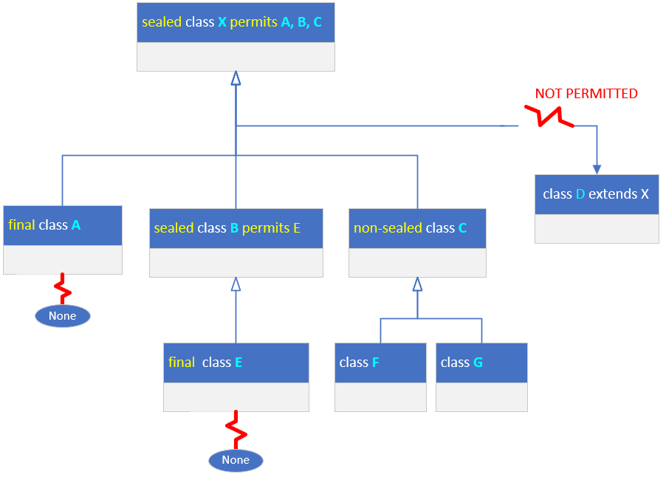
sealed class
On this slide, I have a parent class X, declared as a sealed class, and permitting only classes A, B and C to subclass it.
For that reason class D, which may exist and extends X, won't compile.
You'll have to either add D to the permits clause on X, or remove D from the hierarchy in some way.
COMPLETE JAVA MASTERCLASS
Sealed Classes

Slide 68
sealed class
All subclasses declared in the permits clause, must be declared as final, sealed or non-sealed.
Declaring a class final, means no other subclasses can extend that class, as I show with class A, on this slide.
A subclass declared with a sealed modifier, shown here with class B, must in turn use a permits clause. Its subclasses in turn, have to use one of the three valid modifiers.
COMPLETE JAVA MASTERCLASS
Sealed Classes

Slide 69
sealed class
Lastly, a subclass can use the non-sealed modifier, as shown with class C.
This means it's basically unsealing itself for all it's subclasses.
COMPLETE JAVA MASTERCLASS
Sealed Classes

Slide 70
The Final Section Challenge
In this challenge, you'll be adding functionality to the Pirate Game we've been working on for several videos.
You'll be adding hidden treasure, town features, and opponents.
A town feature, will affect the health of your pirate.
For example, if your pirate runs into an alligator, you may want to subtract health points.
If he finds a fresh water spring, you'll probably increase his health.
As your pirate finds loot, each item should increase his score.
Each town will have different loot, and different features.
COMPLETE JAVA MASTERCLASS
Final Section Challenge

Slide 71
Create a Sealed Combatant class
In this challenge, I want you to abstract some of the functionality of your Pirate player to a Combatant class.
This means you should make a copy of Pirate, calling it Combatant, and placing it in the pirate package.
This class should be abstract, and contain most of Pirate's fields (like name, weapon, and game data), as well as methods related to these fields.
The Pirate class should extend Combatant.
You'll also create a couple of other Combatant classes, such as Islander and Soldier.
You should seal the Combatant class.
COMPLETE JAVA MASTERCLASS
Final Section Challenge

Slide 72
Create Loot and Feature enums
You'll create two enums, both with constructors.
The first, Loot, defines pirate treasure such as gold coins or pearl necklaces, each with its own worth, that when found, will increase your pirate's score.
The second enum, Feature, should describe some town features, that will either add to the pirate's health, or subtract from it.
Features should have a health value (positive or negative), so that when a pirate runs into this feature, his health is adjusted accordingly.
Some examples of features might be an Alligator with a large negative health value, or a Pineapple with a small positive adjustment.
COMPLETE JAVA MASTERCLASS
Final Section Challenge

Slide 73
Create a Town Record
Use a record to create a Town, with the fields: name, island, level, loot, features, and opponents. The last three can be any Collection.
Create a compact constructor, to initialize randomized lists of loot and features. These lists should contain only a portion of the ones available on each enum.
You should also add an opponent or two, in this constructor.
Next, you'll add a custom constructor that takes a name, and additional items to be tracked, in the game data map.
At least one of the opponents should use their weapon, when your pirate uses his.
COMPLETE JAVA MASTERCLASS
Final Section Challenge

Slide 74
Create a Town Record
Randomize part of the use weapon method, so that opponents only occasionally hit each other, and deduct points from each's health accordingly.
Change PirateGame's loadData method, to load up a List of Town, instead of Strings.
Change your game's menu items to include a Find Loot option, and an Experience Town Feature option.
Change your code so that a pirate only visits a new town, after they've found all the loot in the current town.
COMPLETE JAVA MASTERCLASS
Final Section Challenge

