Slide 1

Java Streams - What they are and what they aren't
When you think of a stream, you might be thinking of I/O streams, like a buffered input stream or file output.
That isn't the type of stream I'm talking about here.
Oracle's Java documentation describes a stream as
Streams are a mechanism for describing a whole series of processes, before actually executing them.
Stream
A sequence of elements supporting sequential and parallel aggregate operations.
COMPLETE JAVA MASTERCLASS
Introduction to Streams

Slide 2
A Stream is different from a Collection
The stream and the collection types were designed for different purposes.
A collection is used to store and manage a series of elements in Java, providing direct access to the Collection elements.
You can use collections to manipulate or query a set of data.
There's nothing you can do with a stream, that you couldn't already do with a Collection.
However, a stream was designed to manage the processing of elements.
Streams don’t actually store elements, instead these elements are computed on demand, from a data providing source.
COMPLETE JAVA MASTERCLASS
Introduction to Streams

Slide 3
The Lazy Stream
Another important difference is that streams are lazy, like lambda expression variables.
When you call many of the methods on a stream, execution may not immediately occur.
Instead, you'll need to invoke a special operation on the stream, like you would by calling a lambda's functional method.
This special operation is called a terminal operation.
COMPLETE JAVA MASTERCLASS
Introduction to Streams

Slide 4
Why Use a Stream?
Streams are an exciting addition to Java, because they provide several benefits.
First, they make the code to process data uniform, concise and repeatable, in ways that feel similar to a database's structured query language (SQL).
Second, when working with large collections, parallel streams will provide a performance advantage.
All of the code samples I've provided up to this point, using collections, will continue to be valuable for many use cases.
It's time to talk about this new way of doing things, using this additional functional programming feature.
COMPLETE JAVA MASTERCLASS
Introduction to Streams

Slide 5
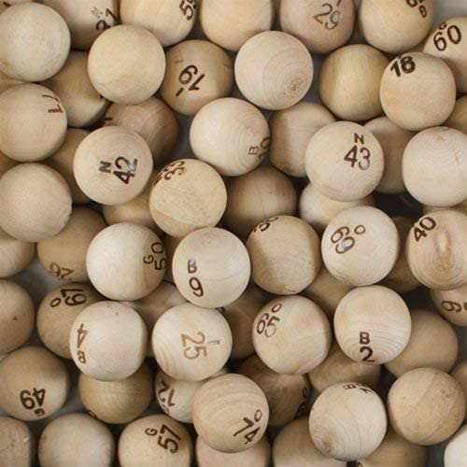
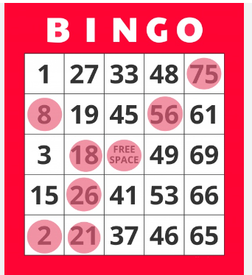
BINGO
Each ball is identified with either a B, I, N, G, or O, and followed by a number.
A B ball will have a number from 1 to 15, an I ball will get a number between 16 thru 30, and so on.
Someone will draw a ball out of the container, and announce it.
Every player will have a five-by-five card, with some randomly generated set of these numbers on it.
The first column has the B numbers, the second column has the I numbers, and so on.
You win by being the first person to match five called numbers in a row, either horizontally, vertically, or diagonally.
COMPLETE JAVA MASTERCLASS
A first look at a stream in action

Slide 6
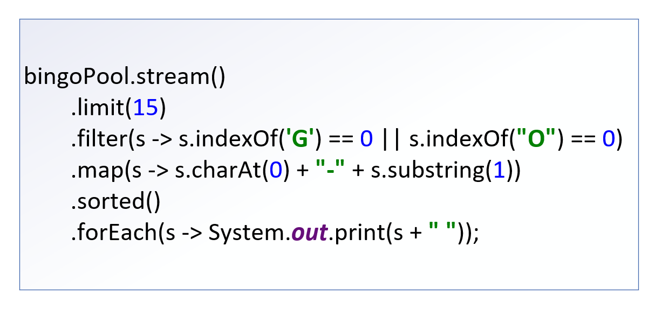
The Stream Pipeline
In the last video, I finished with my first example of using a stream in code.
This entire chain of operations is what's called a Stream Pipeline.
COMPLETE JAVA MASTERCLASS
The Structure of the Stream Pipeline

Slide 7
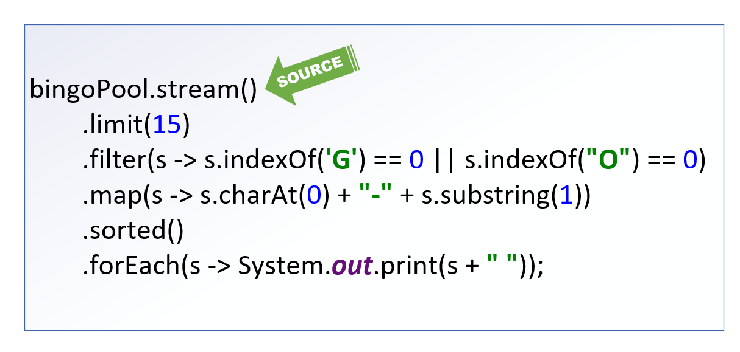
The Pipeline starts with a Source
The source of the stream is where the data elements are coming from.
In our example, it's coming from a list, bingoPool.
All pipelines start with a stream, so in this example, we need to call the stream method on the bingoPool List to get a stream.
There are a lot of other kinds of sources, and ways to create new streams, including infinite streams.
COMPLETE JAVA MASTERCLASS
The Structure of the Stream Pipeline

Slide 8
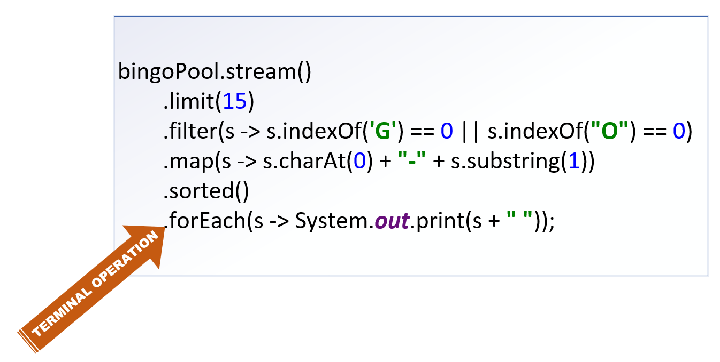
The Pipeline starts with a Source
Stream Pipelines end in a terminal operation, which produces a result or side-effect.
In this example, the forEach operation executes a Consumer implementation.
This prints out some data about each element that was processed, and its current state.
A terminal operation is required.
COMPLETE JAVA MASTERCLASS
The Structure of the Stream Pipeline

Slide 9
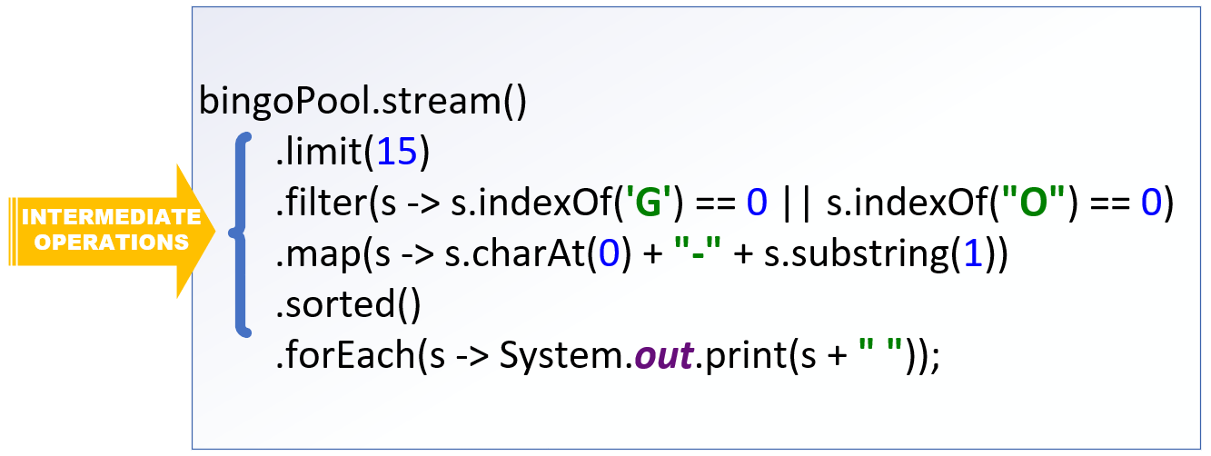
The Intermediate Operations
Everything else between the source and the terminal operation is an intermediate operation.
An intermediate operation is not required.
You can have a pipeline that has just a source and terminal operation, and these are quite common.
Every intermediate operation processes elements on the stream, and returns a stream as a result.
COMPLETE JAVA MASTERCLASS
The Structure of the Stream Pipeline

Slide 10
Streams are Lazy
Without worrying about semantics, I want you to imagine the stream pipeline as a black box.
The source is your input, the result of your terminal operation is your output.
Everything in between, isn't going to happen until something tells that terminal operation to start.
What actually happens in that black box, may not happen exactly as you've described it, or in the order you've specified.
Execution of the intermediate operations is dependent, first on a terminal operation being specified, and second on an optimization process occurring.
COMPLETE JAVA MASTERCLASS
The Structure of the Stream Pipeline

Slide 11
Stream computations are optimized
What this means is that your stream pipeline is kind of a workflow suggestion.
Before the process begins, the stream implementation will perform an evaluation, to optimize the means to the end.
It will determine the best way to get the elements needed, and the most efficient way to process them, to give you the result you've asked for.
The result will be consistent each time, but the process to get there is not guaranteed to be.
Optimizations may change the order of the intermediate operations, it may combine operations, or even skip them altogether.
For this reason, you should avoid side effects in your intermediate operations.
COMPLETE JAVA MASTERCLASS
The Structure of the Stream Pipeline

Slide 12
You can't reuse a stream
Once you invoke a terminal operation on a stream, you can think of the pipeline as being opened, and the flow beginning.
The flow is allowed to continue until all processes have been performed and a result produced.
At that point, the valve is shut, and the pipeline closed.
You can't turn it back on, or reuse it for a new source.
If you want to do the same sort of thing with a different variable for one of the intermediate operations, you'd need to set up a new pipeline.
COMPLETE JAVA MASTERCLASS
The Structure of the Stream Pipeline

Slide 13
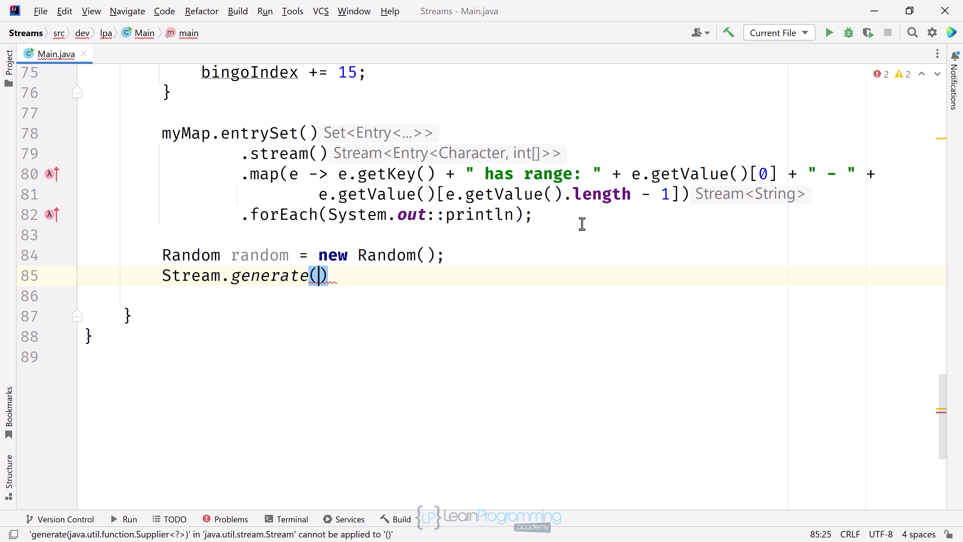
Stream Types May Change As the Pipeline Process Progresses
An intermediate operation can usually be recognized by its signature, because it returns a Stream.
I want to point out, that this doesn't mean the element type of the Stream can't change.
In practice, you'll be regularly transforming your stream element to a different type.
COMPLETE JAVA MASTERCLASS
Stream Sources

Slide 14
Stream Sources
This slide shows the eight methods I covered in this video.
Two can produce infinite streams, the Stream.generate method as well as Stream.iterate, which doesn't include a Predicate parameter.
Method | Finite | Infinite
Collection.stream() | X
Arrays.stream(T[]) | X
Stream.of(T...) | X
Stream.iterate(T seed, UnaryOperator<T> f) | X | X
Stream.iterate(T seed, Predicate<? super T> p, UnaryOperator<T> f) | X
Stream.generate(Supplier<? extends T> s) |  | X
**IntStream.range(int startInclusive, int endExclusive) | X
**IntStream.rangeClosed(int startInclusive, int endExclusive) | X
** range and rangeClosed also available on LongStream, with a long type produced for both.
COMPLETE JAVA MASTERCLASS
Stream Sources

Slide 15
The Stream Source Challenge
In the last video, I reviewed the following methods to generate a Stream.
In this coding challenge, you'll be using most of these methods to set up a few streams of your own.
Method | Finite | Infinite
Collection.stream() | X
Arrays.stream(T[]) | X
Stream.of(T...) | X
Stream.iterate(T seed, UnaryOperator<T> f) | X | X
Stream.iterate(T seed, Predicate<? super T> p, UnaryOperator<T> f) | X
Stream.generate(Supplier<? extends T> s) |  | X
**IntStream.range(int startInclusive, int endExclusive) | X
**IntStream.rangeClosed(int startInclusive, int endExclusive) | X
COMPLETE JAVA MASTERCLASS
Stream Source Challenge

Slide 16
The Stream Source Challenge
Generate the bingo ball labels as 5 different streams, using different Stream creation methods for each.
Assign each pipeline to a stream variable.
Concatenate the five streams together.
Apply the terminal operation, forEach, to the final concatenated stream, to print each label.
These should be printed in order as follows.
B1-B15
I16-I30
N31-N45
G45-G60
O61-O75
COMPLETE JAVA MASTERCLASS
Stream Source Challenge

Slide 17
The Stream Source Challenge
Remember that the map intermediate operation takes a Function, so you can return a different type, than the input stream element.
To do this, you'd use map to return a String, by executing a method or expression that takes an integer and returns a String.
The generate method may be difficult to use without creating side effects, or using other intermediate operations I haven't yet mentioned, but if you want a good challenge, you can play around with this one.
It's time for you to give this a try, and when you're ready, come back, and we can walk through my solution together.
COMPLETE JAVA MASTERCLASS
Stream Source Challenge

Slide 18
The Most Common Intermediate Operations
Up until now, I've kind of glossed over intermediate operations.
I've used filter, limit, map and sorted in my examples.
As you can see from this table, the operations you've already seen briefly, cover half of the basic operations available to your stream pipelines.
Return Type | Operation
Stream<T> | distinct()
Stream<T> | filter(Predicate<? super T> predicate) takeWhile(Predicate<? super T> predicate) dropWhile(Predicate<? super T> predicate)
Stream<T> | limit(long maxSize)
Stream<R> | map(Function<? super T,? extends R> mapper)
Stream<T> | peek(Consumer<? super T> action)
Stream<T> | skip(long n)
Stream<T> | sorted() sorted(Comparator<? super T> comparator)
COMPLETE JAVA MASTERCLASS
Intermediate Operations, distinct, filter, limit, skip, takeWhile, dropWhile

Slide 19
Intermediate Operations that effect the size of the Resulting Stream
I'll start by talking about the set of operations, that may change the number of elements in the resulting stream.
Return Type | Operation | Description
Stream<T> | distinct() | Removes duplicate values from the Stream.
Stream<T> | filter(Predicate<? super T> predicate) takeWhile(Predicate<? super T> predicate) dropWhile(Predicate<? super T> predicate) | These methods allow you to reduce the elements in the output stream. Elements that match the filter's Predicate are kept in the outgoing stream, for the filter and takeWhile operations. Elements will be dropped until or while the dropWhile's predicate is not true.
Stream<T> | limit(long maxSize) | This reduces your stream to the size specified in the argument.
Stream<T> | skip(long n) | This method skips elements, meaning they won't be part of the resulting stream.
COMPLETE JAVA MASTERCLASS
Intermediate Operations, distinct, filter, limit, skip, takeWhile, dropWhile

Slide 20
Declarative Language of Stream Operations Resembles Query commands
The Java API designers designed the Stream to let you process data in a declarative way, much like a structured query language or SQL in a database.
This lets you say what should happen, and not actually how it will happen.
If you've had experience querying databases, you might be familiar with the limit and distinct keywords, available in many database query languages.
The filter operation represents your where clause, and sorted would be your order by clause, and so on.
There are aggregate functions commonly used in queries as well, such as max, min, count and so on.
COMPLETE JAVA MASTERCLASS
Intermediate Operations, distinct, filter, limit, skip, takeWhile, dropWhile

Slide 21
Intermediate Operations that operate on every element
Return Type | Operation | Description
Stream<R> | map(Function<? super T,? extends R> mapper) | This is a function applied to every element in the stream. Because it's a function, the return type can be different, which has the effect of transforming the stream to a different stream of different types.
Stream<T> | peek(Consumer<? super T> action) | This function doesn't change the stream, but allows you to perform some interim consumer function while the pipeline is processing.
Stream<T> | sorted() sorted(Comparator<? super T> comparator) | There are two versions of sorted. The first uses the naturalOrder sort, which means elements in the stream must implement Comparable. If your elements don't use Comparable, you'll want to use sorted and pass a Comparator.
COMPLETE JAVA MASTERCLASS
Intermediate Operations, map, peek, sorted

Slide 22
Primitive Streams
In addition to the generic Stream, that lets you stream any reference type, Java has three primitive streams.
Special Primitve Streams | Mapping from Reference Type to Primitive | Mapping from Primitive Stream to Reference Type
DoubleStream | mapToDouble(ToDoubleFunction<? super T> mapper) | mapToObj(DoubleFunction<? extends U> mapper) boxed()
IntStream | mapToInt(ToIntFunction<? super T> mapper) | mapToObj(IntFunction<? extends U> mapper) boxed()
LongStream | mapToLong(ToLongFunction<? super T> mapper) | mapToObj(LongFunction<? extends U> mapper) boxed()
COMPLETE JAVA MASTERCLASS
Intermediate Operations, map, peek, sorted

Slide 23
Terminal Operations
Now it's time to see why stream processes are such a welcome feature, as I show you other terminal operations you can use.
Some are designed to find matches, most of which are targets for a Predicate lambda expression.
Matching and Searching | Transformations and Type Reductions | Statistical (Numeric) Reductions | Processing
allMatch | collect | average² | forEach
anyMatch | reduce | count | forEachOrdered
findAny¹ | toArray | max¹
findFirst¹ | toList | min¹
noneMatch |  | sum²
 |  | summaryStatistics²
¹Returns an Optional instance
²Available on DoubleStream, IntStream, LongStream
COMPLETE JAVA MASTERCLASS
Terminal Operations for statistical information and matching

Slide 24
Terminal Operations
Some are designed to transform stream data into a collection, or some other reference type.
Others aggregate information, to count elements, or find a minimum or maximum value, and don't take arguments.
Matching and Searching | Transformations and Type Reductions | Statistical (Numeric) Reductions | Processing
allMatch | collect | average² | forEach
anyMatch | reduce | count | forEachOrdered
findAny¹ | toArray | max¹
findFirst¹ | toList | min¹
noneMatch |  | sum²
 |  | summaryStatistics²
¹Returns an Optional instance
²Available on DoubleStream, IntStream, LongStream
COMPLETE JAVA MASTERCLASS
Terminal Operations for statistical information and matching

Slide 25
Terminal Operations
The primitive streams have average and sum as well, and a summaryStatistics operation which gives you count, min, max, average and sum in one result.
Matching and Searching | Transformations and Type Reductions | Statistical (Numeric) Reductions | Processing
allMatch | collect | average² | forEach
anyMatch | reduce | count | forEachOrdered
findAny¹ | toArray | max¹
findFirst¹ | toList | min¹
noneMatch |  | sum²
 |  | summaryStatistics²
¹Returns an Optional instance
²Available on DoubleStream, IntStream, LongStream
COMPLETE JAVA MASTERCLASS
Terminal Operations for statistical information and matching

Slide 26
What is a reduction operation?
A reduction operation is a special type of terminal operation.
Stream elements are processed to produce a single output.
The result can be a primitive type, like a long, in the case of the count operation.
The result can be a reference type, like Optional or one of the statistical types I'll be covering shortly.
It can also be any type of your choice, such as an Array, a List, or some other type.
COMPLETE JAVA MASTERCLASS
Terminal Operations for statistical information and matching

Slide 27
Aggregation Terminal Operations
I can use terminal operations to return information about the aggregated data set.
The methods shown on this slide have no arguments,
They all return numerical data, either directly, or in specialized types to hold that data.
Return Type | Terminal Operations | Stream
long | count() | ALL
Optional | max() | ALL
Optional | min() | ALL
OptionalDouble | average() | DoubleStream IntStream LongStream
double int long | sum() | DoubleStream IntStream LongStream
DoubleSummaryStatistics IntSummaryStatistics LongSummaryStatistics | summaryStatistics() | DoubleStream IntStream LongStream
COMPLETE JAVA MASTERCLASS
Terminal Operations for statistical information and matching

Slide 28
Matching elements in a stream based on a condition
There are three terminal operations that let you get an overall sense of what your stream elements contain, based on some specified condition.
These all return a boolean, and take a Predicate as an argument.
You can think of these as ways to ask true or false questions about the data set, the stream, as a whole.
Return Type | Method | Description
boolean | allMatch(Predicate<? super T> predicate) | Returns true if all stream elements meet the condition specified.
boolean | anyMatch(Predicate<? super T> predicate) | Returns true if there is at least one match to the condition specified.
boolean | noneMatch(Predicate<? super T> predicate) | This operation returns true if no elements match.
COMPLETE JAVA MASTERCLASS
Terminal Operations for statistical information and matching

Slide 29
Code Setup
In the code ahead, I'll be setting up a couple of familiar classes, a Student and a Course.
I'll be mocking up a lot of students, to put some of the stream operations into practice.
This code is very basic, with only the use of the Stream's generate method used at the very end.
COMPLETE JAVA MASTERCLASS
Code Setup, Part 1 (Student Engagement Statistics)

Slide 30
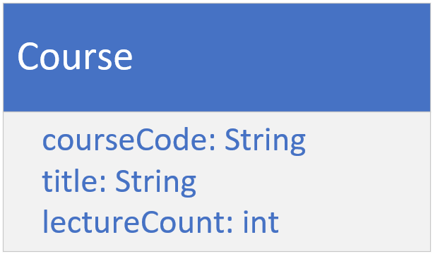
The Course
The course type should have a course code, a course title, and a lecture count.
You can make this an immutable class.
COMPLETE JAVA MASTERCLASS
Code Setup, Part 1 (Student Engagement Statistics)

Slide 31
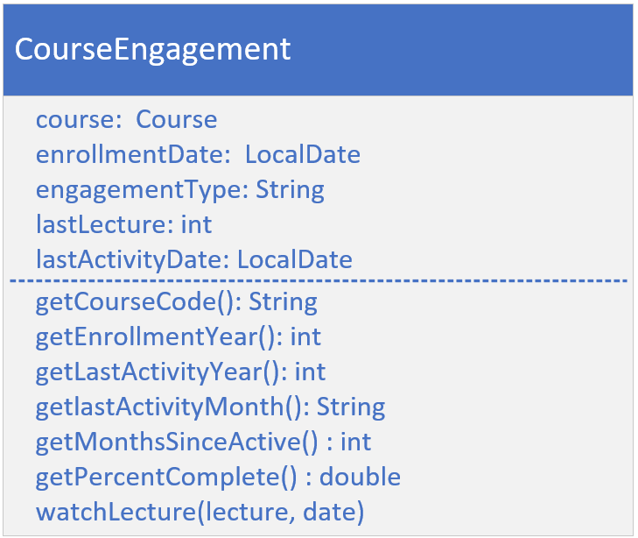
The Course Engagement Type
Each student will have a course engagement instance, for every course they're enrolled in.
It should have the fields for the course, the enrollment date, the engagement type, the last lecture, and the last activity date.
It should have the usual getters, plus getters for calculated fields as shown here.
The getMonthsSinceActive method should return the months elapsed, since the last course activity.
COMPLETE JAVA MASTERCLASS
Code Setup, Part 1 (Student Engagement Statistics)

Slide 32
The Course Engagement Type
The getPercentComplete method should use the last lecture, and the lecture count on course, to return a percentage complete.
The watchLecture method would get called when a student engaged in the course, and should update fields on the engagement record.
It takes a lecture number, and an activity date.
COMPLETE JAVA MASTERCLASS
Code Setup, Part 1 (Student Engagement Statistics)

Slide 33
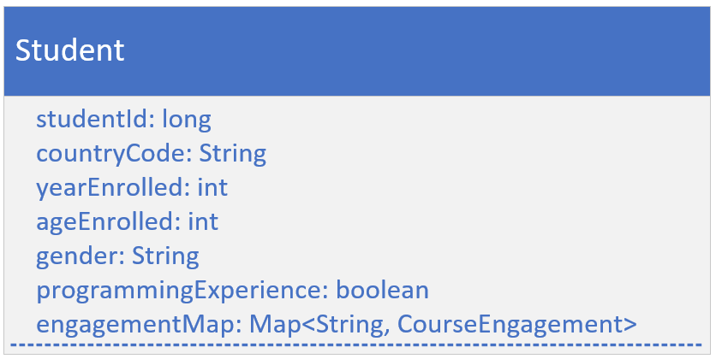
The Student Class's Attributes
The Student class should have a student id, and demographic data, like country code, year enrolled, age at time of enrollment, gender, and a programming experience flag.
Your student should also have a map of CourseEngagements, keyed by course code.
Include getters for all of these fields.
COMPLETE JAVA MASTERCLASS
Code Setup, Part 1 (Student Engagement Statistics)

Slide 34
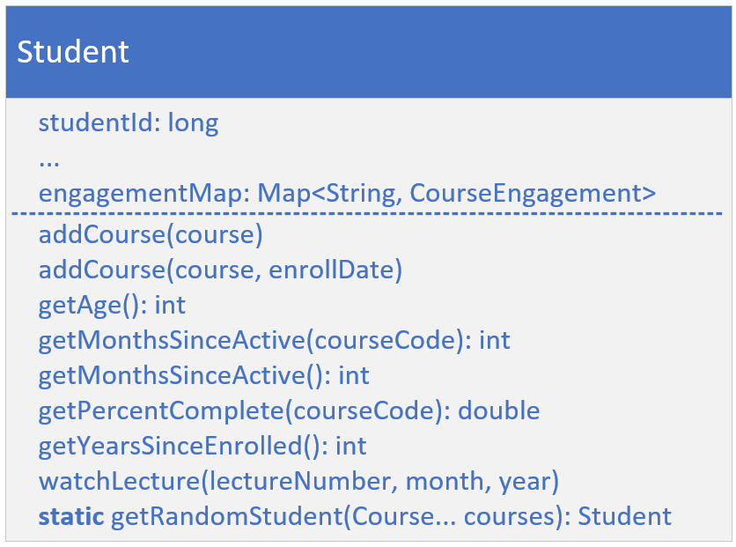
The Student Class's Behavior
In addition to the usual getters, add getter methods for calculated fields, like getYearsSinceEnrolled, and getAge.
Include the getters, getMonthsSinceActive and getPercentComplete, that take a course code and return data from the matching CourseEngagement record.
Add an overloaded version of getMonthsSinceActive, to get the least number of inactive months, from all courses.
COMPLETE JAVA MASTERCLASS
Code Setup, Part 1 (Student Engagement Statistics)

Slide 35
The Student Class's Behavior
You should have overloaded addCourse methods, one that takes a specified activity date, and one that will instead default to the current date.
Include the method watchLecture, that takes a course code, a lecture number and an activity year and month, and calls the method of the same name, on the course engagement record.
COMPLETE JAVA MASTERCLASS
Code Setup, Part 1 (Student Engagement Statistics)

Slide 36
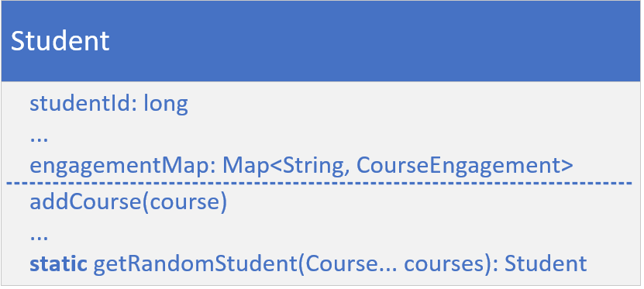
The Student Random Generation method (Supplier)
Finally, create a static factory method on this class, getRandomStudent, that will return a new instance of Student, with random data, populating a student's fields.
Make sure to pass courses to this method, and pass them to the student constructor.
For each course, call watchLecture with a random lecture number, and activity year and month, so that each Student will have a different activity for each course.
COMPLETE JAVA MASTERCLASS
Code Setup, Part 1 (Student Engagement Statistics)

Slide 37
Terminal Operations Challenge
In this challenge, you'll be using the terminal operations shown on this slide.
You'll be using these operations to answer questions about a series of students.
It contains a Student class with demographic data.
Return Type | Terminal Operations
long | count()
DoubleStatistics | summaryStatistics()
boolean | allMatch(Predicate<? super T> predicate)
boolean | anyMatch(Predicate<? super T> predicate)
boolean | noneMatch(Predicate<? super T> predicate)
COMPLETE JAVA MASTERCLASS
Challenge: Terminal Operations

Slide 38
Terminal Operations Challenge
This class has a factory method, to generate a new instance of a Student, using random data.
This factory method will also generate some random activity, for each course passed as an argument, to the Student constructor.
Return Type | Terminal Operations
long | count()
DoubleStatistics | summaryStatistics()
boolean | allMatch(Predicate<? super T> predicate)
boolean | anyMatch(Predicate<? super T> predicate)
boolean | noneMatch(Predicate<? super T> predicate)
COMPLETE JAVA MASTERCLASS
Challenge: Terminal Operations

Slide 39
The Terminal Operations Challenge
Create a source for a stream of Students.
Use the static method on Student as the Supplier.
Use a large enough number to get a variety of Student data.
Use a combination of the intermediate and terminal operations we've covered so far, to answer the following questions.
How many male and female students are in the group.
How many students fall into the three age ranges, less than age 30, between 30 and 60, over 60 years old.
COMPLETE JAVA MASTERCLASS
Challenge: Terminal Operations

Slide 40
The Terminal Operations Challenge
Use summaryStatistics on the student's age, to get a better idea of how old the student population is.
What countries are the students from? Print a distinct list of the country codes.
Are there students that are still active and have been enrolled for more than 7 years? Use one of the match terminal operations to answer this question.
Next, select 5 of the students above and print their information out.
COMPLETE JAVA MASTERCLASS
Challenge: Terminal Operations

Slide 41
Additional Terminal (Reduction) Operations
Reduction operations combine the contents of a stream, to return a value, or they can return a collection.
On this slide, I want to show you some additional terminal operations, and their return types and signatures.
Return Type | Terminal Operations
R R | collect(Collector<? superT,A,R> collector) collect(Supplier<R> supplier,BiConsumer<R,? superT> accumulator,BiConsumer<R,R> combiner)
Optional<T> T <U> U | reduce(BinaryOperator<T> accumulator) reduce(T identity,BinaryOperator<T> accumulator) reduce(U identity,BiFunction<U,? superT,U> accumulator,BinaryOperator<U> combiner)
Object[] A[] | toArray() toArray(IntFunction<A[]> generator)
List<T> | toList()
COMPLETE JAVA MASTERCLASS
Terminal operations for processing and transforming stream elements

Slide 42
Revised View of Transformative Operations
There is one interface I haven't talked about yet, and that's the Collector.
This is not a functional interface, but there are helper methods on another class, called Collectors that provide these special types.
Return Type | Terminal Operations
R R | collect(Collector collector) collect(Supplier supplier,BiConsumer accumulator,BiConsumer combiner)
Optional T <U> U | reduce(BinaryOperator accumulator) reduce(T identity,BinaryOperator accumulator) reduce(U identity,BiFunction accumulator,BinaryOperator combiner)
Object[] A[] | toArray() toArray(IntFunction generator)
List | toList()
COMPLETE JAVA MASTERCLASS
Terminal operations for processing and transforming stream elements

Slide 43
The collect method
The collect method has two overloaded versions.
The first can be used by passing it the result of any of the many factory methods on the Collectors class.
I showed you asList and asSet, as two examples of static methods on that class.
The second is more complex, but gives you ultimate flexibility, as you saw with the TreeSet example I just showed you.
Return Type | Method Parameters
R R | collect(Collector collector) collect(Supplier supplier,BiConsumer accumulator,BiConsumer combiner)
COMPLETE JAVA MASTERCLASS
Using Stream's collect & reduce terminal operations

Slide 44
Challenge, Use terminal operations to select specific students
Create a new class called MainChallenge, with a main method that does the following:
Copy the two courses, jmc and pymc, from the MainCollect's main method, passing both an additional argument for the lecture count. 50 for pymc, and 100 for jmc.
Add a third course, titled "Creating Games in Java". You don't have to pass a lecture count for this one.
Use Stream.generate or Stream.iterate to generate 5000 random students and create a list of these.
Use the getPercentComplete method, to calculate the average percentage completed for all students for just the Java Masterclass, using the reduce terminal operation.
COMPLETE JAVA MASTERCLASS
Challenge: Terminal Operations, Part 2

Slide 45
Challenge, Use terminal operations to select specific students
Use this result, multiplying it by 1.25, to collect a group of students (either as a list, or a set). These would be the students who've completed more than three quarters of that average percentage.
Sort by the longest enrolled students who are still active, because you're going to offer your new course to 10 of these students, for a trial run.
Add the new course to these ten students.
Make one change to the Student's getRandomStudent method, using a minimum lecture of 30.
COMPLETE JAVA MASTERCLASS
Challenge: Terminal Operations, Part 2

Slide 46
What's the Optional Type?
Optional is a generic class, whose purpose is to be a container for a value which may or may not be null.
It was created by Java's engineers, to address the problem of the NullPointerException, which is one of the most common errors in Java.
This type is primarily intended for use as a method return type, under specific conditions.
COMPLETE JAVA MASTERCLASS
What's Optional?

Slide 47
No Result is valid vs. No Result is a problem
Optional tries to solve the problem of when no result, or no data, is a perfectly valid situation, vs. when no result might really be an error.
You can think of many situations where no data makes sense.
Not everyone has a middle initial in their name, or even a last name for that matter.
No data for a birthdate may or may not be an exception.
New inventory may not yet have a sales price.
Optional is a way of indicating that a value may not be present and can therefore be safely ignored during processing.
COMPLETE JAVA MASTERCLASS
What's Optional?

Slide 48
Creating an instance of Optional
Optional is just another generic class, so you declare it like any other type, with type arguments.
But you don't construct an Optional.
Instead, you use one of the static factory methods as shown below.
These methods are empty, of, and ofNullable.
Factory Method | When to Use | Best Practice Notes
Optional<T> empty() | Use this method to create an Optional that you know has no value. | Never return null from a method that has Optional as a return type.
Optional<T> of(T value) | Use this method to create an Optional that you know has a value. | Passing null to this method raises a NullPointerException. Use ofNullable instead, if a possible value might be null.
Optional<T> ofNullable(T value) | Use this method to create an Optional when you are uncertain if the value is null or not.
COMPLETE JAVA MASTERCLASS
What's Optional?

Slide 49
The downside of Optional
Wrapping elements in Optional will consume more memory and has the possibility of slowing down execution.
Wrapping elements in Optional adds complexity and reduces readability of your code.
Optional is not serializable.
Using Optional for fields or method parameters is not recommended.
I'll point you to a StackExchange message, from the author of Optional, if you want further reading.
https://stackoverflow.com/questions/26327957/should-java-8-getters-return-optional-type/26328555#26328555
COMPLETE JAVA MASTERCLASS
What's Optional?

Slide 50
The Terminal Operations that return Optional
In this video, I'll be covering the final few terminal operations, all of which return an Optional.
Return Type | Terminal Operations
OptionalDouble | average()
Optional<T> | findAny()
Optional<T> | findFirst()
Optional<T> | max(Comparator<? super T> comparator)
Optional<T> | min(Comparator<? super T> comparator)
Optional<T> | reduce(BinaryOperator<T> accumulator)
COMPLETE JAVA MASTERCLASS
More Terminal Operations

Slide 51
static import
The static import statement is a similar idea.
It lets you import one or more static members of a class.
I can use the static import statement, specifying the Collectors class, with a wild card to import all static members.
import static java.util.stream.Collectors.*;
COMPLETE JAVA MASTERCLASS
Streams to Maps

Slide 52
The flatMap operation
The flatMap intermediate operation performs one-to-many transformations on elements in a stream pipeline.
It's called flatMap, because it flattens results from a hierarchical collection, into one stream of uniformly typed elements.
The difference is in the return type of the function.
For map, you return a different instance of an object.
In this case, you're exchanging one type for another, for each element on the stream.
For flatMap, you return a Stream, which means you're exchanging one element for a stream of elements back.
Stream<R> | map(Function< T, R> mapper) | flatMap(Function<T, Stream> mapper)
COMPLETE JAVA MASTERCLASS
Maps to Streams (using flatMap)

Slide 53
Streams Section Challenge
In this challenge, you'll again use Streams with the Student Engagement Code.
Before you start, first change the getRandomStudent method on Student, to select a random number and random selection of courses.
Every student should be enrolled and have activity in at least one course.
COMPLETE JAVA MASTERCLASS
Streams Challenge

Slide 54
Streams Section Challenge
Set up three or four courses, using the lecture count version of the constructor on several of these, to pass lecture counts greater than 40.
Generate a list of 10,000 students who've enrolled in the past 4 years.
Pass the Supplier Functional Interface code three or four courses.
COMPLETE JAVA MASTERCLASS
Streams Challenge

Slide 55
Streams Section Challenge
Next, answer the following questions.
How many of the students are enrolled in each course?
How many students are taking 1, 2, or 3 courses?
Determine the average percentage complete, for all courses, for this group of students. Hint, try using Collectors.averagingDouble to get this information.
For each course, get activity counts by year, using the last activity year field.
Think about how you'd go about answering these questions, using some of the Stream operations you've learned, especially the collect terminal operation in conjunction with the Collectors helper class methods.
COMPLETE JAVA MASTERCLASS
Streams Challenge

