Slide 1

Introduction
Up to this point in the course, I've covered most of the core functionality in Java.
I want to take this moment, to loop back to some topics I didn't cover at all, or in enough detail, or only mentioned in passing.
This is functionality you may find yourselves using daily, and although the topics are less exciting, they're no less important.
In this section, I'll review the Math class, some additional randomization features, and the BigDecimal class.
After this, I'll be talking about date and time topics, covering many of Java's features in the java.time package.
COMPLETE JAVA MASTERCLASS
Introduction

Slide 2
Introduction
This will segue nicely into a discussion about Java's support for Localization and Internationalization.
By the end of this section, you can boast that you know most of Java's core features.
There's still a lot to cover, and I want to congratulate you for persevering this far!
So let's get going.
COMPLETE JAVA MASTERCLASS
Introduction

Slide 3
java.util.Math
You can think about the Math class as your calculator.
It has functions you'd find on a basic calculator, as well as a few scientific methods.
COMPLETE JAVA MASTERCLASS
Functionality on java.lang.Math

Slide 4
Use Math.random or Random's methods?
Maybe you've found some code on the internet, on how to randomize a character, and it comes back with code similar to what I am showing here.
The Math.random method uses an instance of the Random class and invokes the nextDouble method on that class.
The first time you call Math.random, a single new instance of java.util.Random is created and used for all subsequent calls.
COMPLETE JAVA MASTERCLASS
Kotlin Variables and Datatypes

Slide 5
Common Usage of Math.random, getting a range of numbers
This was a pattern used a lot, because until JDK 17, the Random.nextInt method only supported an upper bound.
When you use Random, you have to use an instance of it.
COMPLETE JAVA MASTERCLASS
Kotlin Variables and Datatypes

Slide 6
What's a seed?
In most programming languages, the random functions aren't truly random.
Algorithms exist that create distributions of numbers, that achieve what a random distribution might look like, over a large range of values.
These are called pseudorandom number generators, and they're dependent on an initial value called a seed.
COMPLETE JAVA MASTERCLASS
Kotlin Variables and Datatypes

Slide 7

A Dice Rolling game
In this challenge, I want you to start working on a dice rolling game, similar to an existing boxed game called Yahtzee, if you've ever played it.
The objective of the game is to roll five dice, getting certain combinations of numbers, each scored differently.
The player gets multiple tries to roll the dice, but after the first roll, players can select which dice they want to roll again.
COMPLETE JAVA MASTERCLASS
Randomization Challenge (Rolling Dice)

Slide 8
Implementing the game
In this challenge, use the ints method on Random to generate a finite stream, to create a list of 5 random Integers, all between 1 and 6.
These will be the dice for your first roll.
Use the Scanner with System.in to have the user enter one of the following entries:
The player should press Enter to keep all the dice. This will end the play in this first part of the challenge.
The player should enter ALL, to re throw all five dice.
The player should enter numbers, representing dice face values, for those individual dice to be rolled again.
Continue to loop, and throw the dice selected by the user, until the user presses enter.
COMPLETE JAVA MASTERCLASS
Randomization Challenge (Rolling Dice)

Slide 9
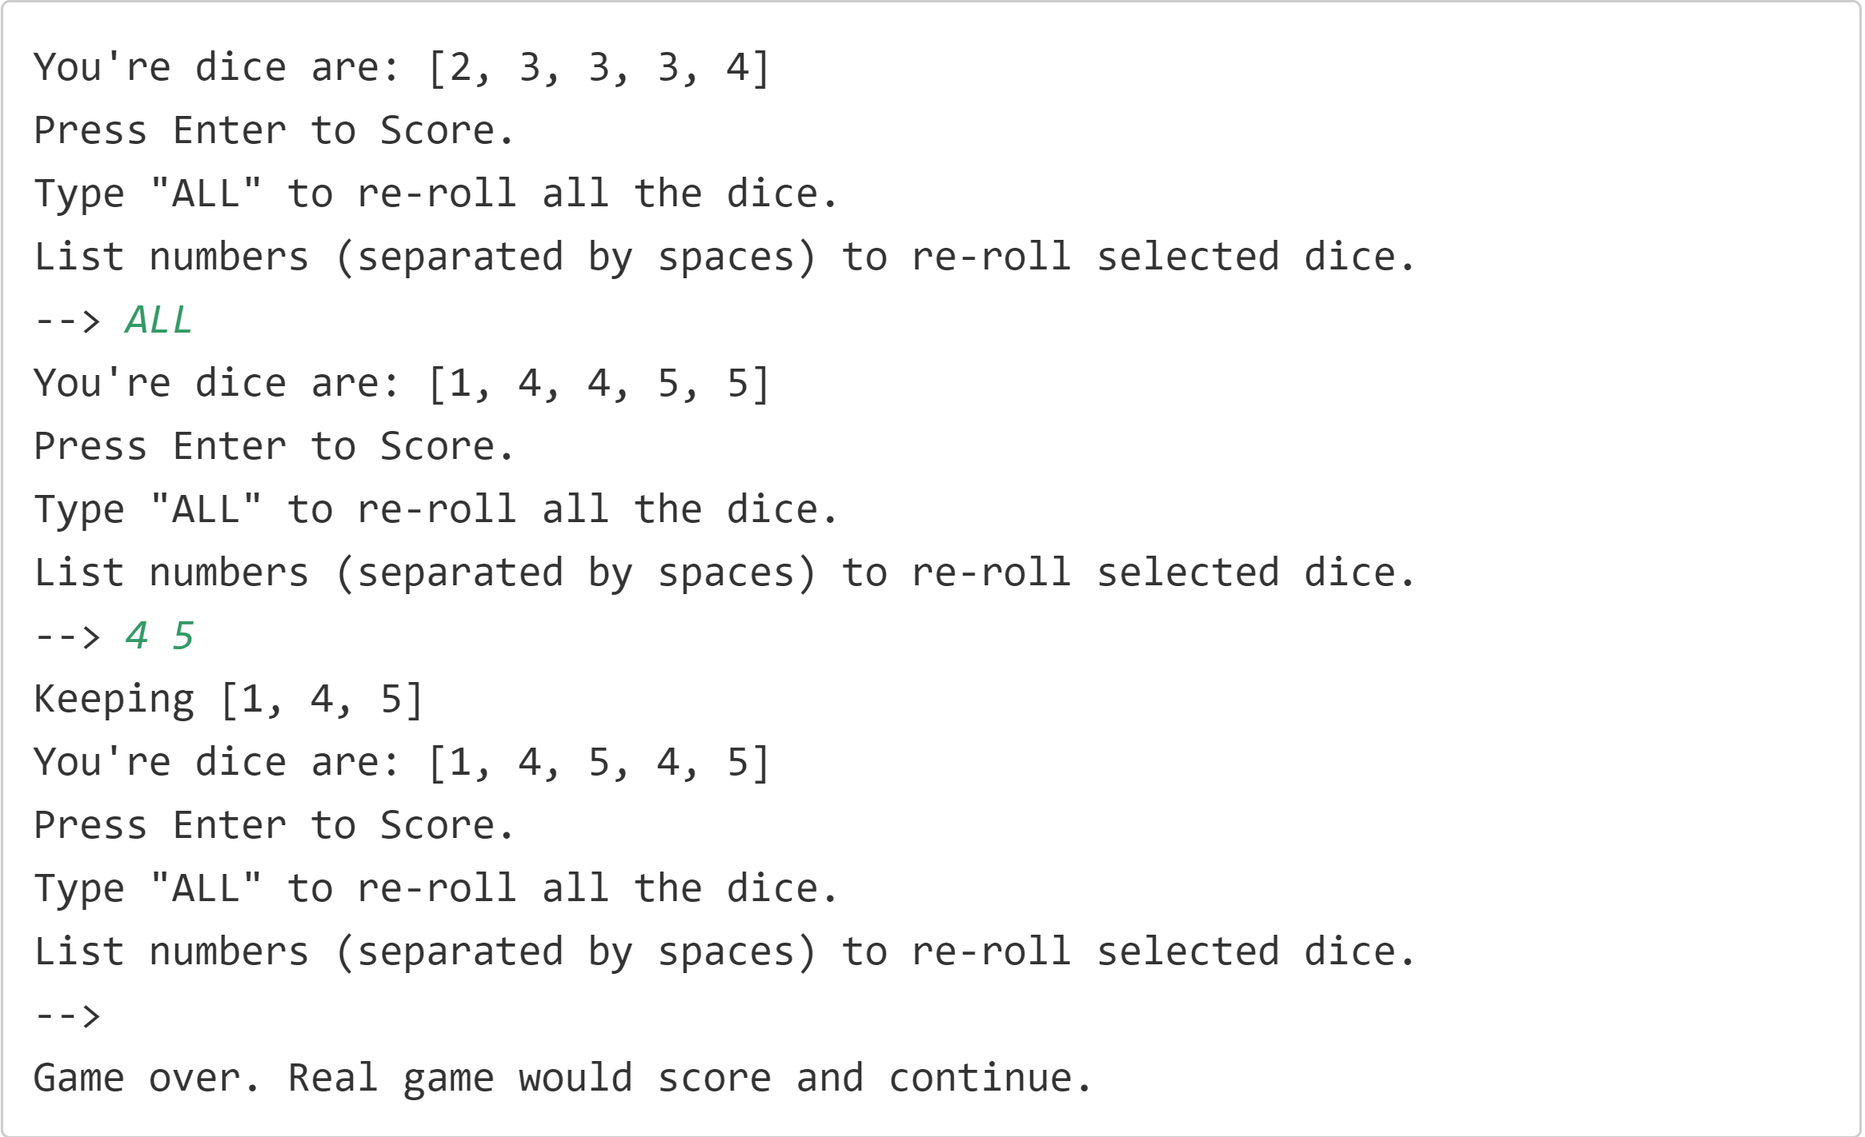
Sample Output
Sample output is shown on this slide.
The system will roll the five dice, getting 5 random numbers from 1 to 6, and present these numbers to the player.
The user will be prompted with the three options they have.
COMPLETE JAVA MASTERCLASS
Randomization Challenge (Rolling Dice)

Slide 10
Sample Output
In this example, the user first enters ALL at the prompt, and all the dice are rolled again.
At the second prompt, the user enters 4 and 5 separated by a space, and only the first dice with a four, and the first dice with a 5 are rerolled.
In the last case, the user presses enter, and the play ends.
COMPLETE JAVA MASTERCLASS
Randomization Challenge (Rolling Dice)

Slide 11
Bonus
If you want an extra challenge, use the GameConsole code, created in an earlier section of the course, to implement a DiceGame and DicePlayer.
Implement Scoring as shown on this slide.
The user can pick which score card item to apply their dice to, but the dice must meet certain conditions, otherwise a score of zero will be returned.
ScoreCard Item | Score | Conditions |  | ScoreCard Item | Score | Conditions
Aces | 1 * number of 1's | none |  | Three of Kind | Sum of Dice | Must of three of one number, or Score = 0
Twos | 2 * number of 2's | none |  | Four of Kind | Sum of Dice | Must of three of one number, or Score = 0
Threes | 3 * number of 3's | none |  | Five of Kind | 50 pts | Must of three of one number, or Score = 0
Fours | 4 * number of 4's | none |  | Small Straight | 30 pts | Must have 5 contiguous number, or Score = 0
Fives | 5 * number of 5's | none |  | Large Straight | 40 pts | Must have 5 contiguous numbers, or Score = 0
Sixes | 6 * number of 6's | none |  | Full House | 25 pts | Must have 3 of one value, and 2 of another, or Score = 0.
COMPLETE JAVA MASTERCLASS
Randomization Challenge (Rolling Dice)

Slide 12
Bonus
ScoreCard Item | Score | Conditions |  | ScoreCard Item | Score | Conditions
Aces | 1 * number of 1's | none |  | Three of Kind | Sum of Dice | Must of three of one number, or Score = 0
Twos | 2 * number of 2's | none |  | Four of Kind | Sum of Dice | Must of three of one number, or Score = 0
Threes | 3 * number of 3's | none |  | Five of Kind | 50 pts | Must of three of one number, or Score = 0
Fours | 4 * number of 4's | none |  | Small Straight | 30 pts | Must have 5 contiguous number, or Score = 0
Fives | 5 * number of 5's | none |  | Large Straight | 40 pts | Must have 5 contiguous numbers, or Score = 0
Sixes | 6 * number of 6's | none |  | Full House | 25 pts | Must have 3 of one value, and 2 of another, or Score = 0.
I've included this code, implemented as an enum (dev.lpa.chance.ScoredItem), in the code in the resources section of this video, if you want to use that.
Each DicePlayer should have a ScoreCard with each of these items, initialized to an unscored value, when the player is created.
After rolling the dice, the user should be prompted to pick from the remaining list of unscored items.
COMPLETE JAVA MASTERCLASS
Randomization Challenge (Rolling Dice)

Slide 13
Bonus
ScoreCard Item | Score | Conditions |  | ScoreCard Item | Score | Conditions
Aces | 1 * number of 1's | none |  | Three of Kind | Sum of Dice | Must of three of one number, or Score = 0
Twos | 2 * number of 2's | none |  | Four of Kind | Sum of Dice | Must of three of one number, or Score = 0
Threes | 3 * number of 3's | none |  | Five of Kind | 50 pts | Must of three of one number, or Score = 0
Fours | 4 * number of 4's | none |  | Small Straight | 30 pts | Must have 5 contiguous number, or Score = 0
Fives | 5 * number of 5's | none |  | Large Straight | 40 pts | Must have 5 contiguous numbers, or Score = 0
Sixes | 6 * number of 6's | none |  | Full House | 25 pts | Must have 3 of one value, and 2 of another, or Score = 0.
The game ends when the user quits or completes the score card.
COMPLETE JAVA MASTERCLASS
Randomization Challenge (Rolling Dice)

Slide 14
Implement DiceGame, DicePlayer and run game with GameConsole
This video is the bonus section of the last challenge.
In this part, you'll implement the DiceGame and DicePlayer classes, and score dice combinations for a player's score card.
You should implement Scoring as shown on this slide, which I've shown you in the previous video.
This code is implemented as an enum (dev.lpa.dice.ScoredItem), in the code in the resources section of this video.
ScoreCard Item | Score | Conditions |  | ScoreCard Item | Score | Conditions
Aces | 1 * number of 1's | Score = 0 if no ones |  | Three of Kind | Sum of Dice | Must of three of one number, or Score = 0
Twos | 2 * number of 2's | Score = 0 if no twos |  | Four of Kind | Sum of Dice | Must of three of one number, or Score = 0
Threes | 3 * number of 3's | Score = 0 if no threes |  | Five of Kind | 50 pts | Must of three of one number, or Score = 0
Fours | 4 * number of 4's | Score = 0 if no fours |  | Small Straight | 30 pts | Must have 5 contiguous number, or Score = 0
Fives | 5 * number of 5's | Score = 0 if no fives |  | Large Straight | 40 pts | Must have 5 contiguous numbers, or Score = 0
Sixes | 6 * number of 6's | Score = 0 if no sixes |  | Full House | 25 pts | Must have 3 of one value, and 2 of another, or Score = 0.
COMPLETE JAVA MASTERCLASS
Bonus Challenge (DiceGame with Scoring)

Slide 15
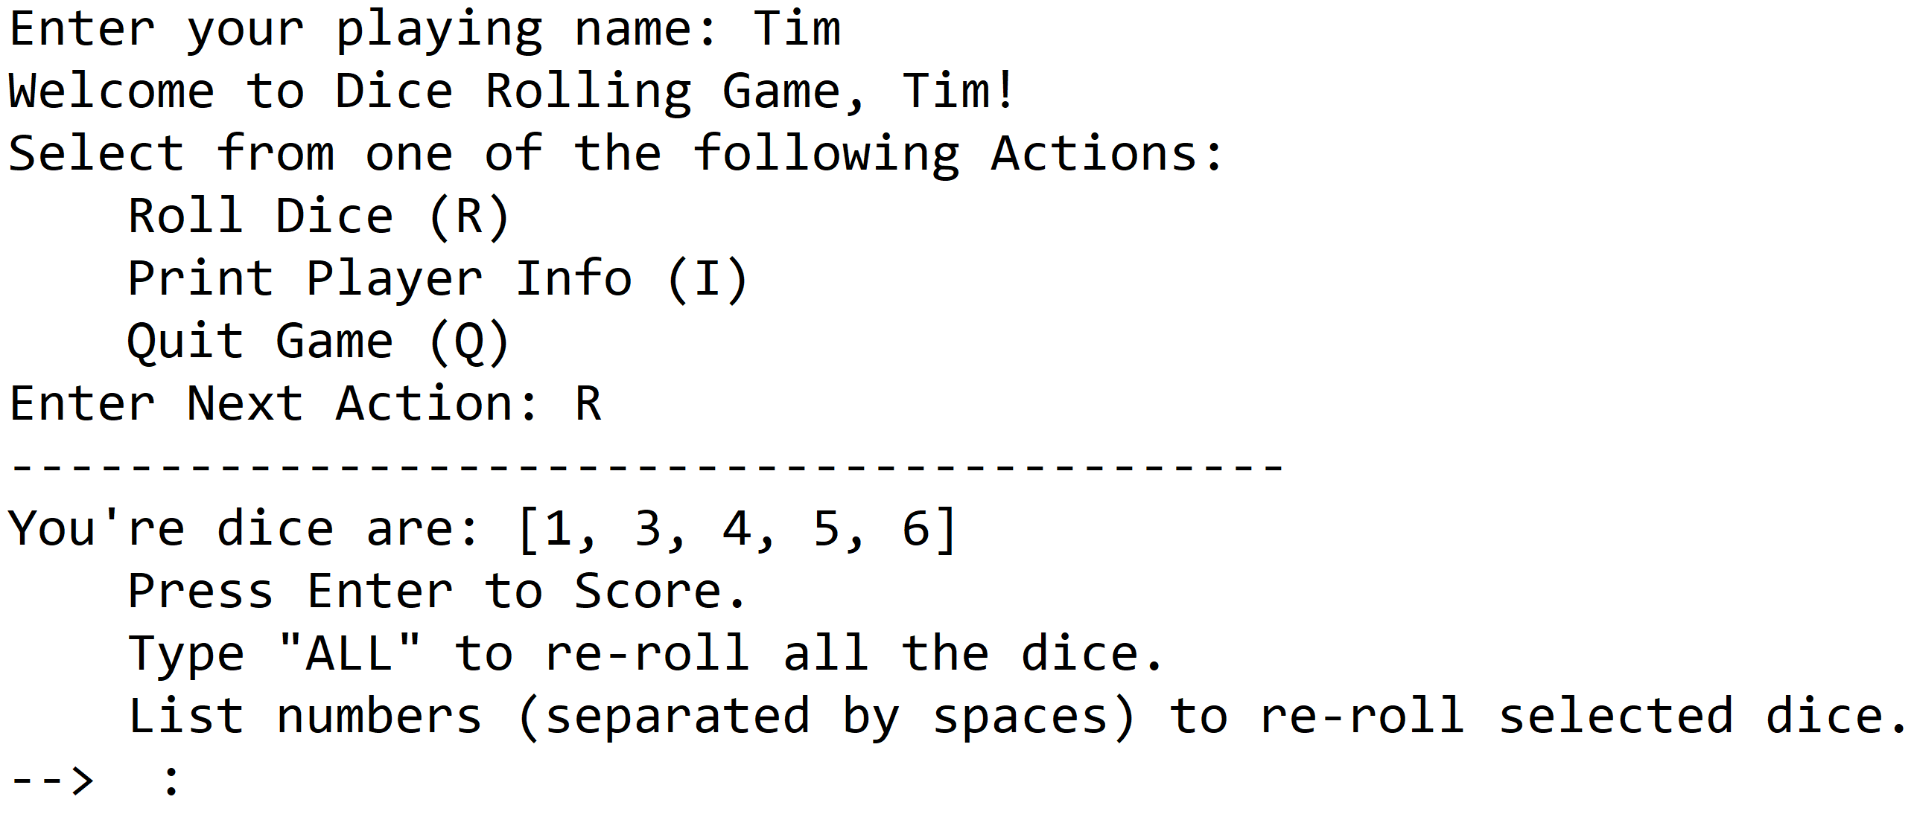
Implement DiceGame and run game with GameConsole
COMPLETE JAVA MASTERCLASS
Bonus Challenge (DiceGame with Scoring)

Slide 16
Implement DiceGame and run game with GameConsole
DicePlayer should implement Player.
Each DicePlayer should have a ScoreCard with a place for each of the scored items, initialized to an unscored value when the player is created.
I'll be using an EnumMap for the Player's scorecard.
The roll the dice action should match what you built in the previous challenge
This means the player should be able to choose to keep the dice, re roll them all, or pick only some of the dice to re roll. You can maintain the current dice values as a field on your DicePlayer.
COMPLETE JAVA MASTERCLASS
Bonus Challenge (DiceGame with Scoring)

Slide 17
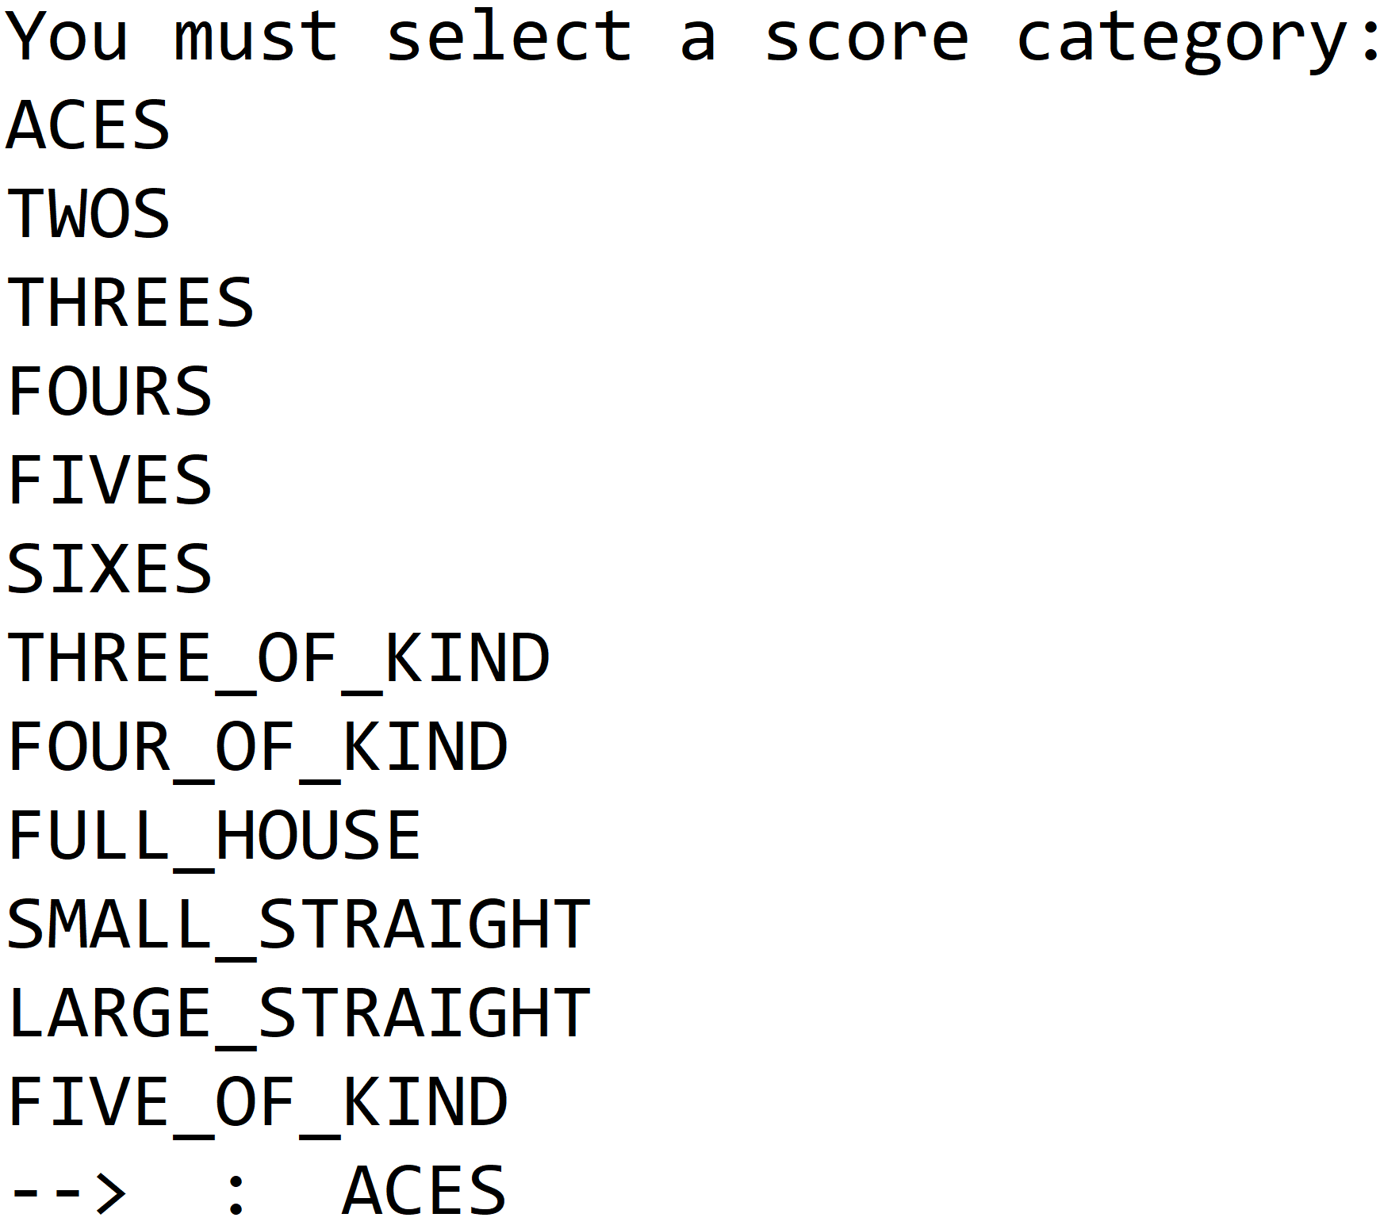
Implement DicePlayer's scoring method
Each player must pick the item on the score card to use, to get a score for their dice combination.
Once an item is scored, it can't be rescored, so display only valid unscored items, for your player to select from.
Sample output for selecting how the dice should be scored is shown on this slide.
This should be presented after the user selects Enter, during the roll the dice action.
COMPLETE JAVA MASTERCLASS
Bonus Challenge (DiceGame with Scoring)

Slide 18
Some floating point number basics
Precision defines the number of digits in a decimal number.
Precision includes digits to both the left and the right of the decimal point.
Scale is the number of digits to the right of the decimal point in a number.
Examples | Precision | Scales
15.456 | 5 | 3
8 | 1 | 0
100000.000001 | 12 | 6
.123 | 3 | 3
COMPLETE JAVA MASTERCLASS
Introduction to BigDecimal

Slide 19
Fractional Numbers may not be able to be accurately represented by floating point numbers
First, many floating-point numbers can only approximate the decimal number they're supposed to represent.
Think about the number 1/3, which has an infinitely repeating decimal.
This fraction, by necessity will get rounded at some point.
Its scale wasn't big enough as a float, when we applied it to our fairly large life insurance benefit.
The double worked well enough for this calculation, but it was still off by a penny, when reconciling a rounded dollar amount with a calculated double amount.
COMPLETE JAVA MASTERCLASS
Introduction to BigDecimal

Slide 20
BigDecimal
The BigDecimal class stores a floating-point number in two integer fields.
The first field holds an unscaled value, with a type of BigInteger, another class in the java.math package, that can store numbers, bigger than even long values.
The second field is the scale, which can be positive, zero or negative.
A positive or 0 scale defines how many digits in the unscaled value, are after the decimal point.
You can use a negative scale as well, which means the unscaled value is multiplied by ten to the power of the negation of the scale.
COMPLETE JAVA MASTERCLASS
Introduction to BigDecimal

Slide 21
BigDecimal Examples
Using the examples I showed you on the first slide, if I created BigDecimal instances, using those values, I would get the unscaled value, and scale, shown here.
The unscaled value has all the digits and no decimal point.
The decimal point's placement is determined by the scale, and again precision identifies the number of digits.
Examples | Unscaled Value | Scale | Precision
15.456 | 15456 | 3 | 5
8 | 8 | 0 | 1
100000.000001 | 100000000001 | 6 | 11
.123 | 123 | 3 | 3
COMPLETE JAVA MASTERCLASS
Introduction to BigDecimal

Slide 22
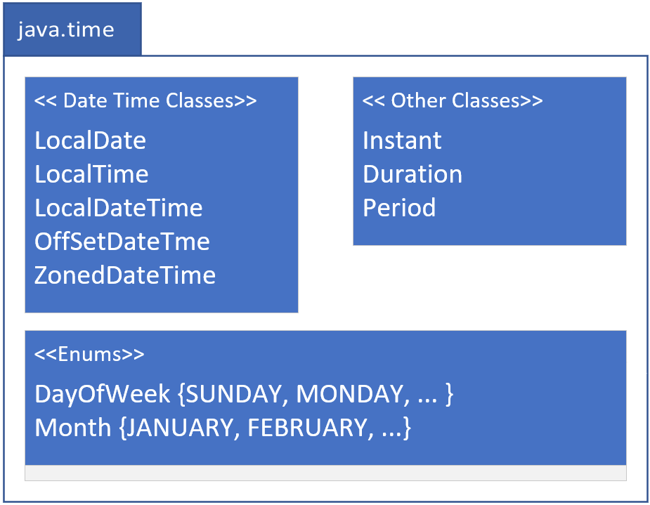
java.time
COMPLETE JAVA MASTERCLASS
Overview: Date & Time (java.time)

Slide 23
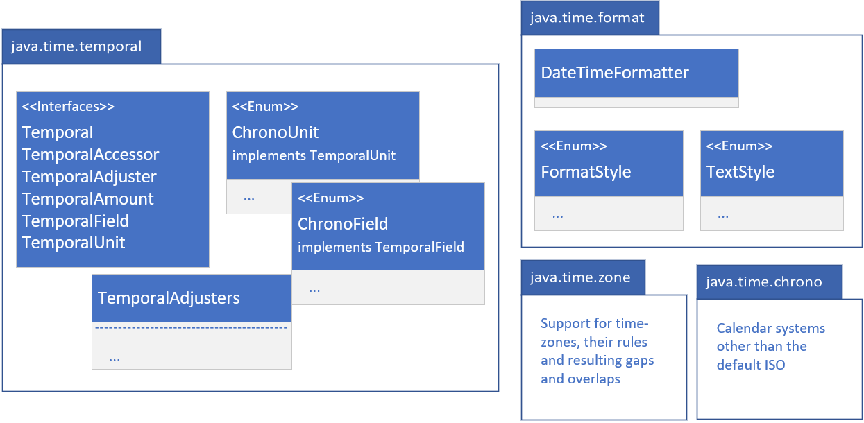
java.time related packages
Java has other packages under the java.time umbrella, as shown on this slide.
These are java.time.temporal, and java.time.format.
You'll likely be using these two packages, and the types within them.
In addition, there are the java.time.zone and java.time.chrono packages.
You're less likely to need the functionality specifically related to these last two packages, so I won't be covering them, but you should be aware of them.
COMPLETE JAVA MASTERCLASS
Overview: Date & Time (java.time)

Slide 24
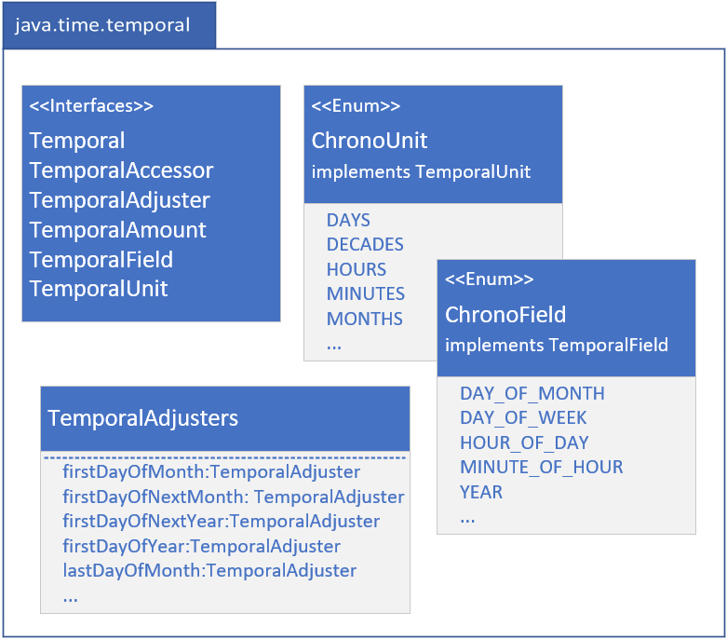
java.time.temporal
The java.time.temporal package contains important interfaces, that the java.time classes implement.
These include the Temporal, and TemporalAccessor interfaces, that describe a uniform way to read from, or write to, a date time object.
The TemporalAdjuster, TemporalAmount, TemporalField and TemporalUnit interfaces are used often as method parameters; to select the specific information you want from a date time object.
COMPLETE JAVA MASTERCLASS
Overview: Date & Time (java.time)

Slide 25
java.time.temporal
There are two enums in this package that I'll be covering, and shown here, ChronoField and ChronoUnit.
The TemporalAdjusters class is a helper class to return specific implementations of TemporalAdjuster, which can give you helpful dates such as first day of month, or last day of year, etc.
COMPLETE JAVA MASTERCLASS
Overview: Date & Time (java.time)

Slide 26
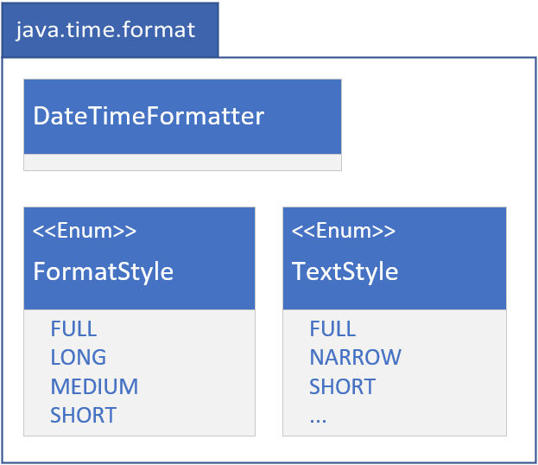
java.time.format
I've shown you how to format date time, using the "%t" specifier, in a formatted String.
The java.time.format package gives you a lot more options, as well as support for localization, which I'll be covering a little bit later in this section.
There are enums to support dates and time in defined styles, called Full, Long, Medium and Short, and I'll show you these in a couple of examples, shortly.
COMPLETE JAVA MASTERCLASS
Overview: Date & Time (java.time)

Slide 27
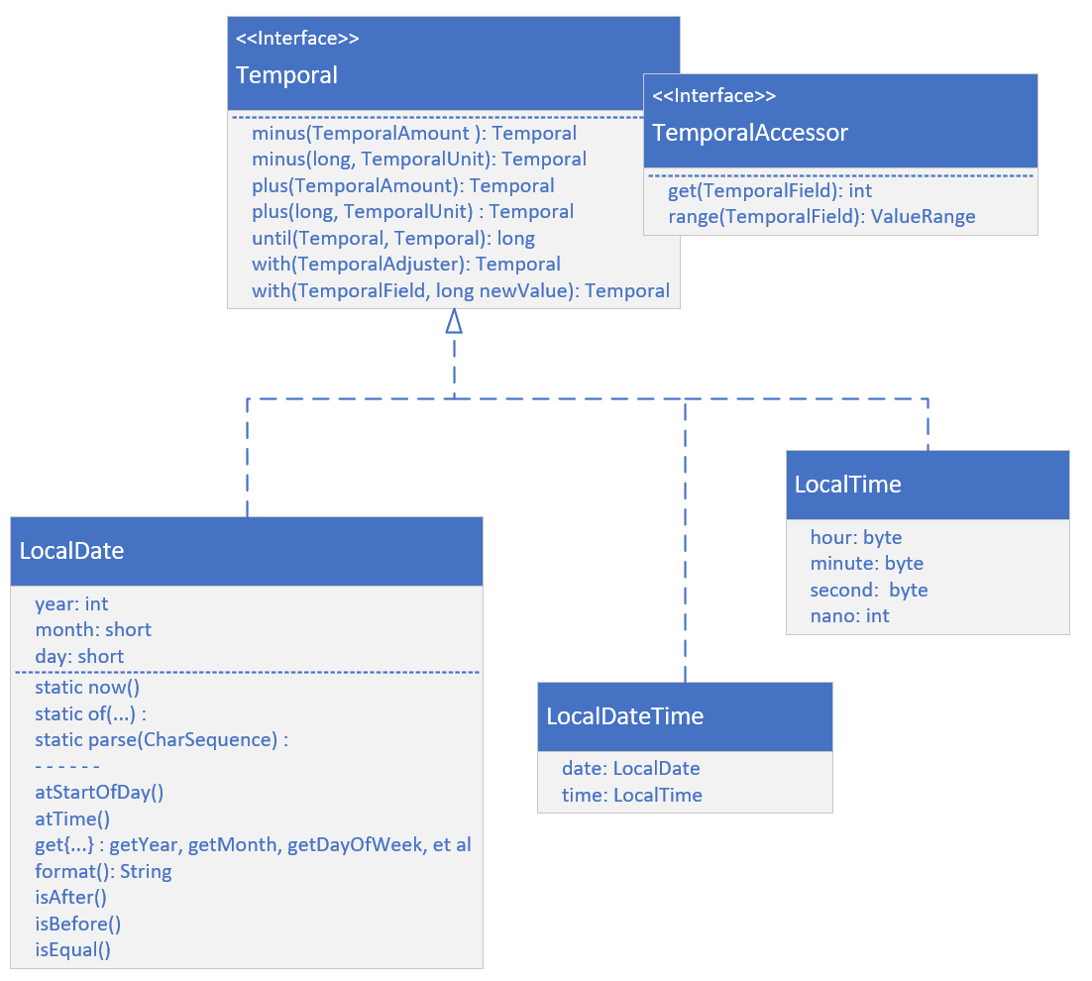
LocalDate, LocalTime and LocalDateTime
On this slide, I'm showing the most common classes for Date and Time, when you don't need to include time zone data.
These are LocalDate, LocalTime, and LocalDateTime.
Each implement both the Temporal and the TemporalAccessor interfaces, and the methods on those interfaces, as I'm showing here.
These include the get and range methods from TemporalAccessor.
COMPLETE JAVA MASTERCLASS
Overview: Date & Time (java.time)

Slide 28
LocalDate, LocalTime and LocalDateTime
From Temporal, there are methods to add or subtract units of time from your objects.
These are the plus and minus methods.
Field values can be directly set on a returned copy, using the with methods.
I'm also showing methods on LocalDate, that in general, are methods available in some form, on any of the temporal objects.
These have prefixes such as: at, get, and is.
COMPLETE JAVA MASTERCLASS
Overview: Date & Time (java.time)

Slide 29
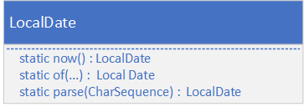
Creating instances of Temporal Implementations
There are several static methods, which return a new instance of a temporal class.
There is the now method, that gives you a representation of the current moment, for the class you specify.
You can create instances, using any of the several overloaded versions that exist for the of factory method.
Alternately, you can use the parse method with a character sequence, usually a String, that's formatted in a predetermined way, or you can pass in a defined format.
The methods shown on this slide are purposely shown without too much detail.
You can use similarly named methods on any of the temporal implementations, with varying parameters and return types.
COMPLETE JAVA MASTERCLASS
Overview: Date & Time (java.time)

Slide 30
Temporal Instances Are Immutable
All temporal instances of classes, in the java.time package, are immutable and thread safe.
A new instance is returned from methods that write to a temporal instance, such as the plus or minus methods, for example.
You'll need to assign the result of these methods to a variable.
The original instance won't be modified.
COMPLETE JAVA MASTERCLASS
Overview: Date & Time (java.time)

Slide 31
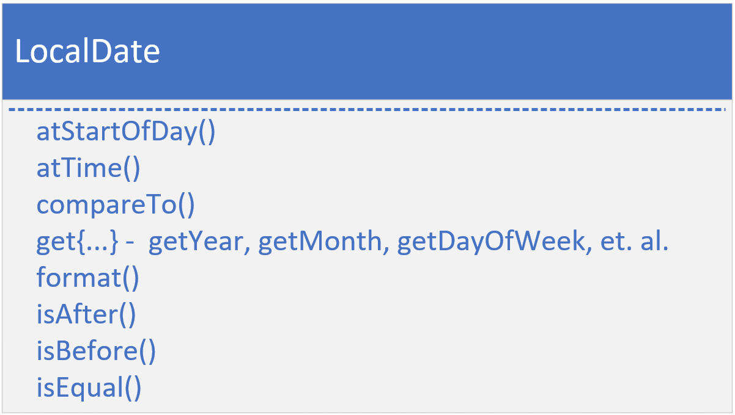
Methods of Temporal Implementations
In addition to the methods on the Temporal and TemporalAccessor interfaces, most implementations have methods prefixed with at, get, and is, as well as a format method.
The at methods allow you to combine temporal instances. As an example, a time is combined with the LocalDate for both the atStartOfDay and atTime methods and return LocalDateTime instances.
The Date and Time instances implement Comparable, so each has a compareTo method.
COMPLETE JAVA MASTERCLASS
Overview: Date & Time (java.time)

Slide 32
Methods of Temporal Implementations
The get methods are specific to the class, so for LocalDate, you'd have date related getters, like getYear, getMonth, getDayofWeek, and so on.
For LocalTime, these would be getHour, getMinute, etc.
Each class supports isAfter, isBefore and isEqual, so you can compare units of date or time.
And there's a format method, to output a formatted date.
COMPLETE JAVA MASTERCLASS
Overview: Date & Time (java.time)

Slide 33
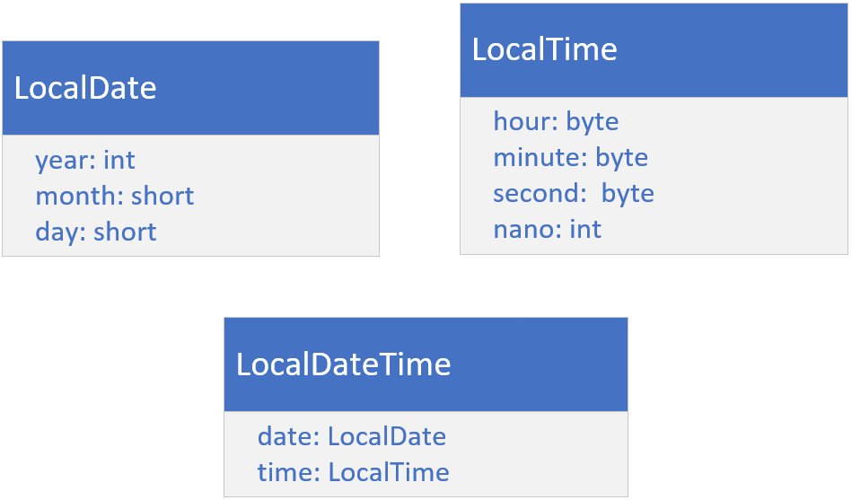
LocalDate, LocalTime, and LocalDateTime classes
On this slide, I want you to see that Java is internally storing the date fields, and the time fields, as separate numeric fields.
These fields can be retrieved, with or without context, of the other fields.
For example, you can get day of the month, or day of the year.
LocalDate uses an int for year, and a short for month and day.
LocalTime uses bytes for the hour, minute, and second, and an int for nanoseconds.
LocalDateTime has two fields, a date, with a type of LocalDate, and a time, with a type of LocalTime.
COMPLETE JAVA MASTERCLASS
Overview: Date & Time (java.time)

Slide 34
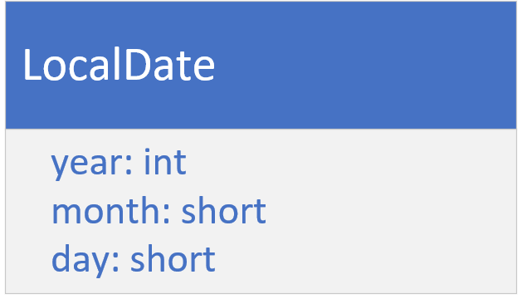
The LocalDate Class
LocalDate is a class for storing and managing a date, with a year, month, and day, without reference to a specific time zone.
This kind of date might be used for an anniversary date, a birth date, or a special holiday like Cinco de Mayo (the 5th of May), or Thanksgiving Day.
This class doesn't have a clock time component.
COMPLETE JAVA MASTERCLASS
Overview: Date & Time (java.time)

Slide 35
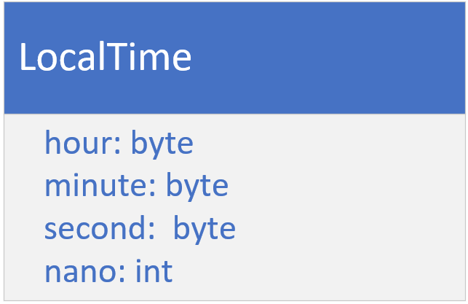
The LocalTime Class
The LocalTime class provides a description of the local time as seen on a wall clock.
It contains neither a date or a time zone.
Time is represented as hour-minute-second, with nanosecond precision, if it's available.
COMPLETE JAVA MASTERCLASS
Overview: Date & Time (java.time)

Slide 36
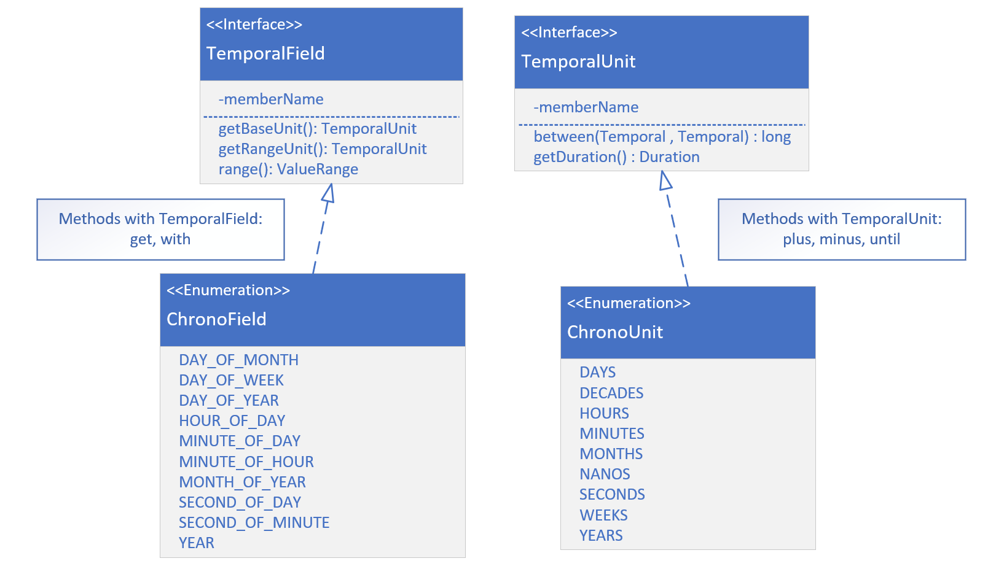
TemporalField vs. Temporal Unit
A TemporalField represents a specific field within a date-time, such as MONTH_OF_YEAR, DAY_OF_WEEK, or HOUR_OF_DAY. It defines fields we commonly think about in terms of date-time components (e.g., the month part of a date or the hour part of a time).
COMPLETE JAVA MASTERCLASS
LocalDate

Slide 37
TemporalField vs. Temporal Unit
In contrast, a TemporalUnit represents a unit or duration of time, such as YEARS, MONTHS, DAYS, or MINUTES. Rather than representing a part of a date or time, it represents the amount of time you might use to measure intervals between date-times.
On this slide, I am showing both interfaces, and a couple of the methods that would be implemented.
COMPLETE JAVA MASTERCLASS
LocalDate

Slide 38
TemporalField vs. Temporal Unit
I'm also showing you just some of the enum constants on ChronoField and ChronoUnit. Ones that are pretty commonly used.
The get and with methods take a TemporalField as a parameter.
The plus, minus, and until methods, take a TemporalUnit.
COMPLETE JAVA MASTERCLASS
LocalDate

Slide 39
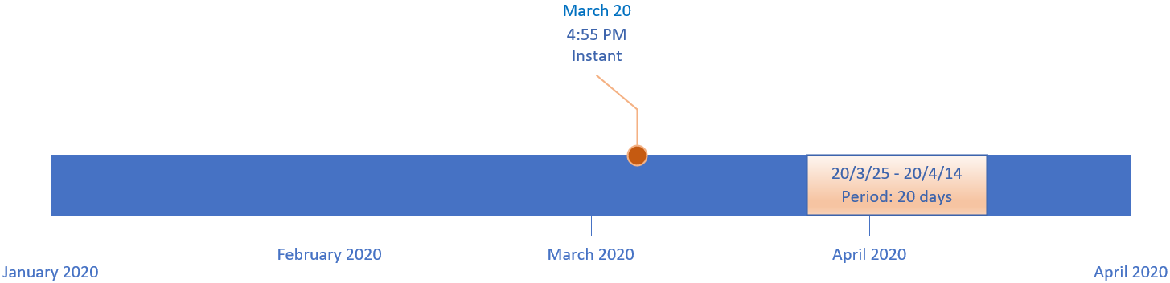
A Date-Based Timeline
This slide shows a timeline from January 1, 2020, through the end of April of the same year.
A point on a timeline, shown here as March 20, at 4:55 pm, is called an Instant in time.
An interval (or span of time) on a date time line is called a Period.
It's often represented by elapsed time in date units such as years, months, or days.
COMPLETE JAVA MASTERCLASS
Overview: Instance, Period, Duration and Time Zones

Slide 40
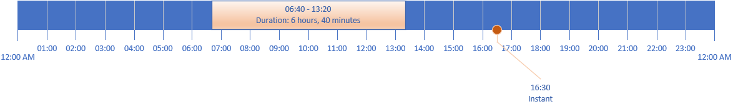
An Hourly Timeline
This slide shows a timeline for a single 24-hour day.
This timeline can have an Instant as well, as shown at 16:30 which represents 4:30 pm, on this timeline.
This slide is also showing a span of time, from 6:40 am until 1:20 pm.
When the interval is time based (in terms of the units being in hours, minutes or seconds), this is called a Duration.
On this slide, the Duration lasted 6 hours and 40 minutes.
COMPLETE JAVA MASTERCLASS
Overview: Instance, Period, Duration and Time Zones

Slide 41
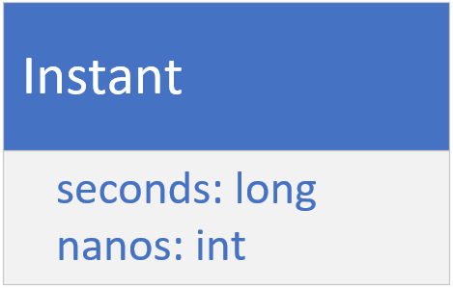
Instant
On the previous slide, I showed you that you can represent an event on a timeline as an Instant.
Java provides the Instant class for this.
It has two fields, one for seconds, a long, and one for nano seconds, an int.
COMPLETE JAVA MASTERCLASS
Overview: Instance, Period, Duration and Time Zones

Slide 42
Instant
If you're new to programming, you might be asking what does seconds mean?
How can you store a moment in time as seconds?
Doesn't it need some context, like a starting point in time, from which to measure these seconds, or a defined timeline?
These seconds are called epoch seconds, and the epoch is the starting point for many such points in time.
Instead of having to specify this point in time, every time you want a time stamp or instant of time, many software languages use a specific date and time, called Epoch Time.
COMPLETE JAVA MASTERCLASS
Overview: Instance, Period, Duration and Time Zones

Slide 43
What's the significance of the EPOCH Time?
00:00:00 UTC, Thursday 1st January 1970 is called alternately Unix Time, POSIX Time, Epoch Time or Unix Epoch Time.
Computer systems have different epoch times, but many software languages use this particular date and time, including Java, as the predetermined start of time.
It's used to create time stamps whose meaning, as seconds, can be understood.
If you ever do want to see it, or use it, it's a constant named EPOCH, on the LocalDate and Instant classes.
UTC is a symbol that stands for Coordinated Universal Time, which coordinates with Greenwich Mean Time (GMT).
COMPLETE JAVA MASTERCLASS
Overview: Instance, Period, Duration and Time Zones

Slide 44
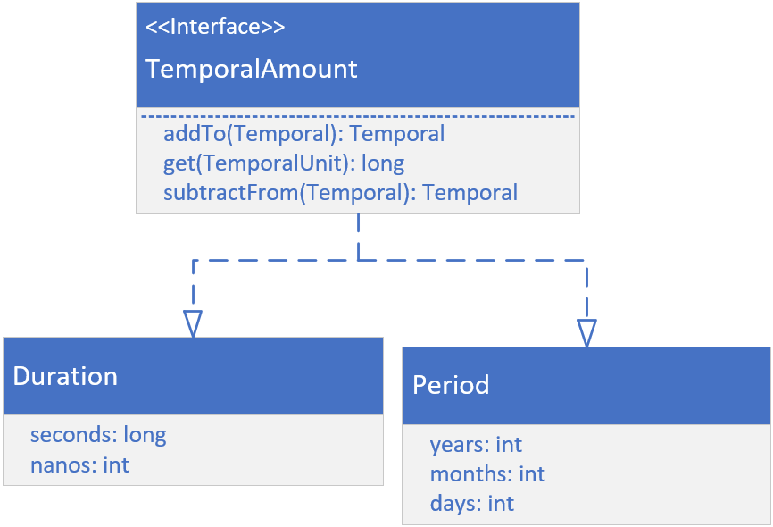
Duration and Period
If you look at the Duration class on this slide, you might think it looks like the Instant class, but there are significant differences.
First, Duration and Period do not implement Temporal or TemporalAccessor.
They instead implement TemporalAmount, as shown.
This means these classes are something quite different from a unit of date or time.
They are amounts of time.
Both represent elapsed time between units of time (or dates).
COMPLETE JAVA MASTERCLASS
Overview: Instance, Period, Duration and Time Zones

Slide 45
Greenwich Mean Time
Maybe you'll remember from an old geography class, that the earth is drawn with imaginary lines on it, to help uniformly describe locations on earth.
The lines drawn from the north pole to the south pole are called meridians.
These could be drawn anywhere, but a Prime Meridian was historically agreed upon, as a starting point or the zero measurement.
This is a reference point for all other measurements.
COMPLETE JAVA MASTERCLASS
Overview: Instance, Period, Duration and Time Zones

Slide 46
Greenwich Mean Time
The time in Greenwich, was solar time, based on the position of the sun in the sky.
When atomic clocks were introduced, they were able to provide more precise time than Greenwich Mean Time (GMT).
In 1972, GMT was superseded by UTC, which stands for Coordinated Universal Time, and is based on atomic time.
The differences between GMT and UTC can differ by up to 0.9 seconds in a day.
For this reason, GMT and UTC are often used interchangeably, when you don't need great precision.
COMPLETE JAVA MASTERCLASS
Overview: Instance, Period, Duration and Time Zones

Slide 47
Time Zone
A Time Zone consists of two parts, a UTC offset, and optionally, information about Daylight Savings Time.
Java derives it's time zone data from three sources:
The Internet Assigned Numbers Authority (IANA)'s Time Zone Database (TZDB) is the default, and takes precedence over the others.
IATA (the airline industry body).
Microsoft.
COMPLETE JAVA MASTERCLASS
Overview: Instance, Period, Duration and Time Zones

Slide 48
Time Zone
Two helpful links are displayed on this slide.
The first site gives you a list of the time zone identifiers.
The second gives you a list of day light savings rules.
Both of these sites use the IANA Time Zone database as their source.
https://twiki.org/cgi-bin/xtra/tzdatepick.html
https://en.wikipedia.org/wiki/Daylight_saving_time_by_country
COMPLETE JAVA MASTERCLASS
Overview: Instance, Period, Duration and Time Zones

Slide 49
Before JDK 8 and the introduction of the java.time package
There are classes in java.util that may look attractive to use, and were used before JDK 8.
You'll probably run across these classes at some point in older code.
These are
Date
TimeZone
GregorianCalendar
COMPLETE JAVA MASTERCLASS
Overview: Instance, Period, Duration and Time Zones

Slide 50
Before JDK 8 and the introduction of the java.time package
Additional classes for formatting are in the java.text package:
DateFormat
SimpleDateFormat
The use of these classes in new code is discouraged.
The immutable thread-safe classes, provided by the java.time packages, should be used, instead.
I won't be covering these old classes in this course, except to point them out here, so you'll recognize them if you see them.
COMPLETE JAVA MASTERCLASS
Overview: Instance, Period, Duration and Time Zones

Slide 51
System.currentTimeMillis
System.currentTimeMillis returns the milliseconds since epoch time, so midnight, January 1, 1970 UTC.
This time is based on the operating system.
This can be used to measure elapsed times, or provide timestamps.
COMPLETE JAVA MASTERCLASS
Overview: Instance, Period, Duration and Time Zones

Slide 52
System.nanoTime
System.nanoTime uses the JVM's high resolution time source, to return nanoseconds, from an arbitrary origin time, which is not Epoch time, and may even be a time in the future.
This origin time may differ across different JVM instances.
For this reason, this time can't be used to represent real time, or wall clock time.
It shouldn't be used as timestamps for data.
Instead, it's purpose is to measure elapsed time for invocations in a single JVM instance.
COMPLETE JAVA MASTERCLASS
Overview: Instance, Period, Duration and Time Zones

Slide 53
Instant
The Instant class is designed to represent only a point in time, or a timestamp.
Internally, it stores a value in seconds and nanoseconds, from the fixed epoch time of 1970-01-01Z.
As such, an Instant can't be formatted as a date or time, without providing time-zone information.
When printed, Z is used as the suffix to indicate this timestamp is in reference to UTC.
This allows for comparisons, regardless of time zones or operating systems, which is why it's an effective timestamp.
COMPLETE JAVA MASTERCLASS
Instant, ZonedDateTime, Duration, Period and ChronoUnit.between

Slide 54
Localization
Where you are matters, because where you are or the region, you're from, determines how you'll expect to see dates, currencies, and numbers formatted.
Even ignoring language differences, these formats can be different for different cultures and locations.
For example, Australia displays dates differently than the United States.
Many countries use different currency symbols and have different scales for the least significant currency digit.
COMPLETE JAVA MASTERCLASS
Localization, Introduction to Locale

Slide 55
Locale
Locale is an English word for a place where something happens.
It's also the name of a class in the java.util package that underpins support for both localization and internationalization.
Java has some built-in support for localization, with methods that let you pass a Locale instance to them.
COMPLETE JAVA MASTERCLASS
Localization, Introduction to Locale

Slide 56
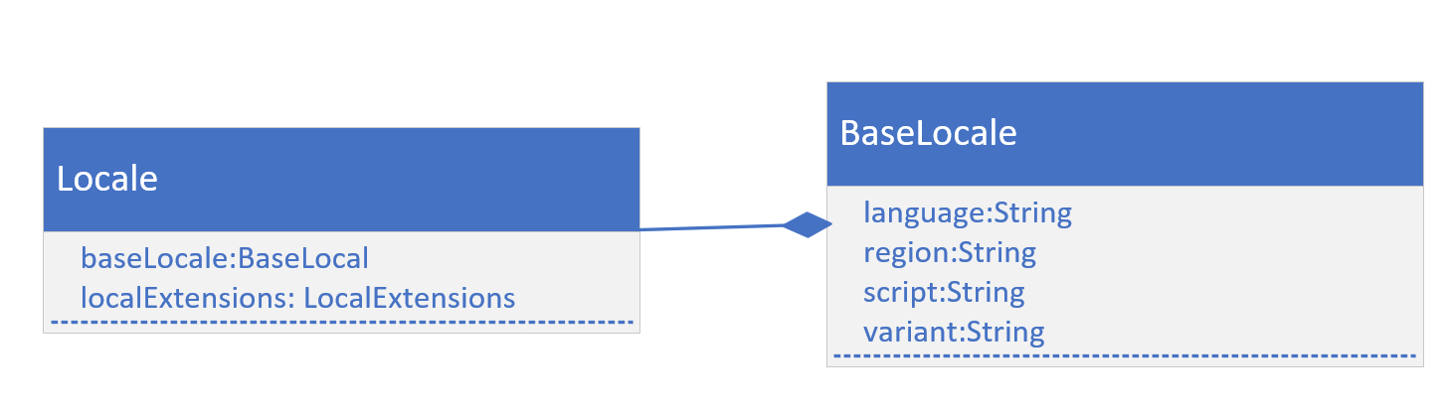
Locale
A locale has five fields, a language, a country (or region), a variant, and less apparent, are script and extensions.
Underneath the covers, most of the fields are on a BaseLocale class as shown on this slide.
COMPLETE JAVA MASTERCLASS
Localization, Introduction to Locale

Slide 57
Java's localization support
Java provides localization support for dates, numbers, and currencies with no additional effort, other than defining a Locale and passing it to certain methods.
For language constructs, other than a month or a weekday specified in a date, you'll need to do some additional work.
In this video, I'll be covering the built-in support.
COMPLETE JAVA MASTERCLASS
Localization, Introduction to Locale

Slide 58
Internationalization
Internationalization, or I18n for short, is a method of designing your application to allow language and regional elements, with the help of locales to be plug and play.
Strings used in messages or user interface elements and images are stored externally to the application.
These can be retrieved using a locale, and then displayed for a specific user.
Java uses the ResourceBundle class to support this feature.
COMPLETE JAVA MASTERCLASS
Localization, Introduction to Locale

Slide 59
Locale
On this slide, I'm showing you a useful link, which displays all of the JDK 17 supported locales.
https://www.oracle.com/java/technologies/javase/jdk17-suported-locales.html#compatlocales
COMPLETE JAVA MASTERCLASS
Localization, Introduction to Locale

Slide 60
Scheduling a meeting for people in different areas of the world
Imagine you work for a company that has employees from around the world, and you need to find an hour of time to schedule two employees to meet.
The meeting should be on a work day, Monday through Friday, and between the hours of 7 am and 9 pm (meaning the meeting should not be scheduled any later than 8 pm) for either employee.
One of the employees is on the East Coast of the United States, the other is in Sydney, Australia.
Print all the possible hours in the upcoming 10 day range, ignoring the current day, when these two employees could potentially meet together.
COMPLETE JAVA MASTERCLASS
DateTime and Localization Challenge

Slide 61
Scheduling a meeting for people in different areas of the world
Print the date and time of each possible hour, for both zones, using the employee's locale.
The example output on this slide, demonstrates what one possible hour would look like, and the dates formatted to the employee's locale.
Include the week day in the output, and the hour using am or pm, rather than a 24 hour format.
Jane [America/New_York] : Wednesday, June 14, 2023, 5:00 PM <---> Joe [Australia/Sydney] : Thursday, 15 June 2023, 7:00 am
COMPLETE JAVA MASTERCLASS
DateTime and Localization Challenge

Slide 62
The ResourceBundle class
The ResourceBundle class is an abstract class in the java.util package.
You can implement classes that extend this abstract class.
You can get an instance of a ResourceBundle, by calling one of several static getBundle methods, on the ResourceBundle class.
The latter approach is dependent on resource data, either stored in a series of files, or provided by a service.
COMPLETE JAVA MASTERCLASS
Internationalization (ResourceBundle)

Slide 63
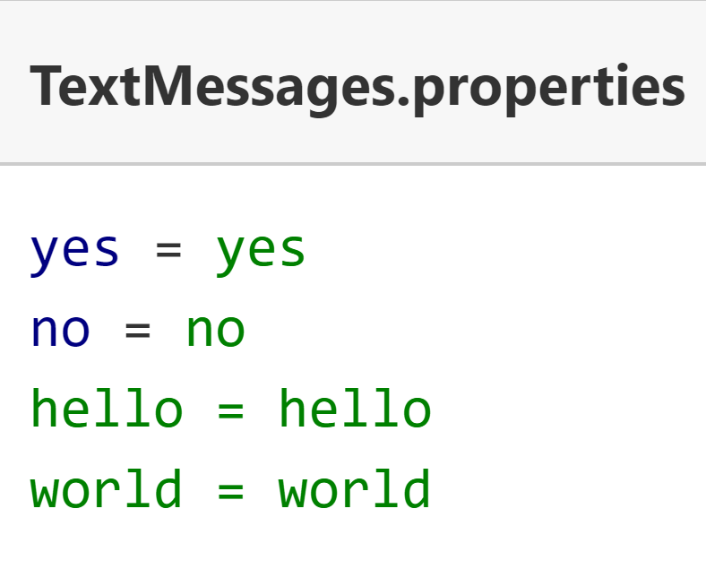
ResourceBundle data in a .properties file
Data that's customized is often textual, in the form of user messages, button labels or menu items, but may contain other elements such as images or audio components.
To date, the most common method of supplying data for a ResourceBundle, is using the properties file.
This is a simple text file, containing key value pairs.
The key is a string, a name to be used when the data is requested, and the value is also a single text literal.
The properties file name includes a base name, called the bundle name and some part of the Locale identifier, and ends with the extension .properties.
Here, I'm showing an example of a base TextMessages properties file.
COMPLETE JAVA MASTERCLASS
Internationalization (ResourceBundle)

Slide 64
ResourceBundle data
You'll create additional properties files, to support other languages.
You can think of a bundle as a series of files that have the same base bundle name but are differentiated by Locale specifics.
If you need to support the spanish language for example, you would create a TextMessages_es.properties file, with spanish language text literals for yes, no, hello and so on.
COMPLETE JAVA MASTERCLASS
Internationalization (ResourceBundle)

Slide 65
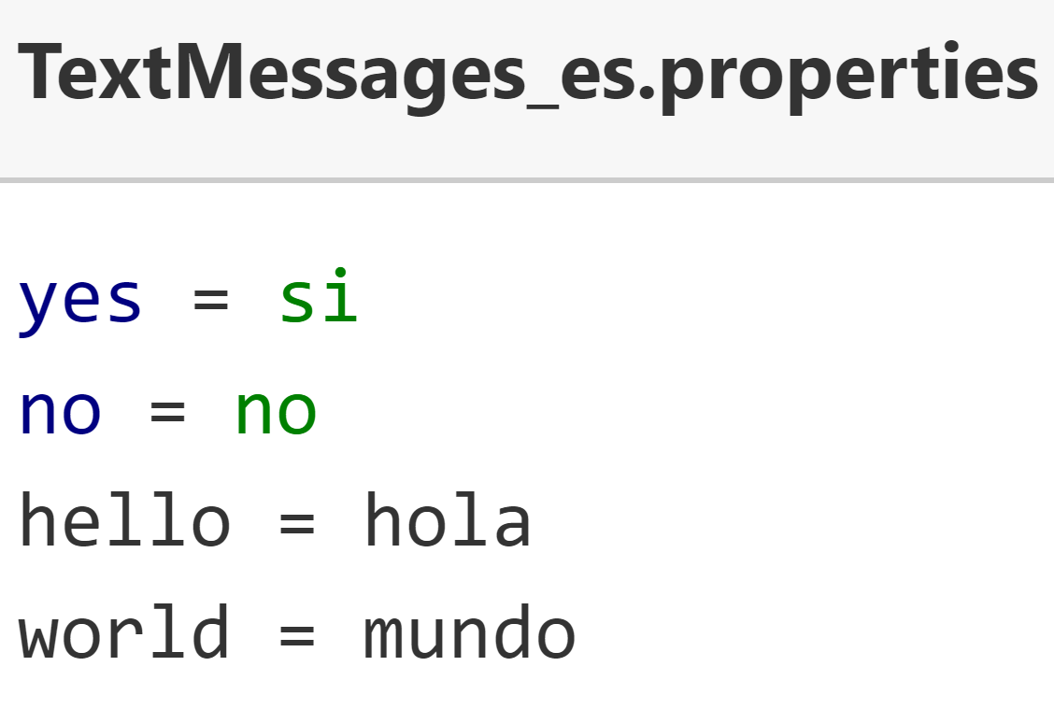
ResourceBundle data
I show an example of this file here.
Notice that the keys for both these properties files are in English, and are the same for both files.
Whatever language you choose for your keys is up to you, but they do need to be consistent across files, so that the key can be used to look up the value.
Of course, there are many language dialects, so you may need to also provide additional language variations for these, which can be done by including country, script and or a variant.
COMPLETE JAVA MASTERCLASS
Internationalization (ResourceBundle)

Slide 66
Java's matching process to locate the best bundle
Java has specific rules for searching and matching one of these properties files, to a Locale.
These rules can be found in the ResourceBundle class documentation.
Here, I include the link to this information.
https://docs.oracle.com/en/java/javase/17/docs/api/java.base/java/util/ResourceBundle.html#default_behavior
COMPLETE JAVA MASTERCLASS
Internationalization (ResourceBundle)

Slide 67
ResourceBundle - alternatives to .properties files
You're not limited to using properties files for your internationalization support.
You can extend the ResourceBundle class, or another related abstract class called the ListResourceBundle class. You'd have the subclasses house your data in code, or source it from another place.
You can use other file formats, such as xml, with a little extra configuration, by extending both the ResourceBundle and ResourceBundle.Control classes.
You can find instructions for this in the ResourceBundle.Control API documentation, the link is displayed here.
Alternately, you can make a call to a service provider.
You can also mix and match any of these methods.
https://docs.oracle.com/en/java/javase/17/docs/api/java.base/java/util/ResourceBundle.Control.html
COMPLETE JAVA MASTERCLASS
Internationalization (ResourceBundle)

