Slide 1



SIAG/CSE
BUSINESS MEETING
Thursday, March 3, 2011
6:45-7:15 pm

Slide 2

NEW CSE OFFICERS
1/1/2011-12/31/2012
Chair: Kirk Jordan
Vice Chair: Carol Woodward
Program Director: Karen Willcox
Secretary/Treasurer: Luke Olson

Slide 3
THANKS TO THE OUTGOING
SIAG/CSE OFFICERS
Tamara Kolda, Chair
Kirk Jordan, Vice Chair
Ulrich Ruede, Program Director
Carol Woodward, Secretary/Treasurer

Slide 4
MEETING AGENDA
Update CSE11 Conference
SIAG/CSE Membership Report – the State of CSE SIAG
CSE Business Review
Conferences
CSE Prizes
General Discussion
General Annoucements
Contacts

Slide 5
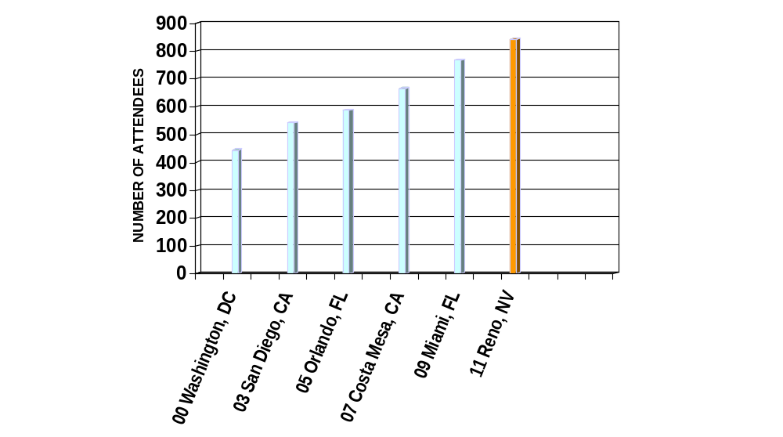
CSE Conference History
SIAG/CSE CONFERENCE HISTORY
CSE11
Reno
as of 3/3/09

Slide 6
SIAG/CSE CONFERENCE
SIAM Conference on Computational
  Science & Engineering (CSE11)
Co-chairs
Padma Raghavan,
Pennsylvania State University, USA
Ulrich Ruede,
University Erlangen-Nuremberg, Germany
Comments from the Co-Chairs?

Slide 7
SIAG/CSE
MEMBERSHIP
REPORT
(as of 12/31/10)

Slide 8
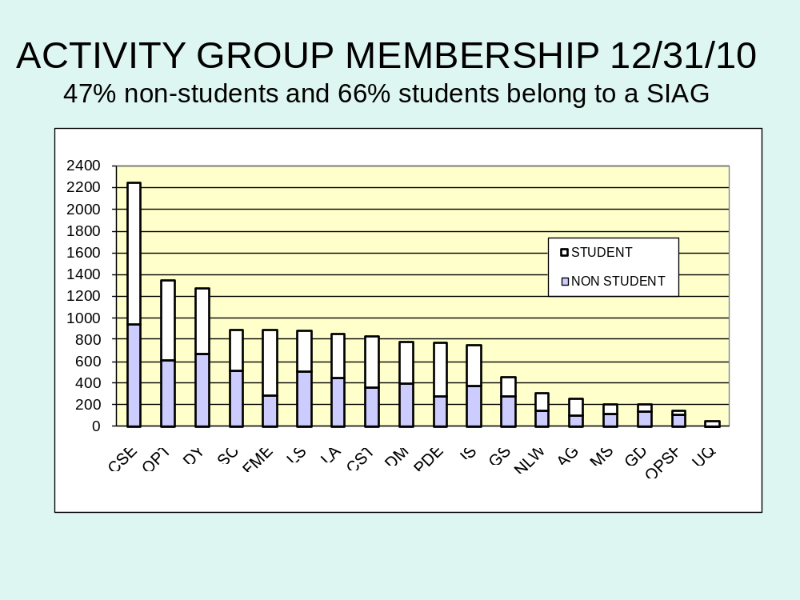

Slide 9
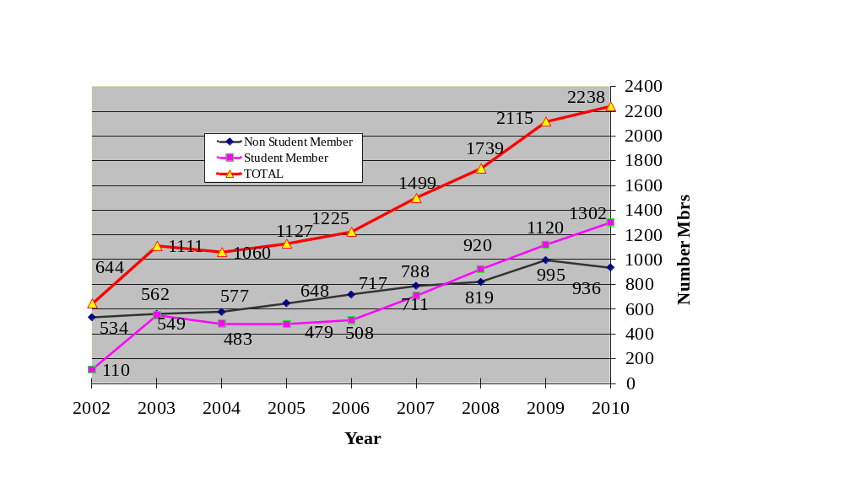

CSE Membership History

Slide 10

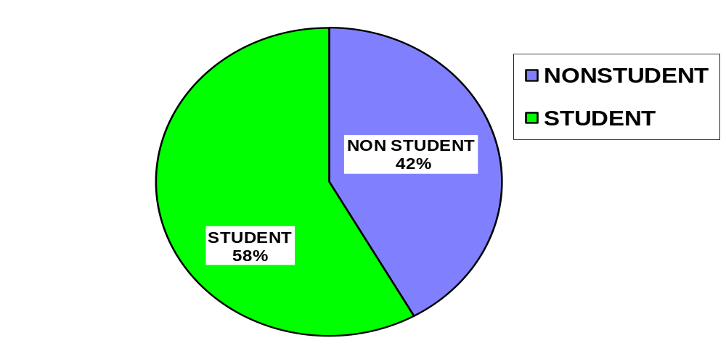
SIAG/CSE MEMBERS
2238 as of 12/31/10

Slide 11
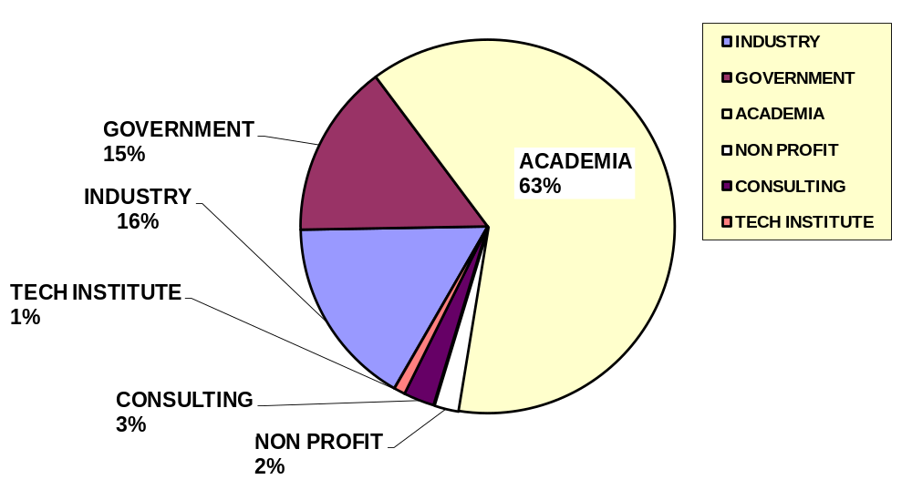
SIAG/CSE MEMBERS BY EMPLOYER TYPE not including students

Slide 12

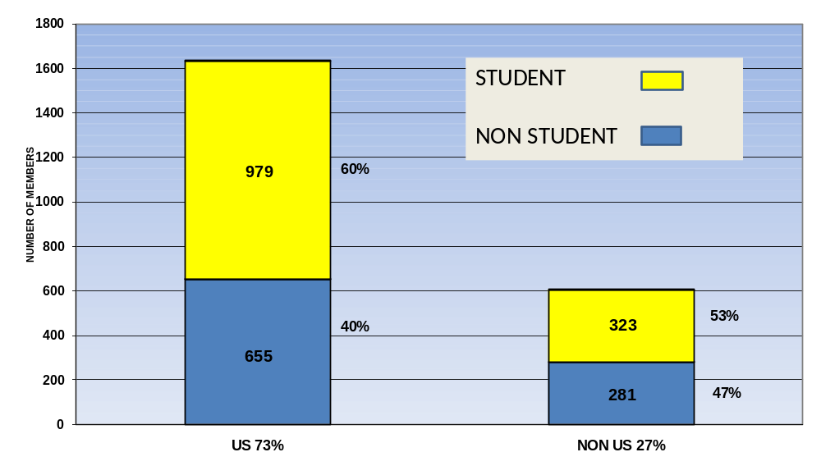
SIAG/CSE MEMBERS BY GEOGRAPHY
73% US, 27% Outside US

Slide 13
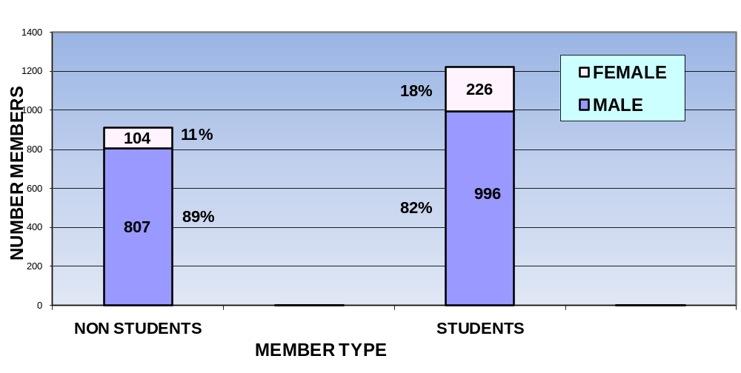
SIAG/CSE MEMBERSHIP BY GENDER
MALE 85% FEMALE 15%

Slide 14
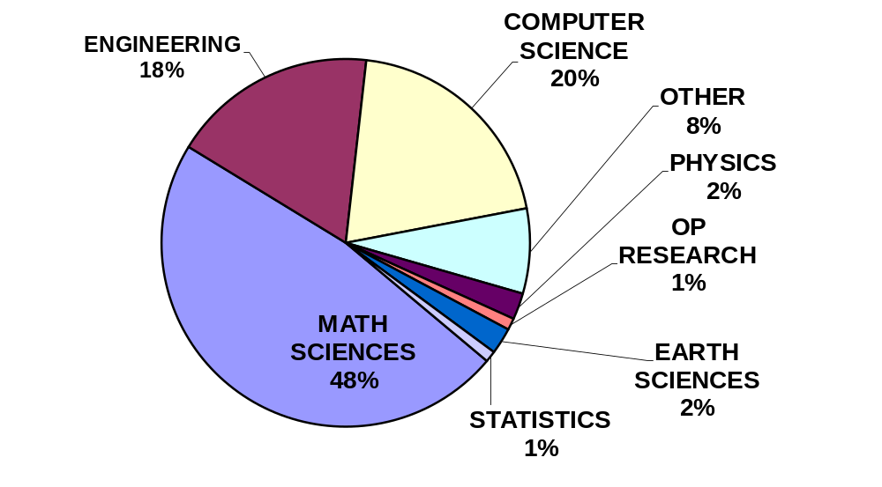
SIAG CSE DEPARTMENTS

Slide 15
CSE BUSINESS
SIAG Charter renewed through 2012 - Next charter renewal due 6/30/2012.
SIAG Elections in 2012:
  Nominating committee will be formed early next year.
  Please email suggestions for committee members or candidates
Electronic Resources
  Moderated Mailing List: siam-cse@siam.org (Carol Woodward to Comment)
  Wiki: http://wiki.siam.org/siag-cse/
    Looking for volunteers to continue to up-date the content! Email Kirk
  SIAG/CSE website:
    http://www.siam.org/activity/cse/
SIAM News: Request for story ideas (email Jim Crowley or Gail Corbett with ideas)

Slide 16
CONFERENCES
ICIAM July 18-22, 2011 - Vancouver, British Columbia, Canada
CSE 13
  Organizers:
    Karen Wilcox
    TBD
  Date: Late February/Early March 2013
  Location: Southeast, East
    Possible locations
      New Orleans, Tampa, Austin, San Antonio, other locations?
  Program Committee: Being Formed
  Specific topics or nominations/volunteers for program committee? Email Karen or Kirk
Organize CS&E tracks or minisymposia at 2014 SIAM Annual Meeting
  Ideas on topics – More at CSE13 but send thoughts now - - Email Karen
CSE 15
  Timing? Late February/Early March
  Location ideas? Email Karen or Carol

Slide 17
CSE PRIZES
SIAM/ACM Prize in Computational Science and Engineering
  Awarded to J. Tinsley Oden – 2011
  Nominations for 2013
Bavarian Graduate School of Computational Engineering (BGCE, http://www.bgce.de/ )
  Ulrich Rüde or Hans-Joachim Bungartz– comment?
Should CSE SIAG have a student prize, too?

Slide 18

GENERAL DISCUSSION
Are publication needs of CS&E community being served by SIAM?
  Ulrich Rüde to comment on new format of SISC
Comments on CSE conferences?
On CS&E at other SIAM conferences?
What role should SIAG/CSE play in…
  Government policy?
  Education?
  Career guidance?
  Collection of Impact – develop a template?
The next “Petzold report”
  Coordinated by Kirk – volunteers to assist needed – email Kirk
Your SIAG -
  Get involved
  Bring forth ideas
  Let Officers know how we can help you
Possible Other Activities?
Other Business?

Slide 19
Panel: Future of Computing
Panel: Future Computing
  9:30 AM - 11:30 AM, Friday, March 4
  Tahoe Room
  “Drivers for rapid changes in the nature of computing and its impacts on CS&E “
Panelists
Andrew Chien, University of California, San Diego
Dan Reed, Microsoft Research
John Shalf, Lawrence Berkeley National Lab
Chairs
Kirk E. Jordan, IBM T.J. Watson Research Center
Robert Schreiber, Hewlett-Packard Laboratories

Slide 20
NEW SIAG/UQ
NEW SIAG/UQ
  New SIAM Activity Group on Uncertainty Quantification (SIAG/UQ)
  a joint collaboration between applied/computational math and statistics, partnering with ASA

Slide 21
Join SIAM!
• If you paid non-member registration fees, you’ll get a discount on membership,
  Non-member registrant, receive $120 credit,
  join for $13.
  Non-member mini speaker/organizer registrant, receive $60 credit, join for $73.
  • If you’re not a SIAG/CSE member, but are a SIAM member, join SIAG/CSE for free.
  • SIAM and SIAG memberships are a good way to be seen/remembered.

Slide 22

SIAG/CSE CONTACTS
Chair: Kirk Jordan
kjordan@us.ibm.com
Vice Chair: Carol Woodward
cswoodward@llnl.gov
Program Director: Karen Willcox
kwillcox@mit.edu
Secretary/Treasurer: Luke Olson
lukeo@illinois.edu

