Slide 1
ISS Project Presentation
Peter Hogya

Slide 2
Overview
Gathered sample pcap files from various sources each containing packet captures of a single attack or normal traffic
Processed pcap files using Wireshark to filter for specific packet features and to remove problematic packets and get csv files
Used Python to preprocess csv files
Converted csv files to arff files
Used Weka to classify packet captures
Took the results from Weka and tried to create a rule set in Snort

Slide 3
Part 1 : Decision Trees
Weka - Signature - Precision : 0.997 Recall : 0.996 Accuracy : 0.999
Weka - Anomaly - Precision : 0.997 Recall : 0.999 Accuracy : 0.999
Snort - Signature - Precision : 0.999 Recall : 0.917 Accuracy : 0.990
The Anomaly rule set proved difficult to test because each attack would trigger multiple alerts.
One of the attacks was completely missed by Snort. It did report those packets had bad checksums so it's possible they were dropped anyway.

Slide 4
Part 2 : Neural Networks
Weka - Attack 1 - Precision : 1 Recall : 1 Accuracy : 1
Weka - Attack 2 - Precision : 1 Recall : 1 Accuracy : 1
Weka - Attack 3 - Precision : 0.929 Recall : 0.433 Accuracy : 0.996
Weka - Attack 4 - Precision : 0.89 Recall : 0.968 Accuracy : 0.992
Weka - Attack 5 - Precision : 0.988 Recall : 0.988 Accuracy : 0.999
Weka - Signature - Precision : 0.882 Recall : 0.706 Accuracy : 0.954
Weka - Anomaly - Precision : 0.869 Recall : 0.675 Accuracy : 0.943

Slide 5
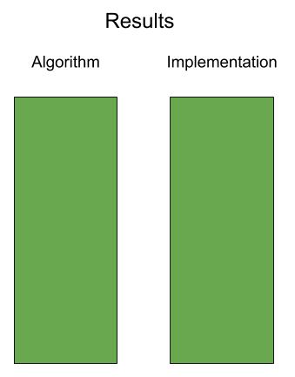
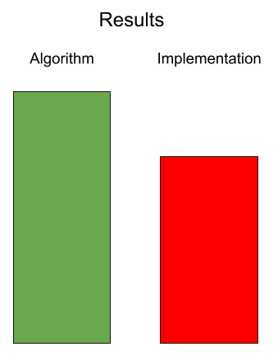
Separation of Algorithm and Implementation Testing
In part 1 both the output from Weka as well as the rule set in Snort were tested.
These results can determine what part of the process should be improved to achieve better results.

Slide 6
Limited Functionality in IDS Rule Syntax
Currently IDS rule syntax in tools like Snort and Suricata lack ranges in many packet features. They're only supported with ports and IP addresses.
Machine learning algorithms attempt to summarize information about known points in the n-dimensional feature space to classify unknown points.
The outputs of these algorithms do not work well with systems that expect point by point answers.

Slide 7
Neural Networks VS Decision Trees
In my project the Decision Trees were more effective overall and were much easier to implement
Results for some individual attacks were perfectly classified with Neural Networks
Implementing Neural Networks using Snort's rule syntax proved problematic
Utilizing Neural Networks effectively would require more / better data, more time, software with more functionality, better hardware

