Slide 1

THE DOUBLE PIVOT SIMPLEX METHOD
TODD EASTON and FABIO VITOR
Department of Industrial and Manufacturing Systems Engineering
Kansas State University
teaston@ksu.edu, fabioftv@ksu.edu
APRIL 25, 2016

Slide 2
Outline
Significance and history
Simplex Method and classic pivots
Solving two variable problems with the Slope Algorithm
Multiple Pivot Framework
Double Pivot Simplex Method
Degeneracy
Computational Study
Conclusions and future research

Slide 3
History of Solving LPs
1947 George Dantzig created the simplex method, which optimally solves linear programs
1954 Dantzig and Orchard-Hays Revised Simplex Method
1979 Khachiyan polynomial time ellipsoid algorithm
1984 Karmarkar polynomial time algorithm
Currently many interior point algorithms
There exists a debate as to whether or not interior point algorithms are better than The Simplex Method.
Can The Simplex Method be improved?

Slide 4
Significance of Solving Linear Programs
Kantorovich and Koopmans win 1975 Nobel Prize in Economics.
Applications in transportation, manufacturing, medicine, finance, governmental policy, etc.
Millions of linear programs (LP) are solved each day to help create a more efficient world.
The Simplex Method is recognized by the Journal of Computing in Science & Engineering as one of the top 10 algorithms of the twentieth century.

Slide 5
Personal History
1992 Take OR class at BYU
1993 Master’s student at Stanford and Dantzig’s final Ph.D. LP lecture
Fall 2011 graphical sensitivity analysis during IMSE 560
Summer 2014 teaching IMSE 680, gut instinct verified
Summer 2015 Fabio started working on Double Pivot Simplex Method

Slide 6




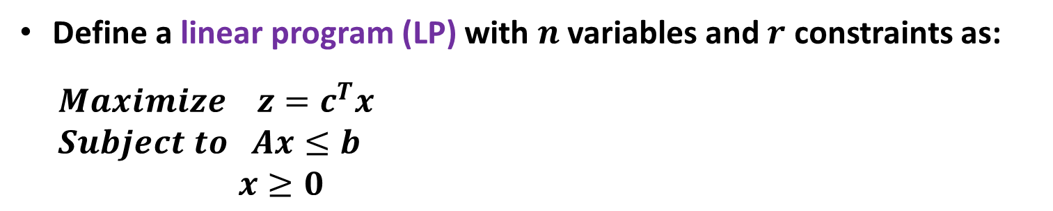
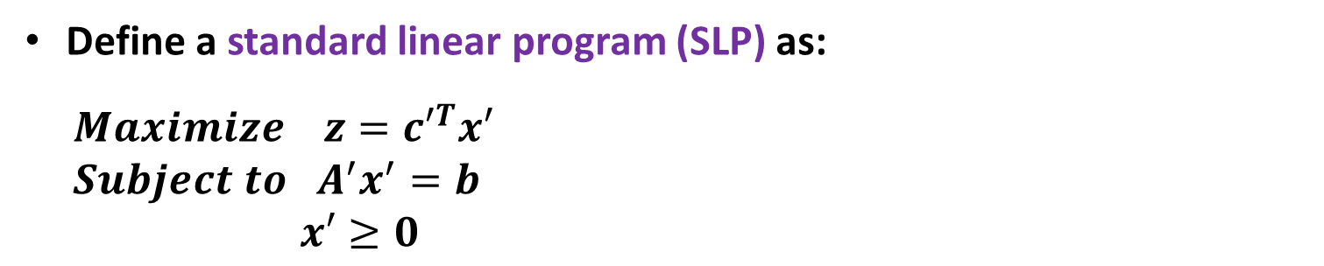
THE DOUBLE PIVOT SIMPLEX METHOD
LINEAR PROGRAMMING BASICS
Define a linear program (LP) with $n$ variables and $r$ constraints as:
$$Maximize z=c^{T}x$$
$$Subject to Ax≤b$$
$x≥0$
Define a standard linear program (SLP) as:
$$Maximize z={c′}^{T}x′$$
$$Subject to A^{′}x^{′}=b$$
$x′≥0$
APRIL 25, 2016

Slide 7
THE DOUBLE PIVOT SIMPLEX METHOD
THE SIMPLEX METHOD DEFINITONS
BV ⊆ N’ is a basis if A_{.BV} has rank r,
NBV= N’\BV
If A_{.BV}⁻¹b ≥0, then BV is a feasible basis
If c_{BV}^{T} A_{.BV}⁻¹A_{.p}-c_{p} ≥0 for all p ∈ NBV, then BV is an optimal basis.
APRIL 25, 2016

Slide 8
The Simplex Method
Start with a feasible basis
Select p ∈ NBV such that c_{BV}^{T} A_{.BV}⁻¹A_{.p}-c_{p} <0, if none exists, then optimal
Select a row by the ratio test
Pivot (swap p with the basic variable from the row of the ratio test)
Repeat until an optimal basis is obtained or it is shown to be unbounded

Slide 9
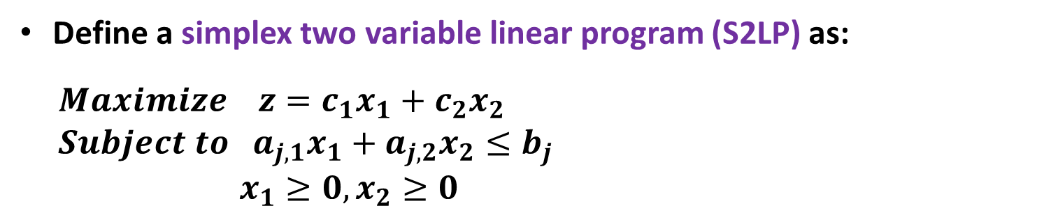

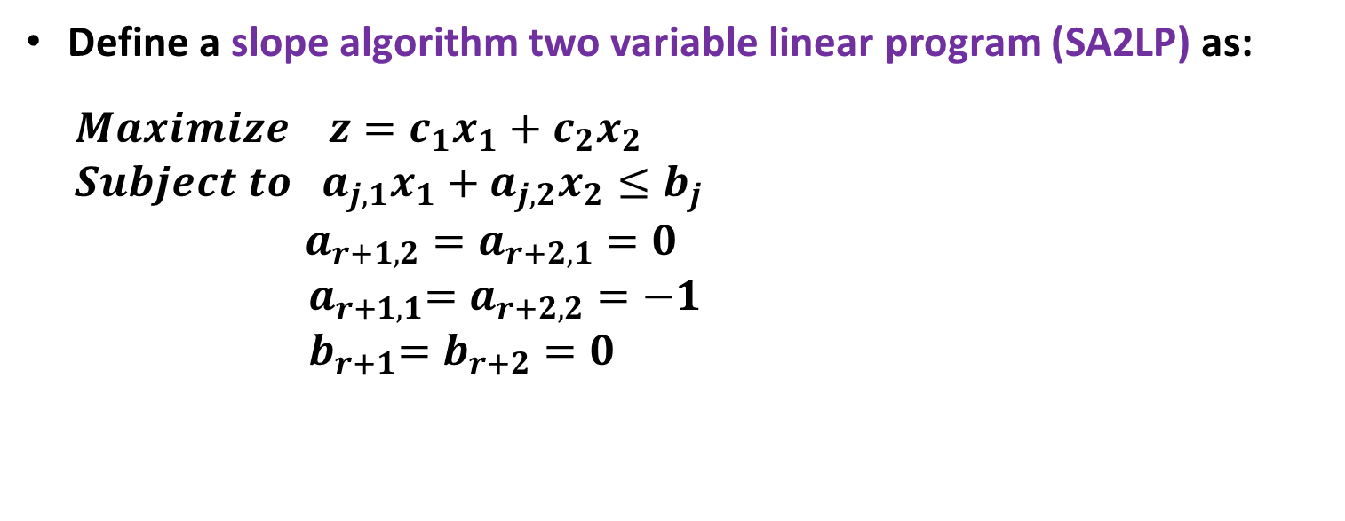

THE DOUBLE PIVOT SIMPLEX METHOD
THE SLOPE ALGORITHM
Define a simplex two variable linear program (S2LP) as:
$$Maximize z=c_{1}x_{1}+c_{2}x_{2}$$
$$Subject to a_{j,1}x_{1}+a_{j,2}x_{2}≤b_{j}$$
$x_{1}≥0, x_{2}≥0$
$$j∈R=\{1,2,…,r\}$$
Define a slope algorithm two variable linear program (SA2LP) as:
$$Maximize z=c_{1}x_{1}+c_{2}x_{2}$$
$$Subject to a_{j,1}x_{1}+a_{j,2}x_{2}≤b_{j}$$
$a_{r+1,2}=a_{r+2,1}=0$
$${ a}_{r+1,1}=a_{r+2,2}=−1$$
$${ b}_{r+1}=b_{r+2}=0$$
$$j∈R′=\{1,2,…,r+2\}$$
APRIL 25, 2016

Slide 10
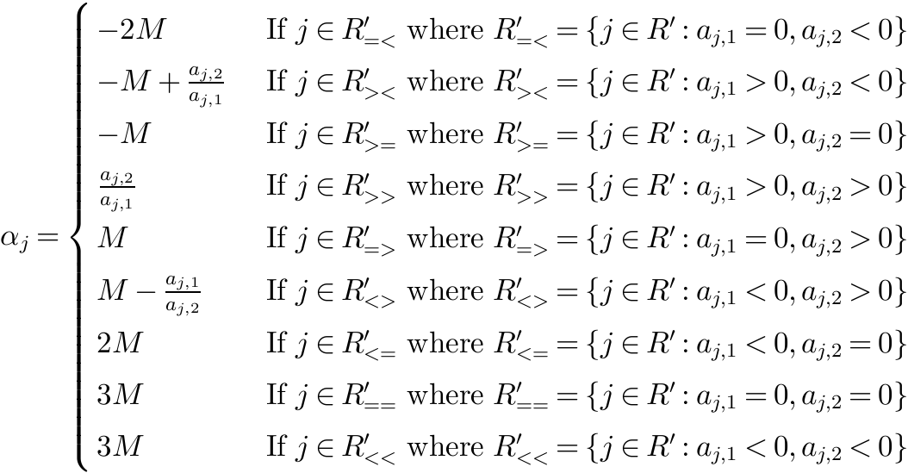
THE DOUBLE PIVOT SIMPLEX METHOD
Calculate a “slope” or angle parameter for each constraint
APRIL 25, 2016

Slide 11
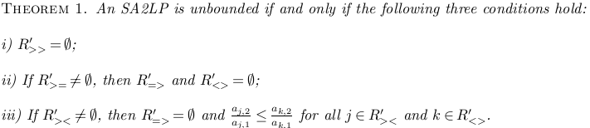
THE DOUBLE PIVOT SIMPLEX METHOD
THE SLOPE ALGORITHM
Theorem for an unbounded SA2LP
APRIL 25, 2016

Slide 12
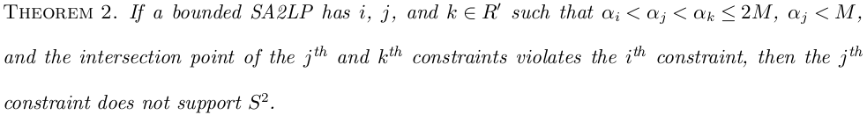
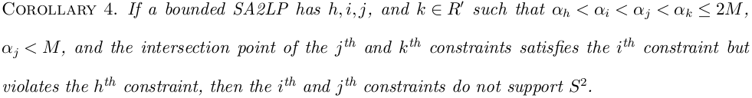
THE DOUBLE PIVOT SIMPLEX METHOD
THE SLOPE ALGORITHM
Theorem/Corollary to check for infeasibility
APRIL 25, 2016

Slide 13
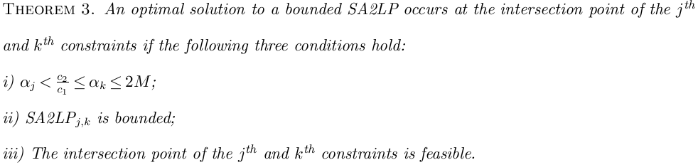
THE DOUBLE PIVOT SIMPLEX METHOD
THE SLOPE ALGORITHM
Theorem for the optimal solution to a bounded SA2LP
APRIL 25, 2016

Slide 14
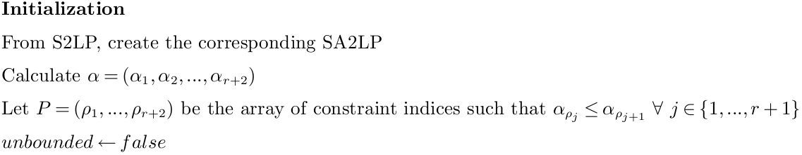

THE DOUBLE PIVOT SIMPLEX METHOD
THE SLOPE ALGORITHM
Running Time (Initialization):
APRIL 25, 2016

Slide 15
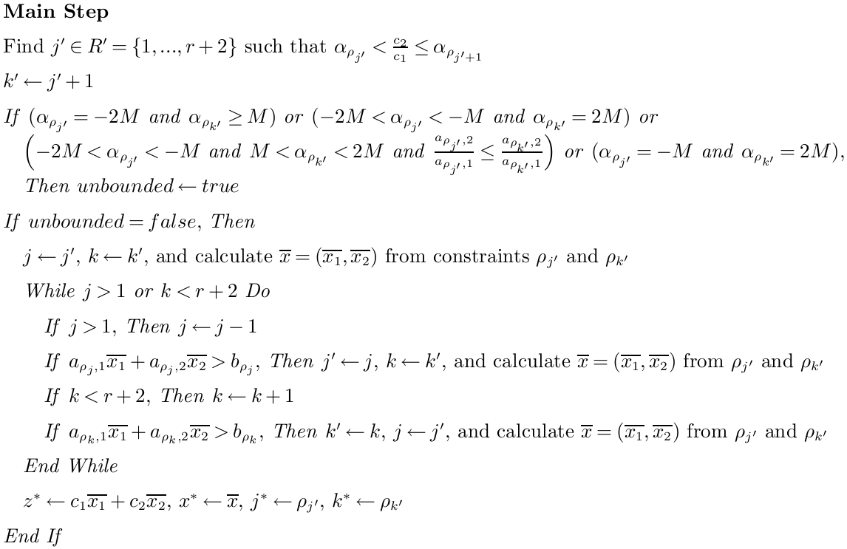

THE DOUBLE PIVOT SIMPLEX METHOD
THE SLOPE ALGORITHM
Running Time (Main Step):
APRIL 25, 2016

Slide 16
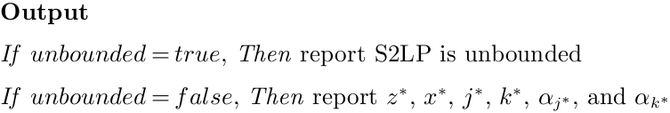

THE DOUBLE PIVOT SIMPLEX METHOD
THE SLOPE ALGORITHM
Running Time (Output):
Running Time (The Slope Algorithm):
APRIL 25, 2016

Slide 17
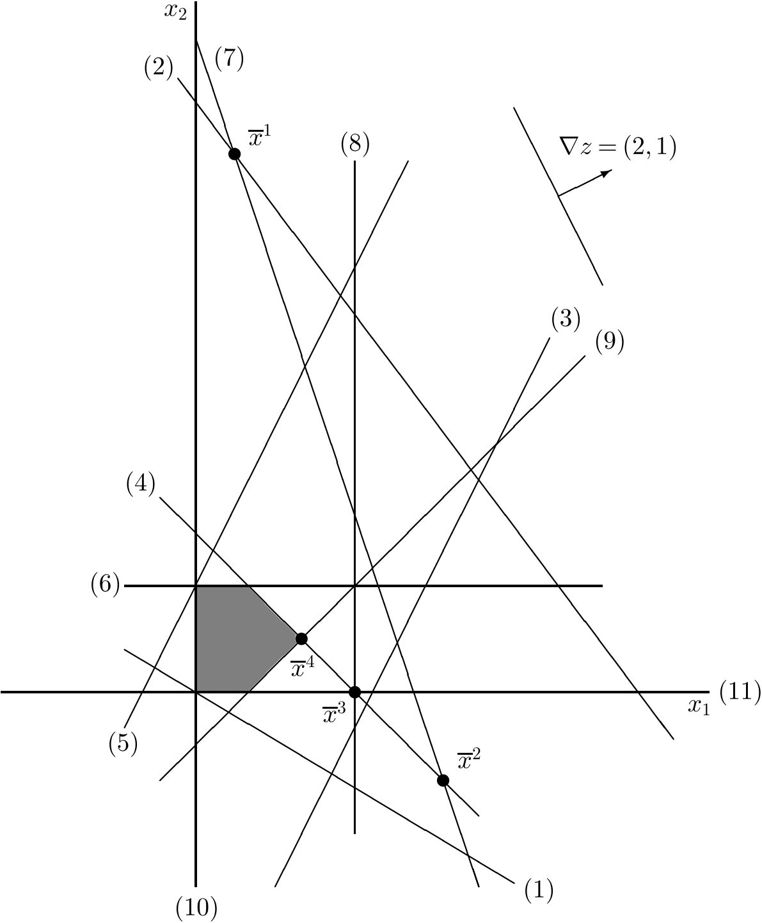
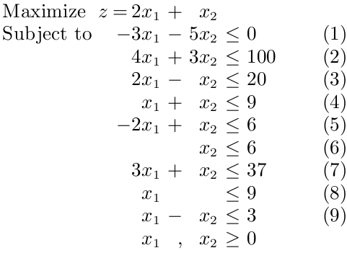
THE DOUBLE PIVOT SIMPLEX METHOD
THE SLOPE ALGORITHM (EXAMPLE)
APRIL 25, 2016

Slide 18
Multiple Pivot Simplex Method
Start with a feasible BV and select Q ⊆ NBV with at least one negative reduced cost
Create a multiple pivot linear program (MPLP)
Maximize (c_{BV}^{T} A_{.BV}⁻¹A_{.Q}-c_{Q})x_{Q}
Subject to A_{.BV}⁻¹A_{.Q}x_{Q}+I x_{BV} = b
x_{Q∪BV} ≥ 0
Replace BV with the optimal basis of MPLP

Slide 19
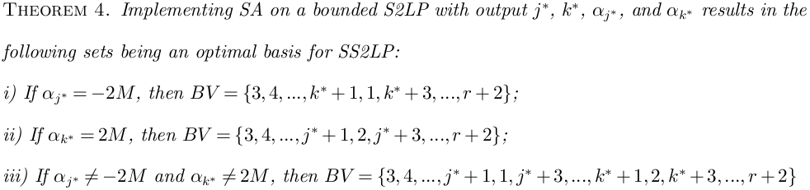
THE DOUBLE PIVOT SIMPLEX METHOD
THE DOUBLE PIVOT SIMPLEX METHOD
Theorem for the optimal basis of an SS2LP
APRIL 25, 2016

Slide 20
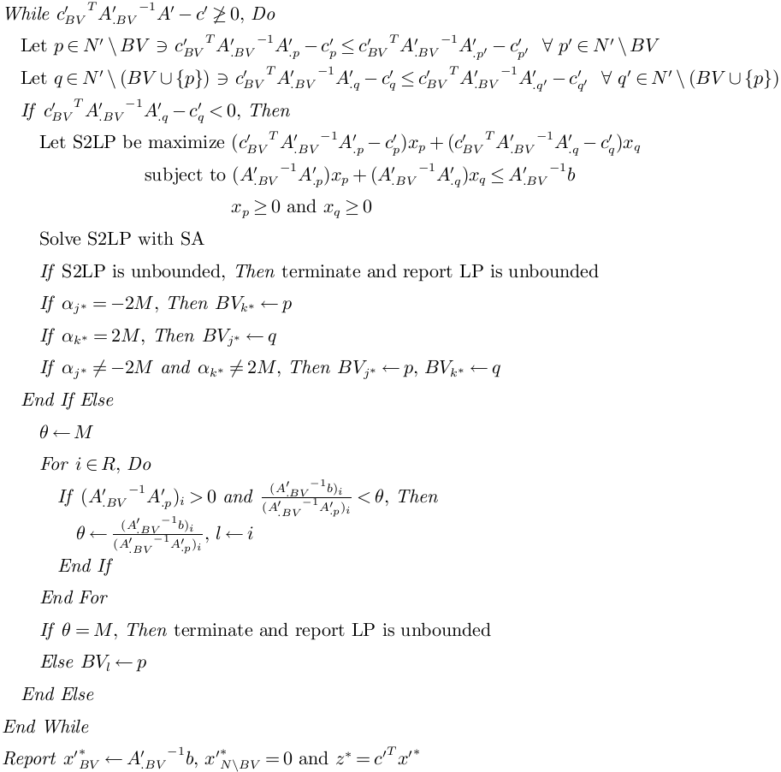
THE DOUBLE PIVOT SIMPLEX METHOD
THE DOUBLE PIVOT SIMPLEX METHOD
APRIL 25, 2016

Slide 21

THE DOUBLE PIVOT SIMPLEX METHOD
THE DOUBLE PIVOT SIMPLEX METHOD
Running Time (The Double Pivot Simplex Method):
APRIL 25, 2016

Slide 22
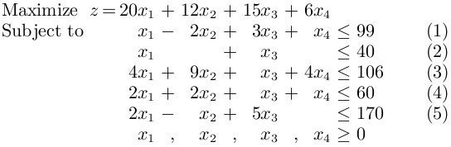
THE DOUBLE PIVOT SIMPLEX METHOD
THE DOUBLE PIVOT SIMPLEX METHOD (EXAMPLE)
APRIL 25, 2016

Slide 23
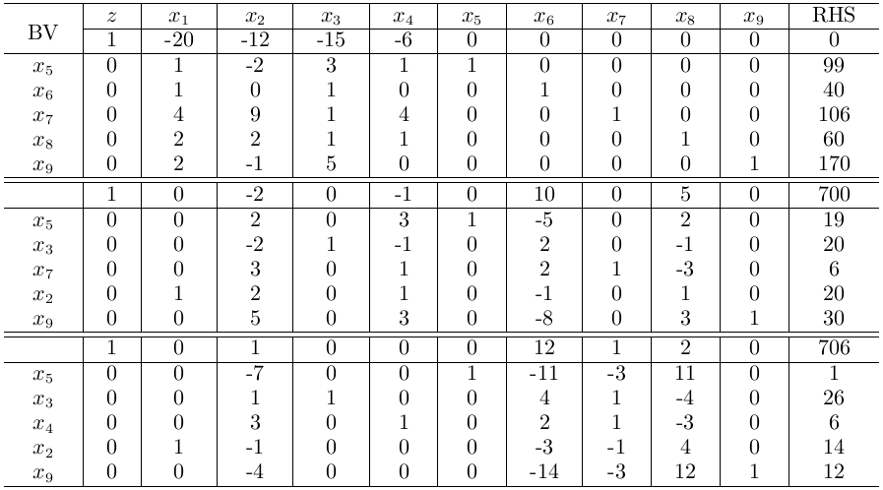
THE DOUBLE PIVOT SIMPLEX METHOD
THE DOUBLE PIVOT SIMPLEX METHOD (EXAMPLE)
APRIL 25, 2016

Slide 24
DPSM Benefits
The Simplex Method requires 4 iterations, not two.
DPSM has same theoretical running time as The Simplex Method
DPSM will improve the objective function by at least as much as The Simplex Method
Calculate the relative benefit per iteration

Slide 25
THE DOUBLE PIVOT SIMPLEX METHOD
THE DOUBLE PIVOT SIMPLEX METHOD AND DEGENERACY
Degeneracy occurs when an SLP has at least one basic variable equals 0
Degeneracy may force the Simplex Method to perform extra operations, pivoting at the same point
Degeneracy may force the Simplex Method to cycle, which prohibits termination
Implementing the Slope Algorithm instead of the ratio test in a simplex framework diminishes some of the issues caused by degeneracy
APRIL 25, 2016

Slide 26
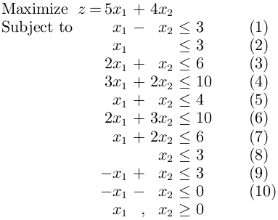
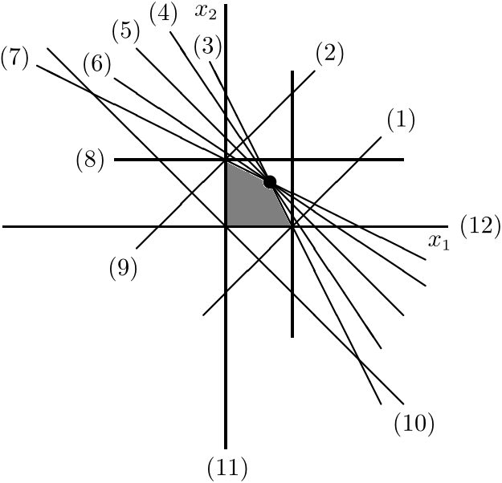
THE DOUBLE PIVOT SIMPLEX METHOD
DEGENERACY (EXAMPLE)
APRIL 25, 2016

Slide 27
Degeneracy Benefits
The Simplex Method finds the basis that corresponds to constraints 5 and 6. It has the optimal point but still needs to pivot.
The Simplex Method cycles on 11 classical problems (Gass and Vinjamuri 2004).
DPSM doesn’t cycle on any of these instances
DPSM can still be degenerate and may cycle

Slide 28
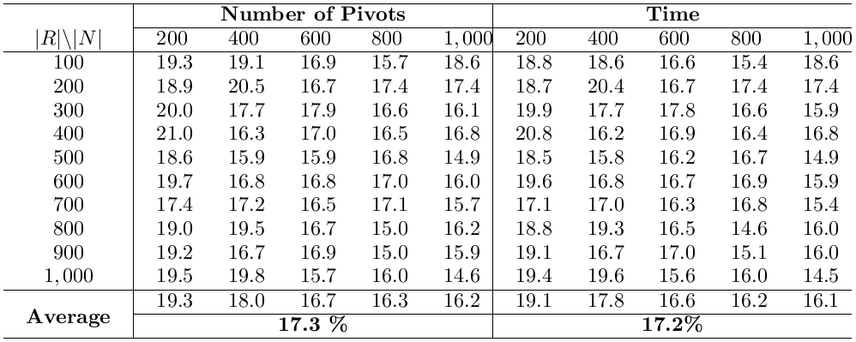
THE DOUBLE PIVOT SIMPLEX METHOD
COMPUTATIONAL STUDY
Random Dense Linear Programs
Number of pivots decreased by 17.3% and solution time by 17.2%, on average;
Relative Improvement for Double Pivots with two entering variables: 472.5%;
Relative Improvement for Double Pivots with only one single variable entering (second most negative reduced cost): 134.8%;
APRIL 25, 2016

Slide 29
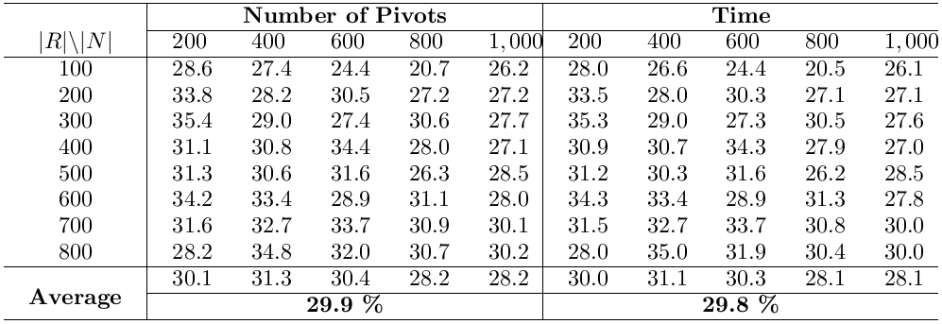
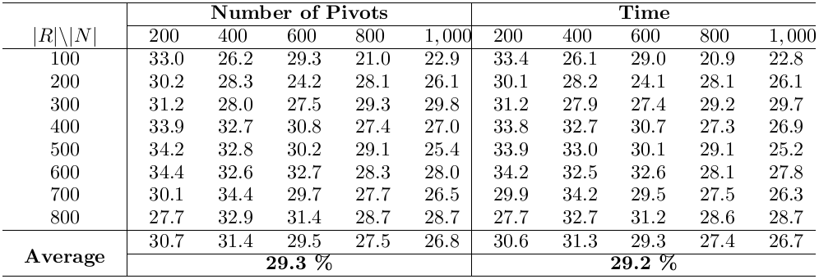
THE DOUBLE PIVOT SIMPLEX METHOD
COMPUTATIONAL STUDY
Sparse Random Linear Programs
Number of pivots decreased by 29.4% and solution time by 29.3%, on average;
Relative Improvement for Double Pivots with two entering variables: 635.1%;
Relative Improvement for Double Pivots with only one single variable entering (second most negative reduced cost): 230.5%;
APRIL 25, 2016

Slide 30
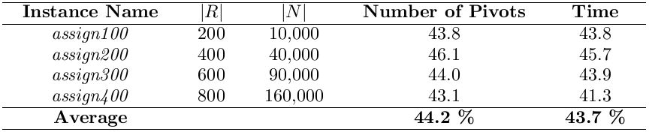
THE DOUBLE PIVOT SIMPLEX METHOD
COMPUTATIONAL STUDY
Benchmark Instances (Linear Relaxation of Assignment Problem)
Number of pivots decreased by 44.2% and solution time by 43.7%, on average.
APRIL 25, 2016

Slide 31
THE DOUBLE PIVOT SIMPLEX METHOD
CONCLUSIONS
The Double Pivot Simplex Method is a significant advancement to one of the most famous and important algorithms in science;
An iteration of the Double Pivot Simplex Method has the same theoretical running time as an iteration of the Simplex Method;
The objective value improvement per iteration of a double pivot is as least as large as the improvement from a classic pivot;
The Double Pivot Simplex Method also diminishes some of the negative effects caused by degeneracy;
The Double Pivot Simplex Method decreases the number of pivots and solution time by approximately 20% and 30%, respectively, compared to the Simplex Method.
APRIL 25, 2016

Slide 32
THE DOUBLE PIVOT SIMPLEX METHOD
FUTURE WORK
Double Pivot Dual Simplex Method
Double Pivot Simplex Method with Upper Bounds
Branch and bound!
Triple (or more) pivot method
Improve interior point methods, nonlinear programming algorithms, and other optimization techniques through a two dimensional search algorithm.
APRIL 25, 2016

Slide 33
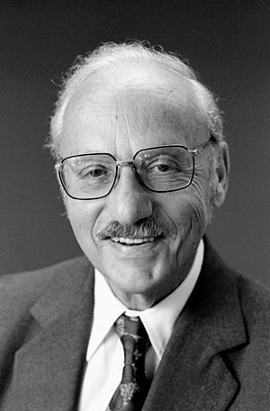
I would like to thank George Dantzig. He still inspires me to believe that everything can be improved. Questions?
http://news.stanford.edu/
news/2006/june7/gifs/dantzig.jpg

