Slide 1
Property-Based Testing
Paul Holser
The Container Store
September 24, 2016

Slide 2
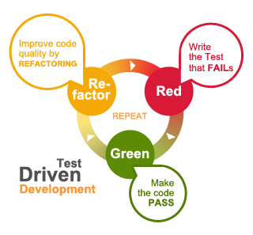
TDD
Specify a tiny bit of system behavior via a test
Write just enough code to get the test to pass
Refactor implementation and tests
Three laws
Notes:
Test-driven development has worked its way (slowly) into the mainstream.
Three laws of TDD (Uncle Bob?)
Write no new production code except to make a failing test pass
Write no more test than is sufficient to fail (not compiling == fail)
Write no more production code than is sufficient to pass the one failing test
Great way to constrain development, work in small batches...

Slide 3
Prime Factors Kata
Given a positive integer n, produce a list of all the prime factors of n.
Notes:
We might choose to practice our TDD skills on a kata.

Slide 4
using Xunit; public class PrimeFactorsTest { [Fact] public void Two() { Assert.Equal( new List<int> { 2 }, PrimeFactors.Of(2));
} }

Slide 5
public static class PrimeFactors { public static List<int> Of(int n) {
// ... } }

Slide 6
public class PrimeFactorsTest { // ... [Fact] public void Three() { Assert.Equal( new List<int> { 3 }, PrimeFactors.Of(3));
} }

Slide 7
public class PrimeFactorsTest { // ... [Fact] public void Four() { Assert.Equal( new List<int> { 2, 2 }, PrimeFactors.Of(4));
} }

Slide 8
public class PrimeFactorsTest { // ... [Fact] public void Five() { Assert.Equal( new List<int> { 5 }, PrimeFactors.Of(5));
} }

Slide 9
public class PrimeFactorsTest { // ... [Fact] public void Six() { Assert.Equal( new List<int> { 2, 3 }, PrimeFactors.Of(6));
} }

Slide 10
Parameterized test
[Theory] [MemberData(nameof(Examples))] public void VerifyFactors( int n, List<int> factors) { Assert.Equal(n, PrimeFactors.Of(n)); } public static IEnumerable<object> Examples() { yield return new object[] { 2, new List<int> { 2 } }; // ... }
Notes:
We start to notice a pattern, and work to eliminate the duplication.
Many test frameworks allow for some some of data-driven test.
Here’s how you might do it using Xunit.

Slide 11
IntelliTest
“IntelliTest explores your .NET code to generate test data and a suite of unit tests. For every statement in the code, a test input is generated that will execute that statement. A case analysis is performed for every conditional branch in the code. For example, if statements, assertions, and all operations that can throw exceptions are analyzed. This analysis is used to generate test data for a parameterized unit test for each of your methods, creating unit tests with high code coverage.”
https://msdn.microsoft.com/library/dn823749.aspx
Notes:
Need VS Enterprise for this.

Slide 12
How confident are you that your algorithm works for any positive integer?
How might you gain more confidence?

Slide 13
public static IEnumerable<object> Examples() { // ... yield return new object[] { 67239812, new List<int> { 2, 2, 61, 275573 } }; // ... yield return new object[] { 949124899, new List<int> { 10723, 88513 } }; }
Notes:
We could continue adding examples. There sure are a lot of positive integers.

Slide 14

Example-based tests
Give us confidence that our code works on the examples we cooked up
How to gain confidence that our code will work for any valid input?

Slide 15

Property-based tests
Given arbitrary inputs that satisfy some constraints, what should be true about the output?

Slide 16
Prime Factors: Property 1
For any int n > 1, multiplying all the elements of PrimeFactors.Of(n) should result in n.
Notes:
These are factors, after all.
The example-based tests don’t explicitly say this should be true.

Slide 17
Prime Factors: Property 2
For any int n > 1, every element of PrimeFactors.Of(n) must be prime.
Use a primality test: Miller-Rabin, AKS...
Notes:
These are prime factors, after all.

Slide 18
Prime Factors: Property 3
For any ints m and n > 1, where m != n, PrimeFactors.Of(m) != PrimeFactors.Of(n)
Every factorization is unique
Notes:
The Fundamental Theorem of Arithmetic

Slide 19
There sure are a lot of ints > 1
Time vs. confidence trade-off

Slide 20
Property-based testing
Need a way to specify properties
Need a way to generate random inputs that satisfy the constraints
Need a way to control the number of trials
Notes:
Control number of trials as a confidence slider.

Slide 21
QuickCheck
Started it all in Haskell
Properties are functions that return Bool
Trials controlled via args to quickCheck
Random values...?
Notes:
******************
******************
Dive out to demo of Haskell QuickCheck
******************
******************

Slide 22
Spawned...
Java: JUnit Theories, QuickTheories, junit-quickcheck
Ruby: rantly, theft
Python: hypothesis
Scala: ScalaCheck
JavaScript: jsverify
...

Slide 23
FsCheck
The .NET way
Written in F#
Write properties in F#, C#
Verify them with NUnit runner, Xunit runner, ...
Notes:
******************
******************
Dive out to VS – prime factors
******************
******************

Slide 24
Shrinking
If a counterexample for a property is found, keep trying to find smaller and smaller examples that still fail the property
Notes:
******************
******************
Back to Haskell ... Shrinking
******************
******************

Slide 25
Random seed
If a counterexample is found, can replay the test using the random generator seeds that produced it.
Notes:
******************
******************
Dive out to demo – junit-quickcheck, introduce a fault, look at the assertion error message
******************
******************

Slide 26
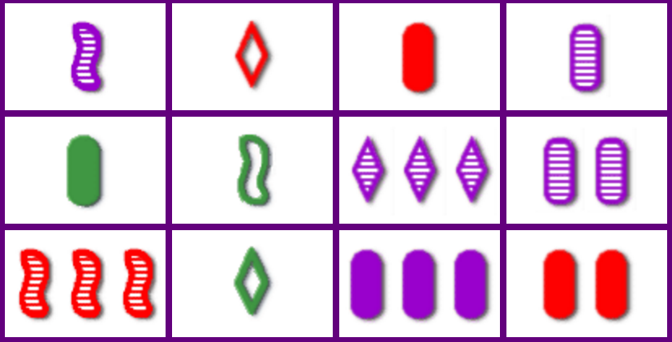
SET®

Slide 27
SET®
81 unique cards
Each has:
One, two or three symbols
Diamond, oval, or squiggle
Red, green, or purple
Solid, shaded, or open
Goal: Find ”sets” in a layout of cards

Slide 28
SET®
A “set” is a group of three cards, in which for each of the characteristics:
Number
Shape
Color
Shading
the characteristic is all the same, or all different.

Slide 29
SET®
Notes:
Dive out to demo

Slide 30
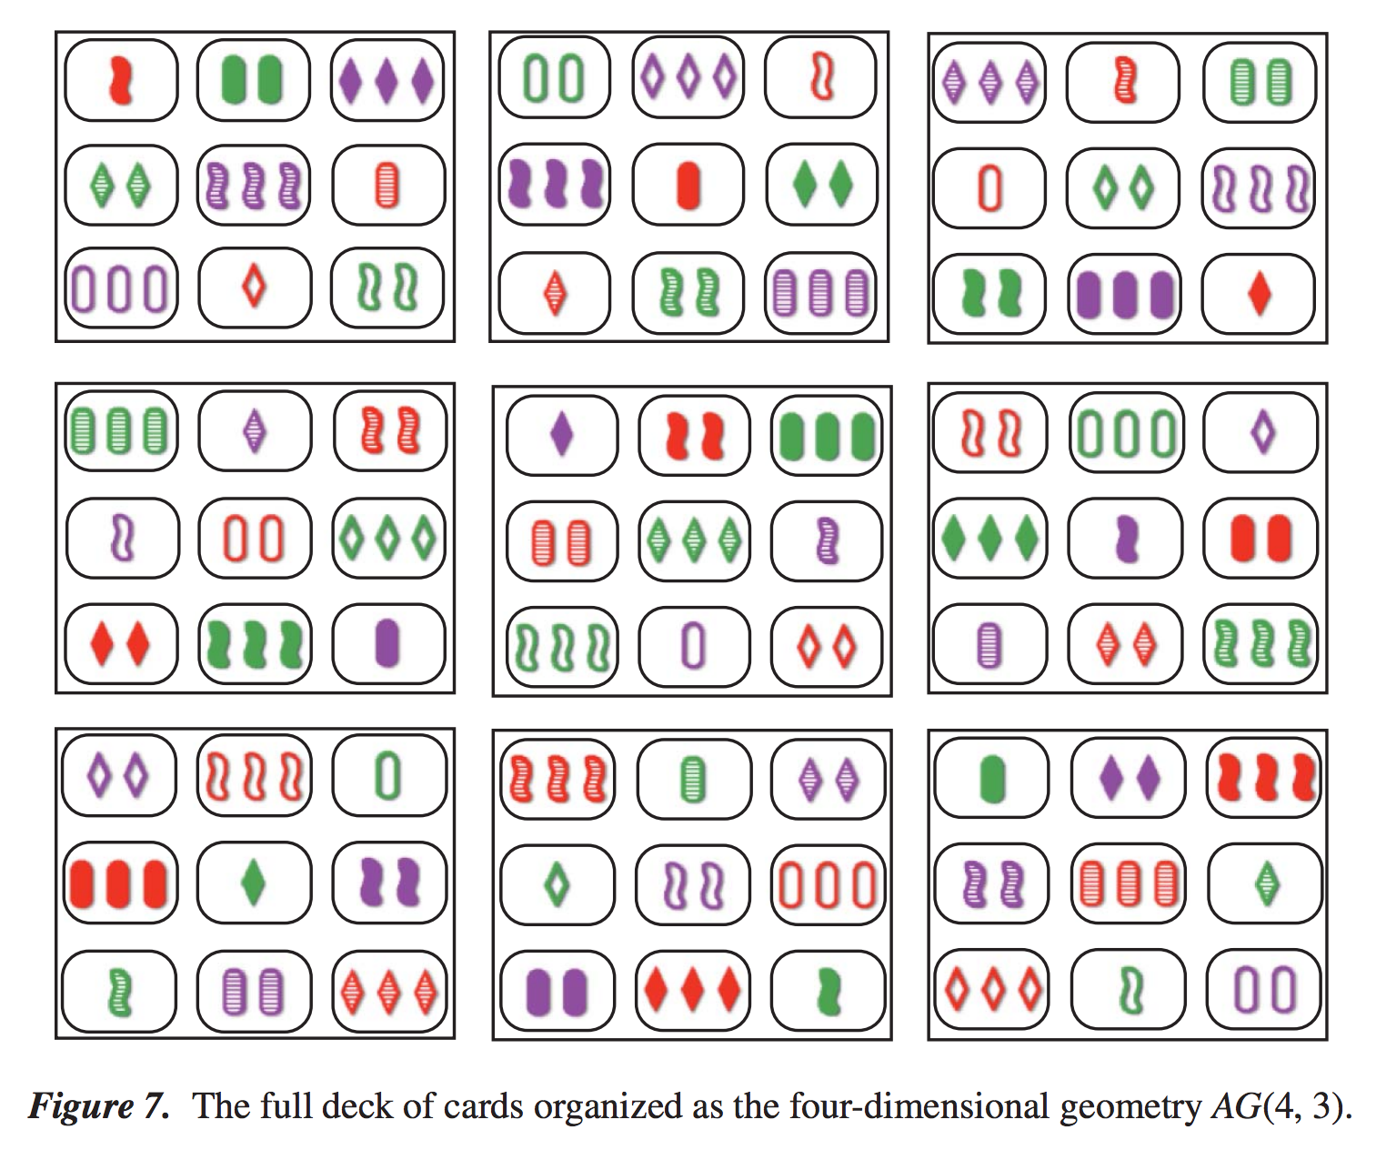
Hypercube
Notes:
Dive out to demo

Slide 31



SET®
Given any two cards, there is a unique third card that makes a “set” with the other two

Slide 32
SET®
func testThirdCardCompletesASet() { property("third card completes a set") <- forAll { (first: Card, second: Card) in let third = completionOf(first, second) return formASet( first, second, third) }
}
Notes:
******************
******************
Dive out to Xcode - SwiftCheck
******************
******************

Slide 33
Discounting Items
Group of line items (description, price, quantity)
$15 discount off the total of the order
How much of the discount applies to each of the line items?
Notes:
Pennies

Slide 34
Discounting Items
Properties?
Given n line items, there are at least n allocations of discount
If a line item is zero-price or zero-quantity, it gets zero of the discount
???
Notes:
Pennies
******************
******************
Dive out to VS
******************
******************

Slide 35
Further learning
Great place to start: http://fsharpforfunandprofit.com
Jessica Kerr’s blog/preso

Slide 36



Thank you!
@pholser
http://www.linkedin.com/in/pholser
http://github.com/pholser

