Slide 1
Precision and Recall
Michael L. Nelson
Old Dominion University
Web Science & Digital Libraries Research Group
@WebSciDL
ODU CS 395 – Spring 2020
2020-04-15

Slide 2
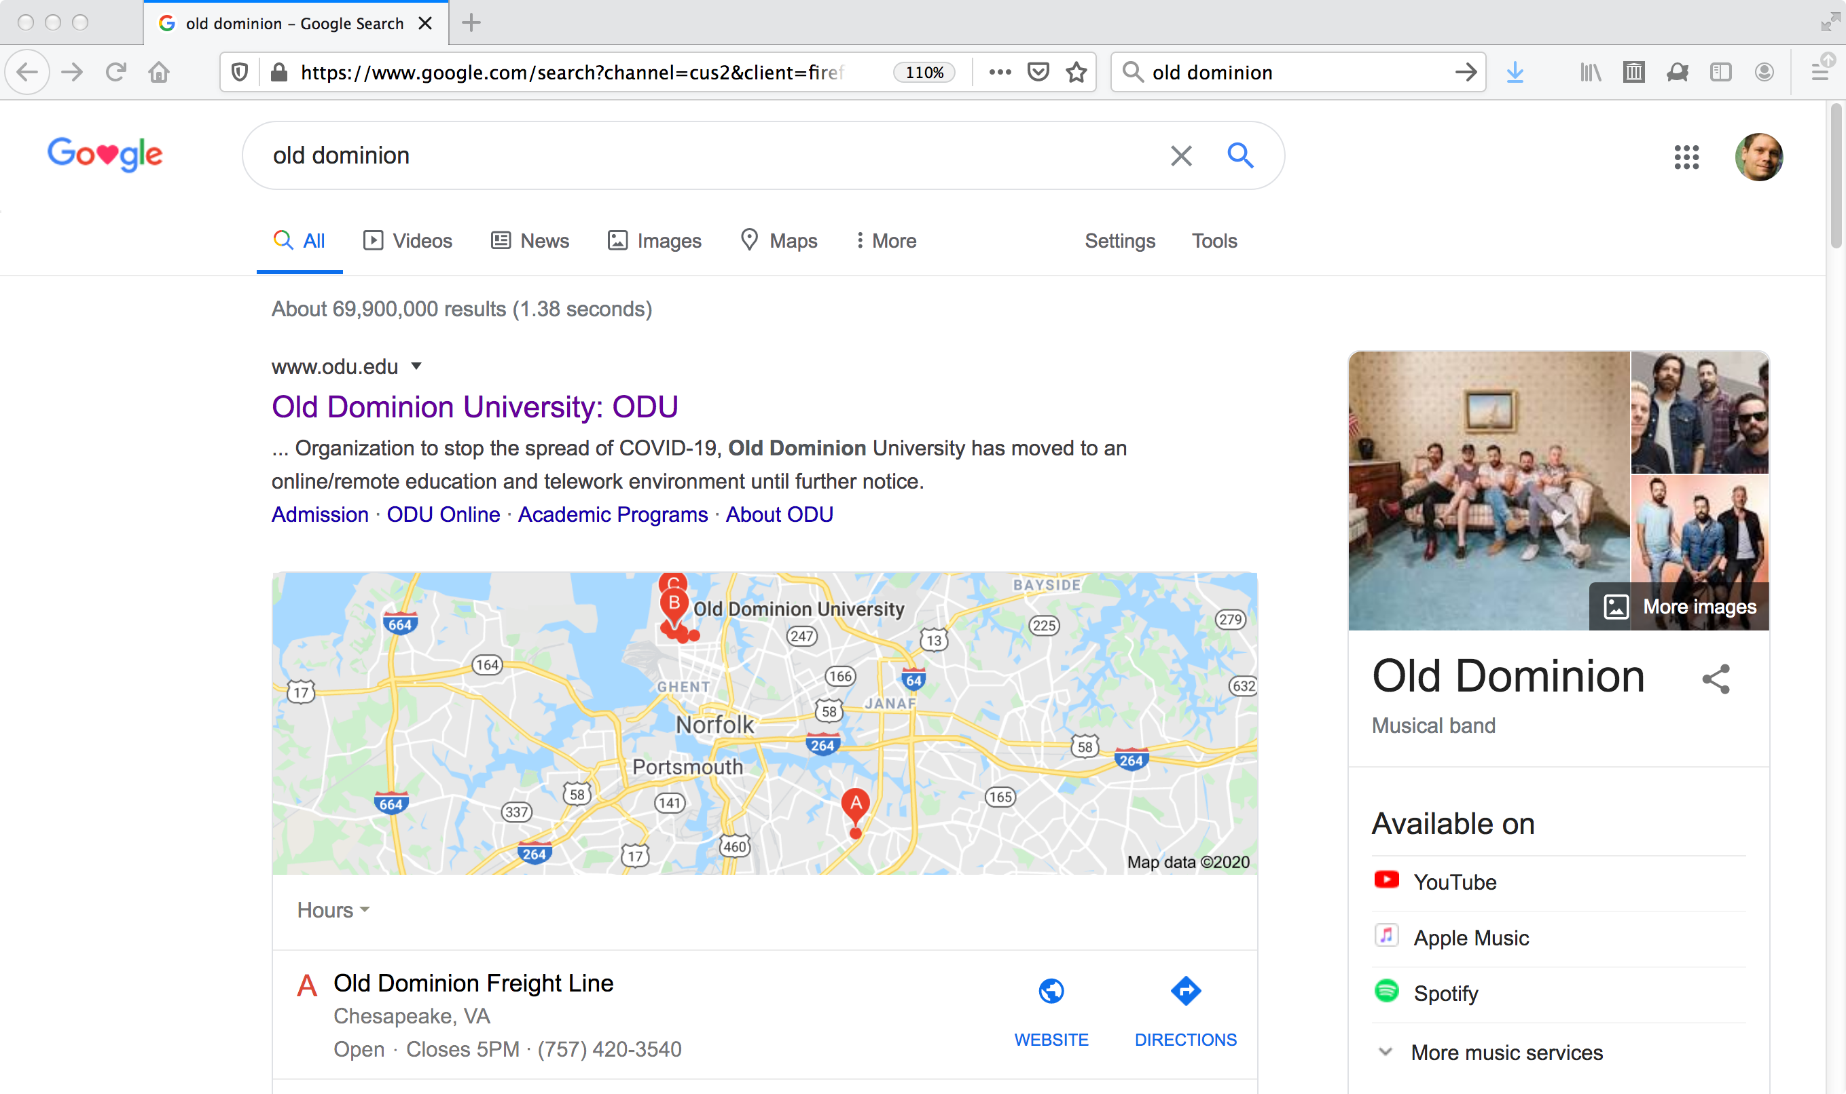
Is this a good result?
For this query, from this IP & acct, on 2020-04-15,
with relevance as assessed by MLN

Slide 3

Precision and Recall
Precision
  "ratio of the number of relevant documents retrieved over the total number of documents retrieved" (p. 10)
  how much extra stuff did you get?
Recall
  "ratio of relevant documents retrieved for a given query over the number of relevant documents for that query in the database" (p. 10)
    note: assumes a priori knowledge of the denominator!
  how much did you miss?

Slide 4
Precision and Recall
1
Precision
figure 1.2
in FBY
0
1
Recall

Slide 5
Precision and Recall
1
In practice, for search engines this top right quadrant is rarely populated. For general queries there is a trade-off between precision and recall.
Precision
figure 1.2
in FBY
0
1
Recall

Slide 6
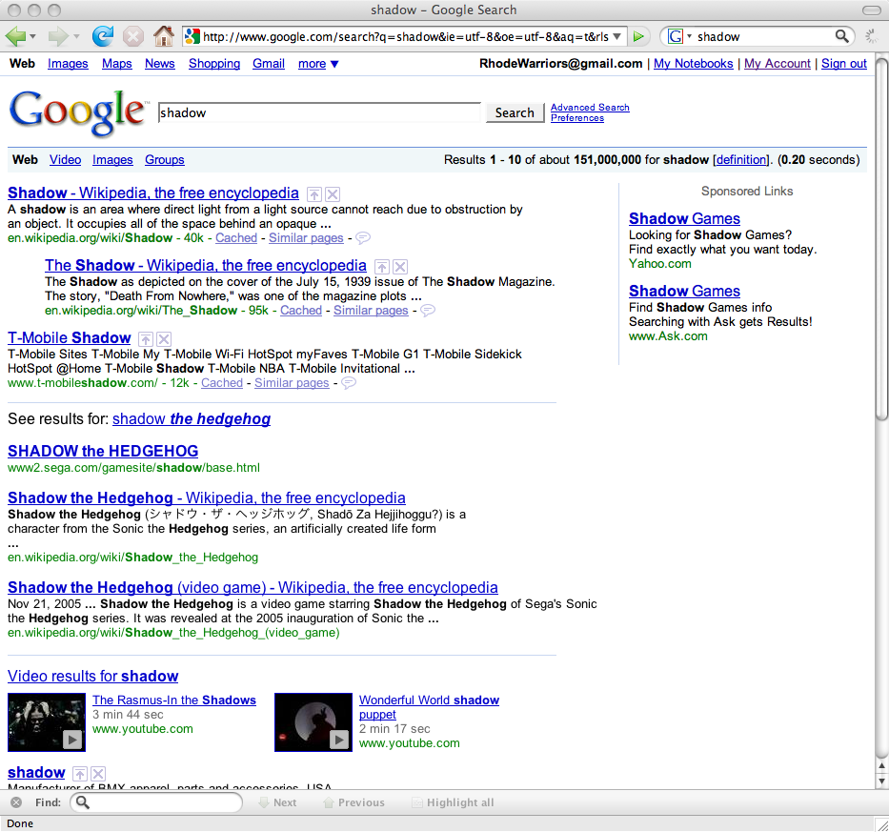
Why Isn't Precision Always 100%?
What were we really searching for?
Science? Games? Music?

Slide 7
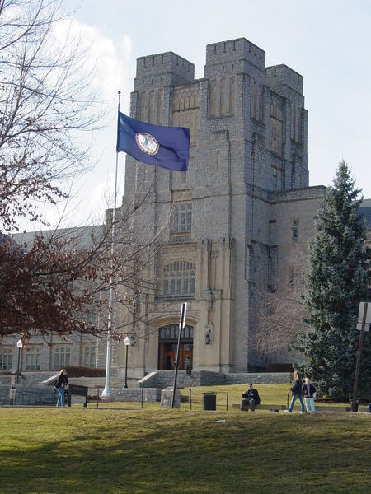
Why Isn't Recall Always 100%?
Virginia Agricultural and Mechanical College?
Virginia Agricultural and Mechanical College
and Polytechnic Institute?
Virginia Polytechnic Institute?
Virginia Polytechnic Institute
and State University?
Virginia Tech?

Slide 8
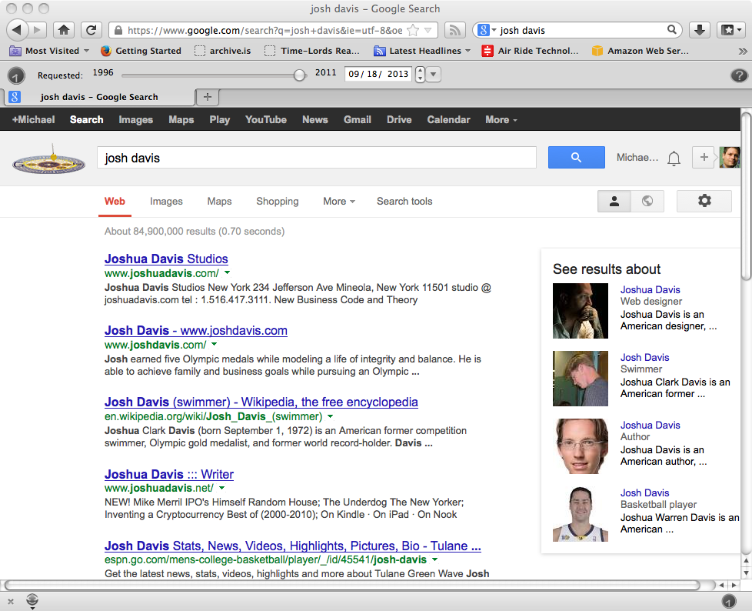
Josh Davis

Slide 9
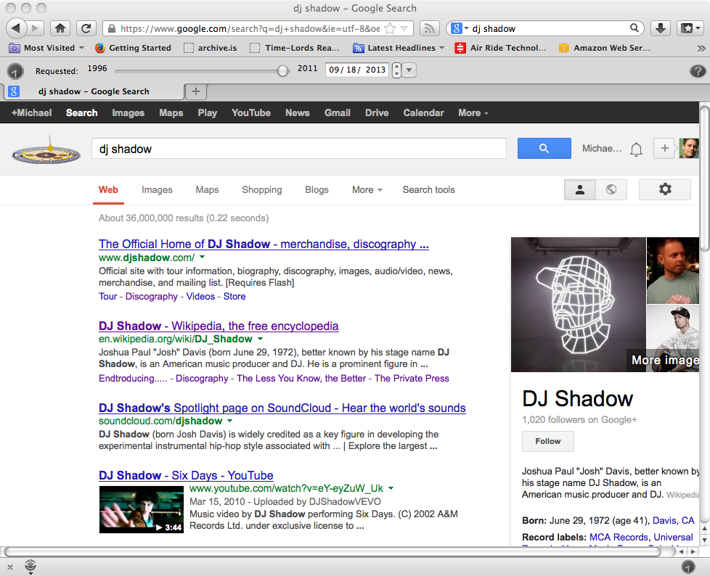
AKA DJ Shadow

Slide 10

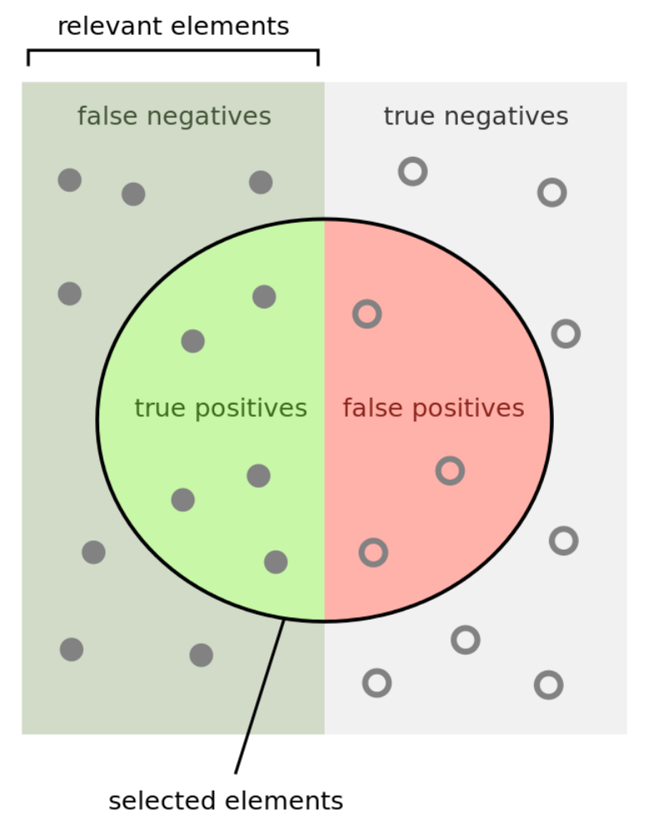
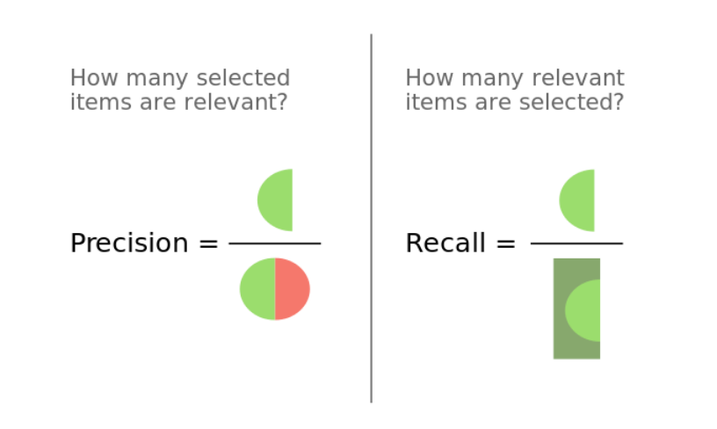
From: https://en.wikipedia.org/wiki/Precision_and_recall

Slide 11
Adapting Precision & Recall for Web Scale
Precision @ n (often n=10)
  Google’s “I’m feeling lucky” == P@1
  previous query for shadow had ~151M hits!
  no one will check more than just a few
  "ten blue links”
    https://econsultancy.com/blog/64228-10-blue-links-are-they-dead-or-alive-in-search/
Relative recall
  recall was hard enough on bounded collections; all but impossible for Web
  relative recall is a way of judging SE overlap
    (recall of system A) / (recall of A + B … + N)

Slide 12
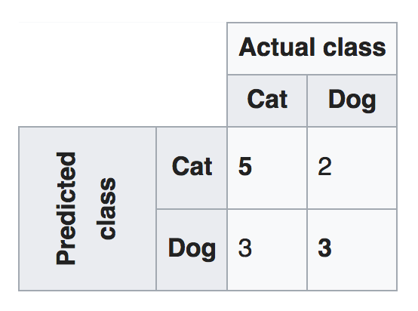
Confusion Matrix
(AKA P&R for ML)
https://en.wikipedia.org/wiki/Confusion_matrix

Slide 13
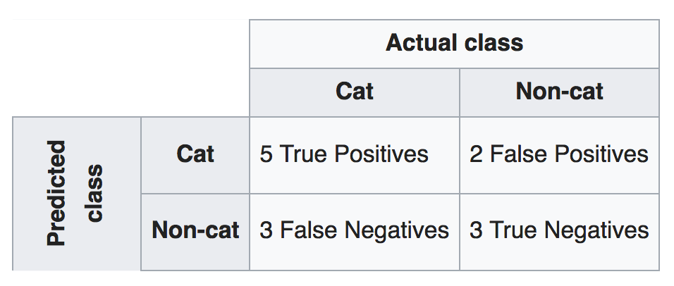
Precision and Recall for the Cat Classifier
Precision = 5TP / (5TP + 2FP) = 5/7 = 0.71
Recall = 5TP / (5TP + 3FN) = 5/8 = 0.63
(dog classifier is evaluated separately)
https://en.wikipedia.org/wiki/Confusion_matrix

Slide 14
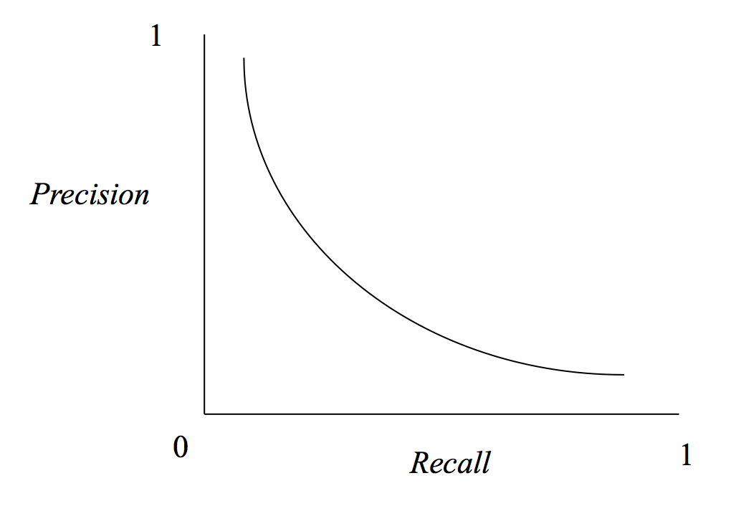
P&R trade-offs typically don’t occur in ML
Remember that with SEs, there’s a trade-off with P&R: trying to return all pages about “cats” will almost surely decrease precision (e.g., “Cool for Cats” is not about felines).
OTOH, we expect classifiers to occupy this region. We expect most animals classified as cats to be cats (P=0.71) and that most cats in the population should be identified as cats (R=0.63).

Slide 15
F₁ Score or F-measure
F₁ is the harmonic mean, which is computed
differently than the arithmetic mean
F₁ = 2 * ( (precision * recall) / (precision + recall) )
For the cat classifier:
F₁ = 2 * ( (0.71 * 0.63) / (0.71 + 0.63) )
F₁ = 2 * ( 0.45 / 1.34 )
F₁ = 0.67
https://en.wikipedia.org/wiki/F1_score

Slide 16
F-measure vs. average
For P = 0.71 & R = 0.63,
there’s no difference:
F₁ = 2 * ( (0.71 * 0.63) / (0.71 + 0.63) )
F₁ = 2 * ( 0.45 / 1.34 )
F₁ = 0.67
Avg = (0.71 + 0.63) / 2
Avg = 0.67
For P = 0.01 & R = 0.99,
(e.g., SE returns a ton of docs regardless of relevance)
there’s a big difference:
F₁ = 2 * ( (0.01 * 0.99) / (0.01 + 0.99) )
F₁ = 2 * ( 0.01 / 1.00 )
F₁ = 0.02
Avg = (0.01 + 0.99) / 2
Avg = 0.50
The harmonic mean reflects a low overall value
if one of the two scores is much lower than the other.

Slide 17
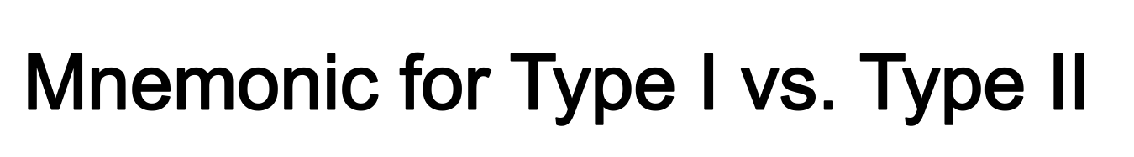
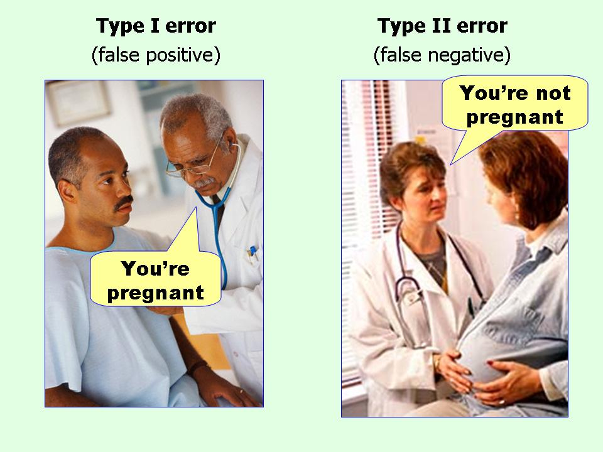
From: http://effectsizefaq.com/category/type-ii-error/

Slide 18

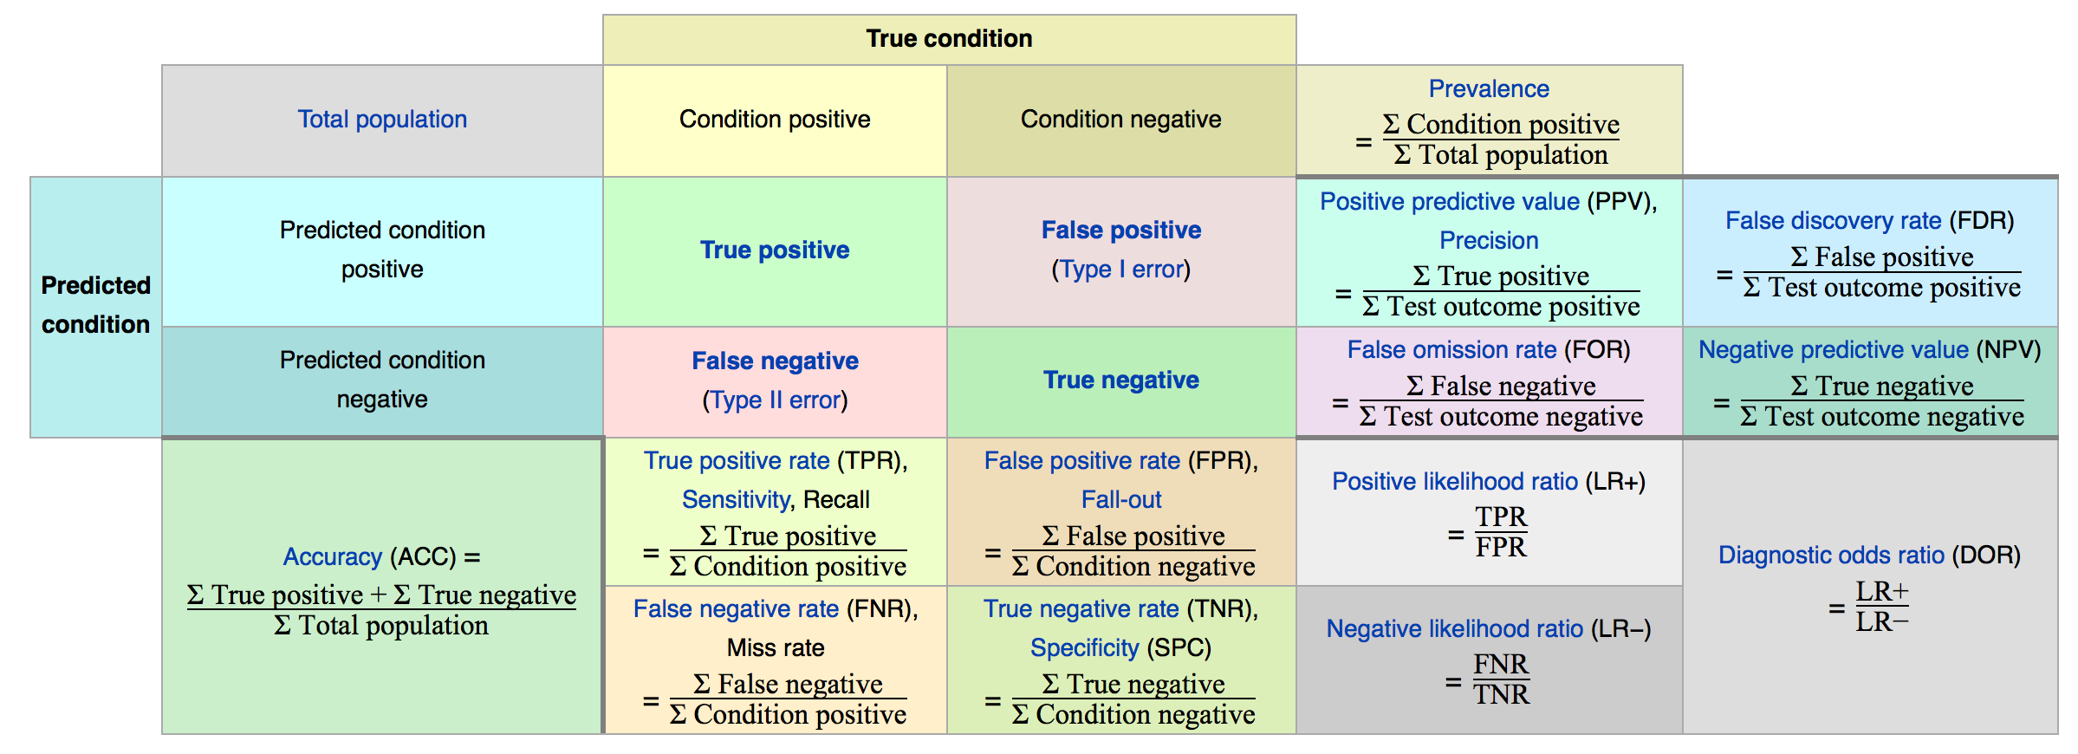
“Accuracy” is often used (incorrectly) as a synonym for
overall performance; it actually has a specific definition.
ACC_{cat} = (5TP + 3TN) / (5TP + 3TN + 2FP + 3FN) = 8/13 = 0.62
From: https://en.wikipedia.org/wiki/Precision_and_recall

