Slide 1
Web Server Design
Week 9- Content Negotiation
Old Dominion University
Department of Computer Science
CS 431/531 Fall 2018
Michael L. Nelson <mln@cs.odu.edu>
2018-10-24

Slide 2
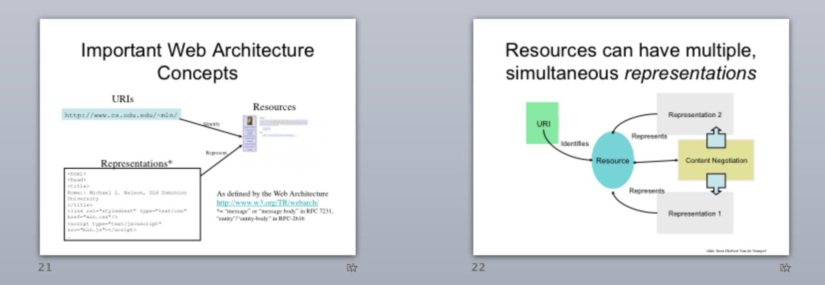
Revisiting Terminology from Week 1

Slide 3
Content Negotiation
RFC 7231, Section 3.4
“Proactive” (“Server-side” in RFC 2616)
  server picks best representation
    (agent can pass in “hints” via Accept.* headers)
    see Apache algorithm at: http://httpd.apache.org/docs/current/content-negotiation.html
“Reactive” (“Agent-side” in RFC 2616)
  server sends a list to the agent and the agent picks from representation
Transparent Negotiation
  combination of server-side and agent-side performed by caches, proxies, etc.
    mentioned in passing in RFC 2616; detailed in RFC 2295
      http://www.ietf.org/rfc/rfc2295.txt

Slide 4
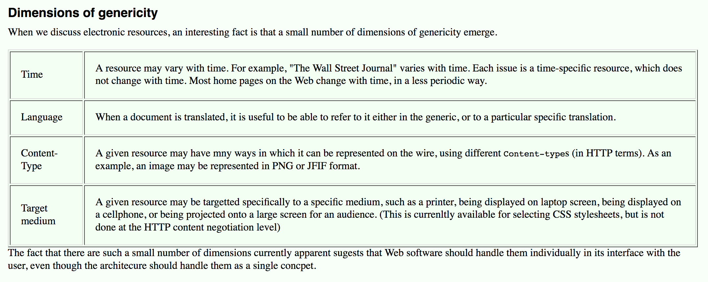
Generic vs. Specific Resources
https://www.w3.org/DesignIssues/Generic

Slide 5
“Cool URIs Don’t Change”
What makes a cool URI?
A cool URI is one which does not change.
What sorts of URI change?
URIs don't change: people change them.
There are no reasons at all in theory for people to change URIs (or stop maintaining documents), but millions of reasons in practice.
In theory, the domain name space owner owns the domain name space and therefore all URIs in it. Except insolvency, nothing prevents the domain name owner from keeping the name. And in theory the URI space under your domain name is totally under your control, so you can make it as stable as you like. Pretty much the only good reason for a document to disappear from the Web is that the company which owned the domain name went out of business or can no longer afford to keep the server running. Then why are there so many dangling links in the world? Part of it is just lack of forethought. Here are some reasons you hear out there:
https://www.w3.org/Provider/Style/URI

Slide 6
“how-we-do-it-now”
There is a crazy notion that pages produced by scripts have to be located in a "cgibin" or "cgi" area. This is exposing the mechanism of how you run your server. You change the mechanism (even keeping the content the same) and whoops - all your URIs change.
For example, take the National Science Foundation:
NSF Online Documents
http://www.nsf.gov/cgi-bin/pubsys/browser/oldbrowse.pl
the main page for starting to look for documents, is clearly not going to be something to trust to being there in a few years. "cgi-bin" and "oldbrowse" and ".pl" all point to bits of how-we-do-it-now. By contrast, if you use the page to find a document, you get first an equally bad
Report of Working Group on Cryptology and Coding Theory
http://www.nsf.gov/cgi-bin/getpub?nsf9814
for the document's index page, but the html document itself by contrast is very much better:
http://www.nsf.gov/pubs/1998/nsf9814/nsf9814.htm
Looking at this one, the "pubs/1998" header is going to give any future archive service a good clue that the old 1998 document classification scheme is in progress. Though in 2098 the document numbers might look different, I can imagine this URI still being valid, and the NSF or whatever carries on the archive not being at all embarrassed about it.
https://www.w3.org/Provider/Style/URI

Slide 7
“what to leave out?”
Everything! After the creation date, putting any information in the name is asking for trouble one way or another.
Authors name- authorship can change with new versions. People quit organizations and hand things on.
Subject. This is tricky. It always looks good at the time but changes surprisingly fast. I discuss this more below.
Status- directories like "old" and "draft" and so on, not to mention "latest" and "cool" appear all over file systems. Documents change status - or there would be no point in producing drafts. The latest version of a document needs a persistent identifier whatever its status is. Keep the status out of the name.
Access. At W3C we divide the site into "Team access", "Member access" and "Public access". It sounds good, but of course documents start off as team ideas, are discussed with members, and then go public. A shame indeed if every time some document is opened to wider discussion all the old links to it fail! We are switching to a simple date code now.
File name extension. This is a very common one. "cgi", even ".html" is something which will change. You may not be using HTML for that page in 20 years time, but you might want today's links to it to still be valid. The canonical way of making links to the W3C site doesn't use the extension.(how?)
Software mechanisms. Look for "cgi", "exec" and other give-away "look what software we are using" bits in URIs. Anyone want to commit to using perl cgi scripts all their lives? Nope? Cut out the .pl. Read the server manual on how to do it.
Disk name - gimme a break! But I've seen it.
So a better example from our site is simply
http://www.w3.org/1998/12/01/chairs
a report of the minutes of a meeting of W3C chair people.
CN is how!
https://www.w3.org/Provider/Style/URI

Slide 8
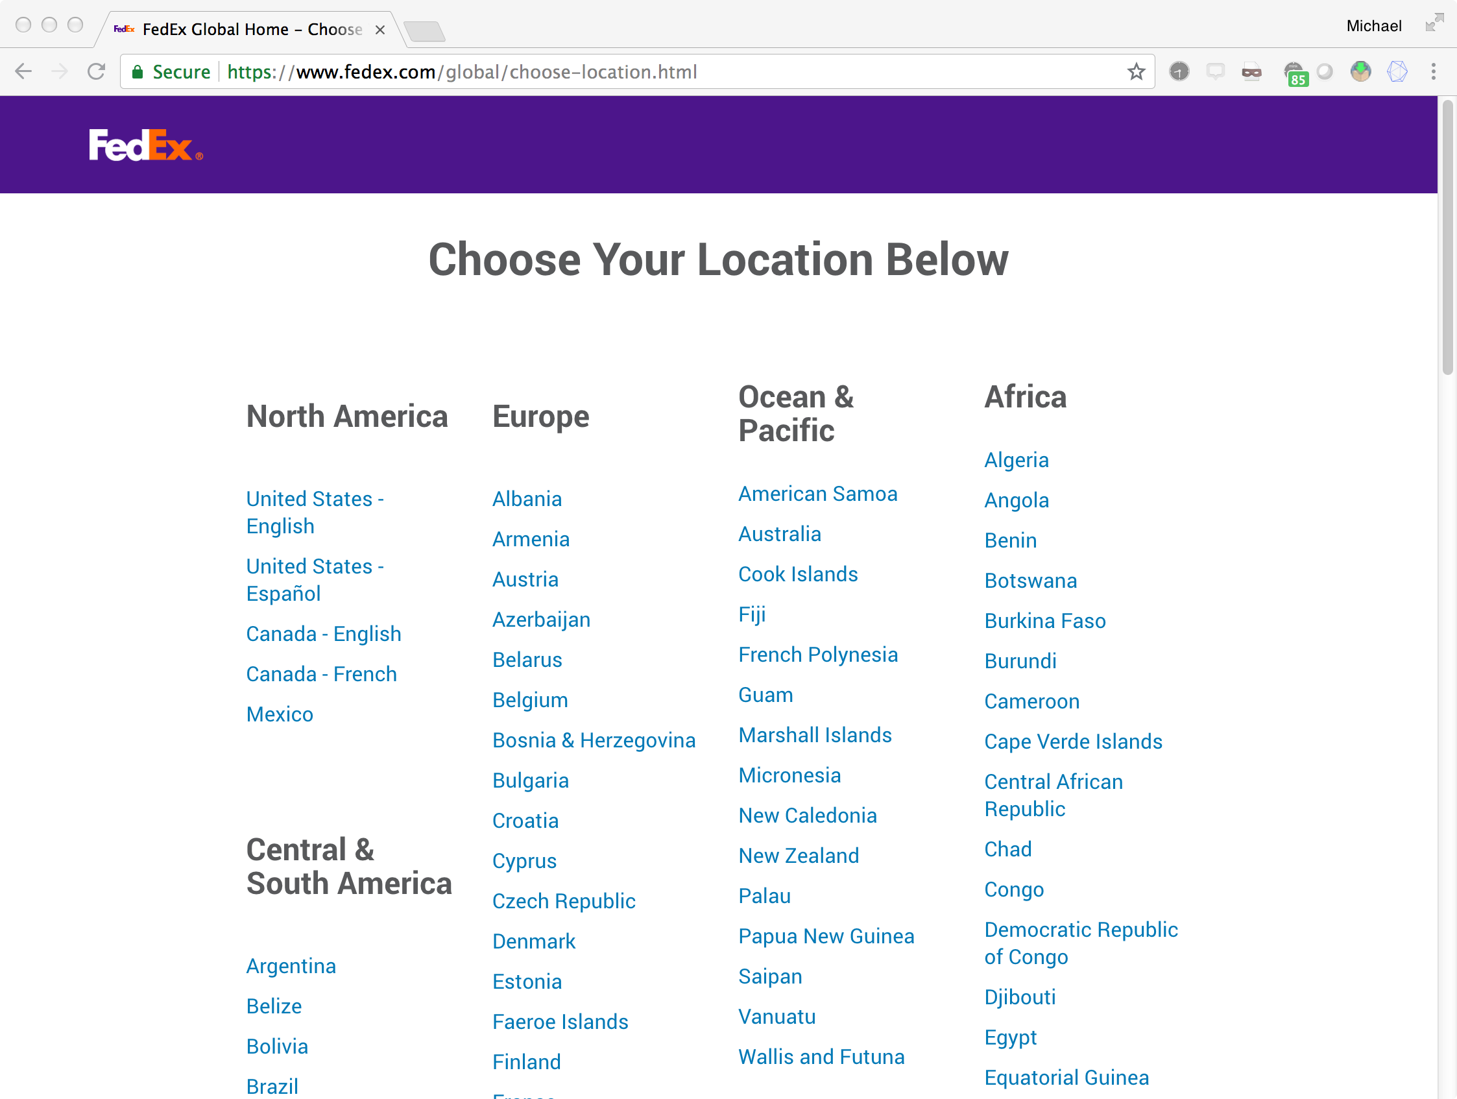
HTTP Solipsism and Content Negotiation
CN has a bad reputation, in part because some people have difficulty believing in things they can’t see
  cf.https://stackoverflow.com/questions/44720631/is-http-content-negotiation-being-used-by-browsers-and-servers-in-practice
  https://stackoverflow.com/questions/44735653/why-would-http-content-negotiation-be-preferred-to-explicit-parameters-in-an-api
And there is a small performance cost
  cf. https://httpd.apache.org/docs/current/misc/perf-tuning.html
  “If at all possible, avoid content negotiation if you're really interested in every last ounce of performance. In practice the benefits of negotiation outweigh the performance penalties. “
And “client-side” (aka reactive) CN is the norm for languages & file types…
But CN in some dimensions
happens all the time in the wild…

Slide 9
Turning on Content Negotiation in Apache
In Apache, content negotiation is turned off by default, and is turned on via:
  Type-map file (*.var)
  Options +Multiviews directive in httpd.conf or .htaccess file
    http://httpd.apache.org/docs/current/content-negotiation.html
In our servers, content negotiation will be on by default

Slide 10
How it Works
If a direct match for the requested URI is found, then the entity is returned
  If the request is for “foo.txt” and you have “foo.txt”, then return “foo.txt”
If a 404 would be result for the current request, AND content negotiation is available for this resource, then content negotiation begins
  If the request is for “foo”, then the server considers the user agent’s preferences and searches for the “best” available representation for “foo”

Slide 11
Request Headers & Status Codes
Request headers
  Accept
  Accept-Charset
  Accept-Encoding
  Accept-Language
  Negotiate (from RFC 2295)
Response headers
  Content-Location
  Vary
  TCN (from RFC 2295)
  Alternates (from RFC 2295)
Status codes
  300 Multiple Choices
  406 Not Acceptable

Slide 12
Test Directory
% cd ~mln/public_html/teaching/cs595-s06/a3-test
% ls
fairlane.gif index.html.de index.html.ja.jis type-map.example
fairlane.jpeg index.html.en index.html.ko.euc-kr vt-uva.html.gz
fairlane.png index.html.es index.html.ru.koi8-r vt-uva.html.Z
% more .htaccess
Options All +MultiViews
note: no “index.html”
Also note: the following examples no longer work on the departmental accounts.
Thanks, nginx.

Slide 13
User-Agent (UA) passes no preferences, server chooses
dhcp65-74-196-93:~/Desktop/cs595-s06 mln$ telnet www.cs.odu.edu 80
Trying 128.82.4.2...
Connected to xenon.cs.odu.edu.
Escape character is '^]'.
HEAD /~mln/teaching/cs595-s06/a3-test/fairlane HTTP/1.1
Host: www.cs.odu.edu
Connection: close
HTTP/1.1 200 OK
Date: Mon, 13 Mar 2006 04:04:22 GMT
Server: Apache/1.3.26 (Unix) ApacheJServ/1.1.2 PHP/4.3.4
Content-Location: fairlane.txt
Vary: negotiate,accept
TCN: choice
Last-Modified: Mon, 13 Mar 2006 04:00:53 GMT
ETag: "2288-c1-4414ee75;4414ee7a"
Accept-Ranges: bytes
Content-Length: 193
Connection: close
Content-Type: text/plain
Connection closed by foreign host.
note: structured ETag
This representation has its own URI: http://www.cs.odu.edu/~mln/teaching/cs595-s06/a3-test/fairlane.txt
But most (all?) UAs will display: http://www.cs.odu.edu/~mln/teaching/cs595-s06/a3-test/fairlane

Slide 14
UA prefers images
dhcp65-74-196-93:~/Desktop/cs595-s06 mln$ telnet www.cs.odu.edu 80
Trying 128.82.4.2...
Connected to xenon.cs.odu.edu.
Escape character is '^]'.
HEAD /~mln/teaching/cs595-s06/a3-test/fairlane HTTP/1.1
Host: www.cs.odu.edu
Accept: image/*; q=1.0
Connection: close
HTTP/1.1 200 OK
Date: Mon, 13 Mar 2006 04:06:45 GMT
Server: Apache/1.3.26 (Unix) ApacheJServ/1.1.2 PHP/4.3.4
Content-Location: fairlane.jpeg
Vary: negotiate,accept
TCN: choice
Last-Modified: Sun, 12 Mar 2006 17:37:16 GMT
ETag: "3b64bd-9639-44145c4c;4414ee7a"
Accept-Ranges: bytes
Content-Length: 38457
Connection: close
Content-Type: image/jpeg
Connection closed by foreign host.
“quality value”
or “qvalue”;
RFC 7231, section 5.3.1

Slide 15
UA prefers png over gif, and gif over jpeg
dhcp65-74-196-93:~/Desktop/cs595-s06 mln$ telnet www.cs.odu.edu 80
Trying 128.82.4.2...
Connected to xenon.cs.odu.edu.
Escape character is '^]'.
HEAD /~mln/teaching/cs595-s06/a3-test/fairlane HTTP/1.1
Host: www.cs.odu.edu
Accept: image/png; q=1.0, image/gif; q=0.5, image/jpeg; q=0.1
Connection: close
HTTP/1.1 200 OK
Date: Mon, 13 Mar 2006 02:30:44 GMT
Server: Apache/1.3.26 (Unix) ApacheJServ/1.1.2 PHP/4.3.4
Content-Location: fairlane.png
Vary: negotiate,accept
TCN: choice
Last-Modified: Sun, 12 Mar 2006 17:37:31 GMT
ETag: "3b64bf-17f9b-44145c5b;4414d473"
Accept-Ranges: bytes
Content-Length: 98203
Connection: close
Content-Type: image/png
Connection closed by foreign host.

Slide 16
UA prefers tiff, but server has no tiff
dhcp65-74-196-93:~/Desktop/cs595-s06 mln$ telnet www.cs.odu.edu 80
Trying 128.82.4.2...
Connected to xenon.cs.odu.edu.
Escape character is '^]'.
HEAD /~mln/teaching/cs595-s06/a3-test/fairlane HTTP/1.1
Host: www.cs.odu.edu
Accept: image/tiff; q=1.0, image/gif; q=0.001
Connection: close
HTTP/1.1 200 OK
Date: Mon, 13 Mar 2006 02:37:10 GMT
Server: Apache/1.3.26 (Unix) ApacheJServ/1.1.2 PHP/4.3.4
Content-Location: fairlane.gif
Vary: negotiate,accept
TCN: choice
Last-Modified: Sun, 12 Mar 2006 20:46:10 GMT
ETag: "3b64c0-c28b-44148892;4414d473"
Accept-Ranges: bytes
Content-Length: 49803
Connection: close
Content-Type: image/gif
Connection closed by foreign host.

Slide 17
Server chooses an encoding
dhcp65-74-196-93:~/Desktop/cs595-s06 mln$ telnet www.cs.odu.edu 80
Trying 128.82.4.2...
Connected to xenon.cs.odu.edu.
Escape character is '^]'.
HEAD /~mln/teaching/cs595-s06/a3-test/vt-uva HTTP/1.1
Host: www.cs.odu.edu
Connection: close
HTTP/1.1 200 OK
Date: Mon, 13 Mar 2006 03:26:35 GMT
Server: Apache/1.3.26 (Unix) ApacheJServ/1.1.2 PHP/4.3.4
Content-Location: vt-uva.html.gz
Vary: negotiate,accept-encoding
TCN: choice
Last-Modified: Sun, 12 Mar 2006 20:52:54 GMT
ETag: "3b64c1-2c54-44148a26;4414d473"
Accept-Ranges: bytes
Content-Length: 11348
Connection: close
Content-Type: text/html
Content-Encoding: x-gzip
Connection closed by foreign host.

Slide 18
UA does not want gzip
dhcp65-74-196-93:~/Desktop/cs595-s06 mln$ telnet www.cs.odu.edu 80
Trying 128.82.4.2...
Connected to xenon.cs.odu.edu.
Escape character is '^]'.
HEAD /~mln/teaching/cs595-s06/a3-test/vt-uva HTTP/1.1
Accept-Encoding: compress; q=0.1, gzip; q=0.0
Host: www.cs.odu.edu
Connection: close
HTTP/1.1 200 OK
Date: Mon, 13 Mar 2006 03:29:54 GMT
Server: Apache/1.3.26 (Unix) ApacheJServ/1.1.2 PHP/4.3.4
Content-Location: vt-uva.html.Z
Vary: negotiate,accept-encoding
TCN: choice
Last-Modified: Sun, 12 Mar 2006 20:52:41 GMT
ETag: "3b64c3-5c0b-44148a19;4414d473"
Accept-Ranges: bytes
Content-Length: 23563
Connection: close
Content-Type: text/html
Content-Encoding: compress
Connection closed by foreign host.

Slide 19
UA wants only German
dhcp65-74-196-93:~/Desktop/cs595-s06 mln$ telnet www.cs.odu.edu 80
Trying 128.82.4.2...
Connected to xenon.cs.odu.edu.
Escape character is '^]'.
HEAD /~mln/teaching/cs595-s06/a3-test/ HTTP/1.1
Accept-Language: de; q=1.0
Host: www.cs.odu.edu
Connection: close
HTTP/1.1 200 OK
Date: Mon, 13 Mar 2006 03:32:36 GMT
Server: Apache/1.3.26 (Unix) ApacheJServ/1.1.2 PHP/4.3.4
Content-Location: index.html.de
Vary: negotiate,accept-language,accept-charset
TCN: choice
Last-Modified: Sun, 12 Mar 2006 16:39:23 GMT
ETag: "3b64b7-1c94-44144ebb;4414d473"
Accept-Ranges: bytes
Content-Length: 7316
Connection: close
Content-Type: text/html
Content-Language: de
Connection closed by foreign host.

Slide 20
UA prefers iso-2022-jp character set
dhcp65-74-196-93:~/Desktop/cs595-s06 mln$ telnet www.cs.odu.edu 80
Trying 128.82.4.2...
Connected to xenon.cs.odu.edu.
Escape character is '^]'.
HEAD /~mln/teaching/cs595-s06/a3-test/index.html HTTP/1.1
Accept-Language: ja; q=1.0
Accept-Charset: iso-2022-jp; q=1.0
Host: www.cs.odu.edu
Connection: close
HTTP/1.1 200 OK
Date: Mon, 13 Mar 2006 03:35:17 GMT
Server: Apache/1.3.26 (Unix) ApacheJServ/1.1.2 PHP/4.3.4
Content-Location: index.html.ja.jis
Vary: negotiate,accept-language,accept-charset
TCN: choice
Last-Modified: Sun, 12 Mar 2006 16:39:23 GMT
ETag: "3b64ba-1dd3-44144ebb;4414d473"
Accept-Ranges: bytes
Content-Length: 7635
Connection: close
Content-Type: text/html; charset=iso-2022-jp
Content-Language: ja
Connection closed by foreign host.

Slide 21
UA wants Japanese, but only in EUC-JP
dhcp65-74-196-93:~/Desktop/cs595-s06 mln$ telnet www.cs.odu.edu 80
Trying 128.82.4.2...
Connected to xenon.cs.odu.edu.
Escape character is '^]'.
HEAD /~mln/teaching/cs595-s06/a3-test/index.html HTTP/1.1
Accept-Language: ja; q=1.0
Accept-Charset: euc-jp; q=1.0
Host: www.cs.odu.edu
Connection: close
HTTP/1.1 406 Not Acceptable
Date: Mon, 13 Mar 2006 03:39:29 GMT
Server: Apache/1.3.26 (Unix) ApacheJServ/1.1.2 PHP/4.3.4
Alternates: {"index.html.de" 1 {type text/html} {language de} {length 7316}},
{"index.html.en" 1 {type text/html} {language en} {length 7233}},
{"index.html.es" 1 {type text/html} {language es} {length 7643}},
{"index.html.ja.jis" 1 {type text/html} {charset iso-2022-jp} {language ja}
{length 7635}},
{"index.html.ru.koi8-r" 1 {type text/html} {charset koi8-r} {language ru}
{length 7277}}
Vary: negotiate,accept-language,accept-charset
TCN: list
Connection: close
Content-Type: text/html; charset=iso-8859-1
Connection closed by foreign host.

Slide 22
UA wants only tiff
dhcp65-74-196-93:~/Desktop/cs595-s06 mln$ telnet www.cs.odu.edu 80
Trying 128.82.4.2...
Connected to xenon.cs.odu.edu.
Escape character is '^]'.
HEAD /~mln/teaching/cs595-s06/a3-test/fairlane HTTP/1.1
Host: www.cs.odu.edu
Accept: image/tiff; q=1.0, */*;q=0.0
Connection: close
HTTP/1.1 406 Not Acceptable
Date: Mon, 13 Mar 2006 04:03:01 GMT
Server: Apache/1.3.26 (Unix) ApacheJServ/1.1.2 PHP/4.3.4
Alternates: {"fairlane.gif" 1 {type image/gif} {length 49803}},
{"fairlane.jpeg" 1 {type image/jpeg} {length 38457}},
{"fairlane.png" 1 {type image/png} {length 98203}},
{"fairlane.txt" 1 {type text/plain} {length 193}}
Vary: negotiate,accept
TCN: list
Connection: close
Content-Type: text/html; charset=iso-8859-1
Connection closed by foreign host.

Slide 23
Same, but with GET
dhcp65-74-196-93:~/Desktop/cs595-s06 mln$ telnet www.cs.odu.edu 80Trying 128.82.4.2...
Connected to xenon.cs.odu.edu.
Escape character is '^]'.
GET /~mln/teaching/cs595-s06/a3-test/fairlane HTTP/1.1
Host: www.cs.odu.edu
Accept: image/tiff; q=1.0, *;q=0.0
Connection: close
HTTP/1.1 406 Not Acceptable
Date: Tue, 14 Mar 2006 03:30:23 GMT
Server: Apache/1.3.26 (Unix) ApacheJServ/1.1.2 PHP/4.3.4
Alternates: {"fairlane.gif" 1 {type image/gif} {length 49803}}, {"fairlane.jpeg" 1 {type image/jpeg} {length 38457}}, {"fairlane.png" 1 {type image/png} {length 98203}},
{"fairlane.txt" 1 {type text/plain} {length 193}}
Vary: negotiate,accept
TCN: list
Connection: close
Transfer-Encoding: chunked
Content-Type: text/html; charset=iso-8859-1
27d
<!DOCTYPE HTML PUBLIC "-//IETF//DTD HTML 2.0//EN">
<HTML><HEAD>
<TITLE>406 Not Acceptable</TITLE>
</HEAD><BODY>
<H1>Not Acceptable</H1>
An appropriate representation of the requested resource /~mln/teaching/cs595-s06/a3-test/fairlane could not be found on this server.<P>
Available variants:
<ul>
<li><a href="fairlane.gif">fairlane.gif</a> , type image/gif
<li><a href="fairlane.jpeg">fairlane.jpeg</a> , type image/jpeg
<li><a href="fairlane.png">fairlane.png</a> , type image/png
<li><a href="fairlane.txt">fairlane.txt</a> , type text/plain
</ul>
<HR>
<ADDRESS>Apache/1.3.26 Server at www.cs.odu.edu Port 80</ADDRESS>
</BODY></HTML>
0

Slide 24
300 Multiple Choices
(it’s kind of like a redirection… a user-drive redirection)
6.4.1. 300 Multiple Choices
The 300 (Multiple Choices) status code indicates that the target
resource has more than one representation, each with its own more
specific identifier, and information about the alternatives is being
provided so that the user (or user agent) can select a preferred
representation by redirecting its request to one or more of those
identifiers. In other words, the server desires that the user agent
engage in reactive negotiation to select the most appropriate
representation(s) for its needs (Section 3.4).
…
For request methods other than HEAD, the server SHOULD generate a
payload in the 300 response containing a list of representation
metadata and URI reference(s) from which the user or user agent can
choose the one most preferred. The user agent MAY make a selection
from that list automatically if it understands the provided media
type. A specific format for automatic selection is not defined by
this specification because HTTP tries to remain orthogonal to the
definition of its payloads. In practice, the representation is
provided in some easily parsed format believed to be acceptable to
the user agent, as determined by shared design or content
negotiation, or in some commonly accepted hypertext format.

Slide 25
Transparent Content Negotiation
Defined in RFC 2295
Client requests CN
  “transparent” does not mean “hide from client”, it means “making transparent all available representations for a given URI”
Three kinds of responses:
  list: “here is a list for the client to choose from”
  choice: “the server made this choice for the client”
  adhoc: “weird things are happening, so the server made a choice” (a (hopefully) rare situation)

Slide 26
% telnet www.cs.odu.edu 80
Trying 128.82.4.2...
Connected to xenon.cs.odu.edu.
Escape character is '^]'.
GET /~mln/teaching/cs595-s06/a3-test/fairlane HTTP/1.1
Negotiate: 1.0
Host: www.cs.odu.edu
Connection: close
HTTP/1.1 300 Multiple Choices
Date: Sun, 07 Jan 2007 18:20:04 GMT
Server: Apache/2.2.0
Alternates: {"fairlane.gif" 1 {type image/gif} {length 49803}}, {"fairlane.jpeg" 1 {type image/jpeg} {length 38457}}, {"fairlane.png" 1 {type image/png} {length 98203}}, {"fairlane.txt" 1 {type text/plain} {length 193}}
Vary: negotiate,accept
TCN: list
Content-Length: 524
Connection: close
Content-Type: text/html; charset=iso-8859-1
<!DOCTYPE HTML PUBLIC "-//IETF//DTD HTML 2.0//EN">
<html><head>
<title>300 Multiple Choices</title>
</head><body>
<h1>Multiple Choices</h1>
Available variants:
<ul>
<li><a href="fairlane.gif">fairlane.gif</a> , type image/gif</li>
<li><a href="fairlane.jpeg">fairlane.jpeg</a> , type image/jpeg</li>
<li><a href="fairlane.png">fairlane.png</a> , type image/png</li>
<li><a href="fairlane.txt">fairlane.txt</a> , type text/plain</li>
</ul>
<hr>
<address>Apache/2.2.0 Server at www.cs.odu.edu Port 80</address>
</body></html>
Connection closed by foreign host.

Slide 27
CN in the wild
$ curl -Is https://www.cnn.com/
HTTP/1.1 200 OK
Content-Type: text/html; charset=utf-8
x-servedByHost: ::ffff:172.17.64.4
access-control-allow-origin: *
cache-control: max-age=60
content-security-policy: [deletia]
x-content-type-options: nosniff
x-xss-protection: 1; mode=block
Content-Length: 1717605
Accept-Ranges: bytes
Date: Mon, 22 Oct 2018 23:46:55 GMT
Via: 1.1 varnish
Age: 214
Connection: keep-alive
Set-Cookie: [deletia]
X-Served-By: cache-iad2644-IAD
X-Cache: HIT
X-Cache-Hits: 8
X-Timer: S1540252016.528240,VS0,VE0
Vary: Accept-Encoding
$ curl -is https://www.cnn.com/ | wc
43 46991 1719081
$ curl -is -H "Accept-encoding: gzip" https://www.cnn.com/ | wc
665 5521 183355
$ curl -is -H "Accept-encoding: compress" https://www.cnn.com/ | wc
43 47025 1719555
$ curl -is -H "Accept-encoding: gzip" https://www.cnn.com/ | grep -ia "Content-Encoding:"
Content-Encoding: gzip
$ curl -is -H "Accept-encoding: compress" https://www.cnn.com/ | grep -ia "Content-Encoding:”
$ # blank line means no match

Slide 28
CN in more than just Accept-Encoding
$ curl -IL -A "iphone" --silent en.wikipedia.org
| egrep -i "(HTTP/1.1 [0-9]|^location:|Vary:)"
HTTP/1.1 301 TLS Redirect
Location: https://en.wikipedia.org/
HTTP/1.1 301 Moved Permanently
Vary: Accept-Encoding,X-Forwarded-Proto,Cookie,Authorization
Location: https://en.wikipedia.org/wiki/Main_Page
HTTP/1.1 302 Found
Location: https://en.m.wikipedia.org/wiki/Main_Page
HTTP/1.1 200 OK
Vary: Accept-Encoding,Cookie,X-CS,X-Subdomain,Authorization

Slide 29
CN with User-Agent
$ curl -I https://www.grosbill.com/
HTTP/1.1 200 OK
Date: Tue, 23 Oct 2018 00:15:16 GMT
Server: Apache/2.4.25 (Debian)
X-Powered-By: PHP/5.6.23
Set-Cookie: [deletia]
Cache-Control: max-age=1
Expires: Tue, 23 Oct 2018 00:15:17 GMT
Vary: User-Agent
Content-Type: text/html; charset=UTF-8
Via: 1.1 google
Transfer-Encoding: chunked
Alt-Svc: clear
$ curl -is https://www.grosbill.com/ | wc
13 1218 34823
$ curl -is -A "iphone" https://www.grosbill.com/ | wc
13 1218 34823
$ curl -is -A "Mozilla/5.0 (iPhone; CPU iPhone OS 8_4_1 like Mac OS X)
AppleWebKit/600.1.4 (KHTML, like Gecko) CriOS/45.0.2454.68 Mobile/12H321
Safari/600.1.4" https://www.grosbill.com/ | wc
13 758 27868
This server is not
so easily fooled!
This method used to be common but has largely been replaced by responsive design
See: https://en.wikipedia.org/wiki/Responsive_web_design
https://www.spiria.com/en/blog/mobile-development/dynamic-serving-vs-responsive-web-design
https://www.clickseed.com/responsive-design-vs-separate-mobile-site-vs-dynamic-serving/

Slide 30
An anonymous representation
$ curl -is -A "Mozilla/5.0 (iPhone; CPU iPhone OS 8_4_1 like Mac OS X)
AppleWebKit/600.1.4 (KHTML, like Gecko) CriOS/45.0.2454.68 Mobile/12H321
Safari/600.1.4" https://www.grosbill.com/ | less
HTTP/1.1 200 OK
Date: Tue, 23 Oct 2018 23:21:55 GMT
Server: Apache/2.4.25 (Debian)
X-Powered-By: PHP/5.6.23
Set-Cookie: versiontype=6; expires=Thu, 22-Nov-2018 23:21:55 GMT;
Max-Age=2592000; path=/; domain=grosbill.com
Cache-Control: max-age=1
Expires: Tue, 23 Oct 2018 23:21:56 GMT
Vary: User-Agent
Transfer-Encoding: chunked
Content-Type: text/html; charset=UTF-8
Via: 1.1 google
Alt-Svc: clear
<!DOCTYPE html><html lang=fr><head><meta charset=utf-8 /> [deletia]
Cf. slide 13, where the representation had its own URI specified in Content-Location.
This representation does not have its own separate, unique URI and can only be accessed
by repeating this (or a similar) user-agent string.

Slide 31
302 CN, No Vary?
$ curl -I https://www.sephora.com/
HTTP/1.1 200 OK
Server: Apache
UFE-Page: Y
Content-Language: en-US
X-Content-Type-Options: nosniff
X-XSS-Protection: 1; mode=block
Content-Type: text/html;charset=UTF-8
Expires: Tue, 23 Oct 2018 03:23:48 GMT
Cache-Control: max-age=0, no-cache, no-store
Pragma: no-cache
Date: Tue, 23 Oct 2018 03:23:48 GMT
Connection: keep-alive
Set-Cookie: [deletia]
Strict-Transport-Security: max-age=31536000
$ curl -ISL -A "iphone" https://www.sephora.com/
HTTP/1.1 302 Moved Temporarily
Server: AkamaiGHost
Content-Length: 0
Location: https://m.sephora.com/
Expires: Tue, 23 Oct 2018 03:23:58 GMT
Cache-Control: max-age=0, no-cache, no-store
Pragma: no-cache
Date: Tue, 23 Oct 2018 03:23:58 GMT
Connection: keep-alive
Set-Cookie: [deletia]
Strict-Transport-Security: max-age=31536000
HTTP/1.1 200 OK
Server: Apache
UFE-Page: Y
Content-Language: en-US
X-Content-Type-Options: nosniff
X-XSS-Protection: 1; mode=block
Content-Type: text/html;charset=UTF-8
Date: Tue, 23 Oct 2018 03:23:58 GMT
Connection: keep-alive
Set-Cookie: [deletia]
Strict-Transport-Security: max-age=31536000
Slightly off-topic, but note:
“Cache-control: max-age” trumps “Expires”,
so “Expires” is redundant
“Pragma: no-cache” and “Connection: Keep-alive”
are deprecated.
sephora.com prohibits caching sbut a Vary: User-Agent response header could be used, cf. 7.1.4 of RFC 7231:
“Likewise, an origin server might use Cache-Control directives (Section 5.2 of [RFC7234]) to supplant Vary if it considers the variance less significant than the performance cost of Vary's impact on caching.”

