Slide 1
Web Server Design
Week 5- Long-lived Connections, Pipelines
Old Dominion University
Department of Computer Science
CS 431/531 Fall 2018
Michael L. Nelson <mln@cs.odu.edu>
2018-10-03

Slide 2
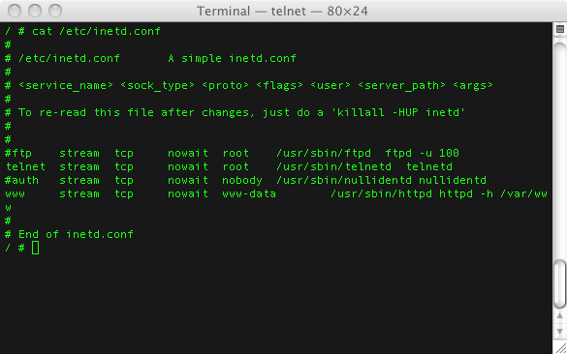
History…
In the prehistoric days, we used “inetd” to start net services
  http://en.wikipedia.org/wiki/Inetd
image from: http://moviecubehacks.wordpress.com/2010/12/10/setting-up-the-ftp-server/

Slide 3
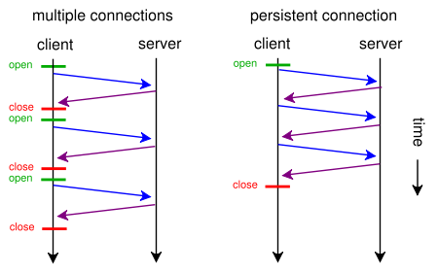
HTTP/1.0 Keep-Alive
In the very early days, web pages had few images, so 1 TCP connection per URL was not so bad
HTTP/1.0
  Keep-Alive extension added (but unevenly supported) to say “don’t hang up”
  see Roy Fielding's early note:
    http://ftp.ics.uci.edu/pub/ietf/http/hypermail/1995q4/0063.html
    now 404, see: http://web.archive.org/web/20081008002735/http://ftp.ics.uci.edu/pub/ietf/http/hypermail/1995q4/0063.html
image from: http://en.wikipedia.org/wiki/File:HTTP_persistent_connection.svg

Slide 4
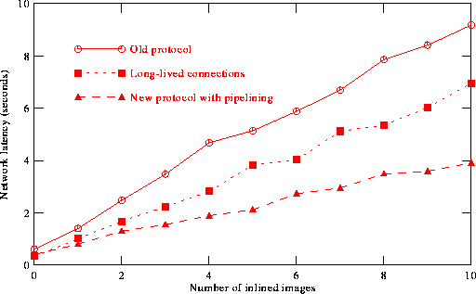
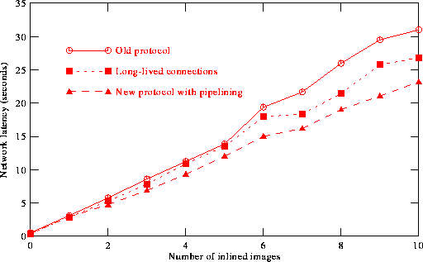
Latency in HTTP/1.0
image size = 2.5k
image size = 45k
Figs 6-1 & 6-2 from Padmanabhan & Mogul, “Improving HTTP Latency”, Proceedings of 2nd WWW Conference, 1994
http://dx.doi.org/10.1016/0169-7552(95)00106-1
http://scholar.google.com/scholar?cluster=319752692681403502&hl=en&as_sdt=0,47

Slide 5
HTTP/1.1 Keep-Alive is Default
HTTP/1.1
  Persistent connections (as they are now called) are the norm
    see section 19.7.1, RFC 2068; section 19.6.2, RFC 2616, sections 6.1 and A.1.2, RFC 7230
  you now have to specify a non-persistent connection with Connection: close

Slide 6
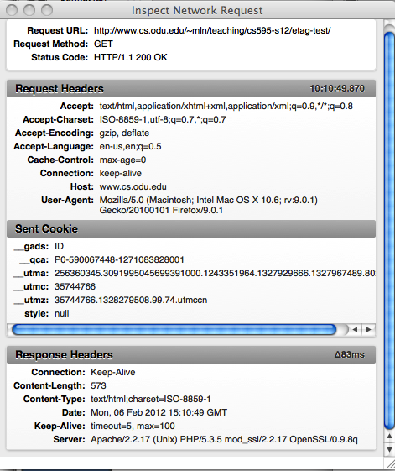
Old Headers Die Hard…
(FF 9.0.1)

Slide 7
Long-Lived Connections
If the client does not send a “Connection: close” header, the server can assume the client wishes to maintain the TCP connection
If the server sends a “Connection: close” header, the session is over

Slide 8
Long-Lived Connections
AIHT:~/Desktop/cs595-s06 mln$ telnet www.cs.odu.edu 80 | tee 6-1.out
Trying 128.82.4.2...
Connected to xenon.cs.odu.edu.
Escape character is '^]'.
HEAD /~mln/teaching/cs595-s06/a1-test/ HTTP/1.1
Host: www.cs.odu.edu
HTTP/1.1 200 OK
Date: Sun, 12 Feb 2006 20:58:49 GMT
Server: Apache/1.3.26 (Unix) ApacheJServ/1.1.2 PHP/4.3.4
Content-Type: text/html
HEAD /~mln/teaching/cs595-s06/a1-test/1/ HTTP/1.1
Host: www.cs.odu.edu
HTTP/1.1 200 OK
Date: Sun, 12 Feb 2006 20:58:55 GMT
Server: Apache/1.3.26 (Unix) ApacheJServ/1.1.2 PHP/4.3.4
Content-Type: text/html
HEAD /~mln/teaching/cs595-s06/a1-test/2/ HTTP/1.1
Host: www.cs.odu.edu
HTTP/1.1 200 OK
Date: Sun, 12 Feb 2006 20:59:01 GMT
Server: Apache/1.3.26 (Unix) ApacheJServ/1.1.2 PHP/4.3.4
Last-Modified: Sun, 29 Jan 2006 18:43:15 GMT
ETag: "1f4de2-790-43dd0cc3"
Accept-Ranges: bytes
Content-Length: 1936
Content-Type: text/html
X-Pad: avoid browser bug
Connection closed by foreign host.
request
response
request
response
request
response

Slide 9
Long-Lived Connections
(does not change with SSL)
$ openssl s_client -connect www.cs.odu.edu:443
CONNECTED(00000003)
[much, much SSL deletia]
HEAD /~mln/teaching/cs595-s06/a1-test/ HTTP/1.1
Host: www.cs.odu.edu
HTTP/1.1 200 OK
Server: nginx
Date: Tue, 02 Oct 2018 18:19:41 GMT
Content-Type: text/html;charset=UTF-8
Connection: keep-alive
Front-End-Https: on
HEAD /~mln/teaching/cs595-s06/a1-test/1/ HTTP/1.1
Host: www.cs.odu.edu
HTTP/1.1 200 OK
Server: nginx
Date: Tue, 02 Oct 2018 18:19:46 GMT
Content-Type: text/html;charset=UTF-8
Connection: keep-alive
Front-End-Https: on
HEAD /~mln/teaching/cs595-s06/a1-test/2/ HTTP/1.1
Host: www.cs.odu.edu
Connection: close
HTTP/1.1 200 OK
Server: nginx
Date: Tue, 02 Oct 2018 18:20:09 GMT
Content-Type: text/html
Connection: close
Vary: Accept-Encoding
Front-End-Https: on
closed

Slide 10
Pipelining Requests
6.3.2. Pipelining
A client that supports persistent connections MAY "pipeline" its
requests (i.e., send multiple requests without waiting for each
response). A server MAY process a sequence of pipelined requests in
parallel if they all have safe methods (Section 4.2.1 of [RFC7231]),
but it MUST send the corresponding responses in the same order that
the requests were received.

Slide 11
Pipelined Requests
AIHT:~/Desktop/cs595-s06 mln$ telnet www.cs.odu.edu 80 | tee 6-2.out
Trying 128.82.4.2...
Connected to xenon.cs.odu.edu.
Escape character is '^]'.
HEAD /~mln/teaching/cs595-s06/a1-test/ HTTP/1.1
Host: www.cs.odu.edu
HEAD /~mln/teaching/cs595-s06/a1-test/1/ HTTP/1.1
Host: www.cs.odu.edu
HEAD /~mln/teaching/cs595-s06/a1-test/2/ HTTP/1.1
Host: www.cs.odu.edu
HTTP/1.1 200 OK
Date: Sun, 12 Feb 2006 21:08:44 GMT
Server: Apache/1.3.26 (Unix) ApacheJServ/1.1.2 PHP/4.3.4
Content-Type: text/html
HTTP/1.1 200 OK
Date: Sun, 12 Feb 2006 21:08:44 GMT
Server: Apache/1.3.26 (Unix) ApacheJServ/1.1.2 PHP/4.3.4
Content-Type: text/html
HTTP/1.1 200 OK
Date: Sun, 12 Feb 2006 21:08:44 GMT
Server: Apache/1.3.26 (Unix) ApacheJServ/1.1.2 PHP/4.3.4
Last-Modified: Sun, 29 Jan 2006 18:43:15 GMT
ETag: "1f4de2-790-43dd0cc3"
Accept-Ranges: bytes
Content-Length: 1936
Content-Type: text/html
X-Pad: avoid browser bug
Connection closed by foreign host.
3 requests
3 responses

Slide 12
Pipelined Requests
(also does not change with SSL)
$ openssl s_client -connect www.cs.odu.edu:443
CONNECTED(00000003)
[much, much SSL deletia]
HEAD /~mln/teaching/cs595-s06/a1-test/ HTTP/1.1
Host: www.cs.odu.edu
HEAD /~mln/teaching/cs595-s06/a1-test/1/ HTTP/1.1
Host: www.cs.odu.edu
HEAD /~mln/teaching/cs595-s06/a1-test/2/ HTTP/1.1
Host: www.cs.odu.edu
Connection: close
HTTP/1.1 200 OK
Server: nginx
Date: Tue, 02 Oct 2018 18:46:24 GMT
Content-Type: text/html;charset=UTF-8
Connection: keep-alive
Front-End-Https: on
HTTP/1.1 200 OK
Server: nginx
Date: Tue, 02 Oct 2018 18:46:24 GMT
Content-Type: text/html;charset=UTF-8
Connection: keep-alive
Front-End-Https: on
HTTP/1.1 200 OK
Server: nginx
Date: Tue, 02 Oct 2018 18:46:24 GMT
Content-Type: text/html
Connection: close
Vary: Accept-Encoding
Front-End-Https: on
closed

Slide 13
Error on a safe method?
Keep processing…
AIHT:~/Desktop/cs595-s06 mln$ telnet www.cs.odu.edu 80 | tee 6-3.out
Trying 128.82.4.2...
Connected to xenon.cs.odu.edu.
Escape character is '^]'.
HEAD /~mln/teaching/cs595-s06/a1-test/ HTTP/1.1
Host: www.cs.odu.edu
HEAD /~mln/teaching/cs595-s06/a1-test/XASDFASDASDF/ HTTP/1.1
Host: www.cs.odu.edu
HEAD /~mln/teaching/cs595-s06/a1-test/2/ HTTP/1.1
Host: www.cs.odu.edu
HTTP/1.1 200 OK
Date: Sun, 12 Feb 2006 21:19:37 GMT
Server: Apache/1.3.26 (Unix) ApacheJServ/1.1.2 PHP/4.3.4
Content-Type: text/html
HTTP/1.1 404 Not Found
Date: Sun, 12 Feb 2006 21:19:37 GMT
Server: Apache/1.3.26 (Unix) ApacheJServ/1.1.2 PHP/4.3.4
Content-Type: text/html; charset=iso-8859-1
HTTP/1.1 200 OK
Date: Sun, 12 Feb 2006 21:19:38 GMT
Server: Apache/1.3.26 (Unix) ApacheJServ/1.1.2 PHP/4.3.4
Last-Modified: Sun, 29 Jan 2006 18:43:15 GMT
ETag: "1f4de2-790-43dd0cc3"
Accept-Ranges: bytes
Content-Length: 1936
Content-Type: text/html
X-Pad: avoid browser bug
Connection closed by foreign host.
this error does not
terminate the session

Slide 14
Error on an non-idempotent method?
Stop processing…
% telnet www.cs.odu.edu 80
Trying 128.82.4.2...
Connected to xenon.cs.odu.edu.
Escape character is '^]'.
HEAD /~mln/teaching/cs595-s06/a1-test/ HTTP/1.1
Host: www.cs.odu.edu
POST /~mln/teaching/cs595-s06/a1-test/ HTTP/1.1
Host: www.cs.odu.edu
HEAD /~mln/teaching/cs595-s06/a1-test/2/ HTTP/1.1
Host: www.cs.odu.edu
HTTP/1.1 200 OK
Date: Mon, 06 Feb 2012 15:27:35 GMT
Server: Apache/2.2.17 (Unix) PHP/5.3.5 mod_ssl/2.2.17 OpenSSL/0.9.8q
Content-Type: text/html;charset=ISO-8859-1
HTTP/1.1 404 Not Found
Date: Mon, 06 Feb 2012 15:27:35 GMT
Server: Apache/2.2.17 (Unix) PHP/5.3.5 mod_ssl/2.2.17 OpenSSL/0.9.8q
Content-Length: 348
Content-Type: text/html; charset=iso-8859-1
<!DOCTYPE HTML PUBLIC "-//IETF//DTD HTML 2.0//EN">
<html><head><title>404 Not Found</title>
[deletia]
</body></html>
HTTP/1.1 200 OK
Date: Mon, 06 Feb 2012 15:27:35 GMT
Server: Apache/2.2.17 (Unix) PHP/5.3.5 mod_ssl/2.2.17 OpenSSL/0.9.8q
Last-Modified: Sun, 29 Jan 2006 18:43:15 GMT
ETag: "790-40b83b3fa76c0"
Accept-Ranges: bytes
Content-Length: 1936
Content-Type: text/html
Connection closed by foreign host.
this error does
terminate the session
(and why is it 404?!
-- probably should be a
405 – or a 400?)

Slide 15
Error on an unsafe but idempotent method?
Keep processing…
$ openssl s_client -connect www.cs.odu.edu:443
CONNECTED(00000003)
[much, much SSL deletia]
HEAD /~mln/teaching/cs595-s06/a1-test/ HTTP/1.1
Host: www.cs.odu.edu
PUT /~mln/teaching/cs595-s06/a1-test/1/ HTTP/1.1
Host: www.cs.odu.edu
HEAD /~mln/teaching/cs595-s06/a1-test/2/ HTTP/1.1
Host: www.cs.odu.edu
Connection: close
HTTP/1.1 200 OK
Server: nginx
Date: Tue, 02 Oct 2018 18:59:00 GMT
Content-Type: text/html;charset=UTF-8
Connection: keep-alive
Front-End-Https: on
HTTP/1.1 405 Method Not Allowed
Server: nginx
Date: Tue, 02 Oct 2018 18:59:00 GMT
Content-Type: text/html; charset=iso-8859-1
Transfer-Encoding: chunked
Connection: keep-alive
Allow: GET,HEAD,POST,OPTIONS
[html deletia]
HTTP/1.1 200 OK
Server: nginx
Date: Tue, 02 Oct 2018 18:59:00 GMT
Content-Type: text/html
Connection: close
Vary: Accept-Encoding
Front-End-Https: on
closed
this error does not
terminate the session
since PUT is idempotent
(also note the correct 405)

Slide 16
Assume unknown methods are non-idempotent
Connected to xenon.cs.odu.edu.
Escape character is '^]'.
HEAD /~mln/teaching/cs595-s06/a1-test/ HTTP/1.1
Host: www.cs.odu.edu
NOTAMEHTOD /~mln/teaching/cs595-s06/a1-test/ HTTP/1.1
Host: www.cs.odu.edu
HEAD /~mln/teaching/cs595-s06/a1-test/2/ HTTP/1.1
Host: www.cs.odu.edu
HTTP/1.1 200 OK
Date: Mon, 06 Feb 2012 15:25:41 GMT
Server: Apache/2.2.17 (Unix) PHP/5.3.5 mod_ssl/2.2.17 OpenSSL/0.9.8q
Content-Type: text/html;charset=ISO-8859-1
HTTP/1.1 501 Method Not Implemented
Date: Mon, 06 Feb 2012 15:25:41 GMT
Server: Apache/2.2.17 (Unix) PHP/5.3.5 mod_ssl/2.2.17 OpenSSL/0.9.8q
Allow: GET,HEAD,POST,OPTIONS
Content-Length: 362
Connection: close
Content-Type: text/html; charset=iso-8859-1
<!DOCTYPE HTML PUBLIC "-//IETF//DTD HTML 2.0//EN">
<html><head>
<title>501 Method Not Implemented</title>
</head><body>
<h1>Method Not Implemented</h1>
<p>NOTAMEHTOD to /~mln/teaching/cs595-s06/a1-test/ not supported.<br />
</p>
<hr>
<address>Apache/2.2.17 (Unix) PHP/5.3.5 mod_ssl/2.2.17 OpenSSL/0.9.8q Server
at www.cs.odu.edu Port 80</address>
</body></html>
Connection closed by foreign host.
this error does
terminate the session

Slide 17
Timeout Not Specified in RFCs 2616 or 7230
(but see 6.5 of 7230)
KeepAliveTimeout Directive
Description: Amount of time the server will wait for subsequent requests on a persistent connection
Syntax: KeepAliveTimeout seconds
Default: KeepAliveTimeout 15
Context: server config, virtual host
Status: Core
Module: core
The number of seconds Apache will wait for a subsequent request before closing the connection.
Once a request has been received, the timeout value specified by the Timeout directive applies.
Setting KeepAliveTimeout to a high value may cause performance problems in heavily loaded servers.
The higher the timeout, the more server processes will be kept occupied waiting on connections with
idle clients.
http://httpd.apache.org/docs/2.0/mod/core.html#keepalivetimeout

Slide 18
Apache Gives a 400 on Timeout
% telnet www.cs.odu.edu 80
Trying 128.82.4.2...
Connected to xenon.cs.odu.edu.
Escape character is '^]'.
GET / HTTP/1.1
Host: www.cs.odu.edu
HTTP/1.1 400 Bad Request
Date: Mon, 06 Feb 2012 04:56:12 GMT
Server: Apache/2.2.17 (Unix) PHP/5.3.5 mod_ssl/2.2.17 OpenSSL/0.9.8q
Content-Length: 344
Connection: close
Content-Type: text/html; charset=iso-8859-1
<!DOCTYPE HTML PUBLIC "-//IETF//DTD HTML 2.0//EN">
<html><head>
<title>400 Bad Request</title>
</head><body>
<h1>Bad Request</h1>
<p>Your browser sent a request that this server could not understand.<br />
</p>
<hr>
<address>Apache/2.2.17 (Unix) PHP/5.3.5 mod_ssl/2.2.17 OpenSSL/0.9.8q Server at
www.cs.odu.edu Port 80</address>
</body></html>
Connection closed by foreign host.
After waiting the timeout value,
Apache just gives up and sends
a 400

Slide 19
Now it seems to do nothing…
$ telnet www.cs.odu.edu 80
Trying 128.82.4.2...
Connected to xenon.cs.odu.edu.
Escape character is '^]'.
HEAD / HTTP/1.1
Host: www.google.com
Connection closed by foreign host.
$ openssl s_client -connect www.cs.odu.edu:443
CONNECTED(00000003)
[much, much SSL deletia]
HEAD /~mln/teaching/cs595-s06/a1-test/ HTTP/1.1
Host: www.cs.odu.edu
read:errno=0
After waiting the timeout value,
Apache now just gives up

Slide 20
Why Not a 408?
6.5.7. 408 Request Timeout
The 408 (Request Timeout) status code indicates that the server did
not receive a complete request message within the time that it was
prepared to wait. A server SHOULD send the "close" connection option
(Section 6.1 of [RFC7230]) in the response, since 408 implies that
the server has decided to close the connection rather than continue
waiting. If the client has an outstanding request in transit, the
client MAY repeat that request on a new connection.
I haven't seen a 408 in the wild,
but we will implement it in A2

Slide 21
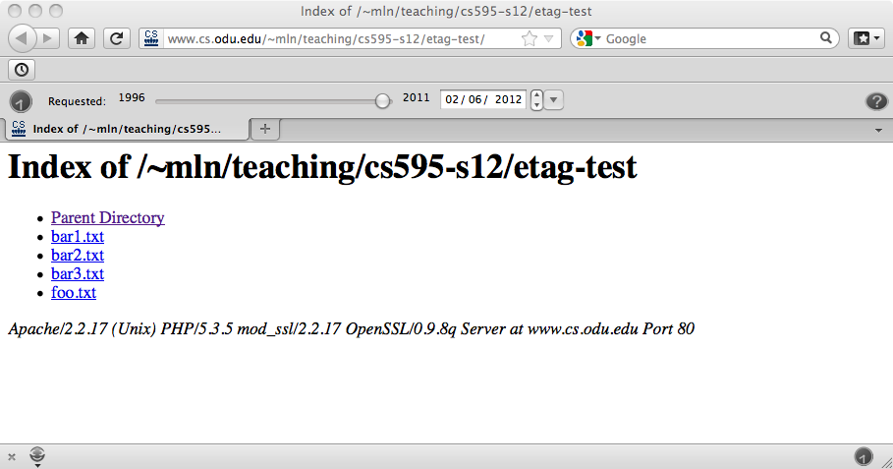
Directory Listings

Slide 22
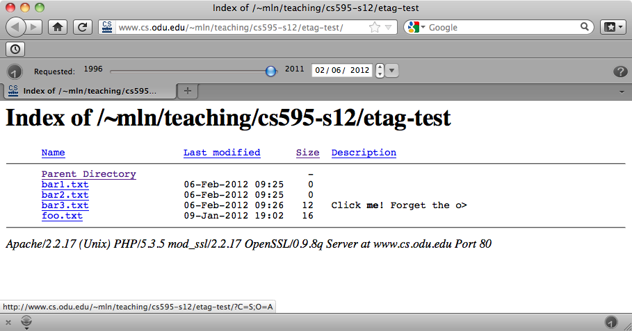
Fancy Directory Listings
% pwd
/home/mln/public_html/teaching/cs595-s12/etag-test
% cat .htaccess
FileETag INode MTime Size
IndexOptions FancyIndexing
AddDescription "Click <b>me</b>! Forget the other files!" bar3.txt
http://www.cs.odu.edu/~mln/teaching/cs595-s12/etag-test/
http://httpd.apache.org/docs/current/mod/mod_autoindex.html

