Slide 1
Web Server Design
Week 8- Transfer and Content Encodings
Old Dominion University
Department of Computer Science
CS 431/531 Fall 2018
Michael L. Nelson <mln@cs.odu.edu>
2018-10-17

Slide 2

HTTP equivalent of “they’re / their / there”, “you’re / your”, etc.
extending the analogy,
“ur” is acceptable only when
you know the rules but
breaking them provides
some measurable comfort
or convenience
http://theoatmeal.com/comics/misspelling

Slide 3
Common Encodings
identity
  no encoding at all; defined in 2616, removed in 7230
gzip
  extension: .gz
  (sometimes seen as x-gzip, deprecated)
compress
  extension: .Z
  (sometimes seen as x-compress, deprecated)
deflate
  extension: .zip
chunked
  breaks the body into a series of server-chosen “chunks”
  optimization for dynamically produced content
IANA registry, cf. “br” & “zstd”; http://www.iana.org/assignments/http-parameters/http-parameters.xhtml

Slide 4
Identity Encoding
The default, “no transformation” encoding
  even though it was removed in 7230 and never really existed in the wild, it is a useful rhetorical construct
  “applying the identity encoding to a resource is an _________ operation”

Slide 5
Content-Codings
“Content coding values indicate an encoding transformation that has been or can be applied to a representation. Content codings are primarily used to allow a representation to be compressed or otherwise usefully transformed without losing the identity of its underlying media type and without loss of information. Frequently, the representation is stored in coded form, transmitted directly, and only decoded by the final recipient.”
  3.1.2.1, RFC 7231

Slide 6
Content Encoding vs. Transfer Encoding
3.1.2.2, RFC 7231
Unlike Transfer-Encoding (Section 3.3.1 of [RFC7230]), the codings
listed in Content-Encoding are a characteristic of the
representation; the representation is defined in terms of the coded
form, and all other metadata about the representation is about the
coded form unless otherwise noted in the metadata definition.
Typically, the representation is only decoded just prior to rendering
or analogous usage.
If the media type includes an inherent encoding, such as a data
format that is always compressed, then that encoding would not be
restated in Content-Encoding even if it happens to be the same
algorithm as one of the content codings.
e.g., GIF uses LZW compression (“compress”),
but this is not reflected in a Content-Encoding header

Slide 7
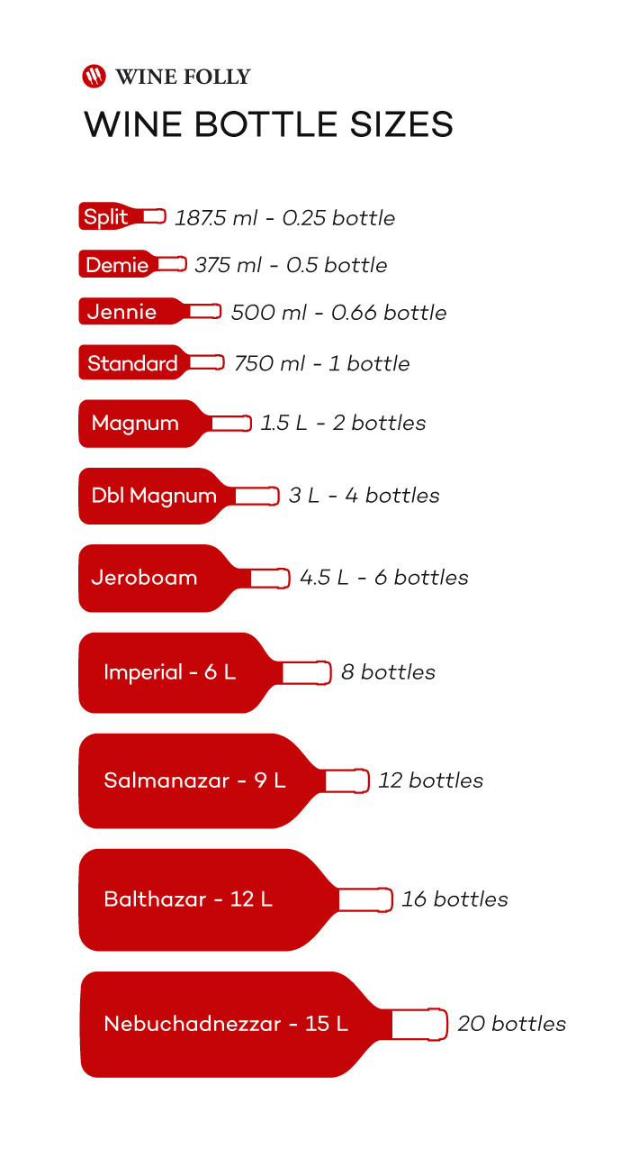
The wine (liquid) is the Content-type; the bottle size is the Content-Encoding
https://winefolly.com/tutorial/wine-bottle-sizes/

Slide 8
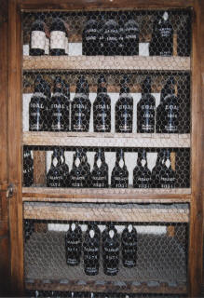
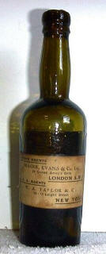
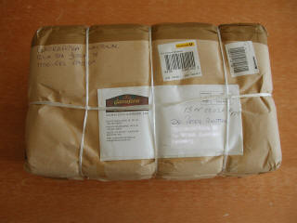
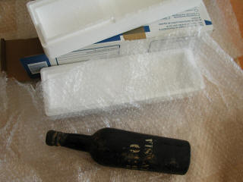
Content Encoding vs.
Transfer Encoding
GET /bottle1 HTTP/1.1
Origin
Server
Client
HTTP/1.1 200 OK
Content-Encoding
Transfer-Encoding
images from: http://www.madeirawineguide.com/madeira_v300/

Slide 9
Content-Encoding Example (Correct)
AIHT:~/Desktop/cs595-s06 mln$ telnet www.cs.odu.edu 80
Trying 128.82.4.2...
Connected to xenon.cs.odu.edu.
Escape character is '^]'.
HEAD /~mln/pubs/bollenj_adaptive.ps.gz HTTP/1.1
Host: www.cs.odu.edu
Connection: close
HTTP/1.1 200 OK
Date: Mon, 20 Feb 2006 04:30:25 GMT
Server: Apache/1.3.26 (Unix) ApacheJServ/1.1.2 PHP/4.3.4
Last-Modified: Thu, 25 Jul 2002 16:58:58 GMT
ETag: "1c16-139ea-3d402e52"
Accept-Ranges: bytes
Content-Length: 80362
Connection: close
Content-Type: application/postscript
Content-Encoding: x-gzip
Connection closed by foreign host.

Slide 10
Content-Encoding Example (Incorrect)
AIHT:~/Desktop mln$ telnet www.cs.odu.edu 80
Trying 128.82.4.2...
Connected to xenon.cs.odu.edu.
Escape character is '^]'.
HEAD /~mln/pubs/bollenj_adaptive.ps.gz HTTP/1.1
Host: www.cs.odu.edu
Connection: close
HTTP/1.1 200 OK
Date: Mon, 26 Feb 2007 02:06:25 GMT
Server: Apache/2.2.0
Last-Modified: Thu, 25 Jul 2002 16:58:58 GMT
ETag: "1c16-139ea-92cab880"
Accept-Ranges: bytes
Content-Length: 80362
Connection: close
Content-Type: application/x-gzip
Connection closed by foreign host.
Wrong, Wrong, Wrong!!!!!!!

Slide 11
Why is it incorrect?
% telnet www.cs.odu.edu 80
Trying 128.82.4.2...
Connected to xenon.cs.odu.edu.
Escape character is '^]'.
HEAD /~mln/adl98.ppt.gz HTTP/1.1
Host: www.cs.odu.edu
Connection: close
HTTP/1.1 200 OK
Date: Mon, 20 Feb 2012 02:21:29 GMT
Server: Apache/2.2.17 (Unix) PHP/5.3.5 mod_ssl/2.2.17 OpenSSL/0.9.8q
Last-Modified: Mon, 25 Mar 2002 17:15:44 GMT
ETag: "33e94-39d06961d5000"
Accept-Ranges: bytes
Content-Length: 212628
Connection: close
Content-Type: application/x-gzip
the encodings are the same,
the types are different

Slide 12
Compress
% telnet www.cs.odu.edu 80
Trying 128.82.4.2...
Connected to xenon.cs.odu.edu.
Escape character is '^]'.
HEAD /~mln/ntrs.tar.Z HTTP/1.1
Host: www.cs.odu.edu
Connection: close
HTTP/1.1 200 OK
Date: Mon, 20 Feb 2012 02:31:45 GMT
Server: Apache/2.2.17 (Unix) PHP/5.3.5 mod_ssl/2.2.17 OpenSSL/0.9.8q
Last-Modified: Thu, 12 Jun 2003 18:45:46 GMT
ETag: "7fffffff-3bfeb99a3ca80"
Accept-Ranges: bytes
Content-Length: 2147483647
Connection: close
Content-Type: application/x-compress

Slide 13
Zip
% telnet www.cs.odu.edu 80
Trying 128.82.4.2...
Connected to xenon.cs.odu.edu.
Escape character is '^]'.
HEAD /~mln/michael-hany.zip HTTP/1.1
Host: www.cs.odu.edu
Connection: close
HTTP/1.1 200 OK
Date: Mon, 20 Feb 2012 03:16:35 GMT
Server: Apache/2.2.17 (Unix) PHP/5.3.5 mod_ssl/2.2.17 OpenSSL/0.9.8q
Last-Modified: Fri, 17 Feb 2012 20:43:13 GMT
ETag: "223e5a1-4b92efe4dfc40"
Accept-Ranges: bytes
Content-Length: 35906977
Connection: close
Content-Type: application/zip

Slide 14
Transfer Encodings
Unlike Content-Encoding (Section 3.1.2.1 of [RFC7231]),
Transfer-Encoding is a property of the message, not of the
representation, and any recipient along the request/response
chain MAY decode the received transfer coding(s) or apply
additional transfer coding(s) to the message body, assuming
that corresponding changes are made to the
Transfer-Encoding field-value.
3.3.1, RFC 7230

Slide 15


Packaging/Shipping Doesn’t
Change the Representation
https://mashable.com/2013/08/22/71-lbs-fedex/
https://about.van.fedex.com/blog/boeing-777-ecodemonstrator/

Slide 16
Chunked Encoding
“The chunked transfer coding wraps the payload body in order to transfer it as a series of chunks, each with its own size indicator, followed by an OPTIONAL trailer containing header fields. Chunked enables content streams of unknown size to be transferred as a sequence of length-delimited buffers, which enables the sender to retain connection persistence and the recipient to know when it has received the entire message.”
4.1, RFC 7230

Slide 17
Chunked Encoding Example
AIHT:~/Desktop/cs595-s06 mln$ telnet www.cs.odu.edu 80
Trying 128.82.4.2...
Connected to xenon.cs.odu.edu.
Escape character is '^]'.
GET /~mln HTTP/1.1
Connection: close
Host: www.cs.odu.edu
Connection closed by foreign host.
HTTP/1.1 301 Moved Permanently
Date: Mon, 09 Jan 2006 19:32:24 GMT
Server: Apache/1.3.26 (Unix) ApacheJServ/1.1.2 PHP/4.3.4
Location: http://www.cs.odu.edu/~mln/
Connection: close
Transfer-Encoding: chunked
Content-Type: text/html; charset=iso-8859-1
12e
<!DOCTYPE HTML PUBLIC "-//IETF//DTD HTML 2.0//EN">
<HTML><HEAD>
<TITLE>301 Moved Permanently</TITLE>
</HEAD><BODY>
<H1>Moved Permanently</H1>
The document has moved <A HREF="http://www.cs.odu.edu/~mln/">here</A>.<P>
<HR>
<ADDRESS>Apache/1.3.26 Server at www.cs.odu.edu Port 80</ADDRESS>
</BODY></HTML>
0

Slide 18
Chunked Encoding Example 2
AIHT:~/Desktop/cs595-s06 mln$ telnet www.cs.odu.edu 80
Trying 128.82.4.2...
Connected to xenon.cs.odu.edu.
Escape character is '^]'.
GET / HTTP/1.1
Host: www.cs.odu.edu
HTTP/1.1 200 OK
Date: Tue, 21 Feb 2006 03:54:31 GMT
Server: Apache/1.3.26 (Unix) ApacheJServ/1.1.2 PHP/4.3.4
Transfer-Encoding: chunked
Content-Type: text/html
5f6
<!DOCTYPE HTML PUBLIC "-//W3C//DTD HTML 4.0 Transitional//EN">
<!-- saved from url=(0036)http://www.cs.odu.edu/newcssite/new/ -->
<!-- saved from url=(0019)http://sci.odu.edu/ -->
<HTML xmlns:st1 = "urn:schemas-microsoft-com:office:smarttags">
<HEAD><TITLE>Department Of Computer Science</TITLE>
[lots of html deleted]
[demo this example to see the various “chunks”]
0

Slide 19
Chunks visible in raw session
$ openssl s_client -connect www.cs.odu.edu:443
CONNECTED(00000003)
[much ssl deletia]
GET / HTTP/1.1
Host: www.cs.odu.edu
Connection: close
HTTP/1.1 200 OK
Server: nginx
Date: Wed, 17 Oct 2018 16:44:12 GMT
Content-Type: text/html
Transfer-Encoding: chunked
Connection: close
d3
<!DOCTYPE HTML PUBLIC "-//W3C//DTD HTML 4.0 Transitional//EN">
<html>
<head>
<title>Redirect</title>
<meta http-equiv="REFRESH" content="0;url=http://www.cs.odu.edu"></HEAD>
<BODY>
Redirecting!
</BODY>
</HTML>
0
closed

Slide 20
User agents will sometimes hide the transfer-encoding chunk sizes!
$ curl -i www.cs.odu.edu
HTTP/1.1 200 OK
Server: nginx
Date: Wed, 17 Oct 2018 16:46:59 GMT
Content-Type: text/html
Transfer-Encoding: chunked
Connection: keep-alive
<html>
<meta http-equiv="refresh" content="0; URL='http://odu.edu/compsci'" />
</html>
$ curl -I www.cs.odu.edu
HTTP/1.1 200 OK
Server: nginx
Date: Wed, 17 Oct 2018 16:47:42 GMT
Content-Type: text/html
Connection: keep-alive
Transfer-Encoding header is present,
but curl has suppressed the byte sizes
(still hidden with “-v” too)
HEAD is less useful as well;
we don’t know the representation size
(both Content-Length and
Transfer-Encoding are absent)

Slide 21
Multiple Transfer encodings are possible, but chunked (if present) is always last
3.3.1, RFC 7230
The Transfer-Encoding header field lists the transfer coding names
corresponding to the sequence of transfer codings that have been (or
will be) applied to the payload body in order to form the message
body.
[…]
If any transfer coding
other than chunked is applied to a request payload body, the sender
MUST apply chunked as the final transfer coding to ensure that the
message is properly framed. If any transfer coding other than
chunked is applied to a response payload body, the sender MUST either
apply chunked as the final transfer coding or terminate the message
by closing the connection.
For example,
Transfer-Encoding: gzip, chunked
indicates that the payload body has been compressed using the gzip
coding and then chunked using the chunked coding while forming the
message body.

Slide 22
TE Request Header &
Transfer-Encoding Response Header
Client specifies preferences for transfer encoding in the TE header
  4.3, RFC 7230
Server marks the encoding used with the Transfer-Encoding header
  3.3.1, RFC 7230
Both headers use the same encoding values available with Content-Encoding, plus the special chunked encoding and the Trailers value

Slide 23
Trailers requested, but server isn’t sending…
dhcp65-74-196-93:~/Desktop/cs595-s06 mln$ telnet www.cs.odu.edu 80
Trying 128.82.4.2...
Connected to xenon.cs.odu.edu.
Escape character is '^]'.
GET / HTTP/1.1
TE: gzip;q=1.0, Trailers
Host: www.cs.odu.edu
HTTP/1.1 200 OK
Date: Mon, 27 Feb 2006 15:52:33 GMT
Server: Apache/1.3.26 (Unix) ApacheJServ/1.1.2 PHP/4.3.4
Transfer-Encoding: chunked
Content-Type: text/html
5f6
<!DOCTYPE HTML PUBLIC "-//W3C//DTD HTML 4.0 Transitional//EN">
<!-- saved from url=(0036)http://www.cs.odu.edu/newcssite/new/ -->
<!-- saved from url=(0019)http://sci.odu.edu/ -->
[more html deleted]

Slide 24
Time / Space Tradeoff
Hard to find examples of compression used in transfer encoding
  https://web.archive.org/web/20001019025549/http://webreference.com:80/internet/software/servers/http/ (read w/ curl or lynx; js rendering fails)https://web.archive.org/web/20050114061329/http://www-128.ibm.com/developerworks/web/library/wa-httpcomp/
  idea: for very heavy volume web servers, answering the request quickly is more important than preserving bandwidth
Complexity of management seems to be the limiting factor in compression with content encodings

Slide 25
Trailer Response Header
The “Trailer” response header lets the client know that additional headers will appear at the end of the chunked response
  sections 4.1.2, 4.4, RFC 7230
  headers can be reconstructed by downstream servers
  headers that can never be trailers:
    Transfer-Encoding
    Content-Length
    Trailer

Slide 26
Trailer Example
HTTP/1.1 200 OK
Date: Mon, 22 Mar 2004 11:15:03 GMT
Content-Type: text/html
Content-Length: 129
Expires: Sat, 27 Mar 2004 21:12:00 GMT
<html><body><p>The file you requested is 3,400 bytes long
and was last modified: Sat, 20 Mar 2004 21:12:00 GMT.
</p></body></html>
HTTP/1.1 200 OK
Date: Mon, 22 Mar 2004 11:15:03 GMT
Content-Type: text/html
Transfer-Encoding: chunked
Trailer: Expires
29
<html><body><p>The file you requested is
5
3,400
23
bytes long and was last modified:
1d
Sat, 20 Mar 2004 21:12:00 GMT
13
.</p></body></html>
0
Expires: Sat, 27 Mar 2004 21:12:00 GMT
“Expires:” response header covered in section 5.3, RFC 7234
Examples from: http://www.tcpipguide.com/free/t_HTTPDataLengthIssuesChunkedTransfersandMessageTrai-3.htm

Slide 27
Two More Request
Headers to Process

Slide 28
Referer Request Header
5.5.2, RFC 7231
The "Referer" [sic] header field allows the user agent to specify a
URI reference for the resource from which the target URI was obtained
(i.e., the "referrer", though the field name is misspelled). A user
agent MUST NOT include the fragment and userinfo components of the
URI reference [RFC3986], if any, when generating the Referer field
value.
Example:
Referer: http://www.example.org/hypertext/Overview.html
cf. rel=“noreferrer” (also note the correct spelling)
https://stackoverflow.com/questions/50773152/when-should-i-use-rel-noreferrer

Slide 29
User-Agent Request Header
5.5.3, RFC 7231
The "User-Agent" header field contains information about the user
agent originating the request, which is often used by servers to help
identify the scope of reported interoperability problems, to work
around or tailor responses to avoid particular user agent
limitations, and for analytics regarding browser or operating system
use. A user agent SHOULD send a User-Agent field in each request
unless specifically configured not to do so.
Example:
User-Agent: CERN-LineMode/2.15 libwww/2.17b3

Slide 30
Lying with User-Agent
$ curl -I "https://www.amazon.com/Mountain-Has-Fallen-EP/dp/B073JS3Y9Q/"
HTTP/1.1 503 Service Unavailable
Content-Type: text/html
Content-Length: 2671
Connection: keep-alive
Server: Server
Date: Wed, 17 Oct 2018 17:19:09 GMT
[deletia]
$ curl -I -A "mozilla" "https://www.amazon.com/Mountain-Has-Fallen-EP/dp/B073JS3Y9Q/"
HTTP/1.1 405 Method Not Allowed
Content-Type: text/html;charset=UTF-8
Connection: keep-alive
Server: Server
Date: Wed, 17 Oct 2018 17:19:32 GMT
[deletia]
$ curl -i -A "mozilla" --silent "https://www.amazon.com/Mountain-Has-Fallen-EP/dp/B073JS3Y9Q/"
| head -10
HTTP/1.1 200 OK
Content-Type: text/html;charset=UTF-8
Transfer-Encoding: chunked
Connection: keep-alive
Server: Server
Date: Wed, 17 Oct 2018 17:20:21 GMT
Strict-Transport-Security: max-age=47474747; includeSubDomains; preload
Vary: Accept-Encoding,User-Agent,X-Amazon-CDN-Cache
P3P: policyref="https://www.amazon.com/w3c/p3p.xml",CP="CAO DSP LAW CUR ADM IVAo IVDo CONo OTPo OUR DELi PUBi OTRi BUS PHY ONL UNI PUR FIN COM NAV INT DEM CNT STA HEA PRE LOC GOV OTC "
Cache-Control: no-cache, no-transform

Slide 31
I’m an iPhone, I swear!
$ curl -IL -A "iphone" --silent en.wikipedia.org
| egrep -i "(HTTP/1.1 [0-9]|^location:)"
HTTP/1.1 301 TLS Redirect
Location: https://en.wikipedia.org/
HTTP/1.1 301 Moved Permanently
Location: https://en.wikipedia.org/wiki/Main_Page
HTTP/1.1 302 Found
Location: https://en.m.wikipedia.org/wiki/Main_Page
HTTP/1.1 200 OK
#1, be pedantic about https
#2, mediawiki version of “index.html”
#3, mobile version “.m” in host
cf. https://www.business2community.com/instagram/post-instagram-computer-02013790

