Slide 1

Document Filtering
Michael L. Nelson
CS 432/532
Old Dominion University
This work is licensed under a Creative Commons Attribution-NonCommercial-ShareAlike 3.0 Unported License
This course is based on
Dr. McCown's class

Slide 2

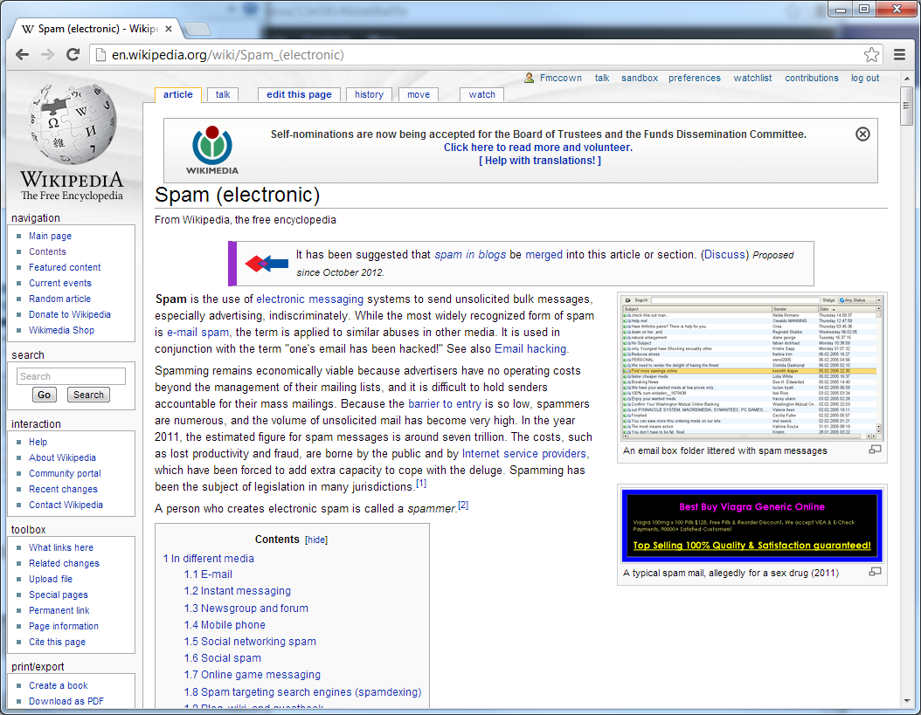
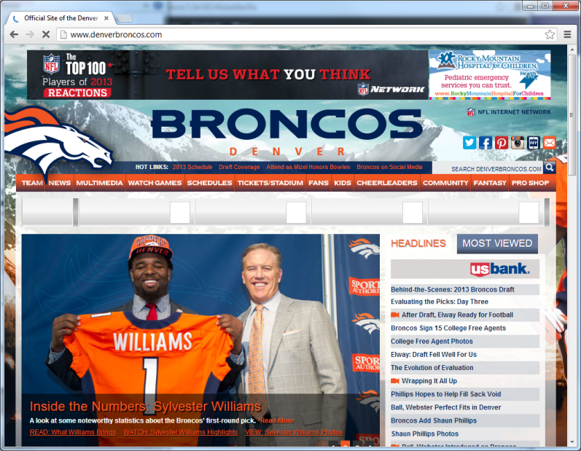

Can we classify these documents?
Science, Leisure, Programming, etc.

Slide 3
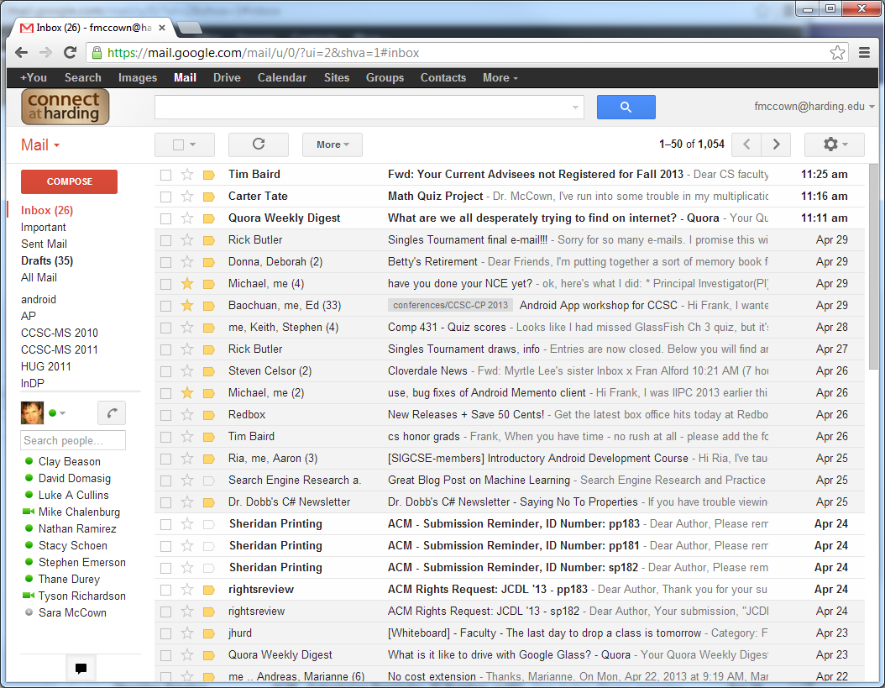
Can we classify these documents?
Important, Work, Personal, Spam, etc.

Slide 4
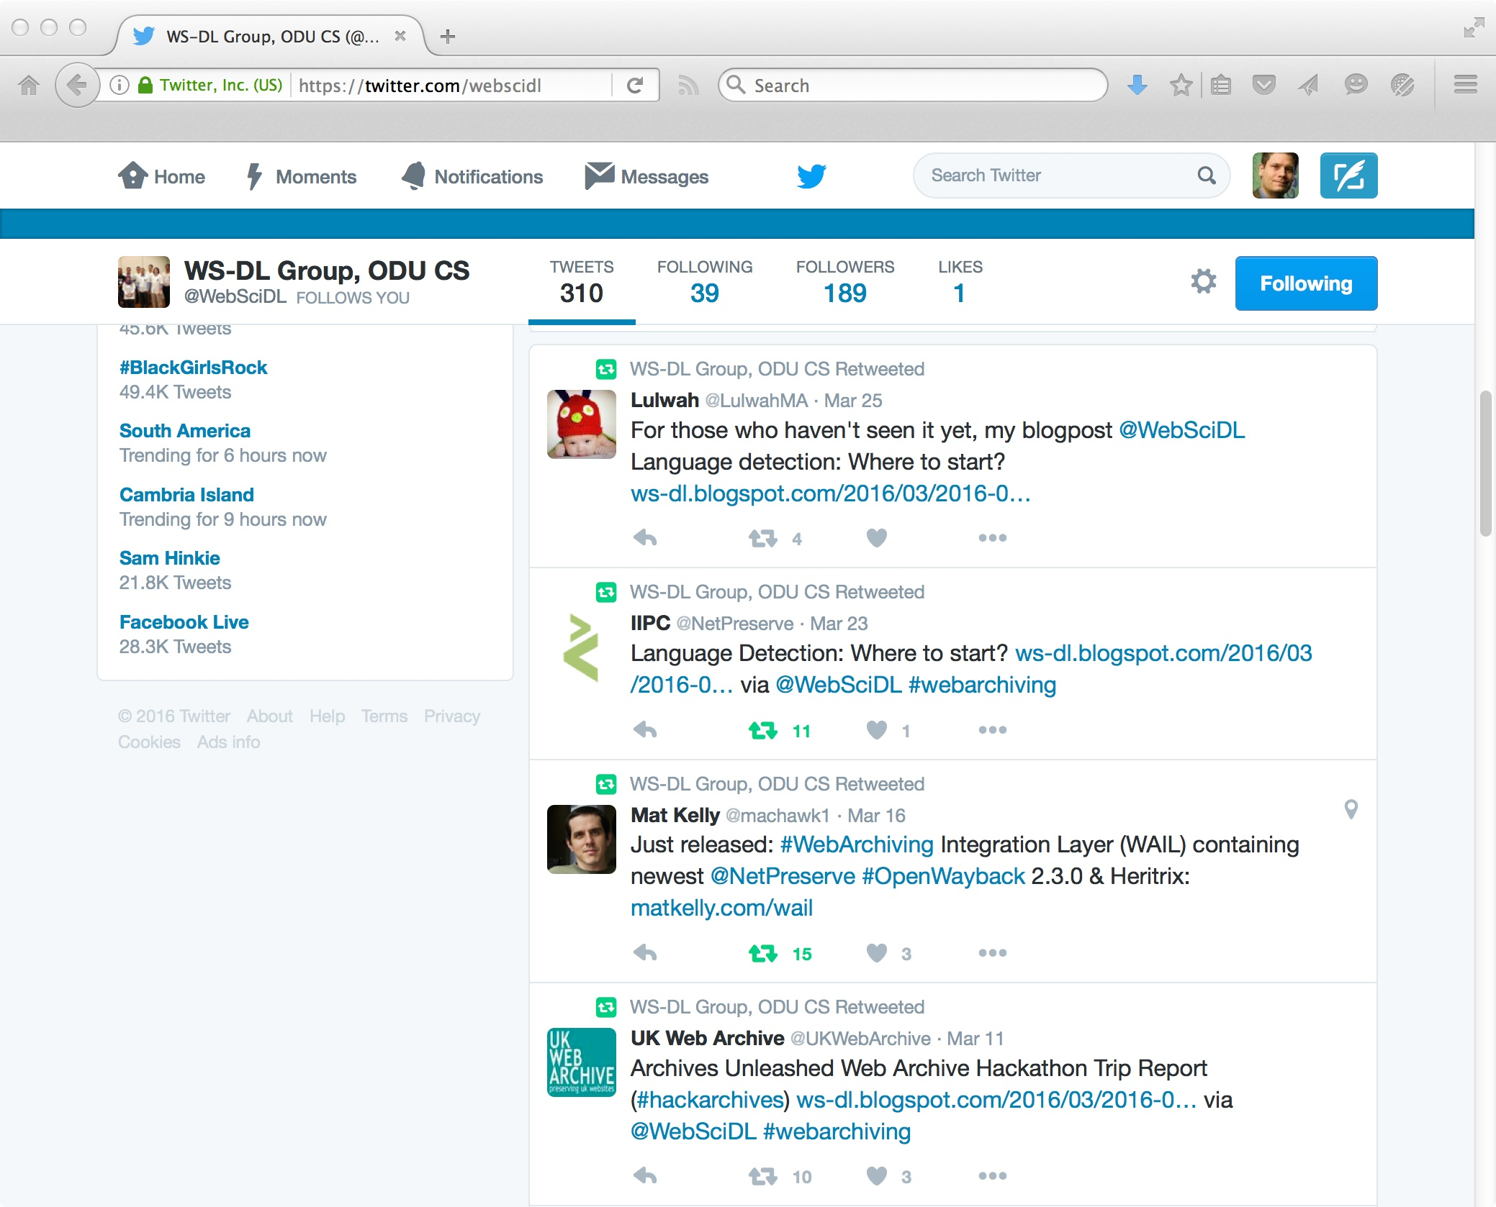
How about very small documents?

Slide 5
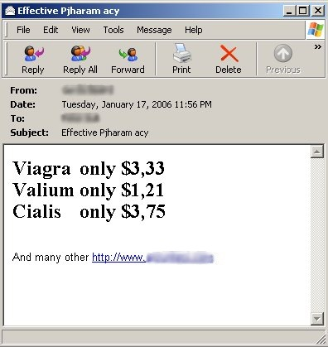
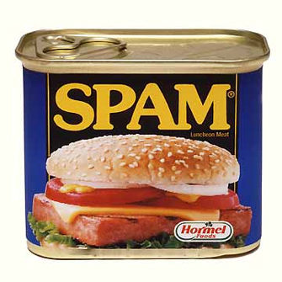
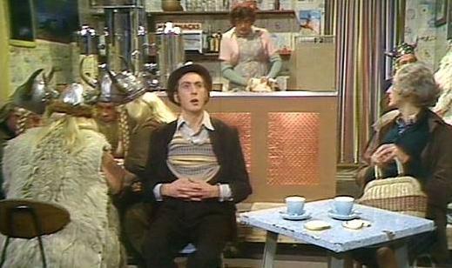
Rule-Based Classifiers
Are Inadequate
If my email has the word "spam", is the message about:
http://www.youtube.com/watch?v=anwy2MPT5RE
http://en.wikipedia.org/wiki/Spam_%28Monty_Python%29
https://docs.python.org/2/faq/general.html#why-is-it-called-python
Rule-based classifiers don't consider context

Slide 6
Features
Many external features can be used depending on type of document
  Links pointing in? Links pointing out?
  Recipient list? Sender's email and IP address?
Many internal features
  Use of certain words or phrases
  Color and sizes of words
  Document length
  Grammar analysis
We will focus on internal features to build a classifier

Slide 7
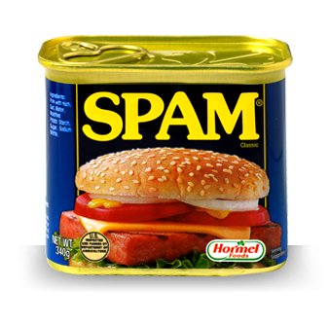
Spam
Unsolicited, unwanted, bulk
messages sent via electronic
messaging systems
Usually advertising or some
economic incentive
Many forms: email, forum posts, blog comments, social networking, web pages for search engines, etc.

Slide 8
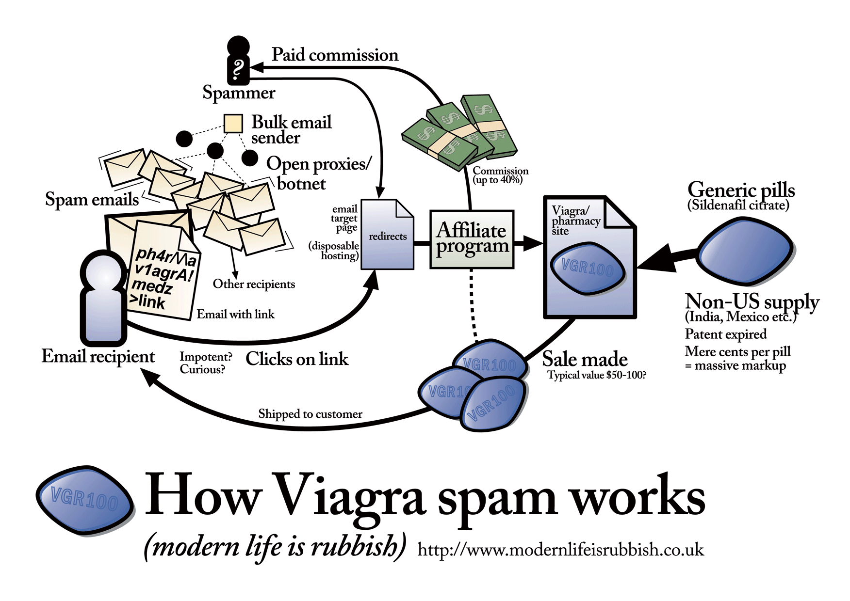
http://modernl.com/images/illustrations/how-viagra-spam-works-large.png

Slide 9
Classifiers
Needs features for classifying documents
Feature is anything you can determine that is present or absent in the item
Best features are common enough to appear frequently but not all the time (cf. stopwords)
Words in document are a useful feature
For spam detection, certain words like viagra usually appear in spam

Slide 10
Classifying with
Supervised Learning
We "teach" the program to learn the difference between spam as unsolicited bulk email, luncheon meat, and comedy troupes by providing examples of each classification
We use an item's features for classification
  item = document
  feature = word
  classification = {good|bad}

Slide 11
Simple Feature Classifications
>>> import docclass
>>> cl=docclass.classifier(docclass.getwords)
>>> cl.setdb('mln.db')
>>> cl.train('the quick brown fox jumps over the lazy dog','good')
the quick brown fox jumps over the lazy dog
>>> cl.train('make quick money in the online casino','bad')
make quick money in the online casino
>>> cl.fcount('quick','good')
1.0
>>> cl.fcount('quick','bad')
1.0
>>> cl.fcount('casino','good')
0
>>> cl.fcount('casino','bad')
1.0

Slide 12
training data
def sampletrain(cl):
cl.train('Nobody owns the water.','good')
cl.train('the quick rabbit jumps fences','good')
cl.train('buy pharmaceuticals now','bad')
cl.train('make quick money at the online casino','bad')
cl.train('the quick brown fox jumps','good')

Slide 13
Conditional Probabilities
>>> import docclass
>>> cl=docclass.classifier(docclass.getwords)
>>> cl.setdb('mln.db')
>>> docclass.sampletrain(cl)
Nobody owns the water.
the quick rabbit jumps fences
buy pharmaceuticals now
make quick money at the online casino
the quick brown fox jumps
>>> cl.fprob('quick','good')
0.66666666666666663
>>> cl.fprob('quick','bad')
0.5
>>> cl.fprob('casino','good')
0.0
>>> cl.fprob('casino','bad')
0.5
>>> cl.fcount('quick','good')
2.0
>>> cl.fcount('quick','bad')
1.0
>>>
Pr(A|B) = "probability of A given B"
fprob(quick|good) = "probability of quick given good"
= (quick classified as good) / (total good items)
= 2 / 3
fprob(quick|bad) = "probability of quick given bad"
= (quick classified as bad) / (total bad items)
= 1 / 2
note: we're writing to a database,
so your counts might be off if you
re-run the examples

Slide 14
Assumed Probabilities
>>> cl.fprob('money','bad')
0.5
>>> cl.fprob('money','good')
0.0
we have data for bad, but should we start with
0 probability for money given good?
>>> cl.weightedprob('money','good',cl.fprob)
0.25
>>> docclass.sampletrain(cl)
Nobody owns the water.
the quick rabbit jumps fences
buy pharmaceuticals now
make quick money at the online casino
the quick brown fox jumps
>>> cl.weightedprob('money','good',cl.fprob)
0.16666666666666666
>>> cl.fcount('money','bad')
3.0
>>> cl.weightedprob('money','bad',cl.fprob)
0.5
define an assumed probability of 0.5
then weightedprob() returns
the weighted mean of fprob and
the assumed probability
weightedprob(money,good) =
(weight * assumed +
countAllCats * fprob())
/ (countAllCats + weight)
= (1*0.5 + 1*0) / (1+1)
= 0.5 / 2
= 0.25
(double the training)
= (1*0.5 + 2*0) / (2+1)
= 0.5 / 3
= 0.166
Pr(money|bad) remains = (0.5 + 3*0.5) / (3+1) = 0.5

Slide 15
Naïve Bayesian Classifier
Move from terms to documents:
  Pr(document) = Pr(term₁) * Pr(term₂) * … * Pr(term_{n})
Naïve because we assume all terms occur independently
  we know this is as simplifying assumption; it is naïve to think all terms have equal probability for completing:
  "Shave and a hair cut ___ ____"
  "New York _____"
  "International Business ______"
Bayesian because we use Bayes' Theorem to invert the conditional probabilities

Slide 16
Probability of Whole Document
Naïve Bayesian classifier determines probability of entire document being given a classification
  Pr(Category | Document)
Assume:
  Pr(python|bad) = 0.2
  Pr(casino|bad) = 0.8
So Pr(python & casino|bad) = 0.2 * 0.8 = 0.16
This is Pr(Document|Category)
How do we calculate Pr(Category|Document)?

Slide 17
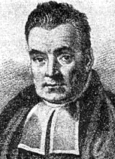
Bayes' Theorem
Given our training data, we know: Pr(feature|classification)
What we really want to know is: Pr(classification|feature)
Bayes' Theorem (http://en.wikipedia.org/wiki/Bayes%27_theorem ) :
Pr(A|B) = Pr(B|A) Pr(A) / Pr(B)
Pr(good|doc) = Pr(doc|good) Pr(good) / Pr(doc)
we know how to
calculate this
#good / #total
we skip this since
it is the same for
each classification
see: https://twitter.com/KirkDBorne/status/850073322884927488 and
https://www.countbayesie.com/blog/2015/2/18/bayes-theorem-with-lego

Slide 18
Our Bayesian Classifier
>>> import docclass
>>> cl=docclass.naivebayes(docclass.getwords)
>>> cl.setdb('mln.db')
>>> docclass.sampletrain(cl)
Nobody owns the water.
the quick rabbit jumps fences
buy pharmaceuticals now
make quick money at the online casino
the quick brown fox jumps
>>> cl.prob('quick rabbit','good')
quick rabbit
0.15624999999999997
>>> cl.prob('quick rabbit','bad')
quick rabbit
0.050000000000000003
>>> cl.prob('quick rabbit jumps','good')
quick rabbit jumps
0.095486111111111091
>>> cl.prob('quick rabbit jumps','bad')
quick rabbit jumps
0.0083333333333333332
we use these values
only for comparison,
not as "real" probabilities

Slide 19
Classification Thresholds
>>> cl.prob('quick rabbit','good')
quick rabbit
0.15624999999999997
>>> cl.prob('quick rabbit','bad')
quick rabbit
0.050000000000000003
>>> cl.classify('quick rabbit',default='unknown')
quick rabbit
quick rabbit
u'good'
>>> cl.prob('quick money','good')
quick money
0.09375
>>> cl.prob('quick money','bad')
quick money
0.10000000000000001
>>> cl.classify('quick money',default='unknown')
quick money
quick money
u'bad'
>>> cl.setthreshold('bad',3.0)
>>> cl.classify('quick money',default='unknown')
quick money
quick money
'unknown'
>>> cl.classify('quick rabbit',default='unknown')
quick rabbit
quick rabbit
u'good'
>>> for i in range(10): docclass.sampletrain(cl)
...
[training data deleted]
>>> cl.prob('quick money','good')
quick money
0.016544117647058824
>>> cl.prob('quick money','bad')
quick money
0.10000000000000001
>>> cl.classify('quick money',default='unknown')
quick money
quick money
u'bad'
>>>
>>> cl.prob('quick rabbit','good')
quick rabbit
0.13786764705882351
>>> cl.prob('quick rabbit','bad')
quick rabbit
0.0083333333333333332
>>> cl.classify('quick rabbit',default='unknown')
quick rabbit
quick rabbit
u'good'
>>>
only classify something as bad if it
is 3X more likely to be bad than good

Slide 20
Fisher Method
Normalize the frequencies for each category
  e.g., we might have far more "bad" training data than good, so the net cast by the bad data will be "wider" than we'd like
Naïve Bayes = combine feature probabilities to arrive at document probability
Fisher = calculate category probability for each feature, combine the probabilities, then see if the set of probabilities is more or less than the expected value for a random document
  Calculate normalized Bayesian probability, then fit the result to an inverse chi-square function to see what is the probability that a random document of that classification would have those features (i.e., terms)

Slide 21
Fisher Code
class fisherclassifier(classifier):
def cprob(self,f,cat):
# The frequency of this feature in this category
clf=self.fprob(f,cat)
if clf==0: return 0
# The frequency of this feature in all the categories
freqsum=sum([self.fprob(f,c) for c in self.categories()])
# The probability is the frequency in this category divided by
# the overall frequency
p=clf/(freqsum)
return p

Slide 22
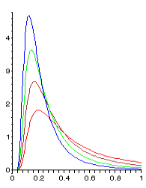
Fisher Code
def fisherprob(self,item,cat):
# Multiply all the probabilities together
p=1
features=self.getfeatures(item)
for f in features:
p*=(self.weightedprob(f,cat,self.cprob))
# Take the natural log and multiply by -2
fscore=-2*math.log(p)
# Use the inverse chi2 function to get the
# probability of getting the fscore
# value we got
return self.invchi2(fscore,len(features)*2)
http://en.wikipedia.org/wiki/Inverse-chi-squared_distribution

Slide 23
Fisher Example
>>> import docclass
>>> cl=docclass.fisherclassifier(docclass.getwords)
>>> cl.setdb('mln.db')
>>> docclass.sampletrain(cl)
Nobody owns the water.
the quick rabbit jumps fences
buy pharmaceuticals now
make quick money at the online casino
the quick brown fox jumps
>>> cl.cprob('quick','good')
0.57142857142857151
>>> cl.fisherprob('quick','good')
quick
0.5535714285714286
>>> cl.fisherprob('quick rabbit','good')
quick rabbit
0.78013986588957995
>>> cl.cprob('rabbit','good')
1.0
>>> cl.fisherprob('rabbit','good')
rabbit
0.75
>>> cl.cprob('quick','good')
0.57142857142857151
>>> cl.cprob('quick','bad')
0.4285714285714286
>>> cl.cprob('money','good')
0
>>> cl.cprob('money','bad')
1.0
>>> cl.cprob('buy','bad')
1.0
>>> cl.cprob('buy','good')
0
>>> cl.fisherprob('money buy','good')
money buy
0.23578679513998632
>>> cl.fisherprob('money buy','bad')
money buy
0.8861423315082535
>>> cl.fisherprob('money quick','good')
money quick
0.41208671548422637
>>> cl.fisherprob('money quick','bad')
money quick
0.70116895256207468
>>>

Slide 24
Classification with Inverse
Chi-Square Result
>>> cl.fisherprob('quick rabbit','good')
quick rabbit
0.78013986588957995
>>> cl.classify('quick rabbit')
quick rabbit
quick rabbit
u'good'
>>> cl.fisherprob('quick money','good')
quick money
0.41208671548422637
>>> cl.classify('quick money')
quick money
quick money
u'bad'
>>> cl.setminimum('bad',0.8)
>>> cl.classify('quick money')
quick money
quick money
u'good'
>>> cl.setminimum('good',0.4)
>>> cl.classify('quick money')
quick money
quick money
u'good'
>>> cl.setminimum('good',0.42)
>>> cl.classify('quick money')
quick money
quick money
>>>
in practice, we'll tolerate false positives
for "good" more than false negatives
for "good" -- we'd rather see a mesg
that is spam rather than lose a mesg
that is not spam.
this version of the classifier does not
print "unknown" as a classification

Slide 25
Classifying Entries in the
F-Measure Blog
encoding problems with supplied python_search.xml
  fixable, but didn't want to work that hard
f-measure.blogspot.com is an Atom-based feed
  music is not classified by genre
edits made to feedfilter.py & data
  commented out "publisher" field
  rather than further edit feedfilter.py, I s/content/summary/g in the f-measure.xml (a hack, I know…)
  changes in read():
# Print the best guess at the current category
#print 'Guess: '+str(classifier.classify(entry))
print 'Guess: '+str(classifier.classify(fulltext))
# Ask the user to specify the correct category and train on that
cl=raw_input('Enter category: ')
classifier.train(fulltext,cl)
#classifier.train(entry,cl)
# where fulltext is now title + summary

Slide 26
F-Measure Example
>>> import feedfilter
>>> import docclass
>>> cl=docclass.fisherclassifier
(docclass.getwords)
>>> cl.setdb('mln-f-measure.db')
>>> feedfilter.read('f-measure.xml',cl)
[lots of interactive training stuff deleted]
>>> cl.classify('cars')
u'electronic'
>>> cl.classify('uk')
u'80s'
>>> cl.classify('ocasek')
u'80s'
>>> cl.classify('weezer')
u'alt'
>>> cl.classify('cribs')
u'alt'
>>> cl.classify('mtv')
u'80s'
>>> cl.cprob('mtv','alt')
0
>>> cl.cprob('mtv','80s')
0.51219512195121952
>>> cl.classify('libertines')
u'alt'
>>> cl.classify('wichita')
u'alt'
>>> cl.classify('journey')
u'80s'
>>> cl.classify('venom')
u'metal'
>>> cl.classify('johnny cash')
u'cover'
>>> cl.classify('spooky')
u'metal'
>>> cl.classify('dj spooky')
u'metal'
>>> cl.classify('dj shadow')
u'electronic'
>>> cl.cprob('spooky','metal')
0.60000000000000009
>>> cl.cprob('spooky','electronic')
0.40000000000000002
>>> cl.classify('dj')
u'80s'
>>> cl.cprob('dj','80s')
0
>>> cl.cprob('dj','electronic')
0
we have "dj spooky" (electronic)
and "spooky intro" (metal)
unfortunately, getwords() ignores "dj" with:
if len(s)>2 and len(s)<20

Slide 27
Improved Feature Detection
entryfeatures() on p. 137
  takes an entry as an argument, not a string (edits from 2 slides ago would have to be backed out)
  looks for > 30% UPPERCASE words
  does not tokenize "publisher" and "creator" fields
    actually, the code just does that for "publisher"
  For "summary" field, it preserves 1-grams (as before) but also adds bi-grams
    For example, "…best songs ever: "Good Life" and "Pink Triangle"." would be split into:
1-grams:
best, songs, ever,
good, life, and, pink,
triangle
bi-grams:
best songs, songs ever, ever good,
good life, life and, and pink,
pink triangle

Slide 28
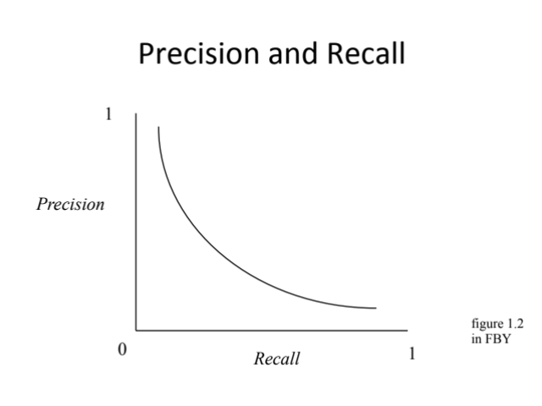
Precision and Recall: Defined the Same, but Expectations are Different
Remember this slide from Week 5?
Now we can expect to populate the
top right-hand corner.
Precision = TP / (TP+FP)
Recall = TP / (TP+FN)
F-Measure = 2 * P*R / (P+R)
https://en.wikipedia.org/wiki/Precision_and_recall

Slide 29
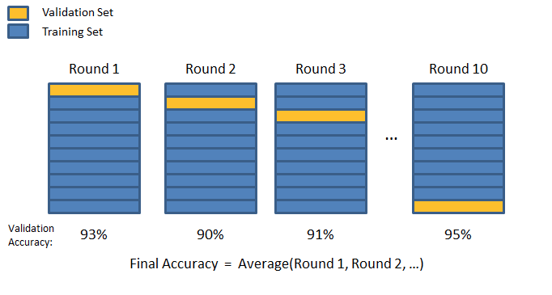
10-Fold Cross Validation
image from: https://chrisjmccormick.wordpress.com/2013/07/31/k-fold-cross-validation-with-matlab-code/
https://en.wikipedia.org/wiki/Cross-validation_%28statistics%29

