Slide 1

kNN and SVM
Michael L. Nelson
CS 423/532
Old Dominion University
This work is licensed under a Creative Commons Attribution-NonCommercial-ShareAlike 3.0 Unported License
This course is based on
Dr. McCown's class

Slide 2
Chapter 8

Slide 3
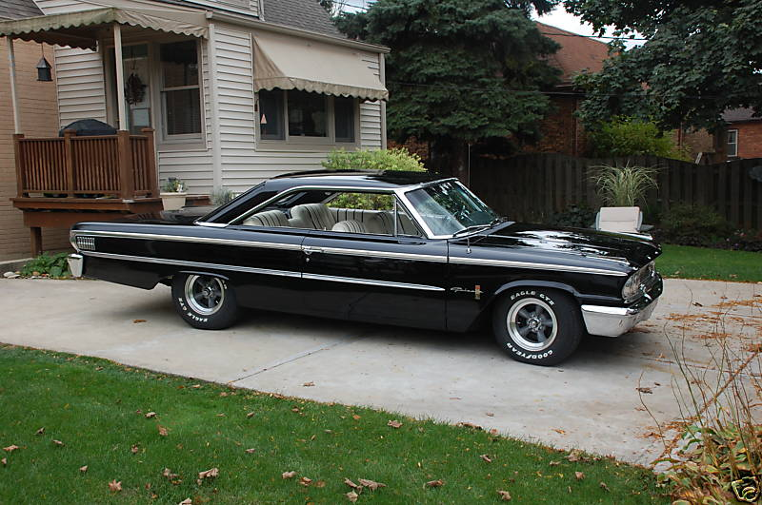
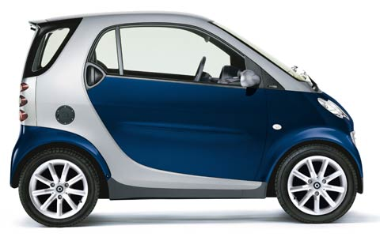
Some Evaluations Are Simple…

Slide 4

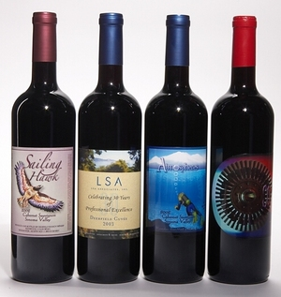
Some Evaluations
Are More Complex…
Chapter 8 price model for wines: price=f(rating,age)
  wines have a peak age
    far into the future for good wines (high rating)
    nearly immediate for bad wines (low rating)
  wines can gain 5X original value at peak age
  wines go bad 5 years after peak age
def wineprice(rating,age):
peak_age=rating-50
# Calculate price based on rating
price=rating/2
if age>peak_age:
# Past its peak, goes bad in 5 years
price=price*(5-(age-peak_age))
else:
# Increases to 5x original value as it
# approaches its peak
price=price*(5*((age+1)/peak_age))
if price<0: price=0
return price

Slide 5
To Anacreon in Heaven…
def wineset1():
rows=[]
for i in range(300):
# Create a random age and rating
rating=random()*50+50
age=random()*50
# Get reference price
price=wineprice(rating,age)
# Add some noise
#price*=(random()*0.2+0.9)
price*=(random()*0.4+0.8)
# Add to the dataset
rows.append({'input':(rating,age),
'result':price})
return rows
>>> import numpredict
>>> numpredict.wineprice(95.0,3.0)
21.111111111111114
>>> numpredict.wineprice(95.0,8.0)
47.5
>>> numpredict.wineprice(99.0,1.0)
10.102040816326529
>>> numpredict.wineprice(20.0,1.0)
0
>>> numpredict.wineprice(30.0,1.0)
0
>>> numpredict.wineprice(50.0,1.0)
112.5
>>> numpredict.wineprice(50.0,2.0)
100.0
>>> numpredict.wineprice(50.0,3.0)
87.5
>>> data=numpredict.wineset1()
>>> data[0]
{'input': (89.232627562980568, 23.392312984476838), 'result': 157.65615979190267}
>>> data[1]
{'input': (59.87004163297604, 2.6353185389295875), 'result': 50.624575737257267}
>>> data[2]
{'input': (95.750031143736848, 29.800709868119231), 'result': 184.99939310081996}
>>> data[3]
{'input': (63.816032861417639, 6.9857271772707783), 'result': 104.89398176429833}
>>> data[4]
{'input': (79.085632724279833, 36.304704141161352), 'result': 53.794171791411422}
good wine, but
not peak age
= low price
skunk water
middling wine,
but peak age
= high price

Slide 6
How Much is This Bottle Worth?
Find the k “nearest neighbors” to the item in question and average their prices. Your bottle is probably worth what the others are worth.
Questions:
  how big should k be?
  what dimensions should be used to judge “nearness”

Slide 7
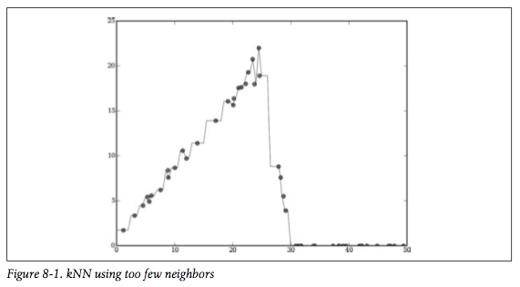
k=1, Too Small

Slide 8
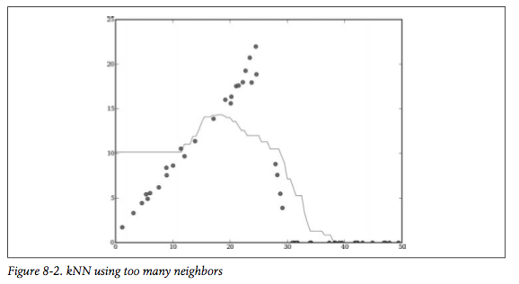
k=20, Too Big

Slide 9
Define “Nearness” as f(rating,age)
>>> data[0]
{'input': (89.232627562980568, 23.392312984476838), 'result': 157.65615979190267}
>>> data[1]
{'input': (59.87004163297604, 2.6353185389295875), 'result': 50.624575737257267}
>>> data[2]
{'input': (95.750031143736848, 29.800709868119231), 'result': 184.99939310081996}
>>> data[3]
{'input': (63.816032861417639, 6.9857271772707783), 'result': 104.89398176429833}
>>> data[4]
{'input': (79.085632724279833, 36.304704141161352), 'result': 53.794171791411422}
>>> numpredict.euclidean(data[0]['input'],data[1]['input'])
35.958507629062964
>>> numpredict.euclidean(data[0]['input'],data[2]['input'])
9.1402461702479503
>>> numpredict.euclidean(data[0]['input'],data[3]['input'])
30.251931245339232
>>> numpredict.euclidean(data[0]['input'],data[4]['input'])
16.422282108155486
>>> numpredict.euclidean(data[1]['input'],data[2]['input'])
45.003690219362205
>>> numpredict.euclidean(data[1]['input'],data[3]['input'])
5.8734063451707224
>>> numpredict.euclidean(data[1]['input'],data[4]['input'])
38.766821739987471

Slide 10
kNN Estimator
>>> numpredict.knnestimate(data,(95.0,3.0))
21.635620163824875
>>> numpredict.wineprice(95.0,3.0)
21.111111111111114
>>> numpredict.knnestimate(data,(95.0,15.0))
74.744108153418324
>>> numpredict.knnestimate(data,(95.0,25.0))
145.13311902177989
>>> numpredict.knnestimate(data,(99.0,3.0))
19.653661909493177
>>> numpredict.knnestimate(data,(99.0,15.0))
84.143397370311604
>>> numpredict.knnestimate(data,(99.0,25.0))
133.34279965424111
>>> numpredict.knnestimate(data,(99.0,3.0),k=1)
22.935771290035785
>>> numpredict.knnestimate(data,(99.0,3.0),k=10)
29.727161237156785
>>> numpredict.knnestimate(data,(99.0,15.0),k=1)
58.151852659938086
>>> numpredict.knnestimate(data,(99.0,15.0),k=10)
92.413908926458447
def knnestimate(data,vec1,k=5):
# Get sorted distances
dlist=getdistances(data,vec1)
avg=0.0
# Take the average of the top k results
for i in range(k):
idx=dlist[i][1]
avg+=data[idx]['result']
avg=avg/k
return avg
mo neighbors,
mo problems

Slide 11
Should All Neighbors Count Equally?
getdistances() sorts the neighbors by distances, but those distances could be:
1, 2, 5, 11, 12348, 23458, 456599
We’ll notice a big change going from k=4 to k=5
How can we weight the 7 neighbors above accordingly?

Slide 12
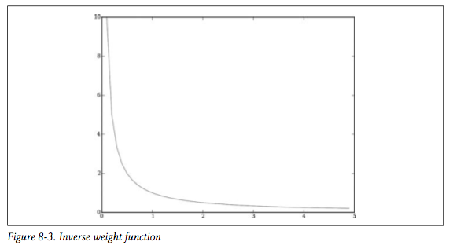
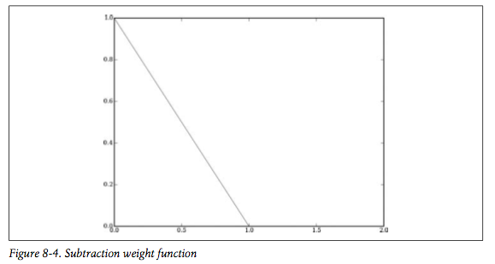
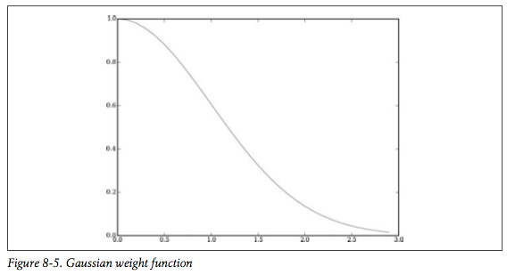
Weight Functions
Falls off too quickly
Goes to Zero
Falls Slowly, Doesn’t Hit Zero

Slide 13
Weighted vs. Non-Weighted
>>> numpredict.wineprice(95.0,3.0)
21.111111111111114
>>> numpredict.knnestimate(data,(95.0,3.0))
21.635620163824875
>>> numpredict.weightedknn(data,(95.0,3.0))
21.648741297049899
>>> numpredict.wineprice(95.0,15.0)
84.444444444444457
>>> numpredict.knnestimate(data,(95.0,15.0))
74.744108153418324
>>> numpredict.weightedknn(data,(95.0,15.0))
74.949258534489346
>>> numpredict.wineprice(95.0,25.0)
137.2222222222222
>>> numpredict.knnestimate(data,(95.0,25.0))
145.13311902177989
>>> numpredict.weightedknn(data,(95.0,25.0))
145.21679590393029
>>> numpredict.knnestimate(data,(95.0,25.0),k=10)
137.90620608492134
>>> numpredict.weightedknn(data,(95.0,25.0),k=10)
138.85154438288421

Slide 14
Cross-Validation
Testing all the combinations would be tiresome…
We cross validate our data to see how our method is performing:
  divide our 300 bottles into training data and test data (typically something like a (0.95,0.05) split)
  train the system with our training data, then see if we can correctly predict the results in the test data (where we already know the answer) and record the errors
  repeat n times with different training/test partitions

Slide 15
Cross-Validating kNN and WkNN
>>> numpredict.crossvalidate(numpredict.knnestimate,data) # k=5
357.75414919641719
>>> def knn3(d,v): return numpredict.knnestimate(d,v,k=3)
...
>>> numpredict.crossvalidate(knn3,data)
374.27654623186737
>>> def knn1(d,v): return numpredict.knnestimate(d,v,k=1)
...
>>> numpredict.crossvalidate(knn1,data)
486.38836851997144
>>> numpredict.crossvalidate(numpredict.weightedknn,data) # k=5
342.80320831062471
>>> def wknn3(d,v): return numpredict.weightedknn(d,v,k=3)
...
>>> numpredict.crossvalidate(wknn3,data)
362.67816434458132
>>> def wknn1(d,v): return numpredict.weightedknn(d,v,k=1)
...
>>> numpredict.crossvalidate(wknn1,data)
524.82845502785574
>>> def wknn5inverse(d,v): return numpredict.weightedknn(d,v,weightf=numpredict.inverseweight)
...
>>> numpredict.crossvalidate(wknn5inverse,data)
342.68187472350417
In this case, we understand the price function and weights well enough
to not need optimization…

Slide 16
Heterogeneous Data
Suppose that in addition to rating & age, we collected:
  bottle size (in ml)
    375, 750, 1500, 3000
    (book goes to 3000, code to 1500)
    http://en.wikipedia.org/wiki/Wine_bottle#Sizes
  the # of aisle where the wine was bought (aisle 2, aisle 9, etc.)
def wineset2():
rows=[]
for i in range(300):
rating=random()*50+50
age=random()*50
aisle=float(randint(1,20))
bottlesize=[375.0,750.0,1500.0][randint(0,2)]
price=wineprice(rating,age)
price*=(bottlesize/750)
price*=(random()*0.2+0.9)
rows.append({'input':
(rating,age,aisle,bottlesize),
'result':price})
return rows

Slide 17
Vintage #2
>>> data=numpredict.wineset2()
>>> data[0]
{'input': (54.165108104770141, 34.539865790286861, 19.0, 1500.0), 'result': 0.0}
>>> data[1]
{'input': (85.368451290310119, 20.581943831329454, 7.0, 750.0), 'result': 138.67018277159647}
>>> data[2]
{'input': (70.883447179046527, 17.510910062083763, 8.0, 375.0), 'result': 83.519907955896613}
>>> data[3]
{'input': (63.236220974521459, 15.66074713248673, 9.0, 1500.0), 'result': 256.55497402767531}
>>> data[4]
{'input': (51.634428621301851, 6.5094854514893496, 6.0, 1500.0), 'result': 120.00849381080788}
>>> numpredict.crossvalidate(knn3,data)
1197.0287329391431
>>> numpredict.crossvalidate(numpredict.weightedknn,data)
1001.3998202008664
>>>
We have more data -- why are the errors bigger?

Slide 18
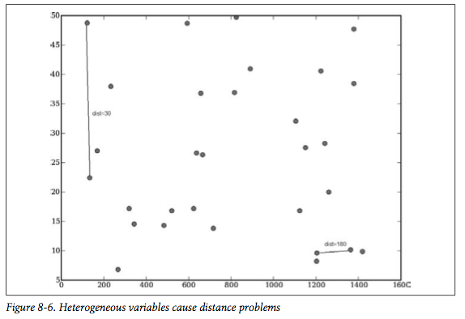
Differing Data Scales
distance=30
distance=180

Slide 19
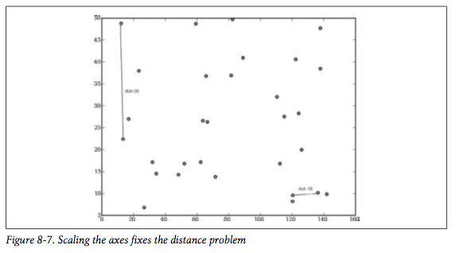
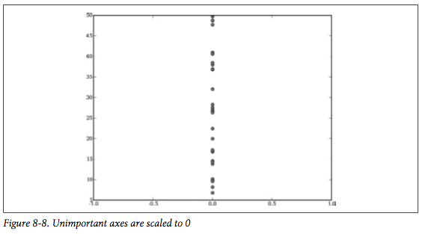
Rescaling The Data
distance=18
Rescale ml by 0.1
Rescale aisle by 0.0

Slide 20
Cross-Validating Our Scaled Data
>>> sdata=numpredict.rescale(data,[10,10,0,0.5])
>>> numpredict.crossvalidate(knn3,sdata)
874.34929987724752
>>> numpredict.crossvalidate(numpredict.weightedknn,sdata)
1137.6927754808073
>>> sdata=numpredict.rescale(data,[15,10,0,0.1])
>>> numpredict.crossvalidate(knn3,sdata)
1110.7189445981378
>>> numpredict.crossvalidate(numpredict.weightedknn,sdata)
1313.7981751958403
>>> sdata=numpredict.rescale(data,[10,15,0,0.6])
>>> numpredict.crossvalidate(knn3,sdata)
948.16033679019574
>>> numpredict.crossvalidate(numpredict.weightedknn,sdata)
1206.6428136396851
my 2nd and 3rd guesses are worse than the initial guess --
but how can we tell if the initial guess is “good”?

Slide 21
Optimizing The Scales
>>> import optimization # using the chapter 5 version, not the chapter 8 version!
>>> reload(numpredict)
<module 'numpredict' from 'numpredict.pyc'>
>>> costf=numpredict.createcostfunction(numpredict.knnestimate,data)
>>> optimization.annealingoptimize(numpredict.weightdomain,costf,step=2)
[4, 8.0, 2, 4.0]
>>> optimization.annealingoptimize(numpredict.weightdomain,costf,step=2)
[4, 8, 4, 4]
>>> optimization.annealingoptimize(numpredict.weightdomain,costf,step=2)
[6, 10, 2, 4.0]
the book got [11,18,0,6] --
the last solution is close,
but we are hoping to see 0
for aisle…
code has:
weightdomain=[(0,10)]*4
book has:
weightdomain=[(0,20)]*4

Slide 22
Optimizing - Genetic Algorithm
>>> optimization.geneticoptimize(numpredict.weightdomain,costf,popsize=5)
1363.57544567
1509.85520291
1614.40150619
1336.71234577
1439.86478765
1255.61496037
1263.86499276
1447.64124381
[lots of lines deleted]
1138.43826351
1215.48698063
1201.70022455
1421.82902056
1387.99619684
1112.24992339
1135.47820954
[5, 6, 1, 9]
the book got [20,18,0,12]
on this one -- or did it?

Slide 23
Optimization - Particle Swarm
>>> import numpredict
>>> data=numpredict.wineset2()
>>> costf=numpredict.createcostfunction(numpredict.knnestimate,data)
>>> import optimization
>>> optimization.swarmoptimize(numpredict.weightdomain,costf,popsize=5,lrate=1,maxv=4,iters=20)
>>> optimization.swarmoptimize(numpredict.weightdomain,costf,popsize=5,lrate=1,maxv=4,iters=20)
[10.0, 4.0, 0.0, 10.0] 1703.49818863
[6.0, 4.0, 3.0, 10.0] 1635.317375
[6.0, 4.0, 3.0, 10.0] 1433.68139154
[6.0, 10, 2.0, 10] 1052.571099
[8.0, 8.0, 0.0, 10.0] 1286.04236301
[6.0, 6.0, 2.0, 10] 876.656865281
[6.0, 7.0, 2.0, 10] 1032.29545458
[8.0, 8.0, 0.0, 10.0] 1190.01320225
[6.0, 7.0, 2.0, 10] 1172.43008909
[4.0, 7.0, 3.0, 10] 1287.94875028
[4.0, 8.0, 3.0, 10] 1548.04584827
[8.0, 8.0, 0.0, 10.0] 1294.08912173
[8.0, 6.0, 2.0, 10] 1509.85587222
[8.0, 6.0, 2.0, 10] 1135.66091584
[10, 10.0, 0, 10.0] 1023.94077802
[8.0, 6.0, 2.0, 10] 1088.75216364
[8.0, 8.0, 0.0, 10.0] 1167.18869905
[8.0, 8.0, 0, 10] 1186.1047697
[8.0, 6.0, 0, 10] 1108.8635027
[10.0, 8.0, 0, 10] 1220.45183068
[10.0, 8.0, 0, 10]
>>>
included in chapter 8 code
but not discussed in book!
see: http://en.wikipedia.org/wiki/Particle_swarm_optimization
cf. [20,18,0,12]

Slide 24
Chapter 9

Slide 25
Matchmaking Site
male:
female:
age,smoker,wants children,interest1:interest2:…:interestN:addr,
age,smoker,wants children,interest1:interest2:…:interestN:addr,match
39,yes,no,skiing:knitting:dancing,220 W 42nd St New York NY,
43,no,yes,soccer:reading:scrabble,824 3rd Ave New York NY,0
23,no,no,football:fashion,102 1st Ave New York NY,
30,no,no,snowboarding:knitting:computers:shopping:tv:travel,151 W 34th St New York NY,1
50,no,no,fashion:opera:tv:travel,686 Avenue of the Americas New York NY,
49,yes,yes,soccer:fashion:photography:computers:camping:movies:tv,824 3rd Ave New York NY,0
46,no,yes,skiing:reading:knitting:writing:shopping,154 7th Ave New York NY,
19,no,no,dancing:opera:travel,1560 Broadway New York NY,0
36,yes,yes,skiing:knitting:camping:writing:cooking,151 W 34th St New York NY,
29,no,yes,art:movies:cooking:scrabble,966 3rd Ave New York NY,1
27,no,no,snowboarding:knitting:fashion:camping:cooking,27 3rd Ave New York NY,
19,yes,yes,football:computers:writing,14 E 47th St New York NY,0
(linebreaks, spaces added for readability)

Slide 26
Start With Only Ages…
>>> import advancedclassify
>>> matchmaker=advancedclassify.loadmatch('matchmaker.csv')
>>> agesonly=advancedclassify.loadmatch('agesonly.csv',allnum=True)
>>> matchmaker[0].data
['39', 'yes', 'no', 'skiing:knitting:dancing', '220 W 42nd St New York NY',
'43', 'no', 'yes', 'soccer:reading:scrabble', '824 3rd Ave New York NY']
>>> matchmaker[0].match
0
>>> agesonly[0].data
[24.0, 30.0]
>>> agesonly[0].match
1
>>> agesonly[1].data
[30.0, 40.0]
>>> agesonly[1].match
1
>>> agesonly[2].data
[22.0, 49.0]
>>> agesonly[2].match
0
24,30,1
30,40,1
22,49,0
43,39,1
23,30,1
23,49,0
48,46,1
23,23,1
29,49,0
…

Slide 27
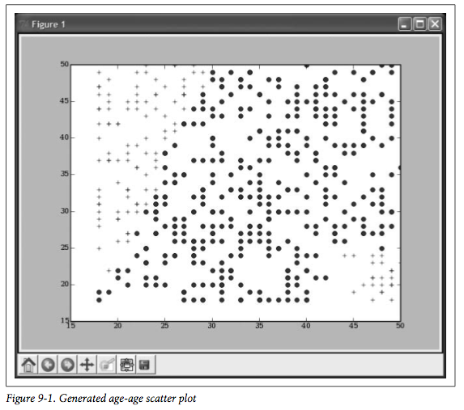
M age vs. F age

Slide 28
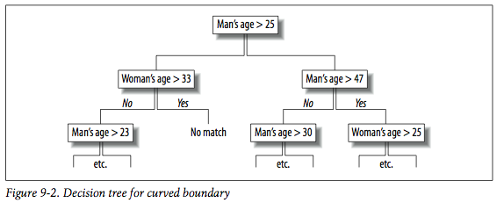
Not a Good Match For a
Decision Tree
(covered in Chapter 7)

Slide 29
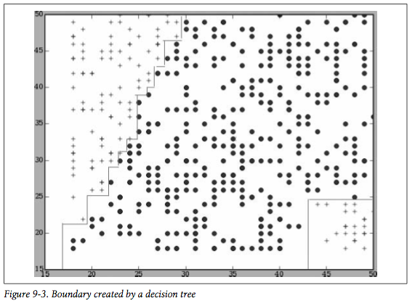
Boundaries are Vertical & Horizontal Only
cf. L¹ norm from ch 3; http://en.wikipedia.org/wiki/Taxicab_geometry

Slide 30
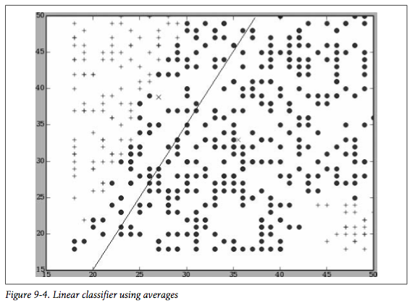
Linear Classifier
>>> avgs=advancedclassify.lineartrain(agesonly)
avg. point
for non-match
avg. point
for match
Are (x,y) a match? Plot the data and compute which point is “closest”.

Slide 31
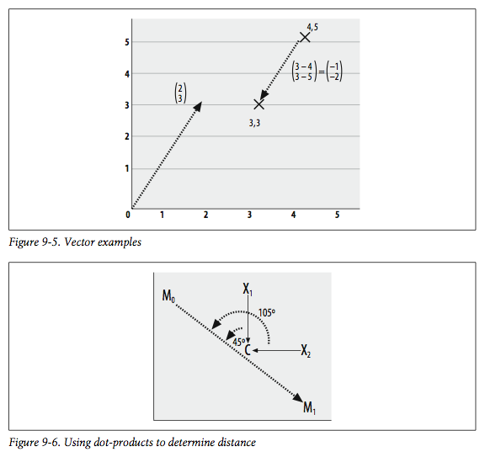
Vector, Dot Product Review
Instead of Euclidean distance,
we’ll use vector dot products.
A = (2,3)
B = (-1,-2)
A•B = 2(-1) + 3(-2)
A•B = -8
also:
A•B = len(A)len(B)cos(AB)
so:
(X₁-C)•(M₀-M₁) is positive,
so X₁ is in class M₀
(X₂-C)•(M₀-M₁) is negative,
so X₂ is in class M₁
M₀=match
M₁=no match

Slide 32
Dot Product Classifier
>>> avgs=advancedclassify.lineartrain(agesonly)
>>> advancedclassify.dpclassify([50,50],avgs)
1
>>> advancedclassify.dpclassify([60,60],avgs)
1
>>> advancedclassify.dpclassify([20,60],avgs)
0
>>> advancedclassify.dpclassify([30,30],avgs)
1
>>> advancedclassify.dpclassify([30,25],avgs)
1
>>> advancedclassify.dpclassify([25,40],avgs)
0
>>> advancedclassify.dpclassify([48,20],avgs)
1
>>> advancedclassify.dpclassify([60,20],avgs)
1
these should not be matches!

Slide 33
Categorical Features
Convert yes/no questions to:
  yes = 1, no = -1, unknown/missing = 0
Count interest overlaps. e.g., {fishing:hiking:hunting} and {activism:hiking:vegetarianism} will have an interest overlap of “1”
  optimizations, such as creating a hierarchy of related interests, are desirable.
    combining outdoor sports like hunting, fishing
  if choosing from a bounded list of interests, measure the cosine between two resulting vectors
    (0,1,1,1,0) (1,0,1,0,1)
  if accepting free text from users, normalize the results
    stemming, synonyms, normalize input lengths, etc.
Convert addresses to latitude, longitude, then convert lat,long pairs to mileage
  mileage is approximate, but book has code with < 10% error which will be fine for determining proximity

Slide 34
Yahoo Geocoding API
>>> advancedclassify.milesdistance('cambridge, ma','new york,ny')
191.51092890345939
>>> advancedclassify.getlocation('532 Rhode Island Ave, Norfolk, VA')
(36.887245, -76.286400999999998)
>>> advancedclassify.milesdistance('norfolk, va','blacksburg, va')
220.21868849853567
>>> advancedclassify.milesdistance('532 rhode island ave., norfolk, va',
'4700 elkhorn ave., norfolk, va')
1.1480170414890398
http://api.local.yahoo.com/MapsService/V1/geocode?appid=appid&location=532+Rhode+Island+Ave,Norfolk,VA
2013 update: of course this no longer works, but similar services are available

Slide 35
Loaded & Scaled
>>> numericalset=advancedclassify.loadnumerical()
>>> numericalset[0].data
[39.0, 1, -1, 43.0, -1, 1, 0, 6.729579883484428]
>>> numericalset[0].match
0
>>> numericalset[1].data
[23.0, -1, -1, 30.0, -1, -1, 0, 1.6738043955092503]
>>> numericalset[1].match
1
>>> numericalset[2].data
[50.0, -1, -1, 49.0, 1, 1, 2, 5.715074975686611]
>>> numericalset[2].match
0
>>> scaledset,scalef=advancedclassify.scaledata(numericalset)
>>> avgs=advancedclassify.lineartrain(scaledset)
>>> scalef(numericalset[0].data)
[0.65625, 1, 0, 0.78125, 0, 1, 0, 0.44014343540421147]
>>> scaledset[0].data
[0.65625, 1, 0, 0.78125, 0, 1, 0, 0.44014343540421147]
>>> scaledset[0].match
0
>>> scaledset[1].data
[0.15625, 0, 0, 0.375, 0, 0, 0, 0.10947399831631938]
>>> scaledset[1].match
1
>>> scaledset[2].data
[1.0, 0, 0, 0.96875, 1, 1, 0, 0.37379045600821365]
>>> scaledset[2].match
0
>>>
def loadnumerical():
oldrows=loadmatch('matchmaker.csv')
newrows=[]
for row in oldrows:
d=row.data
data=[float(d[0]),yesno(d[1]),yesno(d[2]),
float(d[5]),yesno(d[6]),yesno(d[7]),
matchcount(d[3],d[8]),
milesdistance(d[4],d[9]),
row.match]
# [mAge,smoke,kids,fAge,smoke,kids,interest,
# miles], match
newrows.append(matchrow(data))
return newrows
oldest couple, ages are 1.0 and 0.97;
but age is the only thing going for them
(I’m not sure why the interests were
scaled to exactly 0; int vs. float error?)

Slide 36
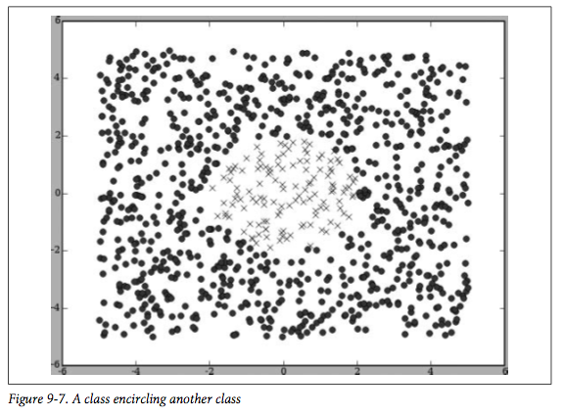
A Linear Classifier Won’t Help
Idea: transform data… convert every (x,y) to (x²,y²)

Slide 37
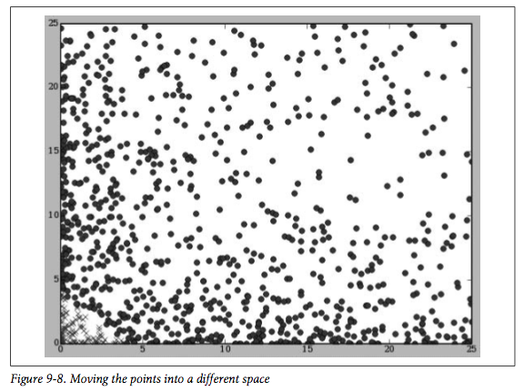
Now a Linear Classifier Will Help…
That was an easy transformation, but what about a transformation
that takes us to higher dimensions? e.g., (x,y) → (x²,xy,y²)

Slide 38
The “Kernel Trick”
We can use linear classifiers on non-linear problems if we transform the original data into higher-dimensional space
  http://en.wikipedia.org/wiki/Kernel_trick
Replace the dot product with the radial basis function
  http://en.wikipedia.org/wiki/Radial_basis_function
import math
def rbf(v1,v2,gamma=10):
dv=[v1[i]-v2[i] for i in range(len(v1))]
l=veclength(dv)
return math.e**(-gamma*l)

Slide 39
Nonlinear Classifier
>>> offset=advancedclassify.getoffset(agesonly)
>>> offset
-0.0076450020098023288
>>> advancedclassify.nlclassify([30,30],agesonly,offset)
1
>>> advancedclassify.nlclassify([30,25],agesonly,offset)
1
>>> advancedclassify.nlclassify([25,40],agesonly,offset)
0
>>> advancedclassify.nlclassify([48,20],agesonly,offset)
0
>>> ssoffset=advancedclassify.getoffset(scaledset)
>>> ssoffset
0.012744361062728658
>>> numericalset[0].match
0
>>> advancedclassify.nlclassify(scalef(numericalset[0].data),scaledset,ssoffset)
0
>>> numericalset[1].match
1
>>> advancedclassify.nlclassify(scalef(numericalset[1].data),scaledset,ssoffset)
1
>>> numericalset[2].match
0
>>> advancedclassify.nlclassify(scalef(numericalset[2].data),scaledset,ssoffset)
0
>>> newrow=[28.0,-1,-1,26.0,-1,1,2,0.8] # Man doesn't want children, woman does
>>> advancedclassify.nlclassify(scalef(newrow),scaledset,ssoffset)
0
>>> newrow=[28.0,-1,1,26.0,-1,1,2,0.8] # Both want children
>>> advancedclassify.nlclassify(scalef(newrow),scaledset,ssoffset)
1
the dot product classfier (slide 32)
predicted matches for these!

Slide 40
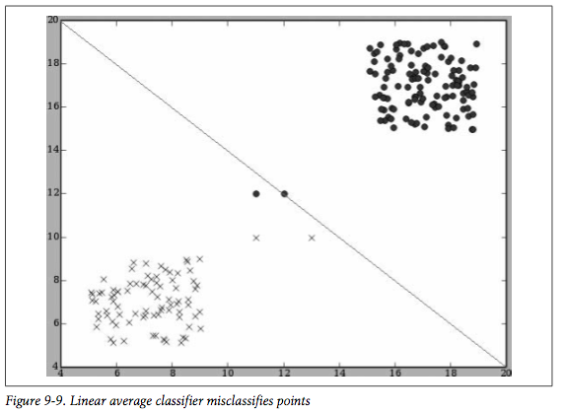
Linear Misclassification

Slide 41
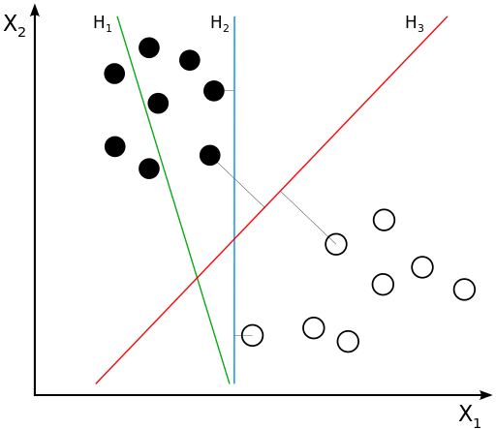
Maximum-Margin Hyperplane
H1 does not separate the
classes at all.
H2 separates the classes,
but with a small margin.
H3 separates the classes
with the maximum margin.
image from: http://en.wikipedia.org/wiki/Support_vector_machine

Slide 42
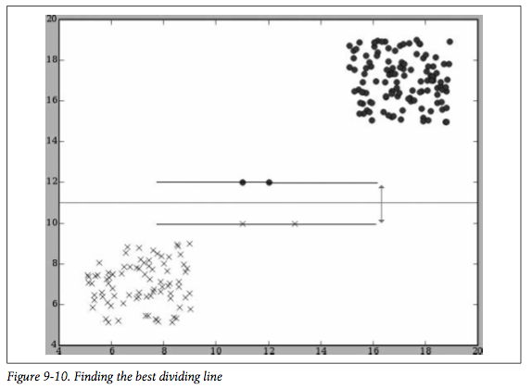
Support Vector Machine
Maximum-Margin
Hyperplane
Support Vectors

Slide 43
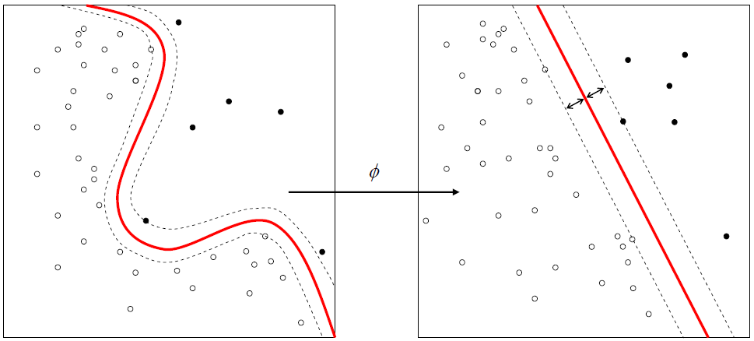
Linear in Higher Dimensions
original input dimensions
higher dimensions via
"kernel trick"
image from: http://en.wikipedia.org/wiki/Support_vector_machine

Slide 44
LIBSVM
classes
training data
>>> from svm import *
>>> prob = svm_problem([1,-1],[[1,0,1],[-1,0,-1]])
>>> param = svm_parameter(kernel_type = LINEAR, C = 10)
>>> m = svm_model(prob, param)
*
optimization finished, #iter = 1
nu = 0.025000
obj = -0.250000, rho = 0.000000
nSV = 2, nBSV = 0
Total nSV = 2
>>> m.predict([1, 1, 1])
1.0
>>> m.predict([1, 1, -1])
-1.0
>>> m.predict([0, 0, 0])
-1.0
>>> m.predict([1, 0, 0])
1.0
check the errata for changes in the Python interface to libsvm:
http://www.oreilly.com/catalog/errataunconfirmed.csp?isbn=9780596529321

Slide 45
LIBSVM on Matchmaker
>>> answers,inputs=[r.match for r in scaledset],[r.data for r in scaledset]
>>> param = svm_parameter(kernel_type = RBF)
>>> prob = svm_problem(answers,inputs)
>>> m=svm_model(prob,param)
*
optimization finished, #iter = 329
nu = 0.777729
obj = -290.207656, rho = -0.965033
nSV = 394, nBSV = 382
Total nSV = 394
>>> newrow=[28.0,-1,-1,26.0,-1,1,2,0.8]# Man doesn't want children, woman does
>>> m.predict(scalef(newrow))
0.0
>>> newrow=[28.0,-1,1,26.0,-1,1,2,0.8]# Both want children
>>> m.predict(scalef(newrow))
1.0
>>> newrow=[38.0,-1,1,24.0,1,1,1,2.8]# Both want children, but less in common
>>> m.predict(scalef(newrow))
1.0
>>> newrow=[38.0,-1,1,24.0,1,1,0,2.8]# Both want children, but even less in common
>>> m.predict(scalef(newrow))
1.0
>>> newrow=[38.0,-1,1,24.0,1,1,0,10.0]# Both want children, but far less in common, 10 miles
>>> m.predict(scalef(newrow))
1.0
>>> newrow=[48.0,-1,1,24.0,1,1,0,10.0]# Both want children, nothing in common, older male
>>> m.predict(scalef(newrow))
1.0
>>> newrow=[24.0,-1,1,48.0,1,1,0,10.0]# Both want children, nothing in common, older female
>>> m.predict(scalef(newrow))
1.0
>>> newrow=[24.0,-1,1,58.0,1,1,0,10.0]# Both want children, nothing in common, much older female
>>> m.predict(scalef(newrow))
1.0
>>> newrow=[24.0,-1,1,58.0,1,1,0,100.0]# Same as above, but greater distance
>>> m.predict(scalef(newrow))
0.0

Slide 46
Cross-validation
>>> guesses = cross_validation(prob, param, 4)
*
optimization finished, #iter = 206
nu = 0.796942
obj = -235.638042, rho = -0.957618
nSV = 306, nBSV = 296
Total nSV = 306
*
optimization finished, #iter = 224
nu = 0.780128
obj = -237.590876, rho = -1.027825
nSV = 300, nBSV = 288
Total nSV = 300
*
optimization finished, #iter = 239
nu = 0.794009
obj = -235.252234, rho = -0.941018
nSV = 307, nBSV = 289
Total nSV = 307
*
optimization finished, #iter = 278
nu = 0.802139
obj = -234.473046, rho = -0.908467
nSV = 306, nBSV = 289
Total nSV = 306
>>> guesses
[0.0, 0.0, 0.0, 0.0, 1.0, 0.0, 0.0, 0.0, 0.0, 0.0, 0.0, 1.0,
[much deletia]
, 1.0, 0.0, 0.0, 0.0, 1.0, 0.0, 0.0, 0.0, 1.0, 0.0, 0.0, 1.0, 0.0, 1.0, 0.0, 0.0]
>>> sum([abs(answers[i]-guesses[i]) for i in range(len(guesses))])
120.0
correct = 380/500 = 0.76
could we do better with
different values for
svm_parameter()?

