Slide 1

Clustering Algorithms
Michael L. Nelson
CS 432/532
Old Dominion University
This work is licensed under a Creative Commons Attribution-NonCommercial-ShareAlike 3.0 Unported License
This course is based on
Dr. McCown's class

Slide 2
Chapter 3: Clustering
We want to cluster our information because we want to:
  find unknown groups or patterns
  visualize our results
Clustering is an example of unsupervised learning
  we don't know what the correct answer is before we start
  supervised learning examples in later chapters

Slide 3
First Things First…
Items to be clustered need numerical scores that "describe" the items
Some examples:
  Customers can be described by the amount of purchases they make each month
  Movies can be described by the ratings given to them by critics
  Documents can be described by the number of times they use certain words

Slide 4
Finding Similar Web Pages
Given N of the web pages, how would we cluster them?
Extract terms
  Break each string by whitespace
  Convert to lowercase
  Remove HTML tags
  Find frequency of each term in each document
  Remove common terms (i.e., stop words, high TF) and very unique terms (i.e., high IDF)
You don’t always remove/extract what you really want:
http://ws-dl.blogspot.com/2017/03/2017-03-20-survey-of-5-boilerplate.html

Slide 5

Grabbing Blog Feeds
Humans read blogs, newsfeeds, etc. in HTML, but machines read blogs in the XML-based syndication formats RSS or Atom
  http://en.wikipedia.org/wiki/RSS_(file_format)
  http://en.wikipedia.org/wiki/Atom_(standard)
Examples (look for autodiscovery icon)
  http://pilotonline.com/
  http://f-measure.blogspot.com/
  http://en.wikipedia.org/wiki/DJ_Shadow
  http://norfolk.craigslist.org/cta/

Slide 6
Creating Blog-Term Matrix
Code on pp. 31-32 for grabbing feeds, getting terms from title and summary (RSS) or description (Atom)
  uses “feedparser” https://pypi.python.org/pypi/feedparser
Static file of blog feeds included in chapter3/blogdata.txt; URIs in chapter3/feedlist.txt
# Returns title and dictionary of
# word counts for an RSS feed
def getwordcounts(url):
# Parse the feed
d=feedparser.parse(url)
wc={}
# Loop over all the entries
# description==RSS; summary==Atom
for e in d.entries:
if 'summary' in e: summary=e.summary
else: summary=e.description
# Extract a list of words
# A8 doesn’t use summary --MLN
words=getwords(e.title+' '+summary)
for word in words:
wc.setdefault(word,0)
wc[word]+=1
return d.feed.title,wc

Slide 7


PCI Code “Fakes” TFIDF, Stopwords
The code on p. 32 is not how we would like to do things
Term Frequency
  "how often this term appears in this document"
Document Frequency
  "how often this term appears in all the documents"
TF x IDF (or just TFIDF)
  a score that balances the frequency of a term in a document vs. frequency of a term in all the documents
  http://en.wikipedia.org/wiki/Tf%E2%80%93idf
  does high TF always equal stopwords?
wordlist=[]
for w,bc in apcount.items():
frac=float(bc)/len(feedlist)
if frac>0.1 and frac<0.5:
wordlist.append(w)
intuition: a term that appears in many documents will get a low IDF; that term is not what the document is "about"
a term that appears in just one or a few documents is a good discriminator and will get a high IDF; if appears in that document a lot, it will also get a high TF and the resulting high TFIDF means that term captures the "aboutness" of the document

Slide 8
blogdata.txt
Terms
% cat blogdata.txt | awk '{FS="\t";print $1, $2, $3, $4, $5, $6}' | less
Blog china kids music yahoo want
The Superficial - Because You're Ugly 0 1 0 0 3
Wonkette 0 2 1 0 6
Publishing 2.0 0 0 7 4 0
Eschaton 0 0 0 0 5
Blog Maverick 2 14 17 2 45
Mashable! 0 0 0 0 1
we make money not art 0 1 1 0 6
GigaOM 6 0 0 2 1
Joho the Blog 0 0 1 4 0
Neil Gaiman's Journal 0 0 0 0 2
Signal vs. Noise 0 0 0 0 12
lifehack.org 0 0 0 0 2
Hot Air 0 0 0 0 1
Online Marketing Report 0 0 0 3 0
Kotaku 0 5 2 0 10
Talking Points Memo: by Joshua Micah Marshall 0 0 0 0 0
John Battelle's Searchblog 0 0 0 3 1
43 Folders 0 0 0 0 1
Daily Kos 0 1 0 0 9
Frequency
Blog Title
http://www.cs.odu.edu/~mln/teaching/cs595-f13/chapter3/code/blogdata.txt

Slide 9
Hierarchical Clustering
A
B
items begin as groups of 1
at each step, find 2 "closest" groups
  and "cluster" those into a new group
repeat until there is only 1 group
(cf. figure 3-1)
C
F
D
also known as hierarchical agglomerative
clustering (HAC) or "bottom-up" clustering.
"top-down" clustering also possible (where
you "split" clusters) but this is not as common.

Slide 10
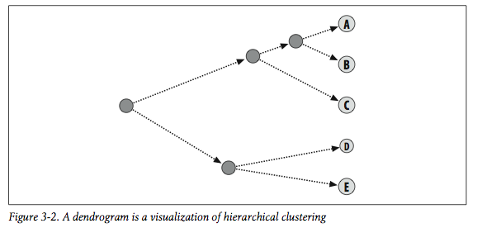
Dendrogram

Slide 11
def hcluster(rows,distance=pearson):
distances={}
currentclustid=-1
# Clusters are initially just the rows
clust=[bicluster(rows[i],id=i) for i in range(len(rows))]
while len(clust)>1:
lowestpair=(0,1)
closest=distance(clust[0].vec,clust[1].vec)
# loop through every pair looking for the smallest distance
# Pearson defined on p. 35; distance=1-similarity --MLN
for i in range(len(clust)):
for j in range(i+1,len(clust)):
# distances is the cache of distance calculations
if (clust[i].id,clust[j].id) not in distances:
distances[(clust[i].id,clust[j].id)]=distance(clust[i].vec,clust[j].vec)
d=distances[(clust[i].id,clust[j].id)]
if d<closest:
closest=d
lowestpair=(i,j)
# calculate the average of the two clusters
mergevec=[
(clust[lowestpair[0]].vec[i]+clust[lowestpair[1]].vec[i])/2.0
for i in range(len(clust[0].vec))]
# create the new cluster
newcluster=bicluster(mergevec,left=clust[lowestpair[0]],
right=clust[lowestpair[1]],
distance=closest,id=currentclustid)
# cluster ids that weren't in the original set are negative
currentclustid-=1
del clust[lowestpair[1]]
del clust[lowestpair[0]]
clust.append(newcluster)
return clust[0]
PCI code,
p. 36

Slide 12
An ASCII Dendrogram
>>> import clusters
>>> blognames,words,data=clusters.readfile('blogdata.txt') # returns blog titles, words in blog (10%-50% boundaries), list of frequency info
>>> clust=clusters.hcluster(data) # returns a tree of foo.id, foo.left, foo.right
>>> clusters.printclust(clust,labels=blognames) # walks tree and prints ascii approximation of a dendogram; distance measure is Pearson's r
-
gapingvoid: "cartoons drawn on the back of business cards"
-
-
Schneier on Security
Instapundit.com
-
The Blotter
-
-
MetaFilter
-
(lots of output deleted)

Slide 13
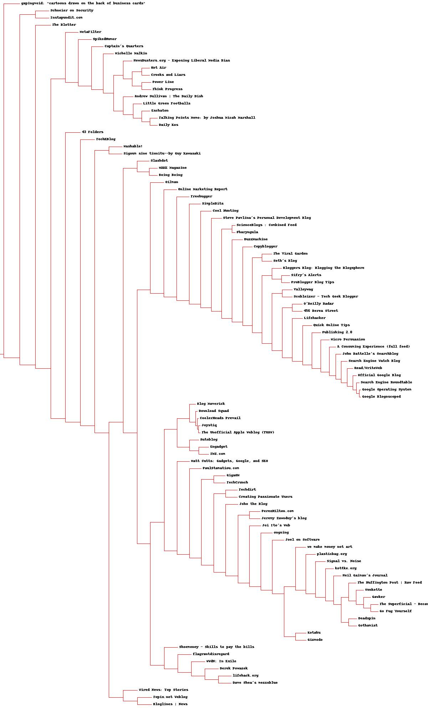
A Nicer Dendrogram w/ PIL
>>> import clusters
>>> blognames,words,data=clusters.readfile('blogdata.txt')
>>> clust=clusters.hcluster(data)
>>> clusters.drawdendrogram(clust,blognames,jpeg='blogclust.jpg')
http://www.cs.odu.edu/~mln/teaching/cs595-f13/chapter3/blogclust.jpg

Slide 14
Rotating the Matrix
>>> rdata=clusters.rotatematrix(data)
>>> wordclust=clusters.hcluster(rdata)
>>> clusters.printclust(wordclust,labels=words)
-
-
links
-
-
full
visit
-
code
-
-
standard
-
rss
-
feeds
feed
(lots of output deleted)
JPEG version at:
http://www.cs.odu.edu/~mln/teaching/cs595-f13/chapter3/wordclust.jpg

Slide 15
K-Means Clustering
Hierarchical clustering:
  is computationally expensive
  needs additional work to figure out the right "groups"
K-Means clustering:
  groups data into k clusters
  how do you pick k? well… how many clusters do you think you might need?
  n.b. results are not always the same!

Slide 16
Example k=2 (cf. fig 3-5)
A
B
A
B
C
C
F
F
D
D
Step 1: randomly drop
2 centroids in graph
Step 2: every item is assigned
to the nearest centroid

Slide 17
Example k=2 (cf. fig 3-5)
A
B
A
B
C
C
F
F
D
D
Step 3: move centroids to
the "center" of their group
Step 4: recompute item /
centroid distance
Step 5: process is done when
reassignments stop

Slide 18
Python Example
>>> kclust=clusters.kcluster(data,k=10) # K-Means with 10 centroids, pp. 43-44
Iteration 0
Iteration 1
Iteration 2
Iteration 3
Iteration 4
Iteration 5
Iteration 6
>>> [blognames[r] for r in kclust[0]] # print blognames in 1st centroid
["The Superficial - Because You're Ugly", 'Wonkette', 'Eschaton', "Neil Gaiman's Journal", 'Talking Points Memo: by Joshua Micah Marshall', 'Daily Kos', 'Go Fug Yourself', 'Andrew Sullivan | The Daily Dish', 'Michelle Malkin', 'Gothamist', 'flagrantdisregard', "Captain's Quarters", 'Power Line', 'The Blotter', 'Crooks and Liars', 'Schneier on Security', 'Think Progress', 'Little Green Footballs', 'NewsBusters.org - Exposing Liberal Media Bias', 'Instapundit.com', "Joi Ito's Web", 'Joel on Software', 'PerezHilton.com', "Jeremy Zawodny's blog", 'Gawker', 'The Huffington Post | Raw Feed']
>>> [blognames[r] for r in kclust[1]] # print blognames in 2nd centroid
['Mashable!', 'Online Marketing Report', 'Valleywag', 'Slashdot', 'Signum sine tinnitu--by Guy Kawasaki', 'gapingvoid: "cartoons drawn on the back of business cards"']
>>> [blognames[r] for r in kclust[2]] # print blognames in 3rd centroid
['Blog Maverick', 'Hot Air', 'Kotaku', 'Deadspin', 'Gizmodo', 'SpikedHumor', 'TechEBlog', 'MetaFilter', 'WWdN: In Exile']

Slide 19
Zebo Data
zebo.com was a product review / wishlist site
  pp. 45-46 describe how to download data from the site
  chapter3/zebo.txt is a static version
  http://www.zebo.com/
    note: zebo.com is defunct
    IA: http://web.archive.org/web/*/zebo.com
    history: http://mashable.com/2006/09/18/how-the-heck-did-zebo-get-4-million-users/

Slide 20
zebo.txt
% cat zebo.txt | awk '{FS="\t";print $1, $2, $3, $4, $5, $6}' | less
Item U0 U1 U2 U3 U4
bike 0 0 0 0 0
clothes 0 0 0 0 1
dvd player 0 0 0 1 0
phone 0 1 0 0 0
cell phone 0 0 0 0 0
dog 0 0 1 1 1
xbox 360 1 0 0 0 0
boyfriend 0 0 0 0 0
watch 0 0 0 0 0
laptop 1 1 0 0 0
love 0 0 1 0 0
<b>car</b> 0 1 1 1 0
shoes 0 0 1 1 1
jeans 0 0 0 0 0
money 1 0 0 1 0
ps3 0 0 0 0 0
psp 0 1 0 1 0
puppy 0 1 1 0 0
house and lot 0 0 0 0 0
essentially same format as
blogdata.txt, except term
frequency is replaced with
binary want / don't want
note dirty data

Slide 21



Jacard & Tanimoto
Jacard Similarity index: intersection / union
Jacard Distance: 1-similarity
Tanimoto is Jacard for vectors; for binary prefs Tanimoto == Jacard
  Note that "Tanimoto" is misspelled "Tanamoto" in the PCI code
  see: http://en.wikipedia.org/wiki/Jaccard_index

Slide 22
Dendrogram for Zebo
>>> wants,people,data=clusters.readfile('zebo.txt')
>>> clust=clusters.hcluster(data,distance=clusters.tanamoto)
>>> clusters.printclust(clust,labels=wants)
-
house and lot
-
mansion
-
phone
-
boyfriend
-
-
-
-
-
family
friends
(output deleted)

Slide 23
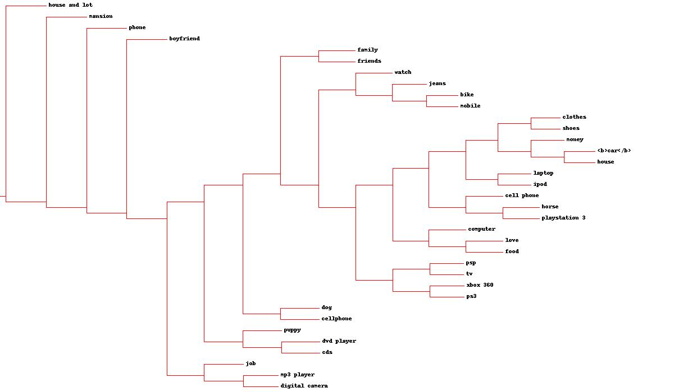
Zebo JPEG Dendrogram
http://www.cs.odu.edu/~mln/teaching/cs595-f13/chapter3/zeboclust.jpg

Slide 24
k=4 for Zebo
>>> kclust=clusters.kcluster(data,k=4)
Iteration 0
Iteration 1
>>> [wants[r] for r in kclust[0]]
['clothes', 'dvd player', 'xbox 360', '<b>car</b>', 'jeans', 'house and lot', 'tv', 'horse', 'mobile', 'cds', 'friends']
>>> [wants[r] for r in kclust[1]]
['phone', 'cell phone', 'watch', 'puppy', 'family', 'house', 'mansion', 'computer']
>>> [wants[r] for r in kclust[2]]
['bike', 'boyfriend', 'mp3 player', 'ipod', 'digital camera', 'cellphone', 'job']
>>> [wants[r] for r in kclust[3]]
['dog', 'laptop', 'love', 'shoes', 'money', 'ps3', 'psp', 'food', 'playstation 3']

Slide 25
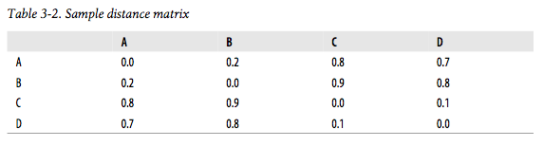
Multidimensional Scaling
Allows us to visualize N-dimensional data in 2 or 3 dimensions
Not a perfect representation of data, but allows us to visualize it without our heads exploding
Start with item-item distance matrix (note: 1- similarity)

Slide 26
MDS Example (cf. figs 3-7 -- 3-9)
C
C
0.4
A
A
0.7
0.6
0.5
D
0.7
D
B
B
0.4
Step 1: randomly drop
items in 2d graph
Step 2: measure all inter-
item distances

Slide 27
MDS Example (cf. figs 3-7 -- 3-9)
0.8
C
C
0.4
0.7
A
0.7
0.7
0.6
0.6
A
0.2
0.5
0.7
0.3
0.6
0.7
D
D
B
B
0.4
0.4
Step 3: compare with actual
item-item distance for 1 item
Step 4: move item in 2D space
(ex. A is closer to B (good), further
from C (good), closer to D (bad))
Repeat for all items until no more changes can be made

Slide 28
Python MDS
>>> blognames,words,data=clusters.readfile('blogdata.txt')
>>> coords=clusters.scaledown(data) # code pp. 50-51
4431.91264139
3597.09879465
3530.63422919
3494.58547715
3463.77217455
3437.59298469
3414.89864608
3395.55257233
3378.52510767
3363.87951104
…
3024.12202228
3024.01331202
3023.87527696
3023.74986258
3023.75364032
>>> clusters.draw2d(coords,blognames,jpeg='blogs2d.jpg')
error starts to get worse,
so we're done

Slide 29
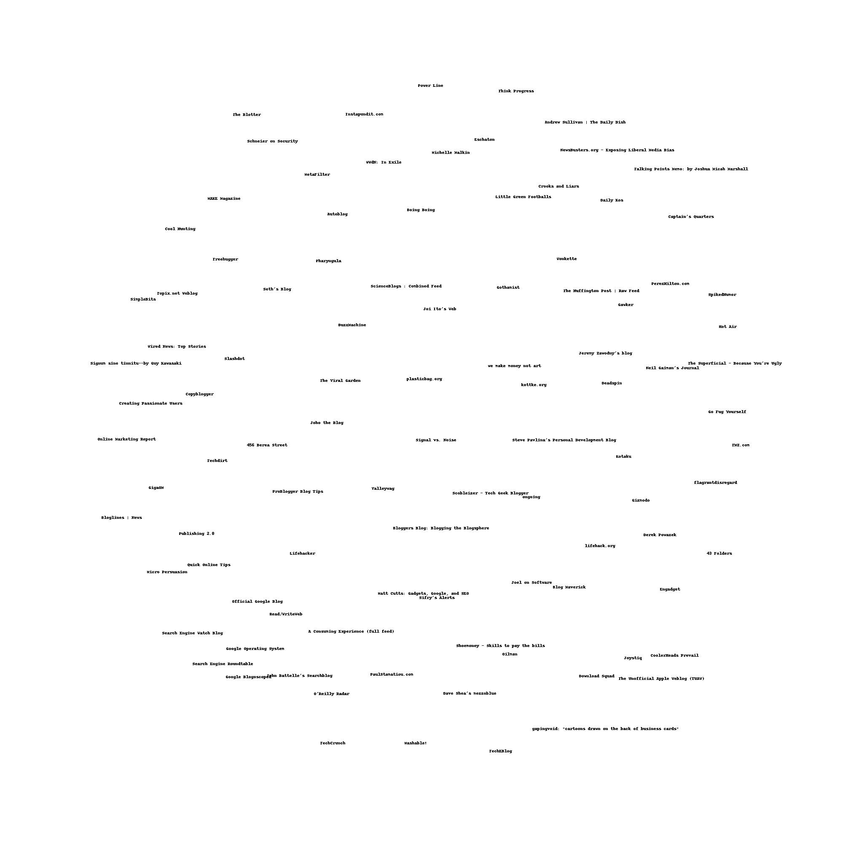
http://www.cs.odu.edu/~mln/teaching/cs595-f13/chapter3/blogs2d.jpg

Slide 30
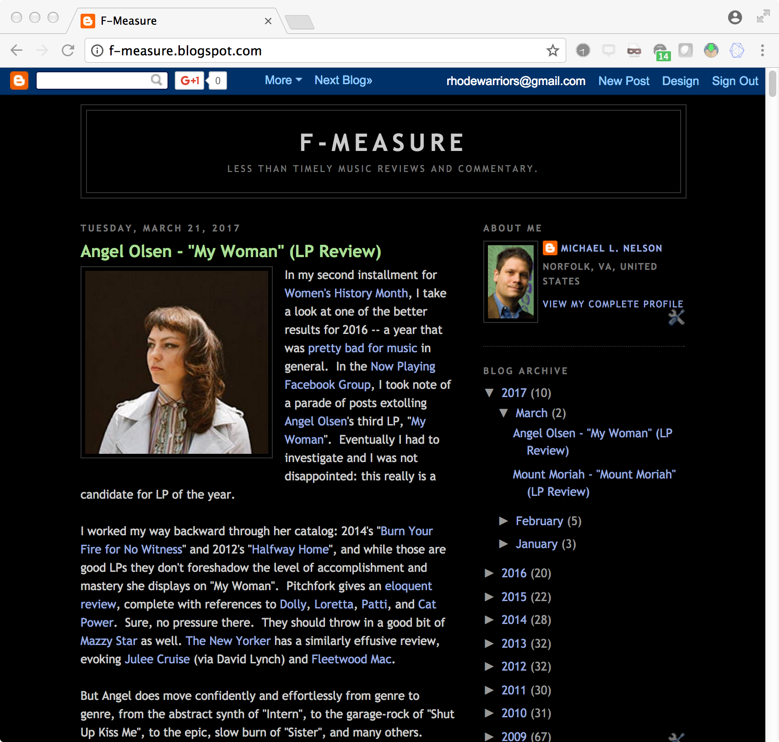

Slide 31
Grabbing Random (?) Blogs
% curl -I -L 'http://www.blogger.com/next-blog?navBar=true&blogID=3471633091411211117'
HTTP/1.1 302 Moved Temporarily
P3P: CP="This is not a P3P policy! See http://www.google.com/support/accounts/bin/answer.py?hl=en&answer=151657 for more info."
Location: https://www.blogger.com/next-blog?navBar=true&blogID=3471633091411211117
Content-Type: text/html; charset=UTF-8
Date: Thu, 13 Nov 2014 16:40:18 GMT
Expires: Thu, 13 Nov 2014 16:40:18 GMT
Cache-Control: private, max-age=0
X-Content-Type-Options: nosniff
X-Frame-Options: SAMEORIGIN
X-XSS-Protection: 1; mode=block
Server: GSE
Alternate-Protocol: 80:quic,p=0.01
Transfer-Encoding: chunked
HTTP/1.1 302 Moved Temporarily
P3P: CP="This is not a P3P policy! See http://www.google.com/support/accounts/bin/answer.py?hl=en&answer=151657 for more info."
Content-Type: text/html; charset=UTF-8
Cache-Control: no-cache, no-store, max-age=0, must-revalidate
Pragma: no-cache
Expires: Fri, 01 Jan 1990 00:00:00 GMT
Date: Thu, 13 Nov 2014 16:40:18 GMT
Location: http://tootie-fruity.blogspot.com/?expref=next-blog
X-Content-Type-Options: nosniff
X-Frame-Options: SAMEORIGIN
X-XSS-Protection: 1; mode=block
Server: GSE
Alternate-Protocol: 443:quic,p=0.01
Transfer-Encoding: chunked
HTTP/1.1 200 OK
X-Robots-Tag: noindex, nofollow
Content-Type: text/html; charset=UTF-8
Expires: Thu, 13 Nov 2014 16:40:19 GMT
Date: Thu, 13 Nov 2014 16:40:19 GMT
Cache-Control: private, max-age=0
Last-Modified: Sun, 05 Oct 2014 07:28:00 GMT
...
Repeat: you'll get different blogs each time

Slide 32
Grabbing RSS and Atom Links
$ curl f-measure.blogspot.com
<!DOCTYPE html PUBLIC "-//W3C//DTD XHTML 1.0 Strict//EN" "http://www.w3.org/TR/xhtml1/DTD/xhtml1-strict.dtd">
<html dir='ltr' xmlns='http://www.w3.org/1999/xhtml' xmlns:b='http://www.google.com/2005/gml/b' xmlns:data='http://www.google.com/2005/gml/data' xmlns:expr='http://www.google.com/2005/gml/expr'>
<head>
<meta content='text/html; charset=UTF-8' http-equiv='Content-Type'/>
…
<meta content='blogger' name='generator'/>
<link href='http://f-measure.blogspot.com/favicon.ico' rel='icon' type='image/x-icon'/>
<link href='http://f-measure.blogspot.com/' rel='canonical'/>
<link rel="alternate" type="application/atom+xml" title="F-Measure - Atom" href="http://f-measure.blogspot.com/feeds/posts/default" />
<link rel="alternate" type="application/rss+xml" title="F-Measure - RSS" href="http://f-measure.blogspot.com/feeds/posts/default?alt=rss" />
<link rel="service.post" type="application/atom+xml" title="F-Measure - Atom" href="http://www.blogger.com/feeds/3471633091411211117/posts/default" />
<link rel="me" href="http://www.blogger.com/profile/13202853768741690867" />
<link rel="openid.server" href="http://www.blogger.com/openid-server.g" />
<link rel="openid.delegate" href="http://f-measure.blogspot.com/" />

Slide 33
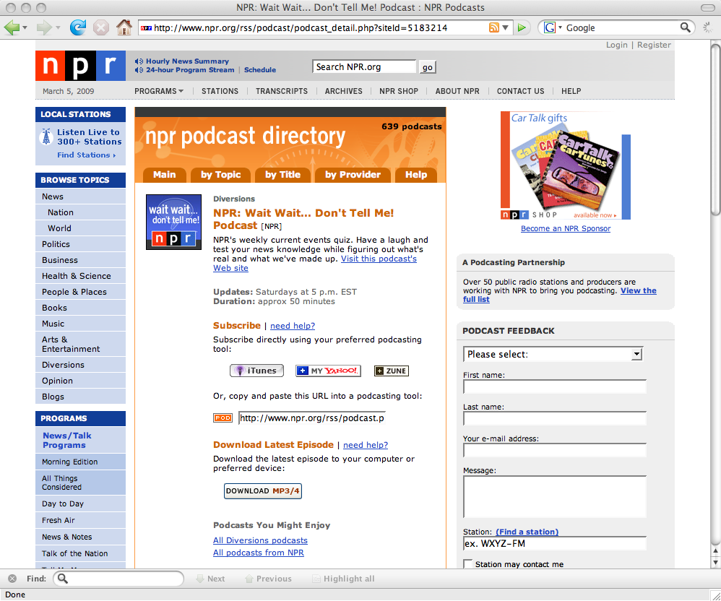
Atom/RSS
autodiscovery
http://www.npr.org/rss/podcast/podcast_detail.php?siteId=5183214
Autodiscovery used to be standard, now browsers require an add-on, e.g.:
https://chrome.google.com/webstore/detail/rss-subscription-extensio/nlbjncdgjeocebhnmkbbbdekmmmcbfjd?hl=en

Slide 34
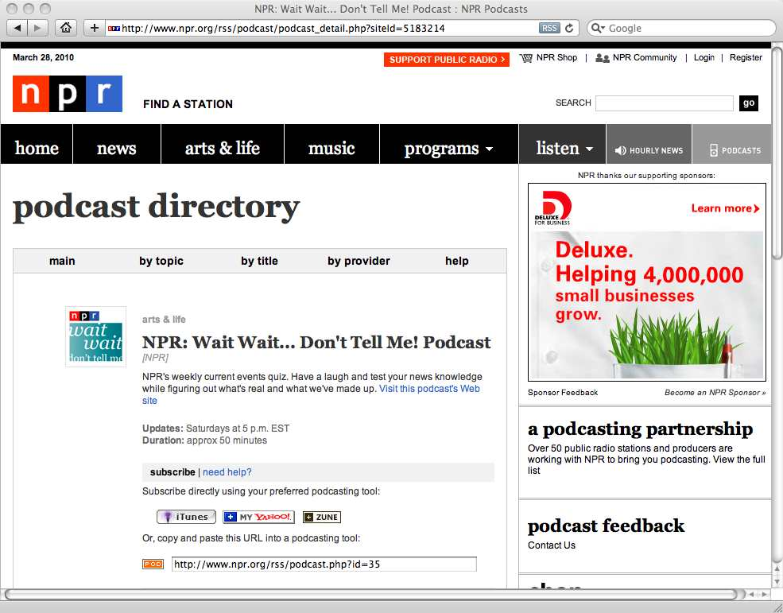
Symbol in Safari
autodiscovery

Slide 35
Syndication Formats
Family Tree
MCF
Dec 96
|
+--------+-------+
| |
RDF * CDF
Feb 97 Mar 97
| |
RSS 0.9--------ScriptingNews
Mar 99 Dec 97
| | |
| +----------+ |
| | |
| RSS 0.91
| Jul 99
| |
RSS 1.0 RSS 0.92
Dec 00 Dec 00
| | |
| | +---+-----+---------+
| | | | |
| | RSS 0.93 RSS 0.94 |
| | Apr 02 Aug 02 |
| | |
| +-----------------------+ |
| | | |
| | RSS 2.0 **
| | Sep 02
| | |
| +---------------------+ |
| | |
| Atom 0.3
RSS 1.1 Dec 03
Jan 05 |
Atom
Jul 05
* A data model rather than a syndication format (serializations may be syndicated)
** Several sub-versions exist
http://en.wikipedia.org/wiki/Syndication_format_family_tree
http://en.wikipedia.org/wiki/History_of_web_syndication_technology

Slide 36


Syndication Data Model
container
metadata…
Title:
Description:
Date:
…
fuzzy semantics -- the
metadata is alternatively
about the thing linked to
as well the description of
the thing linked to.
metadata…
links…
metadata…
links…
and sometimes the
metadata is the data…
metadata…
links…

Slide 37
RSS Data Model
channel
container
metadata…
metadata…
links…
metadata…
links…
items
metadata…

Slide 38
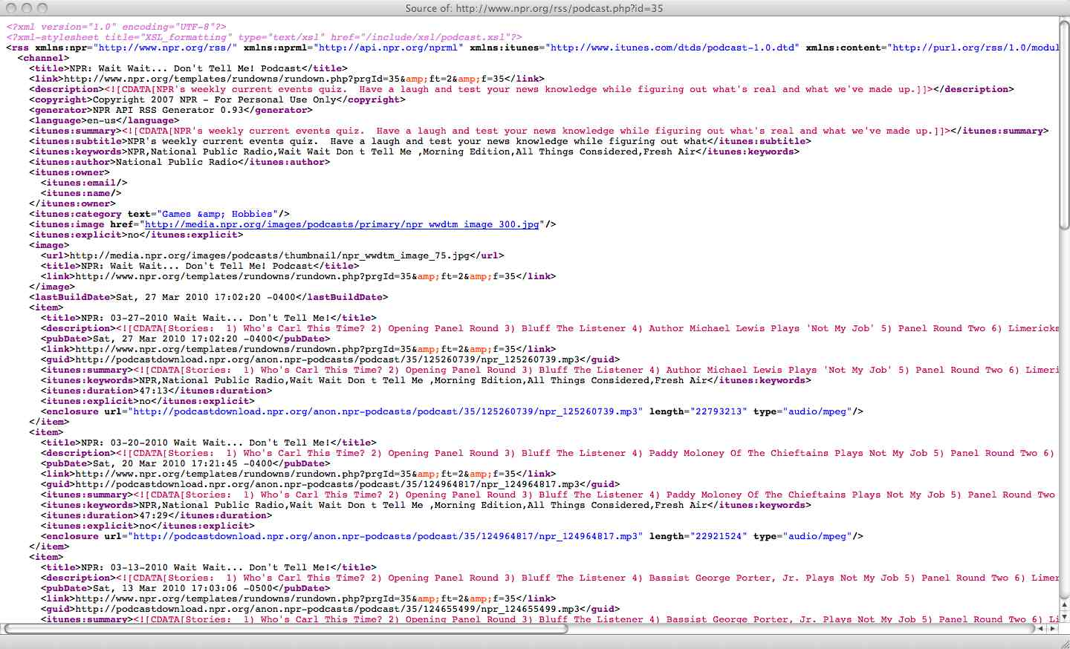
RSS 2.0 Example
http://www.npr.org/rss/podcast.php?id=35

Slide 39
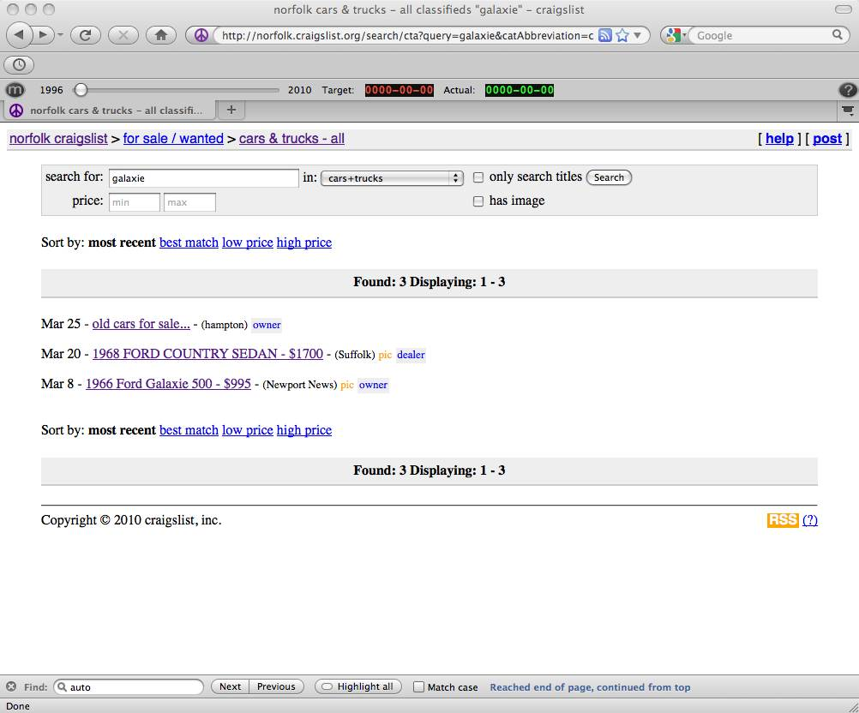
RSS 1.1 Example

Slide 40
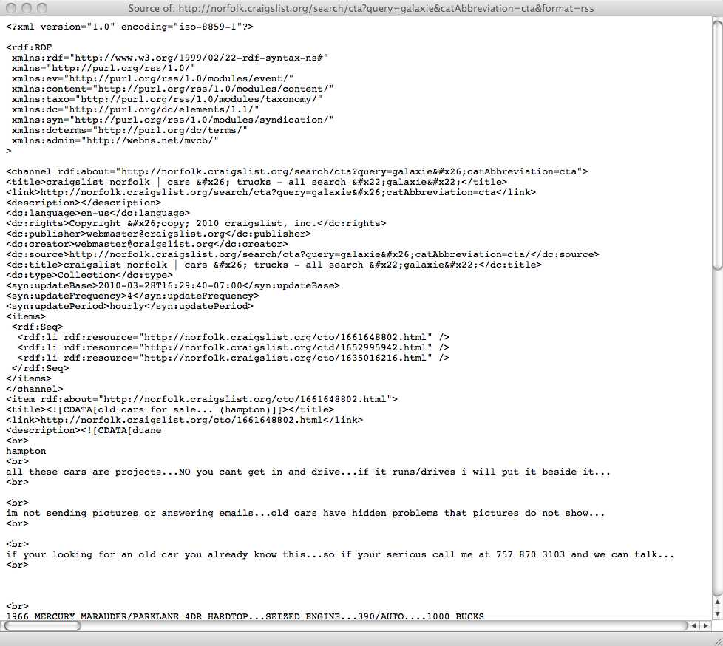
RSS 1.1
uses an rdf:Seq container
inside an <items> element
as a sort of TOC.
use rdf:about to clarify
what the metadata is
"about"
http://norfolk.craigslist.org/search/cta?query=galaxie&catAbbreviation=cta&format=rss

Slide 41
Atom Data Model
feed
container
metadata…
metadata…
links…
metadata…
links…
entries
metadata…

Slide 42
F-Measure Atom Feed
<feed>
<id>tag:blogger.com,1999:blog-3471633091411211117</id>
<updated>2010-03-25T14:34:50.392-07:00</updated>
<title type="text">F-Measure</title>
<subtitle type="html">Less Than Timely Music Reviews and Commentary.</subtitle>
<link rel="http://schemas.google.com/g/2005#feed" type="application/atom+xml"
href="http://f-measure.blogspot.com/feeds/posts/default"/>
<link rel="self" type="application/atom+xml"
href="http://www.blogger.com/feeds/3471633091411211117/posts/default"/>
<link rel="alternate" type="text/html" href="http://f-measure.blogspot.com/"/>
<link rel="hub" href="http://pubsubhubbub.appspot.com/"/>
<link rel="next" type="application/atom+xml"
href="http://www.blogger.com/feeds/3471633091411211117/posts/default?start-index=26
&max-results=25"/>
<author>
<name>Michael L. Nelson</name>
<uri>
http://www.blogger.com/profile/13202853768741690867
</uri>
<email>noreply@blogger.com</email>
</author>
<generator version="7.00" uri="http://www.blogger.com">Blogger</generator>
<openSearch:totalResults>74</openSearch:totalResults>
<openSearch:startIndex>1</openSearch:startIndex>
<openSearch:itemsPerPage>25</openSearch:itemsPerPage>
http://f-measure.blogspot.com/feeds/posts/default

Slide 43
F-Measure Entry (1)
<entry>
<id>
tag:blogger.com,1999:blog-3471633091411211117.post-4311203339742262598
</id>
<published>2010-03-24T18:38:00.001-07:00</published>
<updated>2010-03-25T14:34:50.419-07:00</updated>
<category scheme="http://www.blogger.com/atom/ns#" term="LP review"/>
<category scheme="http://www.blogger.com/atom/ns#" term="2005"/>
<category scheme="http://www.blogger.com/atom/ns#" term="7/10"/>
<category scheme="http://www.blogger.com/atom/ns#" term="The Rescue"/>
<category scheme="http://www.blogger.com/atom/ns#" term="Explosions in the Sky"/>
<title type="text">Explosions in the Sky - "The Rescue" (LP Review)</title>
<content type="html">
<a onblur="try {parent.deselectBloggerImageGracefully();} catch(e) {}"
href="http://2.bp.blogspot.com/_xf_Yufxwils/S6q-2sdPCmI/AAAAAAAAAUw/CIKQ7sFAyKA/s1600/explosions-in-the-sky-the-rescue.jpeg">
<img style="float: left; margin: 0pt 10px 10px 0pt; cursor: pointer; width: 200px; height: 200px;"
src="http://2.bp.blogspot.com/_xf_Yufxwils/S6q-2sdPCmI/AAAAAAAAAUw/CIKQ7sFAyKA/s200/explosions-in-the-sky-the-rescue.jpeg"
alt="" id="BLOGGER_PHOTO_ID_5452380145741400674" border="0" /></a>First, let's get
this out of the way: "<a href="http://en.wikipedia.org/wiki/The_Rescue_%28album%29">
The Rescue</a>" is nowhere near the tour de force that is
"<a href="http://f-measure.blogspot.com/2010/03/explosions-in-sky-those-who-tell-truth.html">
Those Who Tell the Truth Shall Die, Those Who Tell the Truth Shall Live Forever</a>".
[html deletia]

Slide 44
F-Measure Entry (2)
<link rel="replies" type="application/atom+xml"
href="http://f-measure.blogspot.com/feeds/4311203339742262598/comments/default"
title="Post Comments"/>
<link rel="replies" type="text/html"
href="http://f-measure.blogspot.com/2010/03/explosions-in-sky-rescue-lp-review.html#comment-form"
title="0 Comments"/>
<link rel="edit" type="application/atom+xml"
href="http://www.blogger.com/feeds/3471633091411211117/posts/default/4311203339742262598"/>
<link rel="self" type="application/atom+xml"
href="http://www.blogger.com/feeds/3471633091411211117/posts/default/4311203339742262598"/>
<link rel="alternate" type="text/html"
href="http://f-measure.blogspot.com/2010/03/explosions-in-sky-rescue-lp-review.html"
title="Explosions in the Sky - "The Rescue" (LP Review)"/>
<author>
<name>Michael L. Nelson</name>
<uri>
http://www.blogger.com/profile/13202853768741690867
</uri>
<email>noreply@blogger.com</email>
<gd:extendedProperty name="OpenSocialUserId" value="10987861134460077619"/>
</author>
<media:thumbnail
url="http://2.bp.blogspot.com/_xf_Yufxwils/S6q-2sdPCmI/AAAAAAAAAUw/CIKQ7sFAyKA/s72-c/explosions-in-the-sky-the-rescue.jpeg"
height="72" width="72"/>
<thr:total>0</thr:total>
</entry>

Slide 45
Blogs Have Pages…
$ curl http://f-measure.blogspot.com/feeds/posts/default
…
<link rel='next' type='application/atom+xml'
href=
'http://www.blogger.com/feeds/3471633091411211117/posts/default?start-index=26&amp;max-results=25'/>
…
$ curl 'http://www.blogger.com/feeds/3471633091411211117/posts/default?start-index=26&amp;max-results=25'
…
<link rel='next' type='application/atom+xml' href=
'http://www.blogger.com/feeds/3471633091411211117/posts/default?start-index=51&amp;max-results=25'/>
…
$ [repeat until you have no more rel='next' links!]

