Slide 1

CS 800 S26 – Assignment 5
Presented By:
Md Habibur Rahman, PhD Student
Submitted To:
Professor Dr. Michael L. Nelson
Department of Computer Science
Old Dominion University, Norfolk, Virginia
mhabiburx, csrahman.github.io

Slide 2
Paper 1:
@inproceedings {299699, author = {Gelei, Deng and Yi, Liu and V{\'\i}ctor, Mayoral-Vilches and Peng, Liu and Yuekang, Li and Yuan, Xu and Tianwei, Zhang and Yang, Liu and Martin, Pinzger and Stefan, Rass}, title = {{PentestGPT:} Evaluating and Harnessing Large Language Models for Automated Penetration Testing}, booktitle = {33rd USENIX Security Symposium (USENIX Security 24)}, year = {2024}, isbn = {978-1-939133-44-1}, address = {Philadelphia, PA}, pages = {847--864}, url = {https://www.usenix.org/conference/usenixsecurity24/presentation/deng}, publisher = {USENIX Association}, month = aug }

Slide 3
Paper 2:
@inproceedings{10.1145/3708821.3733882,
author = {Shen, Xiangmin and Wang, Lingzhi and Li, Zhenyuan and Chen, Yan and Zhao, Wencheng and Sun, Dawei and Wang, Jiashui and Ruan, Wei},
title = {{PentestAgent:} Incorporating LLM Agents to Automated Penetration Testing},
year = {2025},
isbn = {9798400714108},
publisher = {Association for Computing Machinery},
address = {New York, NY, USA},
url = {https://doi.org/10.1145/3708821.3733882},
doi = {10.1145/3708821.3733882},
booktitle = {Proceedings of the 20th ACM Asia Conference on Computer and Communications Security},
pages = {375–391},
numpages = {17},
keywords = {Penetration Testing, Large Language Model, Agent},
series = {ASIA CCS '25}
}

Slide 4
Background

Slide 5
Background: Why Automate?
Expensive & scarce
Huge cost of expert pentesters¹
Global shortage of cybersecurity professional²
¹https://deepstrike.io/blog/penetration-testing-cost
²https://cybersecurityventures.com/jobs/

Slide 6
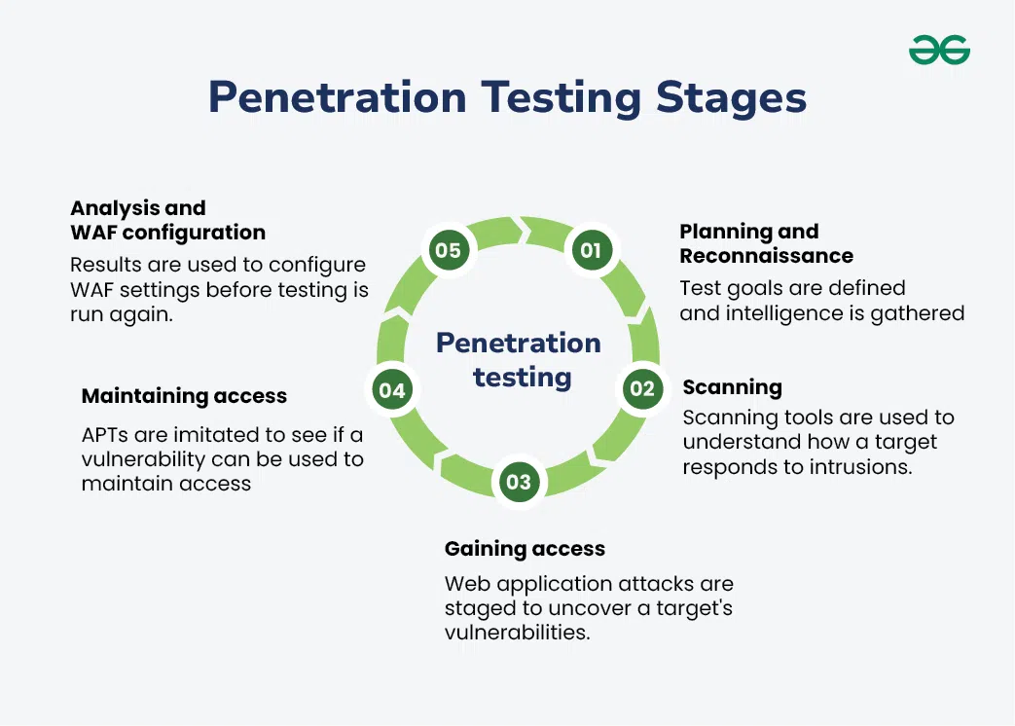
Background: Why Automate?
Multiple stages of complexities
Recon
Scan
Exploit
Gaining Access
Post Exploitation
Reporting
https://media.geeksforgeeks.org/wp-content/uploads/20240613130938/Penetration-Testing-Stages.webp

Slide 7
Background: Why Automate?
LLM as a solution
Can latest models from ChatGPT and Claude replicate expert Pentester logic?
Yes
No

Slide 8
Background: Why Automate?
LLM as a solution
Can latest models from ChatGPT and Claude replicate expert Pentester logic?
Yes
HOW

Slide 9
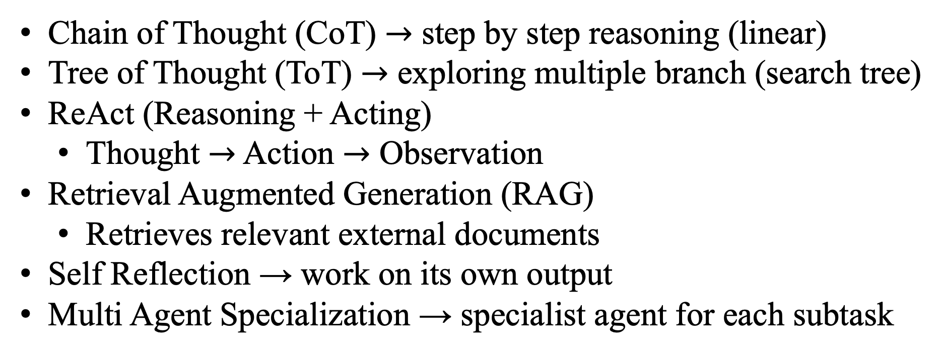
Background: Why Automate?
Chain of Thought (CoT) $→$ step by step reasoning (linear)
Tree of Thought (ToT) $→$ exploring multiple branch (search tree)
ReAct (Reasoning + Acting)
Thought $→$ Action $→$ Observation
Retrieval Augmented Generation (RAG)
Retrieves relevant external documents
Self Reflection → work on its own output
Multi Agent Specialization → specialist agent for each subtask

Slide 10
Background: Why Automate?
Gap in the core
Fail at long task
Lose context
Miss tool feedback
Can’t adapt while doing task

Slide 11
Papers Description

Slide 12
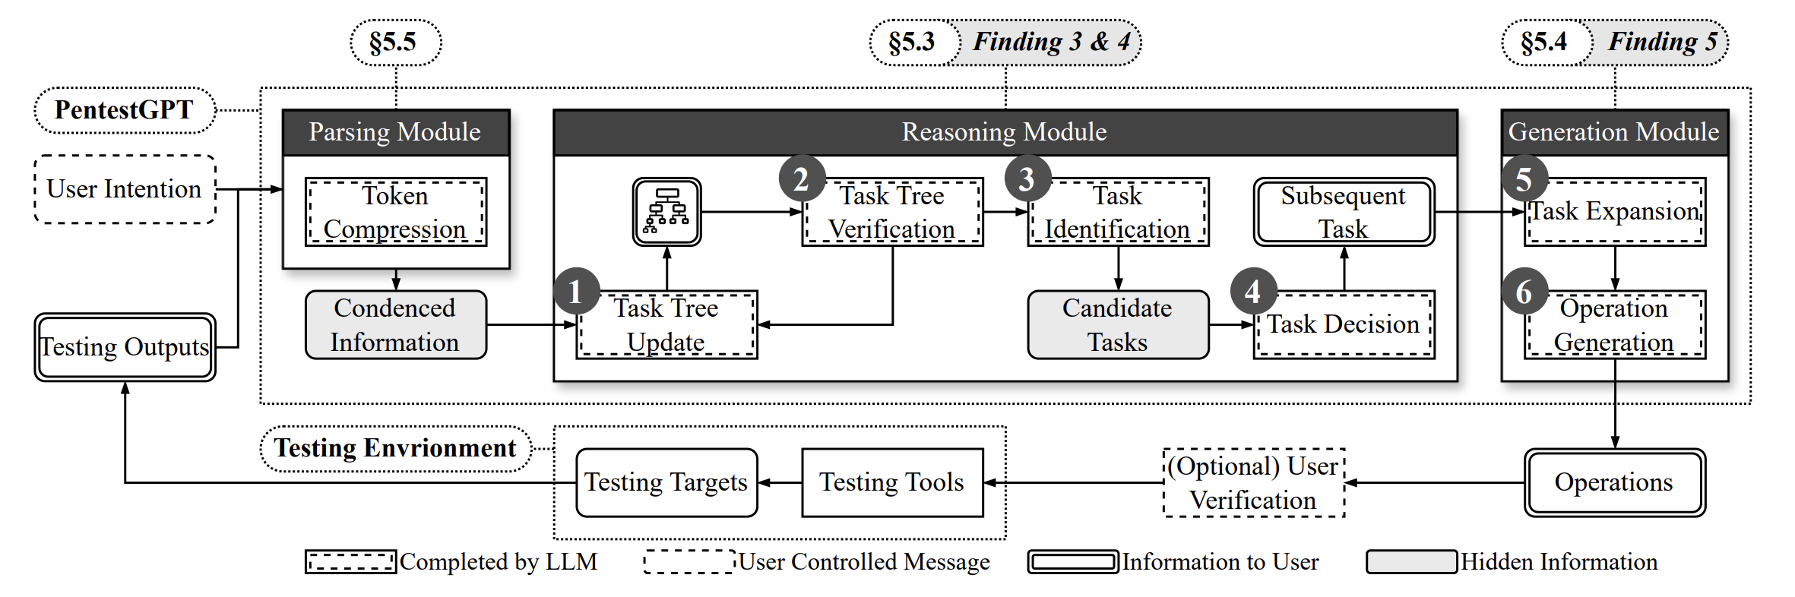
PentestGPT

Slide 13
Limitation of PentestGPT (1)
Relies on human in the loop feedback at each decision point
Can not :
autonomously execute tool
Process result without user intervention

Slide 14
Limitation of PentestGPT (2)
Long penetration testing creates huge output
Summarizer loses critical technical details
Causing reasoning error

Slide 15
Limitation of PentestGPT (3)
Bottleneck
Using single model for planning, interpreting and generating commands. No specialization or parallelism.

Slide 16
Limitation of PentestGPT (4)
Can execute the program
Human manually run the command and pastes the results

Slide 17
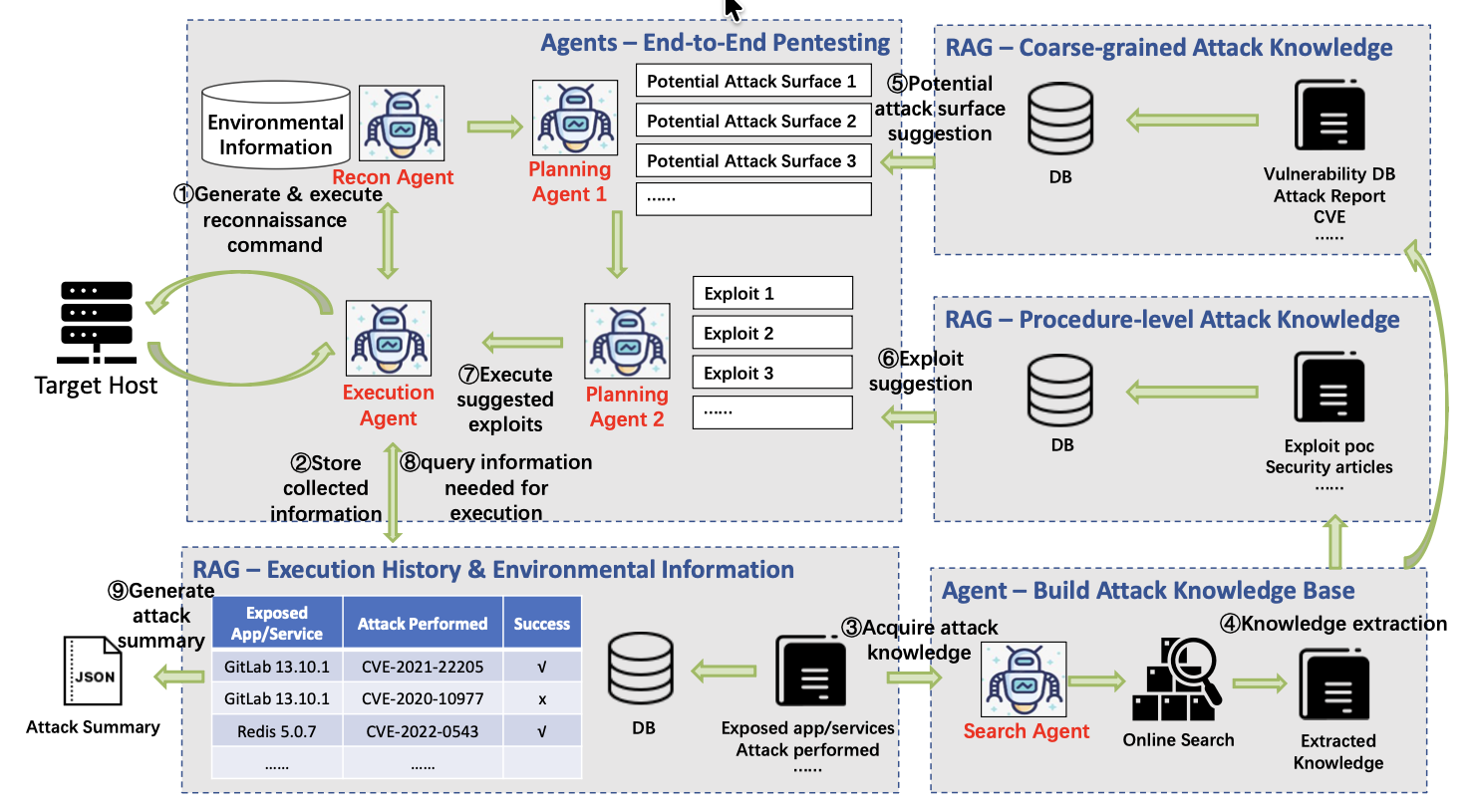
PentestAgent

Slide 18
PentestAgent solving limitations
No human in mid task
Multiple agent specialization
Tool calling API
Memory module for context

Slide 19
PentestGPT Limitation & PentestAgent Solution
PentestGPT Limitations | PentestAgent Response
Human in the loop for tools execution & result interpretation | Using agents to run tools, parsing output and decide next steps autonomosly
Single model design (all phases in one model) | Dedicated agent for each task
Context window overflow | Structured memory module
User execute commands & paste manually | Direct framework integration via tool calling API

Slide 20
Results & Benchmarks
Metrics | PentestGPT | PentestAgent
Benchmark | 13 HTB/VulnHub, 182 sub tasks (VM image) | 67 VulHub CVE targets (Docker)
Overall performance of LLMs on Penetration Testing | 34.25% (182 sub tasks) | 74.2% (GPT-4)

Slide 21
Summary
PentestAgent is the extended and upgraded version of PentestGPT
Removing the manual tasks and introduce agent to work efficiently

