Slide 1
Search Engines
Information Retrieval in Practice
Annotations by Michael L. Nelson
All slides ©Addison Wesley, 2008

Slide 2
Retrieval Models
Provide a mathematical framework for defining the search process
includes explanation of assumptions
basis of many ranking algorithms
can be implicit
Progress in retrieval models has corresponded with improvements in effectiveness
Theories about relevance

Slide 3
Relevance
Complex concept that has been studied for some time
Many factors to consider
People often disagree when making relevance judgments
Retrieval models make various assumptions about relevance to simplify problem
e.g., topical vs. user relevance
e.g., binary vs. multi-valued relevance

Slide 4
Retrieval Model Overview
Older models
Boolean retrieval
Vector Space model
Probabilistic Models
BM25
Language models
Combining evidence
Inference networks
Learning to Rank

Slide 5
Boolean Retrieval
Two possible outcomes for query processing
TRUE and FALSE
“exact-match” retrieval
simplest form of ranking
Query usually specified using Boolean operators
AND, OR, NOT
proximity operators also used

Slide 6
Boolean Retrieval
Advantages
Results are predictable, relatively easy to explain
Many different features can be incorporated
Efficient processing since many documents can be eliminated from search
Disadvantages
Effectiveness depends entirely on user
Simple queries usually don’t work well
Complex queries are difficult
if all results are equally relevant, then that's not much of a ranking…

Slide 7
Searching by Numbers
Sequence of queries driven by number of retrieved documents
e.g. “lincoln” search of news articles
president AND lincoln
president AND lincoln AND NOT (automobile OR car)
president AND lincoln AND biography AND life AND birthplace AND gettysburg AND NOT (automobile OR car)
president AND lincoln AND (biography OR life OR birthplace OR gettysburg) AND NOT (automobile OR car)

Slide 8
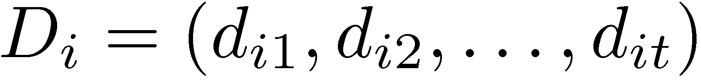
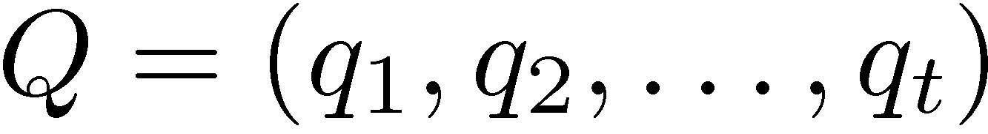
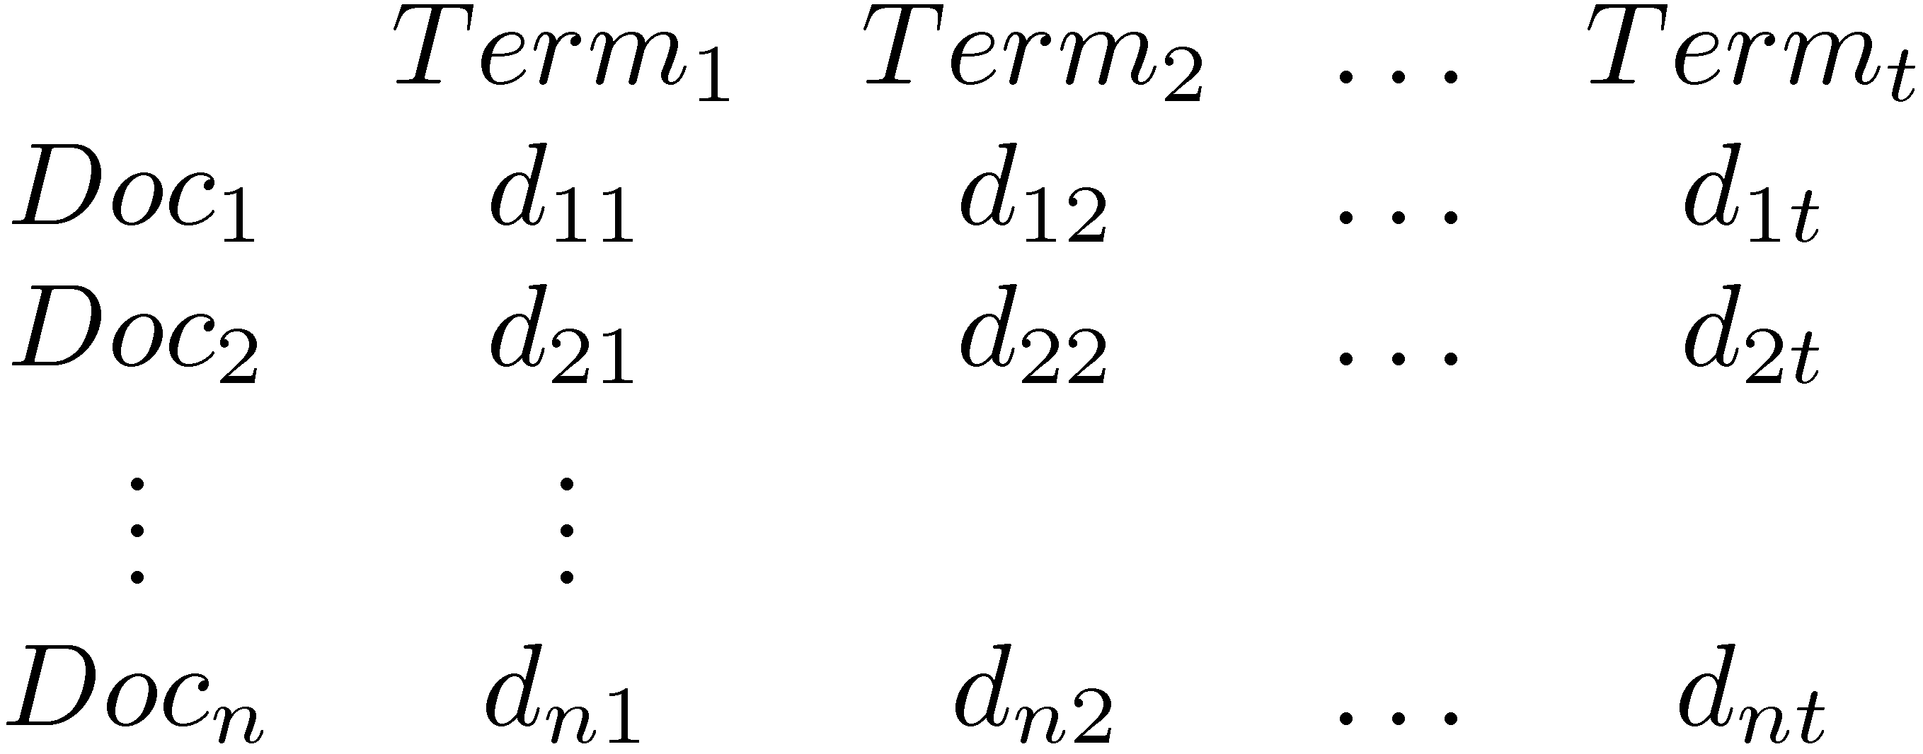
Vector Space Model
Documents and query represented by a vector of term weights
Collection represented by a matrix of term weights

Slide 9
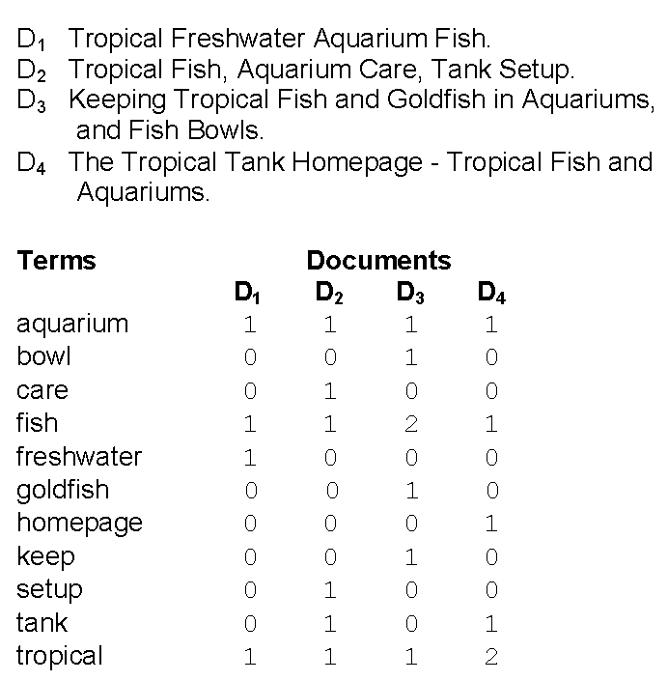
Vector Space Model
Frequency included
Heap’s Law implies
dimensionality is
always increasing
D₁ is a 11-dimensional vector

Slide 10
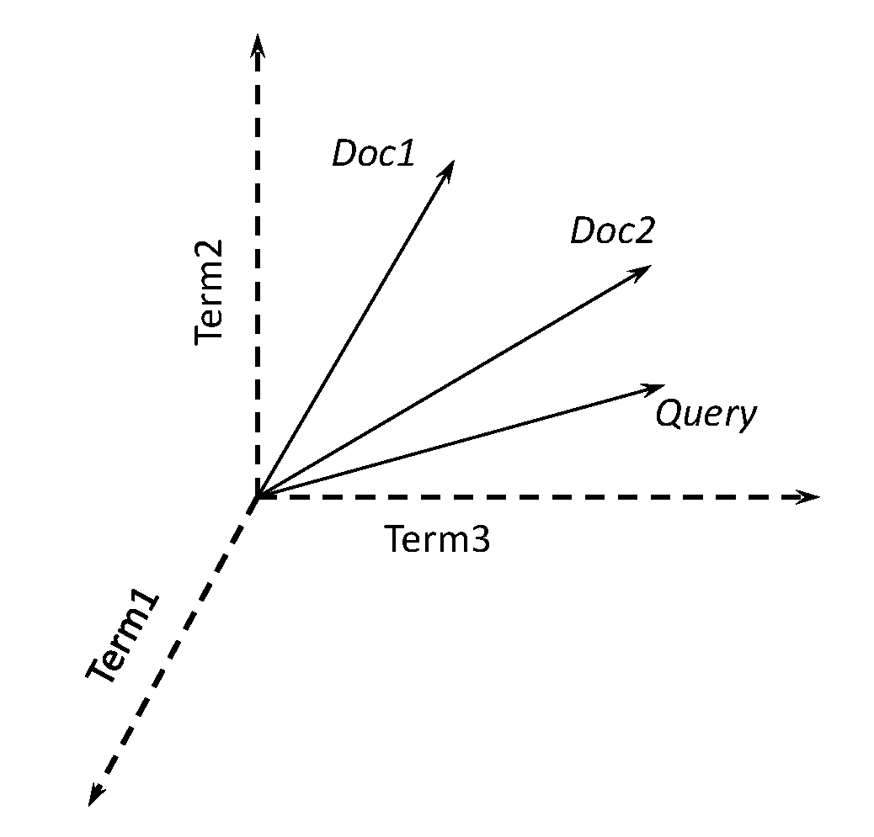

Vector Space Model
3-d pictures useful, but can be misleading for high-dimensional space
Don’t try to visualize an
11-dimensional vector!

Slide 11
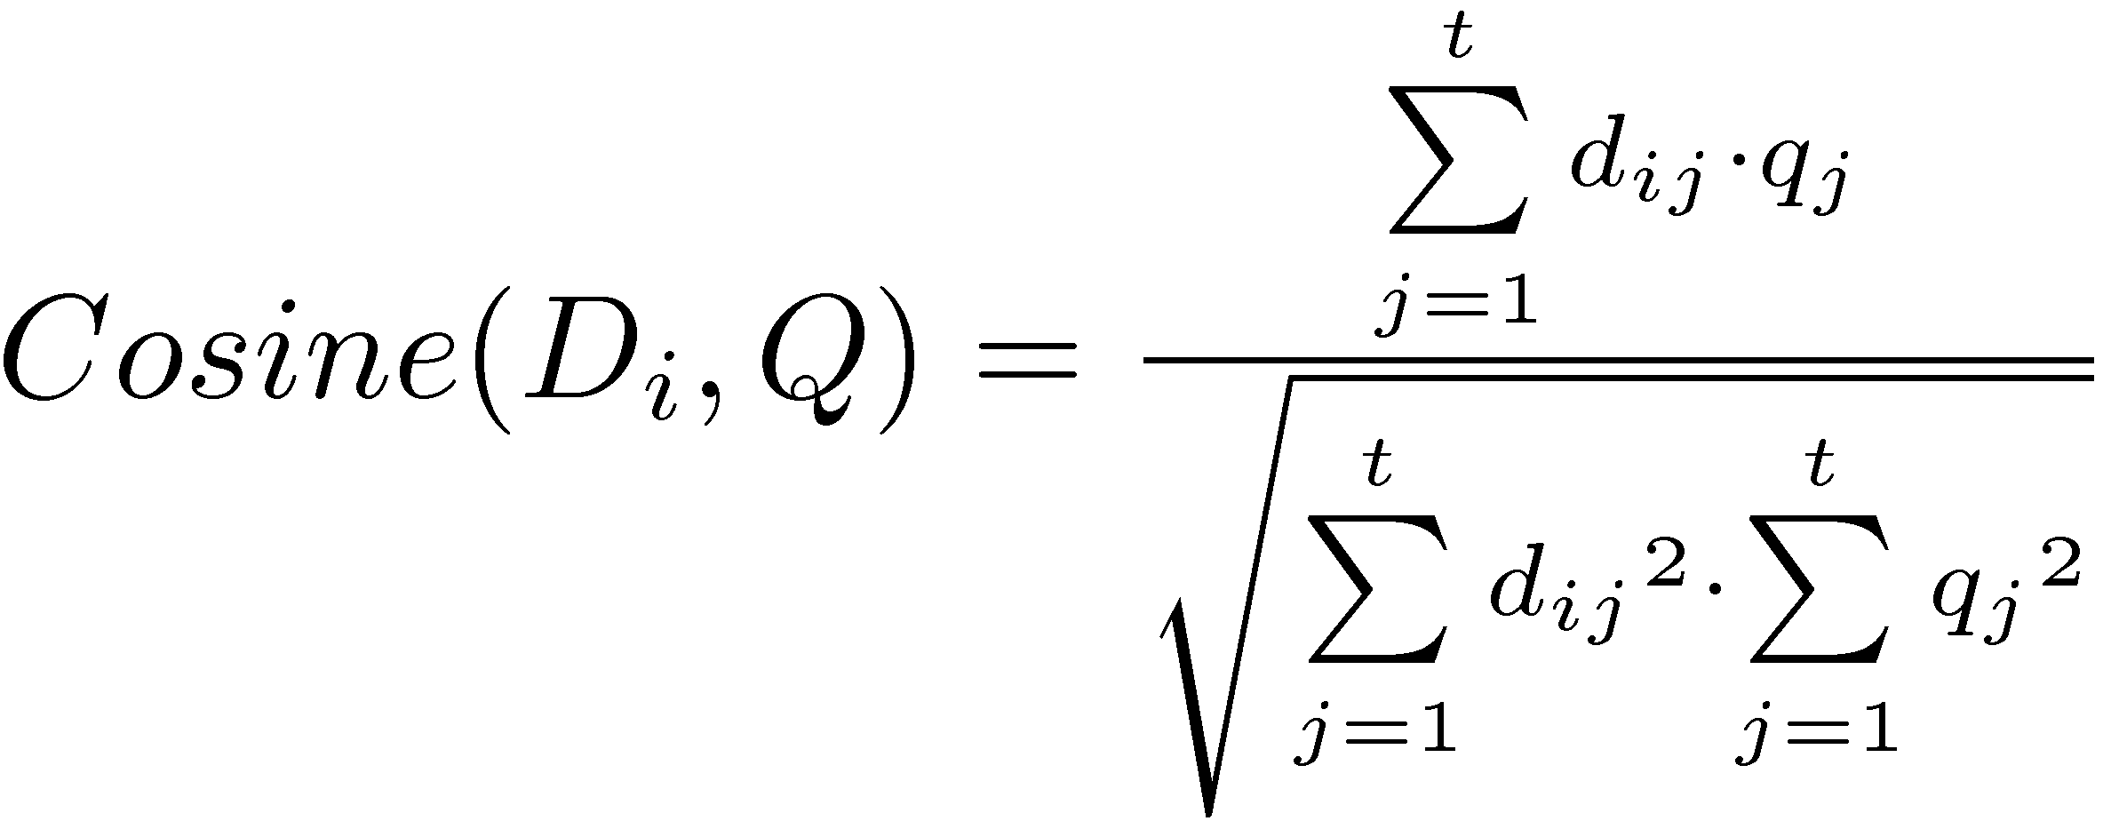
Vector Space Model
Documents ranked by distance between points representing query and documents
Similarity measure more common than a distance or dissimilarity measure
e.g. Cosine correlation

Slide 12
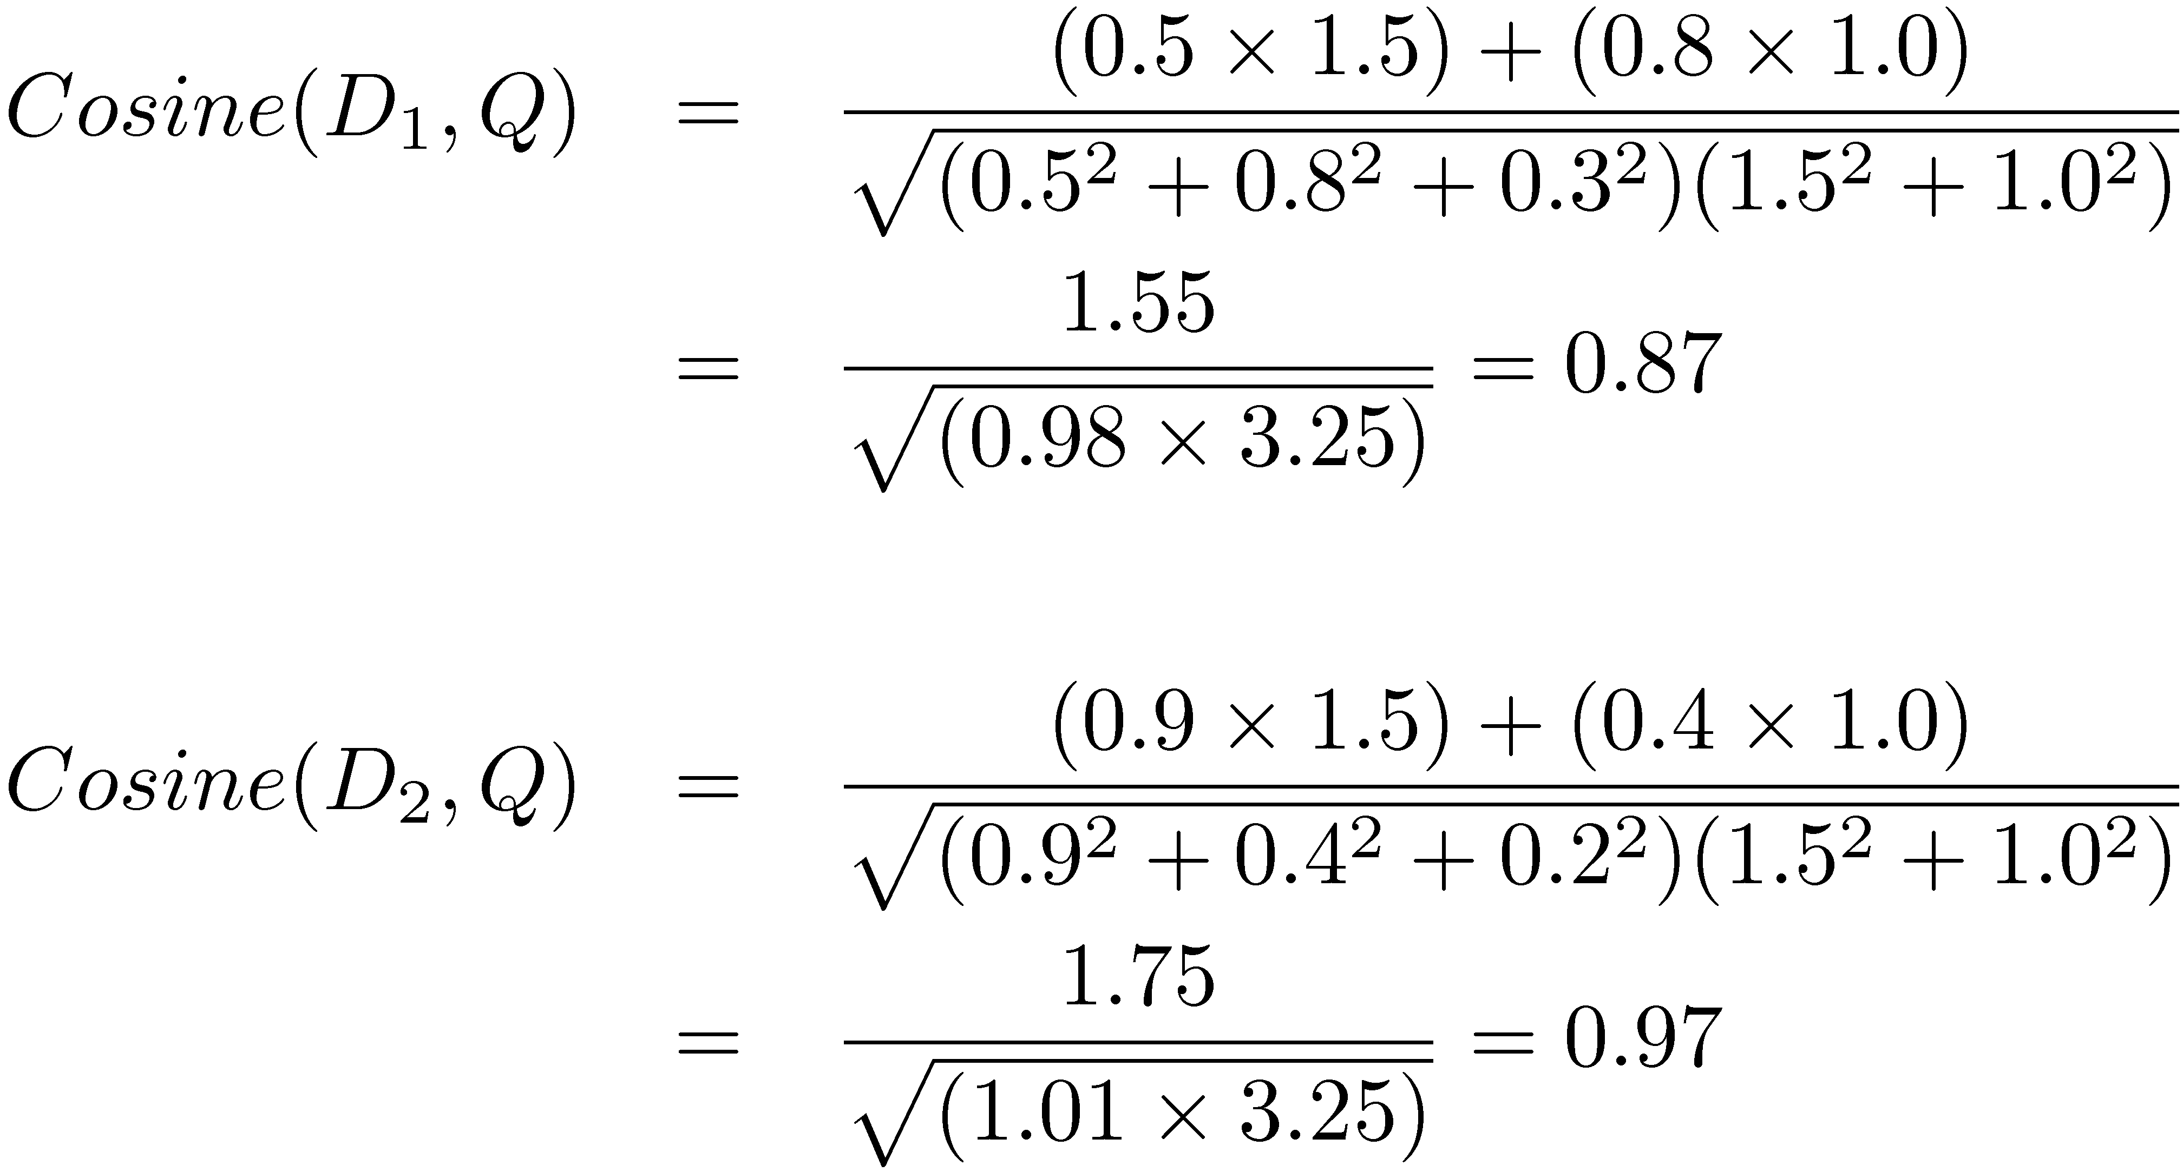
Similarity Calculation
Consider two documents D_{1,} D₂ and a query Q
D₁ = (0.5, 0.8, 0.3), D₂ = (0.9, 0.4, 0.2), Q = (1.5, 1.0, 0)

Slide 13
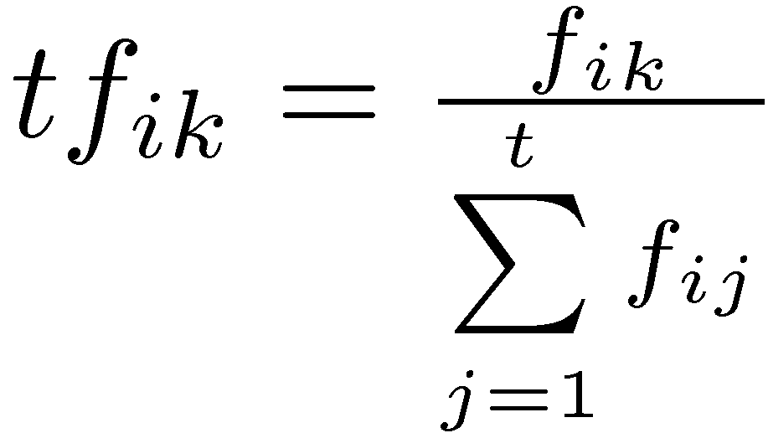
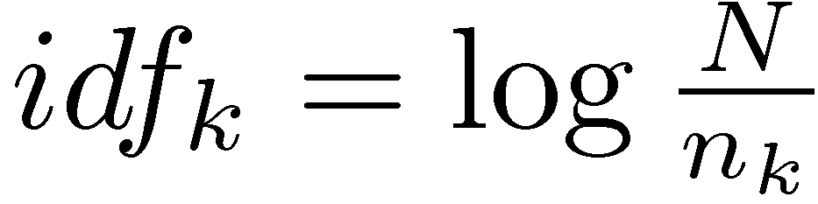
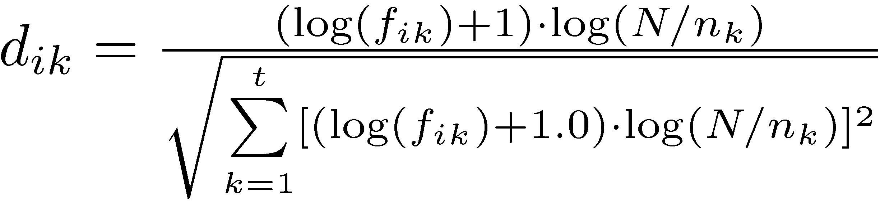
Term Weights
tf.idf weight
Term frequency weight measures importance in document:
Inverse document frequency measures importance in collection:
Some heuristic modifications
tf_{ik} = # of occurrences of term k in doc i /
# of terms in doc i
n_{k} = # of docs
in which term
k appears;
N = # of docs
e.g. +1 to TF to ensure terms with TF=1 have non-zero weight

Slide 14
Relevance Feedback
Rocchio algorithm
Optimal query
Maximizes the difference between the average vector representing the relevant documents and the average vector representing the non-relevant documents
Modifies query according to
α, β, and γ are parameters
Typical values 8, 16, 4
cf. centroids for clustering, or hyperplanes in SVMs
Adds to the query terms that commonly appear in
relevant documents (|Rel|)

Slide 15
Vector Space Model
Advantages
Simple computational framework for ranking
Any similarity measure or term weighting scheme could be used
Disadvantages
Assumption of term independence
No predictions about techniques for effective ranking

Slide 16
Probability Ranking Principle
Robertson (1977)
“If a reference retrieval system’s response to each request is a ranking of the documents in the collection in order of decreasing probability of relevance to the user who submitted the request,
where the probabilities are estimated as accurately as possible on the basis of whatever data have been made available to the system for this purpose,
the overall effectiveness of the system to its user will be the best that is obtainable on the basis of those data.”
summary: "increasing precision" can now
be framed as "increasing the probability"

Slide 17
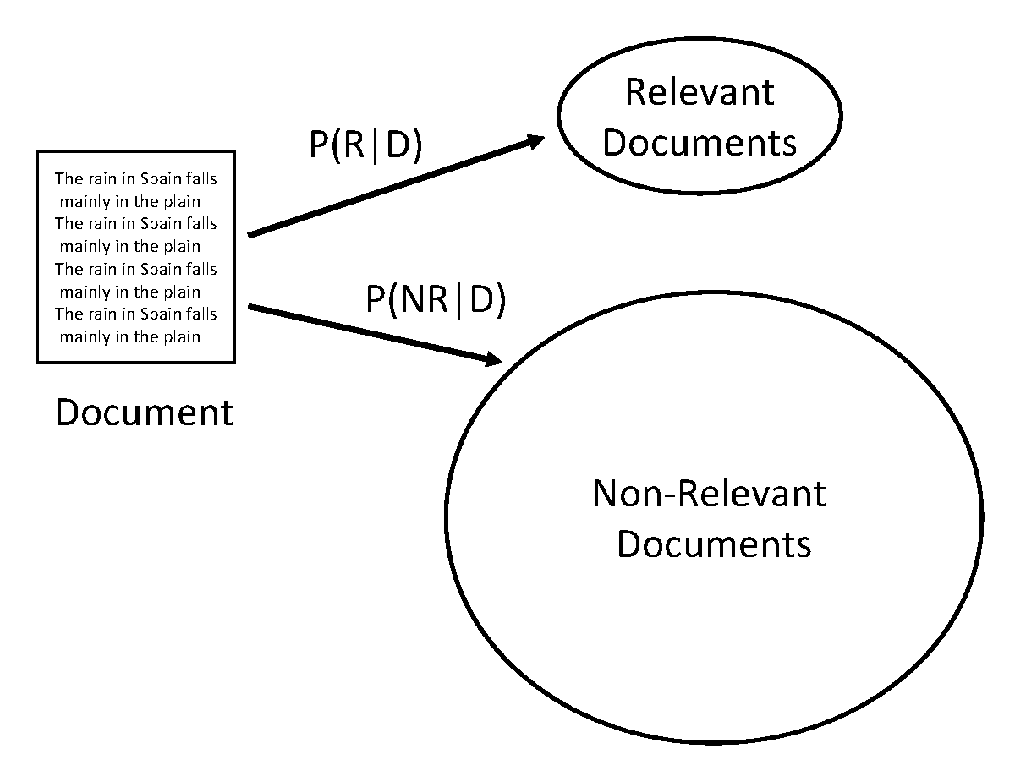
IR as Classification
what we want: P(R|D)
what we can do: P(D|R)

Slide 18
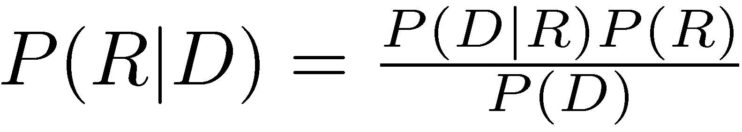
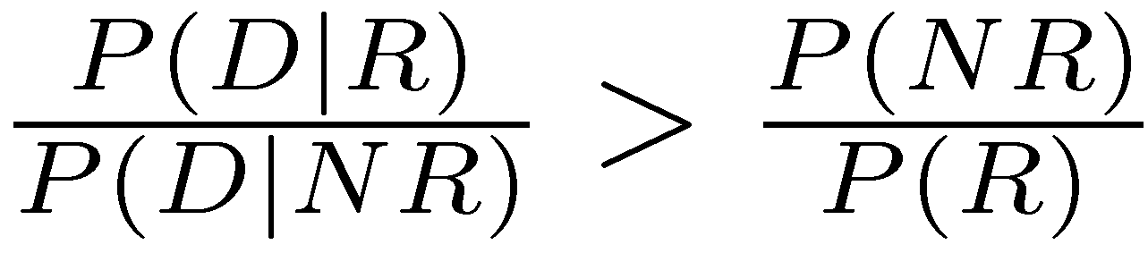
Bayes Classifier
Bayes Decision Rule
A document D is relevant if P(R|D) > P(NR|D)
Estimating probabilities
use Bayes Rule
classify a document as relevant if
lhs is likelihood ratio
P(R) = probability any
doc is relevant
P(D) = constant

Slide 19
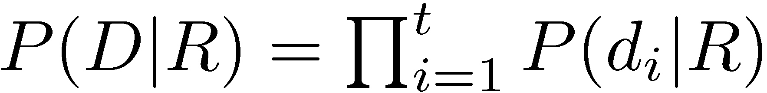
Estimating P(D|R)
Assume independence
Binary independence model
document represented by a vector of binary features indicating term occurrence (or non-occurrence)
p_{i} is probability that term i occurs (i.e., has value 1) in relevant document, s_{i} is probability of occurrence in non-relevant document
d_{i} is term/feature probability
D=(d₁, d₂, d₃, …, d_{n})

Slide 20
Example (p. 247)
D₁ = (1,0,0,1,1)
p_{i} = probability that i^{th} term occurs in a document from the relevant set
P(D₁|R) = p₁ * (1-p₂) * (1-p₃) * p₄ * p₅

Slide 21
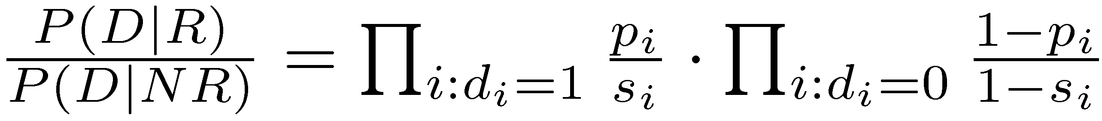
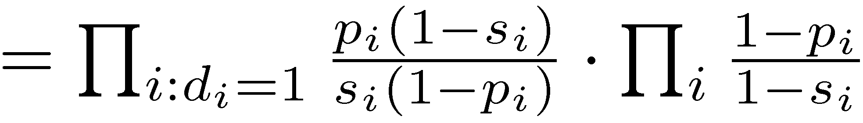
Binary Independence Model
p_{i} probability of occurring in relevant set, s_{i} probability of occurring in non-relevant set
1
All documents

Slide 22
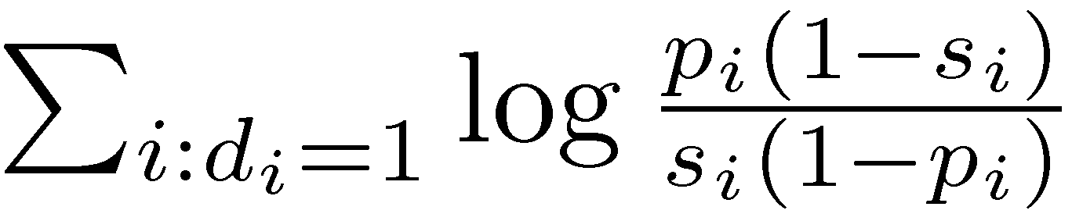
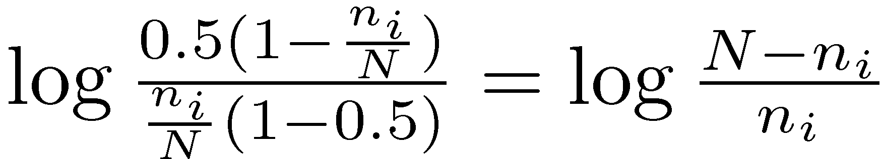
Binary Independence Model
multiplying lots of small #s = bad, switch to sum of logs
Scoring function is
Query provides information about relevant documents
If we assume p_{i} constant, s_{i} approximated by entire collection, get idf-like weight
no info about relevant set? you could assume non-query terms are equal probability p_{i} = s_{i}
better
assumption:
p_{i} = 0.5; s_{i} = n_{i}/N

Slide 23
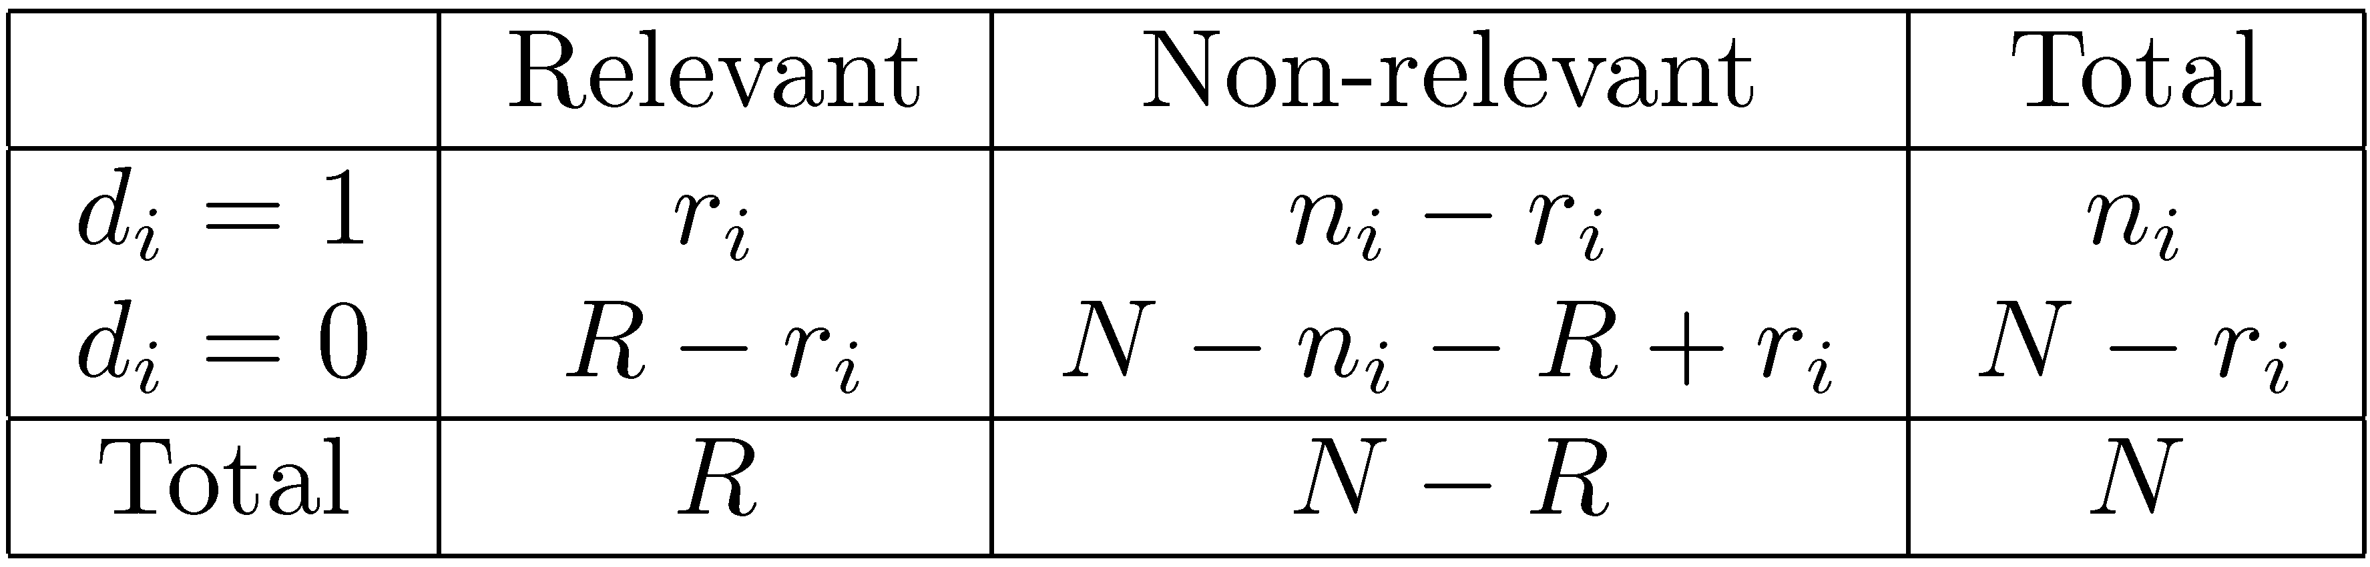
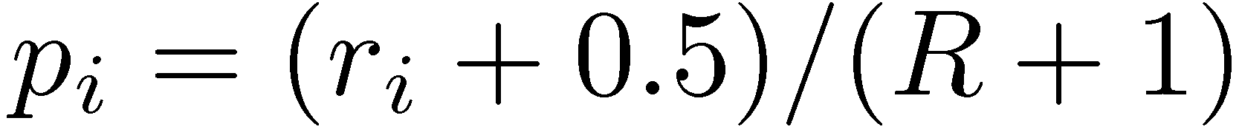
Contingency Table
most of the time
we don’t have
relevance info
N - n_{i}
Estimating p_{i}, s_{i}
(add 0.5 (1 in eqn below) to avoid log 0)
Gives scoring function:
No relevance info? R=0, r_{i}=0; very much like idf…
By itself, no tf component and ranking ~ 50% off

Slide 24
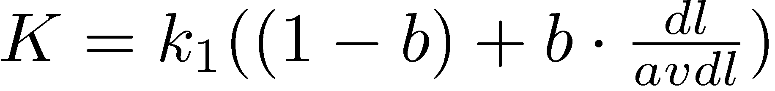
BM25
Popular and effective ranking algorithm based on binary independence model
adds document and query term weights
k1, k2 and K are parameters whose values are set empirically
dl is doc length
Typical TREC value for k1 is 1.2, k2 varies from 0 to 1000, b = 0.75
tf
query tf
b={0,1} ~
{no, full} length normalization
k₁=0 ~ boolean,k₁=large ~ linear
k₁=1.2 ~ mov in sports rankings

Slide 25
BM25 Example
Query with two terms, “president lincoln”, (qf = 1)
No relevance information (r and R are zero)
N = 500,000 documents
“president” occurs in 40,000 documents (n₁ = 40, 000)
“lincoln” occurs in 300 documents (n₂ = 300)
“president” occurs 15 times in doc (f₁ = 15)
“lincoln” occurs 25 times (f₂ = 25)
document length is 90% of the average length (dl/avdl =0.9)
k₁ = 1.2, b = 0.75, and k₂ = 100
K = 1.2 · (0.25 + 0.75 · 0.9) = 1.11

Slide 26
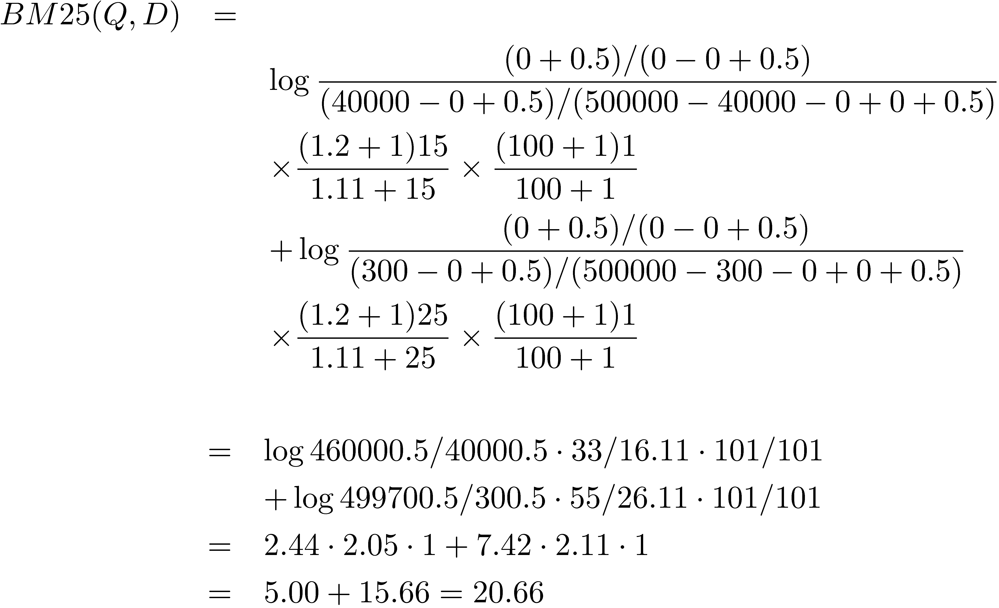
BM25 Example
higher idf for “lincoln” (7.42)
than “president” (2.44)

Slide 27
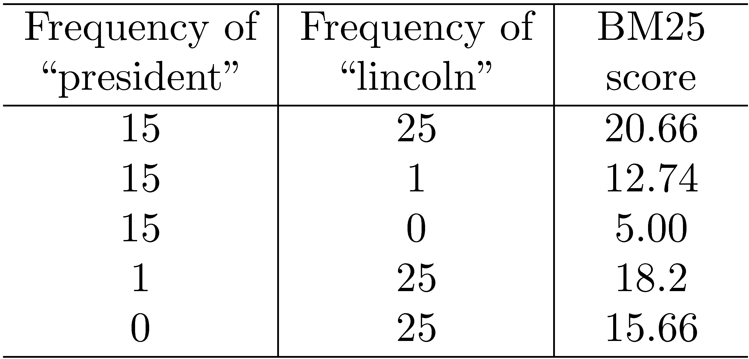
BM25 Example
Effect of term frequencies
(0,25) > (15,1)

Slide 28
Language Model
Unigram language model
probability distribution over the words in a language
generation of text consists of pulling words out of a “bucket” according to the probability distribution and replacing them
N-gram language model
some applications use bigram and trigram language models where probabilities depend on previous words

Slide 29
Language Model
A topic in a document or query can be represented as a language model
i.e., words that tend to occur often when discussing a topic will have high probabilities in the corresponding language model
Multinomial distribution over words
text is modeled as a finite sequence of words, where there are t possible words at each point in the sequence
commonly used, but not only possibility
doesn’t model burstiness
think of a "topic" as a box of
words and if you shake it enough, queries & documents fall out
cf. cache spatial & temporal locality

Slide 30
LMs for Retrieval
3 possibilities:
probability of generating the query text from a document language model
probability of generating the document text from a query language model
comparing the language models representing the query and document topics
Models of topical relevance
My topic models:
{Ford, FE, Galaxie, Fairlane, Mercury, Montego, toploader, C6, 9”,…}
{Beamer, Hokies, football, puntblock, uvasux,…}

Slide 31
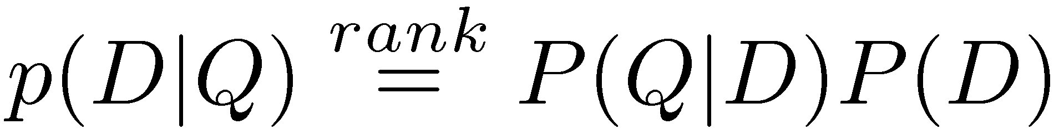
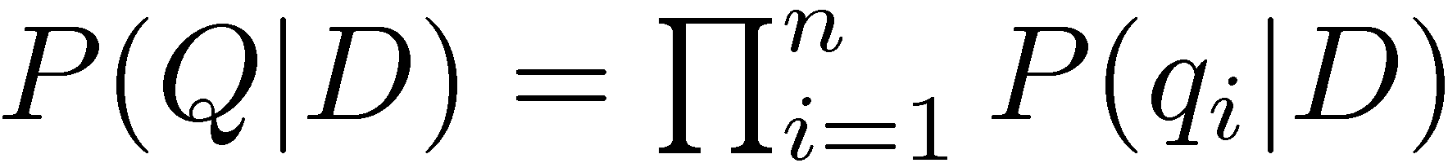
Query-Likelihood Model
Rank documents by the probability that the query could be generated by the document model (i.e. same topic)
Given query, start with P(D|Q)
Using Bayes’ Rule
Assuming prior is uniform, unigram model
Given document D, what is the probability
that we’ll generate all the query terms?

Slide 32
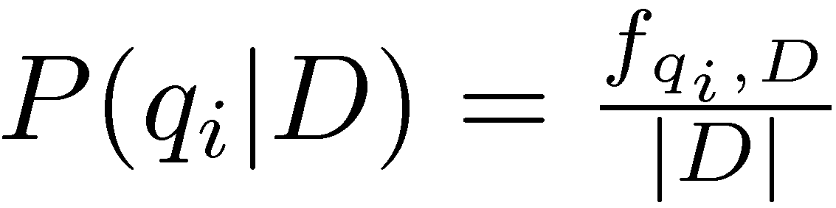
Estimating Probabilities
Obvious estimate for unigram probabilities is
Maximum likelihood estimate
makes the observed value of fqi;D most likely
If query words are missing from document, score will be zero
Missing 1 out of 4 query words same as missing 3 out of 4
Will my old car queries have all of:
{Ford, FE, Galaxie, Fairlane, Mercury, Montego, toploader, C6, 9”,…} ?

Slide 33
Smoothing
Document texts are a sample from the language model
Missing words should not have zero probability of occurring
Smoothing is a technique for estimating probabilities for missing (or unseen) words
lower (or discount) the probability estimates for words that are seen in the document text
assign that “left-over” probability to the estimates for the words that are not seen in the text

Slide 34
Estimating Probabilities
Estimate for unseen words is α_{D}P(q_{i}|C)
P(q_{i}|C) is the probability for query word i in the collection language model for collection C (background probability)
α_{D} is a parameter
Estimate for words that occur is
(1 − α_{D}) P(q_{i}|D) + α_{D} P(q_{i}|C)
Different forms of estimation come from different α_{D}
…and give to unobserved terms
Take some probability
from observed terms…

Slide 35
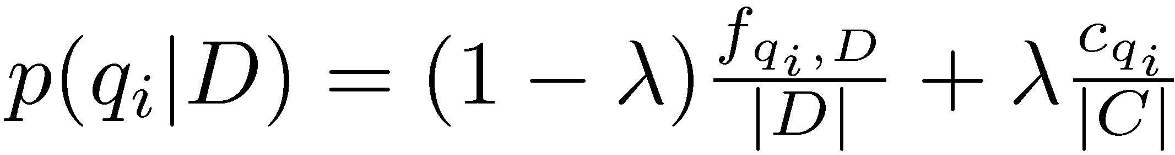
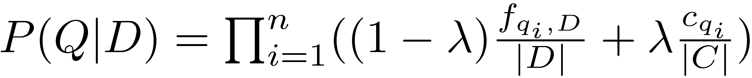
Jelinek-Mercer Smoothing
small λ ~= boolean AND
large λ ~= boolean OR
in TREC, λ ~= 0.1 for short queries
and λ ~= 0.7 for long queries
α_{D} is a constant, λ
Gives estimate of
Ranking score
Use logs for convenience
accuracy problems multiplying small numbers

Slide 36
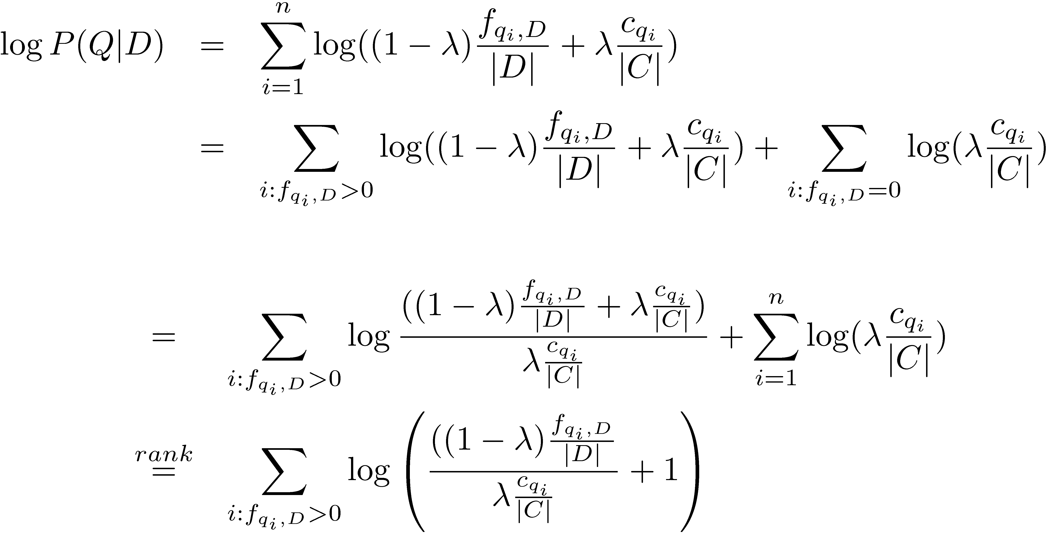
Where is tf.idf Weight?
occurs
does not occur
Add/sub term from
p. 258
Last term can be
dropped
- proportional to the term frequency, inversely proportional to the collection frequency

Slide 37
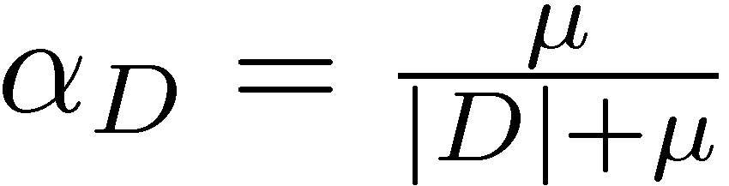
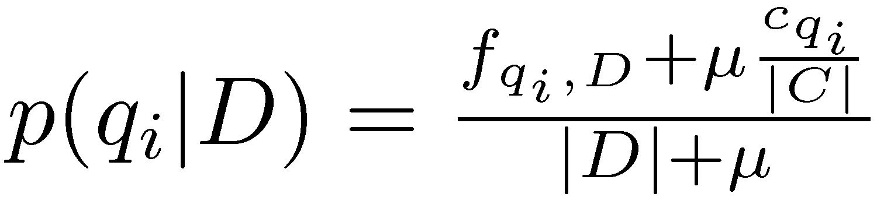
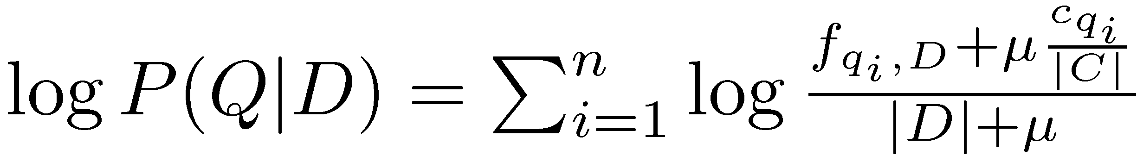
Dirichlet Smoothing
α_{D} depends on document length
Gives probability estimation of
and document score
similar to J-M,
small α_{D} ~= AND
large α_{D} ~= OR
from TREC,  = 1000-2000
generally, Dirichlet > J-M

Slide 38
Query Likelihood Example
For the term “president”
f_{qi,D} = 15, c_{qi} = 160,000
For the term “lincoln”
f_{qi,D} = 25, c_{qi} = 2,400
number of word occurrences in the document |d| is assumed to be 1,800
number of word occurrences in the collection is 10⁹
500,000 documents times an average of 2,000 words
μ = 2,000

Slide 39
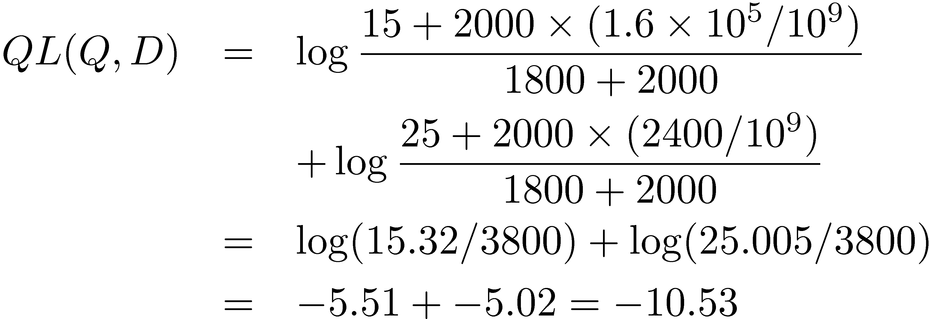
Query Likelihood Example
Negative number because summing logs of small numbers

Slide 40
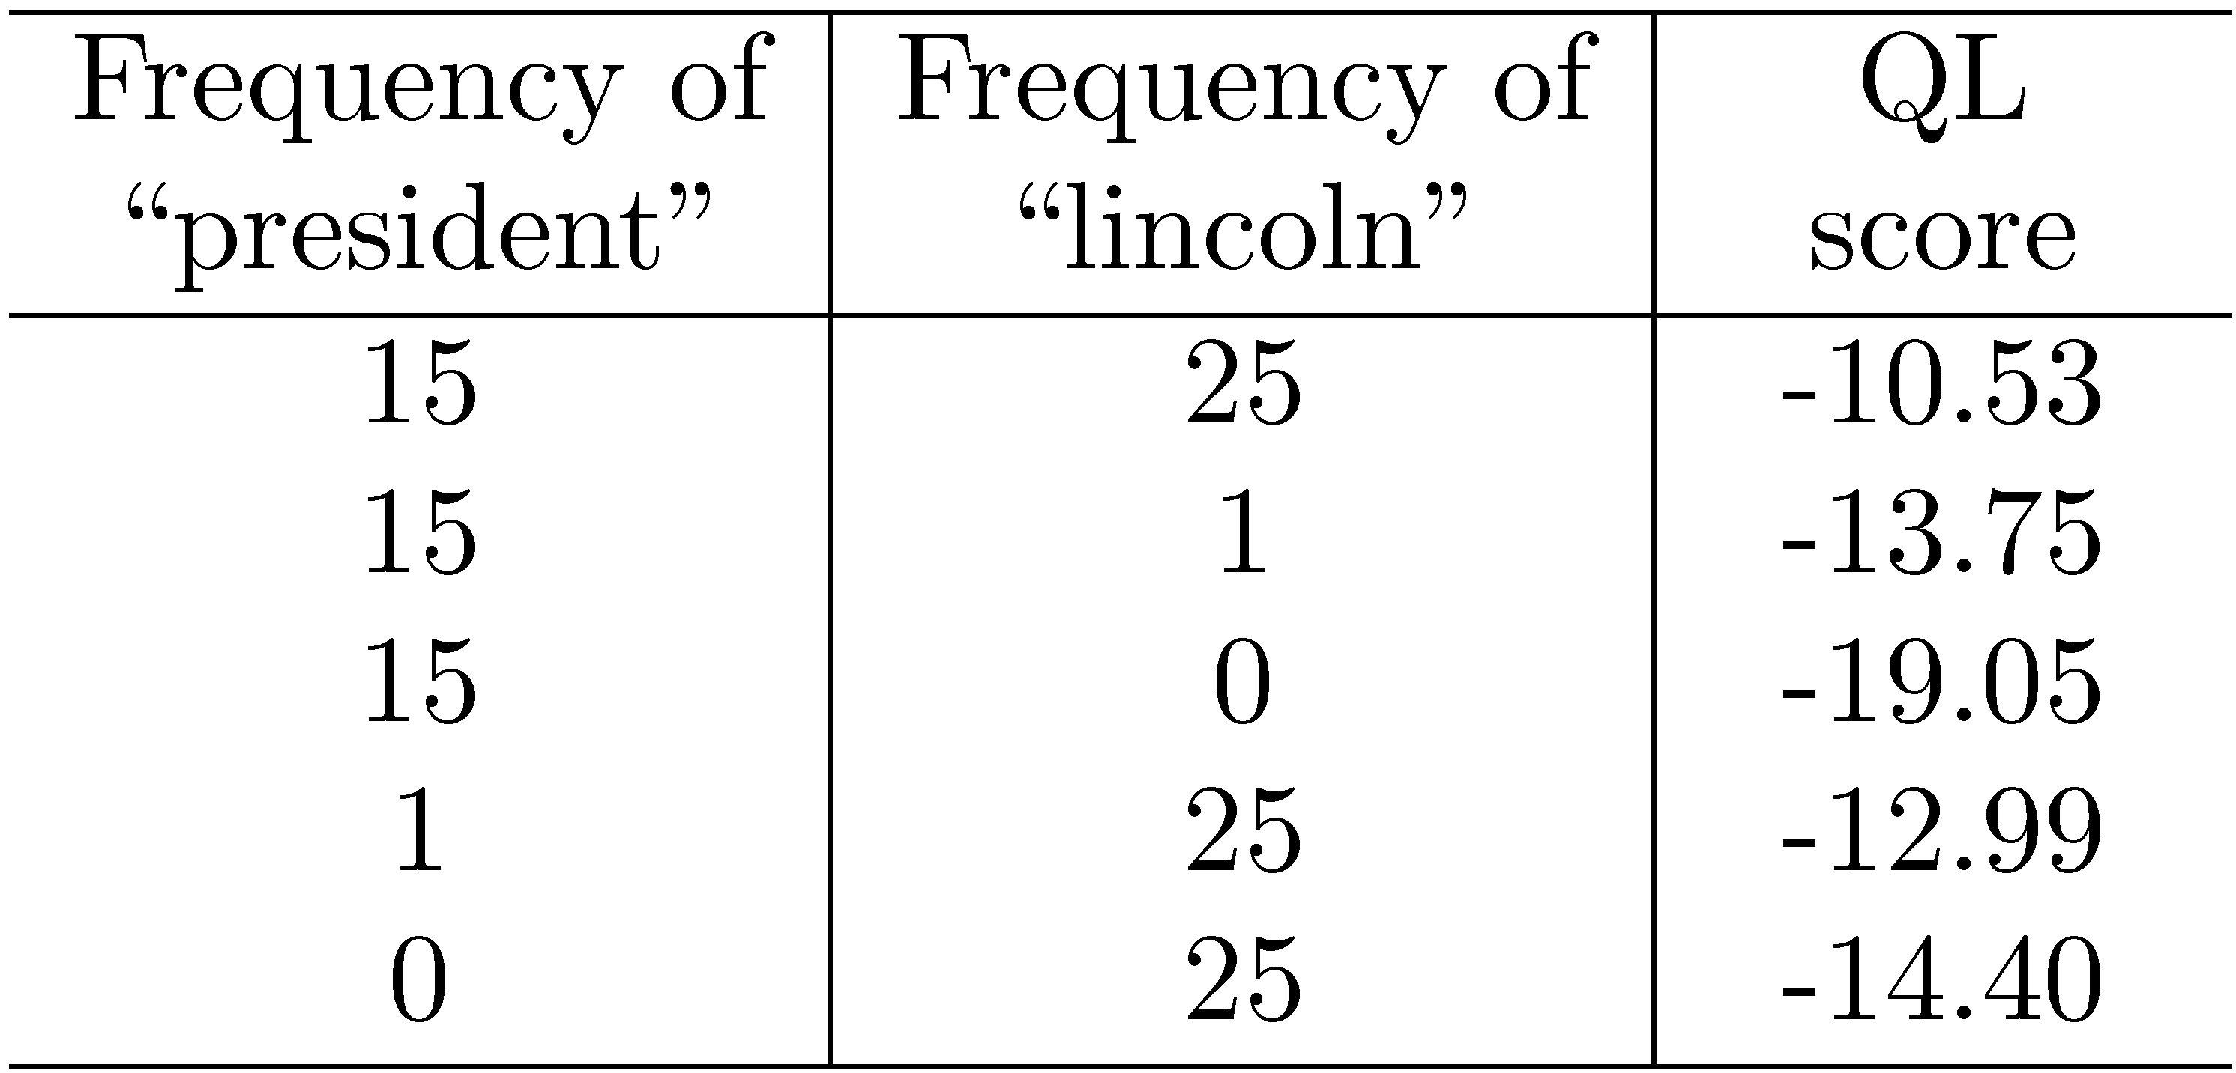
Query Likelihood Example
(0,25) < (15,1)
cf. table 7.2 for BM25

Slide 41
Relevance Models
Relevance model – language model representing information need
query and relevant documents are samples from this model
P(D|R) - probability of generating the text in a document given a relevance model
document likelihood model
less effective than query likelihood due to difficulties comparing across documents of different lengths
shake topic box:
a little = query
a lot = document

Slide 42
Pseudo-Relevance Feedback
Estimate relevance model from query and top-ranked documents
Rank documents by similarity of document model to relevance model
Kullback-Leibler divergence (KL-divergence) is a well-known measure of the difference between two probability distributions
example: we all share the same dictionary (bag of words)
my topic model for "Hokies Football" -> probability distribution
non-fan topic model for "Hokies Football" -> pd (not as good)
Uva fan topic model for "Hokies Football" -> pd (terrible)

Slide 43
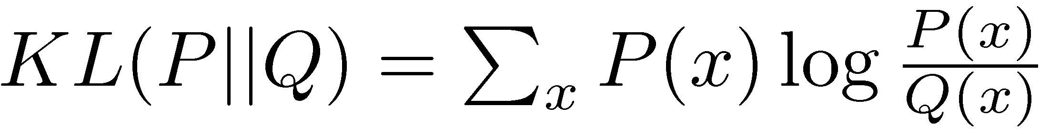
KL-Divergence
AKA “information gain”, “relative entropy”
Given the true probability distribution P and another distribution Q that is an approximation to P,
Use negative KL-divergence for ranking, and assume relevance model R is the true distribution (not symmetric),
clearly my TM for VT fb is "true" ;-)
R=query model (true), D=document model
rhs doesn't depend on D, so drop it

Slide 44
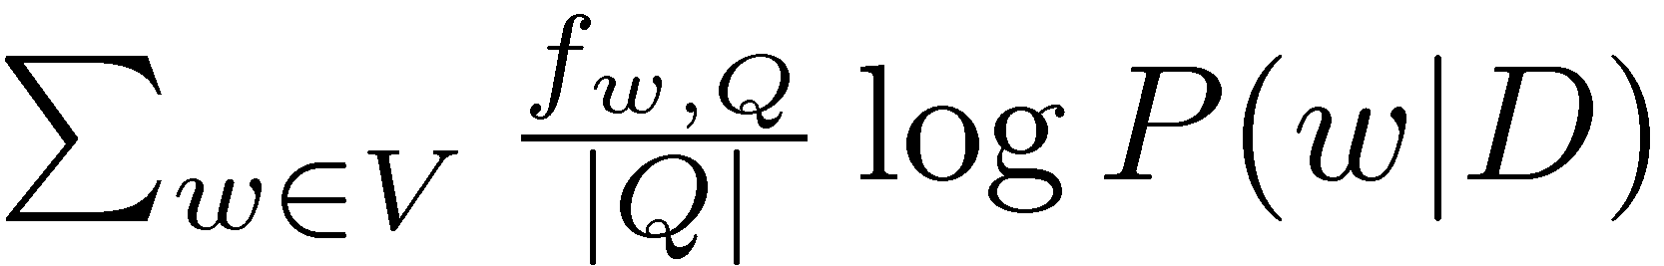

KL-Divergence
Given a simple maximum likelihood estimate for P(w|R), based on the frequency in the query text, ranking score is
rank-equivalent to query likelihood score
Query likelihood model is a special case of retrieval based on relevance model
frequency of term w in query / # terms in query

Slide 45
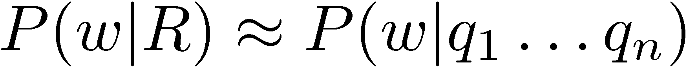
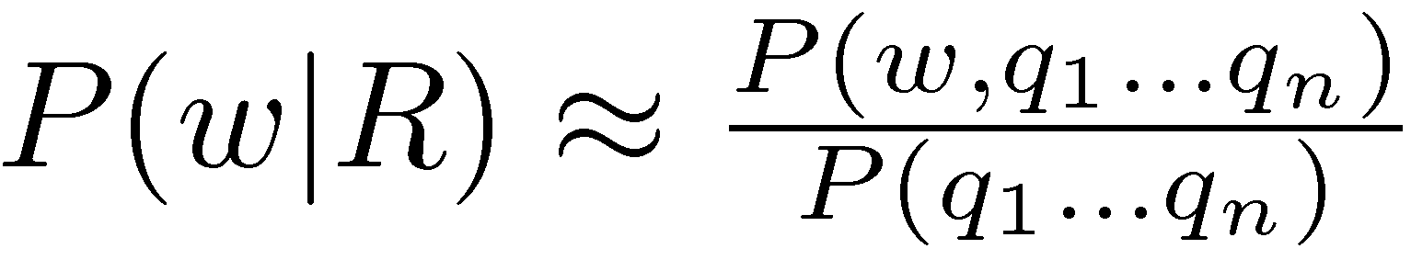
Estimating the Relevance Model
Probability of pulling a word w out of the “bucket” representing the relevance model depends on the n query words we have just pulled out
By definition
history!
normalizing constant

Slide 46
Estimating the Relevance Model
Joint probability is
Assume
Gives

Slide 47
Estimating the Relevance Model
P(D) usually assumed to be uniform
P(w, q₁ . . . q_{n}) is simply a weighted average of the language model probabilities for w in a set of documents, where the weights are the query likelihood scores for those documents
Formal model for pseudo-relevance feedback
query expansion technique

Slide 48
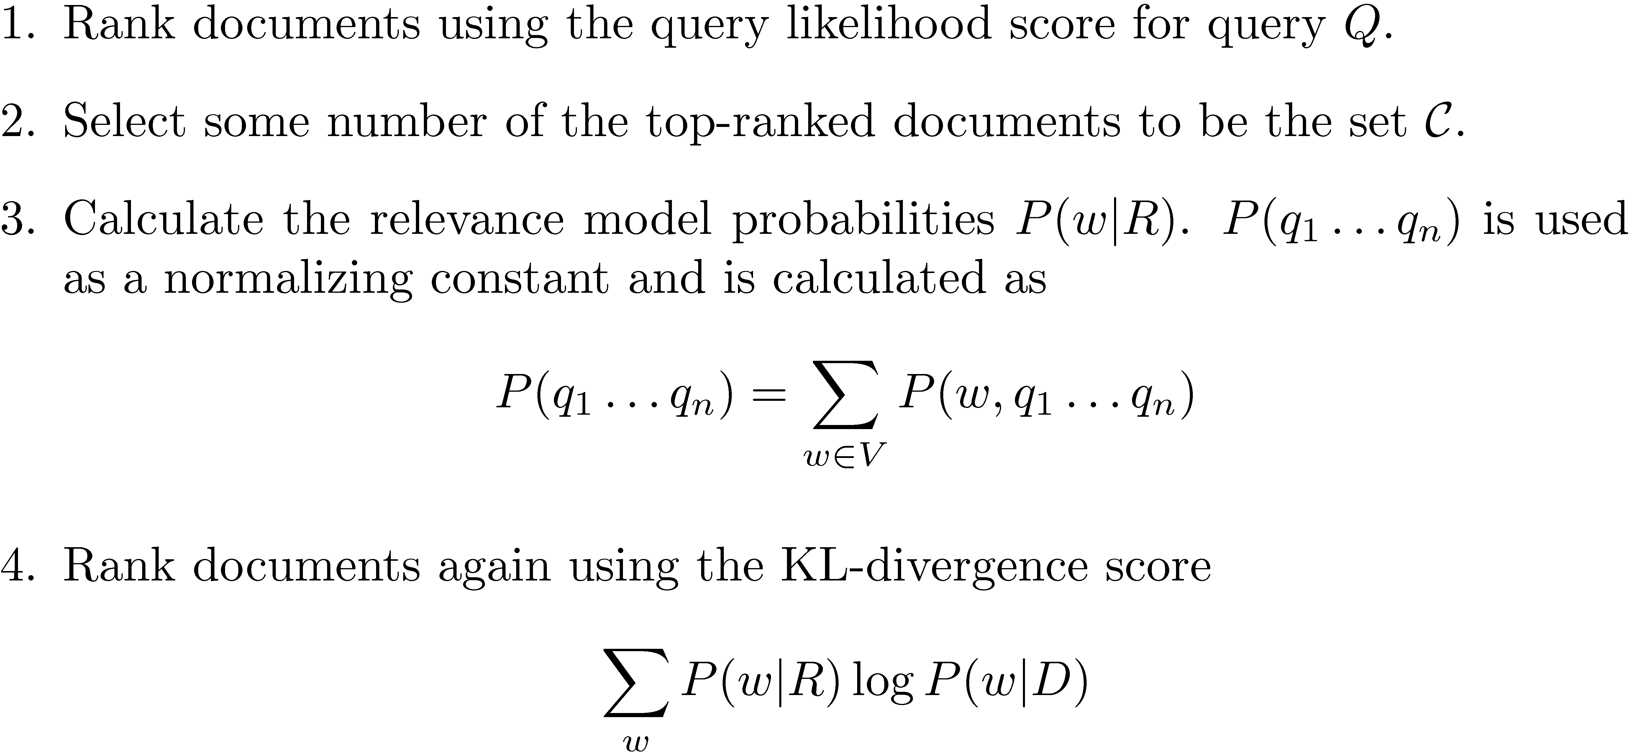
Pseudo-Feedback Algorithm
typically 10-50
typically not all w,
just top 10-25

Slide 49
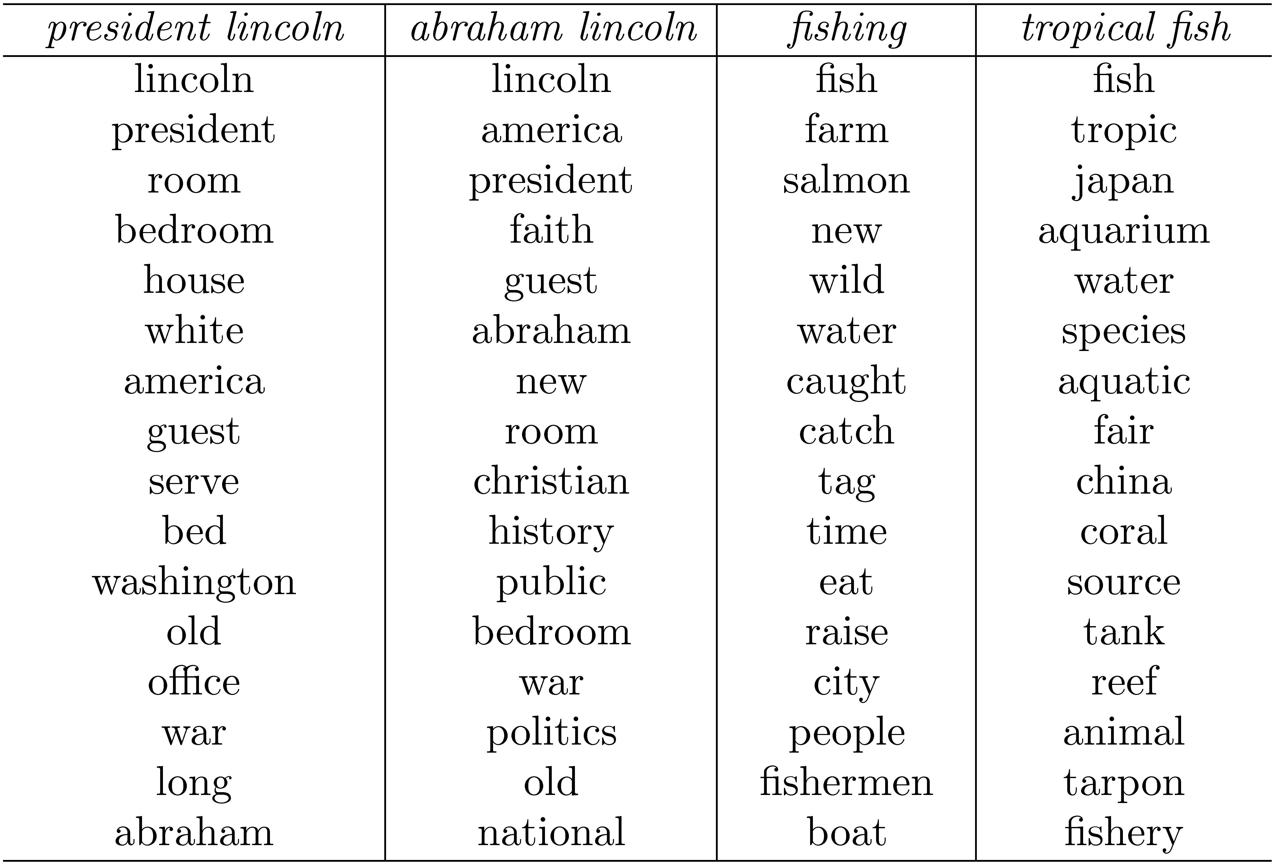
Example from Top 10 Docs
queries
terms in
relevance
model

Slide 50
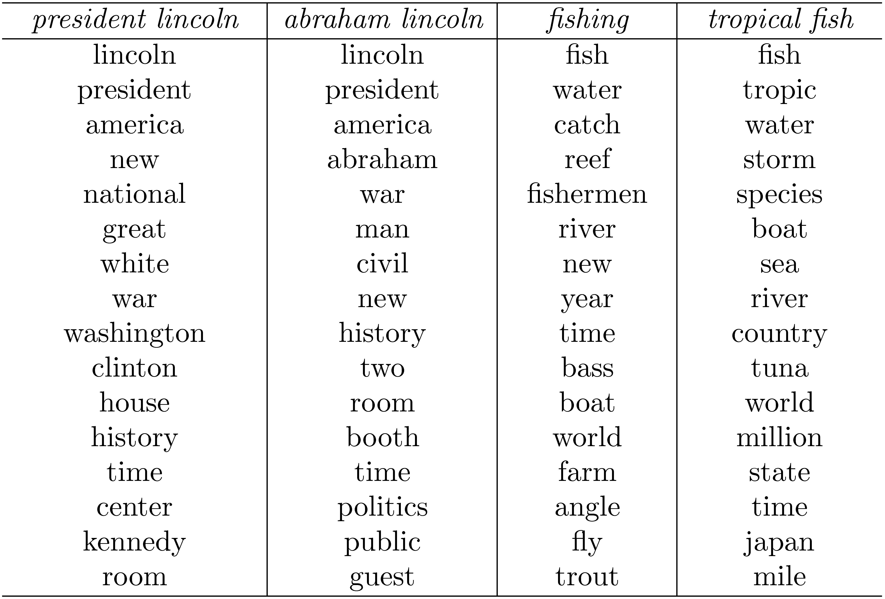
Example from Top 50 Docs

Slide 51
Combining Evidence
Effective retrieval requires the combination of many pieces of evidence about a document’s potential relevance
have focused on simple word-based evidence
many other types of evidence
structure, PageRank, metadata, even scores from different models
Inference network model is one approach to combining evidence
uses Bayesian network formalism

Slide 52
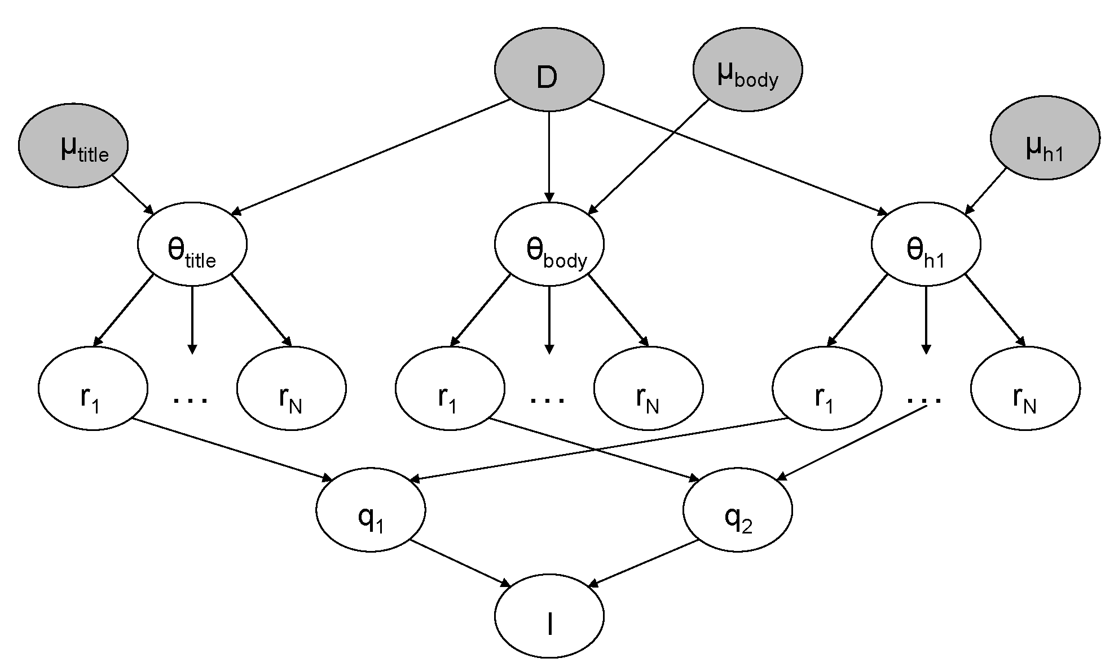
Inference Network

Slide 53
Inference Network
Document node (D) corresponds to the event that a document is observed
Representation nodes (r_{i}) are document features (evidence)
Probabilities associated with those features are based on language models θ estimated using the parameters μ
one language model for each significant document structure
r_{i} nodes can represent proximity features, or other types of evidence (e.g. date)
proximity -> operators: AND, OR, quote, etc.

Slide 54
Inference Network
Query nodes (q_{i}) are used to combine evidence from representation nodes and other query nodes
represent the occurrence of more complex evidence and document features
a number of combination operators are available
Information need node (I) is a special query node that combines all of the evidence from the other query nodes
network computes P(I|D, μ)
“probability an information need is met given the document and the parameters u”

Slide 55
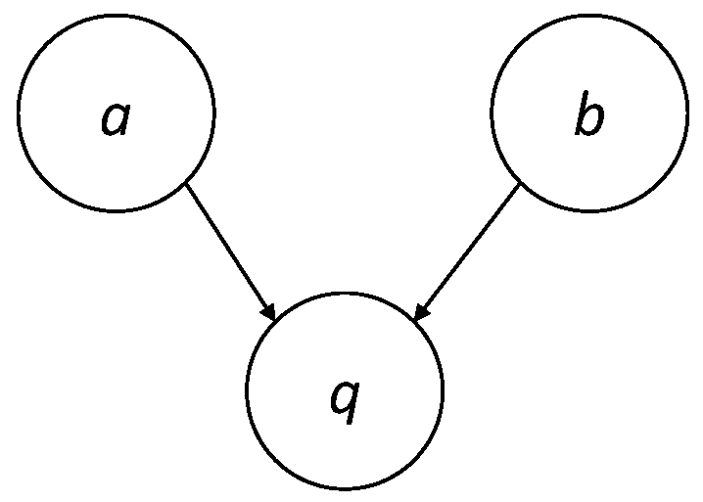
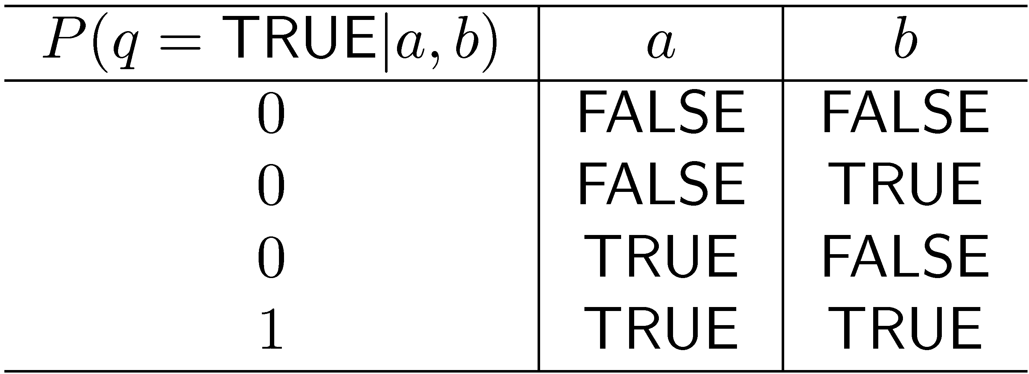
Example: AND Combination
a and b are parent nodes for q

Slide 56
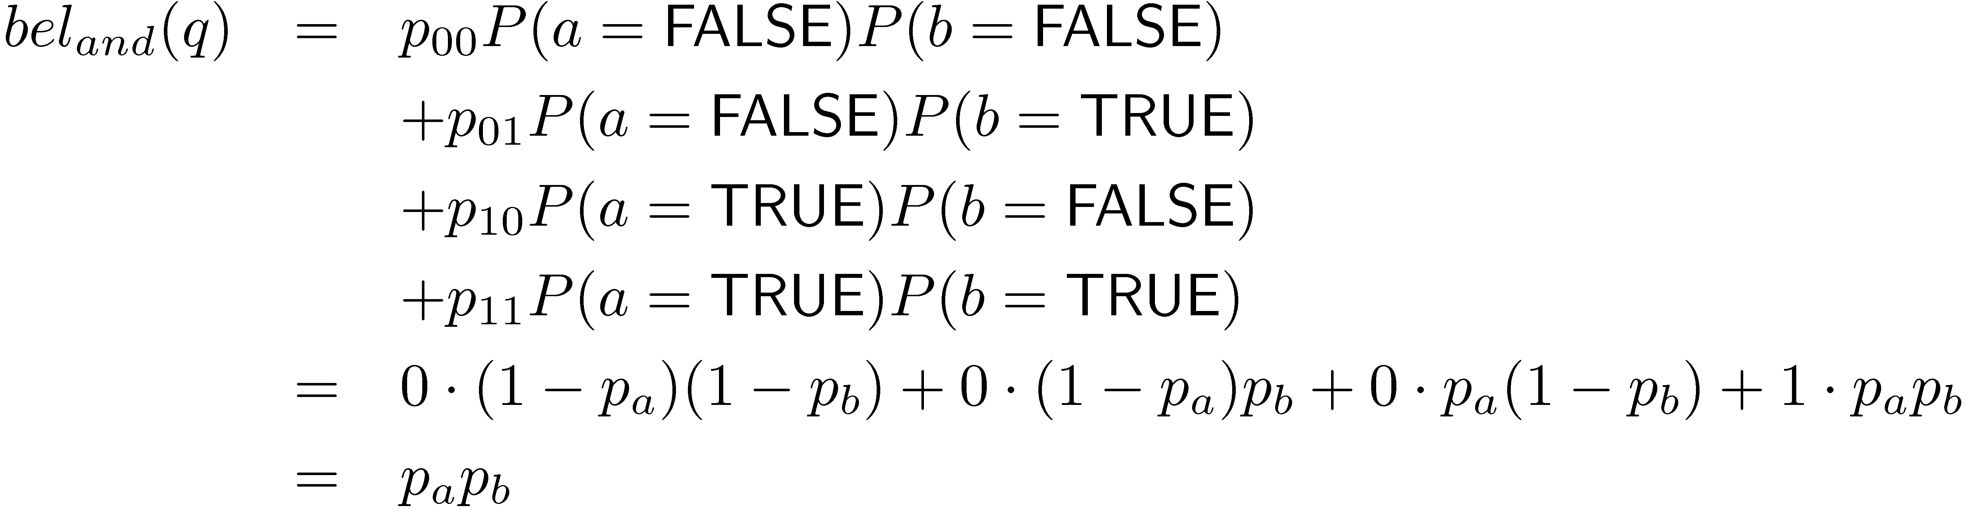
Example: AND Combination
Combination must consider all possible states of parents
Some combinations can be computed efficiently

Slide 57
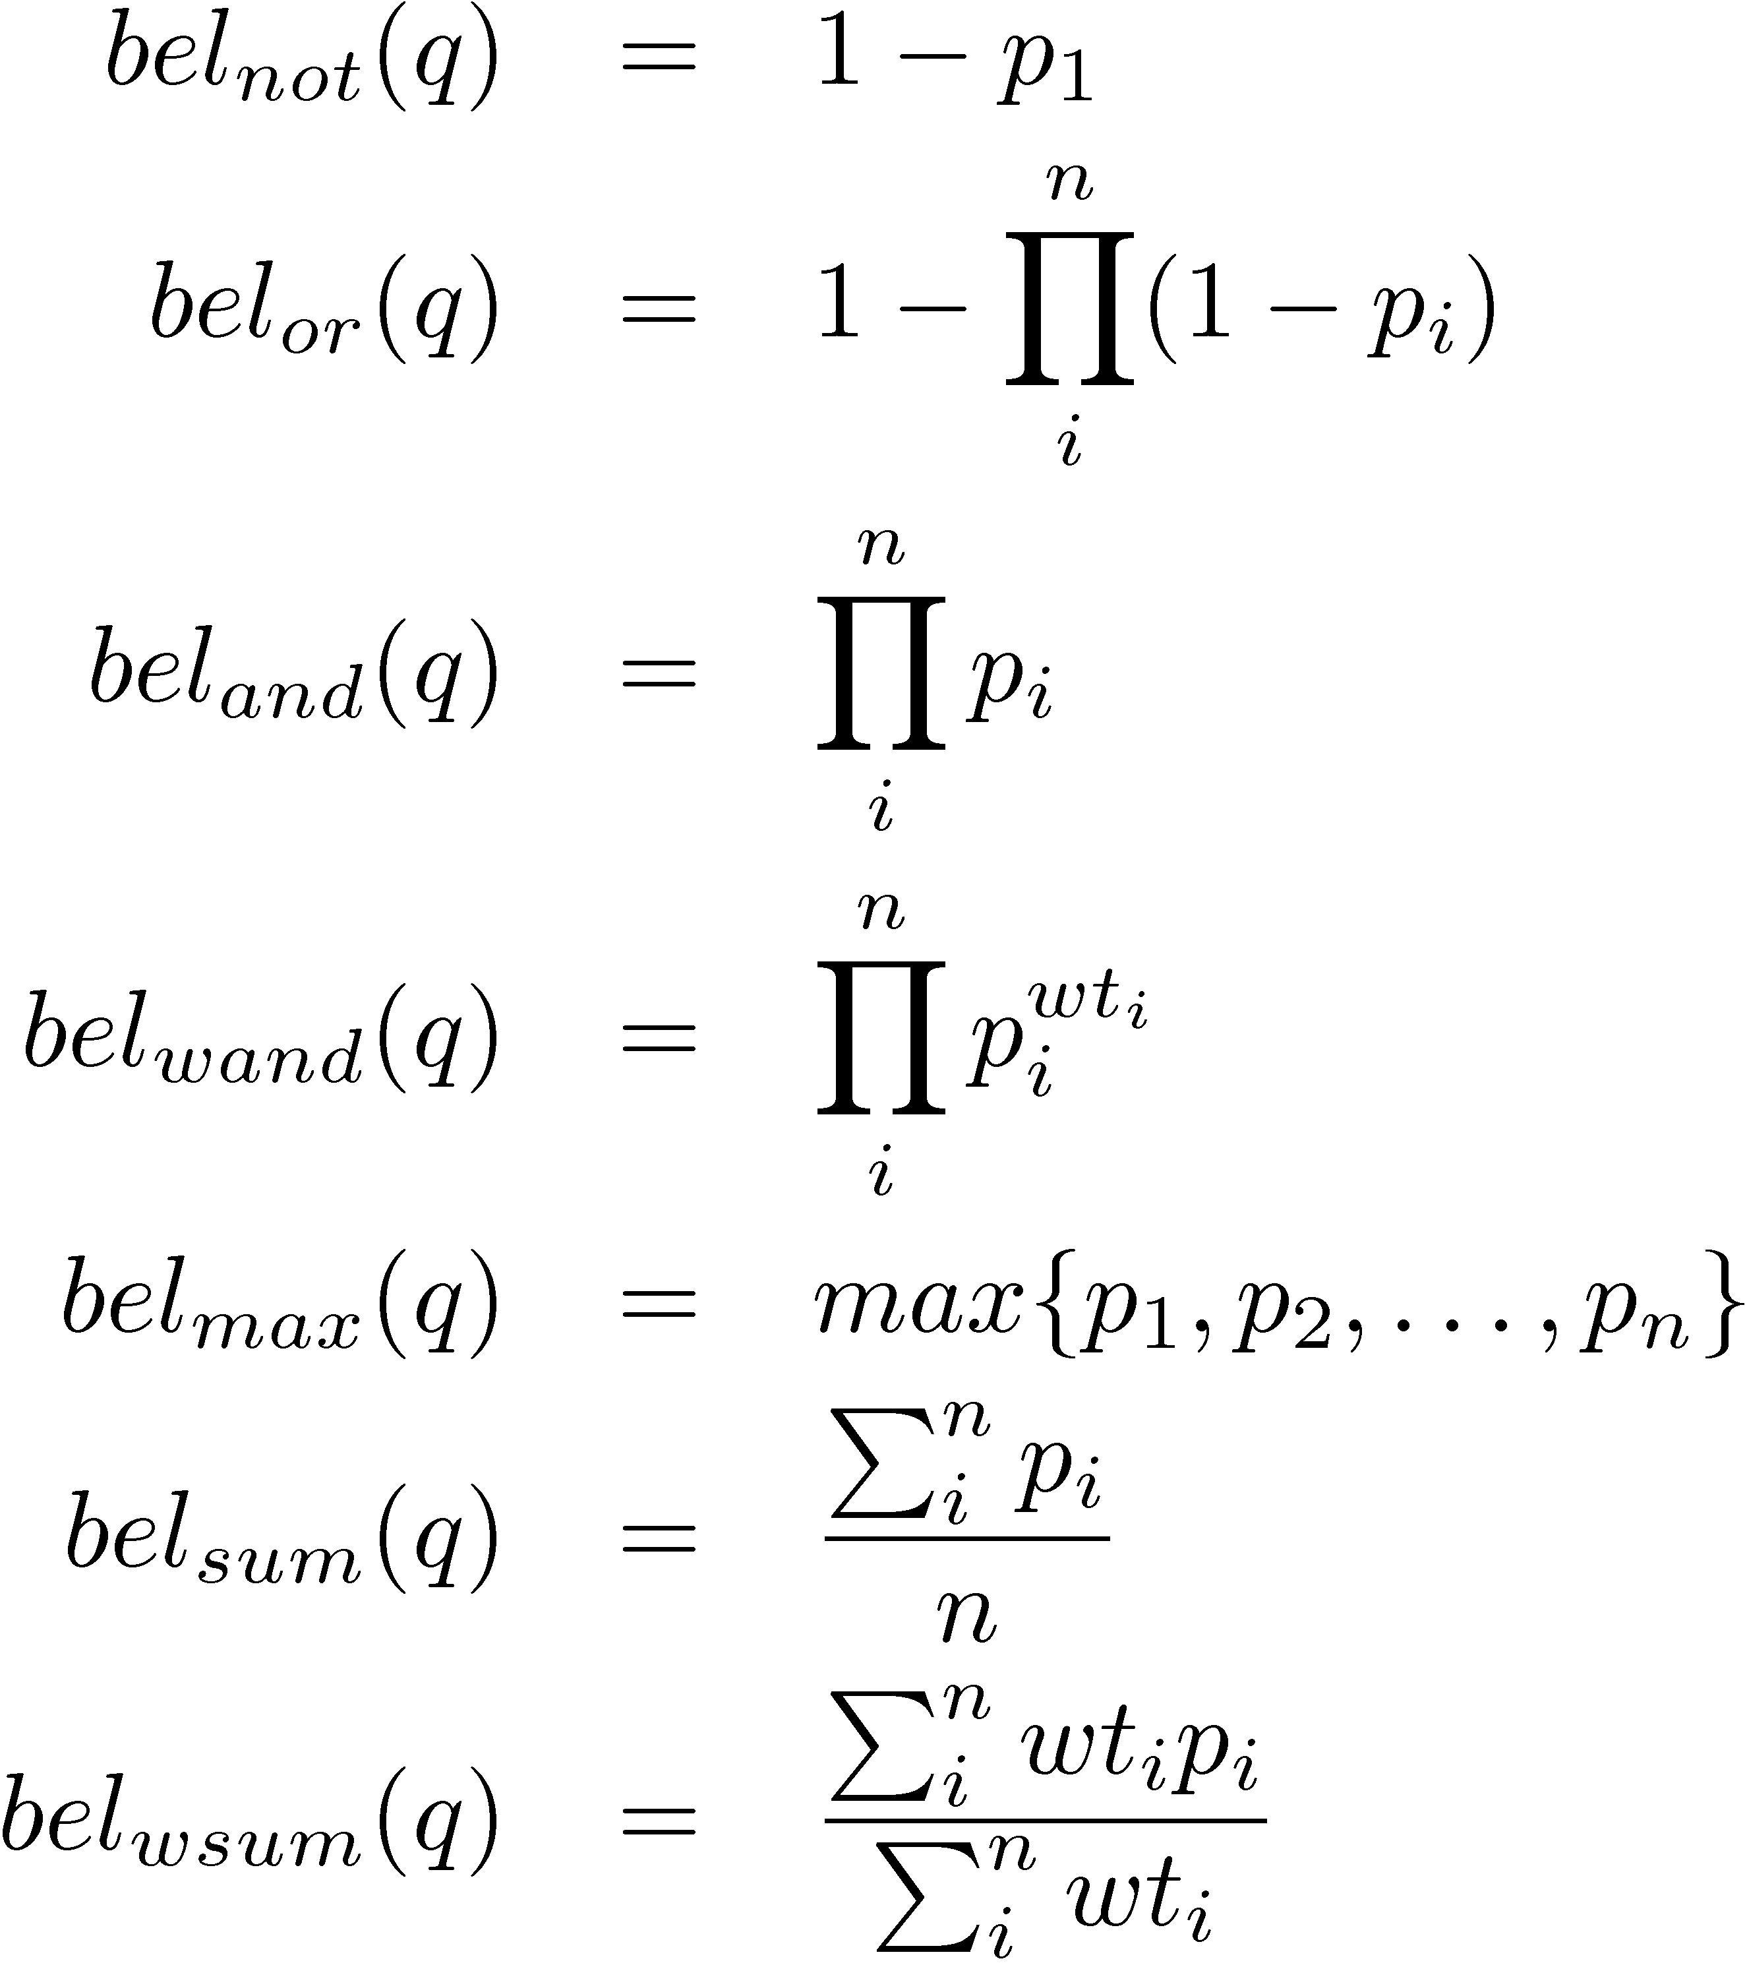
Inference Network Operators
weighted AND; using r_{i} as unigrams,
rank equivalent to query likelihood

Slide 58
Galago Query Language
A document is viewed as a sequence of text that may contain arbitrary tags
A single context is generated for each unique tag name (e.g., <title>, <h1>)
An extent is a sequence of text that appears within a single begin/end tag pair of the same type as the context

Slide 59

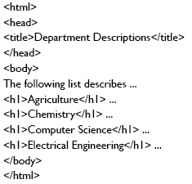


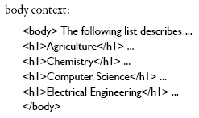
Galago Query Language
h1 = 1 context, 4 extents

Slide 60
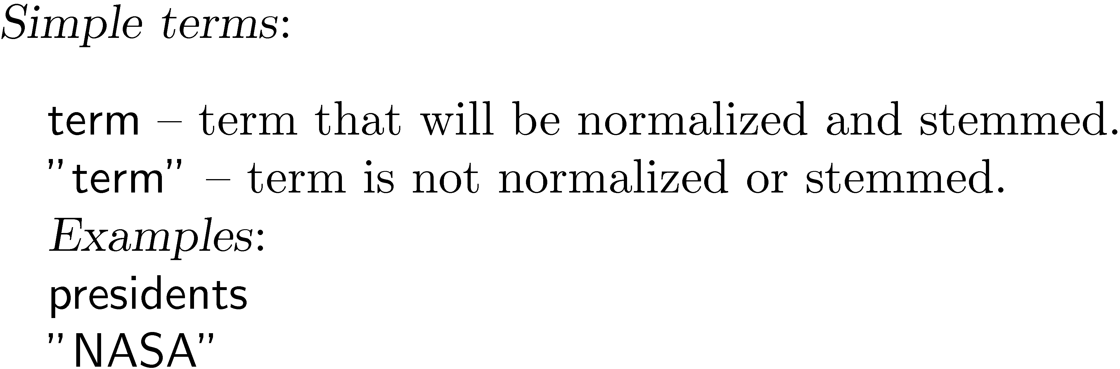
Galago Query Language
TexPoint Display

Slide 61
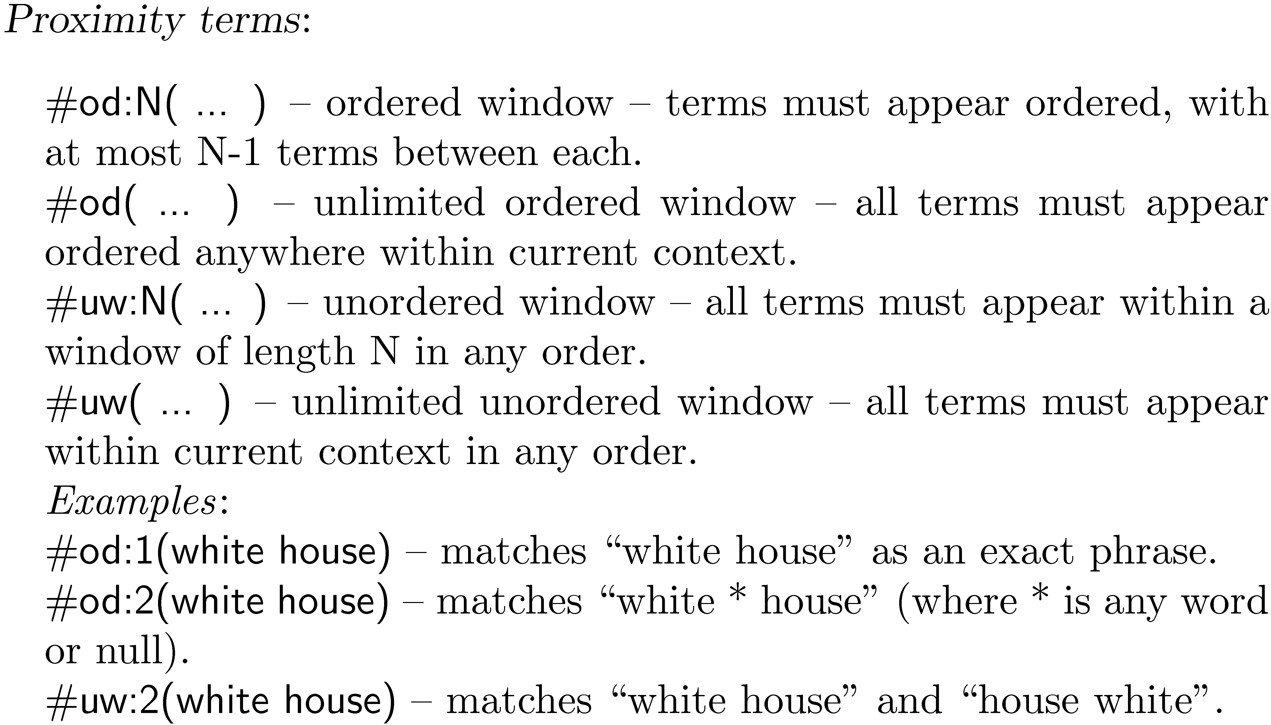
Galago Query Language

Slide 62

Galago Query Language

Slide 63

Galago Query Language

Slide 64

Galago Query Language

Slide 65

Galago Query Language

Slide 66

Galago Query Language

Slide 67
Web Search
Most important, but not only, search application
Major differences to TREC news
Size of collection
Connections between documents
Range of document types
Importance of spam
Volume of queries
Range of query types

Slide 68
Search Taxonomy
(Broder, 2002)
cf. Marchionini ISEE book,
Belkin's ASK article
Informational
Finding information about some topic which may be on one or more web pages
Topical search
Navigational
finding a particular web page that the user has either seen before or is assumed to exist
Transactional
finding a site where a task such as shopping or downloading music can be performed

Slide 69
Web Search
For effective navigational and transactional search, need to combine features that reflect user relevance
Commercial web search engines combine evidence from hundreds of features to generate a ranking score for a web page
page content, page metadata, anchor text, links (e.g., PageRank), and user behavior (click logs)
page metadata – e.g., “age”, how often it is updated, the URL of the page, the domain name of its site, and the amount of text content

Slide 70
Search Engine Optimization
SEO: understanding the relative importance of features used in search and how they can be manipulated to obtain better search rankings for a web page
e.g., improve the text used in the title tag, improve the text in heading tags, make sure that the domain name and URL contain important keywords, and try to improve the anchor text and link structure
Some of these techniques are regarded as not appropriate by search engine companies

Slide 71
Web Search
In TREC evaluations, most effective features for navigational search are:
text in the title, body, and heading (h1, h2, h3, and h4) parts of the document, the anchor text of all links pointing to the document, the PageRank number, and the inlink count
Given size of Web, many pages will contain all query terms
Ranking algorithm focuses on discriminating between these pages
Word proximity is important

Slide 72

Term Proximity
Many models have been developed
N-grams are commonly used in commercial web search
Dependence model based on inference net has been effective in TREC - e.g.
DM = query terms likely to appear near each other

Slide 73

Example Web Query
Q = pet therapy

Slide 74
Machine Learning and IR
Considerable interaction between these fields
Rocchio algorithm (60s) is a simple learning approach
80s, 90s: learning ranking algorithms based on user feedback
2000s: text categorization
Limited by amount of training data
Web query logs have generated new wave of research
e.g., “Learning to Rank”

Slide 75
Generative vs. Discriminative
All of the probabilistic retrieval models presented so far fall into the category of generative models
A generative model assumes that documents were generated from some underlying model (in this case, usually a multinomial distribution) and uses training data to estimate the parameters of the model
probability of belonging to a class (i.e. the relevant documents for a query) is then estimated using Bayes’ Rule and the document model

Slide 76
Generative vs. Discriminative
A discriminative model estimates the probability of belonging to a class directly from the observed features of the document based on the training data
Generative models perform well with low numbers of training examples
Discriminative models usually have the advantage given enough training data
Can also easily incorporate many features

Slide 77
Discriminative Models for IR
Discriminative models can be trained using explicit relevance judgments or click data in query logs
Click data is much cheaper, more noisy
e.g. Ranking Support Vector Machine (SVM) takes as input partial rank information for queries
partial information about which documents should be ranked higher than others

Slide 78
Ranking SVM
Training data is
r is partial rank information
if document da should be ranked higher than db, then (da, db) ∈ ri
partial rank information comes from relevance judgments (allows multiple levels of relevance) or click data
e.g., d1, d2 and d3 are the documents in the first, second and third rank of the search output, only d3 clicked on → (d3, d1) and (d3, d2) will be in desired ranking for this query e.g., (q₁ ,((d3, d1), (d3, d2)))

Slide 79

Ranking SVM
Learning a linear ranking function
where w is a weight vector that is adjusted by learning
d_{a} is the vector representation of the features of document
non-linear functions also possible
Weights represent importance of features
learned using training data
e.g.,

Slide 80

Ranking SVM
Learn w that satisfies as many of the following conditions as possible:
Can be formulated as an optimization problem

Slide 81

Ranking SVM
ξ, known as a slack variable, allows for misclassification of difficult or noisy training examples, and C is a parameter that is used to prevent overfitting

Slide 82


Ranking SVM
Software available to do optimization
Each pair of documents in our training data can be represented by the vector:
Score for this pair is:
SVM classifier will find a w that makes the smallest score (i.e., d_{i}-d_{j}) as large as possible
make the differences in scores as large as possible for the pairs of documents that are hardest to rank

Slide 83
Topic Models
Improved representations of documents
“expanding the documents” instead of query expansion
can also be viewed as improved smoothing techniques
improve estimates for words that are related to the topic(s) of the document
instead of just using background probabilities
Approaches
Latent Semantic Indexing (LSI)
Probabilistic Latent Semantic Indexing (pLSI)
Latent Dirichlet Allocation (LDA)

Slide 84

LDA
Model document as being generated from a mixture of topics
…and realizing |topic models| << |D|
Bucket of topics
Each topic bucket has a bucket of words

Slide 85

LDA
Gives language model probabilities
Used to smooth the document representation by mixing them with the query likelihood probability as follows:

Slide 86
LDA
If the LDA probabilities are used directly as the document representation, the effectiveness will be significantly reduced because the features are too smoothed
e.g., in typical TREC experiment, only 400 topics used for the entire collection
generating LDA topics is expensive
When used for smoothing (the document language model), effectiveness is improved

Slide 87

LDA Example
Top words from 4 LDA topics from TREC news
topic names
manually
assigned

Slide 88
Summary
Best retrieval model depends on application and data available
Evaluation corpus (or test collection), training data, and user data are all critical resources
Open source search engines can be used to find effective ranking algorithms
Galago query language makes this particularly easy
Language resources (e.g., thesaurus) can make a big difference

