Slide 1
Search Engines
Information Retrieval in Practice
Annotations by Michael L. Nelson
All slides ©Addison Wesley, 2008

Slide 2
Classification and Clustering
Classification and clustering are classical pattern recognition / machine learning problems
Classification
Asks “what class does this item belong to?”
Supervised learning task
Clustering
Asks “how can I group this set of items?”
Unsupervised learning task
Items can be documents, queries, emails, entities, images, etc.
Useful for a wide variety of search engine tasks

Slide 3
Classification
Classification is the task of automatically applying labels to items
Useful for many search-related tasks
Spam detection
Sentiment classification
Online advertising
Two common approaches
Probabilistic
Geometric

Slide 4
How to Classify?
How do humans classify items?
For example, suppose you had to classify the “healthiness” of a food
Identify set of features indicative of health
fat, cholesterol, sugar, sodium, etc.
Extract features from foods
Read nutritional facts, chemical analysis, etc.
Combine evidence from the features into a hypothesis
Add health features together to get “healthiness factor”
Finally, classify the item based on the evidence
If “healthiness factor” is above a certain value, then deem it healthy

Slide 5
Ontologies
Ontology is a labeling or categorization scheme
Examples
Binary (spam, not spam)
Multi-valued (red, green, blue)
Hierarchical (news/local/sports)
Different classification tasks require different ontologies

Slide 6
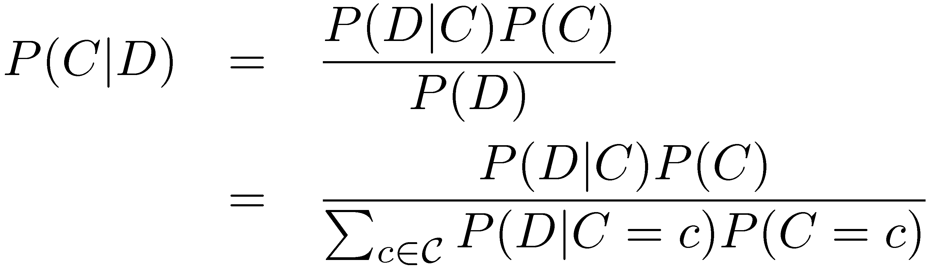
Naïve Bayes Classifier
Probabilistic classifier based on Bayes’ rule:
C is a random variable corresponding to the class
D is a random variable corresponding to the input (e.g. document)

Slide 7
Probability 101: Random Variables
Random variables are non-deterministic
Can be discrete (finite number of outcomes) or continuous
Model uncertainty in a variable
P(X = x) means “the probability that random variable X takes on value x”
X = random variable, x = particular outcome, X = all possible outcomes
Example:
Let X be the outcome of a coin toss
P(X = heads) = P(X = tails) = 0.5
Example: Y = 5 - 2X
If X is random, then Y is random
If X is deterministic then Y is also deterministic
Note: “Deterministic” just means P(X = x) = 1.0!

Slide 8
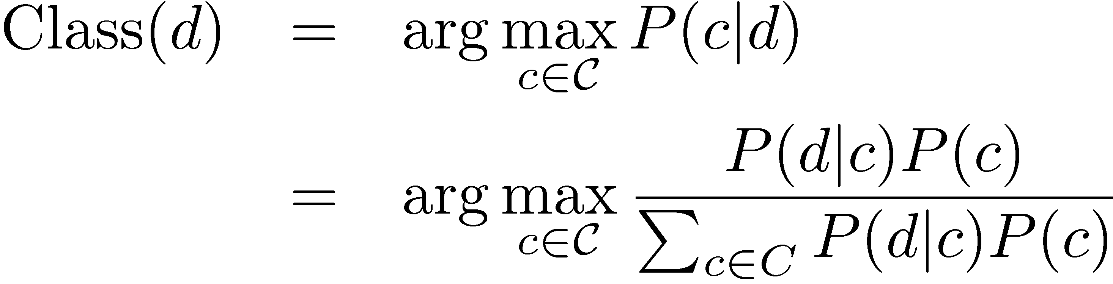
Naïve Bayes Classifier
Documents are classified according to:
Must estimate P(d | c) and P(c)
P(c) is the probability of observing class c
P(d | c) is the probability that document d is observed given the class is known to be c
“arg max” = “return the class c, out of all possible classes C, that maximizes P(c|d)”

Slide 9
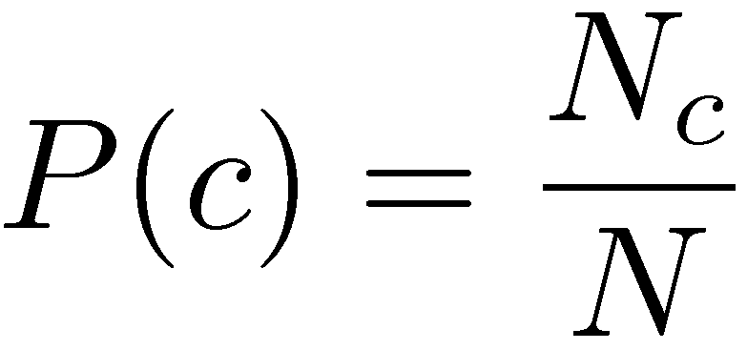
Estimating P(c)
P(c) is the probability of observing class c
Estimated as the proportion of training documents in class c:
N_{c} is the number of training documents in class c
N is the total number of training documents

Slide 10
Estimating P(d | c)
P(d | c) is the probability that document d is observed given the class is known to be c
Estimate depends on the event space used to represent the documents
What is an event space?
The set of all possible outcomes for a given random variable
For a coin toss random variable the event space is S = {heads, tails}

Slide 11
Multiple Bernoulli Event Space
Documents are represented as binary vectors
One entry for every word in the vocabulary
Entry i = 1 if word i occurs in the document and is 0 otherwise
Multiple Bernoulli distribution is a natural way to model distributions over binary vectors
Same event space as used in the classical probabilistic retrieval model

Slide 12
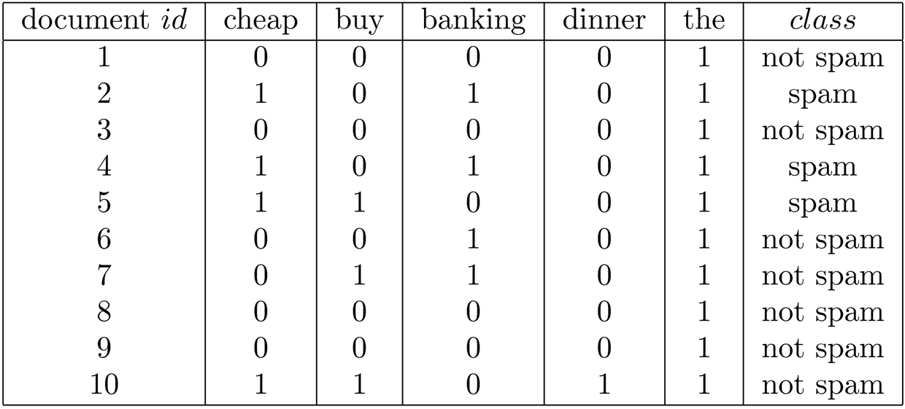
Multiple Bernoulli Document Representation
training data…
some values: P(spam)=3/10, P(not spam)=7/10, P(the|spam)=1,
P(the|not spam)=1, P(dinner|spam)=0, P(dinner|not spam)=1/7,…

Slide 13
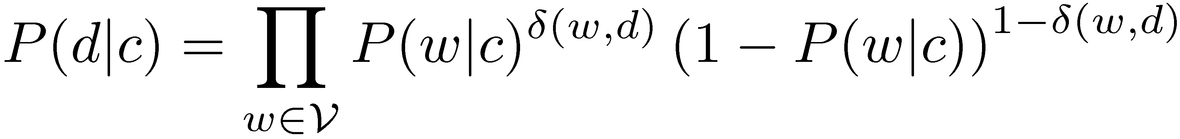
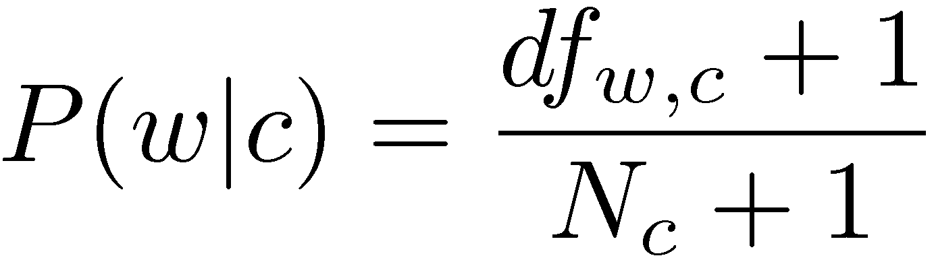
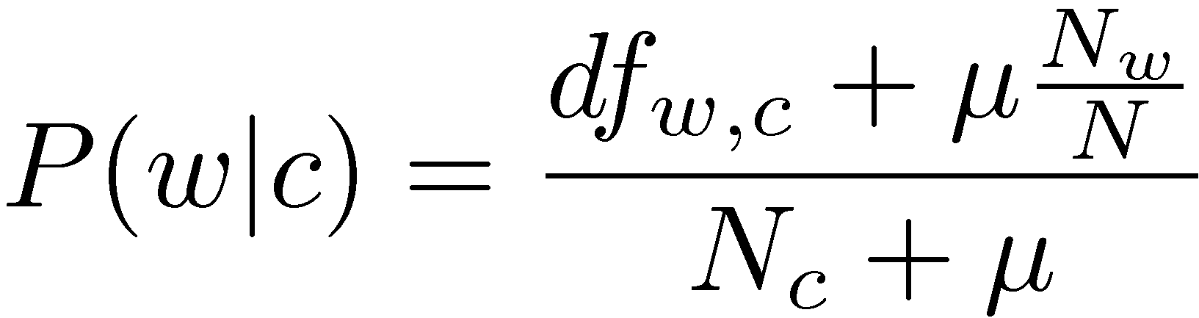
Multiple-Bernoulli: Estimating P(d | c)
P(d | c) is computed as:
Laplacian smoothed estimate:
Collection smoothed estimate:
δ(w,d)=1 iff w ∈ d
problem: if a new spam document
contains "dinner", based on training data
P(dinner|spam)=0, so we'll never mark it
as spam……remember smoothing from
Chapter 7?
N_{w} is # of training docs in which w
appears and μ is a tunable parameter.

Slide 14
Multinomial Event Space
Documents are represented as vectors of term frequencies
One entry for every word in the vocabulary
Entry i = number of times that term i occurs in the document
Multinomial distribution is a natural way to model distributions over frequency vectors
Same event space as used in the language modeling retrieval model

Slide 15
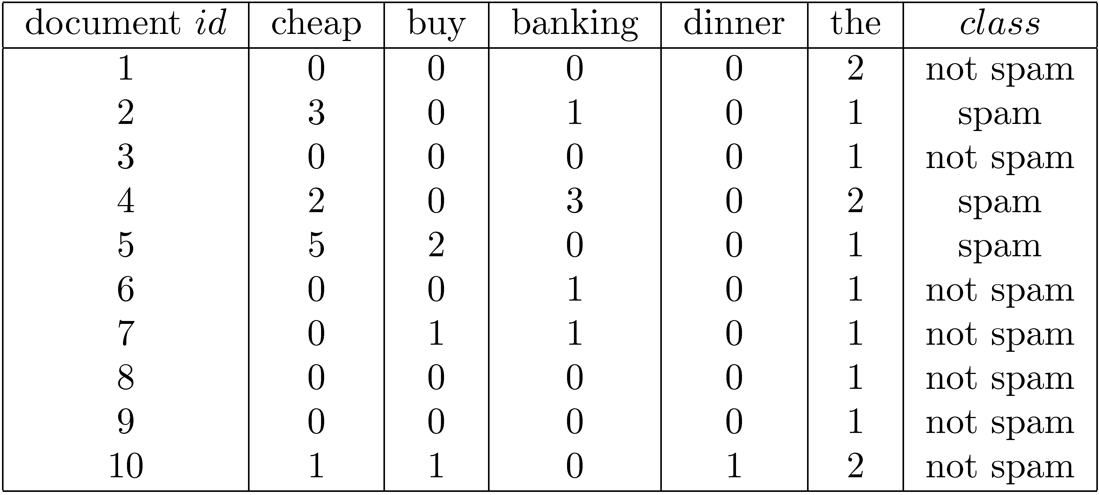
Multinomial Document Representation
training data…larger documents have repeated terms
Q: are tweets suitable for Multiple-Bernoulli?
some values: P(spam)=3/10, P(not spam)=7/10, P(the|spam)=4/20,
P(the|not spam)=9/15,P(dinner|spam)=0, P(dinner|not spam)=1/15,…
note: spam class has 20 terms, not spam class has 15 terms

Slide 16
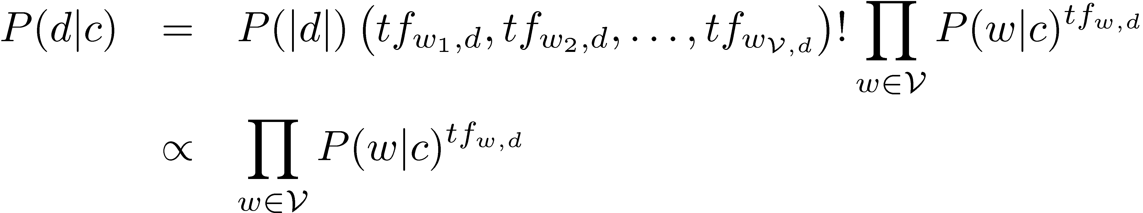
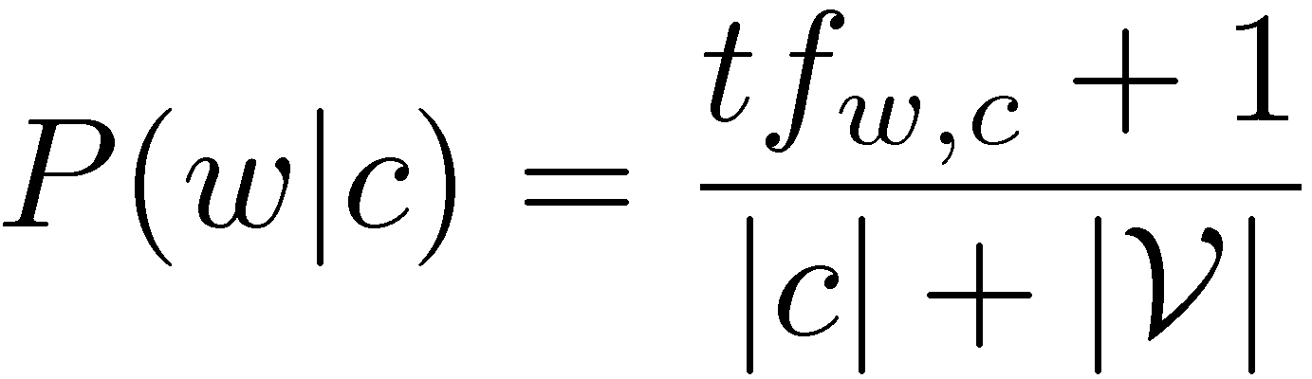
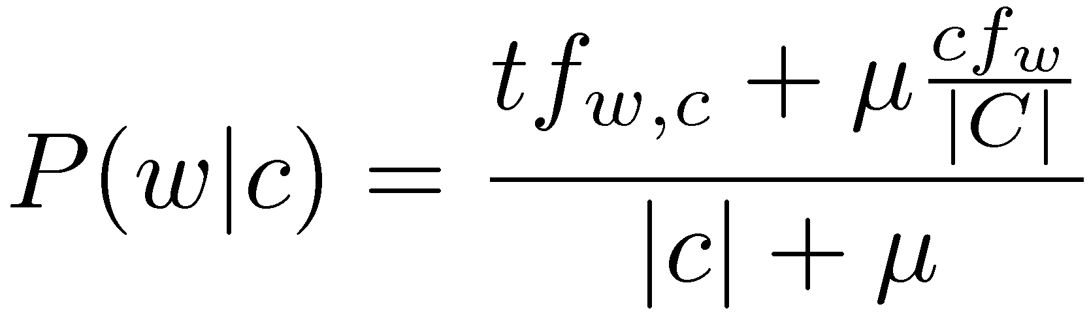
Multinomial: Estimating P(d | c)
P(d | c) is computed as:
Laplacian smoothed estimate:
Collection smoothed estimate:
document dependent
tf_{w,d} = # of times w ∈ d
cf_{w} = # of times w in any training doc;
|C| = total # of terms in all training docs
same as Dirichlet smoothed
language modeling estimate (ch 7)
(applause)

Slide 17
Support Vector Machines
Based on geometric principles
Given a set of inputs labeled ‘+’ and ‘-’, find the “best” hyperplane that separates the ‘+’s and ‘-’s
Questions
How is “best” defined?
What if no hyperplane exists such that the ‘+’s and ‘-’s can be perfectly separated?

Slide 18
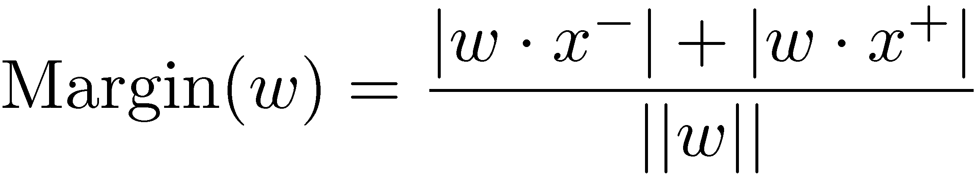
“Best” Hyperplane?
“…a subspace of one dimension
less than its ambient space.”
3D space: 2D hyperplane
2D space: 1D hyperplane
First, what is a hyperplane?
A generalization of a line to higher dimensions
Defined by a vector w
With SVMs, the best hyperplane is the one with the maximum margin
If x⁺ and x⁻ are the closest ‘+’ and ‘-’ inputs to the hyperplane, then the margin is:

Slide 19
Support Vector Machines
w • x > 0
+
+
w • x = 0
–
w • x = 1
w • x = -1
+
–
+
–
+
Margin
–
+
–
+
+
–
–
+
Hyperplane
–
–
–
w • x < 0
+

Slide 20
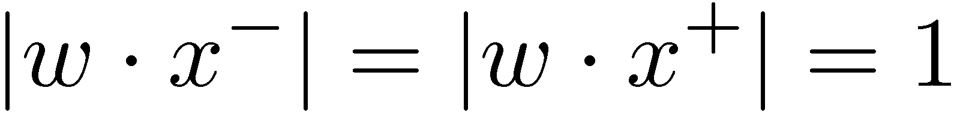
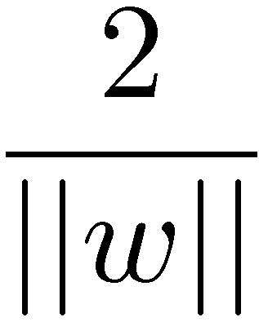
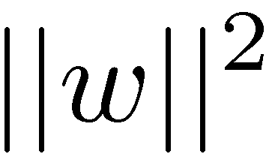
“Best” Hyperplane?
It is typically assumed that , which does not change the solution to the problem
Thus, to find the hyperplane with the largest margin, we must maximize .
This is equivalent to minimizing .
remember:

Slide 21
Separable vs. Non-Separable Data
+
+
–
–
+
+
–
+
+
–
+
–
+
–
+
–
–
–
+
+
+
–
+
–
+
–
–
+
–
+
–
–
+
+
+
+
–
–
–
–
Separable
Non-Separable

Slide 22
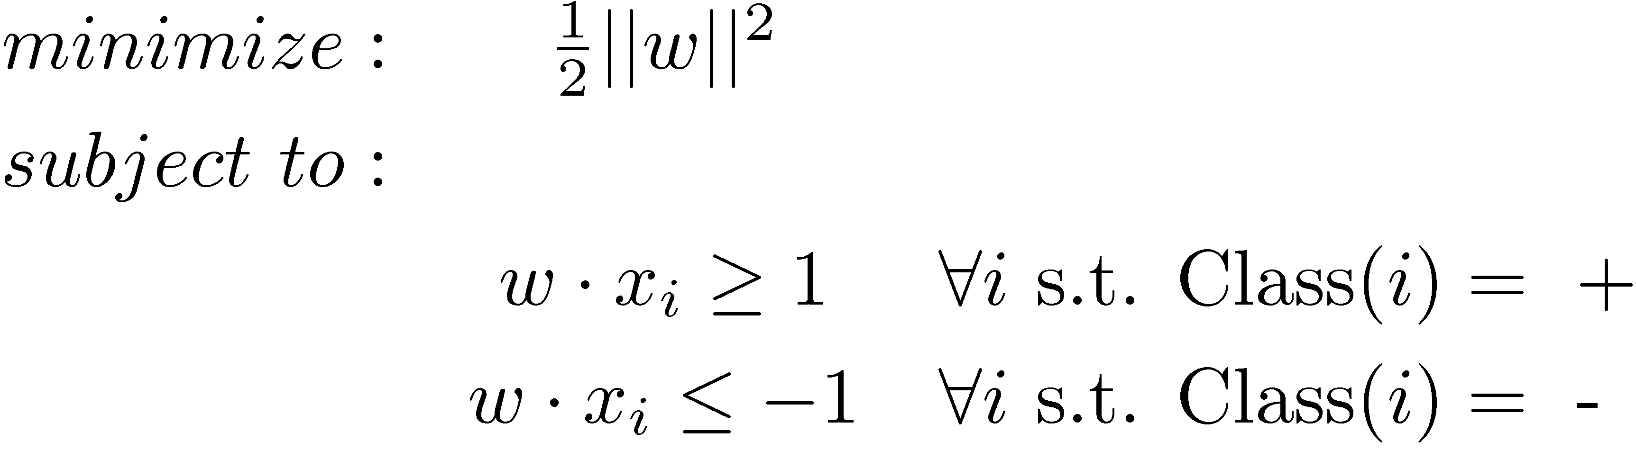
Linear Separable Case
In math:
In English:
Find the largest margin hyperplane that separates the ‘+’s and ‘-’s
remember section 7.6.1 (learning to rank)?

Slide 23
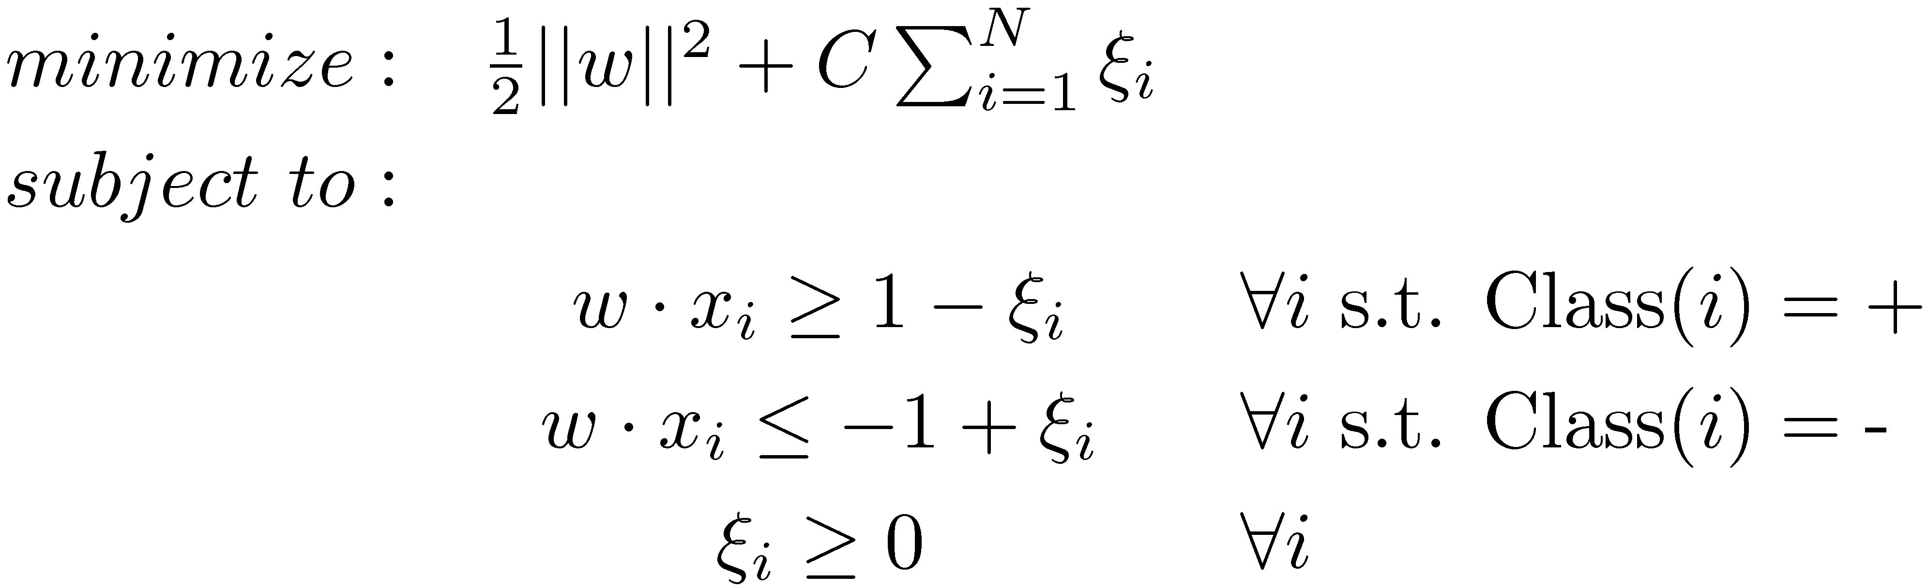
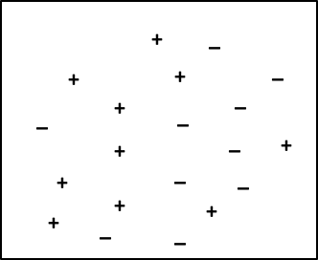
Linearly Non-Separable Case
In math:
In English:
ξ_{i} denotes how misclassified instance i is
Find a hyperplane that has a large margin and lowest misclassification cost
how many are you getting wrong?
ξ_{i}=0? then you're lucky and you have linearly separable data

Slide 24
The Kernel Trick
Linearly non-separable data may become linearly separable if transformed, or mapped, to a higher dimension space
Computing vector math (i.e., dot products) in very high dimensional space is costly
The kernel trick allows very high dimensional dot products to be computed efficiently
Allows inputs to be implicitly mapped to high (possibly infinite) dimensional space with little computational overhead

Slide 25
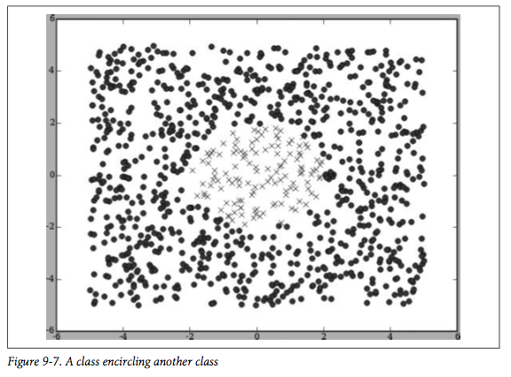
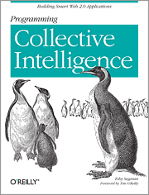
A Linear Classifier Won’t Help
Idea: transform data… convert every (x,y) to (x²,y²)

Slide 26
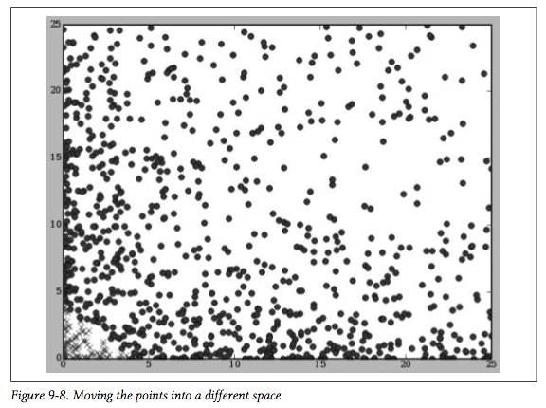
Now a Linear Classifier Will Help…
That was an easy transformation, but what about a transformation
that takes us to higher dimensions? e.g., (x,y) → (x²,xy,y²)

Slide 27
The “Kernel Trick”
We can use linear classifiers on non-linear problems if we transform the original data into higher-dimensional space
http://en.wikipedia.org/wiki/Kernel_trick
Replace the dot product with the radial basis function
http://en.wikipedia.org/wiki/Radial_basis_function
import math
def rbf(v1,v2,gamma=10):
dv=[v1[i]-v2[i] for i in range(len(v1))]
l=veclength(dv)
return math.e**(-gamma*l)

Slide 28
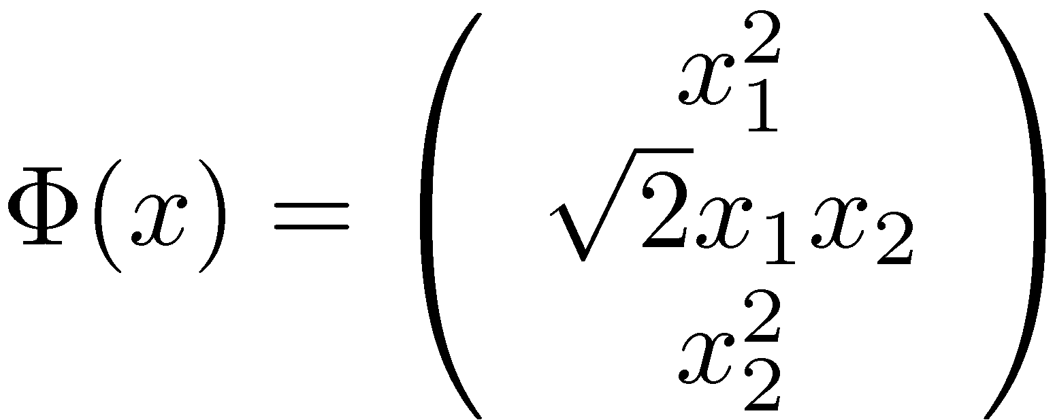
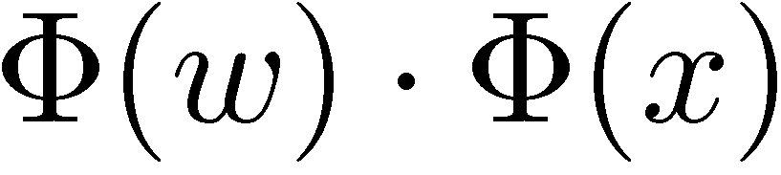
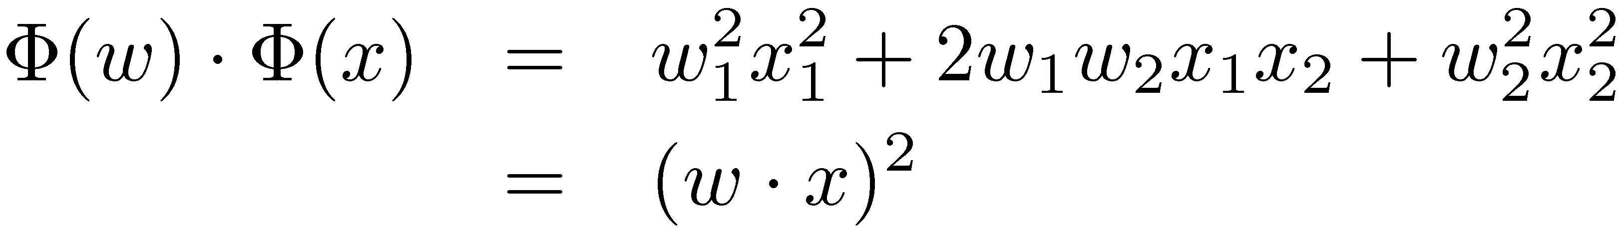
Kernel Trick Example
The following function maps 2-vectors to 3-vectors:
Standard way to compute is to map the inputs and compute the dot product in the higher dimensional space
However, the dot product can be done entirely in the original 2-dimensional space:

Slide 29
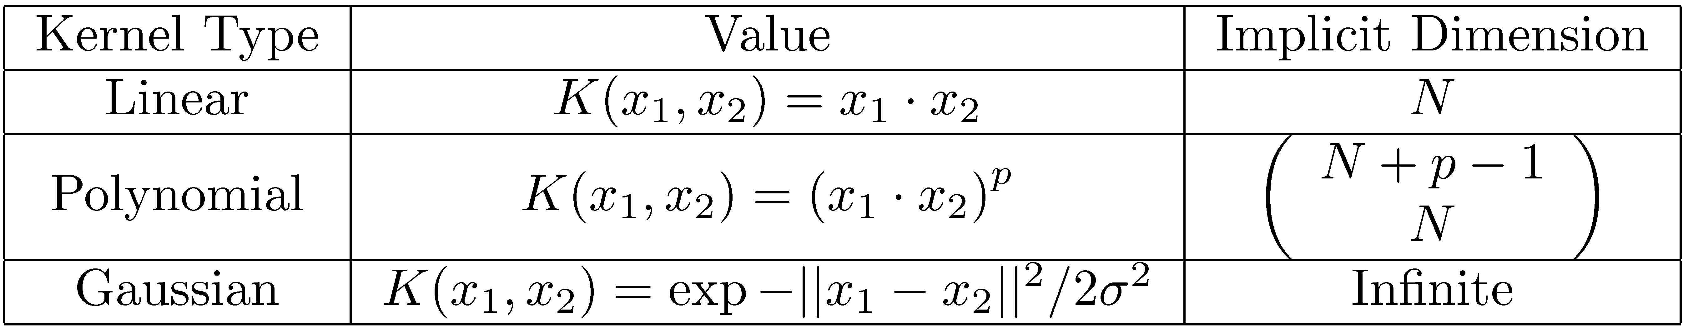
Common Kernels
The previous example is known as the polynomial kernel (with p = 2)
Most common kernels are linear, polynomial, and Gaussian
Each kernel performs a dot product in a higher implicit dimensional space
which kernel should you use? try them and see…

Slide 30
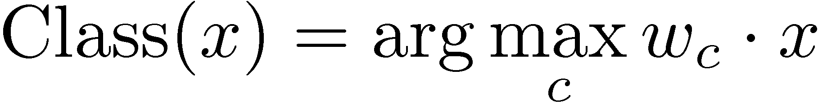
Non-Binary Classification with SVMs
One versus all
Train “class c vs. not class c” SVM for every class
If there are K classes, must train K classifiers
Classify items according to:
One versus one
Train a binary classifier for every pair of classes
Must train K(K-1)/2 classifiers
Computationally expensive for large values of K
classes = {Hokies, Wahoos, Blue Devils, Tar Heels, Monarchs}
classify items by tallying votes from the K(K-1)/2 classifiers

Slide 31
SVM Tools
Solving SVM optimization problem is not straightforward
Many good software packages exist
SVM-Light
LIBSVM
R library
Matlab SVM Toolbox

Slide 32
Evaluating Classifiers
Common classification metrics
Accuracy (precision at rank 1)
Precision
Recall
F-measure
ROC curve analysis
Differences from IR metrics
“Relevant” replaced with “classified correctly”
Microaveraging more commonly used
depending on data, possible to have both high recall & high precision!
1000 Hokies, 20 Wahoos, 5 Blue Devils, 30 Tar Heels, 500 Monarchs
5 classes, 1555 people

Slide 33
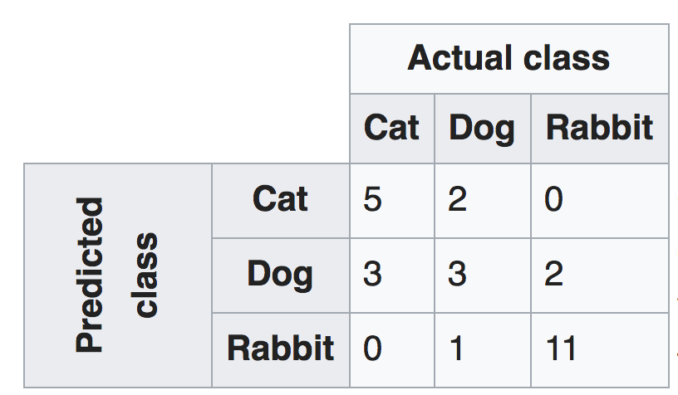
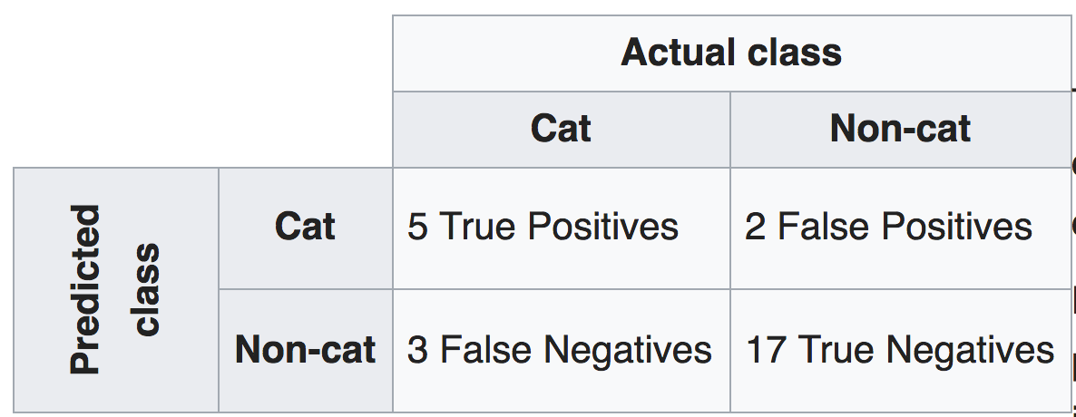
Confusion Matrix
https://en.wikipedia.org/wiki/Confusion_matrix

Slide 34
Classes of Classifiers
Types of classifiers
Generative (Naïve-Bayes)
Discriminative (SVMs)
Non-parametric (nearest neighbor)
Types of learning
Supervised (Naïve-Bayes, SVMs)
Semi-supervised (Rocchio, relevance models)
Unsupervised (clustering)

Slide 35
Generative vs. Discriminative
Generative models
Assumes documents and classes are drawn from joint distribution P(d, c)
Typically P(d, c) decomposed to P(d | c) P(c)
Effectiveness depends on how P(d, c) is modeled
Typically more effective when little training data exists
Discriminative models
Directly model class assignment problem
Do not model document “generation”
Effectiveness depends on amount and quality of training data
not limited by distributional assumptions (e.g., term independence)

Slide 36
Naïve Bayes Generative Process
Class 1
Class 2
Class 3
Generate class according to P(c)
Class 2
Generate document according to P(d|c)

Slide 37
Nearest Neighbor Classification
–
–
+
–
+
–
–
–
–
–
–
+
+
+
+
–
–
+
–
+
+
–
–
+
+
+
–
–
–
–
+
+
+
+
–
–
+
–
+
–
+
+
X
+
–
–
+
+
–
+
–
–
+
+
–
–
+
+
+
–
+
+
–
–
+
–
–

Slide 38
Feature Selection
Document classifiers can have a very large number of features
Not all features are useful
Excessive features can increase computational cost of training and testing
Feature selection methods reduce the number of features by choosing the most useful features

Slide 39
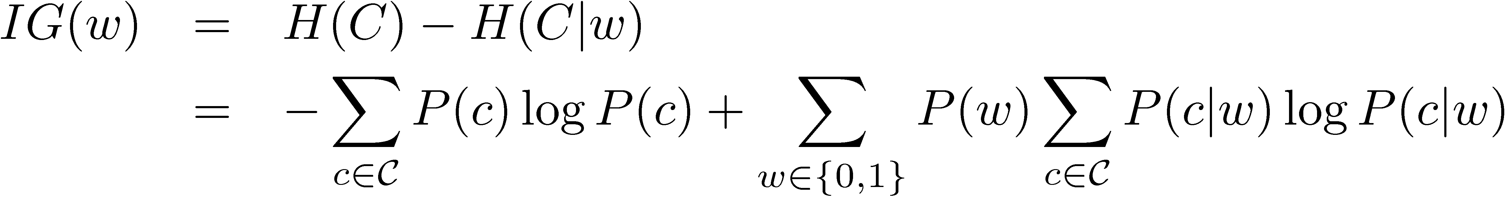
Information Gain
Information gain is a commonly used feature selection measure based on information theory
It tells how much “information” is gained if we observe some feature
Rank features by information gain and then train model using the top K (K is typically small)
The information gain for a Multiple-Bernoulli Naïve Bayes classifier is computed as:
entropy of the class
conditional entropy

Slide 40
Example from p. 363
class = spam
class = ~spam
IG(cheap) = -P(spam)logP(spam) - P(~spam)logP(~spam) +
P(cheap)P(spam|cheap)logP(spam|cheap) +
P(cheap)P(~spam|cheap)logP(~spam|cheap) +
P(~cheap)P(spam|~cheap)logP(spam|~cheap) +
P(~cheap)P(~spam|~cheap)logP(~spam|~cheap)
= -3/10 * log(3/10) - 7/10 * log(7/10) +
4/10 * 3/4 * log(3/4) +
4/10 * 1/4 * log(1/4) +
6/10 * 0/6 * log(0/6) +
6/10 * 6/6 * log (6/6)
IG(cheap) = 0.2749
cheap = 1
cheap = 0
IG(buy) = 0.0008, IG(banking) = 0.0434, IG(dinner) = 0.3612, IG(the) = 0.0

Slide 41
Classification Applications
Classification is widely used to enhance search engines
Example applications
Spam detection
Sentiment classification
Semantic classification of advertisements
Many others not covered here!

Slide 42
Spam, Spam, Spam
Classification is widely used to detect various types of spam
There are many types of spam
Link spam
Adding links to message boards
Link exchange networks
Link farming
Term spam
URL term spam
Dumping
Phrase stitching
Weaving

Slide 43
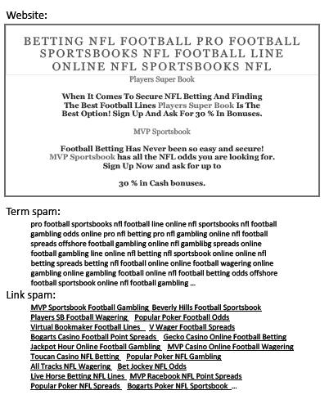
Spam Example

Slide 44
Spam Detection
Useful features
Unigrams
Formatting (invisible text, flashing, etc.)
Misspellings
IP address
Different features are useful for different spam detection tasks
Email and web page spam are by far the most widely studied, well understood, and easily detected types of spam

Slide 45
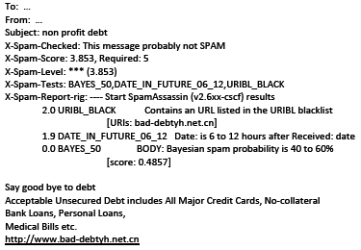
Example Spam Assassin Output

Slide 46
Sentiment
Blogs, online reviews, and forum posts are often opinionated
Sentiment classification attempts to automatically identify the polarity of the opinion
Negative opinion
Neutral opinion
Positive opinion
Sometimes the strength of the opinion is also important
“Two stars” vs. “four stars”
Weakly negative vs. strongly negative

Slide 47
Classifying Sentiment
Useful features
Unigrams
Bigrams
Part of speech tags
Adjectives
SVMs with unigram features have been shown to be outperform hand built rules
Pang et al. 2002: unigrams w/ SVM performed best
multiple-Bernoulli also performed better than multinomial;
presumably b/c sentiment terms rarely appear more than once
80% SVM accuracy, 60% hand-built accuracy

Slide 48
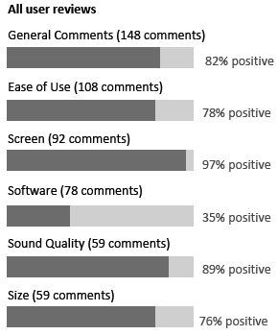
Sentiment Classification Example

Slide 49
Classifying Online Ads
Unlike traditional search, online advertising goes beyond “topical relevance”
A user searching for ‘tropical fish’ may also be interested in pet stores, local aquariums, or even scuba diving lessons
These are semantically related, but not topically relevant!
We can bridge the semantic gap by classifying ads and queries according to a semantic hierarchy

Slide 50
Semantic Classification
Semantic hierarchy ontology
Example: Pets / Aquariums / Supplies
Training data
Large number of queries and ads are manually classified into the hierarchy
Nearest neighbor classification has been shown to be effective for this task
Hierarchical structure of classes can be used to improve classification accuracy
hierarchy manually constructed!
6000+ classes
Broder et al. 2007: SVM on 6000+ classes can be slow to run.
Alternative: define query as either query or doc to be classified, and
corpus as 6000+ classes, and use conventional cosine & TFIDF as NN

Slide 51
Semantic Classification
Aquariums
match ad with doc because
they share "Aquarium" as
least common ancestor
Fish
Supplies
Rainbow Fish Resources
Discount Tropical Fish Food
Feed your tropical fish a gourmet diet for just pennies a day!
www.cheapfishfood.com
Web Page
Ad
classified: Aquariums / Fish
classified: Aquariums / Supplies

Slide 52
Clustering
A set of unsupervised algorithms that attempt to find latent structure in a set of items
Goal is to identify groups (clusters) of similar items
Suppose I gave you the shape, color, vitamin C content, and price of various fruits and asked you to cluster them
What criteria would you use?
How would you define similarity?
Clustering is very sensitive to how items are represented and how similarity is defined!

Slide 53
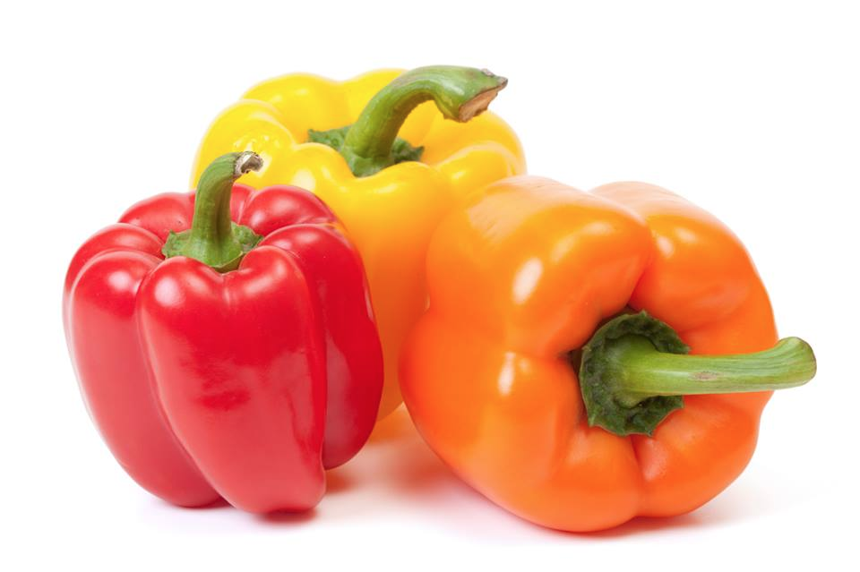
Example from p. 374
Clustering fruit…
"red" cluster = {red grapes, red apples}
"yellow" cluster = {bananas, squash}
now you encounter an orange…
cluster with red or yellow?
create a new cluster?
then you encounter these…
perhaps you’ve identified the
wrong features?
http://www.medicalmedium.com/blog/bell-peppers

Slide 54
Clustering
General outline of clustering algorithms
Decide how items will be represented (e.g., feature vectors)
Define similarity measure between pairs or groups of items (e.g., cosine similarity)
Determine what makes a “good” clustering
Iteratively construct clusters that are increasingly “good”
Stop after a local/global optimum clustering is found
Steps 3 and 4 differ the most across algorithms

Slide 55
Hierarchical Clustering
Constructs a hierarchy of clusters
The top level of the hierarchy consists of a single cluster with all items in it
The bottom level of the hierarchy consists of N (# items) singleton clusters
Two types of hierarchical clustering
Divisive (“top down”)
Agglomerative (“bottom up”)
Hierarchy can be visualized as a dendogram

Slide 56
Example Dendrogram
M
L
K
J
I
H
A
B
C
D
E
F
G

Slide 57
Divisive and Agglomerative Hierarchical Clustering
Divisive
Start with a single cluster consisting of all of the items
Until only singleton clusters exist…
Divide an existing cluster into two new clusters
Agglomerative
Start with N (# items) singleton clusters
Until a single cluster exists…
Combine two existing cluster into a new cluster
How do we know how to divide or combined clusters?
Define a division or combination cost
Perform the division or combination with the lowest cost

Slide 58
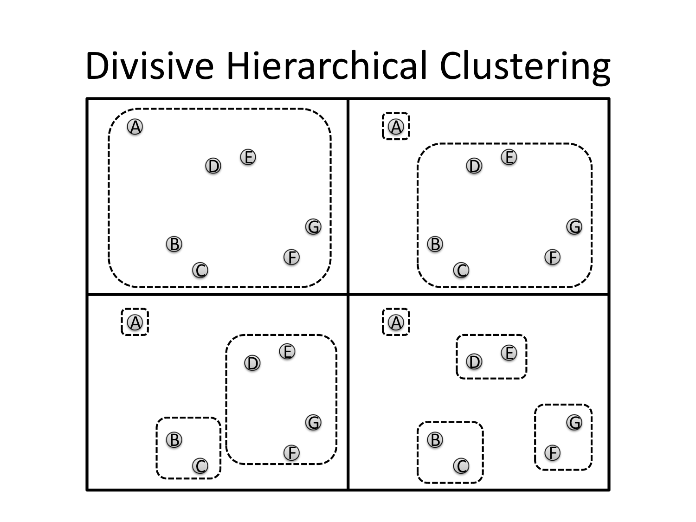
Divisive Hierarchical Clustering
A
A
D
E
D
E
G
G
B
B
F
F
C
C
A
A
D
E
D
E
G
G
B
B
F
F
C
C
new slide from errata

Slide 59
Agglomerative Hierarchical Clustering
A
A
D
E
D
E
G
G
B
B
F
F
C
C
A
A
D
E
D
E
G
G
B
B
F
F
C
C

Slide 60
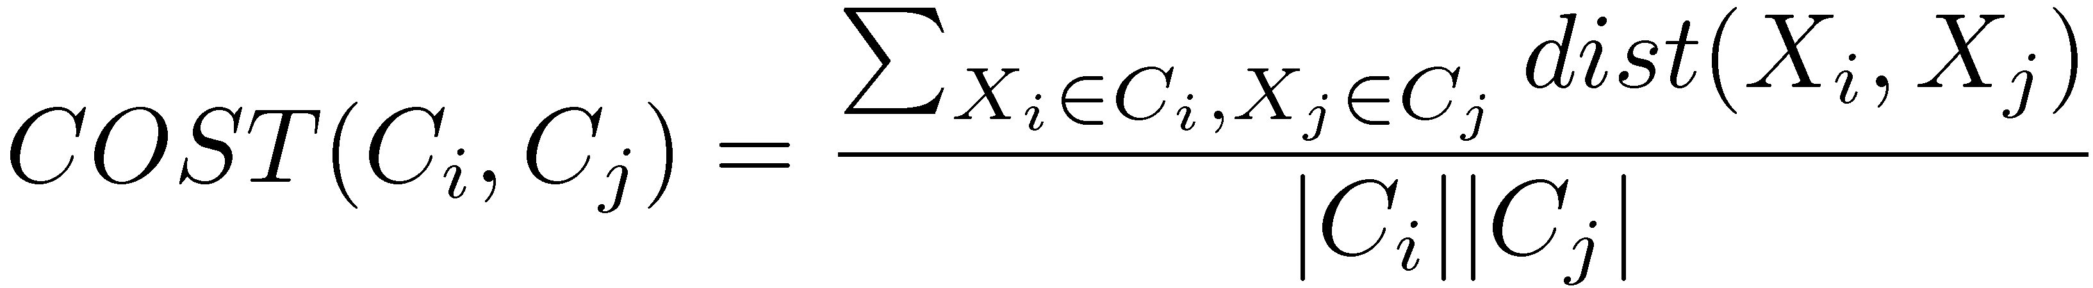
Clustering Costs
Single linkage
Complete linkage
Average linkage
Average group linkage

Slide 61
Clustering Strategies
Single Linkage
Complete Linkage
A
A
D
E
D
E
D
E
ex: compute BD, BE,
CD, CE, take maximum
of all (CE)
ex: compute BD, BE,
CD, CE, take minimum
of all (BD)
G
G
B
B
B
F
F
C
C
C
Average Linkage
Average Group Linkage
A
μ
D
E
μ
compute average across
all instances in a cluster
(microaverage)
compute cluster centroid
(macroaverage)
G
B
μ
F
μ
C

Slide 62
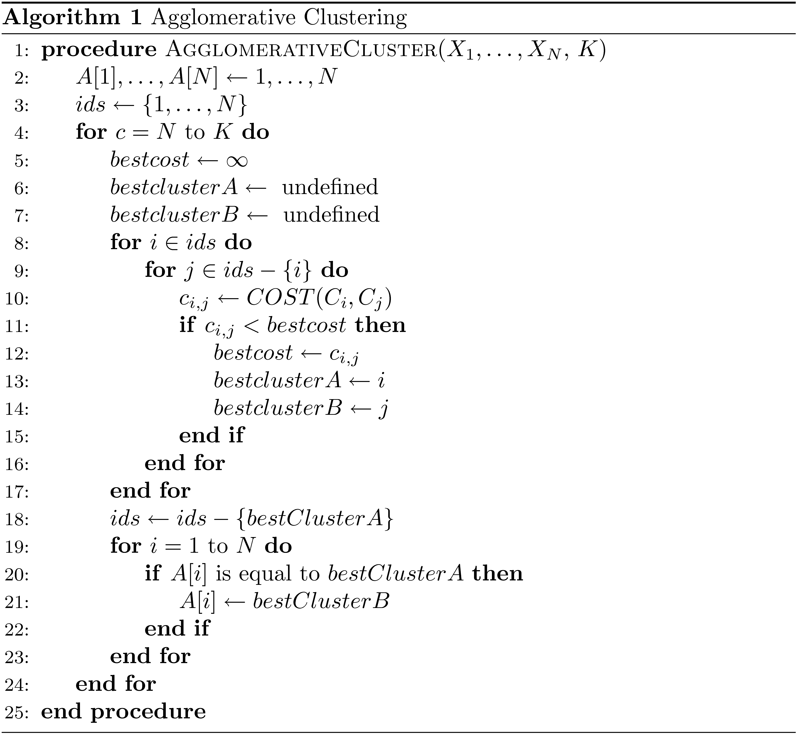
Agglomerative Clustering Algorithm

Slide 63
K-Means Clustering
Hierarchical clustering constructs a hierarchy of clusters
K-means always maintains exactly K clusters
Clusters represented as centroids (“center of mass”)
Basic algorithm:
Step 0: Choose K cluster centroids
Step 1: Assign points to closet centroid
Step 2: Recompute cluster centroids
Step 3: Goto 1
Tends to converge quickly
Can be sensitive to choice of initial centroids
Must choose K!

Slide 64
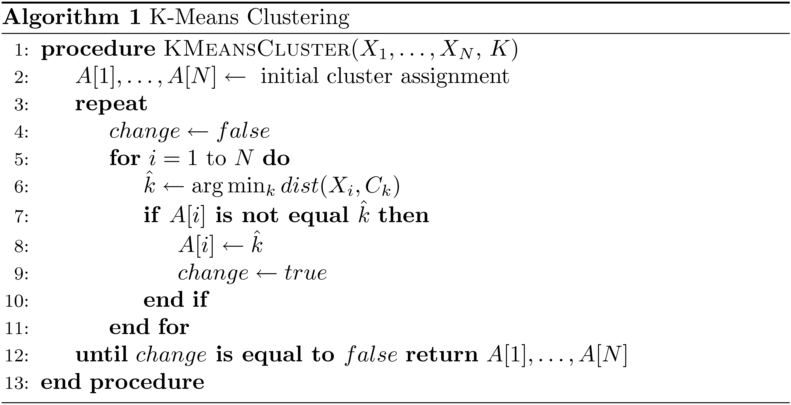
K-Means Clustering Algorithm

Slide 65
K-Means Clustering
Hierarchical clustering:
is computationally expensive
needs additional work to figure out the right “groups”
K-Means clustering:
groups data into k clusters
how do you pick k? well… how many clusters do you think you might need?
n.b. results are not always the same!

Slide 66
Example k=2 (cf. fig 3-5)
A
B
A
B
C
C
F
F
D
D
Step 1: randomly drop
2 centroids in graph
Step 2: every item is assigned
to the nearest centroid

Slide 67
Example k=2 (cf. fig 3-5)
A
B
A
B
C
C
F
F
D
D
Step 3: move centroids to
the “center” of their group
Step 4: recompute item /
centroid distance
Step 5: process is done when
reassignments stop

Slide 68
K-Nearest Neighbor Clustering
Hierarchical and K-Means clustering partition items into clusters
Every item is in exactly one cluster
K-Nearest neighbor clustering forms one cluster per item
The cluster for item j consists of j and j’s K nearest neighbors
Clusters now overlap
K-NN good for "find K things like this" (i.e., precision)

Slide 69
5-Nearest Neighbor Clustering
A
A
A
A
D
A
D
A
D
D
D doesn't really have
5 "good" neighbors;
K=5 is a stretch
C
K=3 would be better for C;
the last 2 items aren't as
close as the first 3
B has at least 6 good
neighbors; K=5 is too
small
B
B
C
C
B
C
D
B
D
B
B
C
C

Slide 70
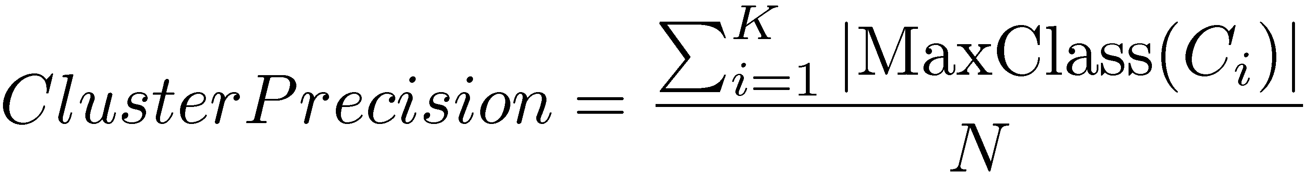
Evaluating Clustering
Evaluating clustering is challenging, since it is an unsupervised learning task
If labels exist (e.g., spam & ~spam), can use standard IR metrics, such as precision and recall
If not, then can use measures such as “cluster precision”, which is defined as:
Another option is to evaluate clustering as part of an end-to-end system (i.e., does it improve ranking or some other task/function)
MaxClass(C_{i}) is the (human
assigned) most frequent, and
thus true, label of C_{i}

Slide 71
How to Choose K?
K-means and K-nearest neighbor clustering require us to choose K, the number of clusters
No theoretically appealing way of choosing K
Depends on the application and data
Can use hierarchical clustering and choose the best level of the hierarchy to use
Can use adaptive K for K-nearest neighbor clustering
Define a ‘ball’ around each item
Difficult problem with no clear solution

Slide 72
Adaptive Nearest Neighbor Clustering
A
A
Parzen windows
D
B
B
C
C
B
C
B
B
B
C
C

Slide 73
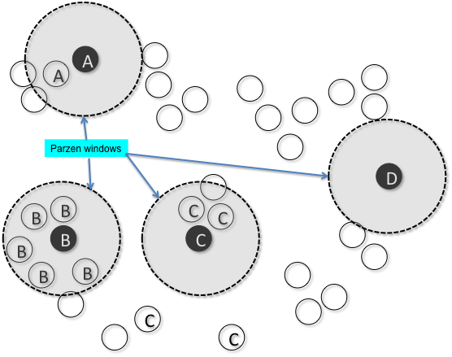
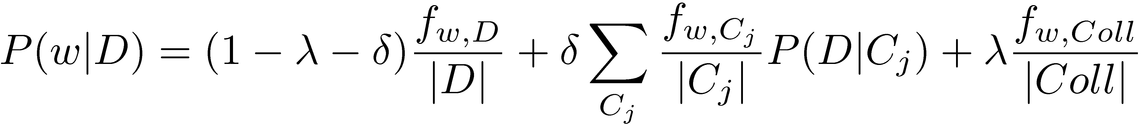
Clustering and Search
Cluster hypothesis
“Closely associated documents tend to be relevant to the same requests” – van Rijsbergen ‘79
Tends to hold in practice, but not always
Two retrieval modeling options
Retrieve clusters according to P(Q | C_{i})
Smooth documents using K-NN clusters:
Smoothing approach more effective
cf. online ads, slide 49
clusters form "super documents".
find right cluster, then rank
individual documents within the
cluster
model from 7.3.1, but with the
additional term for clusters
(multiple, overlapping clusters)

Slide 74
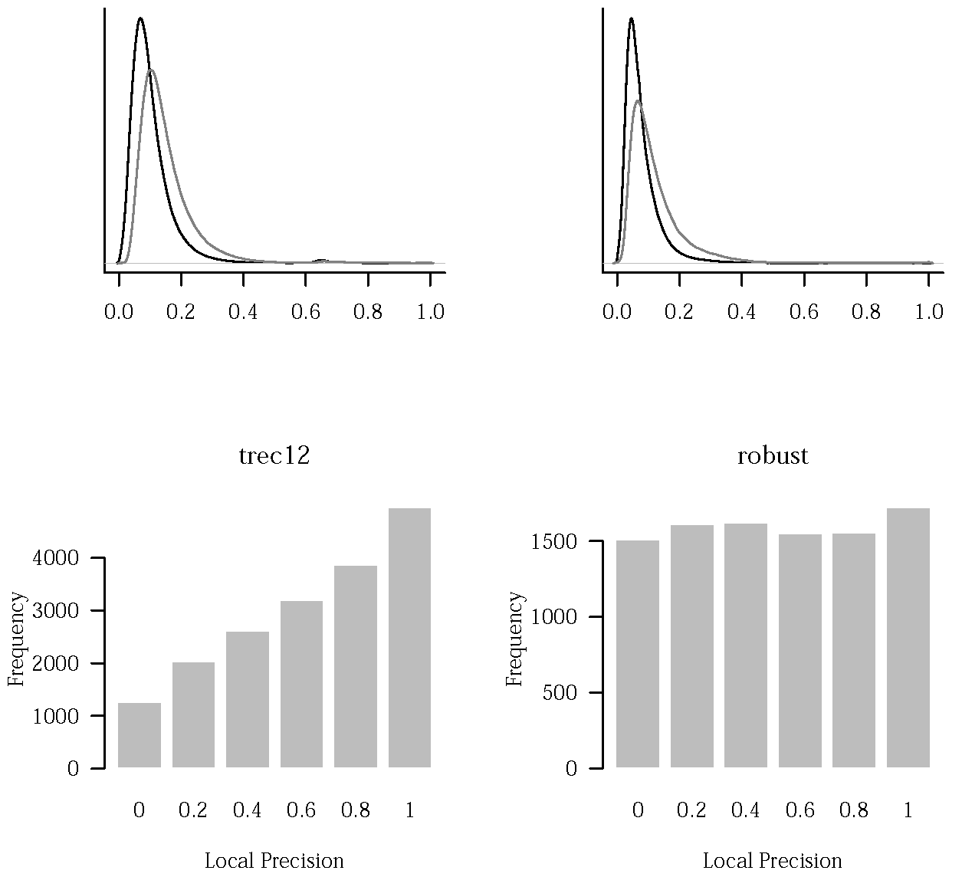
Testing the Cluster Hypothesis
rel-rel pair similarity (black)
rel-nonrel pair similarity (grey)
rel-rel & rel-nonrel pair similarity (top)
do not seem to support the cluster
hypothesis for either collection.
However, local precision seems to
support it for trec12 but not robust.
similarity
similarity
local precision =
similarity of 5-NN

