Slide 1
Understanding Web Archiving Services and Their (Mis)Use on Social Media
2019-05-01
CS795/895
Puneeth Bikkasandra
Old Dominion University

Slide 2
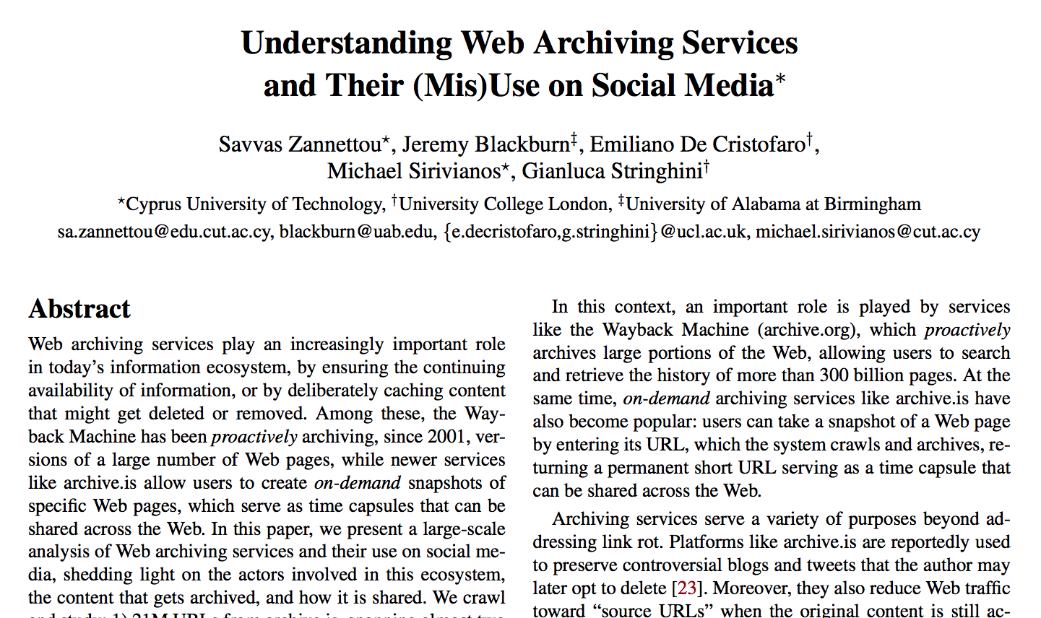
Source: https://arxiv.org/pdf/1801.10396.pdf

Slide 3
Targeted Research Questions:
How are archive URLs disseminated across popular social networks?
What kind of content gets archived, by whom and why?
Are archiving services misused in any way?
https://arxiv.org/pdf/1801.10396.pdf

Slide 4
Archives:
archive.is: on-demand archival service, link shortener hides source URL.
Hosted by: Hostkey (Russian Provider)
Content removal complies with DMCA take down requests.
Wayback Machine: on-demand, proactive crawler.
Owned by: Internet Archive
Respects robots.txt and content removal by website owners.
https://arxiv.org/pdf/1801.10396.pdf

Slide 5
Social Networks:
Twitter:
micro-blogging social network,
users share tweets to their followers.
Reddit:
Social news-aggregator, users post URLs with title.
Posts are up/down voted deciding the order
4chan:
Image board discussion forum, users are anonymous (country or troll flags)
Politically Incorrect board (/pol/) is chosen.
Gab:
Champion free speech with free flow of information.
Voting for popularity content, attracts alt-right users, declined by Google & Apple
https://arxiv.org/pdf/1801.10396.pdf

Slide 6
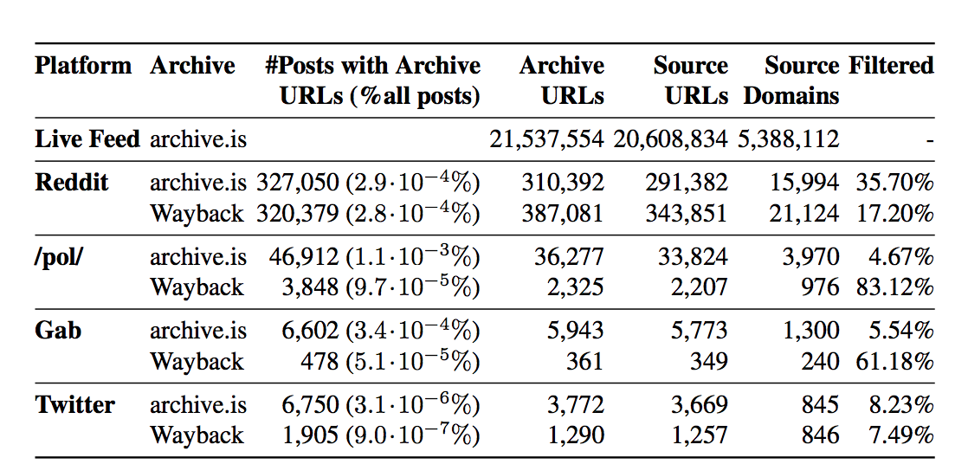
Dataset
21 Million URLs from the archive.is live feed - http://archive.is/livefeed/
356K archive.is + 391K Wayback Machine URLs
Source: Table1 - https://arxiv.org/pdf/1801.10396.pdf

Slide 7
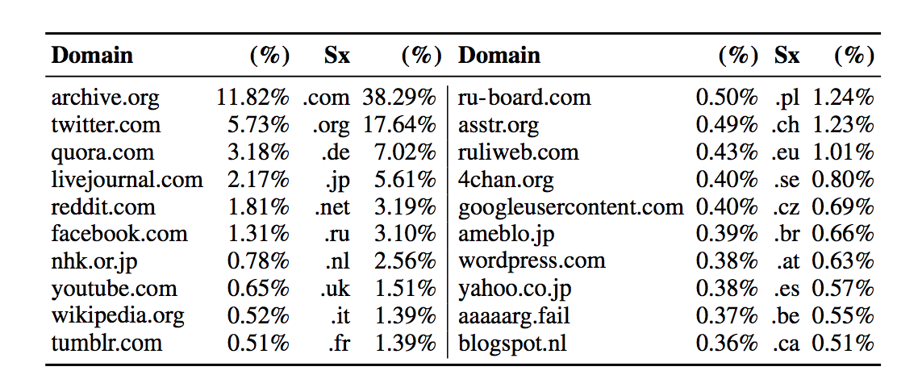
Cross Platform Analysis:
Source: Table 2 - https://arxiv.org/pdf/1801.10396.pdf

Slide 8
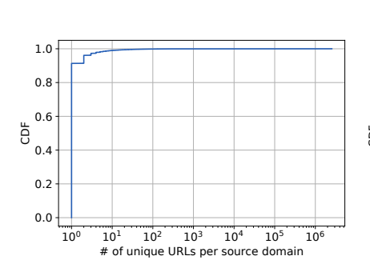
Archive.is Live feed:
Number of distinct URLs per source domain
Extract the domain categories of source URLs using the free Virus Total API (virustotal.com).
Categorization is done at domain-level, results are presented at a per-URL level.
A URL is assigned the same category as its domain
https://arxiv.org/pdf/1801.10396.pdf

Slide 9
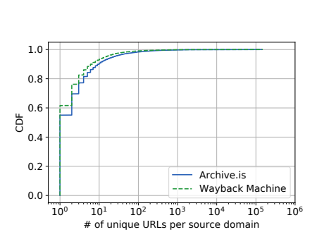
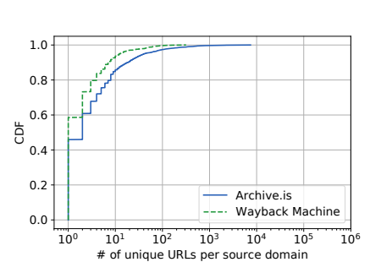
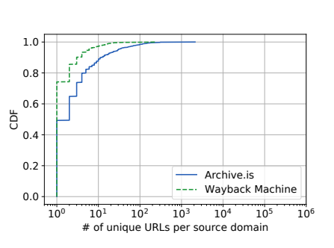
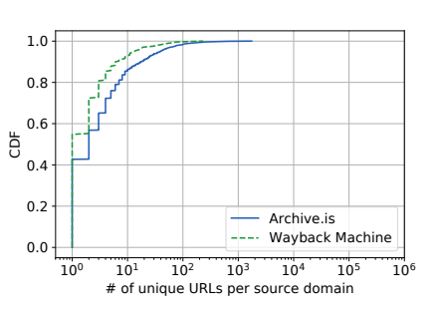
Reddit, /pol/, Twitter and Gab CDF
Source: Figure 1 - https://arxiv.org/pdf/1801.10396.pdf

Slide 10
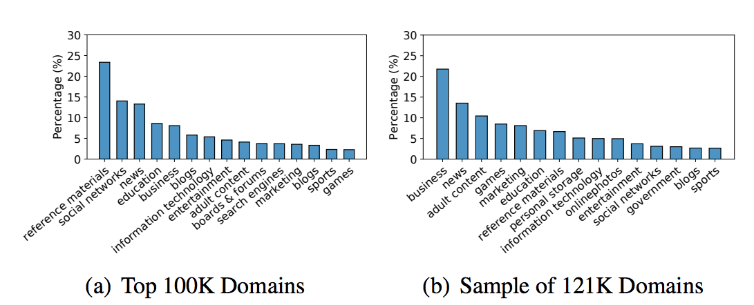
URL Characterization for archive.is live feed:
Source: Figure 2 - https://arxiv.org/pdf/1801.10396.pdf

Slide 11
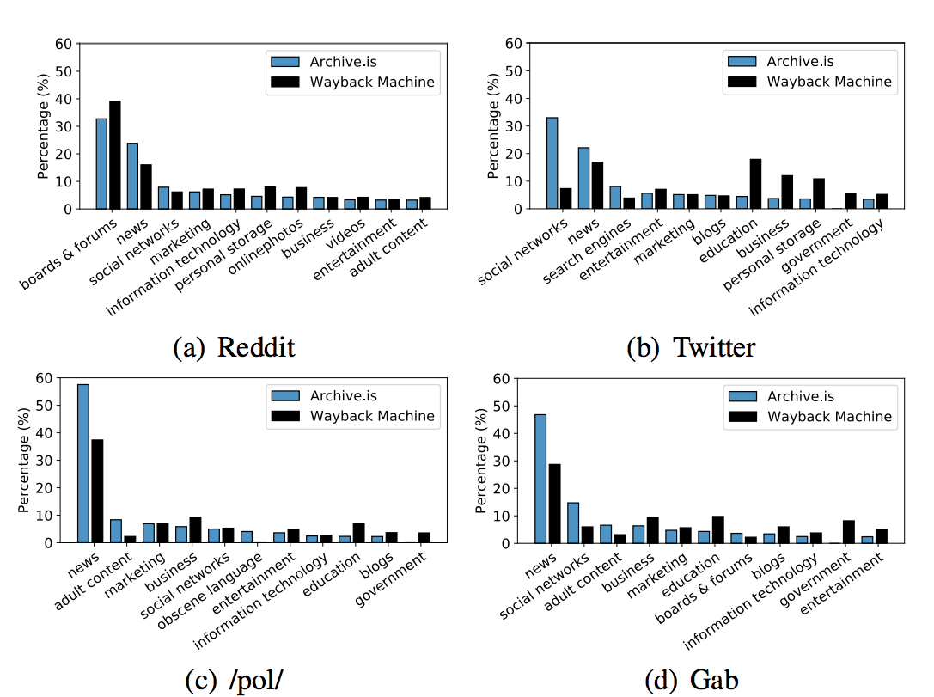
Domain Categories in Social Networks:
Source: Figure 3 - https://arxiv.org/pdf/1801.10396.pdf

Slide 12
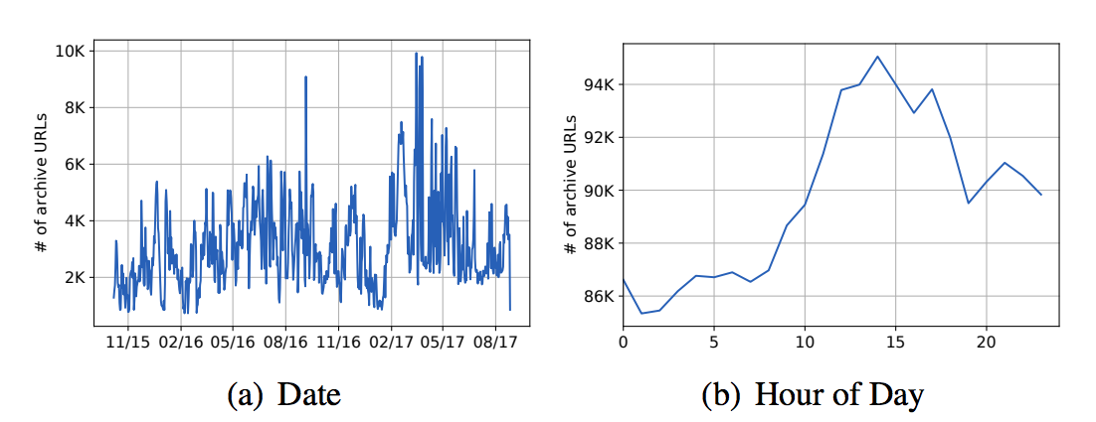
Temporal Dynamics:
Temporal analysis of the archive.is live feed, reporting the number of URLs that are archived each day and on hour of day.
Source: Figure 4 - https://arxiv.org/pdf/1801.10396.pdf

Slide 13
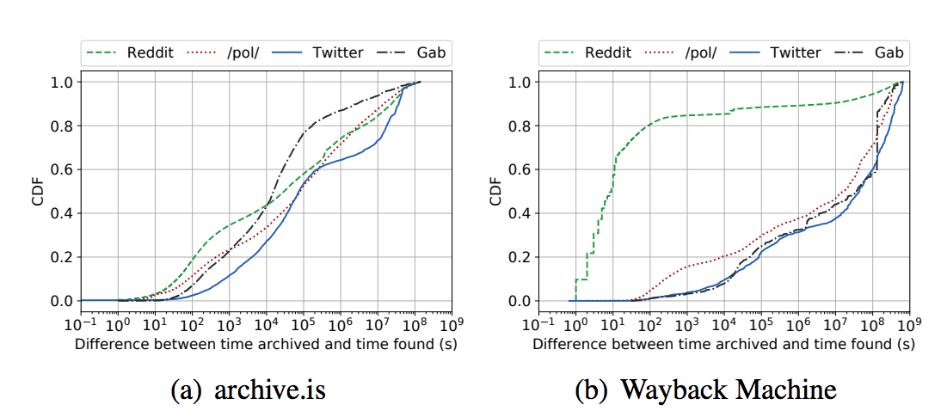
Temporal Dynamics for Social Networks:
Time difference between the archival time and the time appeared on each of the four social networks.
Source: Figure 5 - https://arxiv.org/pdf/1801.10396.pdf

Slide 14
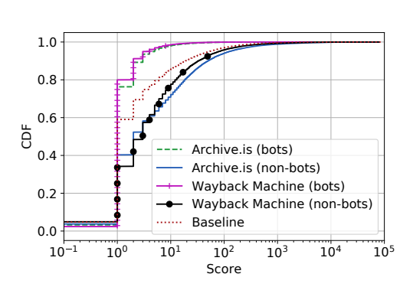
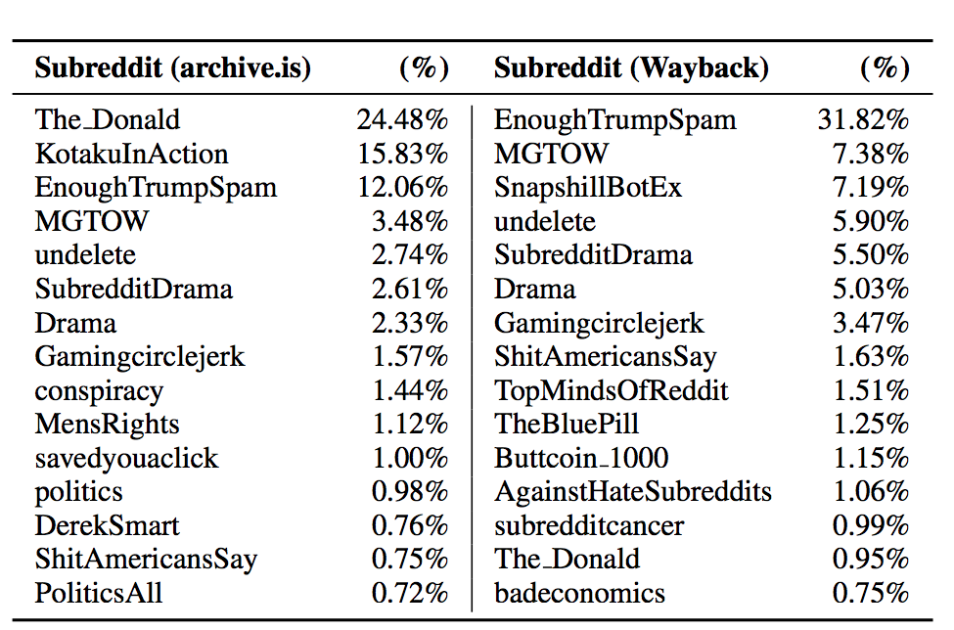
Social Networking Analysis - User Base:
Top 15 subreddits sharing archive.is and Wayback Machine URLs.
Plot showing the scores of posts that include archive.is and Wayback Machine URLs.
Source: Table 7 - https://arxiv.org/pdf/1801.10396.pdf

Slide 15
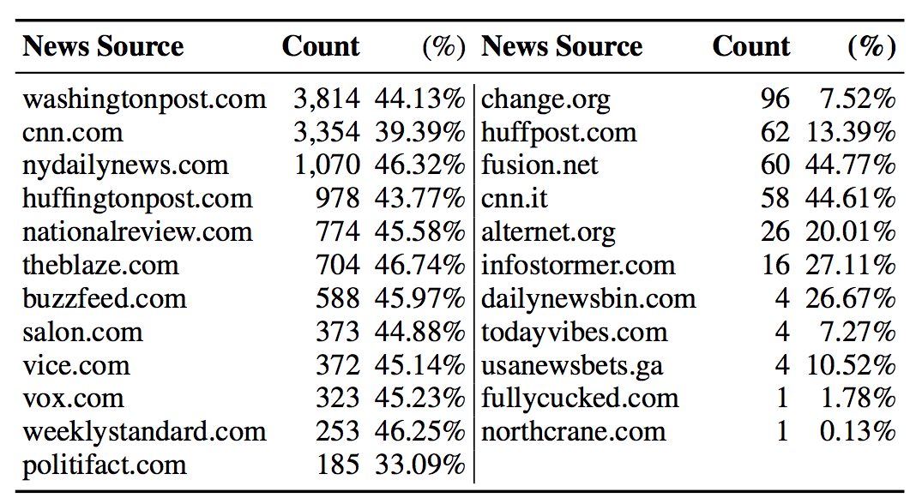
Social Networking Analysis - Deleted in subreddit ‘The_Donald’:
Submissions deleted from The Donald with links to below news sources
Source: Table 8 - https://arxiv.org/pdf/1801.10396.pdf

Slide 16
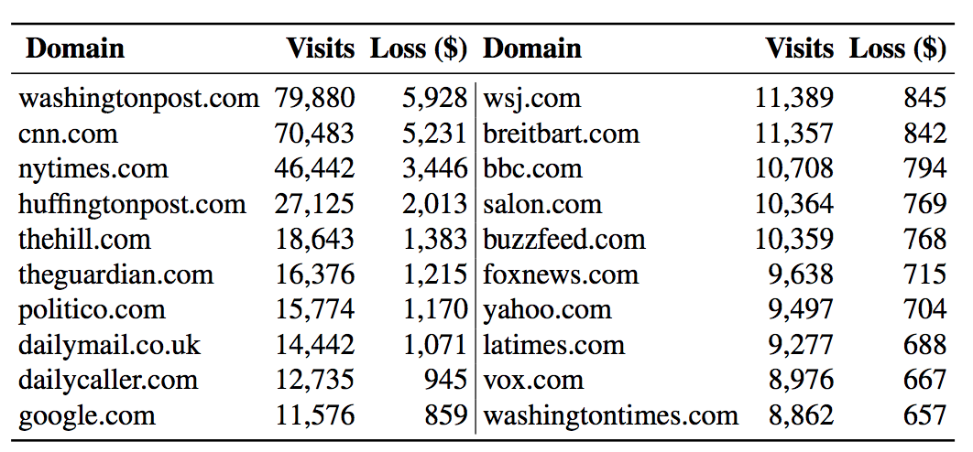
Social Networking Analysis - Ad Revenue Deprivation:
Top 20 domains with the largest ad revenue losses because of the use of archiving services on Reddit.
Source: Table 9 - https://arxiv.org/pdf/1801.10396.pdf

Slide 17
Take Away:
Commonly archived content - News and social media posts.
Archived URLs are mostly shared on “fringe” communities within above discussed social networks favoring archive.is URLs and to bypass censorship policies in some platforms.
Bots are responsible for posting large portion of archive URLs.The_Donald subreddit targets ad revenue of news sources by blocking URLs and instead suggest users to post archive URLs.
It is estimated that Washington Post lose $70K/yr from their ad revenue because of the use of archiving services.

