Slide 1

PhoneGap
... an easier way to make iPhone apps? and more.
Jesse MacFadyen

Slide 2
What is PhoneGap?
It's a tool for building mobile apps using web-tech.
  HTML for layout ( Better yet HTML5 )
  JavaScript for accessing device functionality
  CSS for rich look and feel. ( Better yet CSS3 )

Slide 3
What is PhoneGap?
It's a collection of tools + a consistent cross-device API
    Use the same JavaScript calls to access device functions.
navigator.notification.vibrate();
    Standards based ( W3C - why is this important?)

Slide 4
In the begining ...
  Nitobi was excited by the game-changing iPhone.
  Not excited by the lame-changing Objective-C
    Objective-C is powerful, and good to know, but can you afford to train your whole team of developers?
  @ iPhone Dev Camp in 2008 ( Brian, Brock, Rob, Eric )
    The basis of iPhone - PhoneGap was built in a weekend, and could access GeoLocation and Accelerometer data.

Slide 5
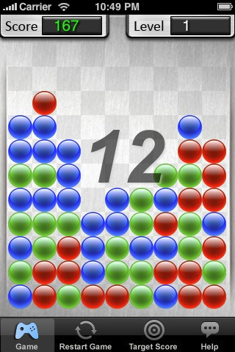
So PhoneGap apps are just web pages?
- Yes, web pages that access device functionality.
- Apps can still provide a rich experience, especially with CSS transitions and tweening animations. Web tricks like CSS Sprites too!
- CSS Transitions are hardware accelerated on the iPhone!
- There are games built with PhoneGap!
Bubble Drop >>

Slide 6
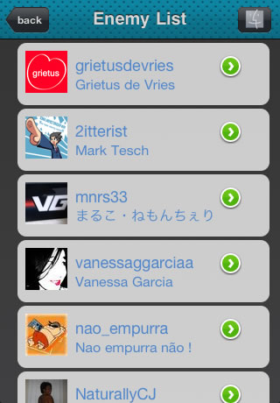
Native Looking?
You can also use JavaScript libraries.
Like:
  jQuery
  MooTools
  XUI
  jQTouch
  ...

Slide 7
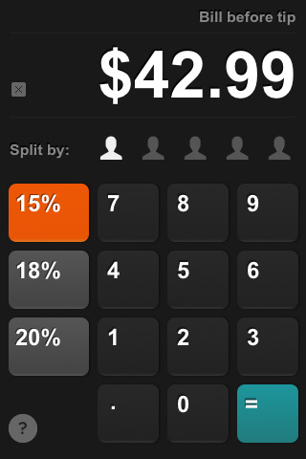
Rich UI ? Rich UX ?
Just because it's a web page doesn't mean it should look like a web page!
Images are usually loaded from the device, so it's quick.
Interaction is quick if you use touch events instead of click events.

Slide 8
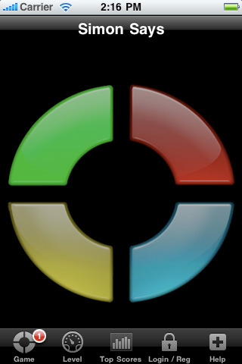









Show me more!

Slide 9
How many PhoneGap apps are there?
  We don't know ... we only know it's a PhoneGap app if we're told.
  My guess : Thousands
  We will post a link to your App on PhoneGap.com if you ask us (nicely)

Slide 10
What Device functions are available?
On iPhone:
  GeoLocation
  Compass ( for 3GS )
  Accelerometer
  Telephony
  Camera
  Media Playback + Recording
  Contacts ( read-only )
  Video with HTML5 Video tag
  FileIO ( local application documents folder )
    Cache images or data from the web

Slide 11
What is the architecture of a typical PhoneGap app built by Nitobi?
  There is usually a server component involved.
  JavaScript calls the server via XHR to get JSON data.
  HTML/JS/CSS + graphic assets are on the device, packaged as part of the build process.
  JavaScript can store retrieved data in a SQLite database for offline access.
  JavaScript can cache images too.

Slide 12
How is PhoneGap different than a mobile web site?
  Mobile websites are domain restricted to their origin url and cannot access other sites/APIs
  PhoneGap applications are loaded from the file:// protocol so server requests are NOT restricted.
  With PhoneGap you can build powerful mashups accessing multiple services.
Twickr ? Flitter ? FaceTube ?

Slide 13
How much does it cost?
  It's free, and open-sourced under the MIT license.
  Free to use, Free to sell, Free to modify, Free to contribute
How does Nitobi make money?
  PhoneGap is the tool that we use to deliver apps to our paying clients.
  When possible, we roll our client based additions back into the community.
  We provide PhoneGap training + support.

Slide 14
Where can I get it?
More info:
http://phonegap.com/
The mailing list / google group
http://groups.google.com/group/phonegap
The repo, fork it
http://github.com/phonegap/phonegap-iphone
The tutorial app
http://github.com/purplecabbage/Jestitute
Nitobi
http://nitobi.com/

Slide 15
Questions?
Jesse MacFadyen
jesse@nitobi.com
blogs.nitobi.com/jesse
twitter.com/purplecabbage
myspace.com/risingj

