Slide 1

Orbital
Live Aircraft, Ship & Satellite Tracking
CSC480 · Team Orbital ·

Slide 2
The Problem: Fragmented & Closed
Live tracking data for aircraft, ships, and satellites does exist — but it's scattered across siloed APIs, raw and unprocessed, metered by strict rate limits, and locked behind commercial paywalls. No free tool shows all three on a single map.
Fragmented
Raw
Data lives in separate, incompatible sources
Unprocessed, inconsistent formats
Metered
Closed
Strict rate limits on every API
Commercial gatekeeping blocks free access

Slide 3

Architecture & Methodology
Orbital is built on a strictly one-directional pipeline also known as Incremental Development: data flows Ingestion → API → Frontend. Each layer has a single responsibility, and the frontend never touches a raw external source.
Ingestion
API
Frontend
A single shared data shape unifies aircraft, satellites, and ships — so adding a new object type costs one ingestion module and zero frontend changes.

Slide 4
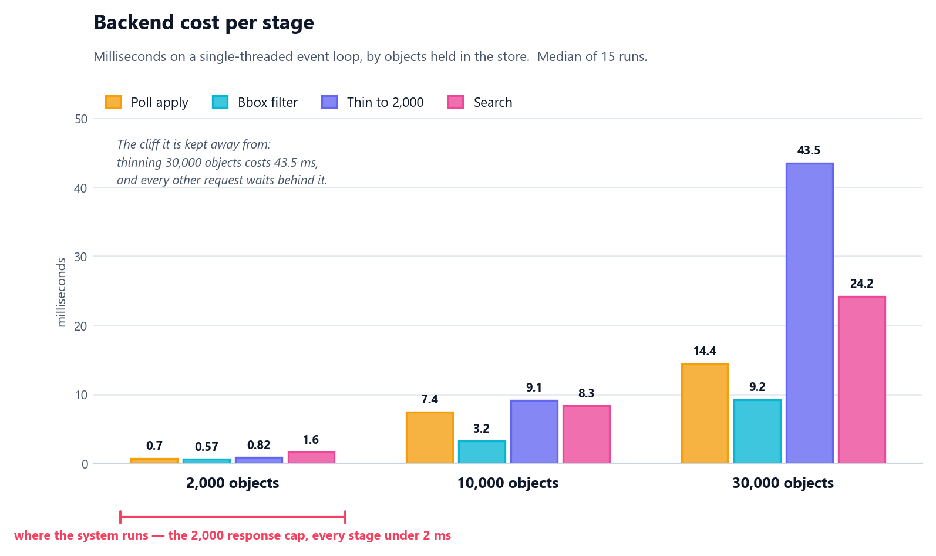
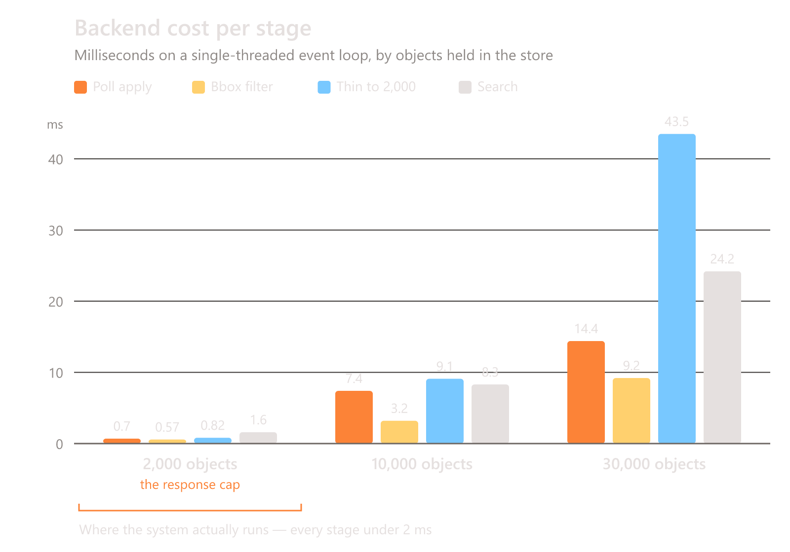
Feasibility & Performance
Live Data at Scale
Orbital is built entirely on free, publicly available data sources. The technical challenge is manageable — the real constraint is rate limiting, not data availability.
Rendering Targets
Both API response times and frontend rendering performance sit comfortably inside target thresholds, even under full load with all three object types active.

Slide 5
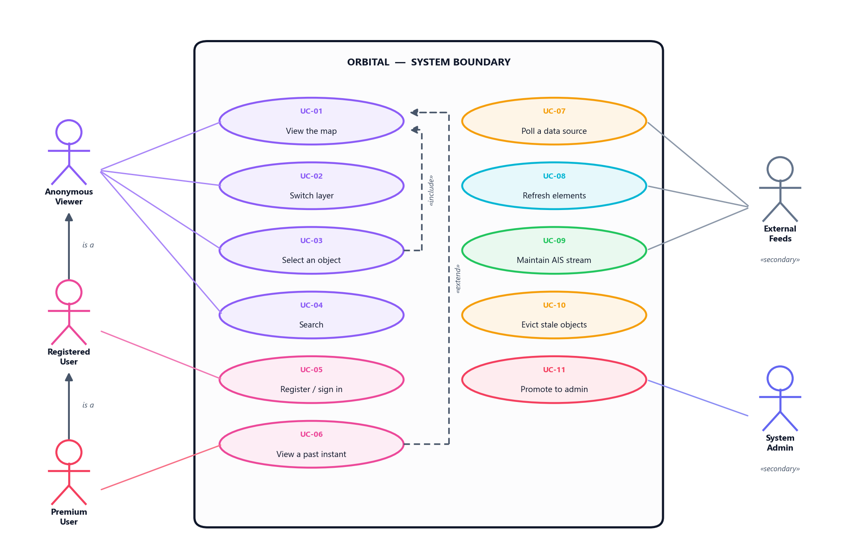
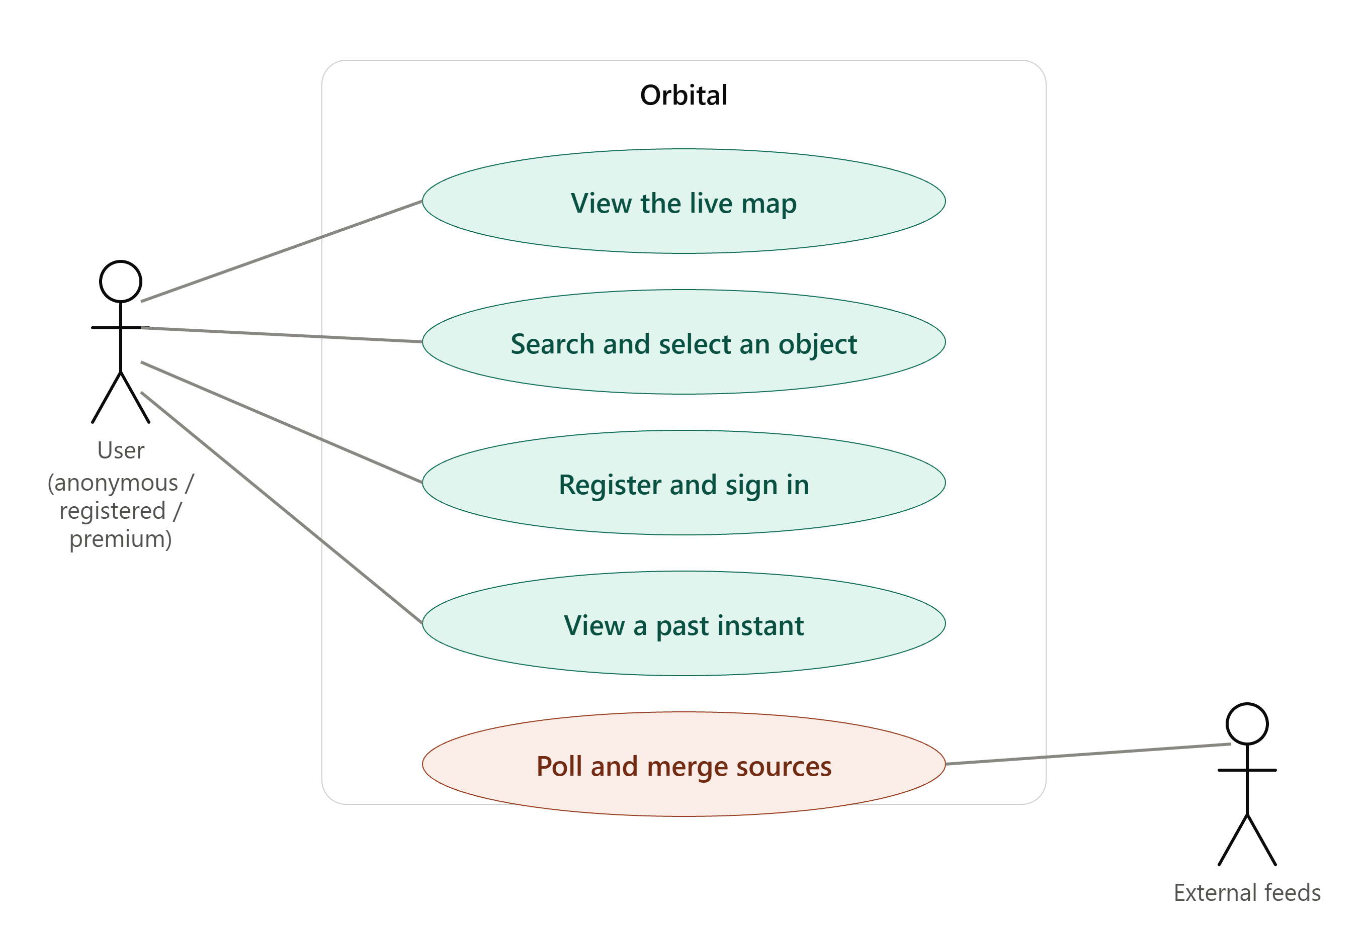
Reliability & Use case
Upstream failure is expected, not exceptional. Orbital handles it
at every layer so the user never sees a blank screen.
Stale-but-Flagged
Dual Sources
When a source goes dark, last-known data is served with a visible freshness indicator
Critical object types are backed by two independent feeds — one failure is never fatal

Slide 6
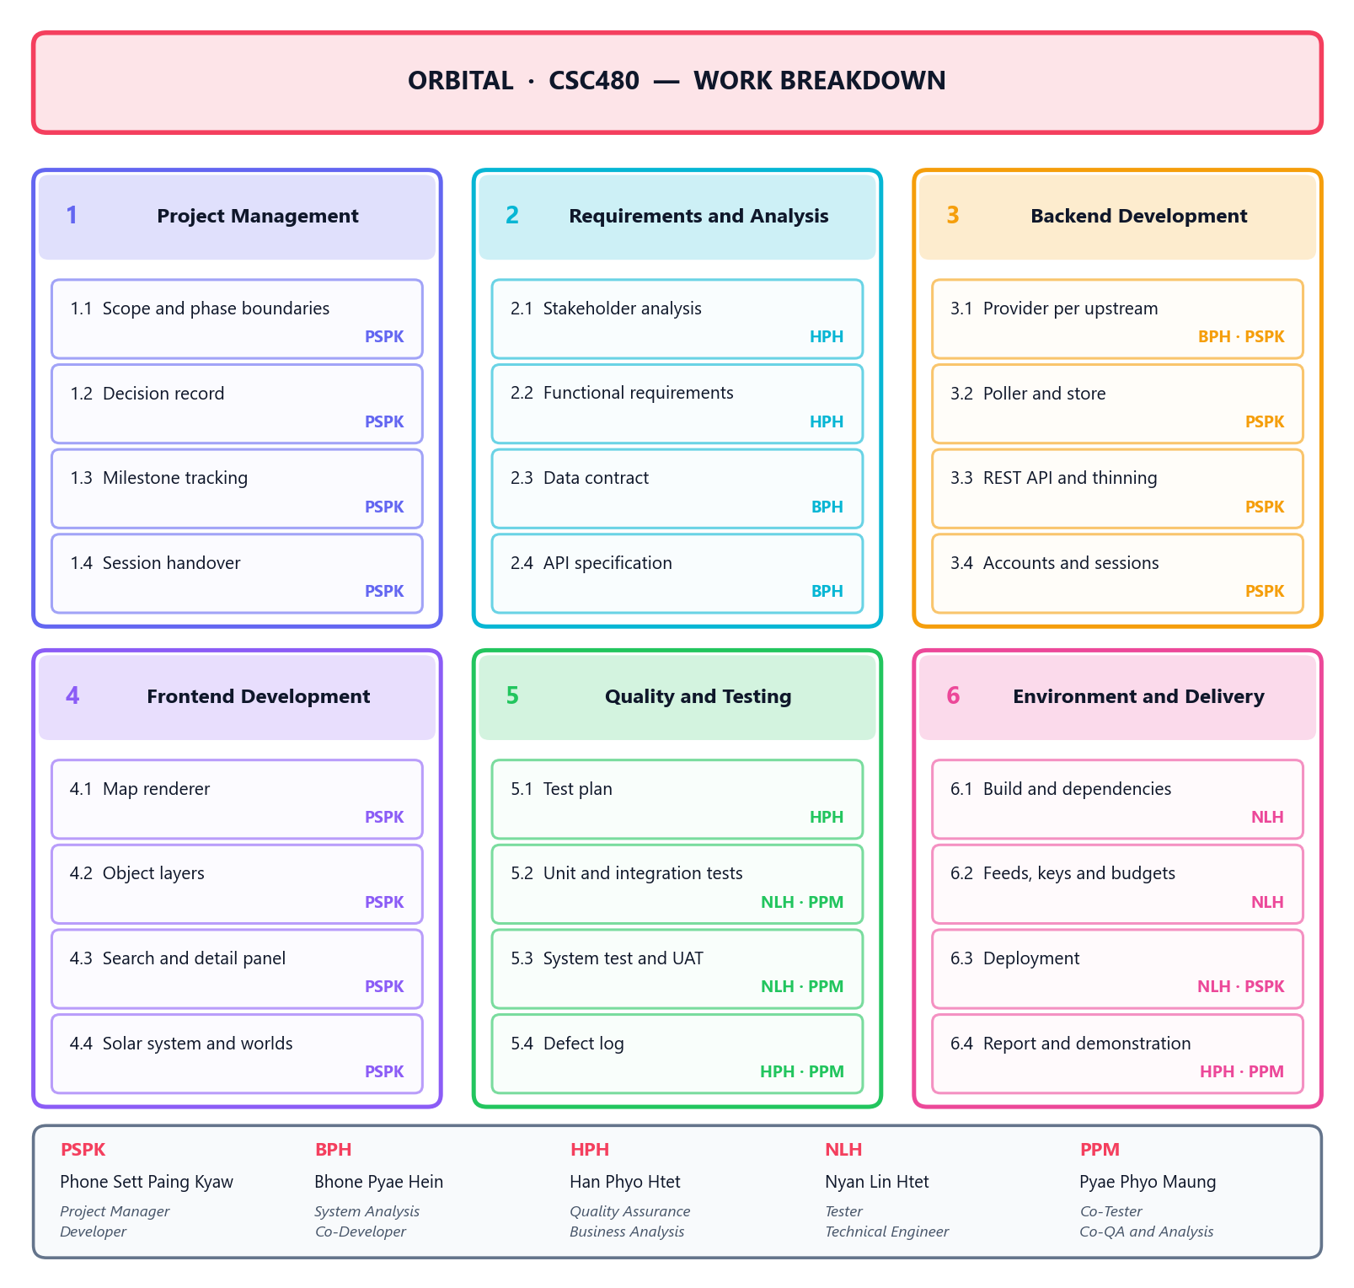
Planning: six packages, five people
Seven roles across five members, so most hold two. Work is decomposed to the level where one person owns one deliverable — any deeper and a WBS is a task list that is stale in a week.
Phase, not component
Package 3 is split by delivered phase.
A component split would describe the
architecture, not the work.
One owner each
Every 1.x deliverable has a name
against it, not a team.
Notes:
Six work packages. Note that backend is broken down by delivered phase rather than by component — that is what makes the cost of each new object type visible.

Slide 7
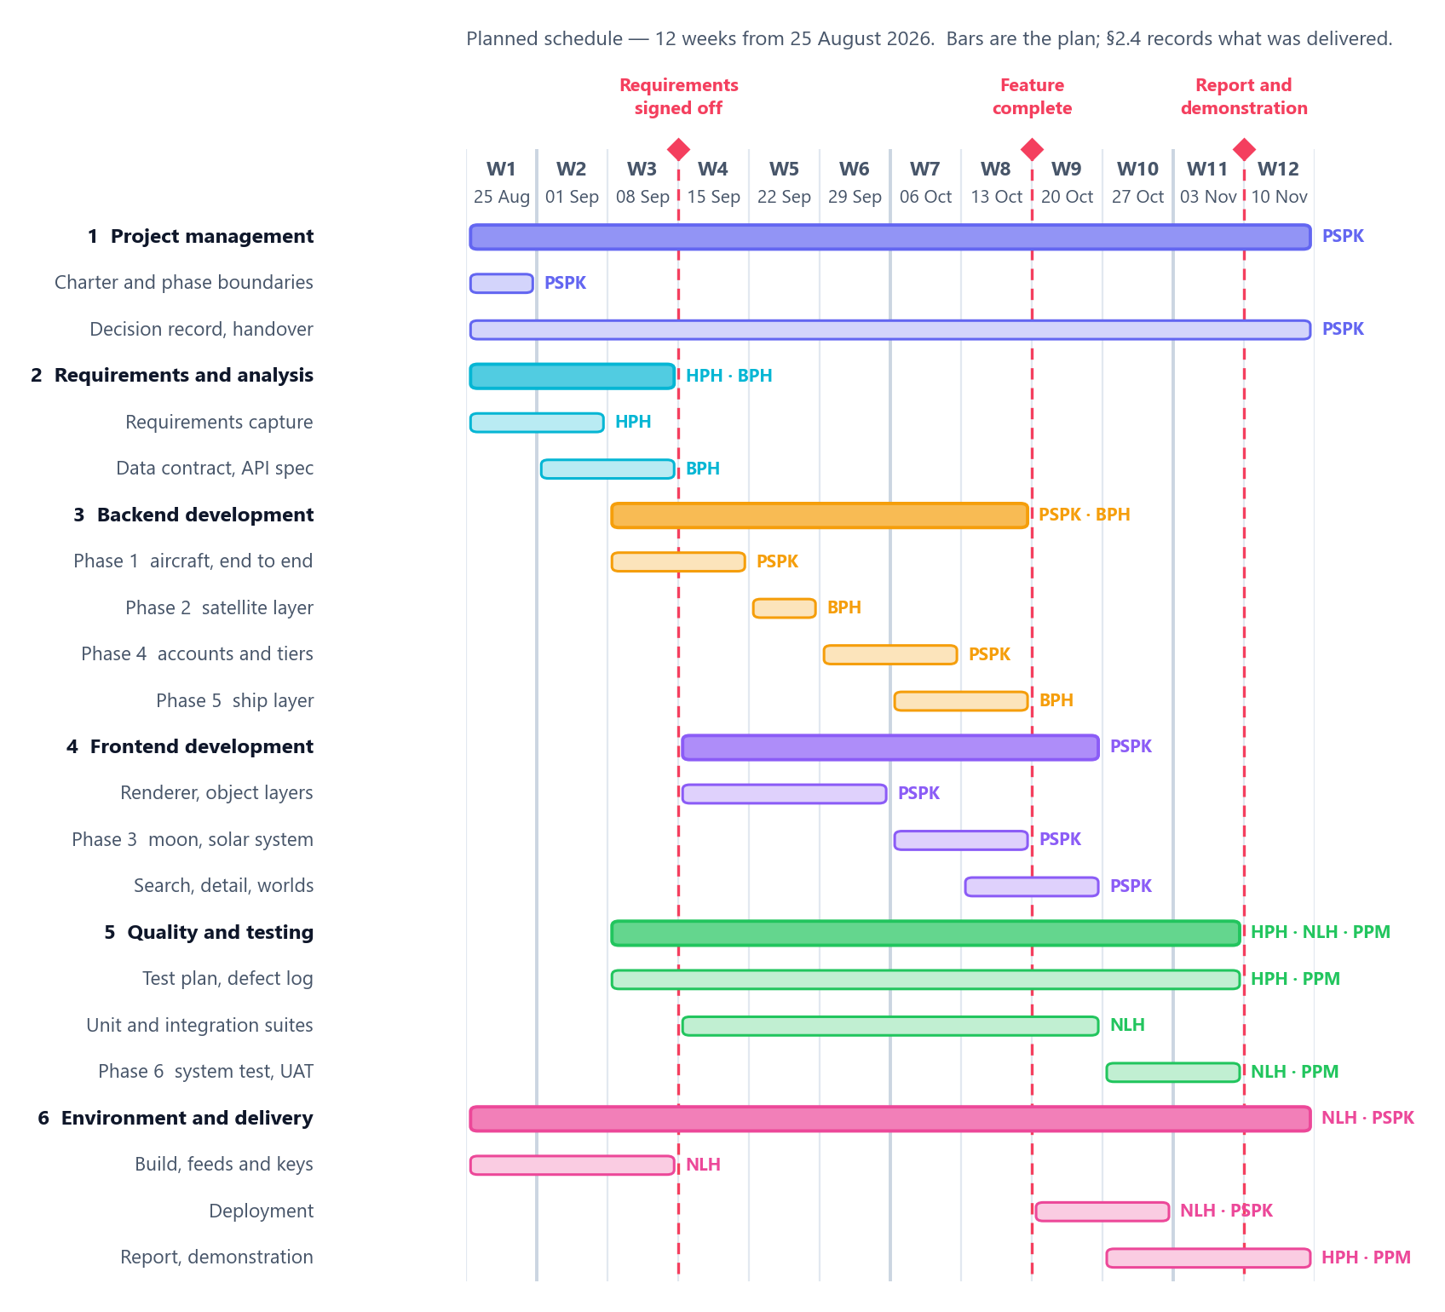
The plan, and the three milestones
Twelve weeks. This is the plan the team worked to, not a chart redrawn afterwards to match what happened — keeping those apart is the only reason comparing them is worth anything.
The critical path
Requirements → data contract →
first provider → poller and store
→ API → first layer on screen.
Then it goes parallel
Satellites, ships and accounts each
touch a different provider or route.
None blocks another — by design.
Notes:
Milestones at weeks 3, 8 and 11. The critical path is the first vertical slice; everything after it runs in parallel because the shared data shape was fixed before any provider was written.

Slide 8
Risks, and what they cost
Graded by likelihood and impact, each with the mitigation that was actually built. One of them happened.
R1 Upstream feed disappears
HAPPENED
R2 Rate limited or banned
HELD
OpenSky became unreachable from every cloud host, mid-project.
One backend for all viewers; limits measured, not assumed.
Cost: one provider module and one registry entry. Nothing above the ingestion layer changed.
Four requests a minute against a measured cap of five.
R3 Browser cannot draw the count
HELD
R4 Traffic outgrows one backend
HELD
40,000 objects is not a legible map at any frame rate.
One worker serves every viewer, on a free tier, single-threaded.
Responses thinned to 2,000; one layer at a time; positions interpolated between polls.
Viewer count costs no upstream quota. Twenty-nine polls in thirty answer 304 without building a response.
Notes:
R1 is the one that actually happened: the architecture was designed so that losing a feed costs one module, and when OpenSky went it cost exactly that. R4 is the one with a ceiling, and be ready for the follow-up - scaling is vertical only, because a second worker would open a second AIS socket and the two stores would disagree. Past a bigger box the design has to change, and 4.6 says so. The full register of ten is section 4.6.

Slide 9
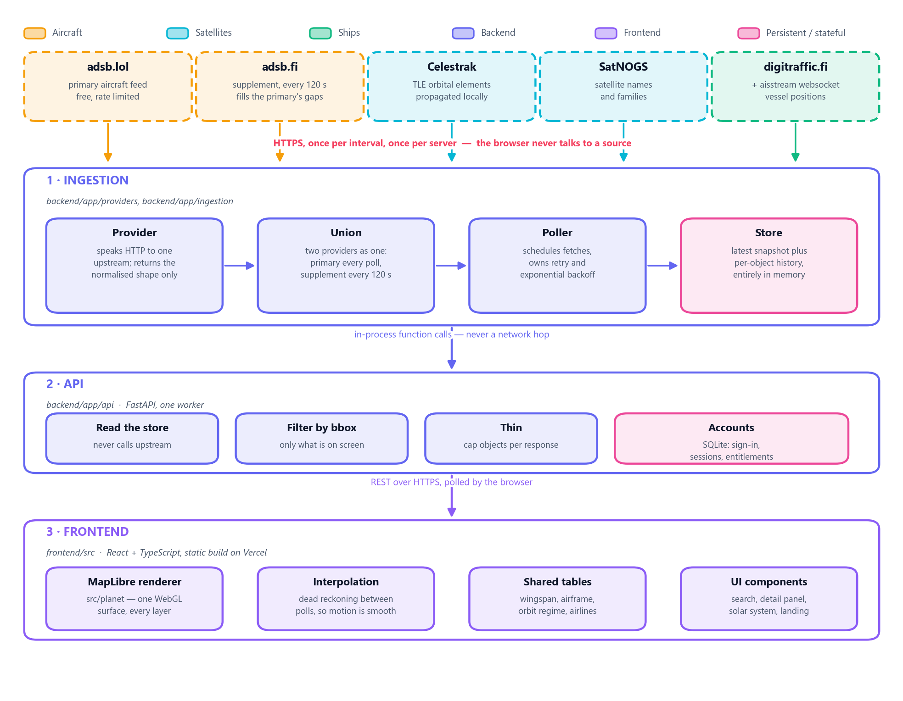
Three layers, one direction
Each layer knows only the layer beneath it. The browser never talks to a data source, so rate limiting is enforced in exactly one place — a hundred tabs cost the same quota as one.
Notes:
Five external feeds, three internal layers. The single most important property: upstream failure is contained at layer 1.

Slide 10
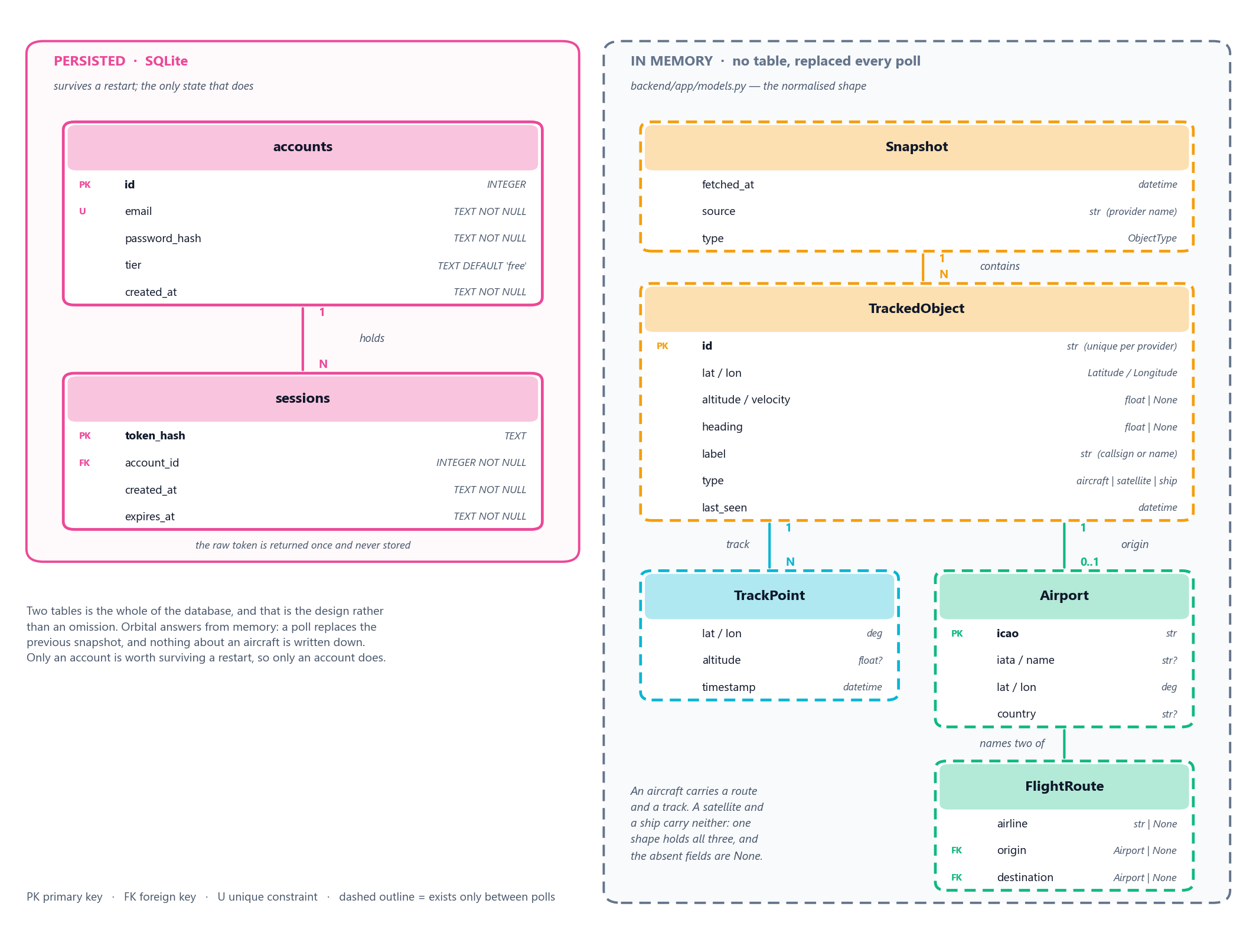
Two tables — and that is the design
A tracker looks like a system that needs a large database. Orbital deliberately has almost none.
Accounts and sessions
The only state worth surviving a
restart. The raw session token is
returned once and never stored.
Everything else is memory
A poll replaces the snapshot.
No schema migration for the thing
that changes most: a feed's shape.
Notes:
The honest cost: Orbital cannot answer a question about last Tuesday. Entitlement windows are bounded by what is still in memory, not by a query.

Slide 11
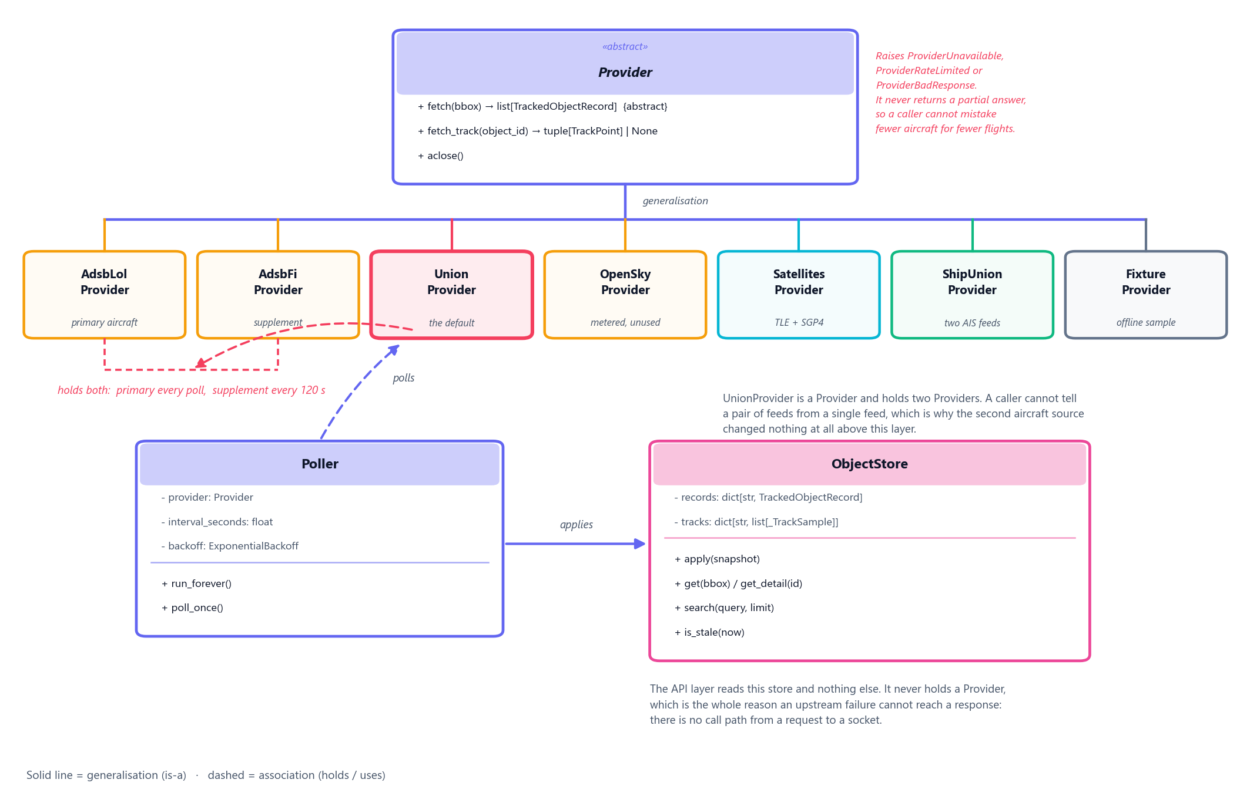
Why a second feed cost one file
UnionProvider inherits Provider and holds two of them. A caller cannot tell a pair of feeds from a single feed — which is why losing a primary source changed nothing above ingestion.
Notes:
Seven concrete providers, one abstraction. The API never holds a Provider, so there is no call path from a request to a socket.

Slide 12
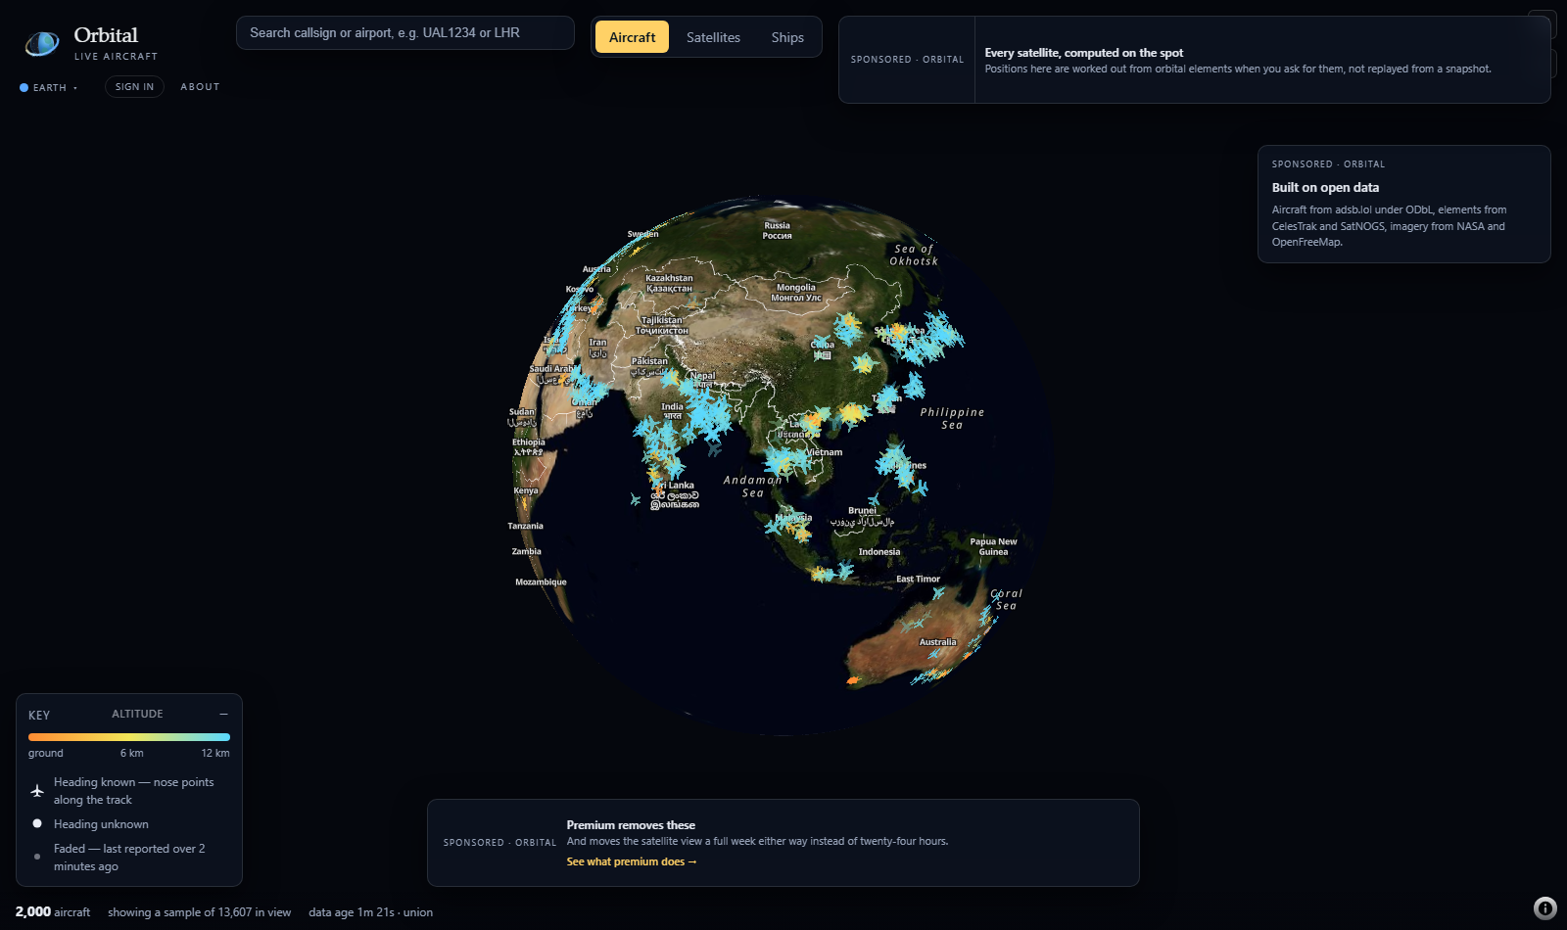
The interface, and the honesty line
Captured from the live deployment. The counts in the status bar are the real ones at the moment of capture.
The map is the product
Controls sit in the corners.
Nothing floats over the centre.
One layer at a time
Three at once is 40,000 markers
and no legible map.
It reports its own limits
2,000 of 13,607 drawn, the data age,
and which feed answered.
Notes:
The status bar states that 2,000 of 13,607 objects in view are drawn, how old the data is, and which feed answered. A tracker that showed a sample as though it were everything would be easier to build and would be lying.

Slide 13
What Orbital Delivers
One Map
Resilient
Aircraft, ships, and satellites — unified, free, in a single browser view
Survives upstream failure with flagged stale data and dual-source fallbacks
Extensible
Performant
New object types cost one module — the architecture scales without rework
10,000+ aircraft rendered in under 2 seconds, rate-limit budget protected

