Slide 1
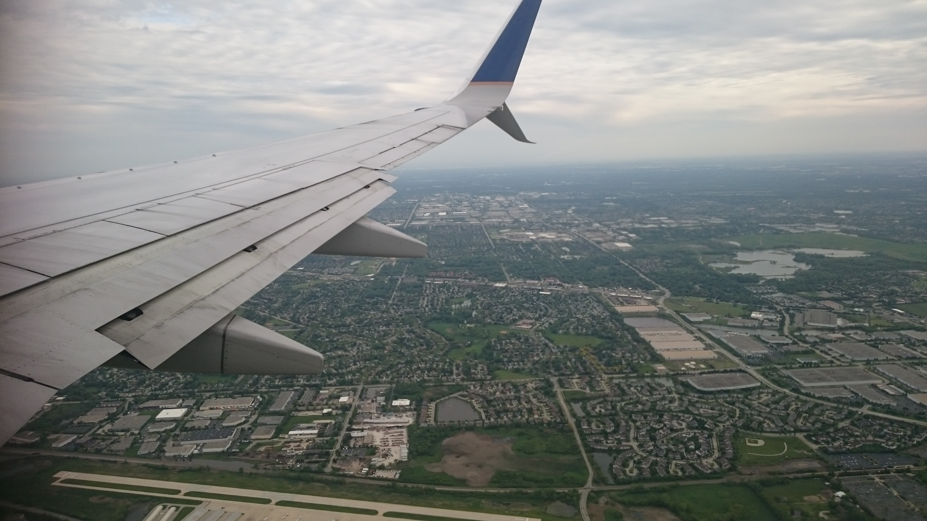
SIA REIMAGINE

Slide 2
THE PROBLEM STATEMENT
How can we improve
the recruitment process?
Inspire more millennial to be part of the cabin crew?

Slide 3
THE IDEA
Automation for round 1 interviews
Gamification for round 2
interviews
Meet the person & Select applicant

Slide 4
Automation is key
Entertainment is a value added factor

Slide 5
THANK YOU!

