Slide 1
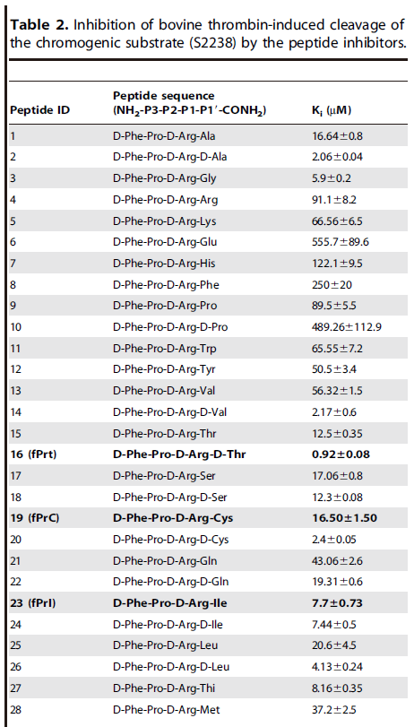
DOI | POI | RANK
10.1371/journal.pone.0034354 | α-thrombin | 5
Notes:
Containing D-type amino acids with thorough data

Slide 2
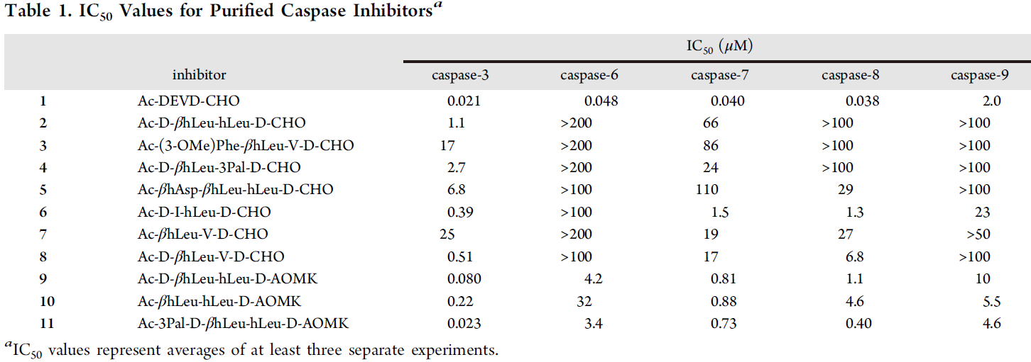
DOI | POI | RANK
10.1021/cb400209w | Caspase-3 | 4
Notes:
Selectively inhibits caspase-3 versus caspase-7 with thorough data
Contains a beta-ncaa
AOMK group at C terminal

Slide 3
DOI | POI | RANK
10.1021/cb5004256 | Caspase-8/9 | 4
Notes:
Selectively inhibits initiator caspase versus executioner caspase with thorough data
Containing a beta-ncaa
KE group at C terminal

Slide 4
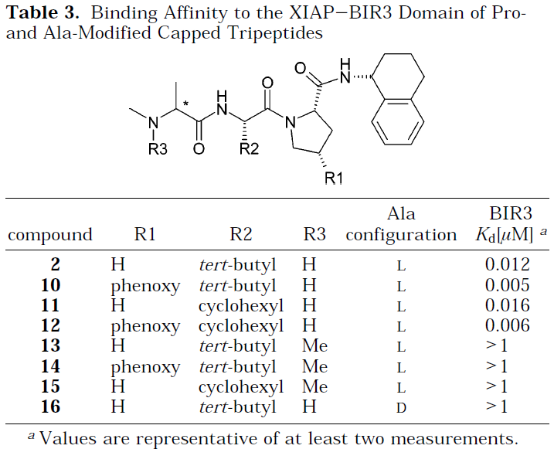
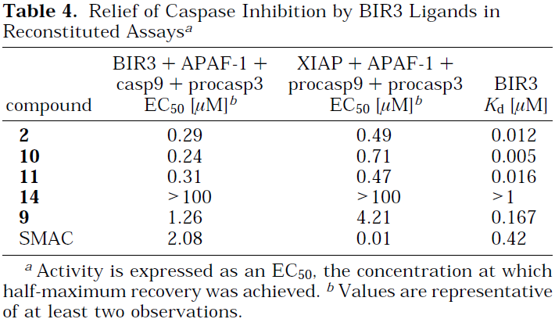
DOI | POI | RANK
10.1021/jm040037k | XIAP | 4
Notes:
Thorough data
Containing a cyclohexyl group in ncaa
Tetrahydronaphthyl amide group at C terminal
Notes:
XIAP是IAP家族中最有效力的caspase抑制物。XIAP分子N-端的3个BIR结构域可以结合并抑制caspase-3、caspase-7和caspase-9，但是不能直接抑制caspase-1、caspase-6、caspase-8或caspase-10。

Slide 5
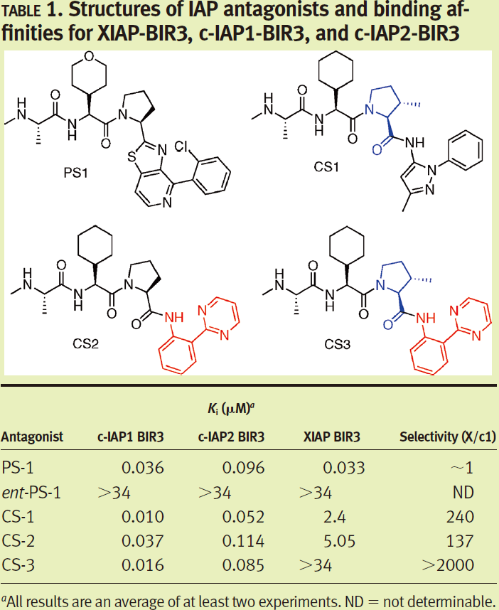
DOI | POI | RANK
10.1021/cb900083m | c-IAP1 | 4
Notes:
Selectively inhibits c-IAP1 versus XIAP
Containing a cyclohexyl group in ncaa
Capping group at C terminal

Slide 6
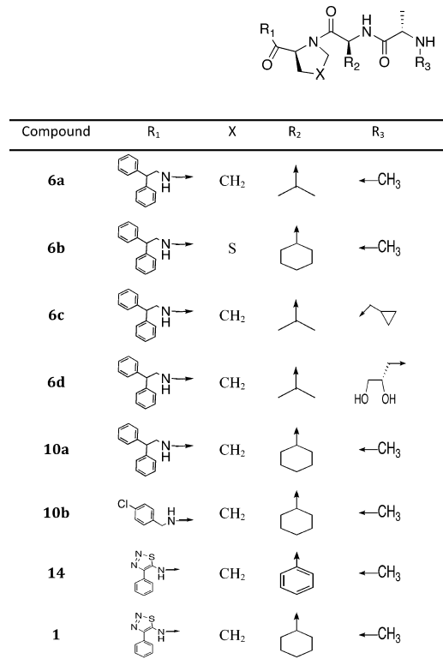
DOI | POI | RANK
10.1021/jm300060k | IAP | 4
Notes:
Thorough data
Containing a cyclohexyl group in ncaa
Capping group at N terminal

Slide 7
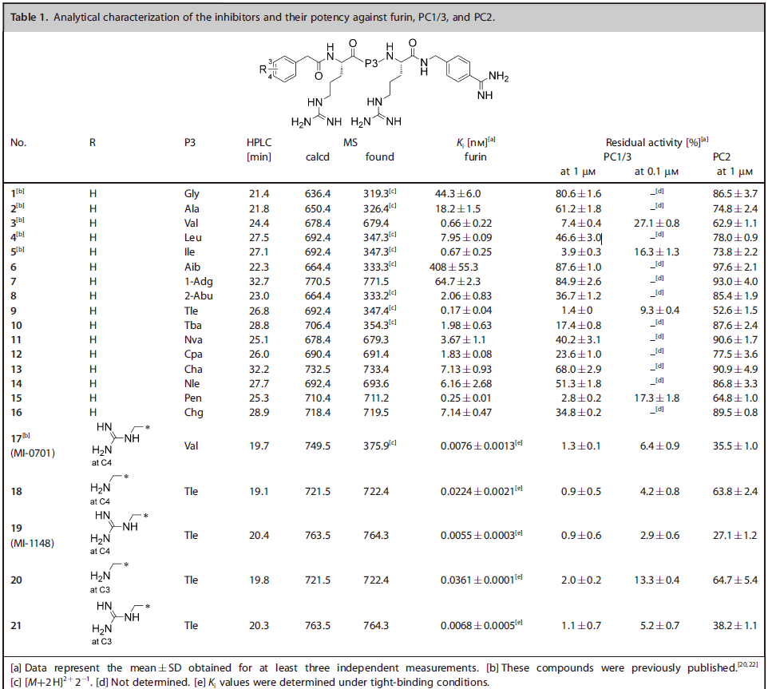
DOI | POI | RANK
10.1002/cmdc.201500103 | furin | 4
Notes:
Thorough data
Phac/Amba group at N/C terminal as the scaffold of furin inhibitor

Slide 8
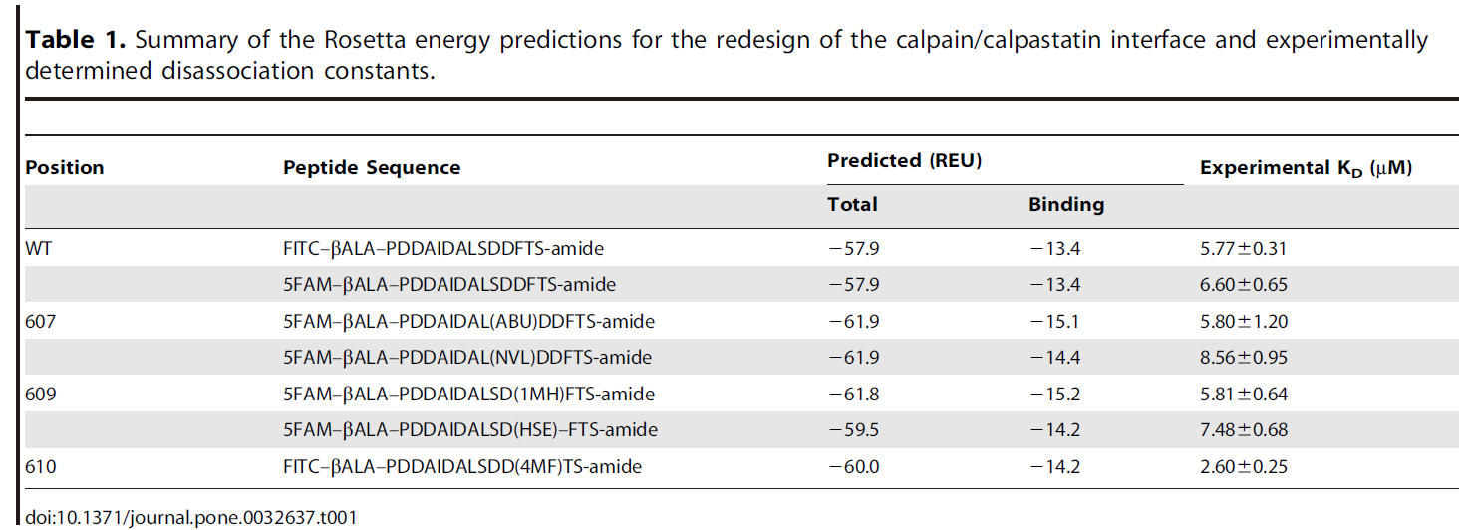
DOI | POI | RANK
10.1371/journal.pone.0032637 | calpain | 2
Notes:
Rational design by rosetta
No peptide-protein complex in pdb

