Slide 1
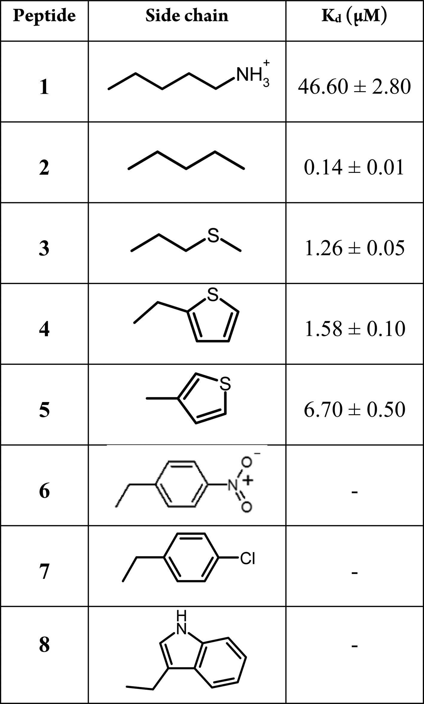
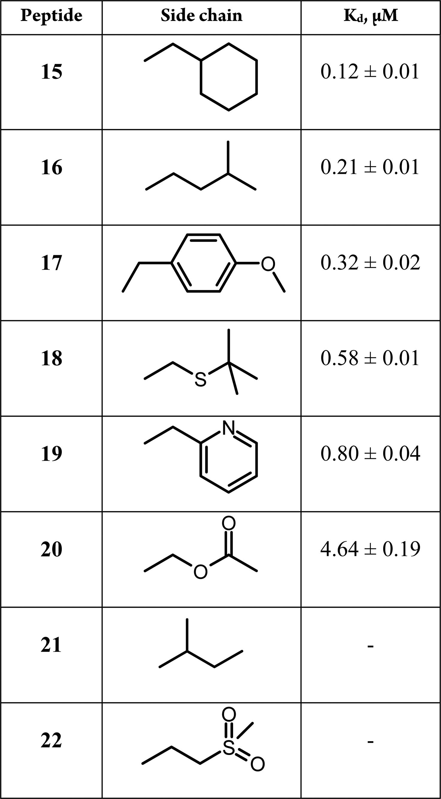
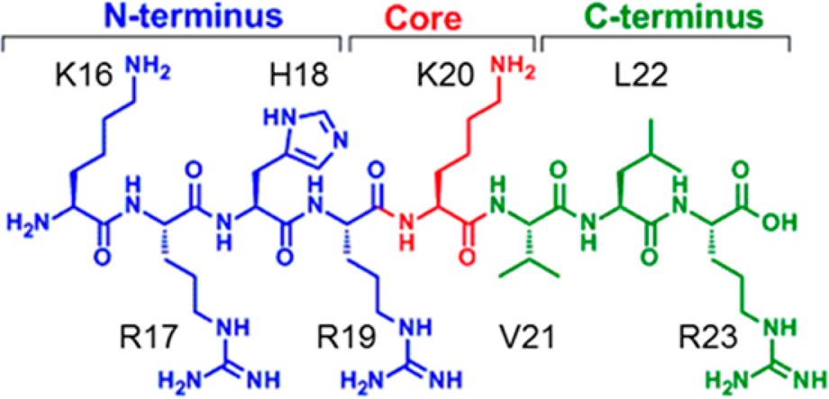
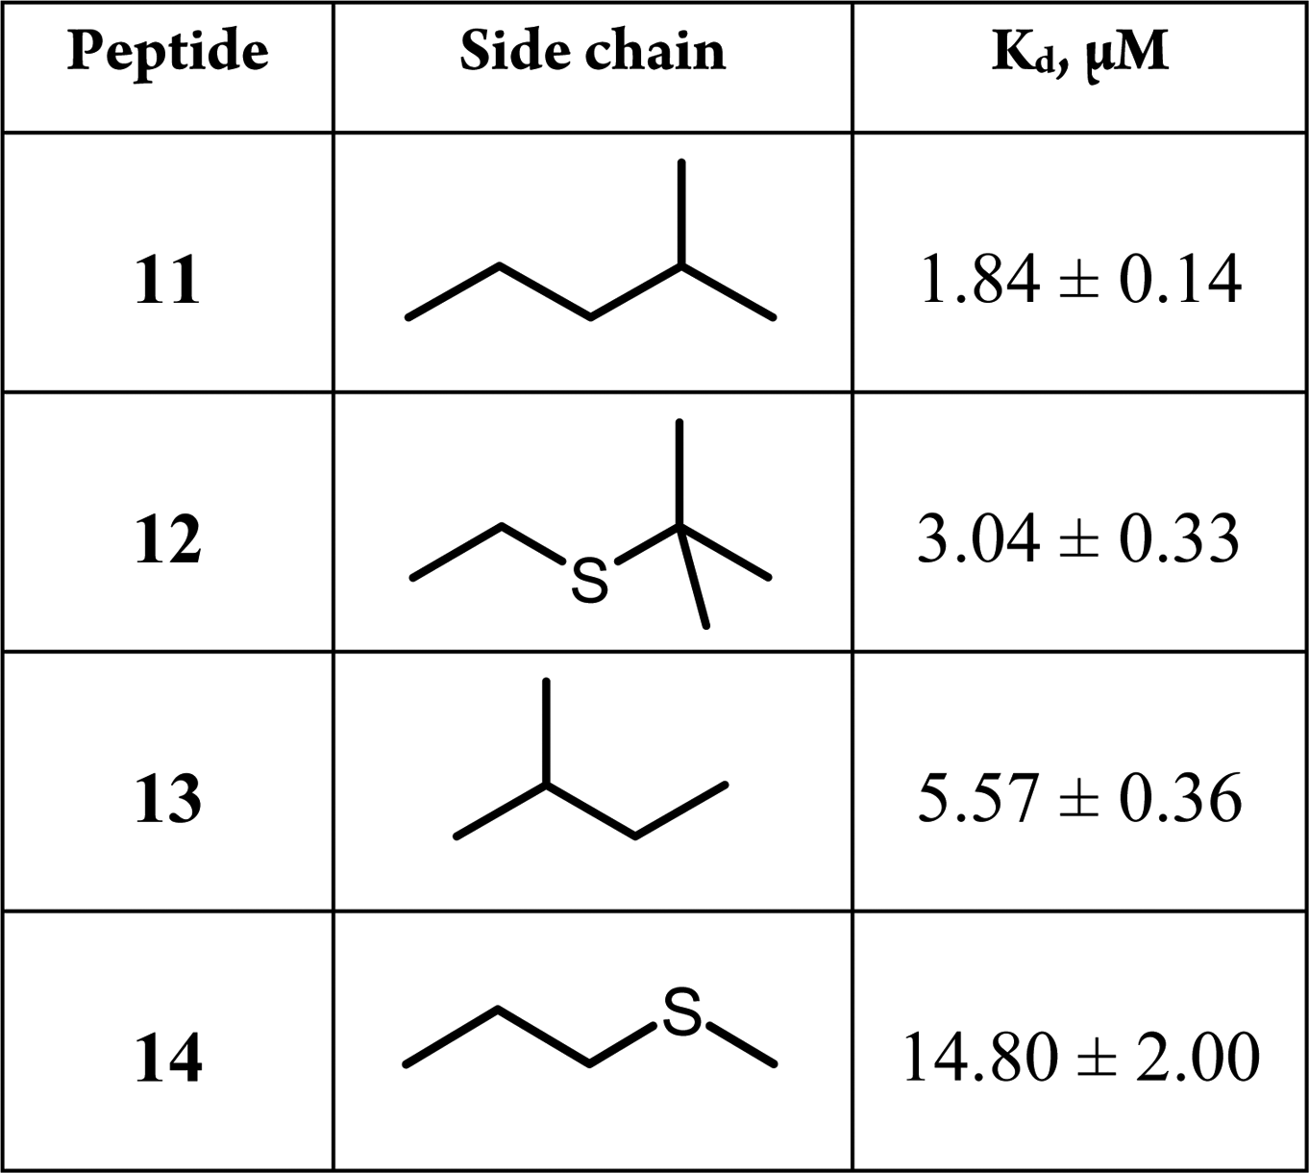
DOI | PDB | POI | RANK
10.1021/acsmedchemlett.6b00303 | 1ZKK (native), 5TEG | SETD8 | 5
Peptide | Sequence | K_{d}, μM
9 | RHR(Nle)VLR | 0.35 ± 0.01
10 | HR(Nle)VL | 15 ± 2.0
Truncated of KRHR(Nle)VLR
H4 peptide
K20 Substituted of native H4
R17 Substituted of KRHR(Nle)VLR
L22 Substituted of KRHR(Nle)VLR

Slide 2
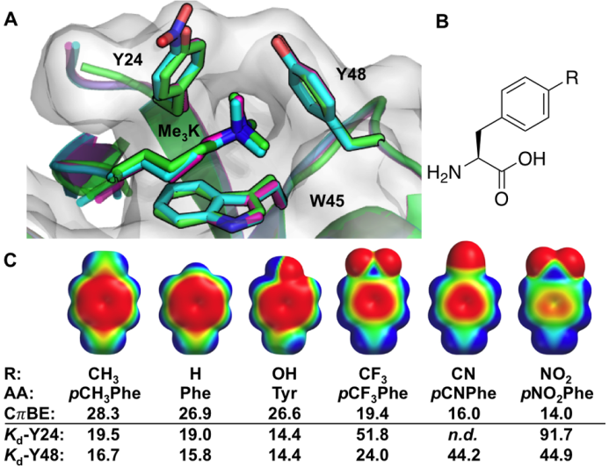
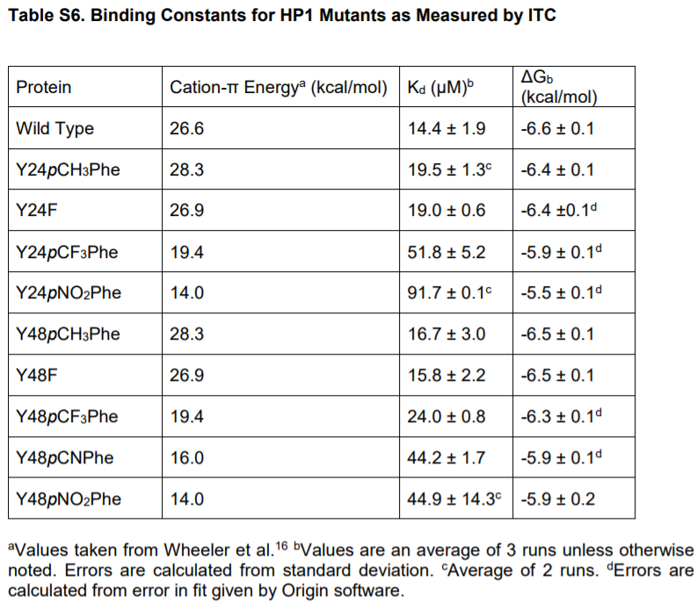
DOI | PDB | POI | RANK
10.1021/jacs.7b09223 | 1KNE (wt), 6AT0, 6ASZ | HP1 | 5
peptide:H3K9me3 (ARTKQTARK(Me)₃STGGKAY)

Slide 3
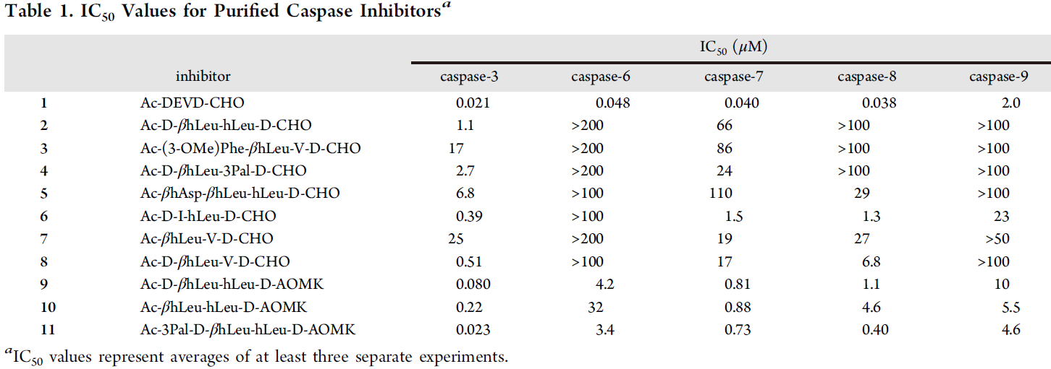
DOI | POI | RANK
10.1021/cb400209w | Caspase-3 | 4
Notes:
Selectively inhibits caspase-3 versus caspase-7 with thorough data
Contains a beta-ncaa
AOMK group at C terminal (covalently bonds to protein)

Slide 4
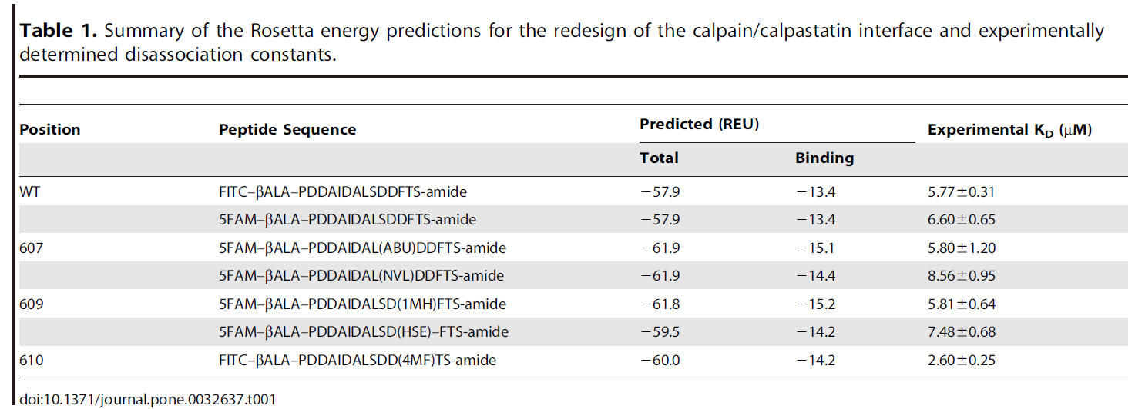
DOI | POI | RANK
10.1371/journal.pone.0032637 | calpain | 2
Notes:
Rational design by rosetta
No peptide-protein complex in pdb

