Slide 1
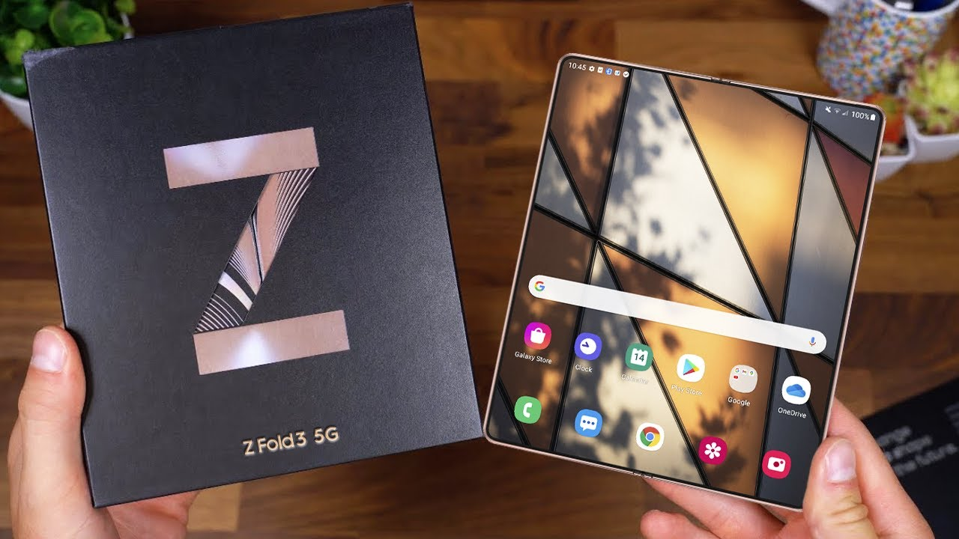
TOPIC:
BUILDING ONLINE PHONE BUSINESS WEBSITE
Students : Nguyễn Văn Phong
Class : 22NS
Course : 2022-2027
Instructors : Th.S Đặng Quang Hiển

Slide 2
CONTENT
1
REASON FOR CHOOSE TOPIC
2
WEB INTERFACE DESIGN PROCESS
3
WEBSITE DESIGN
4
CONCLUSION AND DIRECTION OF DEVELOPMENT

Slide 3
1. REASON FOR CHOOSE TOPIC
The development of information technology.
The shopping of customers is also increasingly modern and they prefer to shop online more.
Human needs like modern and youthful.
Website design subject is being studied by the school.

Slide 4
2. WEB INTERFACE DESIGN PROCESS
Outline ideas
Easy to use interface.
Updated information quickly.
Display full product information.
Detailed functionality of the website.
Main page: homepage, contact, details, about..
Sketch on paper.
Graphic design and color matching.
Define the markup language.
Define customer requirements
Design

Slide 5
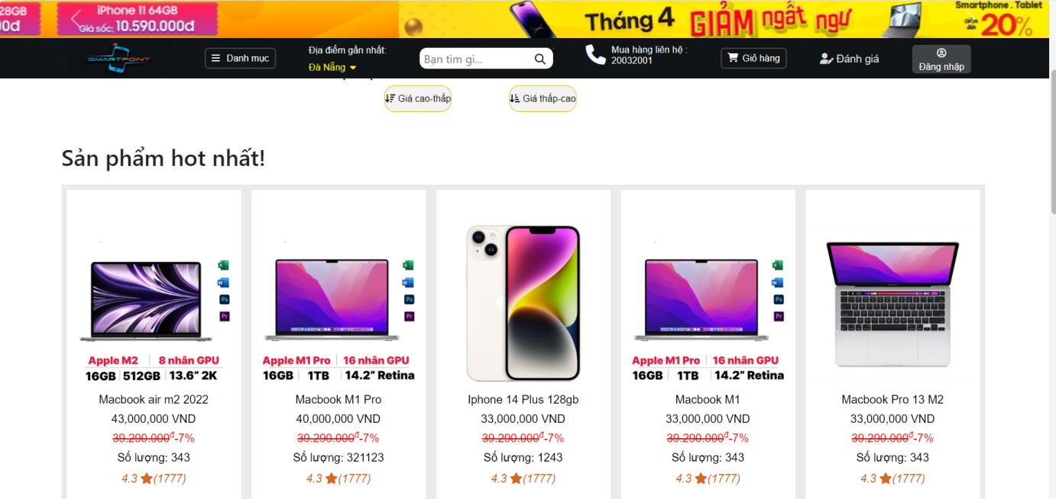
3. DESIGN WEBSITE...
User interface:

Slide 6
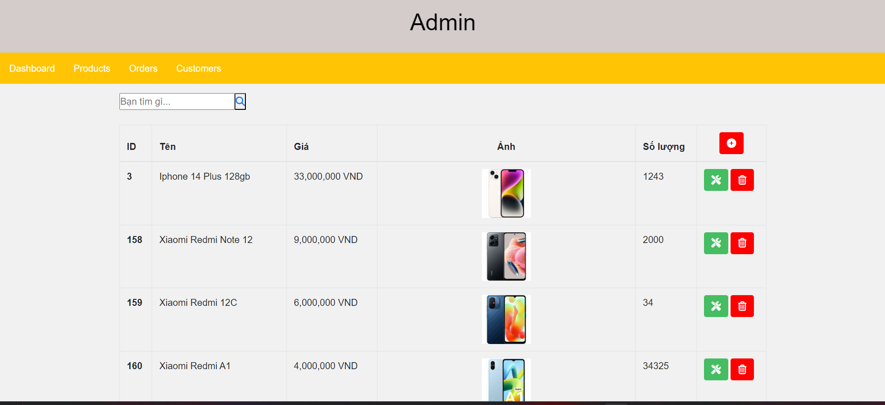
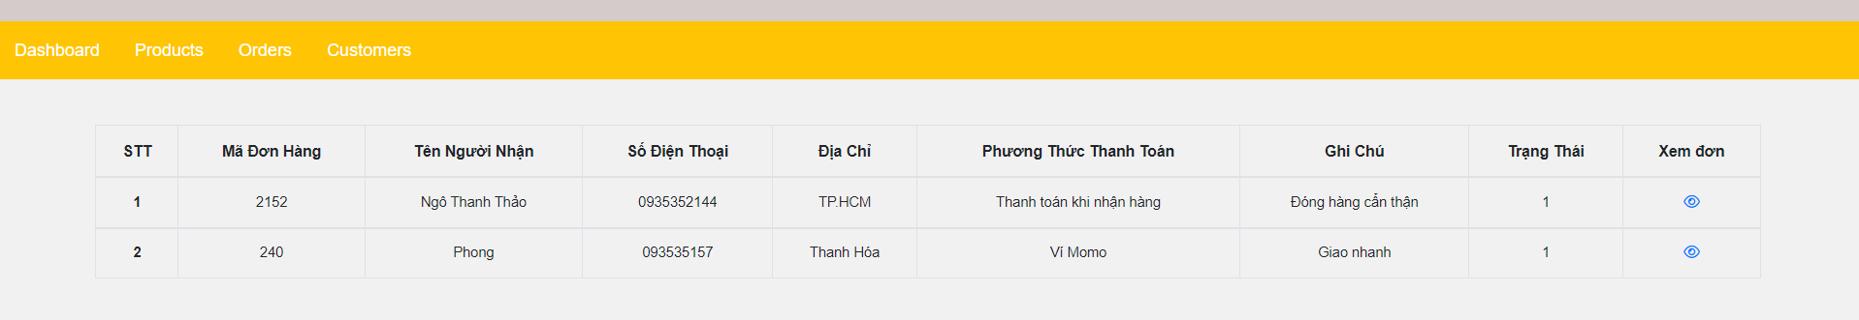
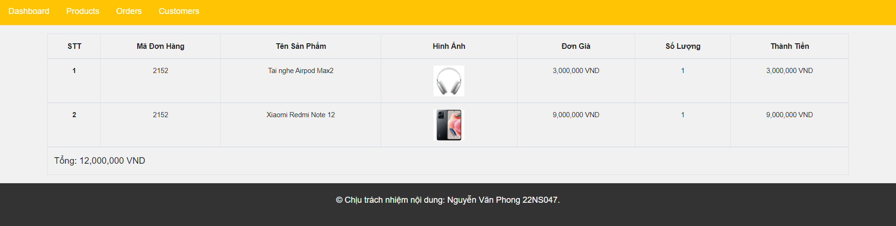
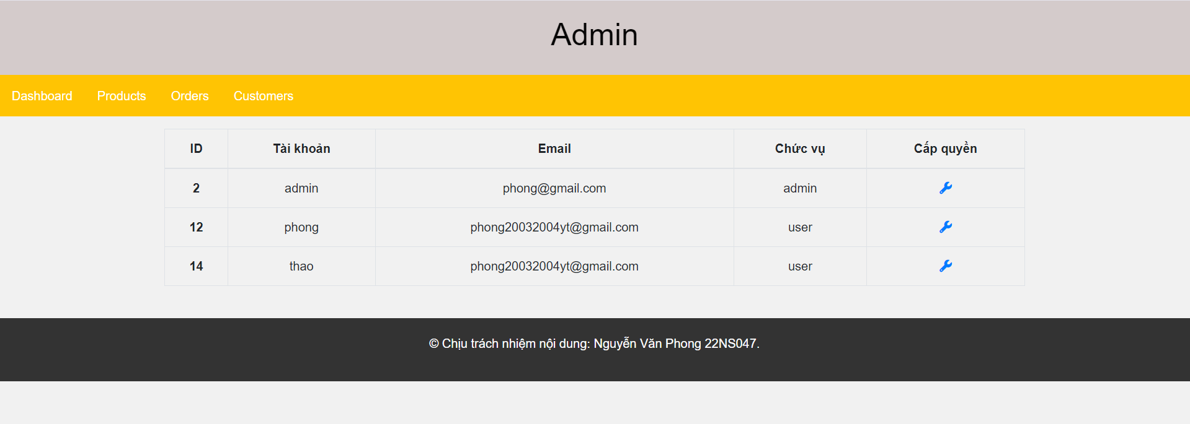
3. DESIGN WEBSITE...
Admin interface:

Slide 7
4. CONCLUSIONS AND DEVELOPMENT ORIENTATIONS
Conclude:
Performing the basic functions of an online sales website, allowing:
Friendly interface.
Search and view products.
Create cart, create and submit orders.
See if orders have been processed.
Member registration, account login .
Online payment.
Product comments with facebook account.
Product rating by star rating.

Slide 8
4. CONCLUSION AND DIRECTION OF DEVELOPMENT
Development direction:
Build more search criteria
Try to perfect the functions already done
Add functions to support languages, currencies
Build a nicer interface with reasonable, user-friendly navigation tools
On the administrative side: build more search functions, update user information
Build more languages for your website and add some extra functionality

Slide 9
Thank you

